Slide 1
Science Hall, Science Building, Chonnam National University
2024-07-25(Thu) ~ 26(Fri)
Infrared Spectroscopy for Impurity Detection in Scintillators and Quantum Computing Applications
Soongsil University and OMEG institute
Jubin Park
Collaborators : Prof. Myung-Ki Cheoun, Prof. Kyung Kwang Joo
Dr. Ji Young Choi, Mr. Minkyu Lee, and Ms. Chae-Hyun Yoon

Slide 2
Contents
1. Infrared Spectroscopy for Impurity Detection in Scintillators
1-1. Brief introduction to IR spectroscopy and its dictionary 1-2. Impurities in LAB-based Liquid Scintillators
2. Quantum Computing Applications : D-Wave Quantum Computer (QC)
1-1. Two types of QCs 1-2. What is the quantum annealing ? 1-3. Hydrogen molecule 1-4. Deuteron
3. Conclusions

Slide 3
I. Infrared Spectroscopy for Impurity Detection in Scintillators

Slide 4
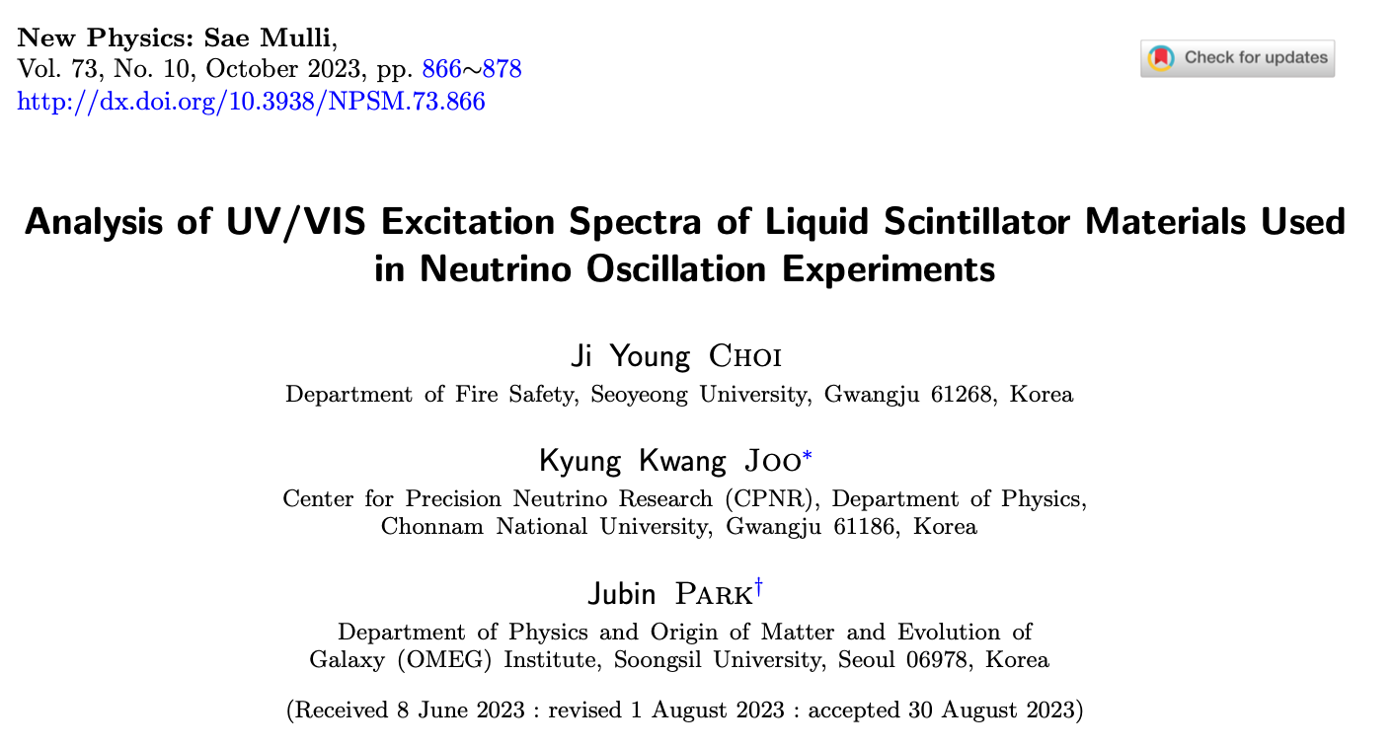
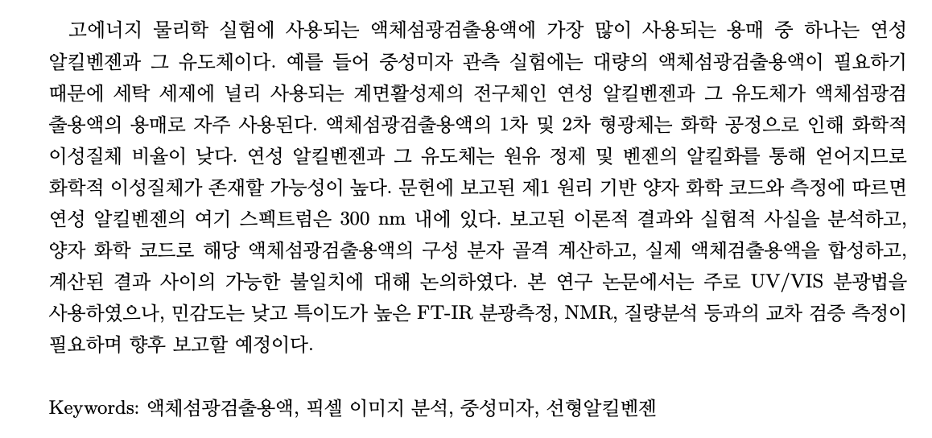

Slide 5
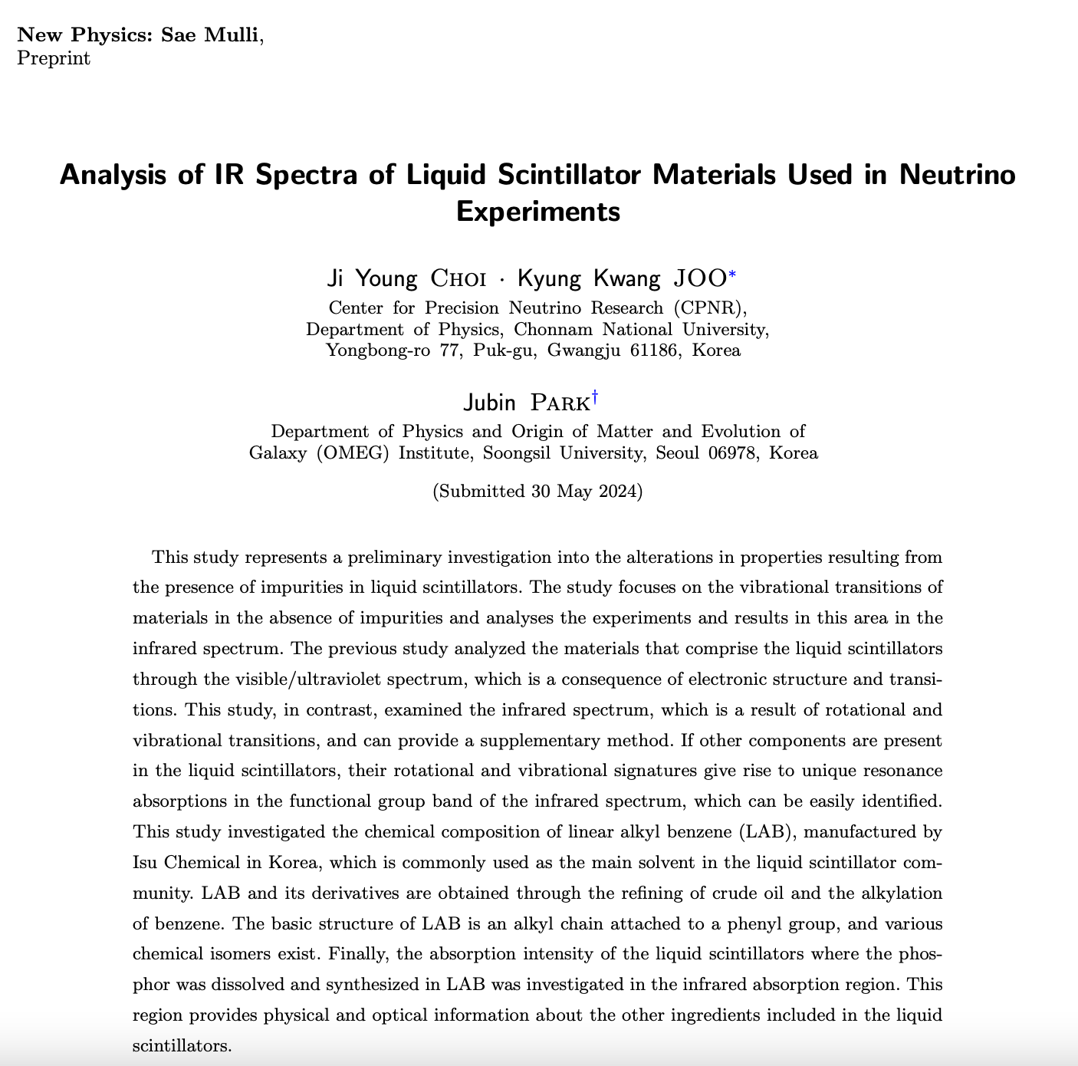
New Physics: Sae Mulli, Vol. 74, No. 8, Aug 30 (2024)

Slide 6
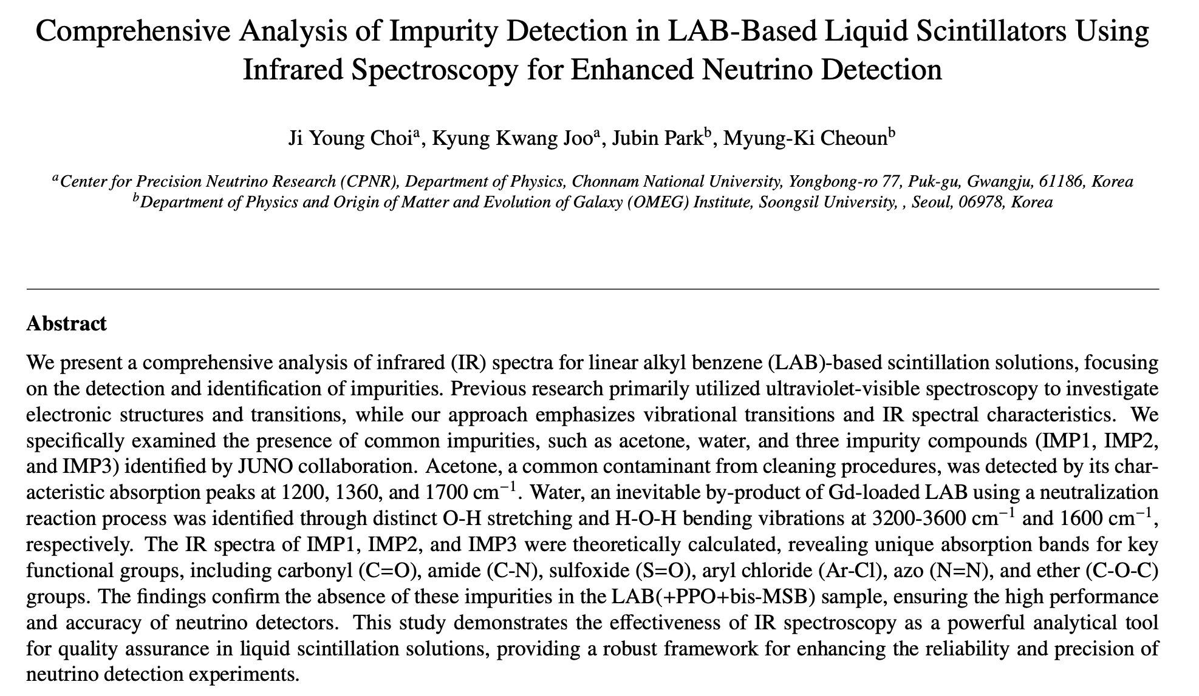
Submitted to the PTEP (Progress of Theoretical and Experimental Physics) journal

Slide 7
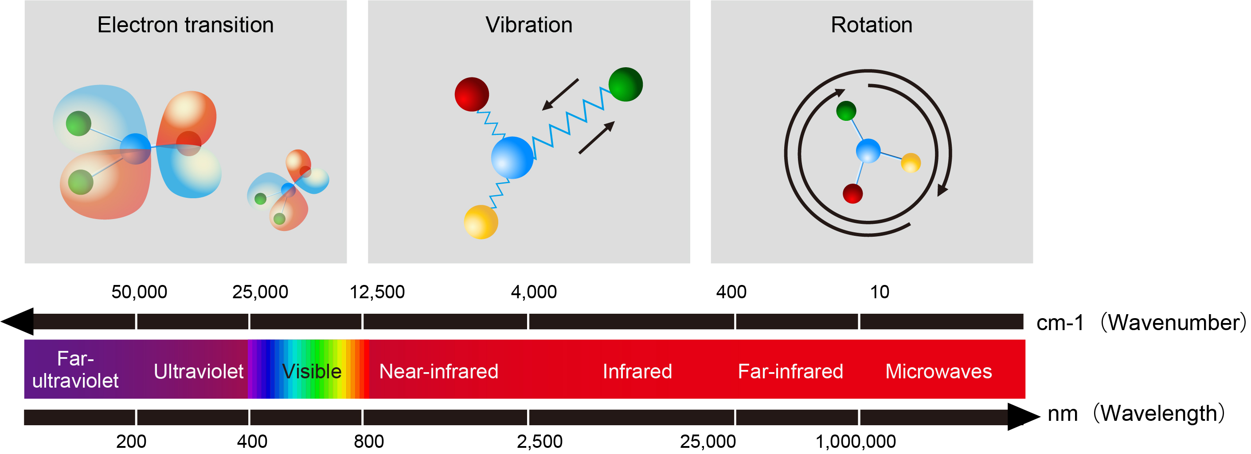
Molecular Spectroscopy
https://www.yokogawa.com/about/research-development/inv_center/research-themes/material-innovation-research/spectroscopy/#New-tab

Slide 8
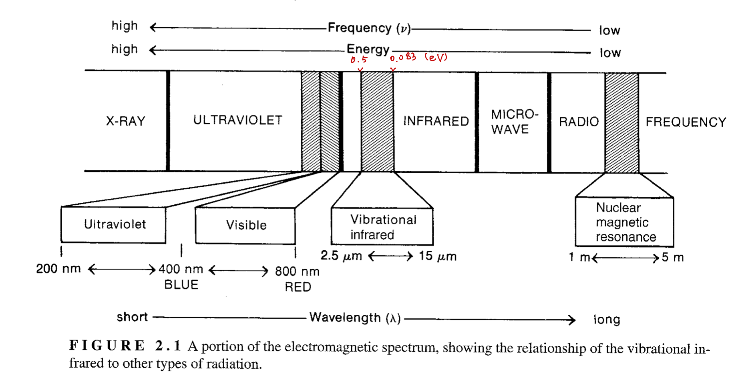
[IS_3rd_PLK]
Region of Spectrum | Energy Transitions
X-rays | Bond breaking
Ultraviolet / Visible | Electronic
Infrared | Vibrational
Microwave | Rotational
Radio frequencies | Nuclear spin (nuclear magnetic resonance, NMR) Electronic spin (electron spin resonance, ESR)

Slide 9
[IS_3rd_PLK]
Only those bonds that have a dipole moment that changes as a function of time are capable of absorbing infrared radiation !!!
IR-active
Thus, a symmetric bond which has identical or nearly identical groups on each end will not absorb in the infrared !

Slide 10
[IS_3rd_PLK]
Infra-red spectroscopy
Dictionary
https://www.chem.ucalgary.ca/courses/351/Carey5th/Ch13/ch13-0.htmlc

Slide 11
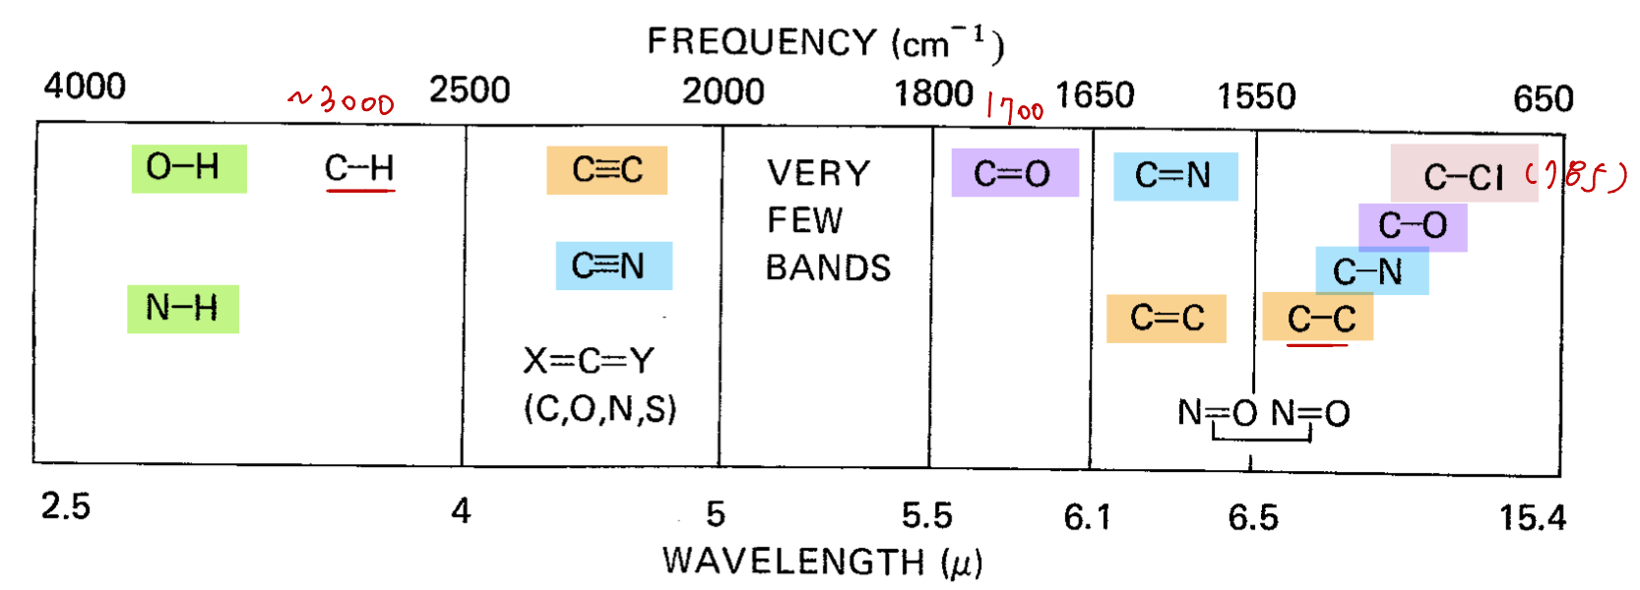
[IS_3rd_PLK]

Slide 12
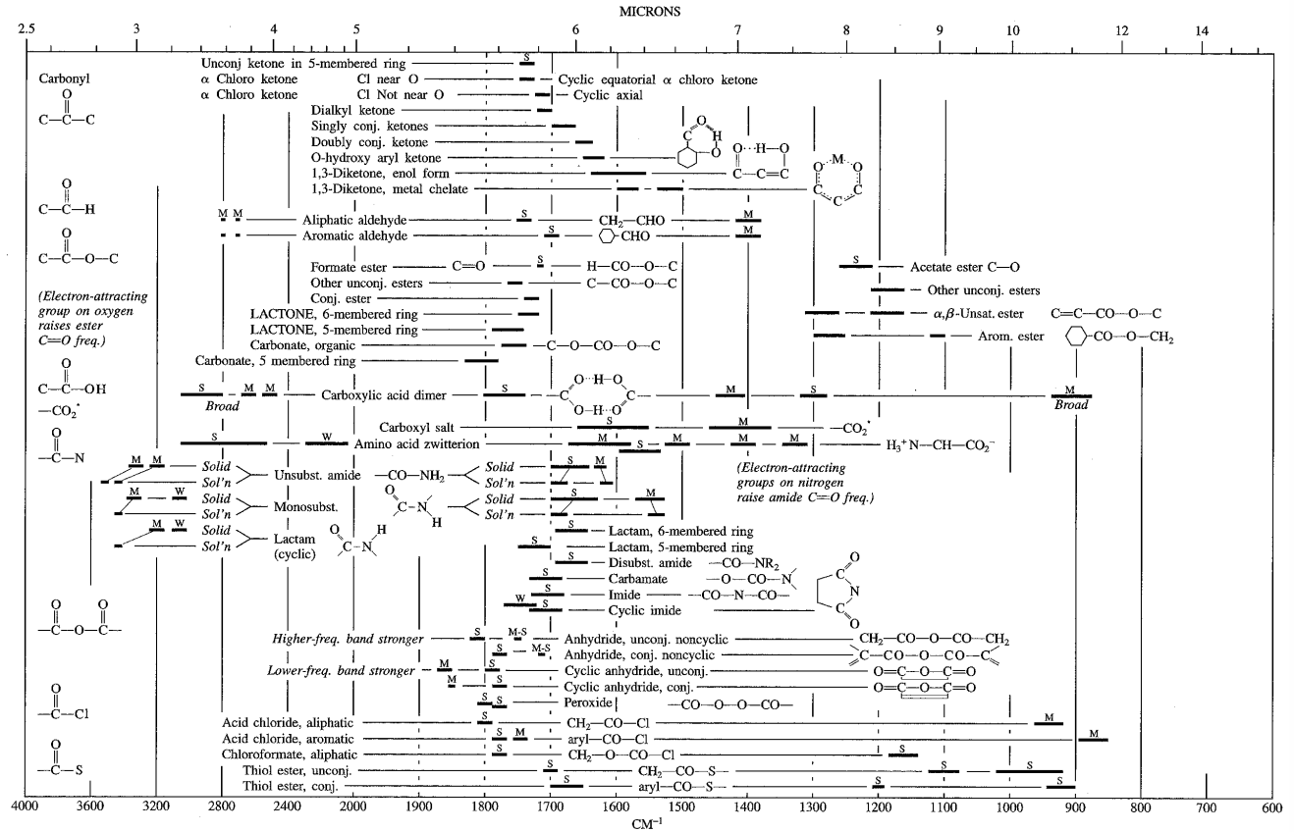
[IS_3rd_PLK]

Slide 13
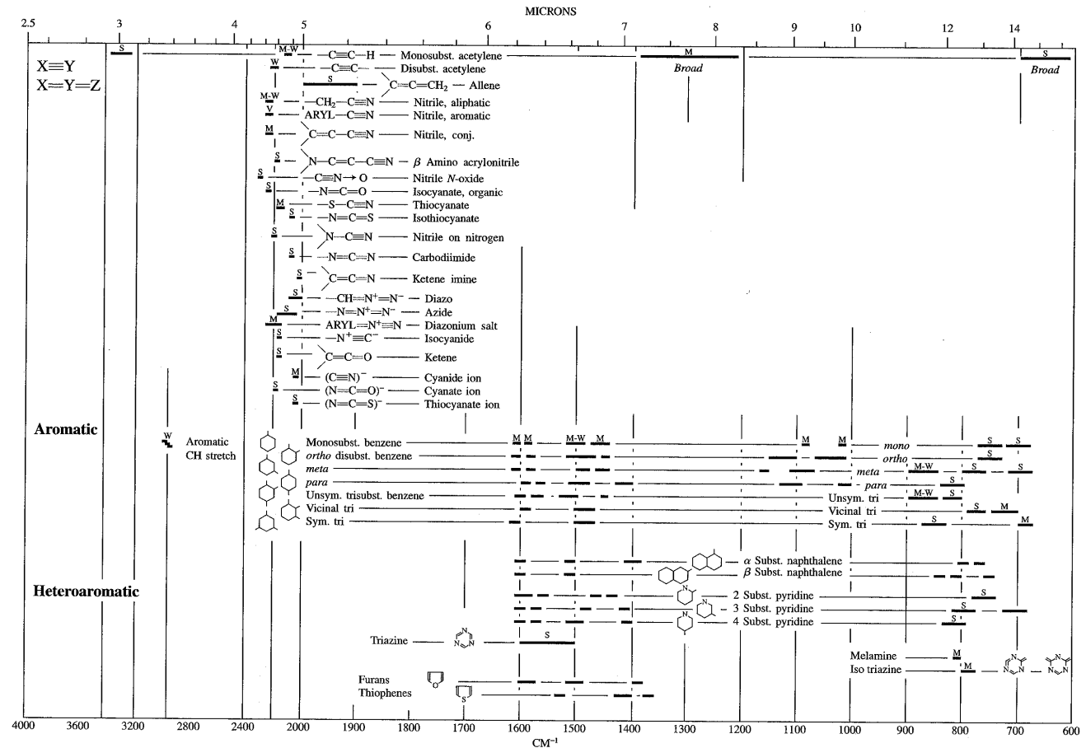
[IS_3rd_PLK]

Slide 14
Impurities in LAB-based Liquid Scintillators

Slide 15
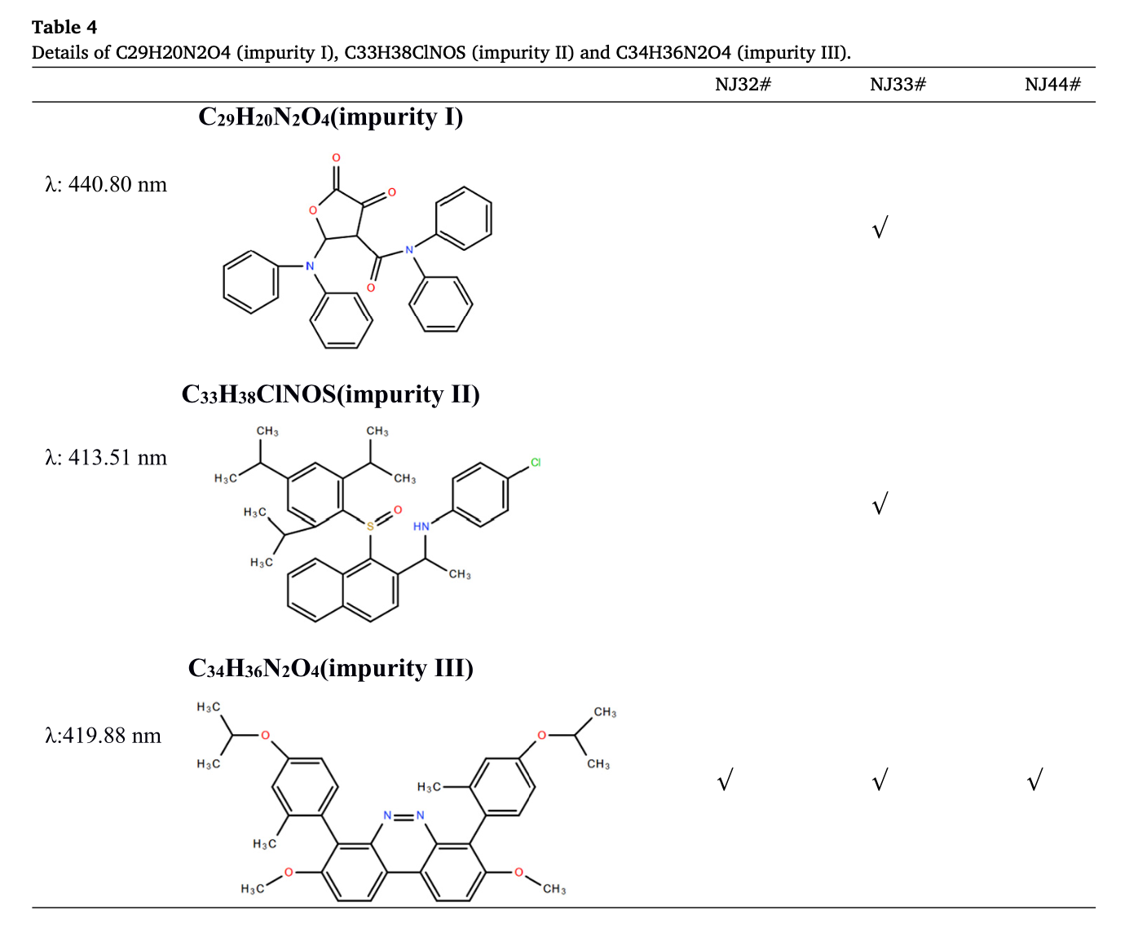
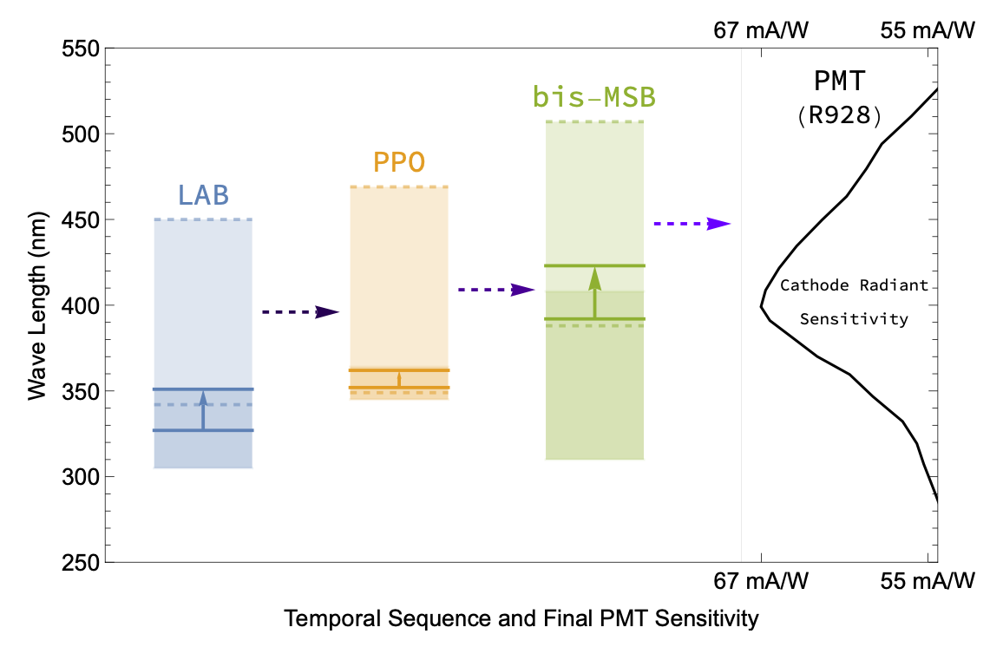

Slide 16
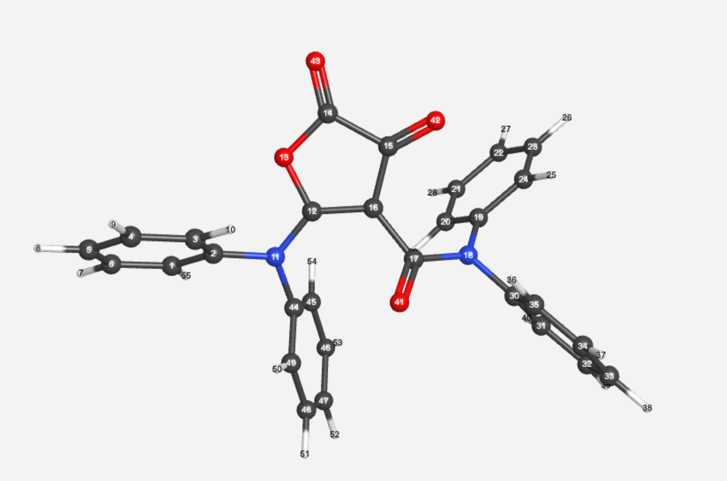
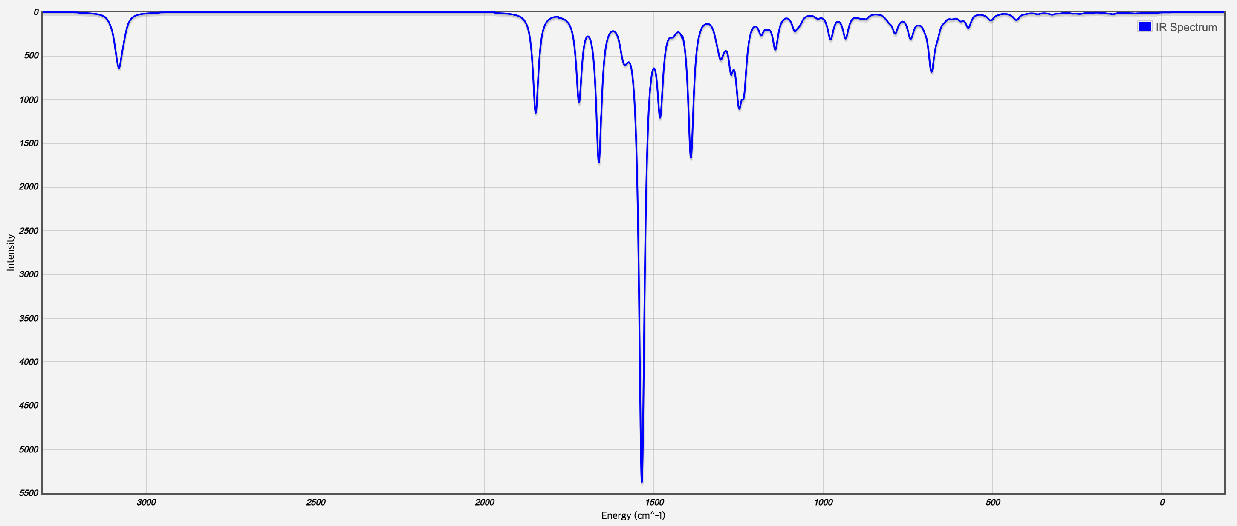
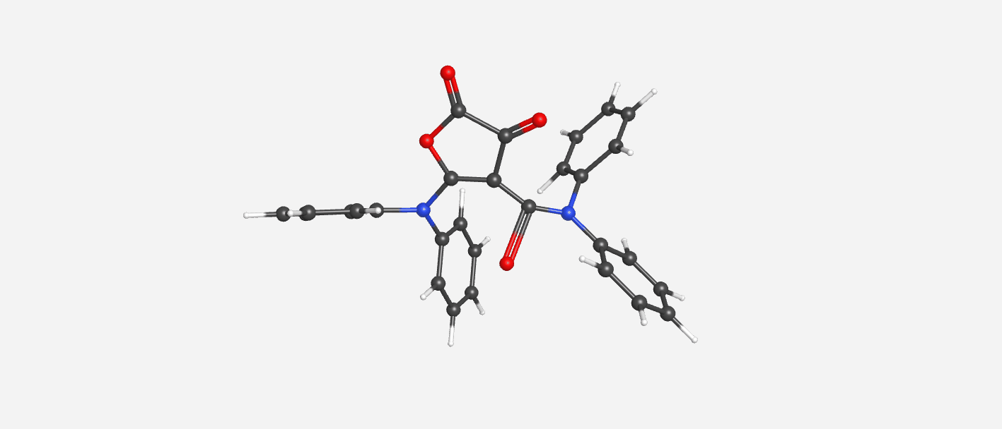
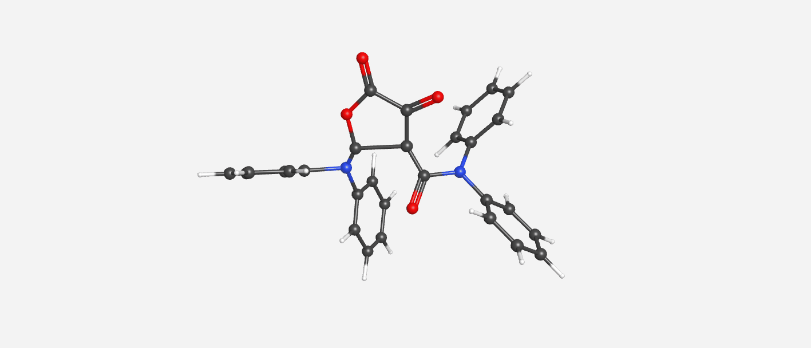

Slide 17
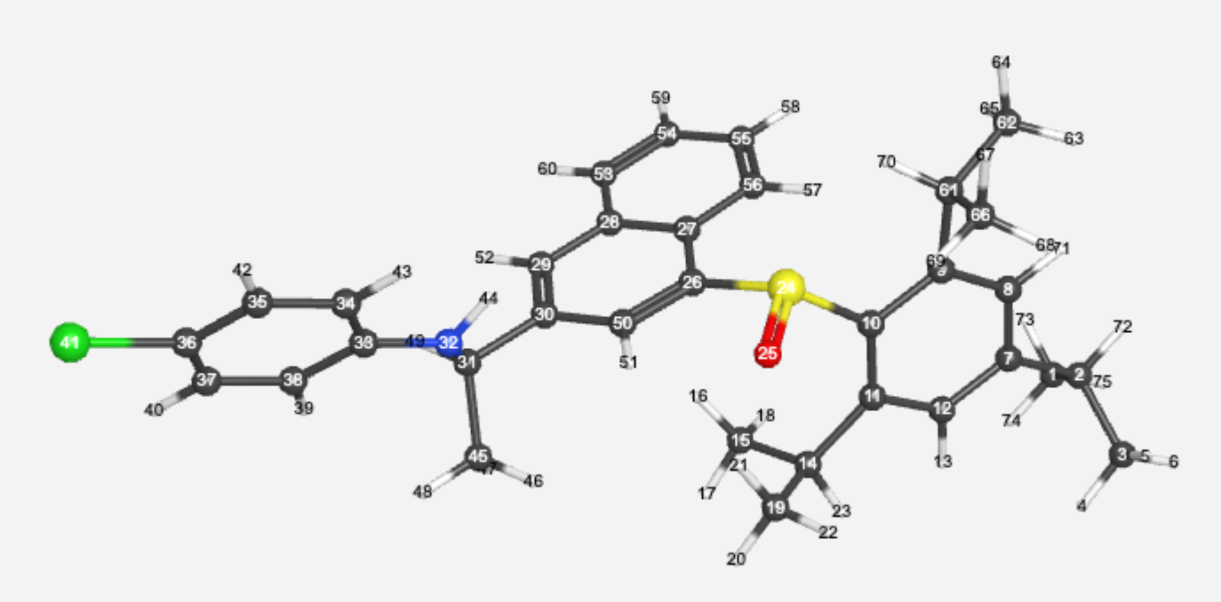
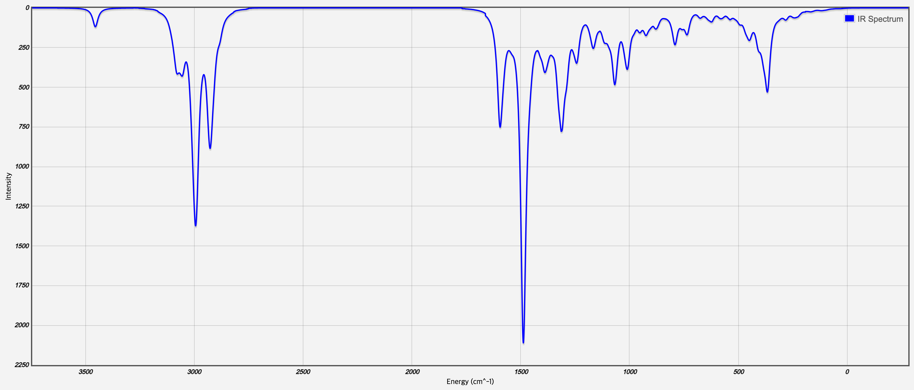
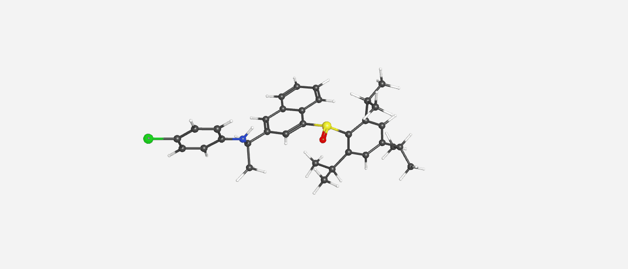
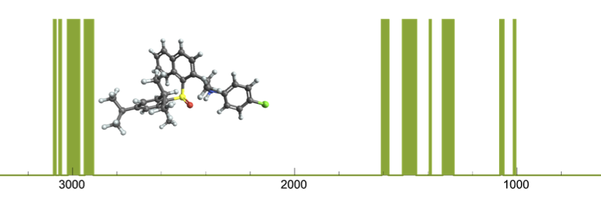
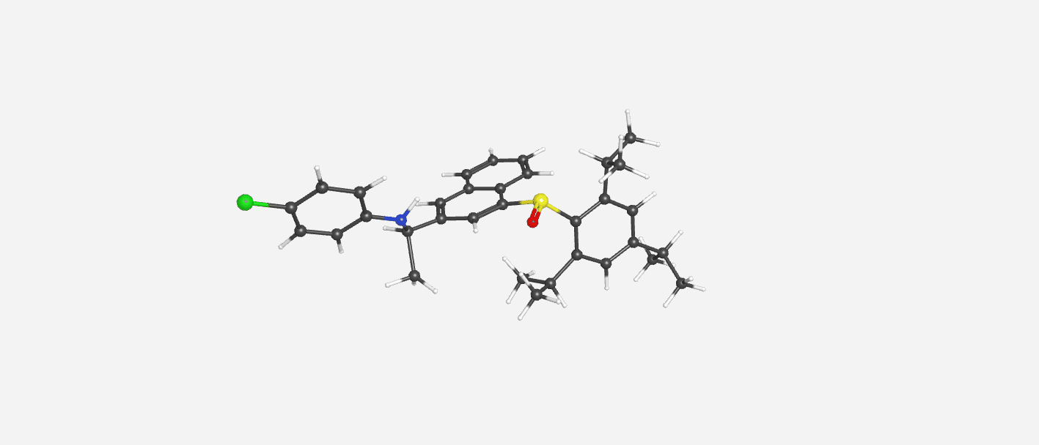

Slide 18
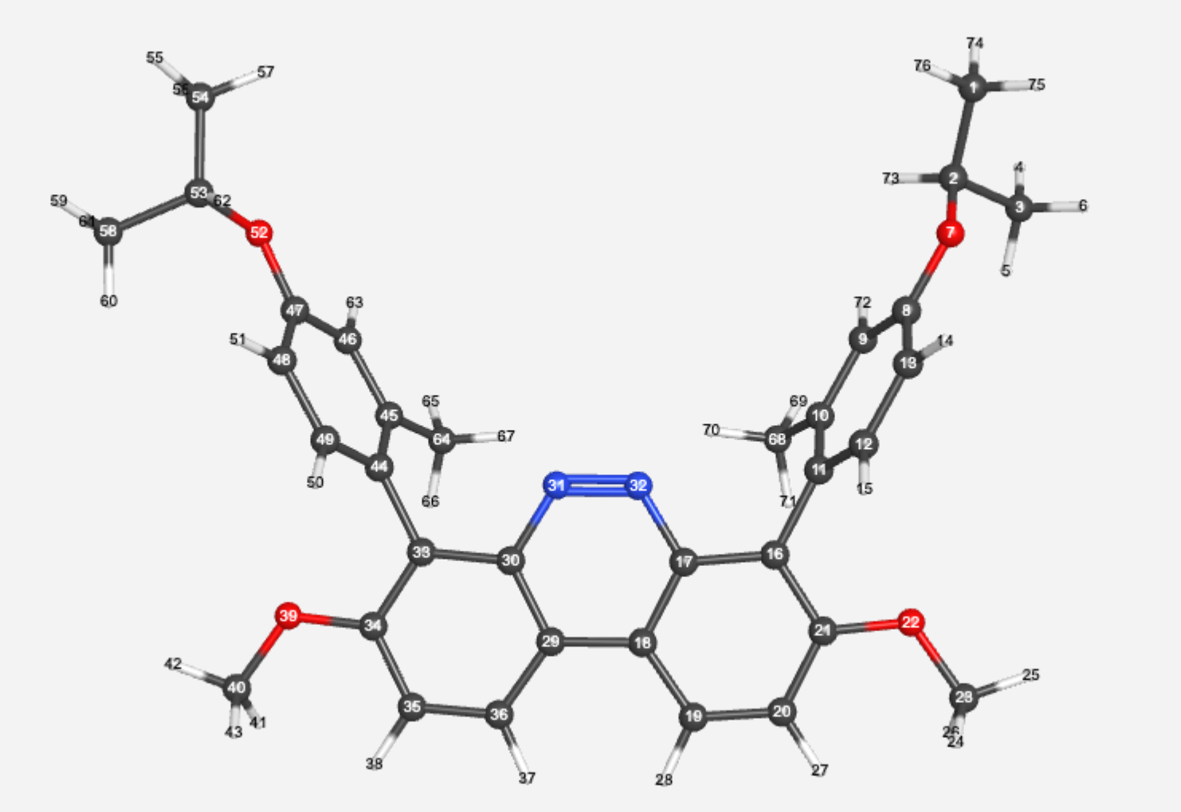
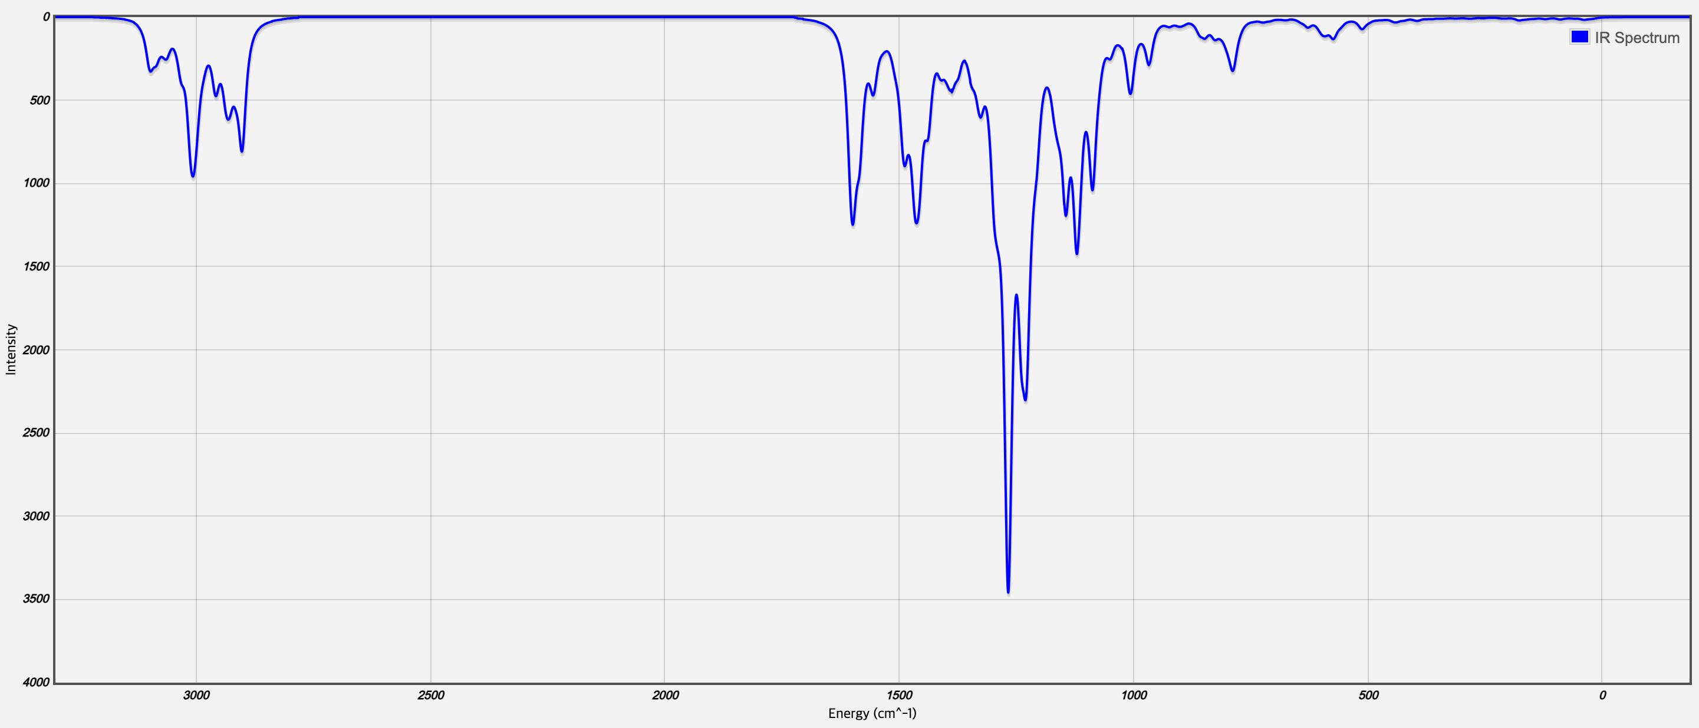
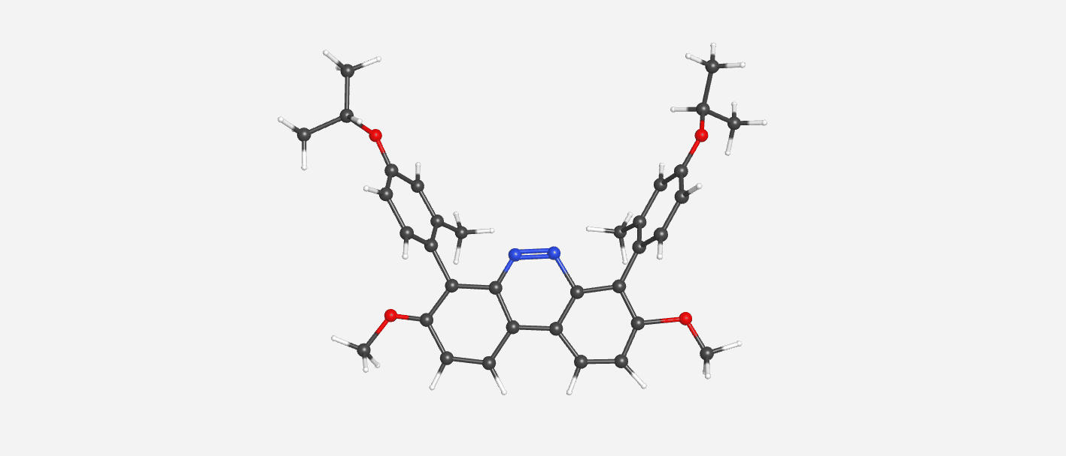
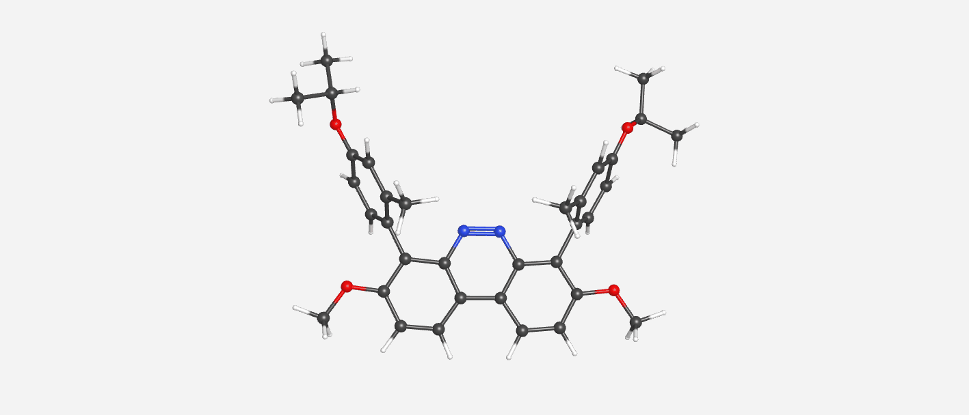
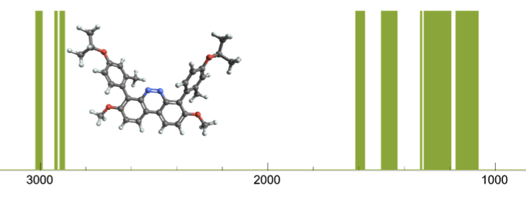
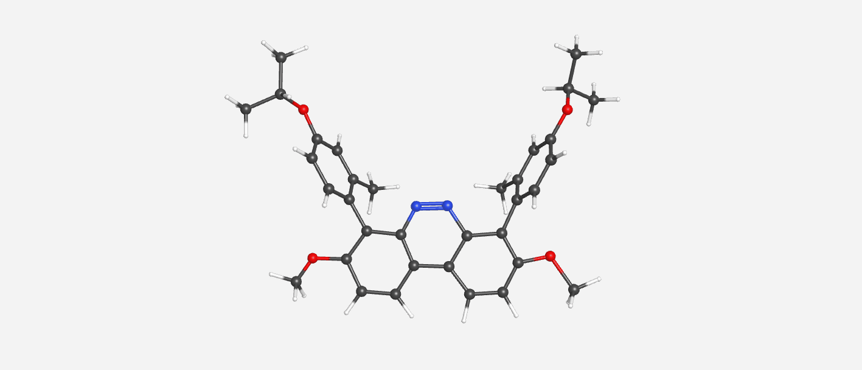

Slide 19
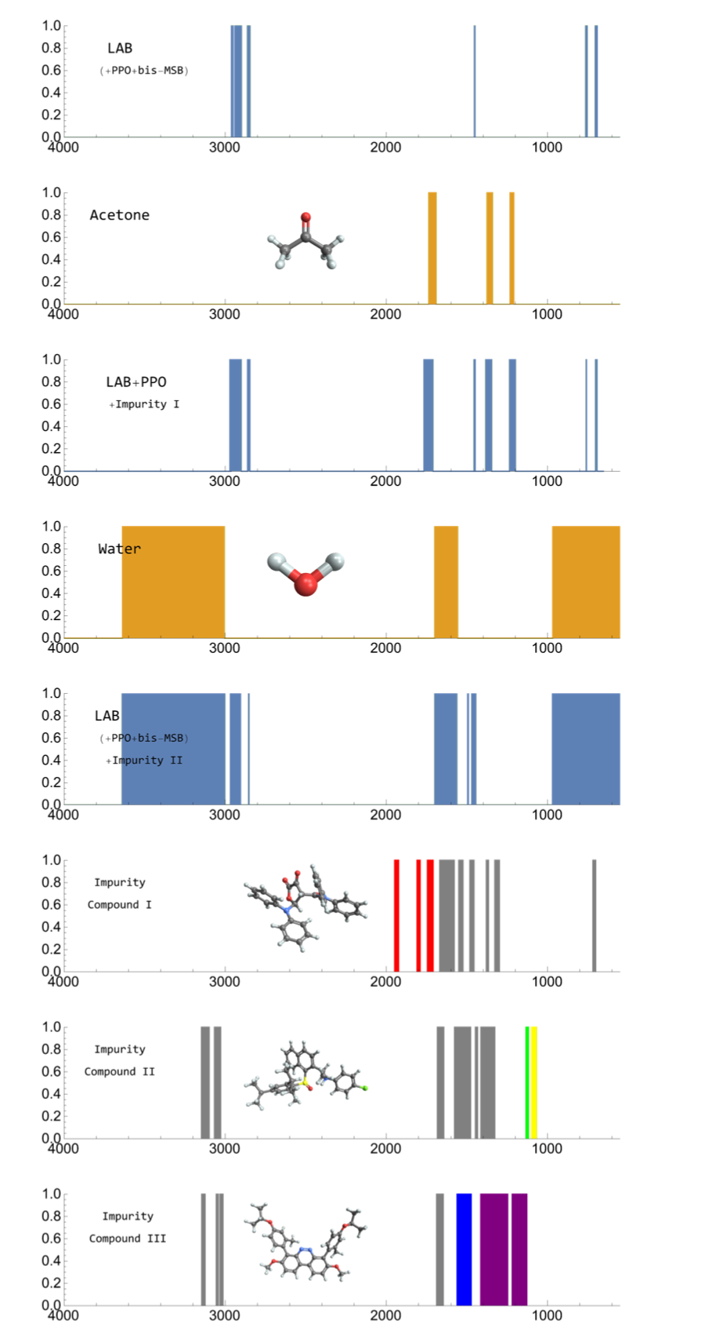
LAB + (PPO + bis-MSB)
Acetone
LAB + PPO + impurity I (=Acetone)
Water
LAB (+ PPO + bis-MSB) + impurity II (=Water)
Impurity Compound I
Impurity Compound II
Impurity Compound III

Slide 20
Quantum Computing Applications $D−Wave Quantum Computer$

Slide 21
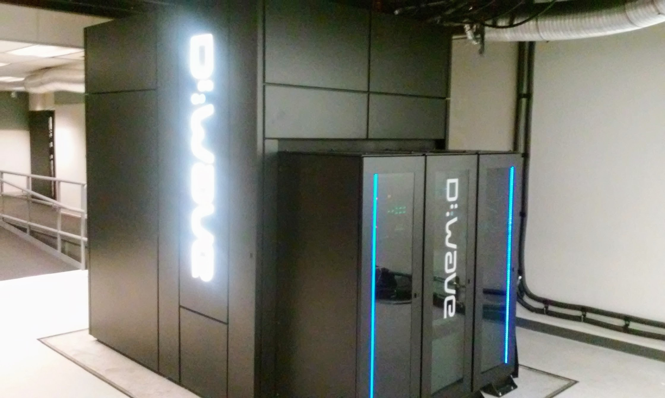
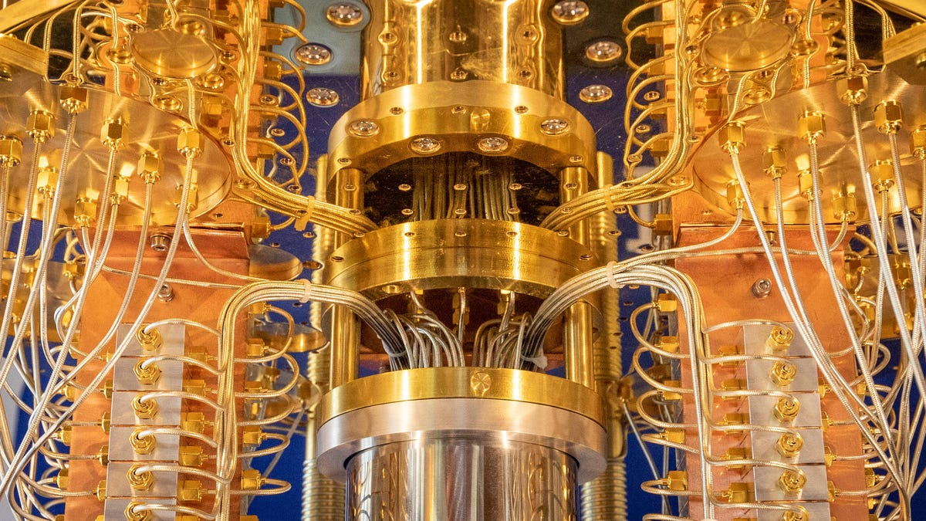
$Two types of QCs$
$Introduction to Quantum Computer$
D-wave Quantum Annealer
IBM-Q, ION-Q
D-wave Advantage 2 (2023)
7000++ qubit
High applicability and accuracy of quantum measurement
Programming difficulty
Require more qubits
IBM-Q, Ion-Q
400++ qubit
Large quantum error
Programmable
Require more qubits
Prof. Hunpyo Lee - Accelerated Variational Eigensolver in combination with Quantum Annealer

Slide 22
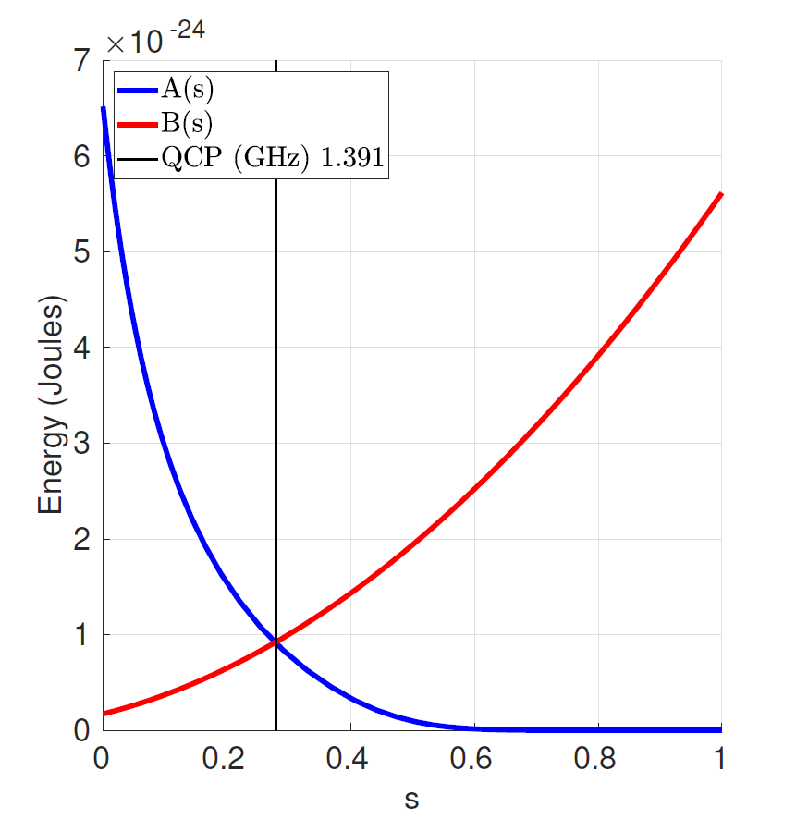
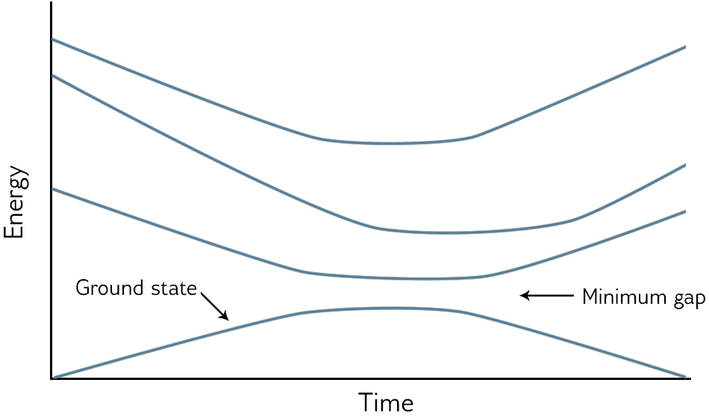
5 page
$$D−Wave Quantum Computer$$
$Introduction to D−Wave Quantum Computer$
$$H_{Ising}=−\frac{A\left(s\right)}{2}\left(\sum_{i}{{\hat{σ}}_{x}^{\left(i\right)}}\right)+\frac{B\left(s\right)}{2}\left(\sum_{i}{h_{i}{\hat{σ}}_{z}^{\left(i\right)}+}\sum_{i,j}{J_{i,j}{\hat{σ}}_{z}^{\left(i\right)}{\hat{σ}}_{z}^{\left(j\right)}}\right)$$
$$3) Annealing$$
$$Initial state$$
$$Final state$$
What is Quantum Annealing? — D-Wave System Documentation documentation (dwavesys.com)

Slide 23
Hydrogen Molecule

Slide 24
11 page
$$II. D−Wave Quantum Computer$$
$Quantum Annealing Example :Hydrogen model$
$The electronic structure problem and its mapping on an Ising Hamiltonian$
$$→ H=−\sum_{i}{\frac{{∇_{i}}^{2}}{2}}−\sum_{i,A}{\frac{Z_{A}}{\left|r_{i}−R_{A}\right|}}+\sum_{i,j}{\frac{1}{\left|r_{i}−r_{j}\right|}}$$
$$Kinetic Energy of electrons$$
$$Coulomb interaction btw electrons \& nuclei$$
$$Coulomb interaction btw electrons$$
$$M :nuclei \& N :electrons$$
-
-
$$r_{i} :position of electrons$$
+
+
$$M_{A} :mass in atomic units of the nuclei$$
$$R_{A} :position in atomic units of the nuclei$$
$$Z_{A} :charge in atomic units of the nuclei$$
$$\left\langle H_{2}\right\rangle$$
arXiv:1811.05256

Slide 25
12 page
II. $D−Wave Quantum Computer$
$Quantum Annealing Example :Hydrogen model$
$The electronic structure problem and its mapping on an Ising Hamiltonian$
$$→ H=\sum_{i,j}{h_{ij}{a_{j}}^{+}a_{i}+\frac{1}{2}}\sum_{i,j,k,l}{h_{ijkl}{a_{i}}^{+}{a_{j}}^{+}a_{k}a_{l}}$$
$${a_{i}}^{+} :fermionic creation operator$$
$$\left\{a_{i},{a_{j}}^{+}\right\}=δ_{ij}$$
$$a_{j} :fermionic annihilation operator$$
$$h_{ij}=\left\langle ψ_{i} | −\frac{{∇_{i}}^{2}}{2}−\sum_{A}{\frac{Z_{A}}{|r_{i}−R_{A}|}} | ψ_{j}\right\rangle$$
$$\& h_{ijkl}=\left\langle ψ_{i}ψ_{j} | \frac{1}{|r_{i}−r_{j}|} | ψ_{k}ψ_{l}\right\rangle$$
$$∗∗fermionic creation \& annihilation −−→ Pauli matrice$$
arXiv:1811.05256

Slide 26
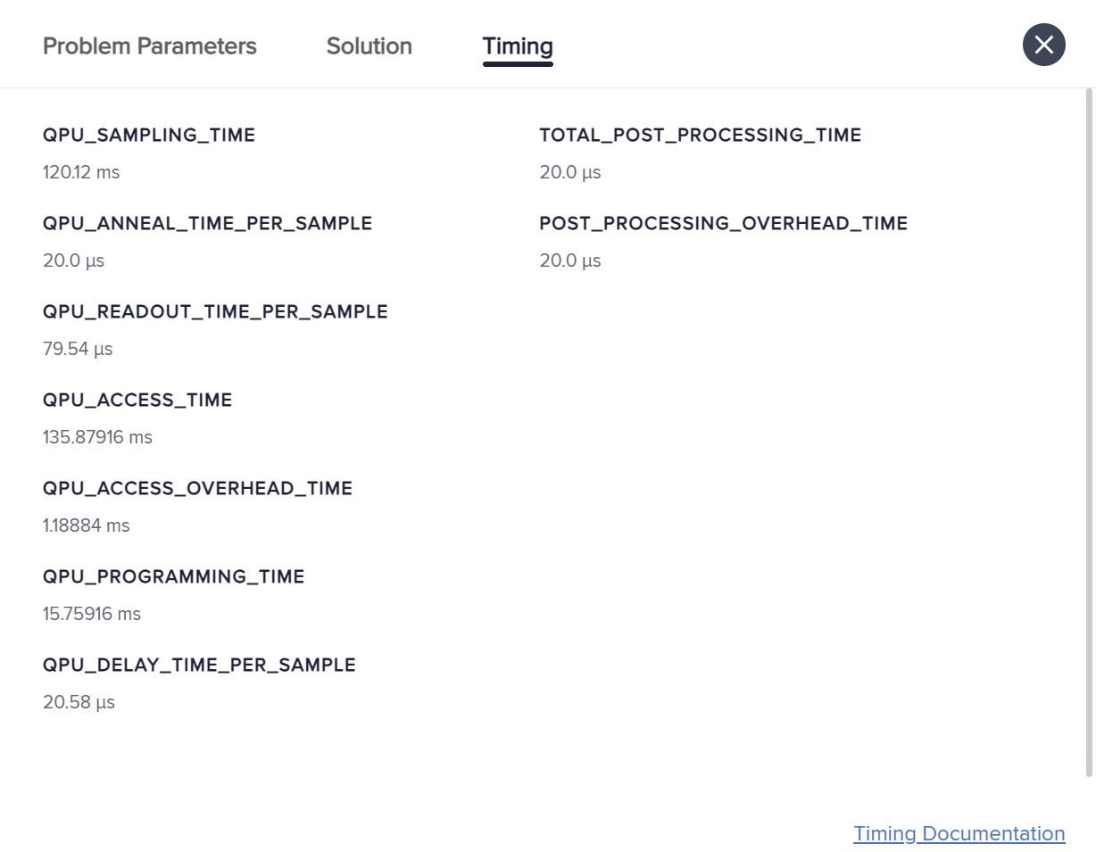
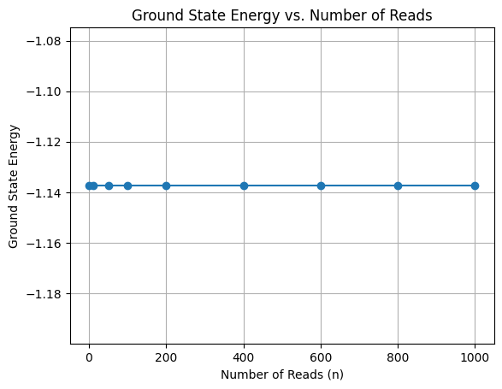
$D−Wave Quantum Computer$
15 page
$Hydrogen molecule model$
$Quantum Annealing using D wave$
$$:−1.\text{137308} \text{hartree}$$
$$1hartree=27.2114eV$$

Slide 27
$D−Wave Quantum Computer$
14 page
$$1hartree=27.2114eV$$
$Classical Eigensolver :−1.137306 hartree \text{10.21}\text{s}$
$Variational Quantum Eigensolver :−1.137306 \text{hartree}$
$$\text{16.79}\text{s}$$
$Quantum Annealing simulation :−1.137306 hartree \text{ 17.69}\text{s}$
Estimate the Hydrogen Ground State Energy (ucsd.edu) & arXiv:2009.10779
& 10.1103/PhysRevLett.121.013001
qiskit-nature/docs/tutorials/03_ground_state_solvers.ipynb at main · qiskit-community/qiskit-nature (github.com)

Slide 28
Deuteron

Slide 29
$D−Wave Quantum Computer$
7 page
$Deuteron model$
p
n
$$M_{p}=938.3MeV/c^{2}$$
$${\& M}_{n}=939.6MeV/c^{2}$$
$$\& κ=0.67 \& r_{0}=1.27fm \& a_{0}=0.67fm$$
$$\& λ=32{fm}^{−1} \& M=\frac{M_{p}+M_{n}}{2}=938.95MeV/c^{2}$$
$$\left\langle Deuteron\right\rangle$$
$$Nuclear interaction btw proton \& neutron$$
$$→ H=\sum_{i=1}^{Z}{\frac{{p_{i}}^{2}}{2M_{p}}}+\sum_{i=Z+1}^{A}{\frac{{p_{j}}^{2}}{2M_{n}}}+\sum_{k=1}^{A}{V(r_{k})}+\sum_{1≤i_{1}≤i_{2}≤Z}{\frac{e^{2}}{4πϵ_{0}}\frac{1}{\left|r_{i_{1}}−r_{i_{2}}\right|}}+\frac{1}{2}\sum_{k_{1}≠k_{2}}{v(k_{1},k_{2})}$$
$$proton→{\{ψ_{π,i}\}}_{i=1}^{N_{π}}$$
$$neutron→{\{ψ_{υ,j}\}}_{j=1}^{N_{υ}}$$
$$Kinetic Energy of proton$$
$$Kinetic Energy of neutron$$
$$\& U_{c}\left(r\right)=\frac{U_{0}\left(1±κ\frac{N−Z}{N+Z}\right)}{1+\exp\left(\frac{r−r_{0}A^{\frac{1}{3}}}{a_{0}}\right) }$$
$$→ V\left(r\right)=U_{c}\left(r\right)−2λ{\frac{ℏ}{2Mc}}^{2}∙\frac{dU_{c}\left(r\right)}{dr}s∙l$$
$$→ wood saxon potential$$
QCSH: A full quantum computer nuclear shell-model package | Science China Physics, Mechanics & Astronomy (springer.com)

Slide 30
$D−Wave Quantum Computer$
8 page
$Deuteron model$
$$→ H=\sum_{α′}{\sum_{α}{g_{π}(α^{′},α)a_{π,α′}^{+}a_{π,α}⨂I_{ν}}}+\sum_{α_{1}^{′}α_{2}^{′}}{\sum_{α_{1}α_{2}}{h_{π}(α_{1}^{′},α_{2}^{′},α_{1},α_{2})a_{π,α_{1}^{′}}^{+}a_{π,α_{2}^{′}}^{+}a_{π,α_{2}}a_{π,α_{1}}⨂I_{ν}}}$$
$$+\sum_{β′}{\sum_{β}{g_{ν}(β^{′},β)I_{π}⨂a_{ν,β′}^{+}a_{ν,β}}}+\sum_{β_{1}^{′}β_{2}^{′}}{\sum_{β_{1}β_{2}}{h_{ν}(β_{1}^{′},β_{2}^{′},β_{1},β_{2})I_{π}⨂a_{ν,β_{1}^{′}}^{+}a_{ν,β_{2}^{′}}^{+}a_{ν,β_{2}}a_{ν,β_{1}}}}$$
$$+\sum_{α^{′}β^{′}}{\sum_{αβ}{h_{πν}(α^{′},α,β′,β)a_{π,α^{′}}^{+}a_{π,α }⨂a_{ν,β^{′}}^{+}a_{ν,β }}}$$
$$α,α^{′},α_{1},α_{1}^{′},α_{2},α_{2}^{′}∈\{1,2,…,N_{π}\}$$
$$β,β^{′},β_{1},β_{1}^{′},β_{2},β_{2}^{′}∈\{1,2,…,N_{ν}\}$$
$$∗ g_{π}\left(α^{′},α\right)=\left\langle ψ_{π,α′} | \frac{p^{2}}{2M_{p}}+V(r) | ψ_{π,α′}\right\rangle \& g_{ν}\left(β^{′},β\right)=\left\langle ψ_{ν,β′} | \frac{p^{2}}{2M_{n}}+V(r) | ψ_{ν,β′}\right\rangle$$
$$h_{π}\left({α_{1}}^{′},{α_{2}}^{′},α_{1},α_{2}\right)=\left\langle ψ_{π,α_{1}^{′}} | \left\langle ψ_{π,α_{2}^{′}} | \frac{1}{2}\left\{\frac{e^{2}}{4πϵ_{0}}\frac{1}{\left|r_{i_{1}}−r_{i_{2}}\right|}+v\left(π_{1},π_{2}\right)\right\} | ψ_{π,α_{1}}\right\rangle | ψ_{π,α_{2} }\right\rangle$$
$$h_{ν}\left(β_{1}^{′},β_{2}^{′},β_{1},β_{2}\right)=\left\langle ψ_{ν,β_{1}^{′}} | \left\langle ψ_{ν,β_{2}^{′}} | \frac{1}{2}v\left(ν_{1},ν_{2}\right) | ψ_{π,β_{1}}\right\rangle | ψ_{π,β_{2} }\right\rangle$$
$$\& h_{πν}\left(α^{′},α,β^{′},β\right)=\left\langle ψ_{π,α′ } | \left\langle ψ_{υ,β′ } | v\left(π,ν \right) | ψ_{π,α }\right\rangle | ψ_{ν,β }\right\rangle$$
QCSH: A full quantum computer nuclear shell-model package | Science China Physics, Mechanics & Astronomy (springer.com)

Slide 31
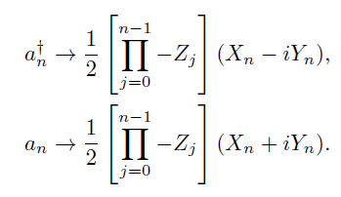
$D−Wave Quantum Computer$
9 page
$Deuteron model$
$$→ H_{N}=\sum_{n,n^{′}=0}^{N−1}{\left\langle n′ | T+V | n\right\rangle a_{n′}^{+}a_{n}}$$
$$\left\langle n′ | T | n\right\rangle =\frac{ℏw}{2}\left[\left(2n+\frac{3}{2}\right)δ_{n}^{n^{′}}−\sqrt{n\left(n+\frac{1}{2}\right)}δ_{n}^{n^{′}+1}−\sqrt{\left(n+1\right)\left(n+\frac{3}{2}\right)}δ_{n}^{n^{′}−1}\right] \& \left\langle n′ | V | n\right\rangle =V_{0}δ_{n}^{0}δ_{n}^{n′}$$
$$→Jordan−Wigner transformation method$$
Phys. Rev. Lett. 120, 210501-Published 23 May 2018

Slide 32
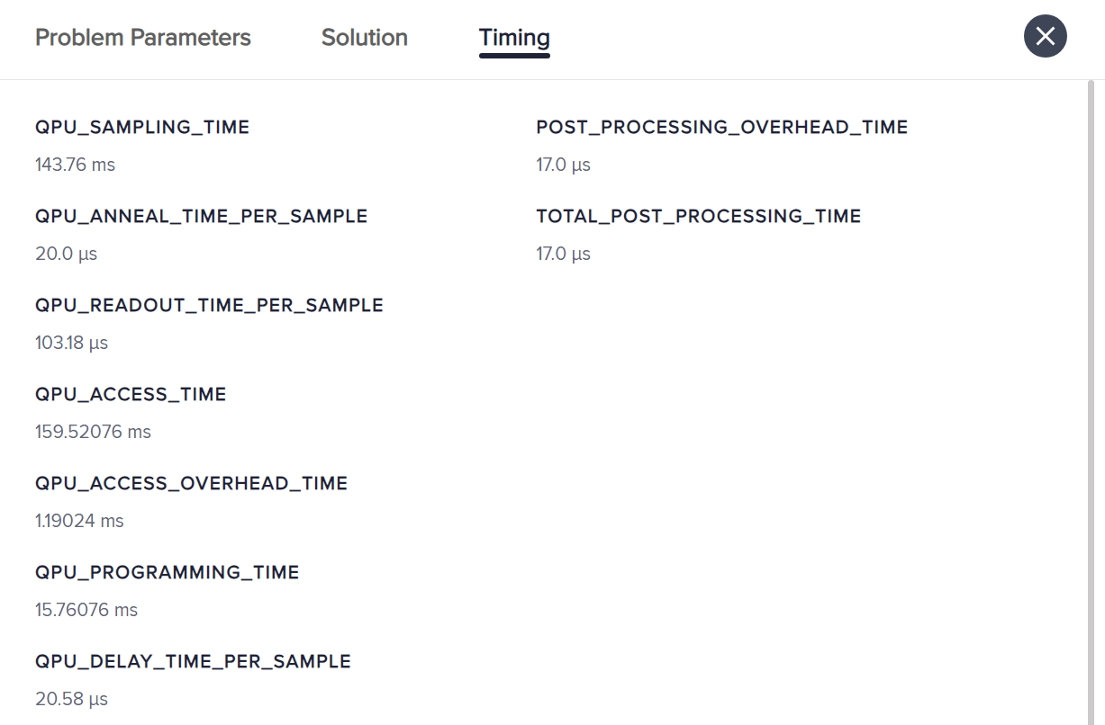
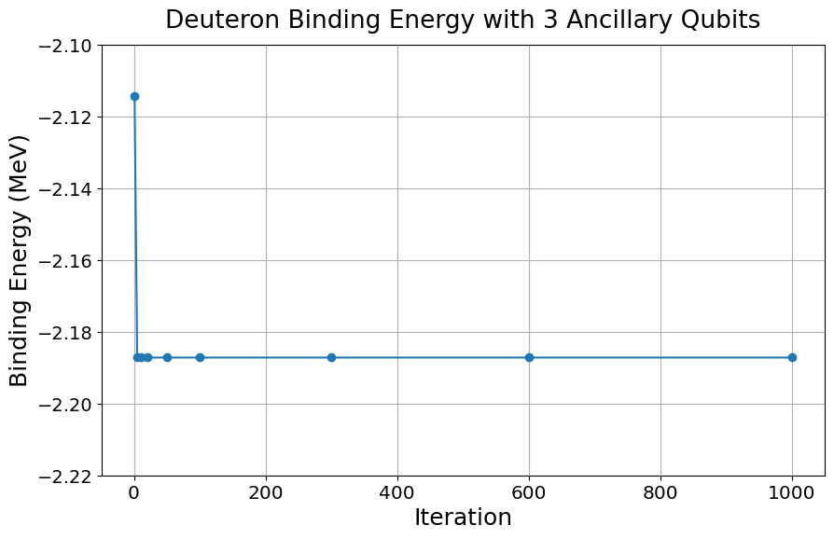
$D−Wave Quantum Computer$
11 page
$Deuteron model$
$$\text{−2.}\text{19}\text{MeV}$$
Ancillary Qubits | Binding Energy (MeV) | QPU Access Time (ms)
1 | -0.22 | 79.76
2 | -1.69 | 122.2
3 | -2.19 | 159.5

Slide 33
Conclusions
We presented a comprehensive analysis of infrared (IR) spectra for linear alkyl benzene (LAB)-based scintillation solutions, focusing on the detection and identification of impurities.
Acetone, a common contaminant from cleaning procedures, was detected by its characteristic absorption peaks at 1200, 1360, and 1700 cm−1.
Water, an inevitable by-product of Gd-loaded LAB using a neutralization reaction process, was identified through distinct O-H stretching and H-O-H bending vibrations at 3200-3600 cm−1 and 1600 cm−1, respectively.
The IR spectra of IMP1, IMP2, and IMP3 were theoretically calculated, revealing unique absorption bands for key functional groups, including carbonyl (C=O), amide (C-N), sulfoxide (S=O), aryl chloride (Ar-Cl), azo (N=N), and ether (C-O-C) groups.
The findings confirm the absence of these impurities in the LAB(+PPO+bis-MSB) sample, ensuring the high performance and accuracy of neutrino detectors.

Slide 34
Applications of Quantum Computing: A New Approach to Understanding Quantum Many-Body Phenomena
Classical computers operate with bits, whereas quantum computers use qubits and can be categorized into two main types.
Our exploration of Quantum Annealing demonstrated its suitability for optimization problems, utilizing the D-Wave system to solve these issues.
We adapted the Hamiltonian of the deuteron model to make it compatible with quantum computing.
By gradually increasing the number of ancillary qubits, we computed the deuteron binding energy.
Our observations indicated that with more ancillary qubits, the calculated deuteron binding energy converged towards the experimental value of −2.22 MeV.

Slide 35
Thank you for your attention!

