Slide 1
Physics of SND@LHC and SHiP experiments
Yeong Gyun Kim (광주교대)

Slide 2

SND@LHC

Slide 3
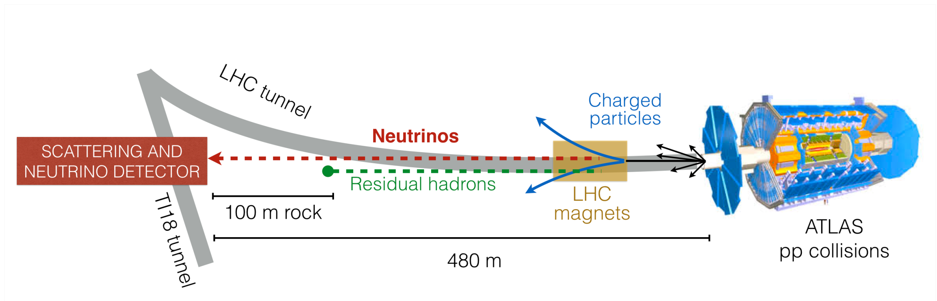
SND@LHC experiment
The Scattering and Neutrino Detector at the LHC
Located 480 m downstream of the ATLAS interaction point along the beam collision axis
Charged particles deflected by LHC magnets. 100 m rock absorbs residual hadrons
However, neutrinos and (if exist) Feebly Interacting Particles can reach the detector
The pseudo-rapidity range covered by the detector target 7.2 < η < 8.4 (not explored before)

Slide 4
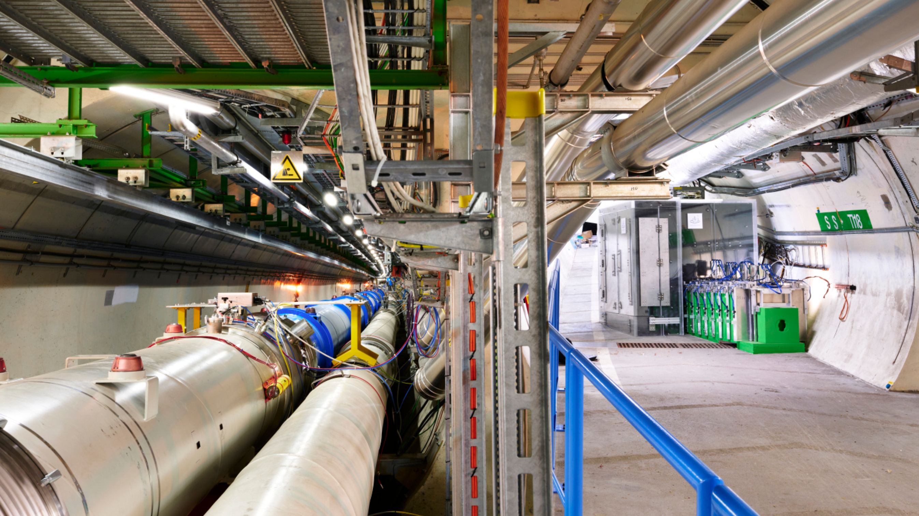
SND@LHC experiment
Installed in the TI18 tunnel and Taking Data (LHC Run 3)

Slide 5
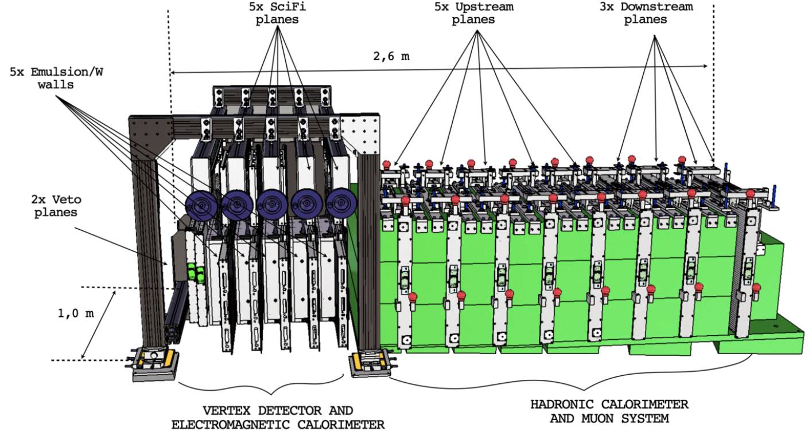
SND@LHC Detector
-Upstream VETO PLANES
Two planes of scintillator bars
act as a veto for charged particles
-TARGET REGION
Five walls of Emulsion Cloud Chamber
(Emulsion + Tungsten 830 kg),
each followed by a Scintillating Fiber
plane (timestamp)
-MUON SYSTEM
Eight iron slabs, each followed by
one or two planes of scintillating bars

Slide 6
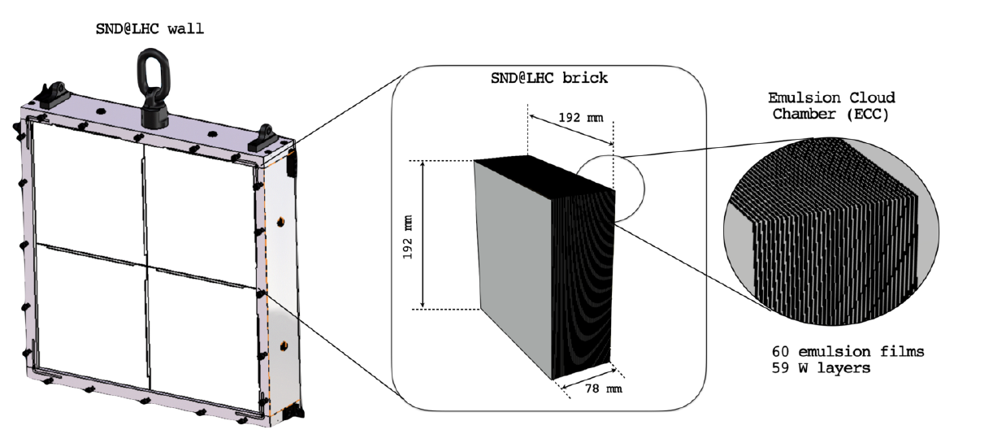
SND@LHC Detector
An emulsion wall is composed of four bricks, each consisting of 60 emulsion films interleaved with 59 tungsten plates

Slide 7
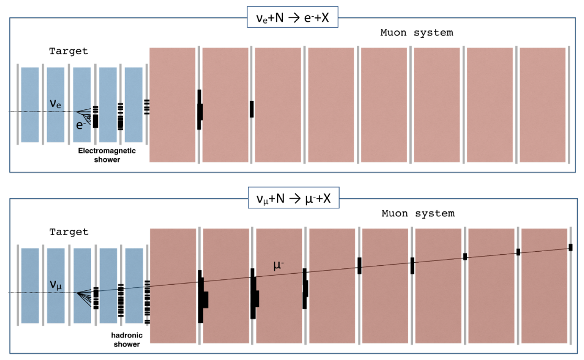
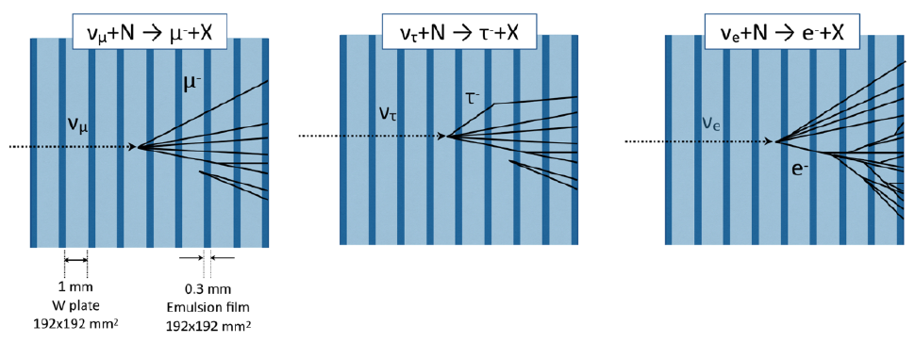
Event Reconstruction
Distinguish all three flavors of neutrinos.
Two-phase event reconstruction
The First Phase (electronic detectors)
Tagging incoming charged particles (veto planes)
Muon identification (muon system)
Calorimetric energy measurement (ECAL, HCAL)
The Second Phase (nuclear emulsions)
Extract and analyze emulsion data (~20 fb⁻¹)
Reconstruct ν primary and secondary vertices
Match emulsion and electronics reconstruction

Slide 8
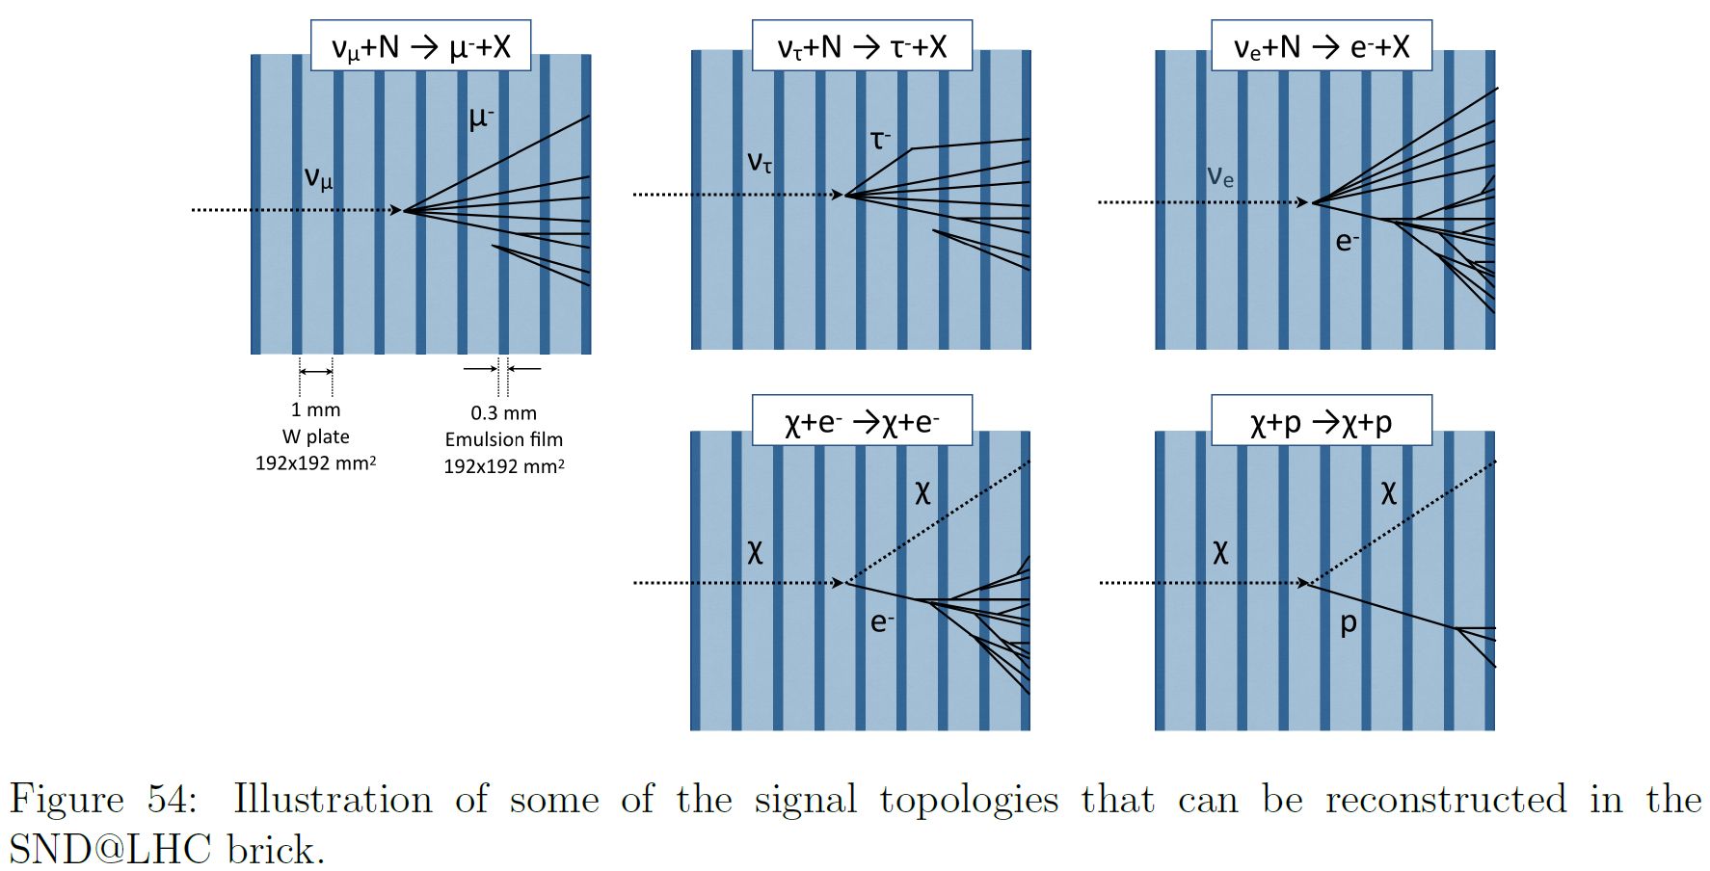
Event Reconstruction
Charged Current
Interactions
Neutral Current
Interactions

Slide 9
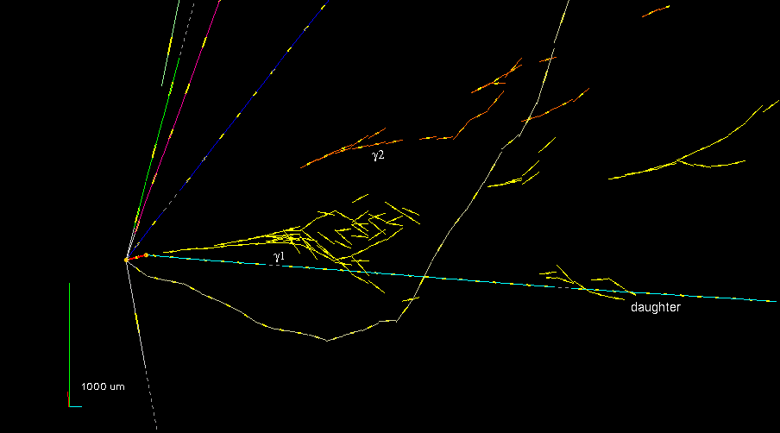
The First Tau Neutrino Candidate in OPERA
Physics Letters B691 (2010) 138
𝜏 → 𝜌𝜈_{𝜏} with 𝜌 → 𝜋⁰ 𝜋 and 𝜋⁰ → 𝛾𝛾

Slide 10
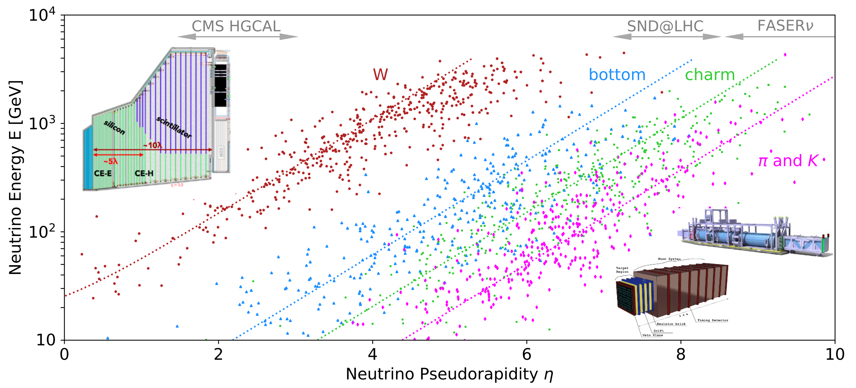
Neutrinos at the LHC
Neutrinos at the LHC can originate from the weak decay of a variety of SM particles of different masses.
P. Foldenauer,
F. Kling and P. Reimitz
[arXiv:2108.05370]

Slide 11
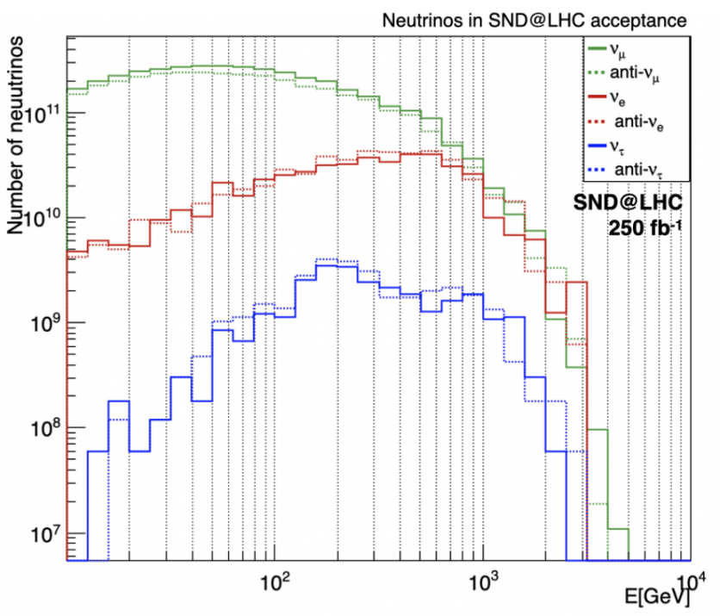
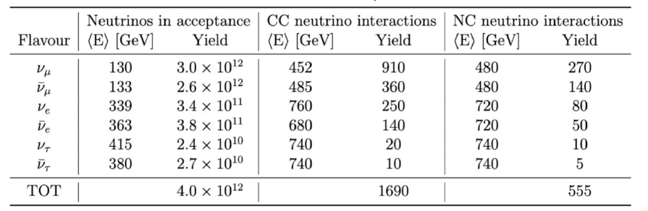
Neutrinos at the LHC
O(10¹²) neutrinos produced in the far forward direction (250 fb⁻¹ )
~1690 CC neutrino interactions, ~555 NC interactions (tungsten 830 kg)
Ratio of NC/CC events ~ 0.33 : A consistency test of SM

Slide 12
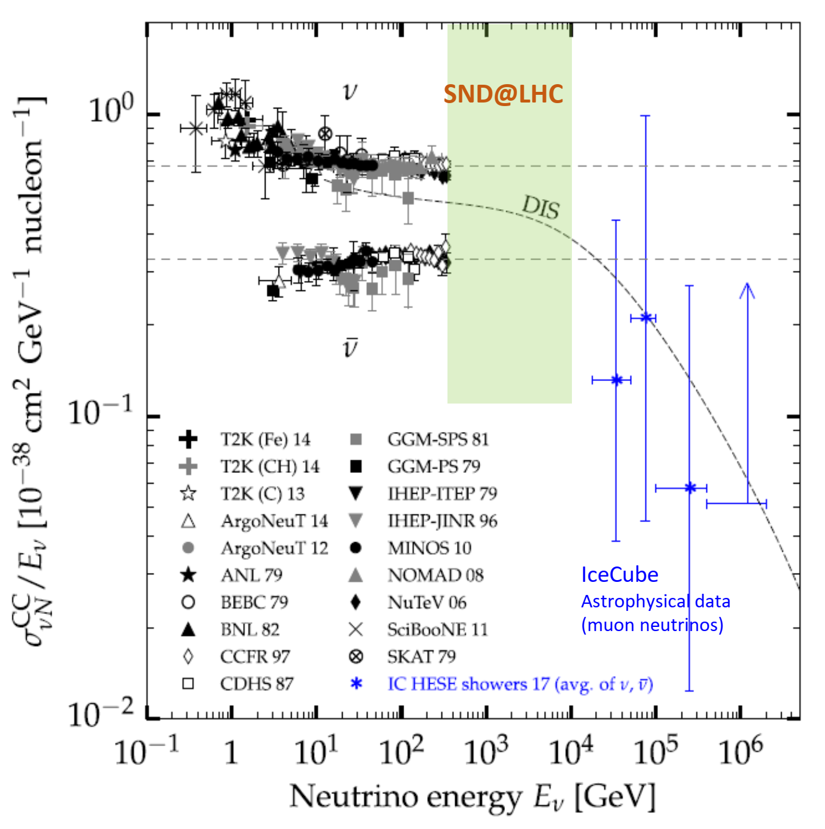
Neutrinos at the LHC
Neutrino energy range
360 GeV < E < 6.3 TeV
is unexplored.
No collider neutrinos had
ever been detected so far.
SND@LHC and FASER
provide the first detection
and study of the collider
neutrinos.

Slide 13
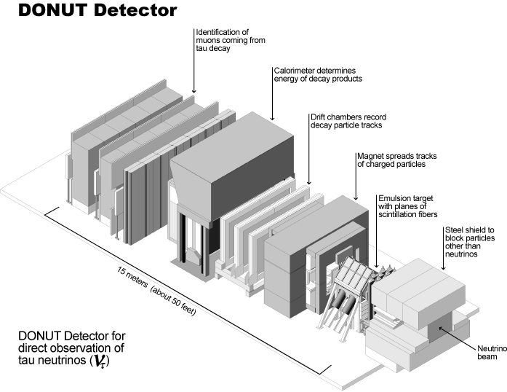
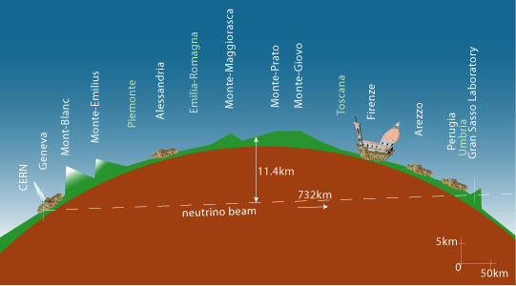
Neutrinos at the LHC
Tau neutrinos detected so far (DONuT 9 events, OPERA 10 events)
No anti-tau neutrinos has ever been identified experimentally.
~ 30 tau-neutrino events expected at the SND@LHC (250 fb⁻¹)

Slide 14
Physics in SND@LHC
Measurement of the pp → v_{e}X cross section
Charmed-hadron production in pp collisions
Lepton flavor universality in neutrino interactions
Measurement of the NC/CC ratio
Search for Feebly Interacting Particles

Slide 15

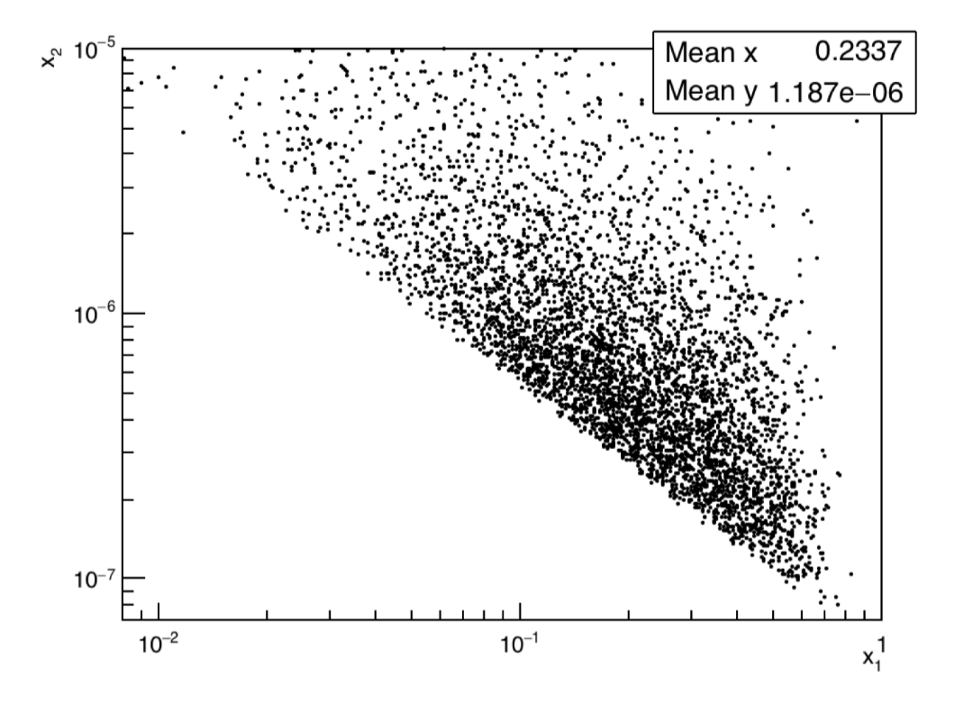
Charmed-hadron production at LHC
Electron neutrinos in 7.2<η<8.4 mainly originate from the decay of charmed hadrons produced in the LHC pp collisions.
Measurement of pp → ν_{e}X cross-section can provide insight into the heavy-quark production in an unexplored domain.
The dominant partonic process for associated charm
production at the LHC is gluon-gluon scattering
Measurement of electron neutrinos can provide
valuable constraints on the gluon PDF in small x region
Correlation between momentum fractions x₁ and x₂
for events in the SND@LHC acceptance

Slide 16





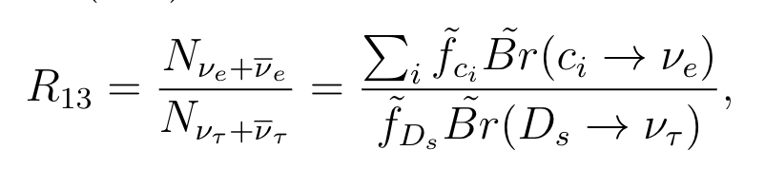
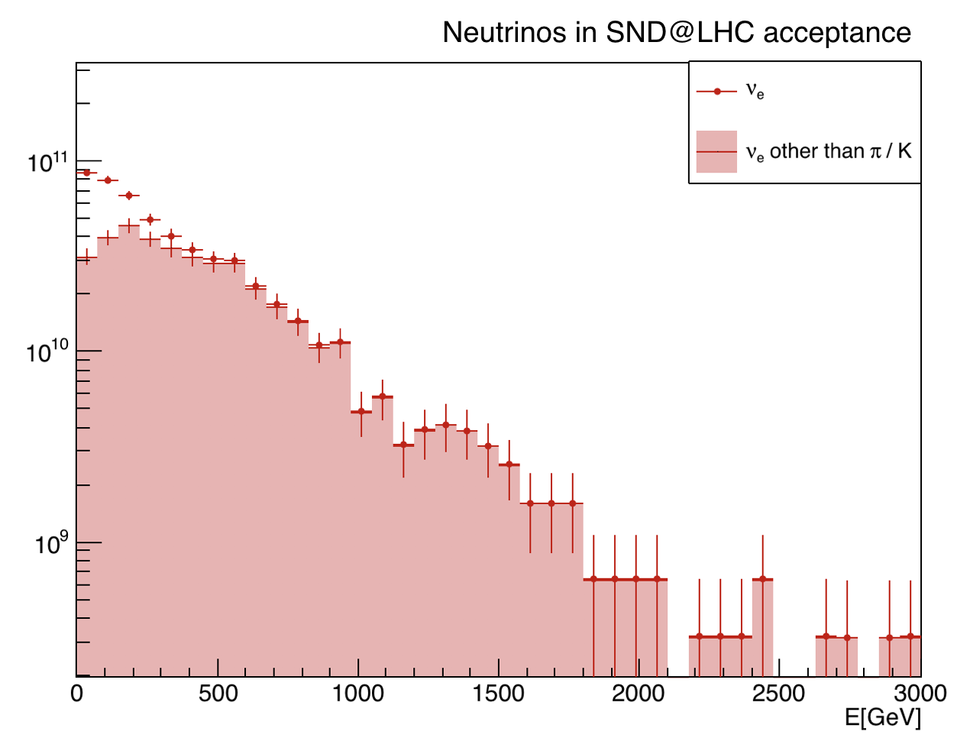
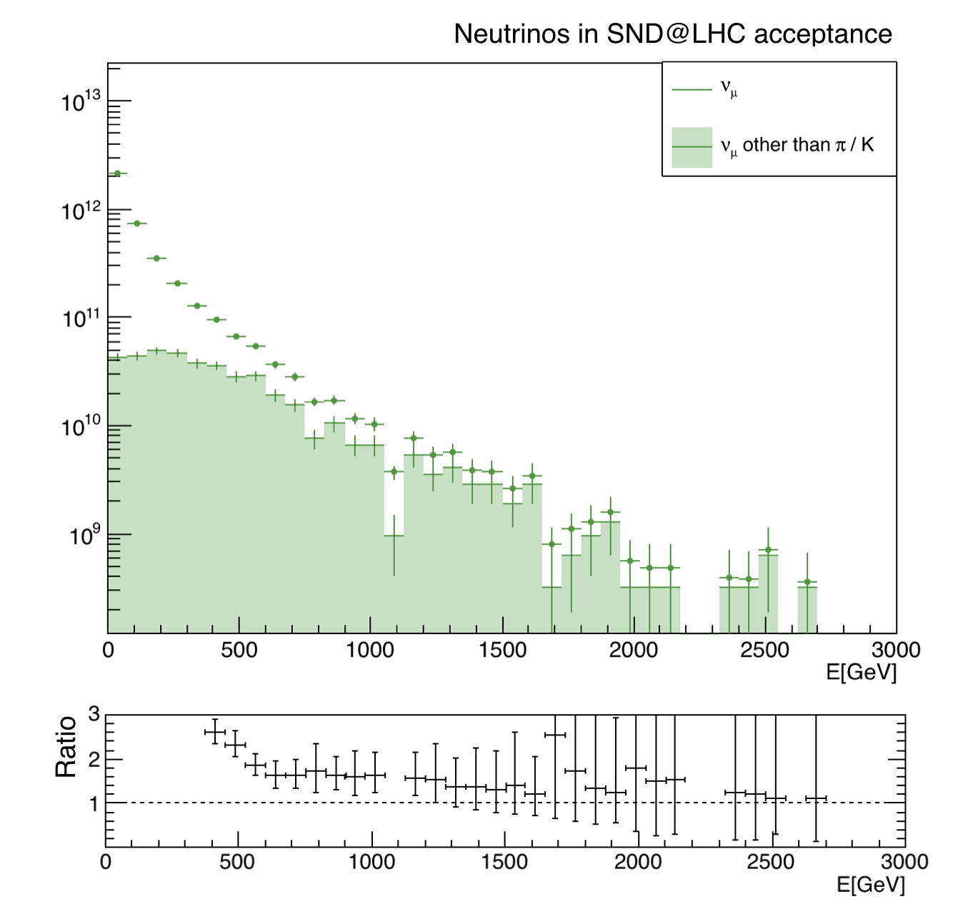

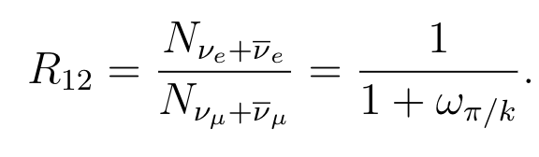
Lepton Flavor Universality
The ability of the SND@LHC to identify all three neutrino flavors offers a unique opportunity to test Lepton Flavor Universality in neutrino interactions
The ν_{e}/ν_{τ} ratio is sensitive to the ν-nucleon interaction cross section ratio of the two neutrino species.
contamination
from 𝜋/k
The measurement of the R₁₂ ratio
can be used as a test of the LFU
For E > 600 GeV

Slide 17


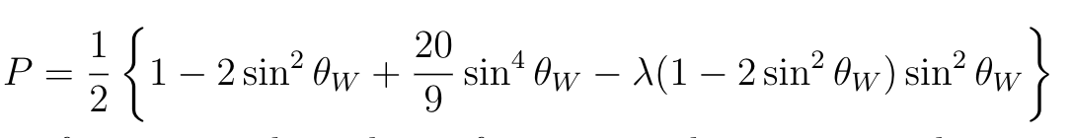
Measurement of the NC/CC ratio
Lepton identification of the three different flavors allows to distinguishing Charged-Current from Neutral-Current interaction at SND@LHC.
If differential neutrino and anti-neutrino flux are equal,
the NC/CC ratio can be written as
In case of DIS, P can be written as
- SND@LHC plans to measure
this ratio as a consistency test
of the Standard Model
- The systematic uncertainty 10%
The statistical error 5%
(For a tungsten target λ=0.04)

Slide 18
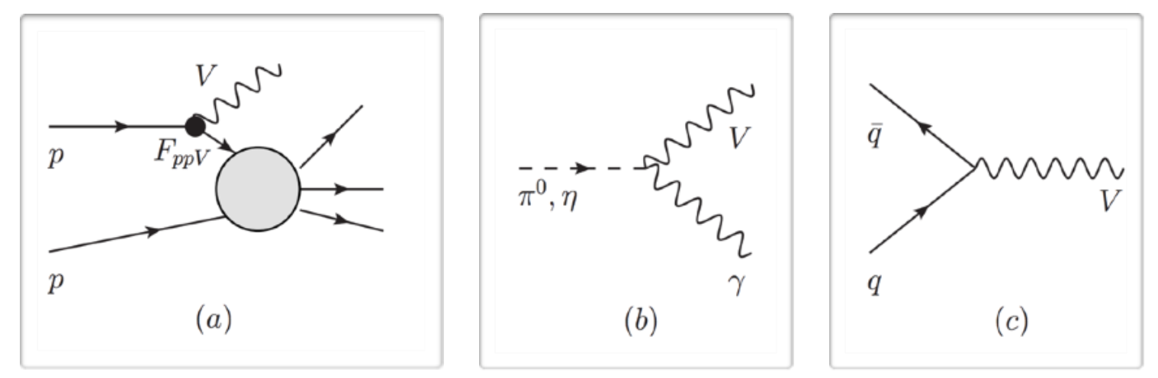
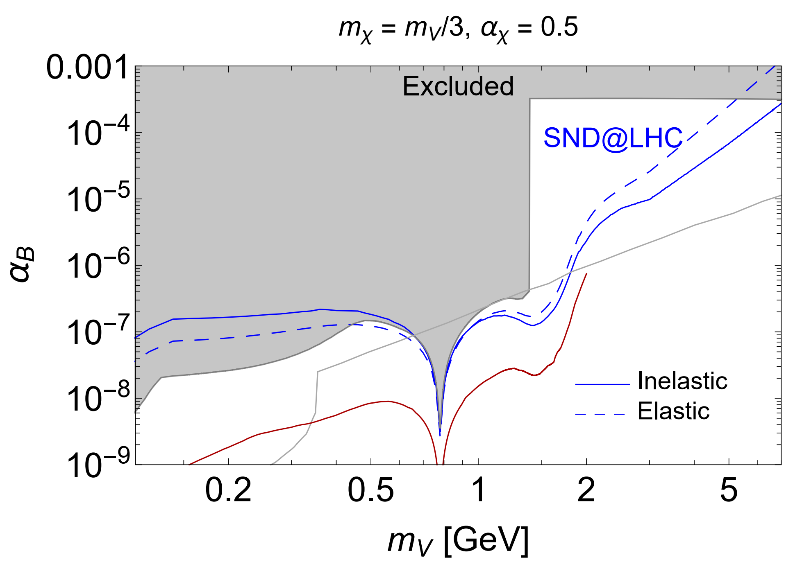
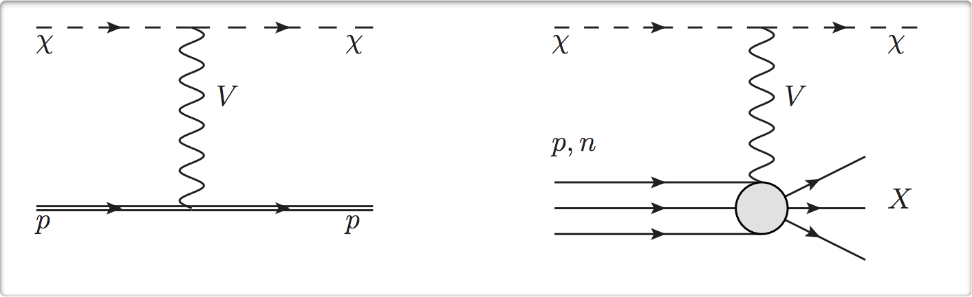
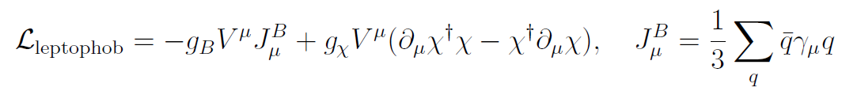
Search for Feebly Interacting Particles
SND@LHC will also be capable of exploring models with FIPs.
A Leptophobic DM model

Slide 19
Observation of collider muon neutrinos
First Physics Results

Slide 20
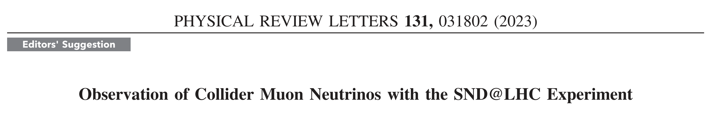
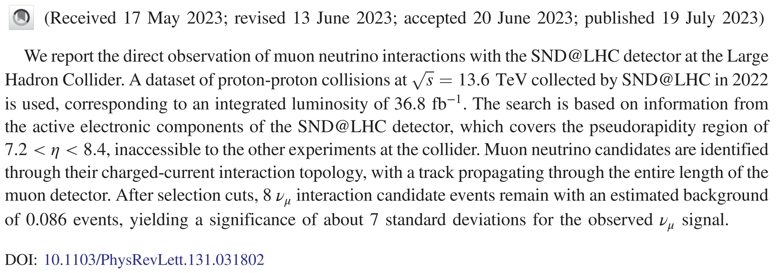
Observation of Collider Muon Neutrinos
SND@LHC reported the first observation of muon neutrinos from
LHC collisions, using exclusively data from electronic detectors.

Slide 21
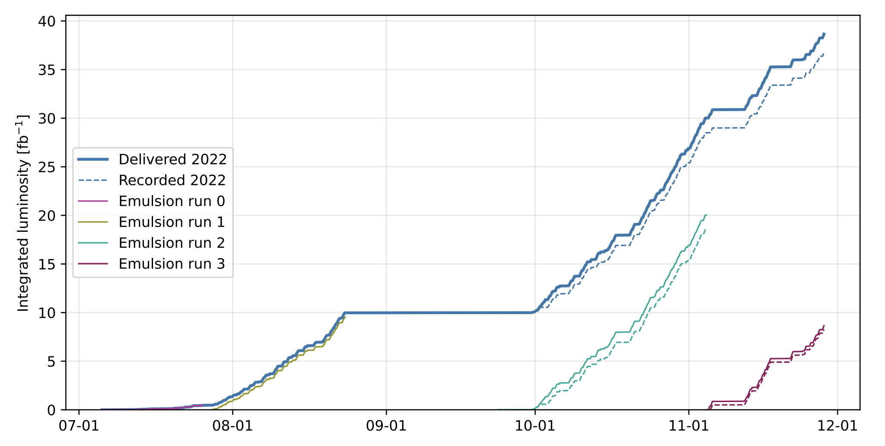
Integrated Luminosity (2022)
The data set of proton-proton collisions at 13.6 TeV, collected by SND@LHC in 2022, was used, corresponding to an integrated luminosity of 36.8 fb⁻¹.

Slide 22
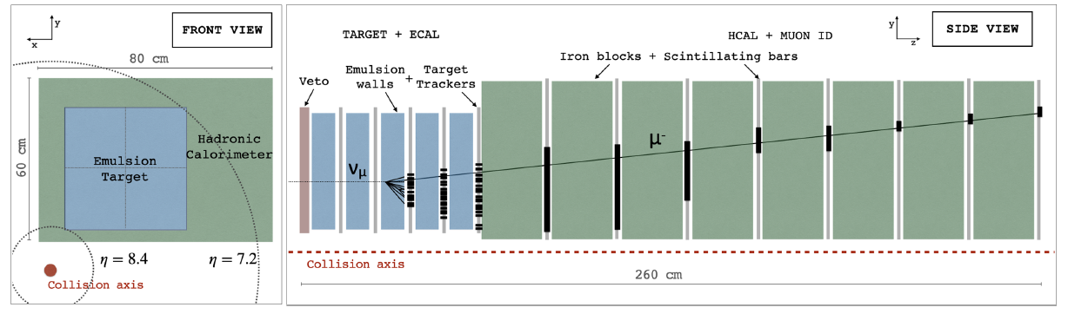
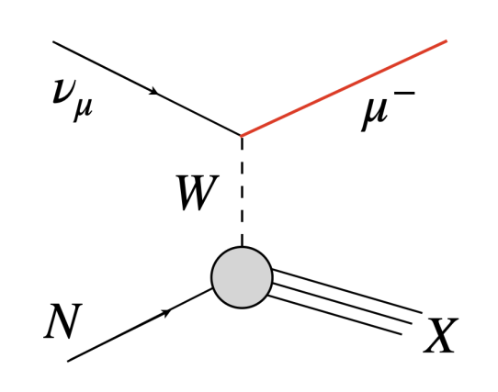
Signature of muon neutrino interaction
In SND@LHC, the dominant CC process occurring for muon neutrinos is deep inelastic scattering.
The signature of these interactions includes an isolated muon track in the muon system, associated with a hadronic shower (SciFi and HCAL)

Slide 23

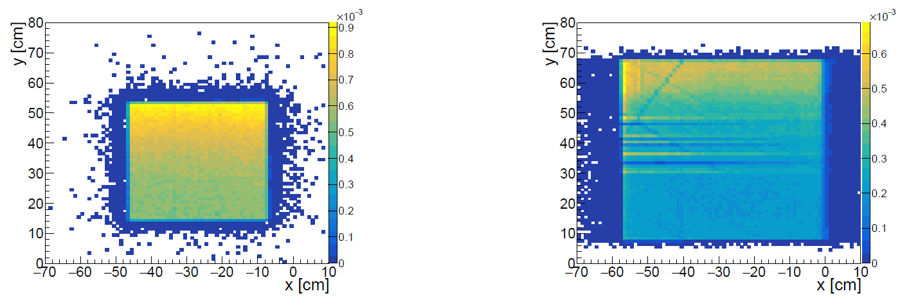
Analysis strategy
Expected number of ν_{μ} signal ~ (target mass 792 kg, 36.8 fb⁻¹)
Background : ~ 10⁹ muons reaching the detector location.
Muon flux measured with electronic detectors
~ 2.07 x 10⁴ cm⁻²/fb⁻¹
The expected muon flux in the fiducial area
~ 1.69 x 10⁴ cm⁻²/fb⁻¹
SciFi tracks
DS tracks
Need a selection with strong rejection power for a very clean signal.

Slide 24
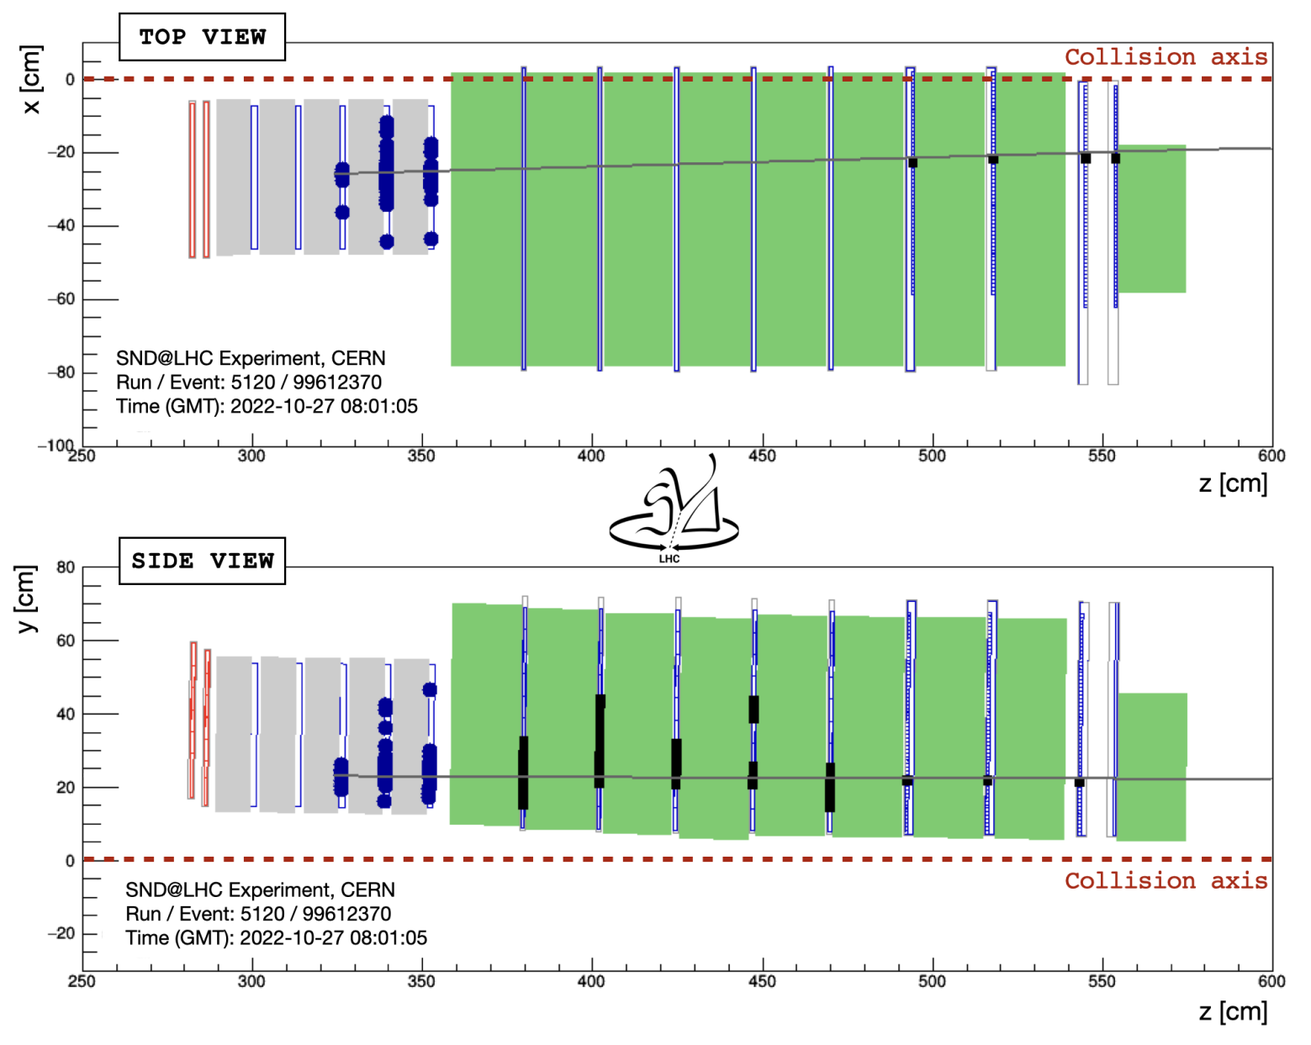
Signal Selection
Fiducial region cut : reject charged particles
entering from the front and sides of the detector.
Detector activity starts in the 3rd or 4th target walls
Constrained in an inner XY region (25x26 cm²)
Signal efficiency from MC ~ 7.5 %
Efficiency on data ~ 5.9 x 10⁻⁵
Neutrino ID cut : select signal-like signature patterns.
Large hadronic activity in the calorimetric system
A clean outgoing muon track in the muon system
Hit time distribution consistent with an event from the IP1
Overall efficiency on signal (MC) ~ 2.7 %
Overall efficiency on data ~ 10⁻⁹
Display of a ν_{μ} CC candidate event

Slide 25
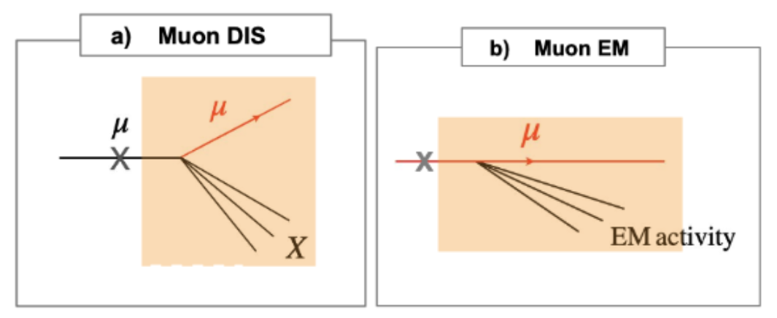
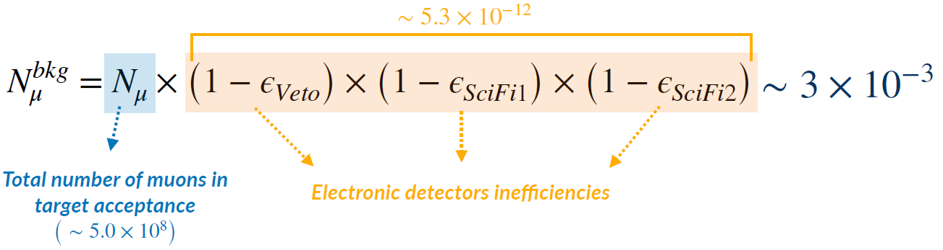
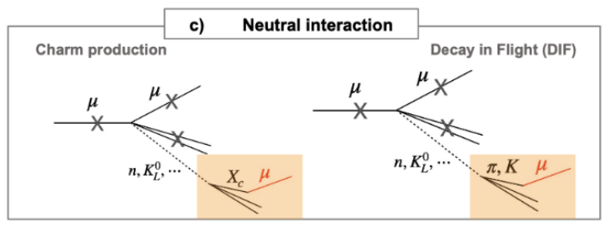


Backgrounds
Penetrating Muons : Muons are not vetoed and produce showers in the detector
Muon-induced neutral particles : Muons can interact in surrounding material, producing
neutral particles which mimic neutrino interactions

Slide 26
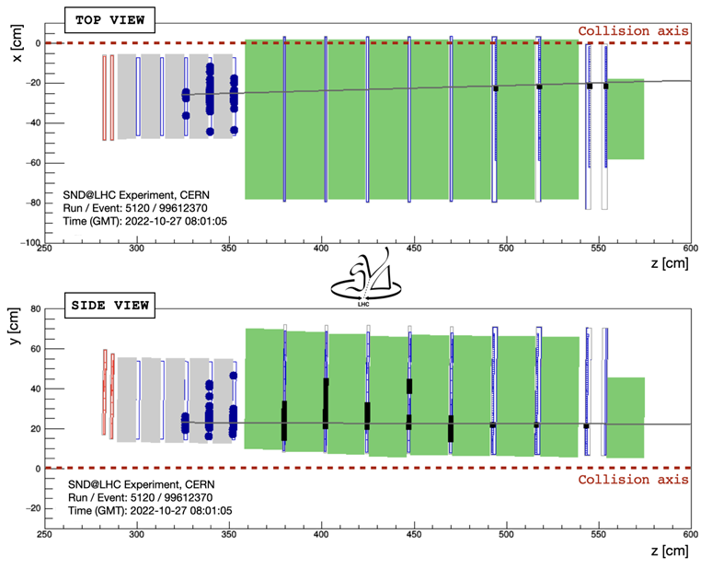
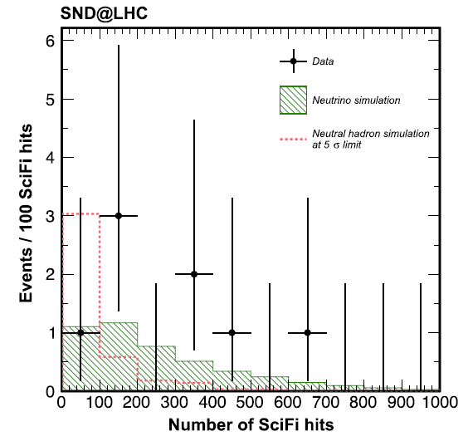
Observation of muon neutrinos
After selection cuts, 8 ν_{μ} interaction candidate events remain (4.2 expected)
An estimated background of 0.086 events
A significance of 6.8 standard deviations for the observed ν_{μ} signal

Slide 27
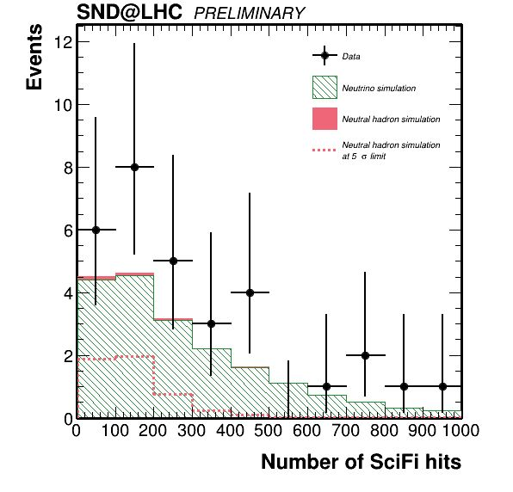
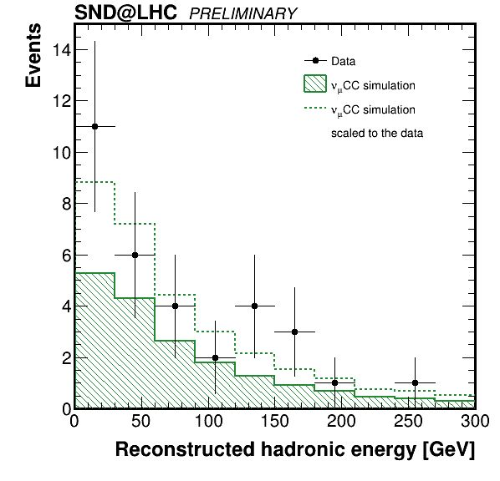
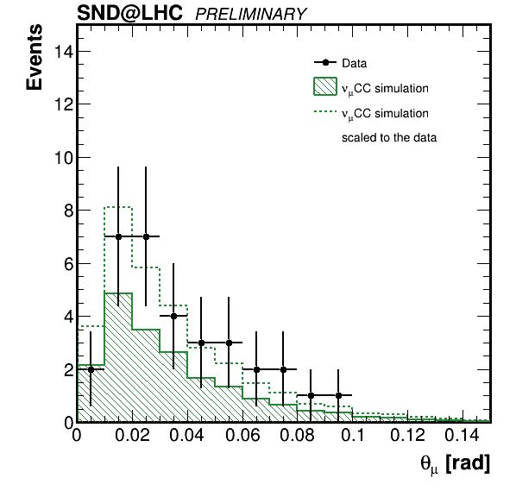
Updated muon neutrino results (2022-2023)
Events expected in 68.6 fb⁻¹
Signal: 19.1± 4.1
Neutral hadrons: 0.25 ± 0.06
32 events observed

Slide 28
Observation of collider neutrinos without final state muons
arXiv: 2411.18787

Slide 30
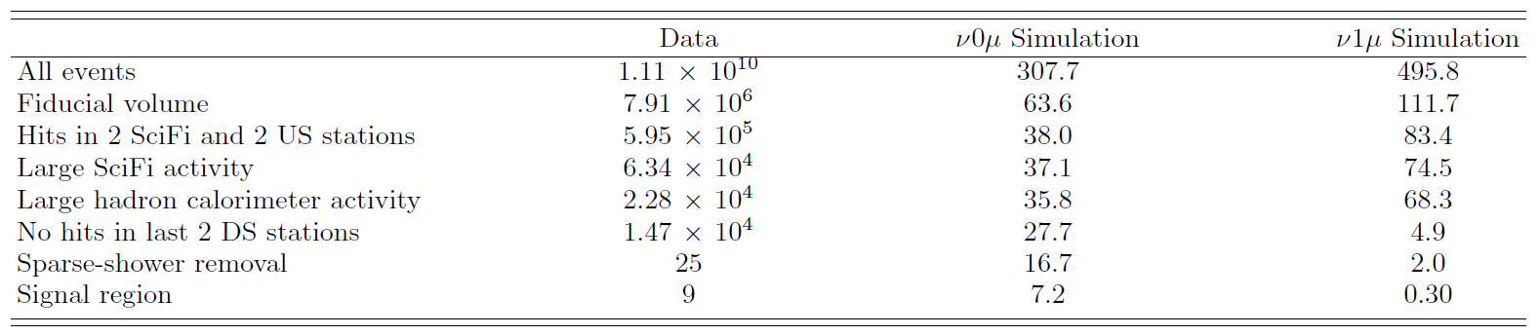
Observation of neutrinos with no muons
Sensitive to CC interactions of either ν_{e} or ν_{τ} flavor, as well as
to neutral current (NC) neutrino interactions.
Data sample used, collected in 2022 and 2023 ~ 68.6 fb⁻¹
Select muon-less shower-like events

Slide 31
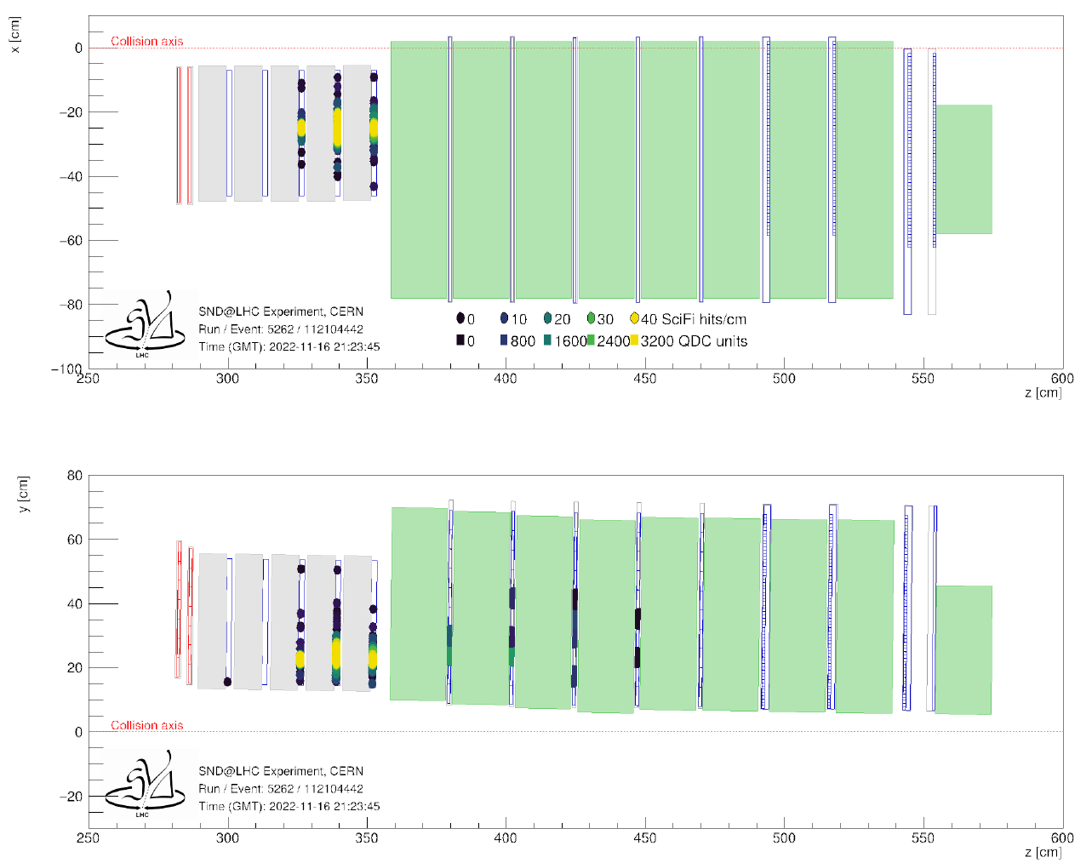
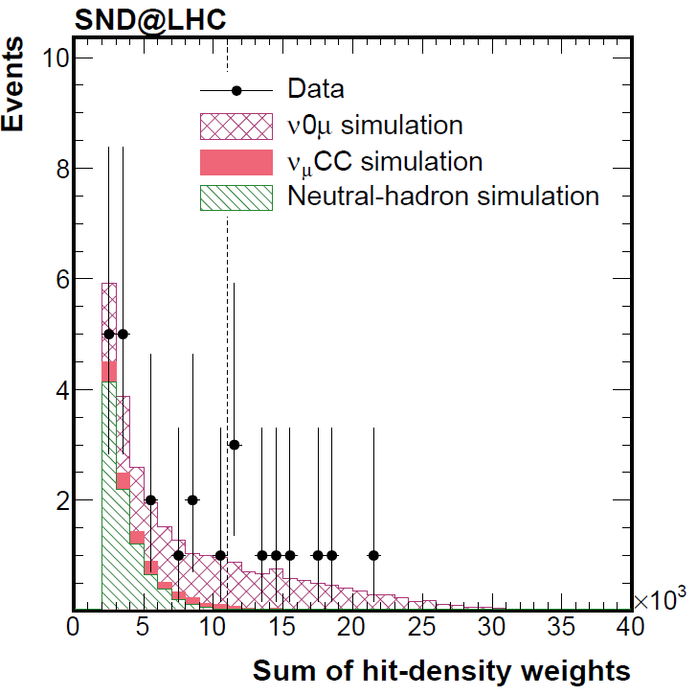
Observation of neutrinos with no muons
Observed 9 events with 6.4 sigma significance
(Expected 7.2 signal events with 5.5 sigma significance)

Slide 32
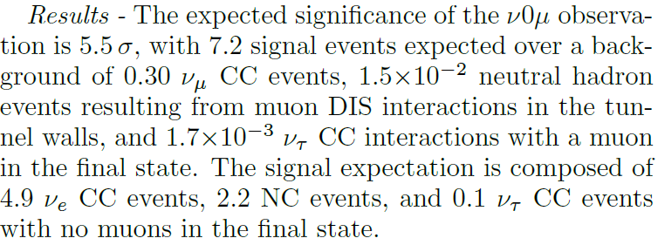
Observation of neutrinos with no muons

Slide 33
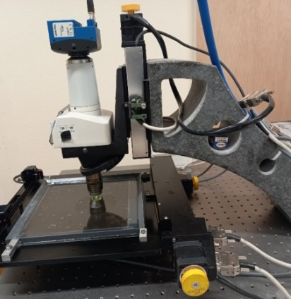
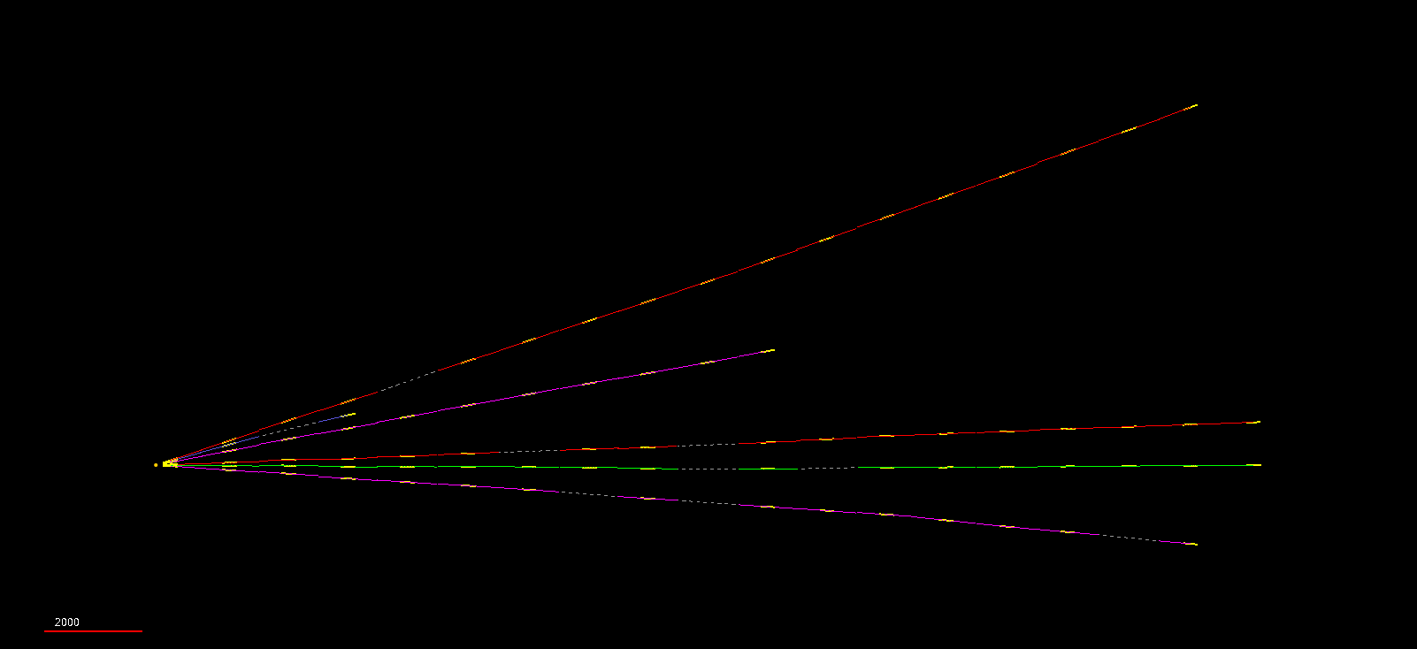
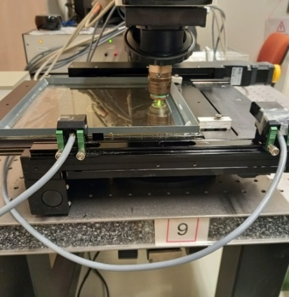
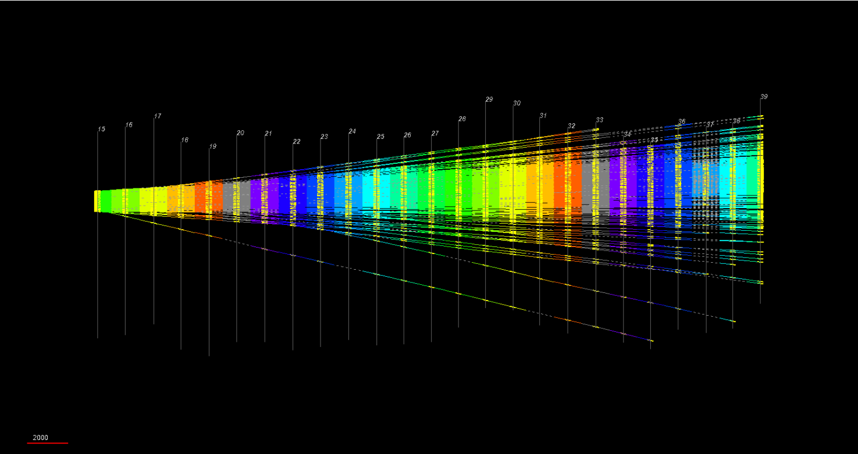
Nuclear Emulsion Scanning
Ongoing vertex reconstruction Emulsion scanned : 800 kg x 43 fb⁻¹
Neutral vertex candidate
6 tracks: plate 13 to 31
Muon tracks starting from 1 mm²
Track density per 10 fb⁻¹ → ~10⁵ tracks/cm²

Slide 34
SND@HL-LHC
Silicon trackers will replace the emulsion films, enabling more efficient operation. A Magnetised Calorimeter will be installed to improve energy measurement and charge separation.

Slide 35


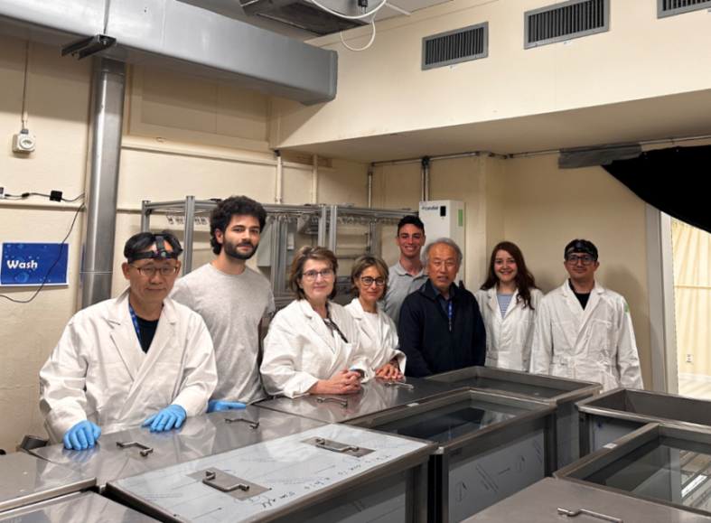
SND@LHC Collaboration
150 members, 24 Institutes in 14 Countries and CERN.
8 members, 4 Institutes in Korea.

Slide 36

SHiP experiment

Slide 37
Where is New Physics?
No solid predictions about where it might appear
Energy Frontier: NP Particles are heavy and can only be observed at higher collision energies (ex. FCC-hh)
Intensity Frontier:
NP particles are relatively light but
interact only feebly with SM
Intensity-Frontier Experiments
→ SHiP Experiment

Slide 38
The SHiP Experiment
2013: Letter of Intent
2015: Technical Proposal, Physics Case
2019: Comprehensive Design Study Report
2023: BDF/SHiP at ECN3 (proposal)
2024: Approved by CERN RB in March

Slide 39
The SHiP Experiment
A Beam-Dump Experiment at the SPS
Search for Feebly Interacting Particles
Perform measurements in Neutrino Physics
Location: ECN3 experimental cavern
SPS 400 GeV high-intensity proton beam
Nominal beam intensity 4 x 10¹³ PoT/spill
4 x 10¹⁹ PoT per year
6 x 10²⁰ PoT (15 years)

Slide 40
Overview of BDF/SHiP

Slide 41
Target Complex
The 400 GeV proton beam will hit a 1.5 m-long W target
Thick target (12 λ), High A & Z, Short λ
Followed by 2.3-m long hadron absorber
Productions per year
(4 x 10¹⁹ Proton on Target)
~10¹⁷ charm hadrons
~10¹³ beauty hadrons
~10¹⁵ τ (tau) leptons

Slide 42
Muon Shield
Designed to deflect muons away
Three options (two warm and one hybrid) are currently under consideration

Slide 43
Scattering and Neutrino Detector (SND)
Integrated into the muon shield (~ 30 m from the target)
Positioned at the center of the last magnet
High precision VTX detector (Emulsion, Silicon), Magnetized Tracking CAL

Slide 44
Hidden Sector Decay Spectrometer (HSDS)
Decay Vessel (1 atm He gas filled) + Spectrometer (Particle ID)

Slide 45
The SHiP Experiment : Schematic
Neutrinos
FIPs

Slide 46
Neutrinos
assuming a 3 tonne detector and 15 years of operation
~10⁶ ν_{e} , ~10⁷ ν_{μ} , ~10⁵ ν_{τ}
ν_{τ} cross-section measurement
Charm physics with neutrinos
Lepton Flavor Universality
….

Slide 47
Sensitivity of SHiP to FIPs
Heavy Neutral
Lepton
Dark Photon
Dark Scalar
Inelastic DM

Slide 48
BDF/SHiP preliminary schedule
Construction start ~2029 and data-taking in ~2033

Slide 49
Backup

Slide 50
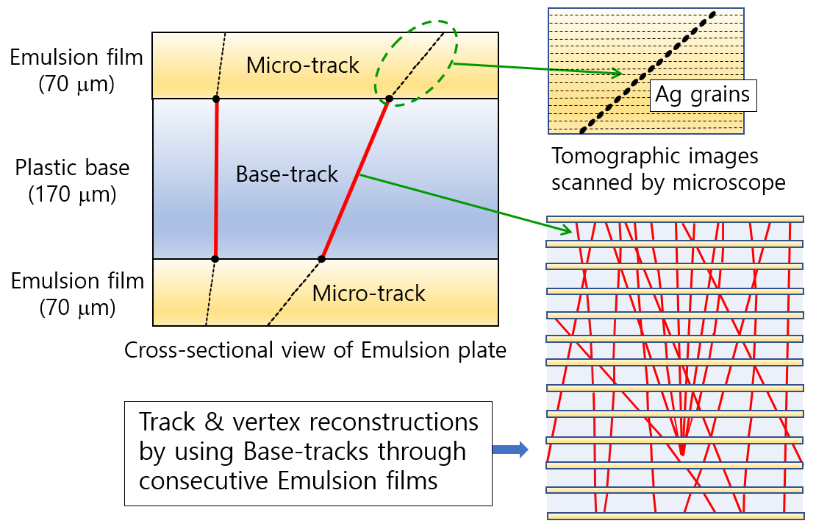


Event Reconstruction

Slide 51
Decay Vessel: Helium-filled baloon

Slide 52
Tau Neutrinos
Charged current cross section

Slide 53
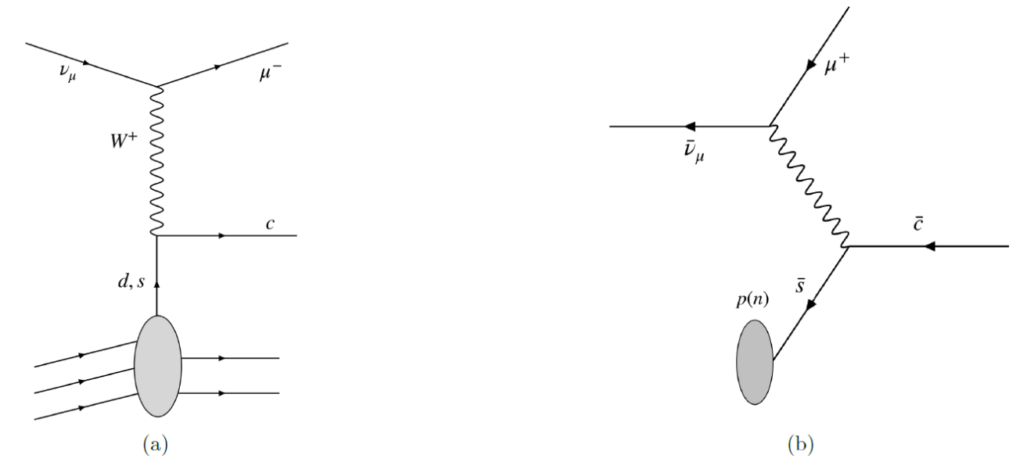
Neutrino-induced charm production
High-energy neutrino interactions produce charmed hadrons
Nuclear emulsion technology offers a unique possibility to identify charmed hadrons through the observation of a two vertex topology.
- Charmed-hadron production in
anti-neutrino interactions selects
the anti-strange quark in the nucleon.
- Measurement can be used to
measure the s-quark content of the nucleon,
thus providing important information for
many precision test of the SM.

Slide 54
Heavy Neutral Leptons
Production and subsequent decay of the particle N

