Slide 1
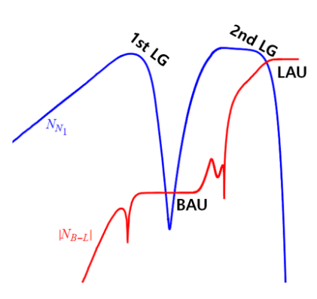
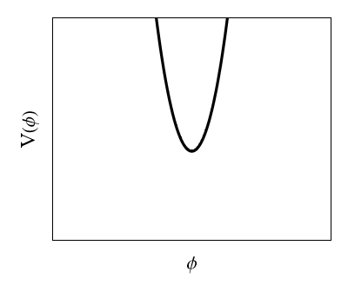
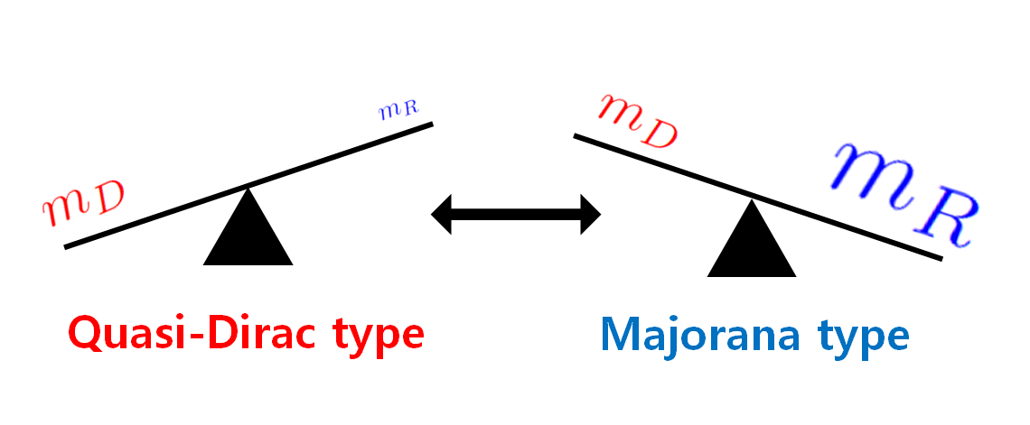
Neutrino with wave dark matter
From type oscillation to second leptogenesis
Yechan Kim
KAIST
PRD 108, 095028 (2023); JHEP 03 (2024) 003;
PRD 111, 055026 (2025); JHEP 07 (2025) 269
CPNR Workshop 2025

Slide 2





Neutrino with wave dark matter
Many unknowns in Neutrino physics
- Neutrino oscillation parameters
- Neutrino absolute mass
- CP violation in PMNS
- Sterile neutrino
…
- Neutrino is Dirac type or Majorana type?
- Cosmic neutrino background (CnuB)
- Leptogenesis for BAU

Slide 3
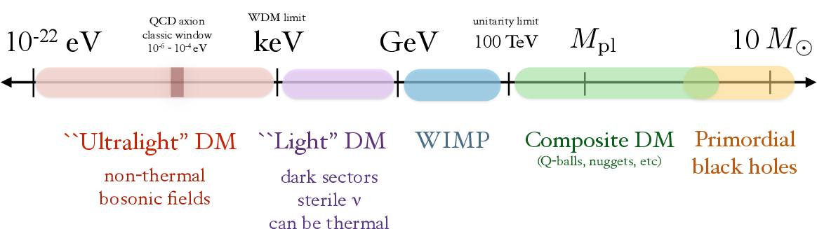
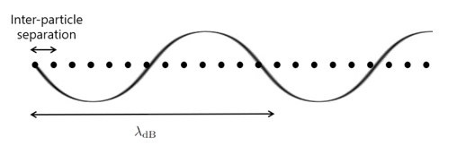
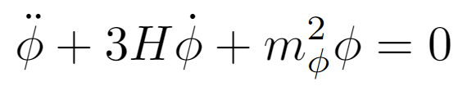
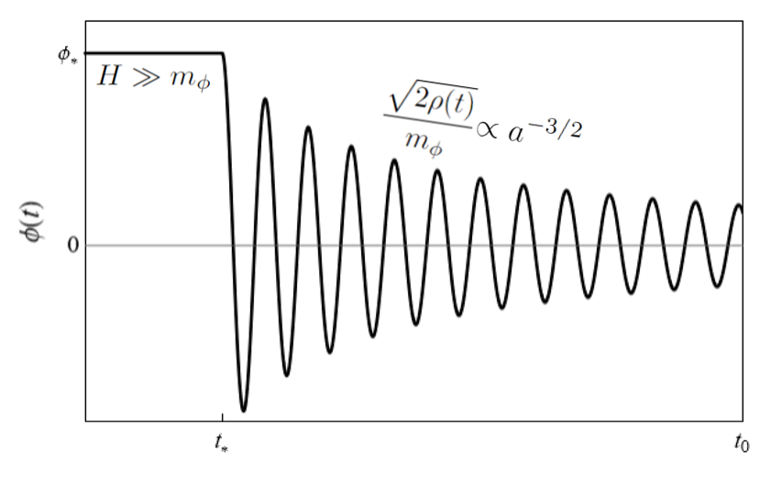

Neutrino with wave dark matter
Many unknowns in Neutrino physics
Wave dark matter
with ultra-light mass scale
- Neutrino oscillation parameters
- Neutrino absolute mass
- CP violation in PMNS
- Sterile neutrino
…
- Neutrino is Dirac type or Majorana type?
- Cosmic neutrino background (CnuB)
- Leptogenesis for BAU

Slide 4
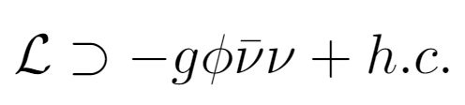
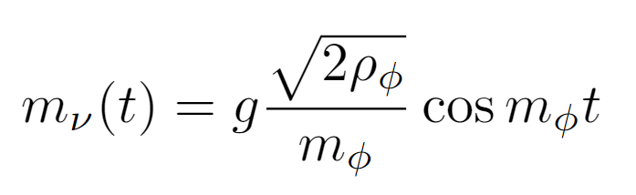
Neutrino with wave dark matter
Neutrino mass variation
Dirac-Majorana neutrino
type oscillation
A Berlin (2016);
G Krnjaic, PAN Machado, L Necib (2017) …
YL ChoeJo, Y Kim, HS Lee (2023)
Potential oscillation
Second leptogenesis
Y Kim, HS Lee (2025)
YL ChoeJo, K Enomoto, Y Kim, HS Lee (2023);
YL ChoeJo, K Enomoto, Y Kim, HS Lee (2024)

Slide 5
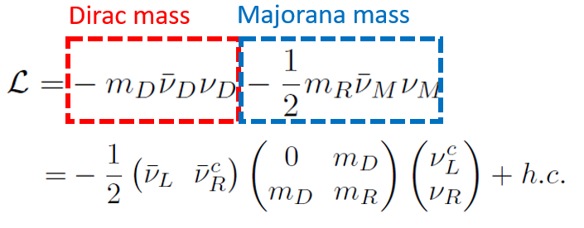
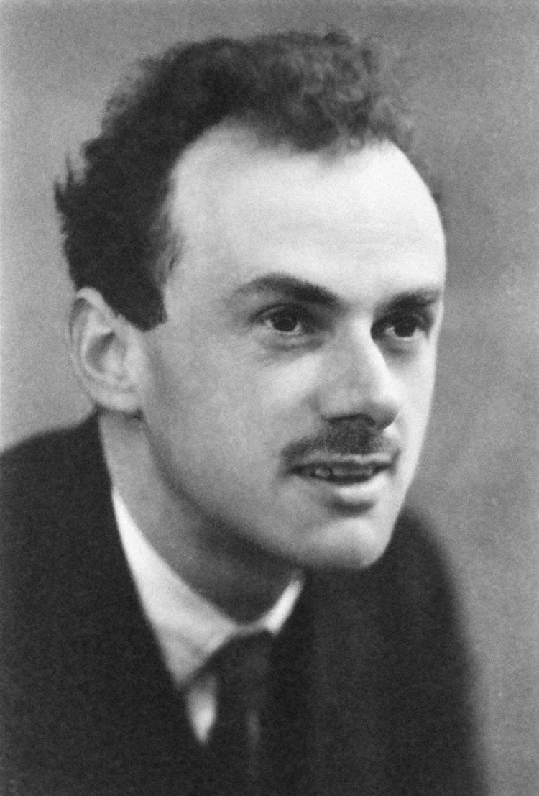
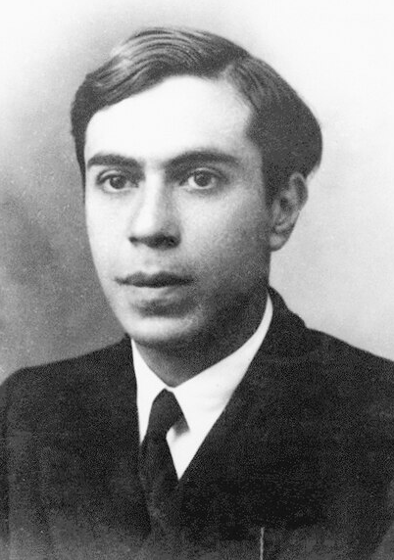




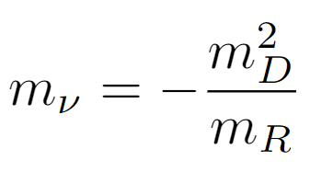
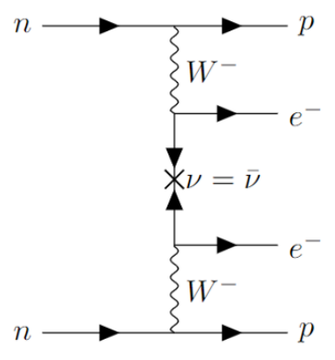
Dirac-Majorana neutrino type oscillation
Dirac
Majorana
vs
Quasi-Dirac type
Majorana type
Seesaw is broken
LNV is suppressed
Seesaw
mechanism
Neutrinoless double
beta decay

Slide 6
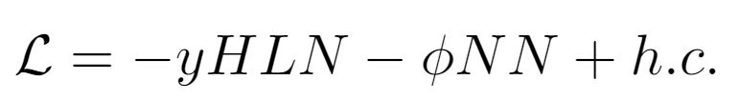
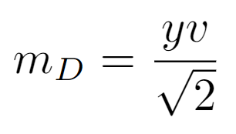
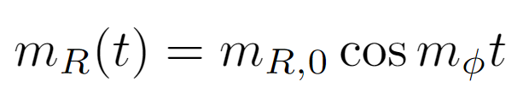
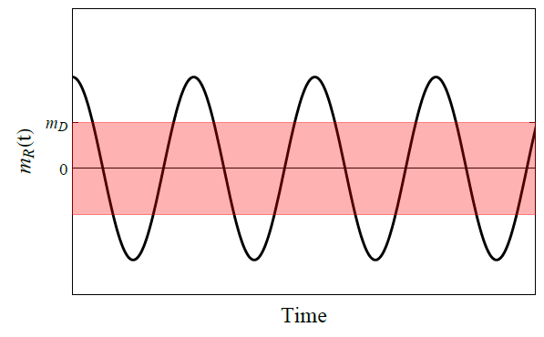
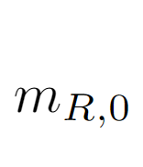


Dirac-Majorana neutrino type oscillation
Majorana
Pure-Dirac
instantly
Quasi-Dirac
“Dirac-Majorana
neutrino type oscillation”

Slide 7
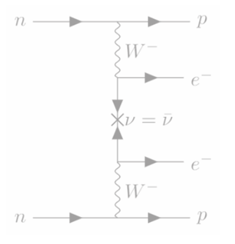

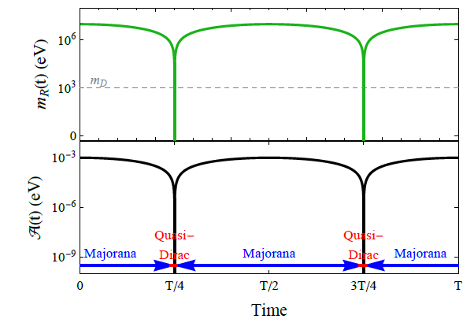

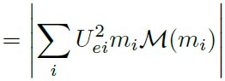
Dirac-Majorana neutrino type oscillation
LNV
LNV
Quasi-Dirac
type
Majorana
type
Turn-on/off behavior of 0νββ decay

Slide 8
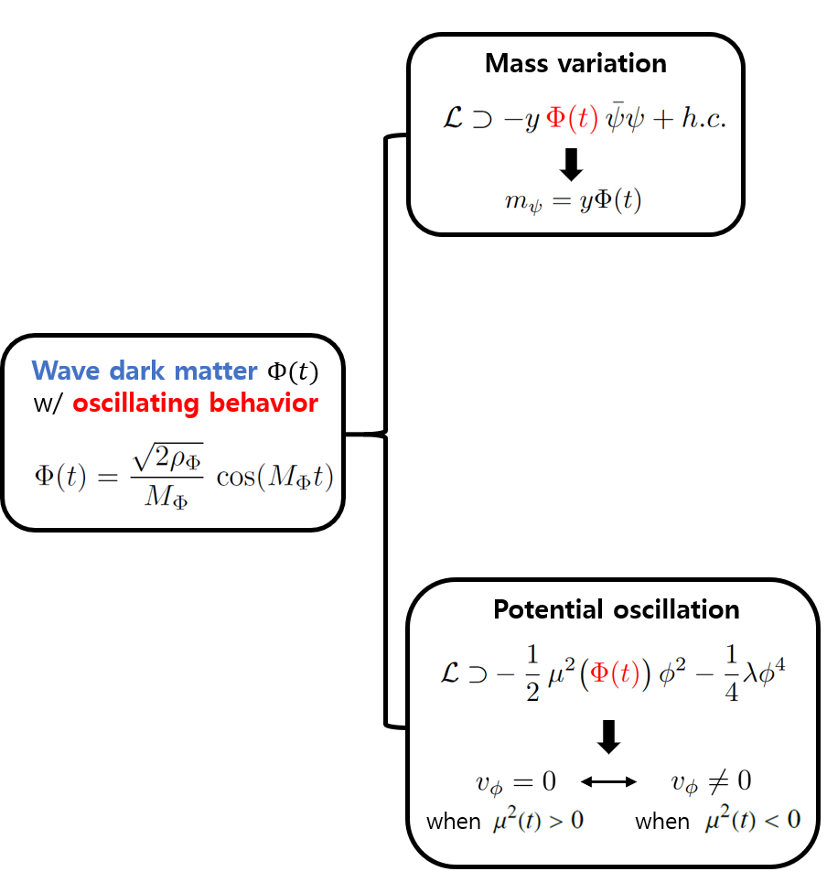
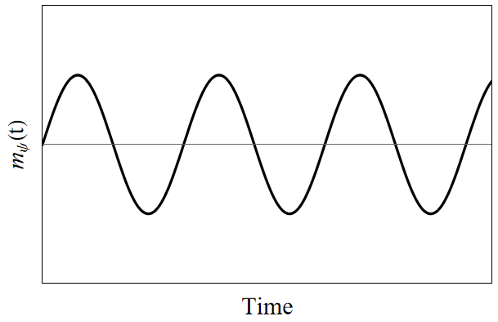
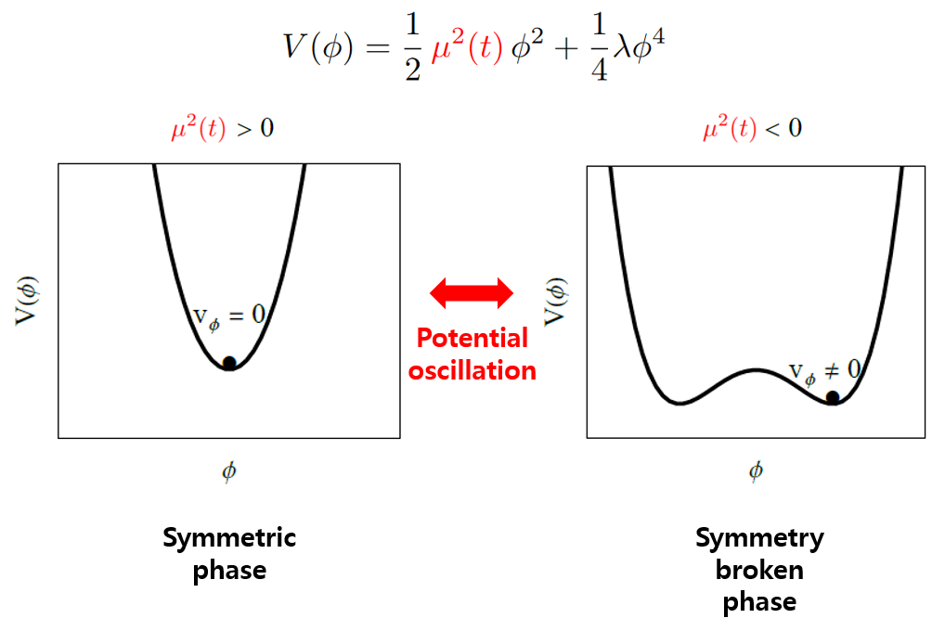
Potential oscillation

Slide 9


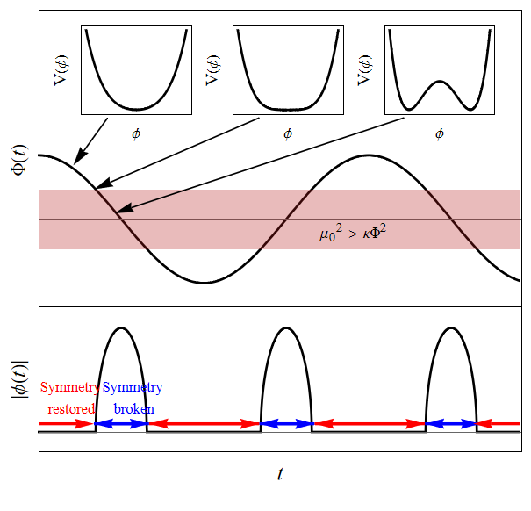
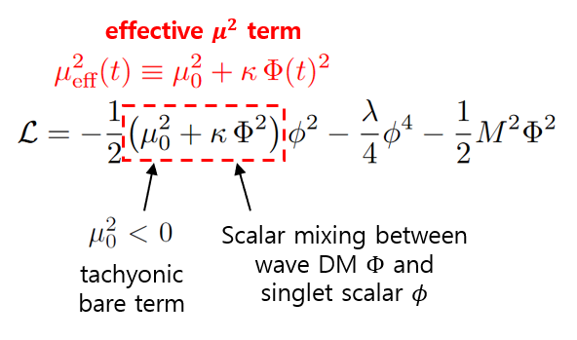
Potential oscillation
Symmetry-restored
Symmetry-broken

Slide 10
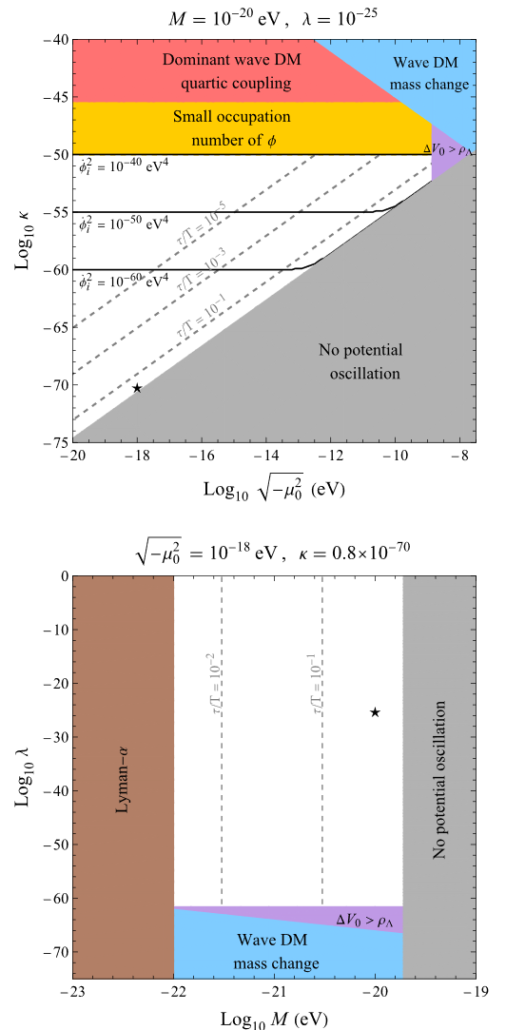
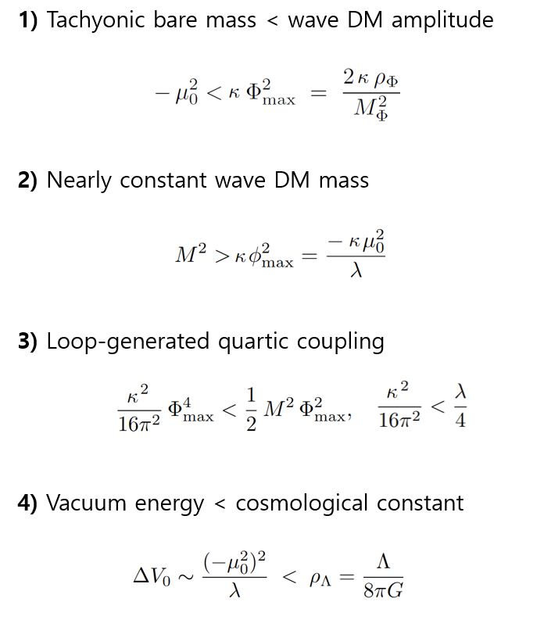
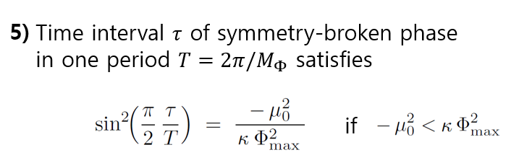
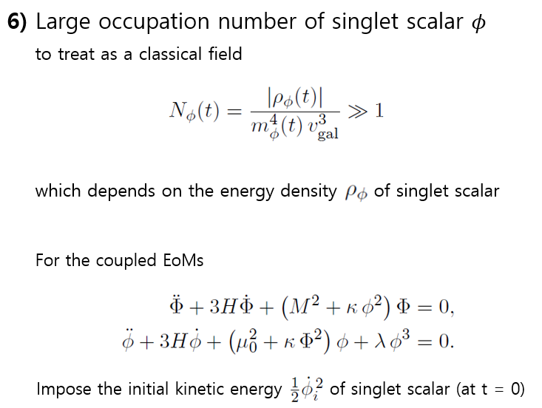
Potential oscillation

Slide 11
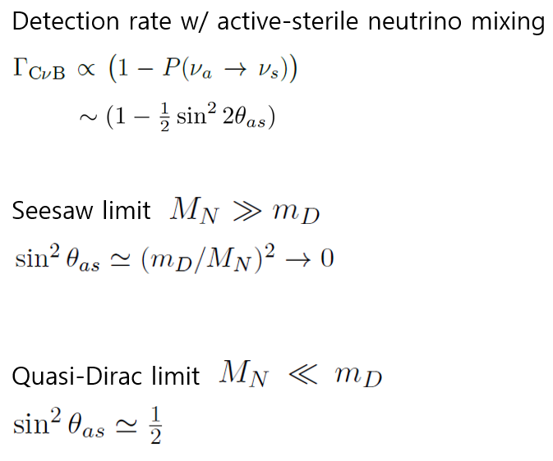
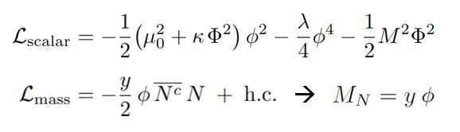

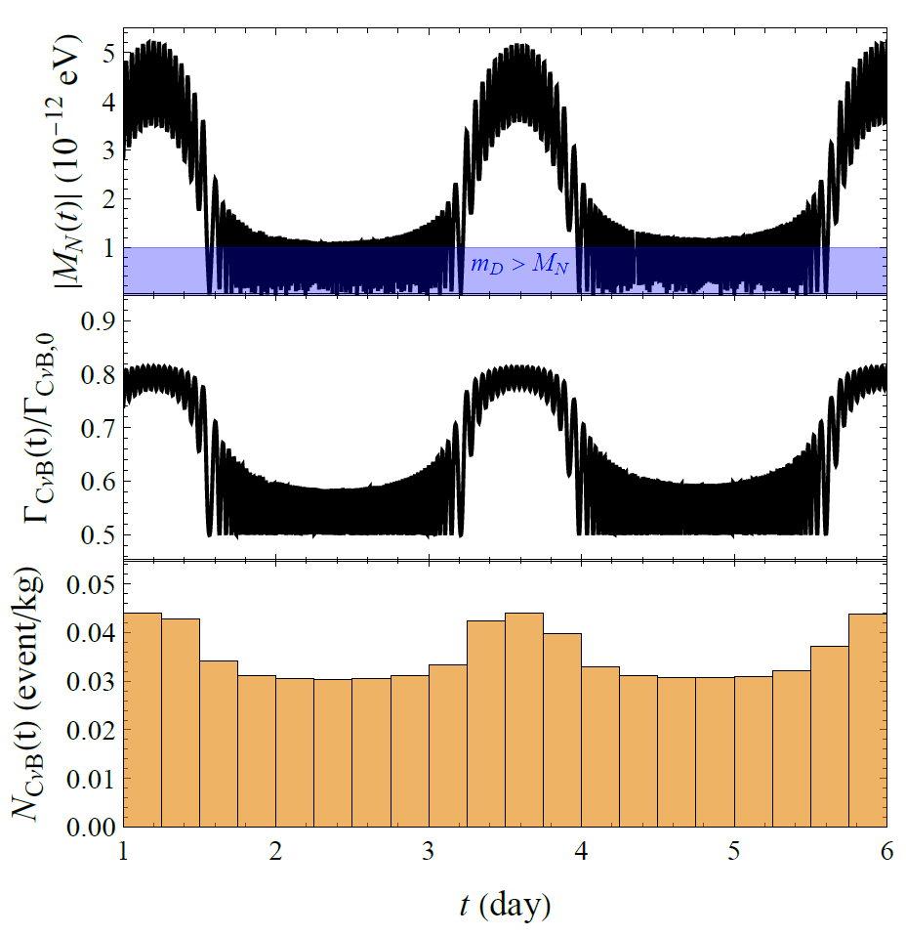
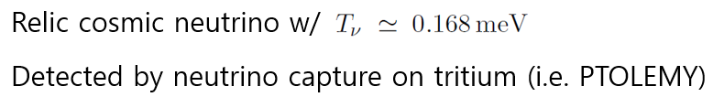

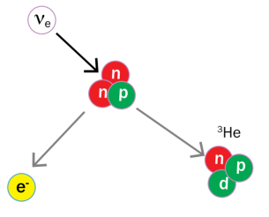
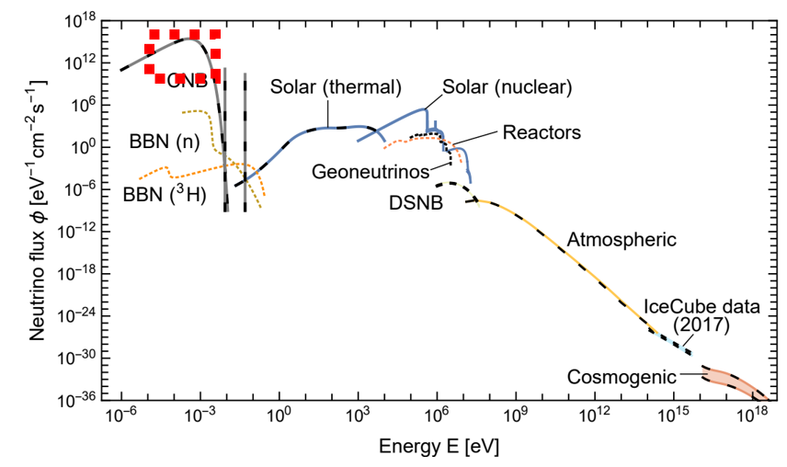
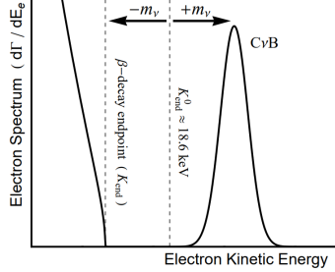

Potential oscillation
Implications for neutrino sector
Symmetry-restored
Symmetry-broken
Cosmic neutrino background (C$υ$B)
Edoardo Vitagliano et al (2019)
Andrew J. Long et al (2014)

Slide 12

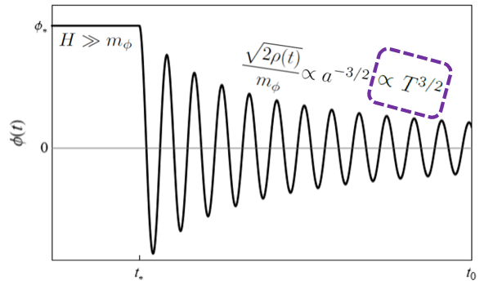
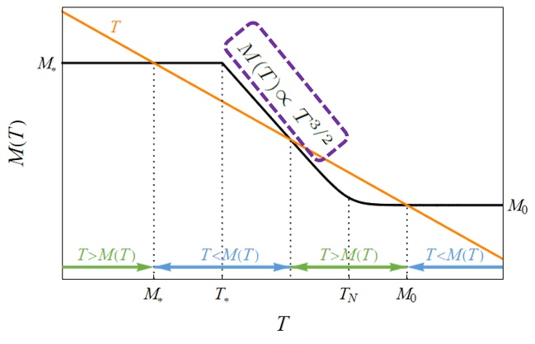
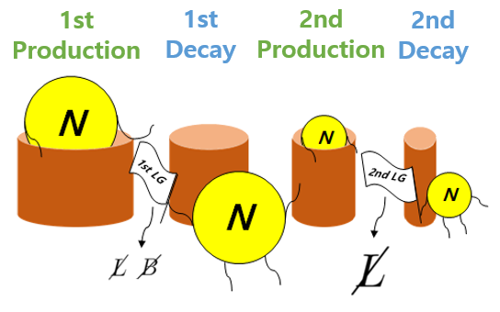
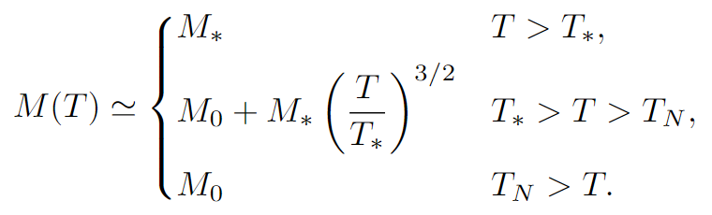
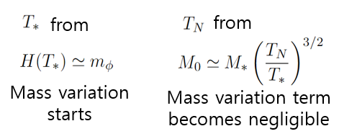
Second leptogenesis
1st
Production
1st
Decay
2nd
Production
2nd
Decay
Temperature-dependent mass of N

Slide 13
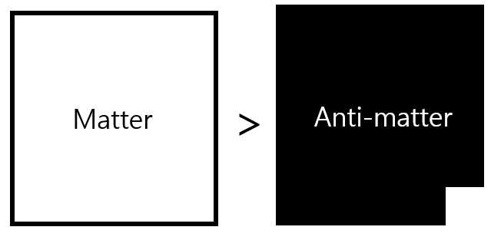
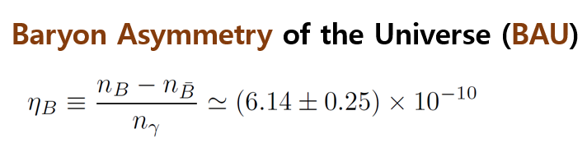


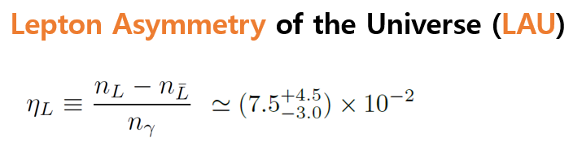
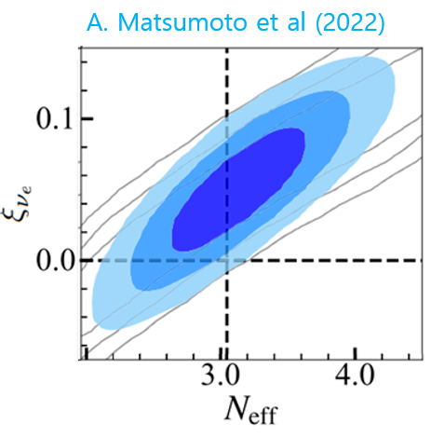
Second leptogenesis
Leptogenesis
CP-violating out-of-equilibrium decay of
Heavy Majorana neutrino
,
Lepton Asymmetry
Sphaleron
Baryon Asymmetry
EWSB
Sphaleron decoupling
Second leptogenesis

Slide 14
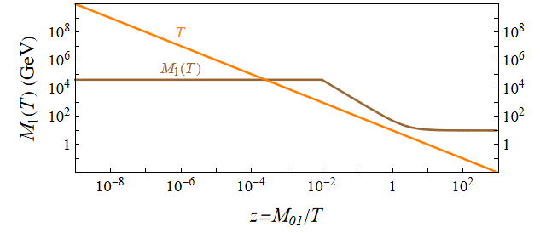

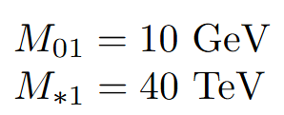
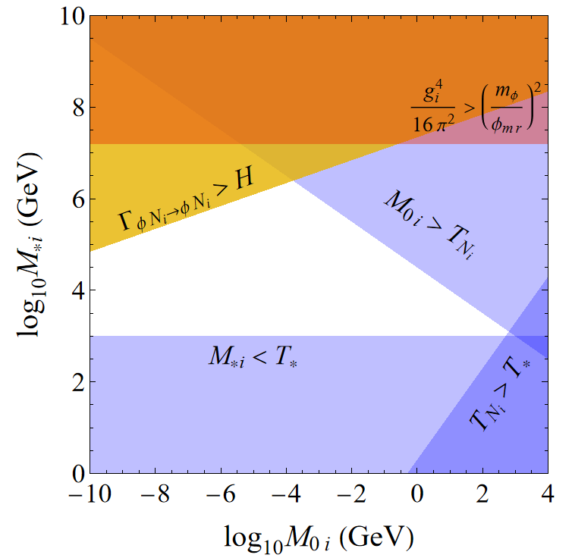



Second leptogenesis

Slide 15





Second leptogenesis
Sphaleron decoupling
2nd LG
LAU
1st LG
BAU

Slide 16
Summary
The interaction between neutrino and wave DM induce time-varying mass of the neutrino and also for the evolution over cosmic history.
The neutrino type may oscillate if the ratio of the Dirac and Majorana mass term varies.
The wave DM can generate the periodic symmetry breaking and restoration of the potential, and this leads to the modulation behavior of CnuB.
The temperature-dependent mass of the heavy neutrino provides the second leptogenesis, which can explain the large discrepancy between baryon and lepton asymmetries.
Thank You!

Slide 17


Back up
Quasi-Dirac & Majorana limits

Slide 18





Back up
Constraints on type oscillation

Slide 19


Back up
Neutrinoless double beta (0νββ) decay
r: inter-nucleon distance (fm)

Slide 20
Back up
Conditions and constraints on potential oscillation

Slide 21



Back up
Singlet scalar dynamics in potential oscillation

Slide 22


Back up
Remarks on potential oscillation

Slide 23


Back up
Remarks on potential oscillation

Slide 24

Back up
Parameter space for second LG
To avoid dominant quartic coupling
To avoid thermalization of wave DM by scattering

Slide 25





Back up
Decay, scattering, and CP asymmetry in second LG

