Slide 1
Neutrino Transport by GR1D for CC Supernova Simulation - Quenching & Effective mass with Degeneracy -
Youngso Choi, Dukjae Jang and Myung-Ki Cheoun (OMEG/SSU)
H. Togashi (Kyoto Uni.)

Slide 2
Neutrino and Photon Opacity in SN explosion, CMB and RHIC
Youngso Choi, Dukjae Jang and Myung-Ki Cheoun (OMEG/SSU)
H. Togashi (Kyoto Uni.)
CPNR-OMEG Joint Workshop on Neutrino, Nuclear, and Nuclear Astrophysics

Slide 3
Density Functional Theory and CC Supernovae
Youngso Choi, Dukjae Jang and Myung-Ki Cheoun (OMEG/SSU)
H. Togashi (Kyoto Uni.)
Japan-Korea Forum for Collaboration on Nuclear Density Functional Theory (Daegu2026)

Slide 4
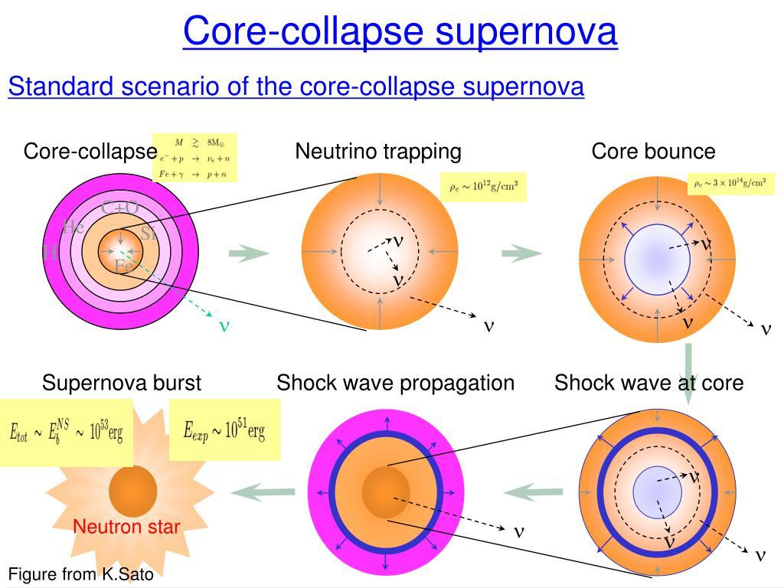
Neutrino Cooling

Slide 5
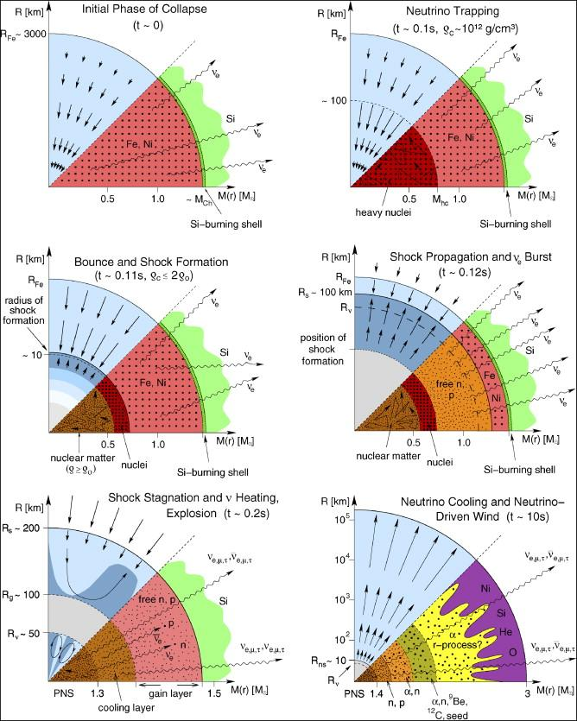
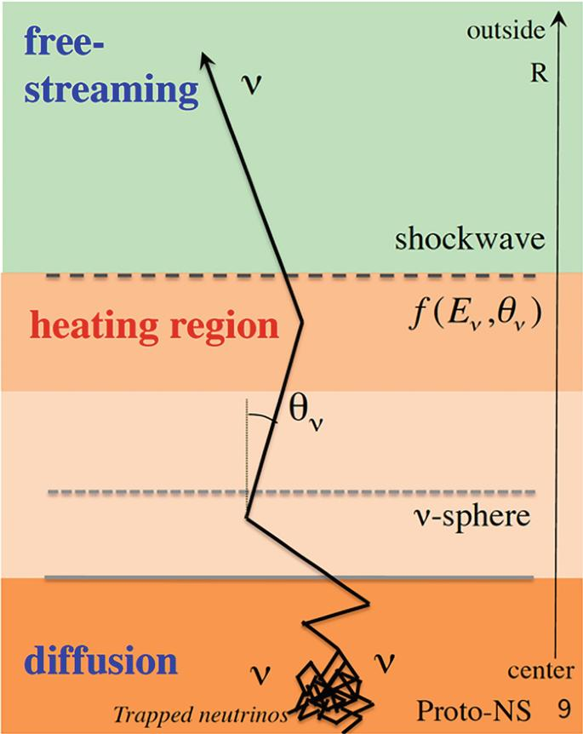
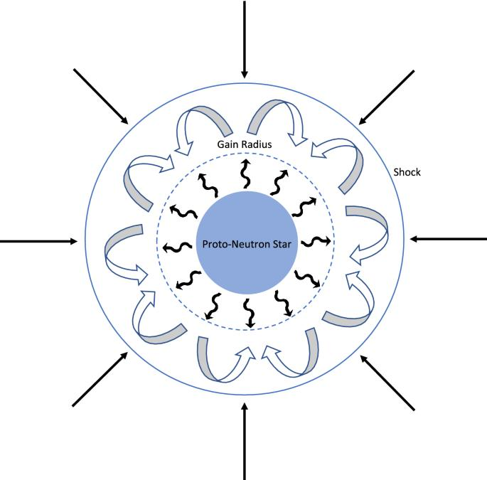

Neutrino Cooling

Slide 6
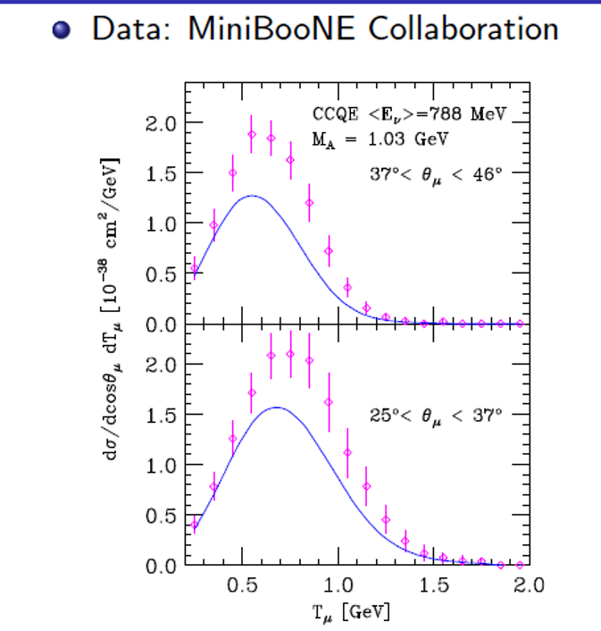
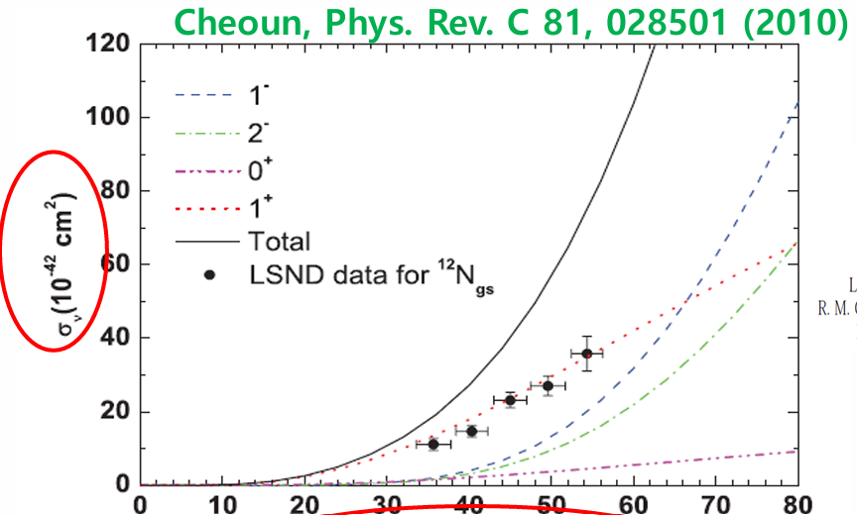
Neutrino Cooling
Typical X-section Absorption and Bremsstrahlung

Slide 7
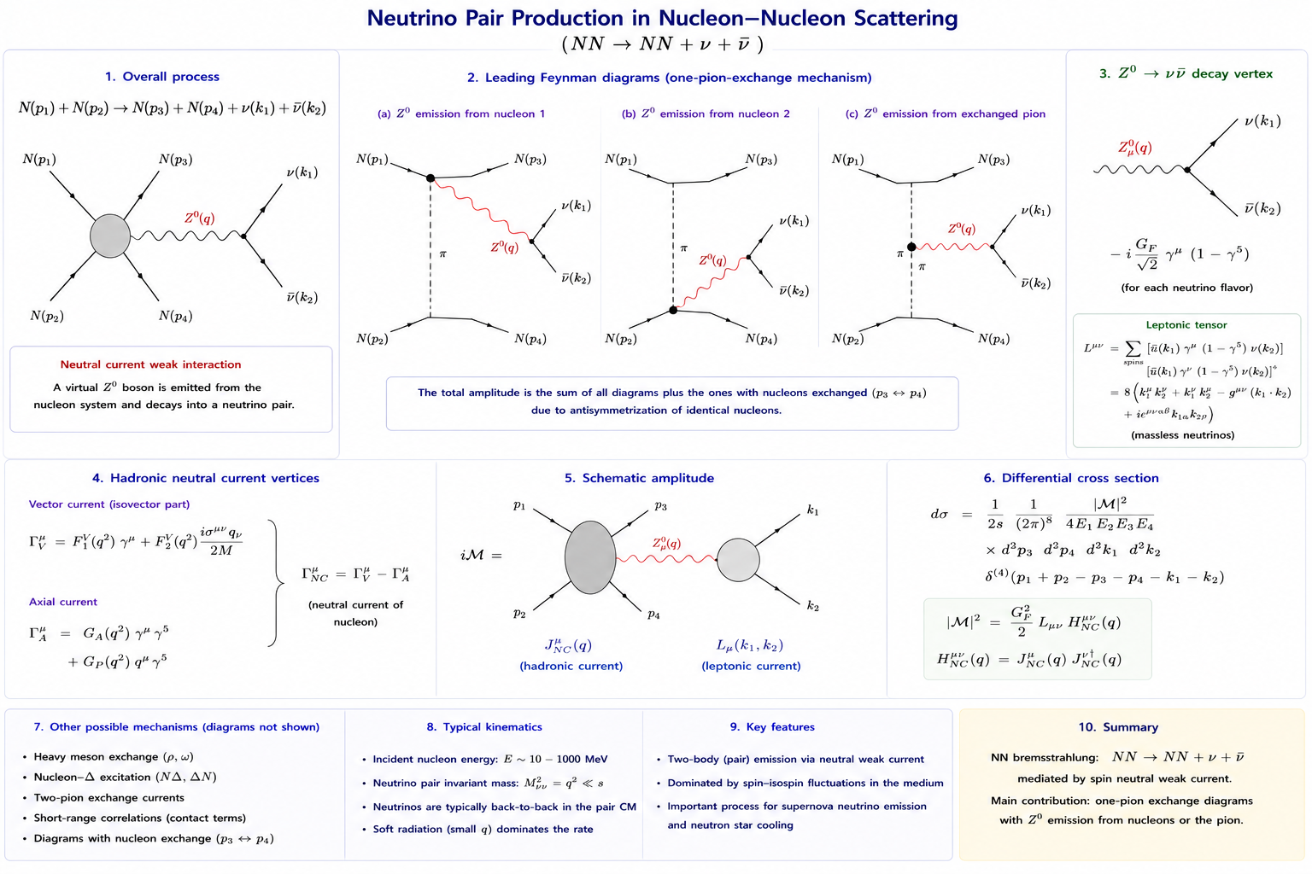
Neutrino Cooling

Slide 8
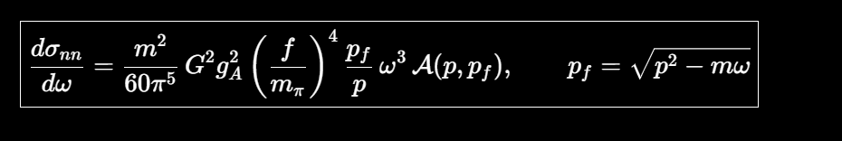
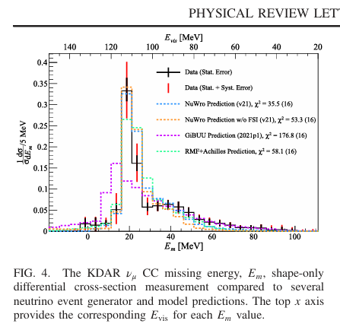
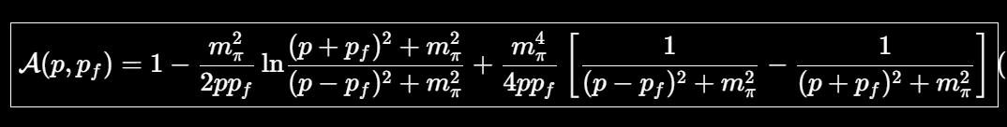
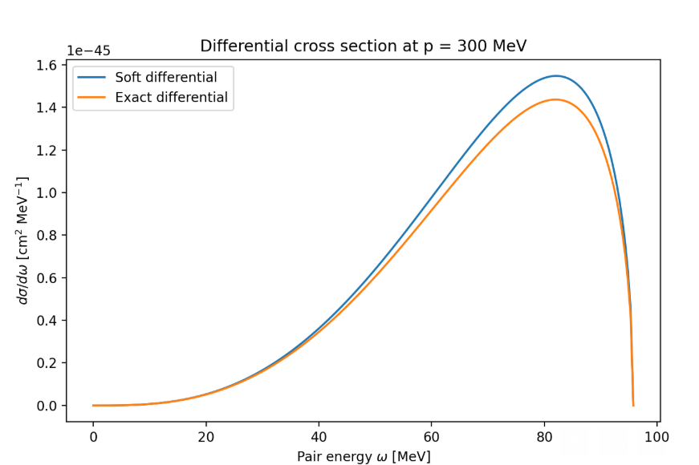
Neutrino Cooling
Typical X-section Absorption and Bremsstrahlung

Slide 9
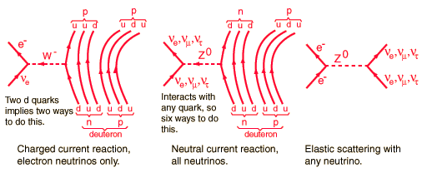
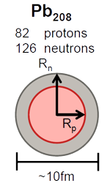
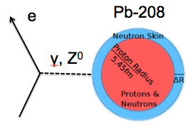
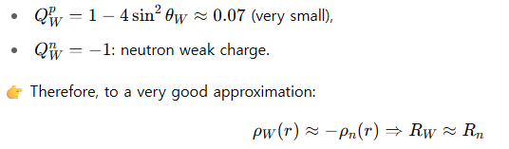
2. Physics Motivation of DIF and DAR Neut. from Accelerator ? Nuclear Physics
Neutrino scattering could be
the alternative
to the NST measurement !!!
Notes:
NST 설명. 가속기 neutrino 로 NST 측정 가능 => 고밀도 핵물리학에 대단히 유용. Poster by 채윤 강조.

Slide 10
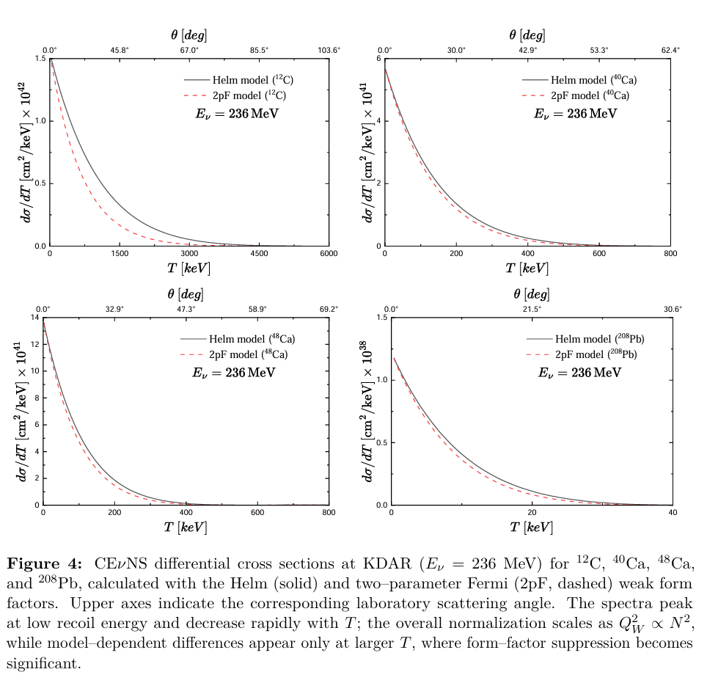
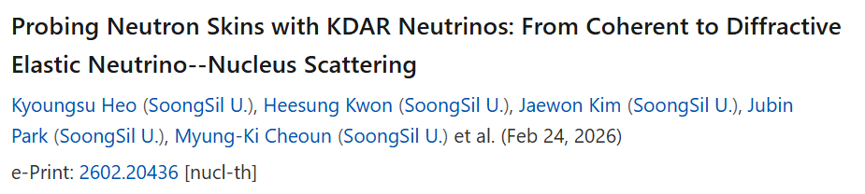
Coherent Neutrino Scattering by KDAR

Slide 11
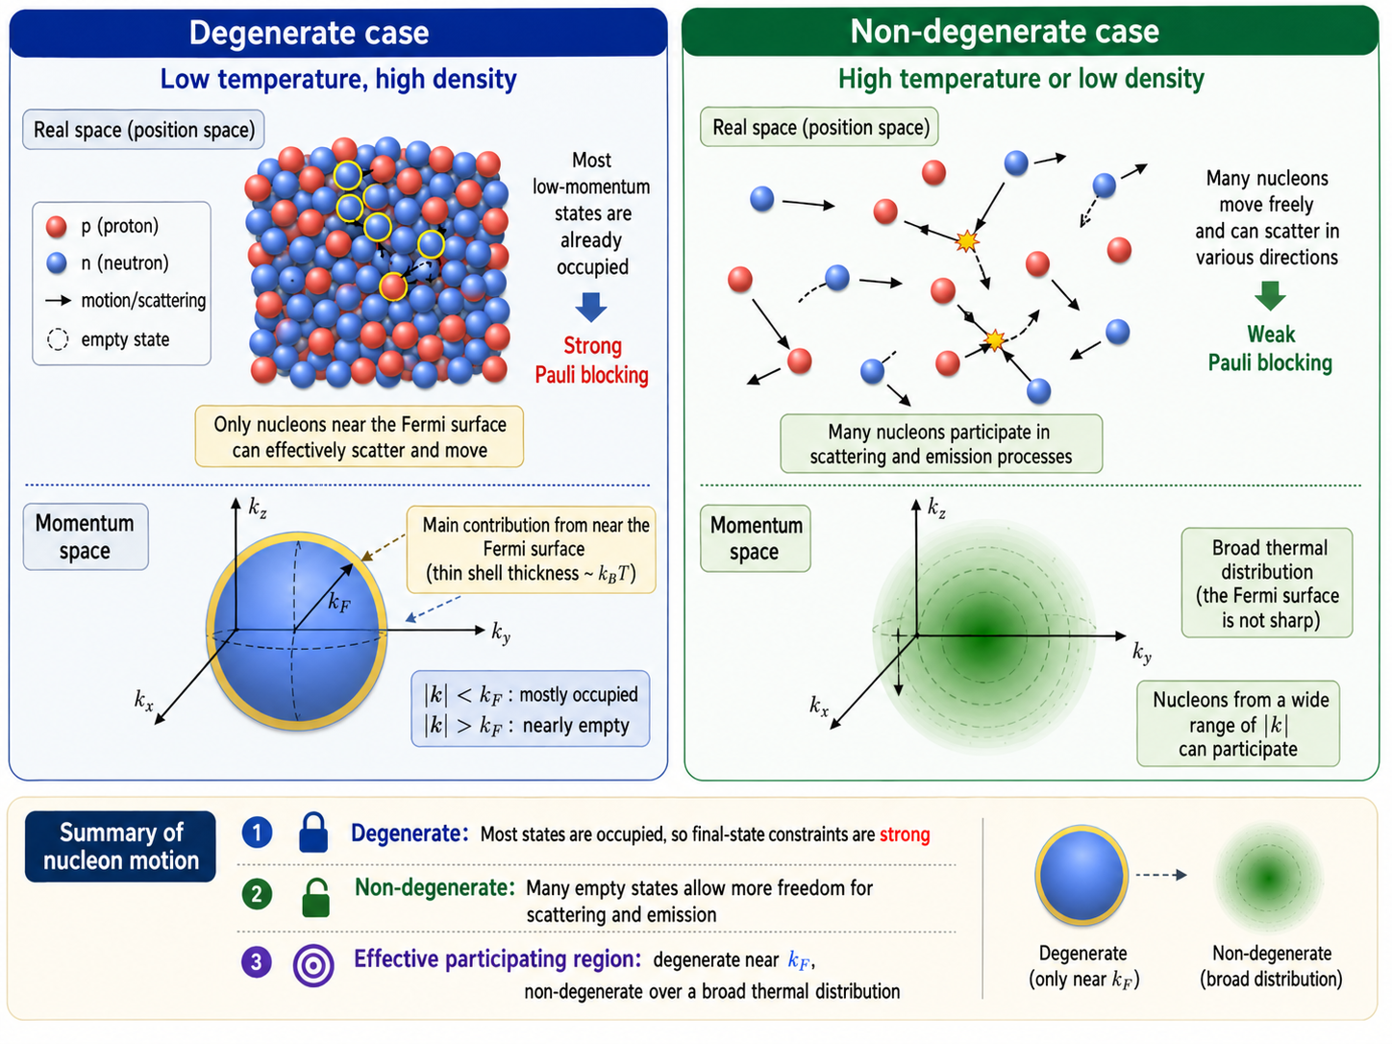



Slide 12
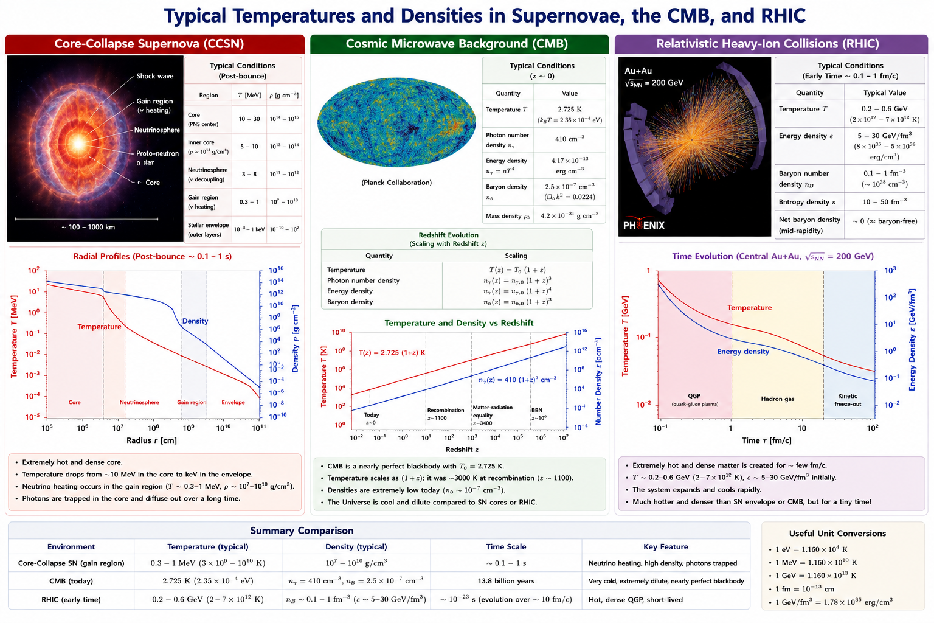
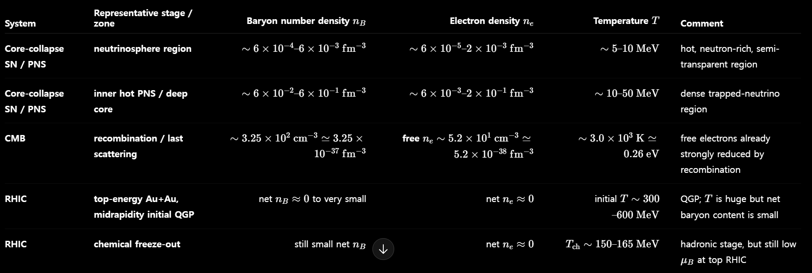


Slide 13
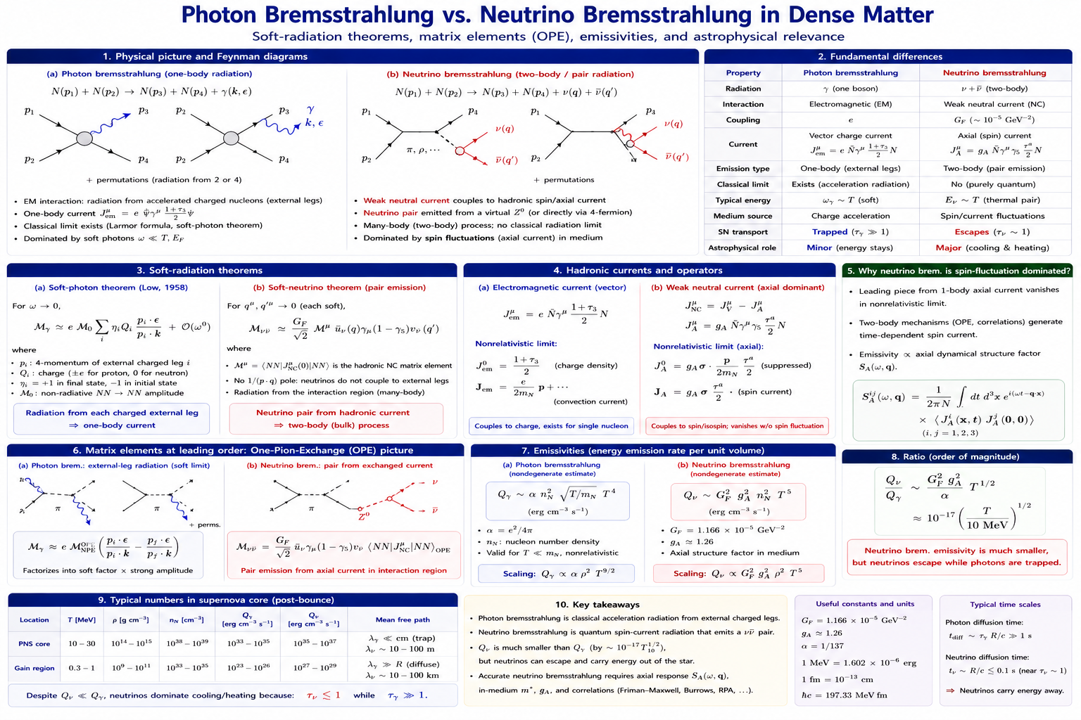
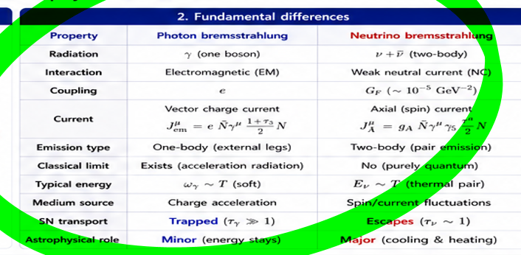

Photon Cooling

Slide 14
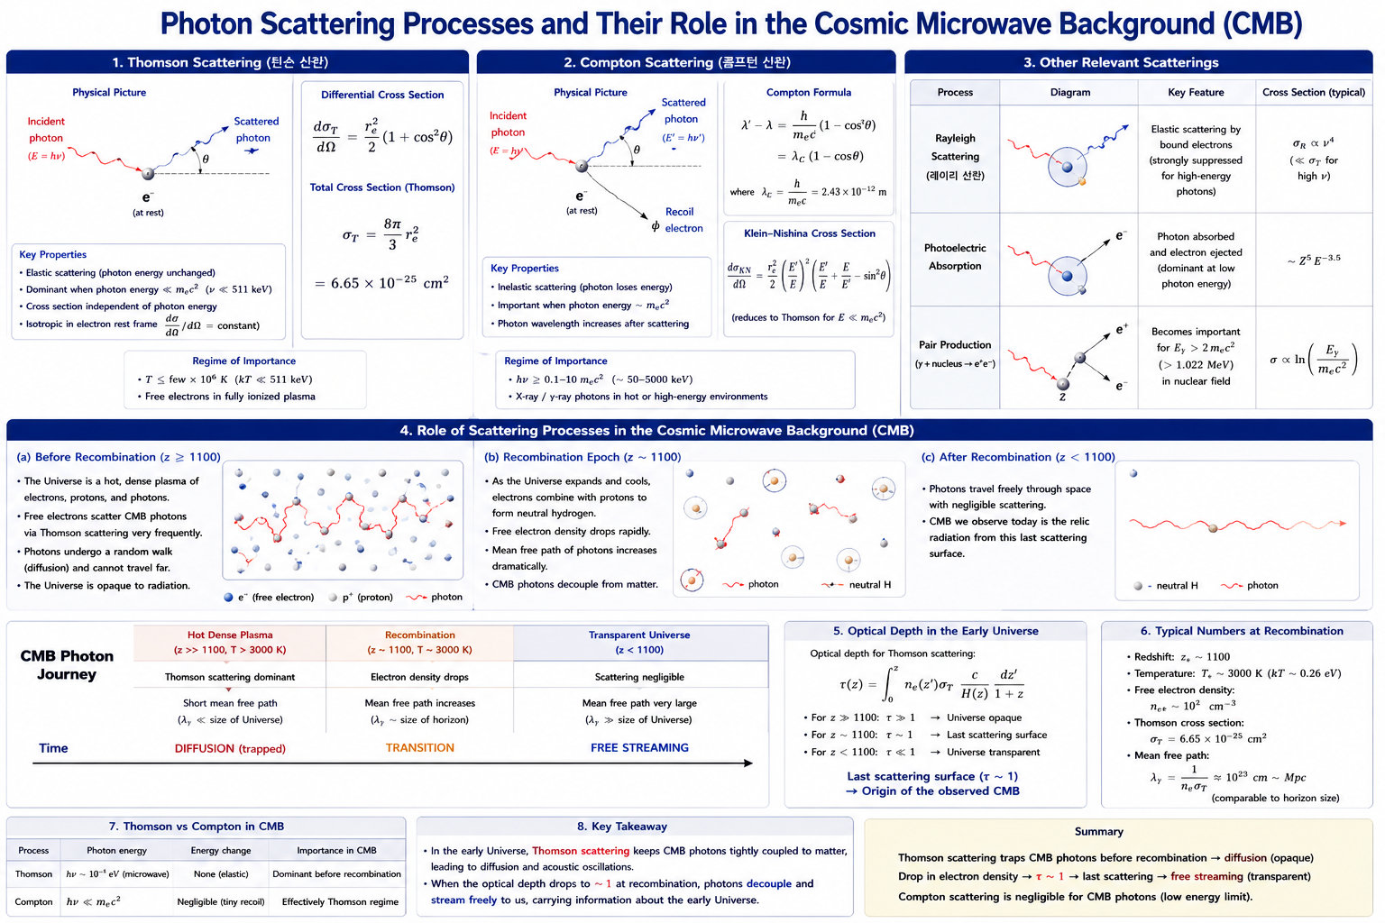

Slide 15
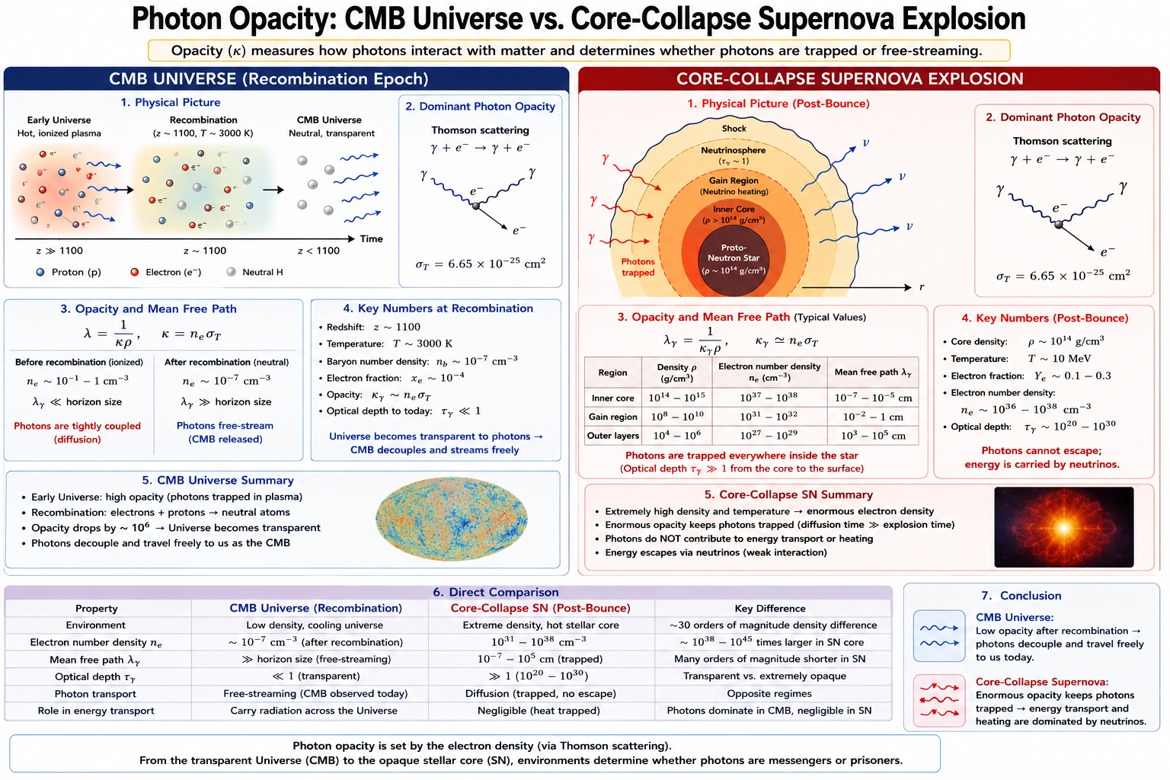
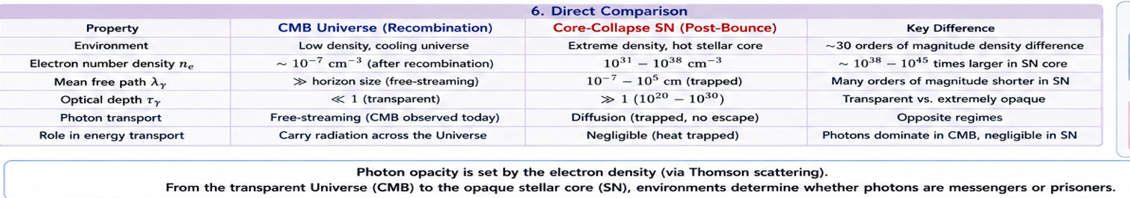
Photon Cooling

Slide 16
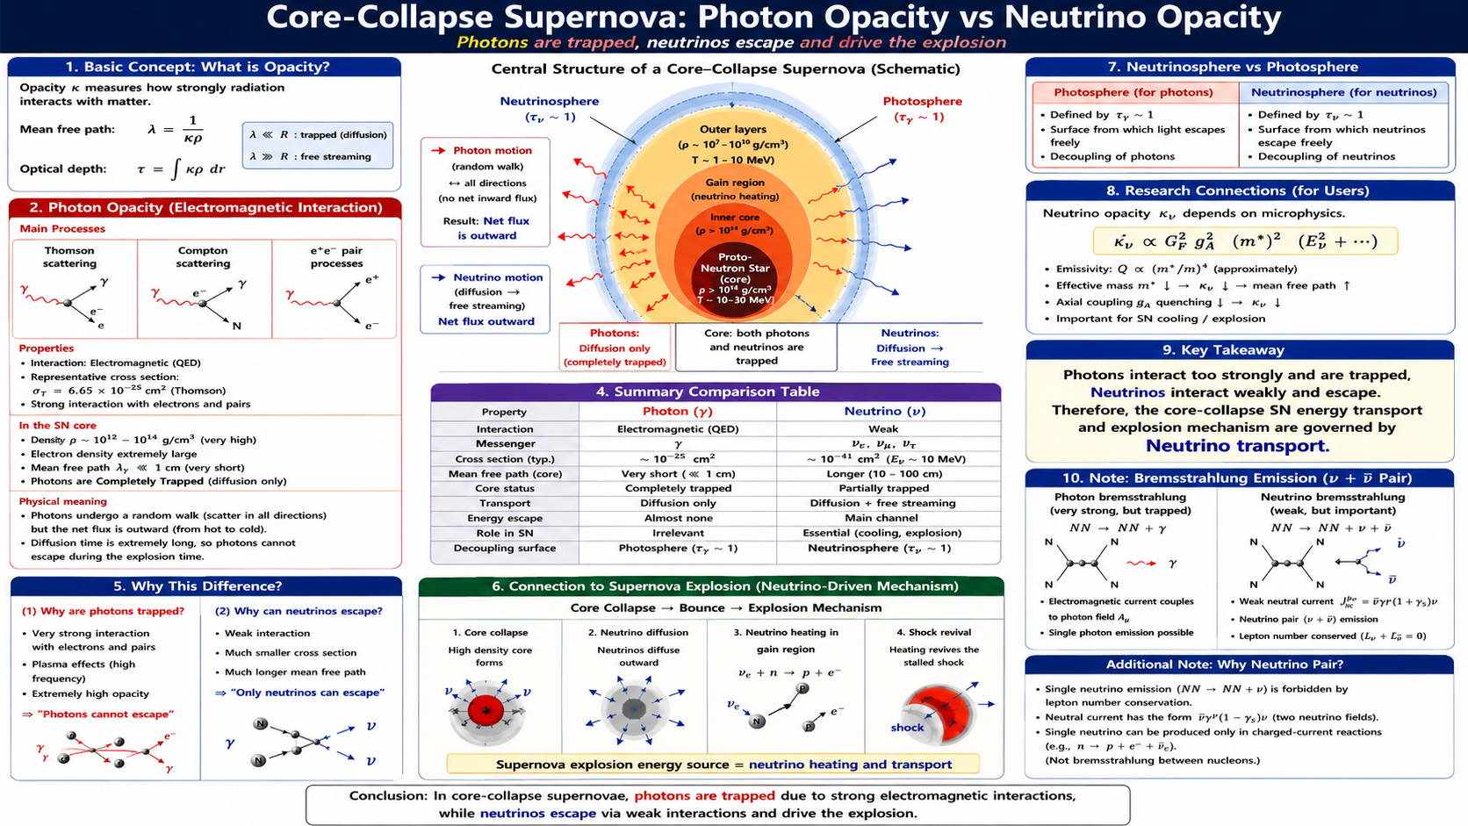
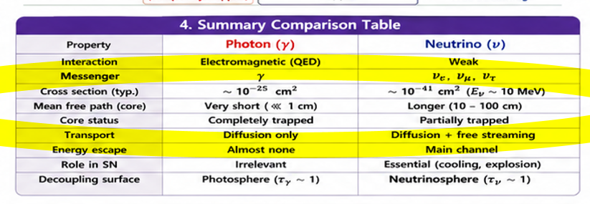

Photon & Neutrino

Slide 17
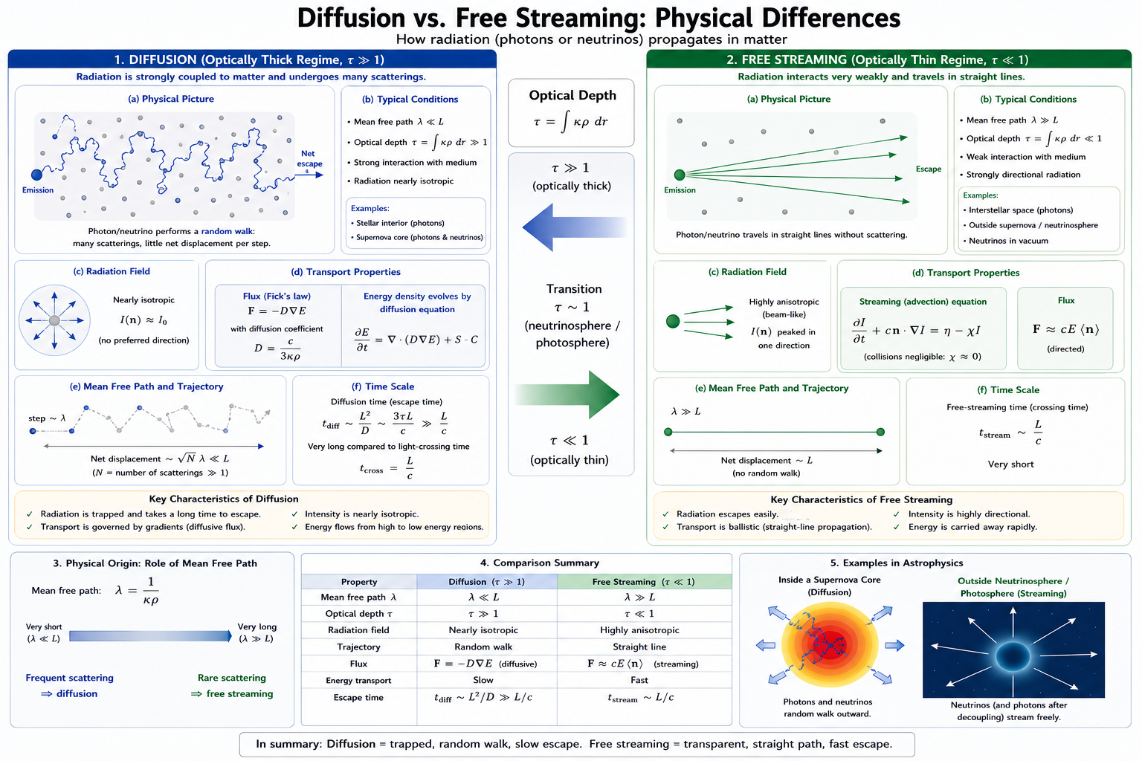

Slide 18
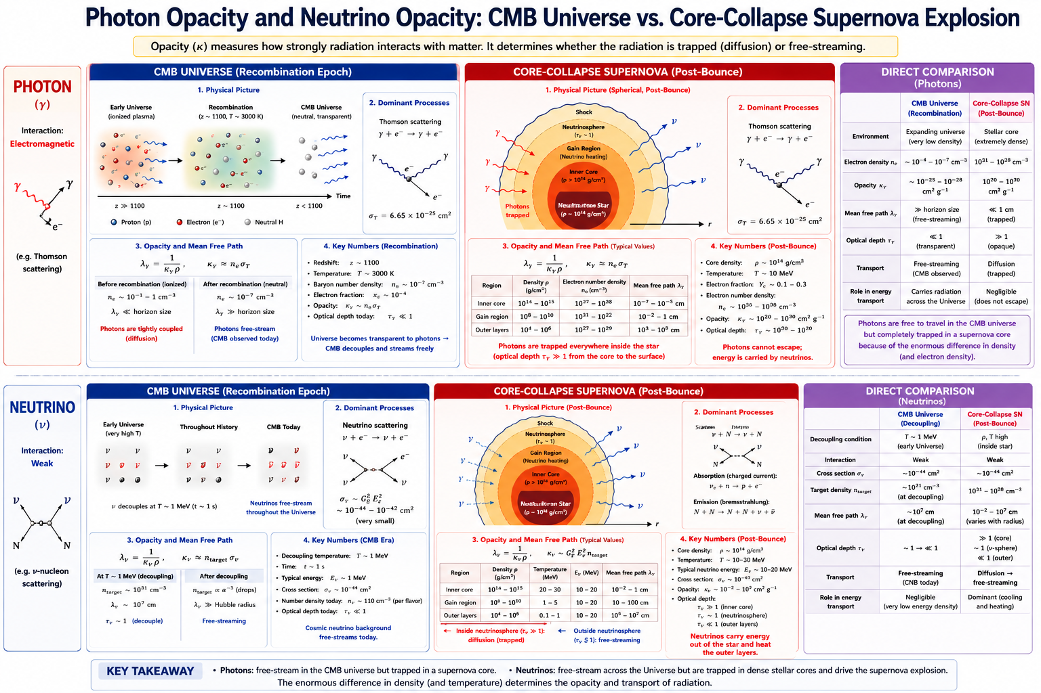


Slide 19
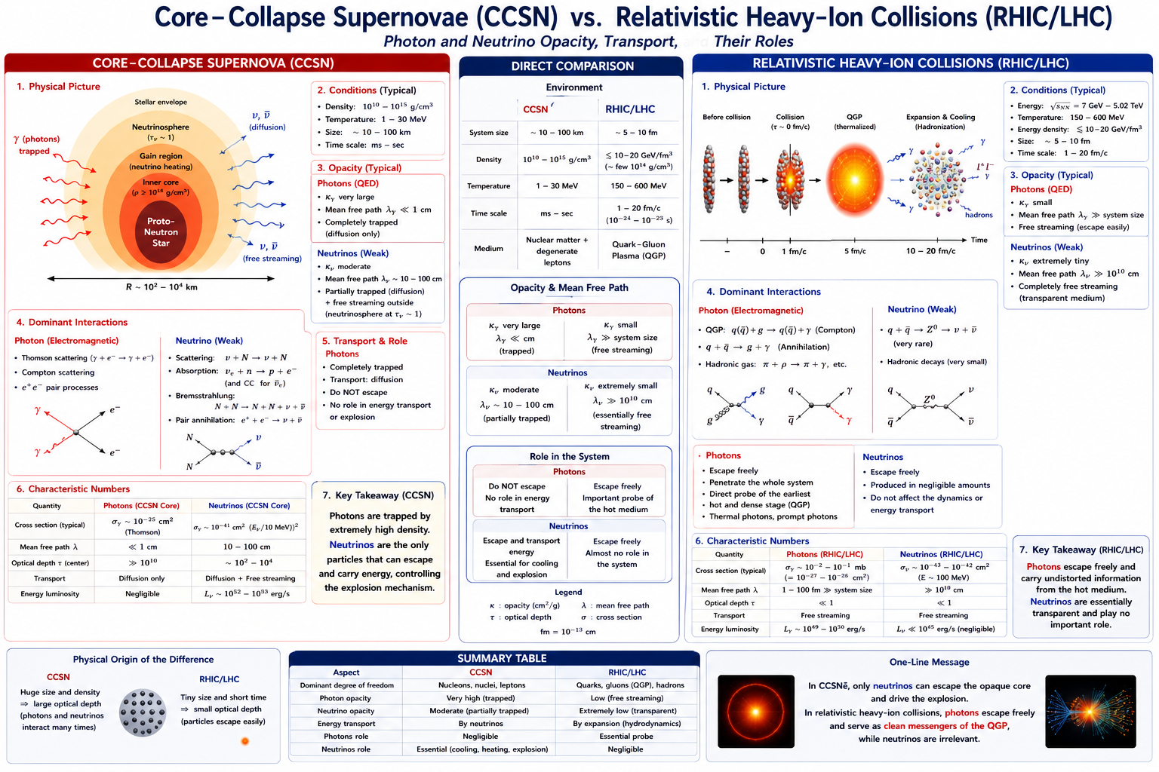

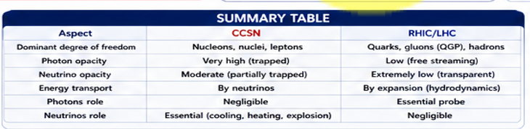

Slide 20
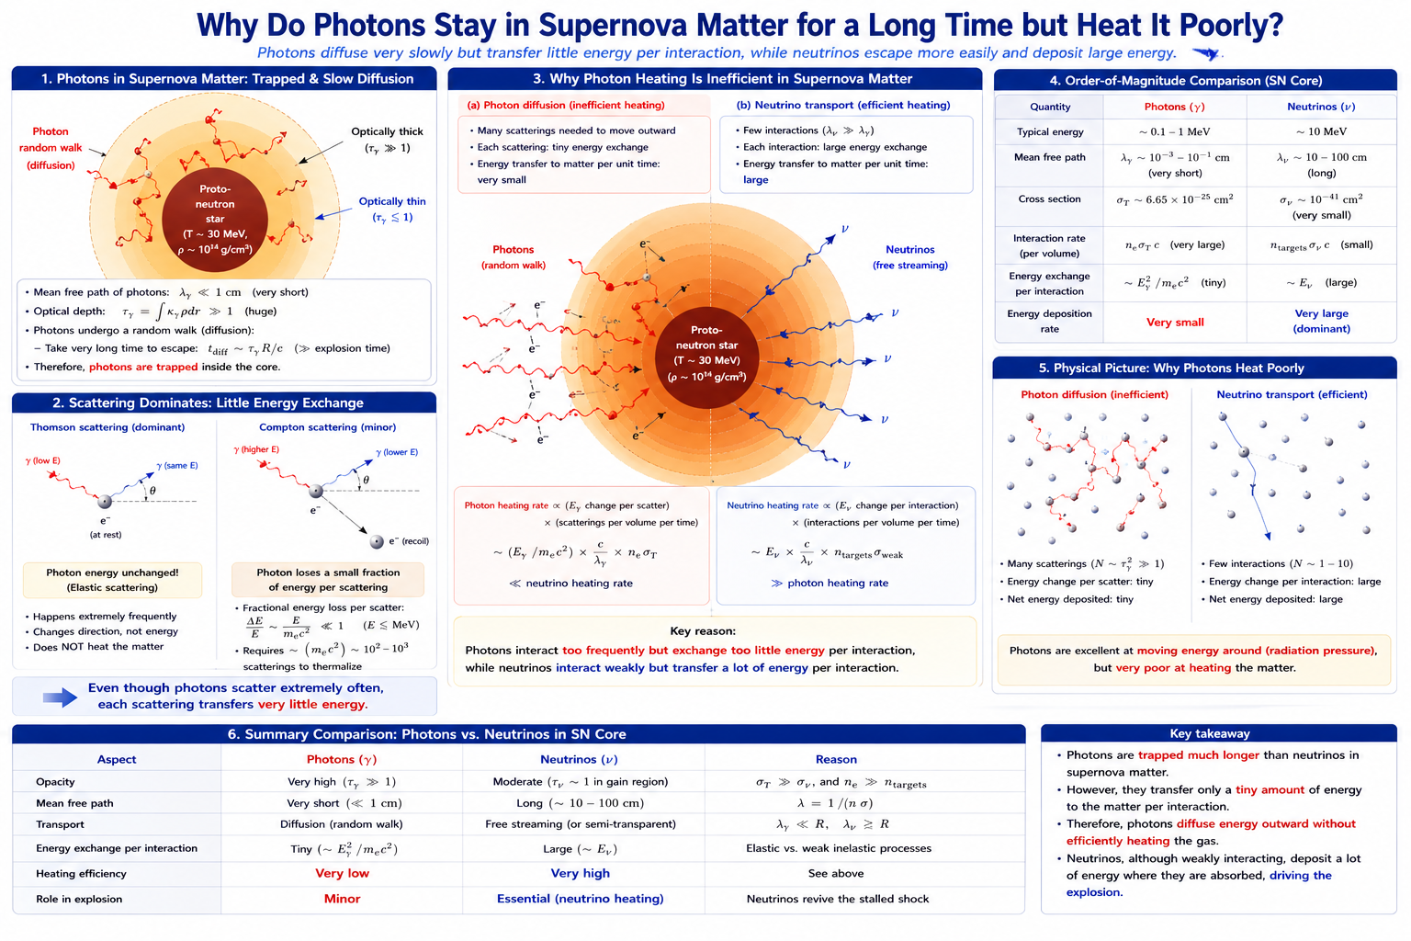

Slide 21
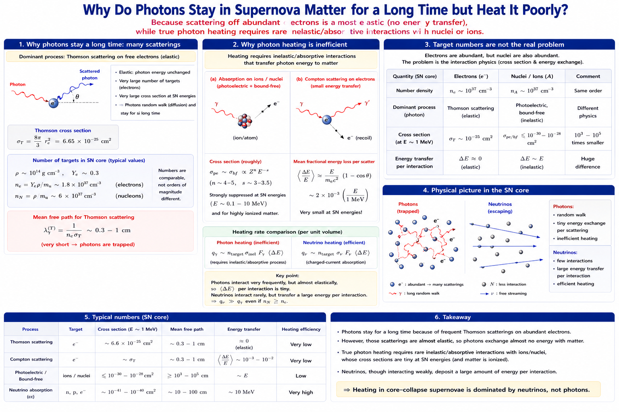
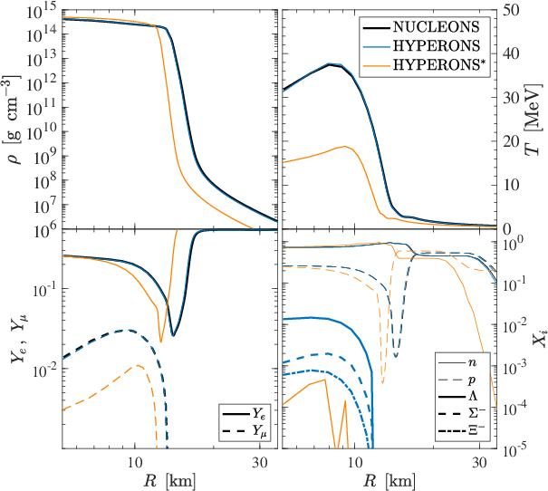


Slide 22
Contents
Introduction and Motivation from CCSNe Neutrino and Neutrino Process
Neutrino Luminosity from CCSNe by Neutrino Transport Equation by GR1D code
Effects of axial vector quenching and nucleon effective mass in nuclear dense matter
Degeneracy factor in CCSN2 and Degenerate and Non-degenerate Description in GR1D
Hybrid Model for Degenerate (Friman..) and Non-degenerate (A. Burrow..) Cases
Effects of axial vector quenching and nucleon effective mass in Hybrid Model
Summary and Conclusion

Slide 23
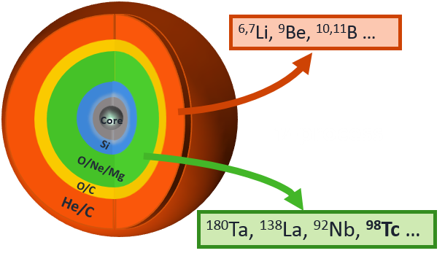
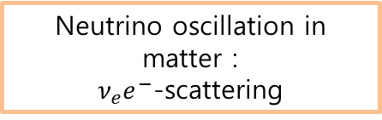
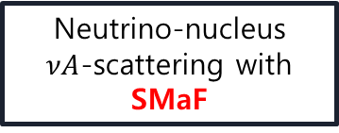











Introduction
Introduction
Neutrino Process in CCSN Explosion
Neutrino Process in CCSN Explosion
Why neutrino process in SN?
$${}_{}^{138}{Ce}$$
$${}_{}^{139}{Ce}$$
$${}_{}^{140}{Ce}$$
stable
unstable
$$β^{+}$$
r-process
(rapidly neutron capture)
$${}_{}^{137}{La}$$
$${}_{}^{138}{La}$$
$${}_{}^{139}{La}$$
$${}_{}^{140}{La}$$
$$β^{−}$$
$${}_{}^{136}{Ba}$$
$${}_{}^{137}{Ba}$$
$${}_{}^{138}{Ba}$$
$${}_{}^{139}{Ba}$$
$${}_{}^{140}{Ba}$$
$${}_{}^{138}{Ba\left(ν_{e},e^{−}\right)}{}_{}^{138}La$$
We need to understand the neutrino source and its propagation in SNe ?
Neutrino sphere
Neutrino propagation with momentum $p$
(Not-to-scale)
$$n_{ν}≈{10}^{32}/cm^{3}$$
P
NS
$$p$$
$$e^{−}$$
$$A$$
$$θ_{q}$$
$$q$$
10km
1000km
250000km
Luminosity and flux of emitted neutrinos from PNS are described by the neutrino transport equation depending on flavor and electron density !
Neutrino Luminosity
Fast Neutrino Conversion & Neutrino self-coupling
Sterile Neutrino
Neutrino oscillation in matter :
$ν_{e}e^{−}$-scattering
Neutrino-nucleus
$νA$-scattering with SMaF
Notes:
Here I explain the production mechanism of 138La. As you see, 138La is surrounded by stable nuclei. It means that the nucleus can not be produced by the s- and r-process.
Enter
However, the neutrino-induced reaction can produce the nucleus via NC and CC reactions. Of course, other processes, so to say gamma-process by the photodisintegration and neutron-capture can make the nucleus.
We have to be very careful of those contributions to pin down the information regarding the neutrino process.
Enter 2 times
For understanding the process, we start from the study of the neutrino luminosity emitting from the proto-neutron star or neutrino-sphere. It depends on the SN simulation, which point will be explained later on.
After the neutrino emission, the propagating neutrino interacts with the mater, mainly electrons, and some nuclei
which were already produced in the pre supernova through the s-process for long and long years.
In a nutshell, for the neutrino-process study, we need to understand the neutrino luminosity, oscillation in matter and the neutrino-induced reactions as well as the neutrino-self interaction.

Slide 24
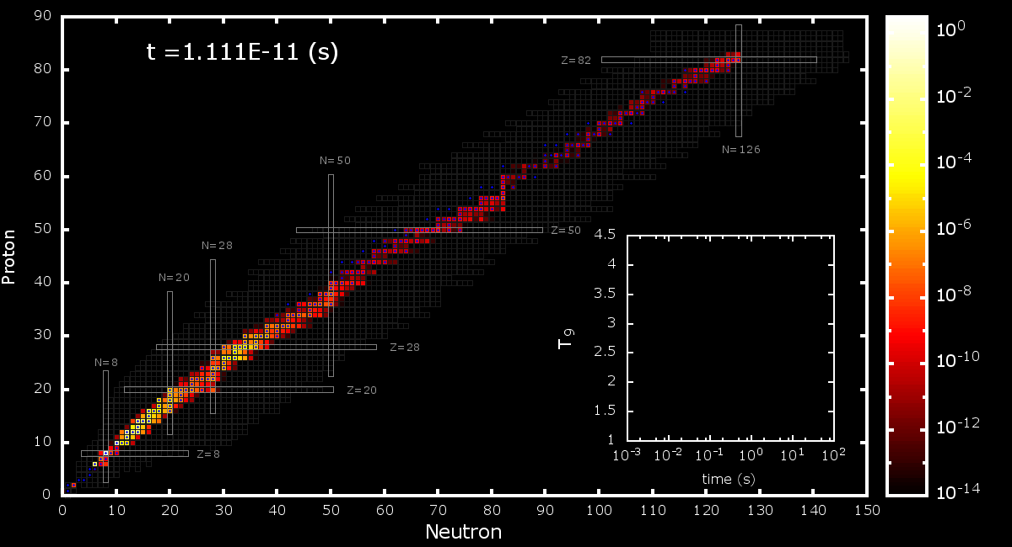

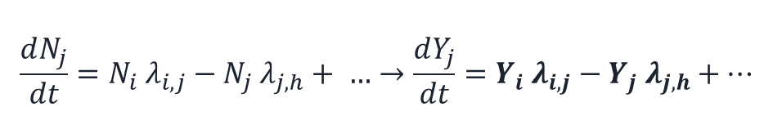
Numerical results for elements abundances
Introduction
Input Data Model for neutrino-process for CCSN Explosion
Network calculation for nucleosynthesis
$$\frac{dN_{j}}{dt}=N_{i} λ_{i,j}−N_{j} λ_{j,h}+ …→\frac{dY_{j}}{dt}=Y_{i} λ_{i,j}−Y_{j} λ_{j,h}+…$$
JINA REALIB
$$Y_{j}=\frac{N_{j}}{ρ N_{A}}$$
+ Modified (n,g) Reactions
+ Neutrino-induced Reactions by QRPA & Branching Ratios
Astrophys.J. 980 (2025) 2, 247
Phys.Rev.C 107 (2023) 2, 024607
Astrophys.J. 937 (2022) 2, 116
Phys.Lett.B 824 (2022) 136813
Astrophys.J. 894 (2020) 2, 99
Phys.Rev.C 100 (2019) 3, 034604
Astrophys.J.Lett. 891 (2020) 1, L24
Astrophys.J. 872 (2019) 2, 164
Acta Phys.Polon.B 50 (2019) 3, 385
Phys.Rev.Lett. 121 (2018) 10, 102701
…
1987 SN model
Pre-supernova Model
Hydrodynamics Model: HCK18, KCK19
Modified Neutrino Flux by Self-interaction : w/ and wo/
Neutrino Luminosity : EQ and NEQ
Mass Hierarchy : NH and IH
Notes:
Before the results, I present the database used for the calculation. These are the data bases for the thermal nuclear reactions.
Others are related to SN simulation. We exploited 1987SN model, pre-supernova model from Kyushu and Tokyo group, and two different hydrodynamics.
These models are crucial to these physics …

Slide 25
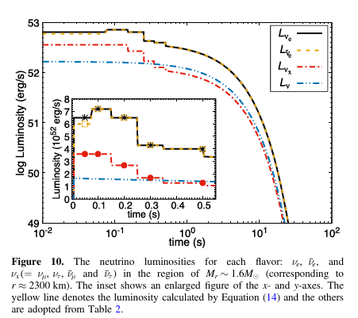

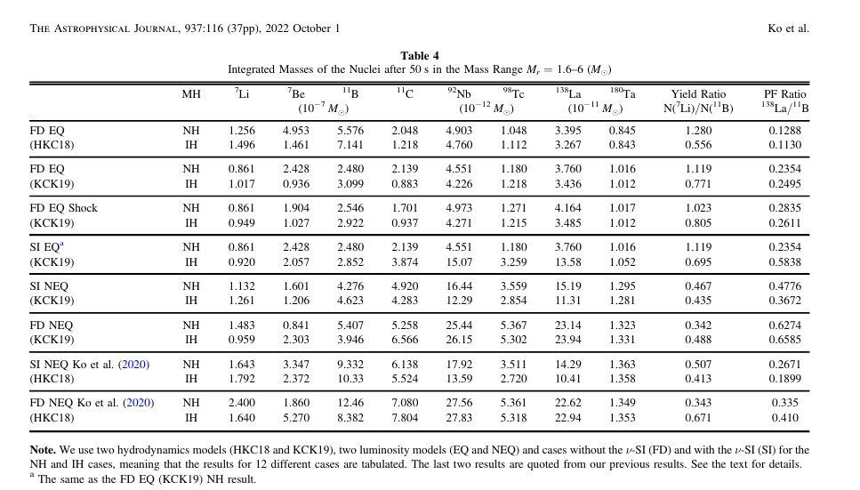









Introduction
Non-equal (NEQ) Neutrino Luminosity in CCSN Explosion
Introduction

Slide 26
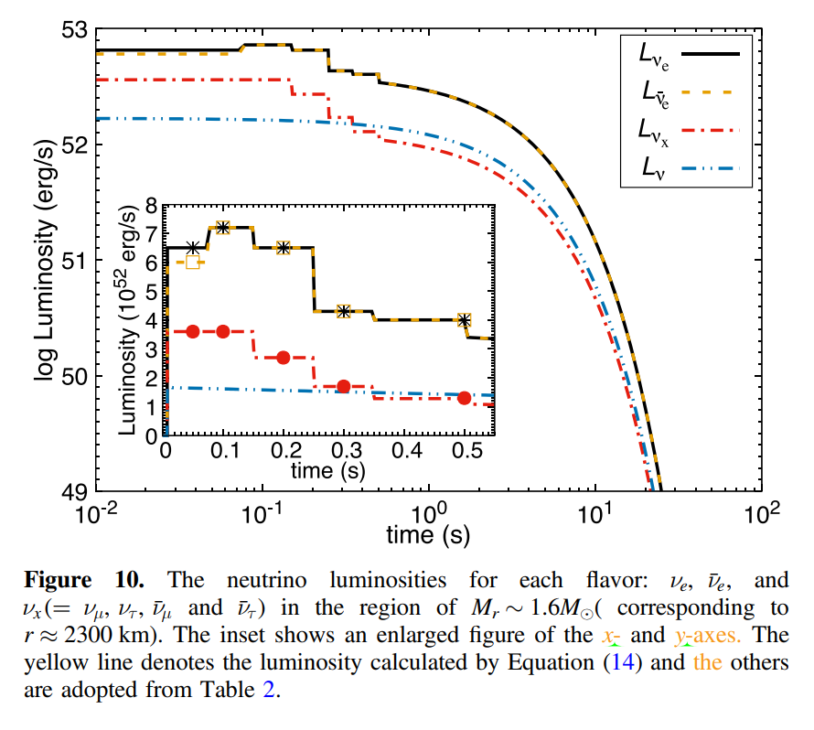
Introduction
Non-equal (NEQ) Neutrino Luminosity in CCSN Explosion
Introduction
NEQ Luminosity is higher than EQ luminosity scenario !!
Notes:
Next is the luminosity dependence. In principle, we have to use the luminosity from the neutrino transport model simulation in the SN explosion simulation.
Since it depends on the model and the simulation, we adopted a synthetic model which collected 6 different SN simulation models as shown here.
According to the SN simulation, the neutrino emission is divided in three stages. One is the neutrino emission from the burst, the 2nd is from the accretion phase, and the last one is from the cooling phase.
We considered the accretion and cooling phases because the neutrinos from the burst phase are easily decoupled for a short time interval after the bounce of the core collapse.

Slide 27
Contents
Introduction and Motivation from CCSNe Neutrino and Neutrino Process
Neutrino Luminosity from CCSNe by Neutrino Transport Equation by GR1D code
Effects of axial vector quenching and nucleon effective mass in nuclear dense matter
Degeneracy factor in CCSN2 and Degenerate and Non-degenerate Description in GR1D
Hybrid Model for Degenerate (Friman..) and Non-degenerate (A. Burrow..) Cases
Effects of axial vector quenching and nucleon effective mass in Hybrid Model
Summary and Conclusion

Slide 28
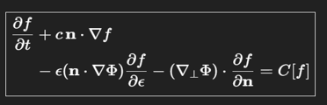
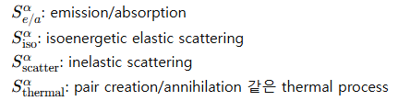
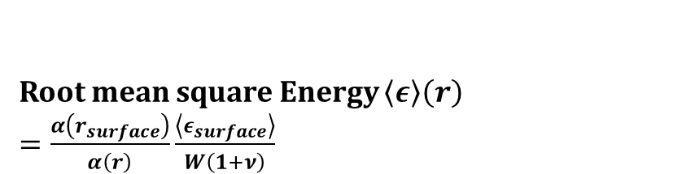


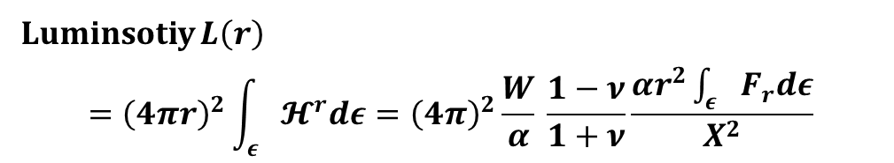
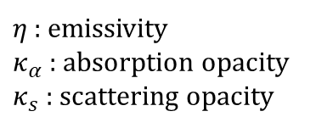
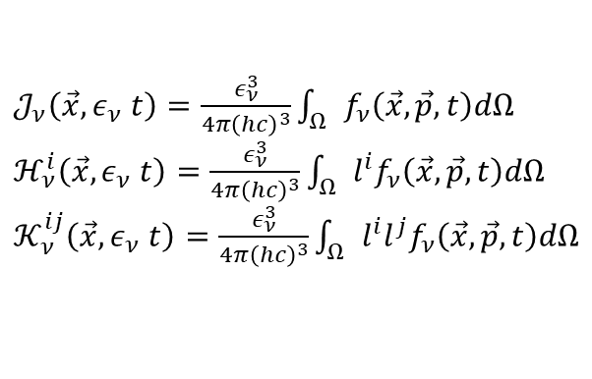
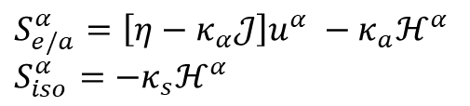


Neutrino transport : GR Boltzmann equation
Boltzmann equation –
Equation describing non-equilibrium system
General Relativistic form of Boltzmann equation
$→ p^{α}\left[\frac{∂f_{μ_{i}}}{∂x^{α}}−Γ_{αγ}^{β}p^{γ}\frac{∂f_{ν}}{∂p^{β}}\right]={\left[\frac{df_{ν}}{dτ}\right]}_{coll}$
$𝒥_{ν}\left(\vec{x}, ε_{ν} t\right)=\frac{ε_{ν}^{3}}{4π{\left(hc\right)}^{3}}\int_{Ω}{f_{ν}\left(\vec{x},\vec{p}, t\right)dΩ}$
$ℋ_{ν}^{i}\left(\vec{x}, ε_{ν} t\right)=\frac{ε_{ν}^{3}}{4π{\left(hc\right)}^{3}}\int_{Ω}{l^{i}f_{ν}\left(\vec{x},\vec{p}, t\right)dΩ}$
$𝒦_{ν}^{ij}\left(\vec{x}, ε_{ν} t\right)=\frac{ε_{ν}^{3}}{4π{\left(hc\right)}^{3}}\int_{Ω}{l^{i}l^{j}f_{ν}\left(\vec{x},\vec{p}, t\right)dΩ}$
Luminsotiy $L\left(r\right)$
$$={\left(4πr\right)}^{2}\int_{ε}{𝓗^{r}dε}={\left(4π\right)}^{2}\frac{W}{α} \frac{1−ν}{1+ν}\frac{αr^{2}\int_{ε}{F_{r}dε}}{X^{2}}$$
Neutrino + Matter interaction
$\frac{dm}{dr}=4π\left(ρhW^{2}−P+τ_{m}^{ν}\right)$
$ρ$ = density, h =enthalpy, W =Lorentz factor, P = pressure
$X=\frac{1}{\sqrt{2m\left(r\right)/r}}$
$\frac{dφ}{dr}=X^{2}\left[\frac{m}{r^{2}}+4πr\left(ρhW^{2}ν^{2}+P+τ_{φ}^{ν}\right)\right]$
$α=\exp\left(φ\right), ν$ = fluid velocity
$$S_{e/a}^{α}+S_{iso}^{α}+S_{scatter}^{α}+S_{thermal}^{α}$$
$S_{e/a}^{α}=\left[η−κ_{α}𝒥\right]u^{α} −κ_{a}ℋ^{α}$
$S_{iso}^{α}=−κ_{s}ℋ^{α}$
Root mean square Energy $\left\langle ε\right\rangle \left(r\right)$
$=\frac{α\left(r_{surface}\right)}{α\left(r\right)}\frac{\left\langle ε_{surface}\right\rangle }{W\left(1+ν\right)}$
$η$ : emissivity
$κ_{α}$ : absorption opacity
$κ_{s}$ : scattering opacity
$${}^{1}Burrows, Reddy \& Thompson, Nuclear Physics A 777, 356 (2006)$$
Notes:
Last, I simply explain how GR1D calculate neutrino data.
Starting with neutrino coefficients, it put on boltzman equation’s collision term, and get neutrino’s distribution function.
Then, get luminosity using moment formalism, and using ADM formalism, get energy.

Slide 29





Data Making Process
Model : SN1987A
Equation of State (EOS) Model
$${\text{Initial} \text{profile}\text{ – }\text{S}\text{15}\text{s}\text{7}\text{b}\text{2}}^{2}$$
EOSmaker
Making Data table
of EOS
Data table dependent on
$\left(\begin{matrix}Density \\ \text{Temperature} \\ Charge fraction\end{matrix}\right)$
Nulib
Making Data table
of neutrino interaction
$$\left(\begin{matrix}\text{Emissi}vity η \\ \text{Absorption} opacity \\ Scattering opacity\end{matrix}\right)$$
GR1D
Making Data table
of Core Collapse supernova
$$\left(\begin{matrix}Luminosity \\ RMS \text{Energy} \\ \begin{matrix}Entropy \\ ⋮\end{matrix}\end{matrix}\right)$$
${}^{1}$O’Connor, E. 2015, ApJS 219, 24.
${}^{2}$Woosley, S.E. & Weaver, T.A. 1995, LLNL Rep. UCRL-ID-122106.
Notes:
I introduce how to make neutrino data.
In my study, I use program called GR1D, name means General relativistic, 1 dimension.
First, prepare Equation of state model.
Second, make EOS data table using EOSmaker, or compose.
Next, make neutrino interaction coefficient data table using program Nulib and EOS data table obtained earlier
Last, put that all data table+initial supernovae profile to GR1D.
Then neutrino from Supernovae data will be created.

Slide 30





Eos.h5
Electron fraction
Temperature
density
Pressure$\left(dynes/cm^{2}\right)$
Energy $\left(erg/g\right)$
Mass number
Mass fraction of all
Number fraction of all
Entropy $\left(k_{B}/baryon\right)$
Adiabatic index
Velocity of sound $\left(cm^{2}/s^{2}\right)$
Chemical potential $\left(MeV/baryon\right)$
dpde, dpdrho, de/dt
Stellar collapse
Stellar initial profile
다운로드
Eos.h5
input
input
input
Nulib.exe
output
Opacity.h5
Neutrino energy
Neutrino species
Electron fraction
Temperature
density
Absorption opacity ($cm$-1)
Emissivity ($erg/cm^{3}/s/MeV/srad)$
Scattering opacity ($cm$-1)
Opacity.h5
input
GR1D.exe
Stellar initial profile
Mass (g)
Radial coordinate (cm)
Temperature (K)
Density (g/cm3)
Radial velocity (cm/s)
Fraction
Angular velocity (rad/s)
output
Neutrino luminosity
Neutrino energy

Slide 31



Equation of States in Default

Slide 32


Sym. Energy is given by the difference of the SNM and PNM energy !!
32

Slide 33







Sometime Q_0 and Q_sym are
denoted as J_0 and J_sym. !
200-400

Slide 34













Equation of States in Default
(Landau effective mass)

Slide 35



Equation of States in Default
Radius:
LNS(61) < SLy4(46) < NRAPR(60) < LS220(74)
Mass:
KDE0v1(55) < SLy4(46) ~ LS220(74)
(Landau effective mass)

Slide 36








LS220 &KDEv01
$T{=(0.105}\sim 182)MeV$
$n_{b}=\left({10}^{−12}\sim 11.9\right)fm^{−3}$
$Y_{q}=(0.03,\sim 0.5)$
Saturation density in symmetric matter $0.155fm^{−3}$
Binding energy per baryon at saturation $16.0 MeV$
Incompressibility $220MeV$
Skewness $411MeV$
Symmetry energy $29.3MeV$
Symmetry energy slope parameter $74MeV$
Symmetry incompressibility $−24MeV$

Slide 37



Equation of States in RMF and …

Slide 38





Density vs pressure (by EOS in COMPOSE)
Min(Y_e) = 0.005
Min(T) = 0.005MeV
Miyatsu, Tsuyoshi, et al. "Can the PREX-2 and CREX results be understood by relativistic mean-field models with the astrophysical constraints?." Physics Letters B 843 (2023): 138013.

Slide 39


Density and Temperature Profiles vs radius
EoS = LS220
for GR1D and NuLib
Black = Burrow
Red = Burrow w/ effective mass and quenching
Blue = FM

Slide 40

Effects of quenching and effective mass in Luminosity for non-degenerate case
Effective mass effects decrease the luminosity during the post bounce
and increases it at the accretion phase !!

Slide 41





Luminosity, Density & Temperature dependence on Equation of States

Slide 42

RMS energy vs time dependence on Equation of States

Slide 43

Luminosity, RMS energy and Entropy vs radius dependence on Equation of States

Slide 44




PNS Radius dependence on Equation of States

Slide 45

Shock (1D) Radius dependence on Equation of States

Slide 46



Slide 47











Absorption by CC reaction in Nulib.
Convenient refence neutrino cross section
$σ_{0}=\frac{4G_{F}^{2}{\left(m_{e}c^{2}\right)}^{2}}{π{\left(ℏc\right)}^{4}}≅1.705×{10}^{−44}cm^{2}$
$ν_{e}−n : σ_{ν_{e}n}=σ_{0}\left(\frac{1+3g_{A}^{2}}{4}\right){\left(\frac{ε_{ν_{e}}+Δ_{np}}{m_{e}c^{2}}\right)}^{2}{\left[1−{\left(\frac{m_{e}c^{2}}{ε_{ν_{e}}+Δ_{np}}\right)}^{2}\right]}^{1/2}$
$\overline{ν_{e}}−p : σ_{\overline{ν_{e}}p}=σ_{0}\left(\frac{1+3g_{A}^{2}}{4}\right){\left(\frac{ε_{\overline{ν_{e}}}±}{m_{e}c^{2}}\right)}^{2}{\left[1−{\left(\frac{m_{e}c^{2}}{ε_{\overline{ν_{e}}}−Δ_{np}}\right)}^{2}\right]}^{1/2}$
$$ν_{e}−A : σ_{ν_{e}A}=\frac{σ_{0}}{14}g_{A}^{2}N_{p}\left(Z\right)N_{n}\left(N\right){\left(\frac{ε_{ν}+μ_{n}−μ_{p}+Δ}{m_{e}c^{2}}\right)}^{2}{\left[1−{\left(\frac{m_{e}c^{2}}{ε_{ν_{e}}+μ_{n}−μ_{p}+Δ}\right)}^{2}\right]}^{1/2}$$
…..
Include the effective nucleon mass & g_a quenching
1f5/2 energy w.r.t gr. state
Burrows, Adam, Sanjay Reddy, and Todd A. Thompson. "Neutrino opacities in nuclear matter." Nuclear Physics A 777 (2006): 356-394.
Δ is the energy of the neutron 1f5/2 state above the ground state and is taken to be 3 MeV [25],
$g_{A, eff}^{}≅g_{A}\left(1−\frac{n_{Baryon}}{4.15\left(n_{0}+n_{Baryon}\right)}\right)$
Within 1% accuracy for all $n_{Baryon}<4.5n_{0}$
Carter, G. W., and M. Prakash. "The quenching of the axial coupling in nuclear and neutron-star matter." Physics Letters B 525.3-4 (2002): 249-254.
Opacity.h5
Neutrino energy
Neutrino species
Electron fraction
Temperature
density
Absorption opacity ($cm$-1)
Emissivity ($erg/cm^{3}/s/MeV/srad)$
Scattering opacity ($cm$-1

Slide 48





Scattering by NC
$$e+ν_{e}$$
Include the g_a quenching
$$←no g_{A}$$
Bowers, Robert L., and James R. Wilson. "A numerical model for stellar core collapse calculations." Astrophysical Journal Supplement Series, vol. 50, Oct. 1982, p. 115-159. 50 (1982): 115-159.
$σ_{ν_{μ,τ}p}=σ_{0}{\left(\frac{ε_{ν}}{m_{e}c^{2}}\right)}^{2}\left[{\left(C_{V}^{′}−1\right)}^{2}+3g_{A}^{2}{\left(C_{A}^{′}−1\right)}^{2}\right]$
$\frac{dσ_{p}}{dΩ}=\frac{σ_{p}}{4π}\left(1+δ_{p}μ\right), δ_{p}=\frac{{\left(C_{V}^{′}−1\right)}^{2}−g_{A}^{2}{\left(C_{A}^{′}−1\right)}^{2}}{{\left(C_{V}^{′}−1\right)}^{2}+3g_{A}^{2}{\left(C_{A}^{′}−1\right)}^{2}}, μ=$cosine of the angular coordinate of the zenith angle
$σ_{n}=\frac{σ_{0}}{4}\left(ε\right){\left(\frac{ε_{ν}}{m_{e}c^{2}}\right)}^{2}\left(\frac{1+3g_{A}^{2}}{4}\right)$ $\frac{dσ_{n}}{dΩ}=σ_{n}\left(1+δ_{n}μ\right)$, $δ_{p}=\frac{1−g_{A}^{2}}{1+3g_{A}^{2}}$ differential cross section for neutrino transport
Burrows, Adam, Sanjay Reddy, and Todd A. Thompson. "Neutrino opacities in nuclear matter." Nuclear Physics A 777 (2006): 356-394.

Slide 49










Neutrino Emission by Bremsstrahlung by A. Burrow
Burrows, Adam, Sanjay Reddy, and Todd A. Thompson. "Neutrino opacities in nuclear matter." Nuclear Physics A 777 (2006): 356-394.
Emissivity $Q_{nb}={\left(2π\right)}^{4}\int{\left[\prod_{i=1}^{4}{\frac{d^{3}{\vec{p}}_{i}}{{\left(2π\right)}^{3}}}\right]\frac{d^{3}q_{ν}}{{\left(2π\right)}^{3}2ω_{ν}}\frac{d^{3}{\vec{q}}_{{\overline{ν}}_{i}}}{{\left(2π\right)}^{3}2ω_{\overline{ν}}}ω\sum_{s}{{\left|ℳ\right|}^{2}δ^{4}\left(P\right)Ξ_{brems}}}$
$\sum_{s}{{\left|ℳ\right|}^{2}}=\frac{64}{4}G_{F}^{2}{\left(\frac{f}{m_{π}}\right)}^{4}g_{A}^{2}\left[{\left(\frac{k^{2}}{k^{2}+m_{π}^{2}}\right)}^{2}+…\right]\frac{ω_{ν}ω_{\overline{ν}}}{ω^{2}}$
$→Q_{nb}^{eff}=Q_{nb}∗{\left(\left(1−\frac{n_{Baryon}}{4.15\left(n_{0}+n_{Baryon}\right)}\right)\right)}^{2}$
m=> m*= m (m*/m)
$g_{A, eff}^{}≅g_{A}\left(1−\frac{n_{Baryon}}{4.15\left(n_{0}+n_{Baryon}\right)}\right)$
Within 1% accuracy for all $n_{Baryon}<4.5n_{0}$
delta = 1.5= 3/2 for Non-deg.case

Slide 50






Neutrino Opacity vs. Density (LS220)
Absorption opacity Emissivity Scattering opacity
No effective mass, What is effect of effective mass ?
$η−κ_{a}𝒥=0,𝒥$: blackbody spectra$\left[ergs/cm^{2}/s/MeV/srad\right]$

Slide 51
Contents
Introduction and Motivation from CCSNe Neutrino and Neutrino Process
Neutrino Luminosity from CCSNe by Neutrino Transport Equation by GR1D code
Effects of axial vector quenching and nucleon effective mass in nuclear dense matter
Degeneracy factor in CCSN2 and Degenerate and Non-degenerate Description in GR1D
Hybrid Model for Degenerate (Friman..) and Non-degenerate (A. Burrow..) Cases
Effects of axial vector quenching and nucleon effective mass in Hybrid Model
Summary and Conclusion

Slide 52



Neutrino Opacity vs. Density & Temperature(KDE)
Black : KDE0v1
Red : + g_a quenching
Blue: + Effective mass
depending on temperature
$η−κ_{a}𝒥=0,𝒥$:
blackbody spectra
$\left[ergs/cm^{2}/s/MeV/srad\right]$

Slide 53



Luminosity of KDE0v1 for g_a quenching
Black : $g_{A,}^{}=1.254$
Red : $g_{A, eff}^{}≅g_{A}\left(1−\frac{n_{Baryon}}{4.15\left(n_{0}+n_{Baryon}\right)}\right)$

Slide 54




(LS220), change of absorption and all
LS220_3335 : ga*를 사용하지 않은 opacity table
LS220_ga_abs : absorption opacity에서만
ga*를 사용한 opacity table
LS220_ga_all : 모든 반응에서 ga*를 사용한 opacity table

Slide 55
Effects of quenching and effective mass in Luminosity for non-degenerate case
Effective mass effects decrease the luminosity during the post bounce
and increases it at the accretion phase !!

Slide 56

Effects of quenching and effective mass in Luminosity for non-degenerate case
Effective mass effects decrease the luminosity during the post bounce
and increases it at the accretion phase !!

Slide 57
However,
this is far from the whole story.
So—what are we really missing?

Slide 59
Contents
Introduction and Motivation from CCSNe Neutrino and Neutrino Process
Neutrino Luminosity from CCSNe by Neutrino Transport Equation by GR1D code
Effects of axial vector quenching and nucleon effective mass in nuclear dense matter
Degeneracy factor in CCSN2 and Degenerate and Non-degenerate Description in GR1D
Hybrid Model for Degenerate (Friman..) and Non-degenerate (A. Burrow..) Cases
Effects of axial vector quenching and nucleon effective mass in Hybrid Model
Summary and Conclusion

Slide 60









Degeneracy by chemical potential & Thermal de Broglie wave length: Degenerate and Non-degenerate vs time and radius
Deg. and Non-deg. Cases
show significant difference
near neutrino sphere !!
No overlap => Classical gas
Overlap => Quantum Degenerate gas

Slide 61




Degeneracy by Chemical Potential & Thermal de Broglie wave length: Degenerate and Non-degenerate vs time for fixed radius
Normal density
Deg. and Non-deg. Cases
show significant difference
around neutrino sphere
just after post-bounce
&
in the cooling phase !!
Black = Burrow
Red = Burrow w/ effective mass and quenching
Blue = FM w/effective mass and quenching

Slide 62



Degeneracy by chemical potential & Thermal de Broglie wave length: Degenerate and Non-degenerate vs radius for fixed time
Normal density
FM79_restored = original FM
Deg. and Non-deg. Cases
show significant difference
around neutrino sphere
just after post-bounce
&
in the cooling phase !!
Black = Burrow
Red = Burrow w/ effective mass and quenching
Blue = FM

Slide 63





Neutrino Emission by Bremsstrahlung (Non-deg. & Deg. Cases)
Burrows, Adam, Sanjay Reddy, and Todd A. Thompson. "Neutrino opacities in nuclear matter." Nuclear Physics A 777 (2006): 356-394.
Emissivity $Q_{nb}={\left(2π\right)}^{4}\int{\left[\prod_{i=1}^{4}{\frac{d^{3}{\vec{p}}_{i}}{{\left(2π\right)}^{3}}}\right]\frac{d^{3}q_{ν}}{{\left(2π\right)}^{3}2ω_{ν}}\frac{d^{3}{\vec{q}}_{{\overline{ν}}_{i}}}{{\left(2π\right)}^{3}2ω_{\overline{ν}}}ω\sum_{s}{{\left|ℳ\right|}^{2}δ^{4}\left(P\right)Ξ_{brems}}}$
$\sum_{s}{{\left|ℳ\right|}^{2}}=\frac{64}{4}G_{F}^{2}{\left(\frac{f}{m_{π}}\right)}^{4}g_{A}^{2}\left[{\left(\frac{k^{2}}{k^{2}+m_{π}^{2}}\right)}^{2}+…\right]\frac{ω_{ν}ω_{\overline{ν}}}{ω^{2}}$
$→Q_{nb}^{eff}=Q_{nb}∗{\left(\left(1−\frac{n_{Baryon}}{4.15\left(n_{0}+n_{Baryon}\right)}\right)\right)}^{2}$
delta = 1.5 for Non-deg. Case
= 4.0 for Deg. case

Slide 64
Density and Temperature Profiles vs radius
EoS = LS220
for GR1D and NuLib
Black = Burrow
Red = Burrow w/ effective mass and quenching
Blue = FM

Slide 65


Density and Temperature Profiles vs radius
EoS = LS220
for GR1D and NuLib
Large effect near neutrino sphere
In degenerate case !!!
Black = Burrow
Red = Burrow w/ effective mass and quenching
Blue = FM

Slide 66






Absorption & Emissivity vs Density & Temperature
Black = Burrow
Red = Burrow w/ effective mass and quenching
Blue = FM w/effective mass and quenching

Slide 67

Comparison of Luminosity vs Time (LS220) by Non-deg. and Deg. cases
Degenerate case delays a bit the neutrino burst during the post-bounce and increases the luminosity
at the accretion phase near neutrino sphere !!

Slide 68

Comparison of Luminosity vs Time (LS220) by Non-deg. and Deg. cases
Degenerate case delays a bit the neutrino burst during the post-bounce and increases the luminosity
at the accretion phase near neutrino sphere !!

Slide 69
Contents
Introduction and Motivation from CCSNe Neutrino and Neutrino Process
Neutrino Luminosity from CCSNe by Neutrino Transport Equation by GR1D code
Effects of axial vector quenching and nucleon effective mass in nuclear dense matter
Degeneracy factor in CCSN2 and Degenerate and Non-degenerate Description in GR1D
Hybrid Model for Degenerate (Friman..) and Non-degenerate (A. Burrow..) Cases
Effects of axial vector quenching and nucleon effective mass in Hybrid Model
Summary and Conclusion

Slide 70

Comparison of Luminosity vs Time (KDE0v1) by Hybrid Model

Slide 71

Luminosity vs Time (KDE0v1) by Hybrid Model
Hybrid model illustrates larger neutrino luminosity rather than Burrow simulation in accretion phase !!

Slide 72


Contents
Introduction and Motivation from CCSNe Neutrino and Neutrino Process
Neutrino Luminosity from CCSNe by Neutrino Transport Equation by GR1D code
Effects of axial vector quenching and nucleon effective mass in nuclear dense matter
Degeneracy factor in CCSN2 and Degenerate and Non-degenerate Description in GR1D
Hybrid Model for Degenerate (Friman..) and Non-degenerate (A. Burrow..) Cases
Effects of axial vector quenching and nucleon effective mass in Hybrid Model
Summary and Conclusion

Slide 73

Comparison of Effective Mass Effects by Hybrid model
Effective mass and quenching effects decreases luminosity near post-bounce and cooling phase,
but increases it at accretion phase near post-bounce near neutrino sphere.
Perhaps, in the degenerate case, luminosity is proportional to effective mass ratio ~1.5

Slide 74

Comparison of Effective Mass Effects by Hybrid Model
Effective mass and quenching effects decreases luminosity near post-bounce and cooling phase,
but increases it at accretion phase near post-bounce near neutrino sphere.
Perhaps, in the degenerate case, luminosity is proportional to effective mass ratio ~1.5.
Effective mass and quenching show larger luminosity rather than the original Hybrid model.

Slide 75
Summary
1. Neutrino already came to your Nuclear Physics.
2. Scattering data, Neutron Skin Thickness are available now.
3. In CCSN, most of gravitational energy is transferred to neutrino energy.
4. Now there are many proposals to detect the SN neutrino as well as other neutrinos on Earth.
5. Most of SN simulation by the neutrino transport equation needs more elaborate treatments of the nuclear physics input.
6. We tried to examine the density dependence of the weak interaction and the effects of the effective nucleon mass in dense mater in the GR1D simulation.

Slide 76
Summary
7. The weak interaction quenching reduces the neutrino absorption, scattering and emission rate, which gives rise to the increase of the mean free path in the neutrino streaming, i.e., makes the SN matter transparent to the neutrino.
8. That is, the neutrino opacity becomes smaller, and consequently provides much larger neutrino luminosity, about 10 % maximally in the neutrino burst and the accretion epoch.
9. But almost no effects are found in the cooling phase.
10. The change of nucleon effective masses is found to be more serious.
11. For the non-degenerate case, the effective mass and quenching effects decreases luminosity near post-bounce and cooling phase, but increases it at accretion phase near post-bounce near neutrino sphere.
12. But, for the degenerate case, the feature is reversed. Perhaps, in the degenerate case, luminosity is proportional to effective mass ratio ~1.5.
13. We need to consider a hybrid model depending the degeneracy factor depending on temperature and density. More deliberate analysis is being done now.

Slide 77



Thanks for your attention !!
崇實大學校

