Slide 1
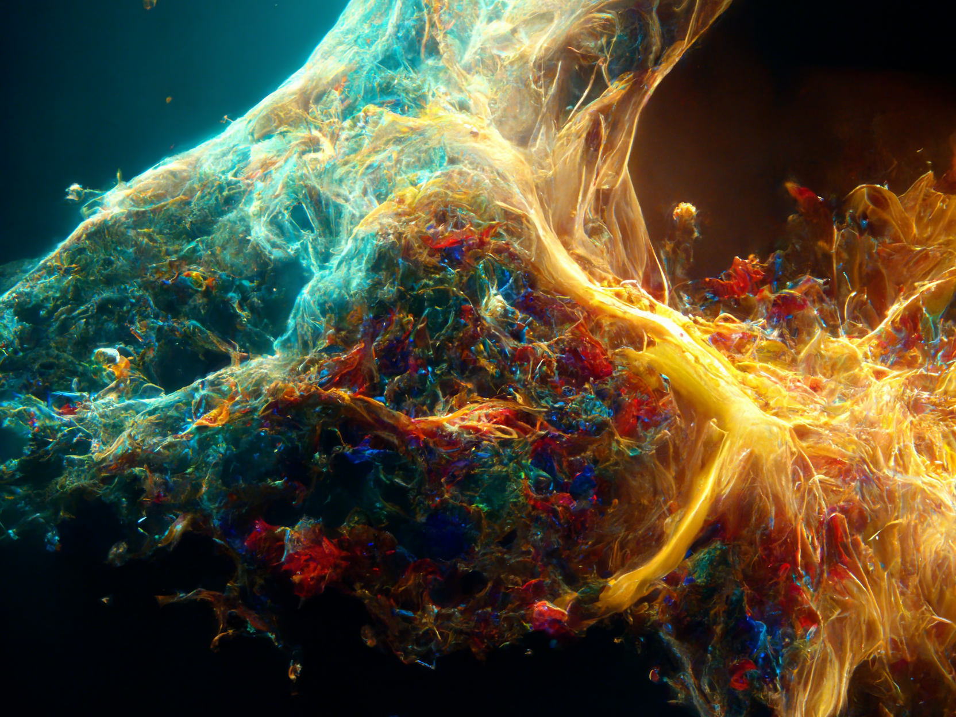
TOPSEGI : A Flexible Python Program for High-Resolution Infrared Molecular Analysis
Minkyu Lee
(Soongsil University)
In collaboration with
Jubin Park (OMEG / Soongsil University)
Sehoon Oh (OMEG / Soongsil University)
Myung-Ki Cheoun (OMEG / Soongsil University)
Se Young Park (OMEG / Soongsil University)
Tomoya Naito (The University of Tokyo / RIKEN iTHEMS, JAPAN)

Slide 2
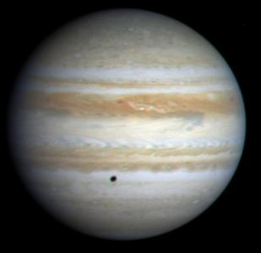
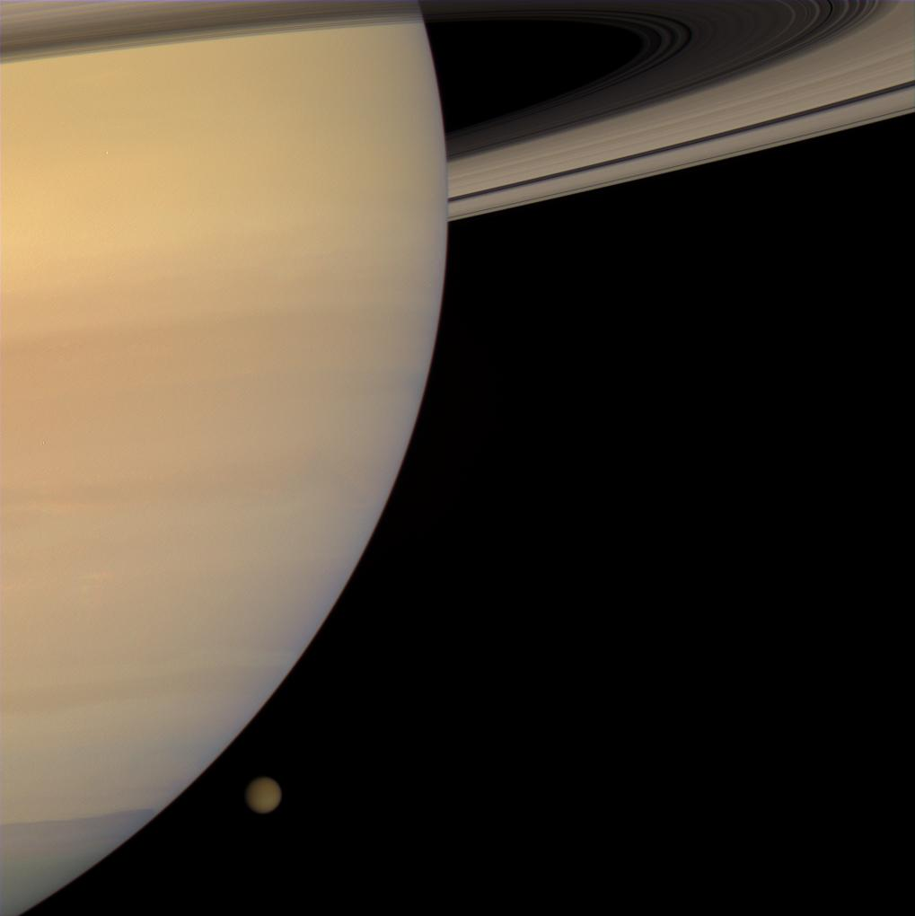
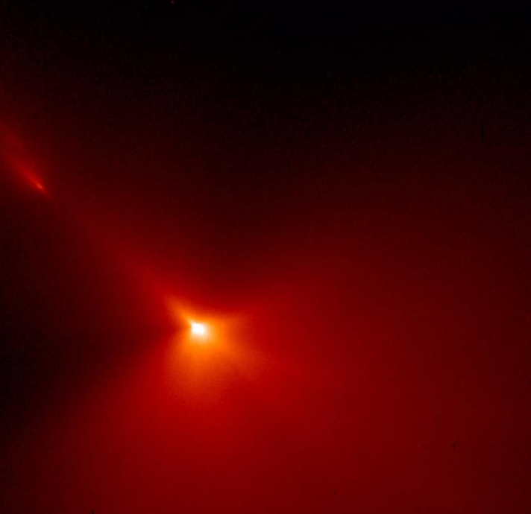
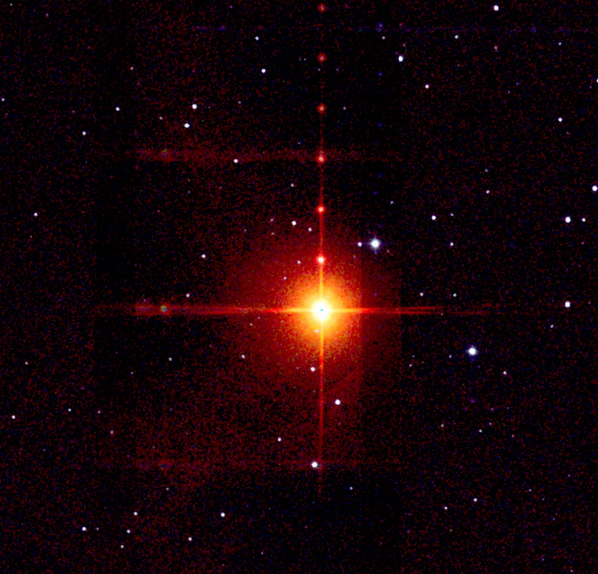
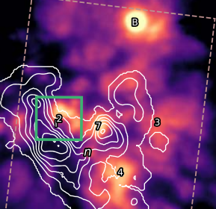
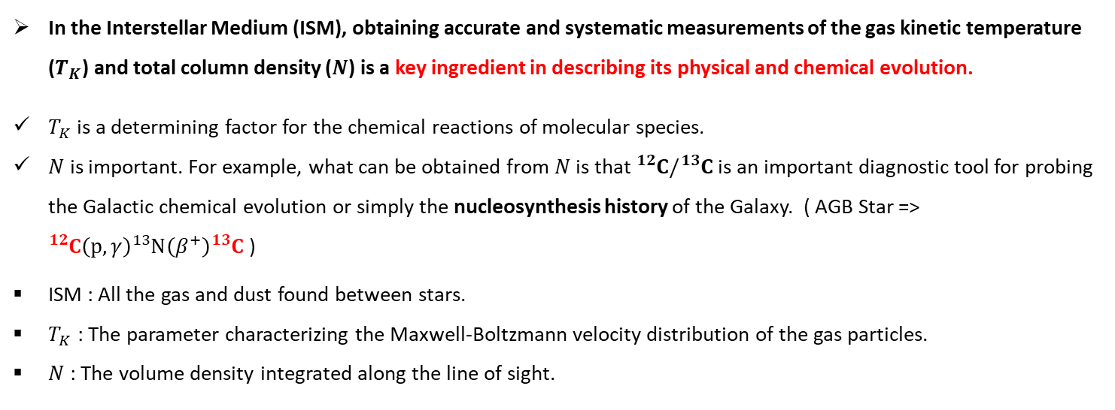
Motivation
In the Interstellar Medium (ISM), obtaining accurate and systematic measurements of the gas kinetic temperature ($T_{K}$) and total column density ($N$) is a key ingredient in describing its physical and chemical evolution.
$T_{K}$is a determining factor for the chemical reactions of molecular species.
$N$ is important. For example, what can be obtained from $N$ is that ${}_{ }^{12}C/{}_{ }^{13}C$ is an important diagnostic tool for probing the Galactic chemical evolution or simply the nucleosynthesis history of the Galaxy. ( AGB Star => ${}_{ }^{12}C\left(p,γ\right){}_{ }^{13}N\left(β^{+}\right){}_{ }^{13}C$ )
ISM : All the gas and dust found between stars.
$T_{K}$ : The parameter characterizing the Maxwell-Boltzmann velocity distribution of the gas particles.
$N$ : The volume density integrated along the line of sight.
Jupiter
(Planet)
Saturn & Titan
(Planet & Satellite)
Hyakutake
(Comet)
IRC +10216
(Carbon star)
Orion IRc2
Pentsak, E. O., Murga, M. S., & Ananikov, V. P. 2024, ACS Earth and SpaceChemistry, 8, 798
Nickerson, Sarah, et al. "The mid-infrared molecular inventory toward orion IRc2." The Astrophysical Journal 945.1 (2023): 26.
https://images.nasa.gov/

Slide 3
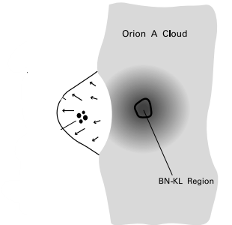
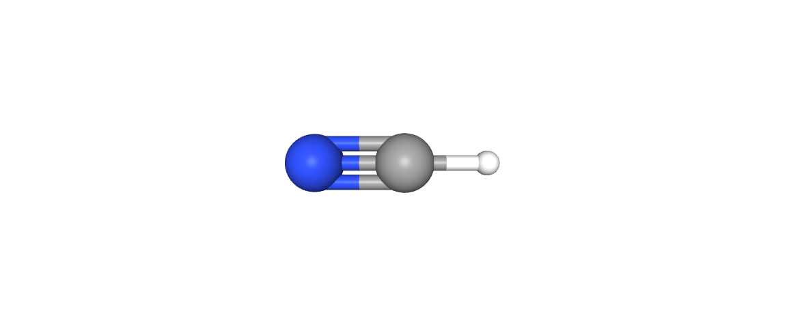
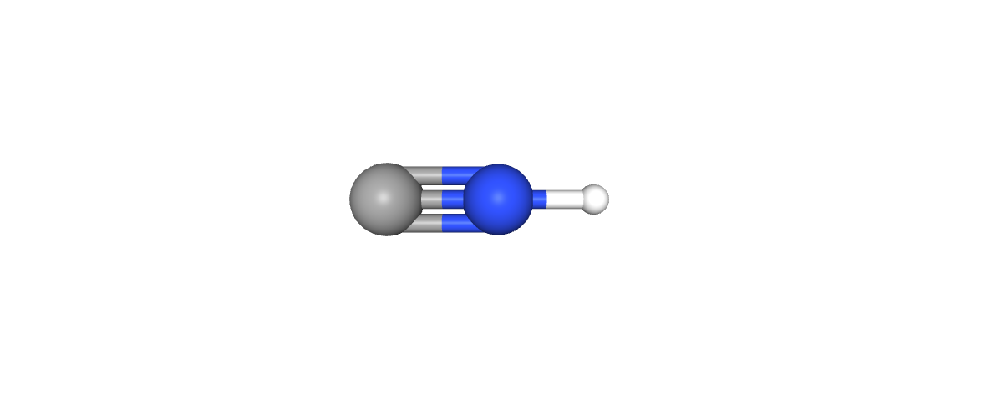
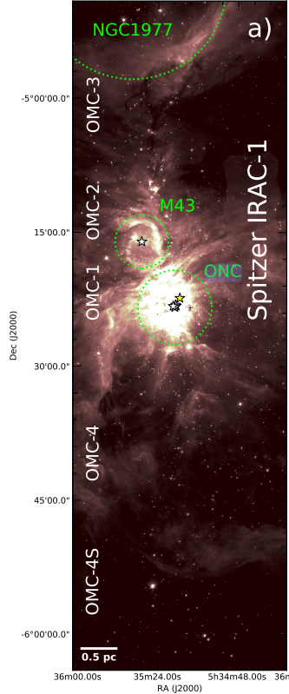
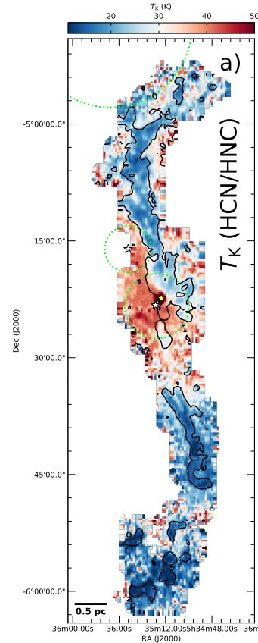
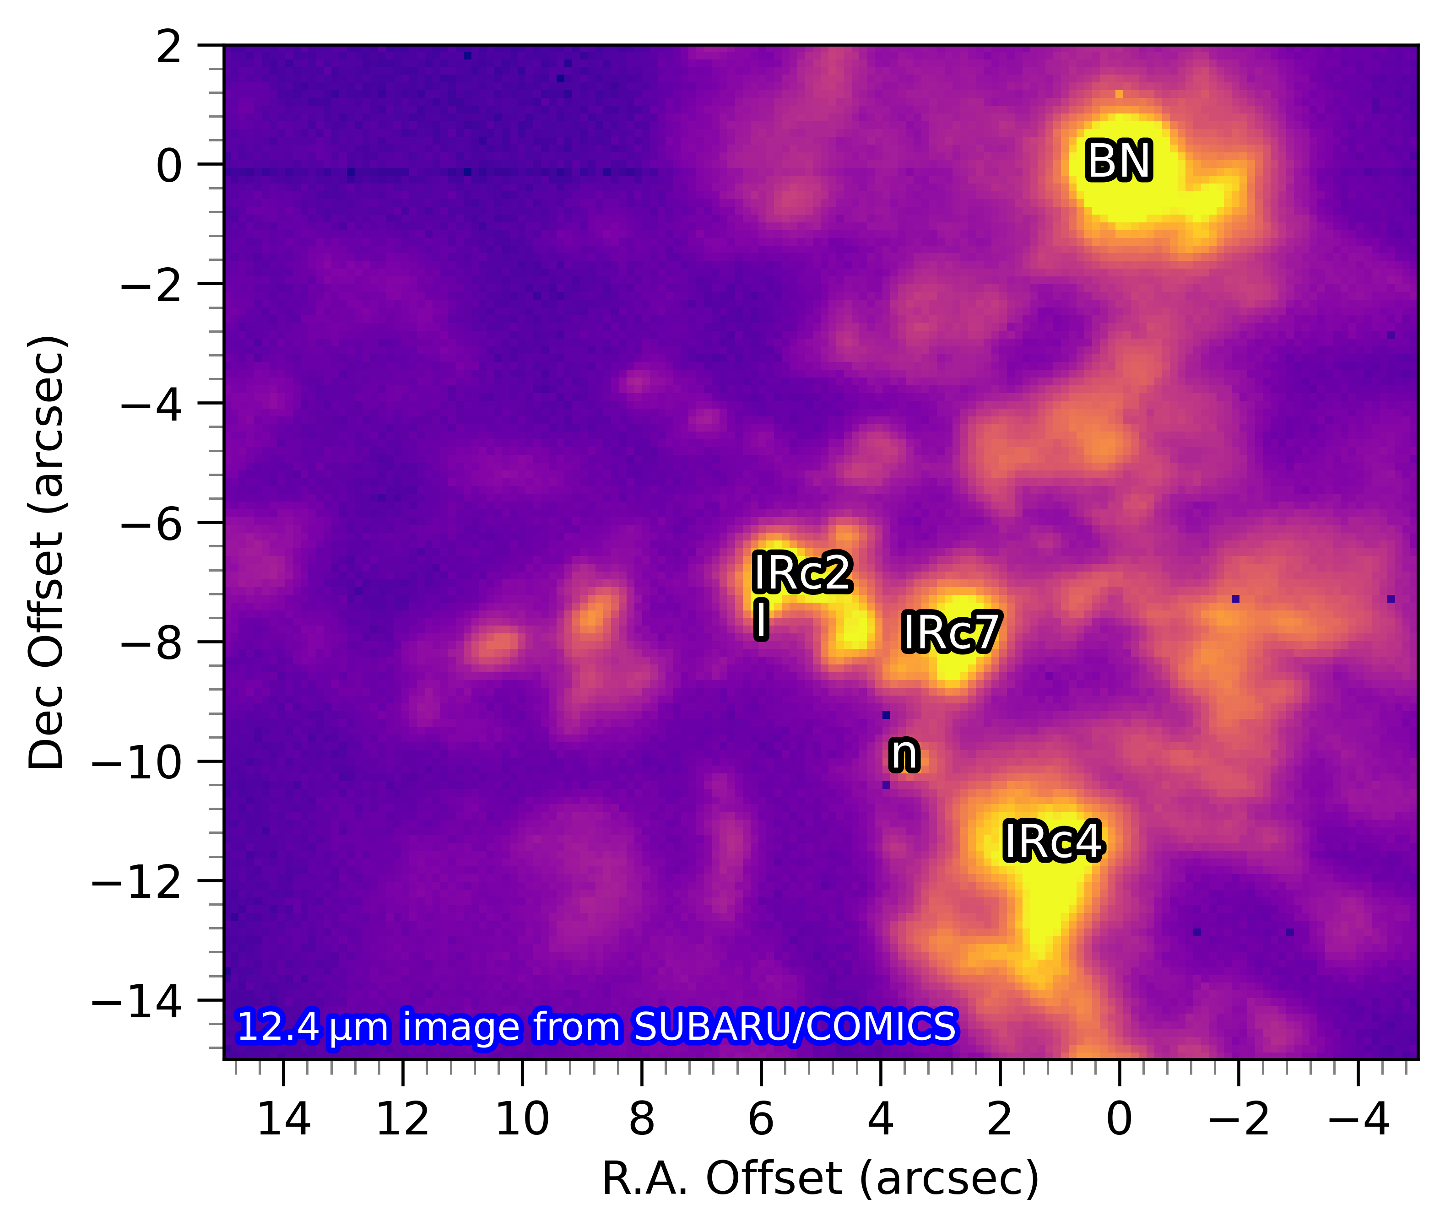
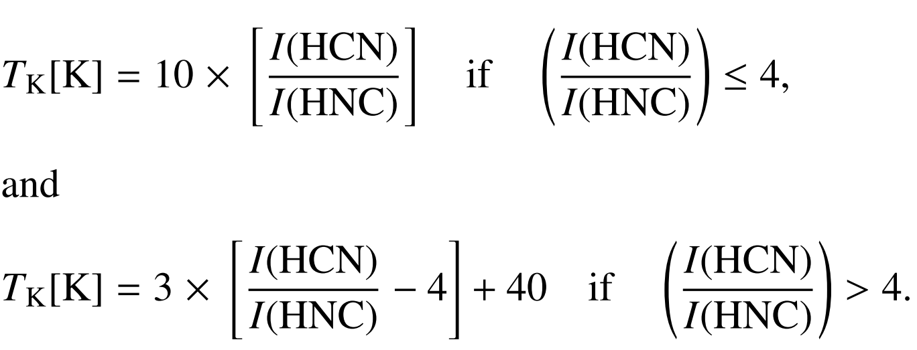
Motivation
HCN: Detected by Snyder & Buhl (1971).
HNC: Identified by Snyder & Buhl (1972),
confirmed by Blackman et al. (1976).
M42
(Orion Nebula)
Chemical thermometer
IRc2 : 100-200K
HCN (J = 1–0) / HNC (J = 1–0)
Orion Nebula Cluster (ONC) : an open cluster of young stars within the Orion Nebula
IRc : InfraRed compact source
Hacar, A., A. D. Bosman, and E. F. Van Dishoeck. "HCN-to-HNC intensity ratio: a new chemical thermometer for the molecular ISM." Astronomy & Astrophysics 635 (2020): A4.
https://pubchem.ncbi.nlm.nih.gov/; https://smoka.nao.ac.jp/

Slide 4
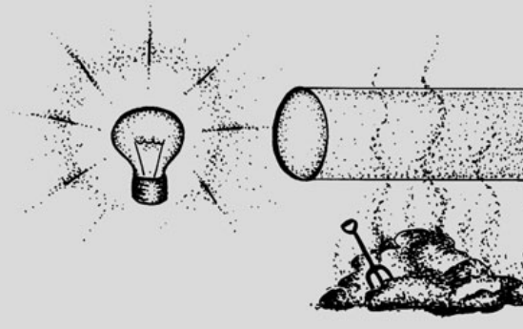
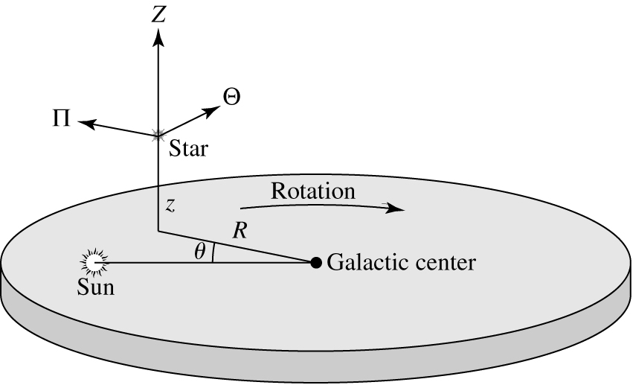
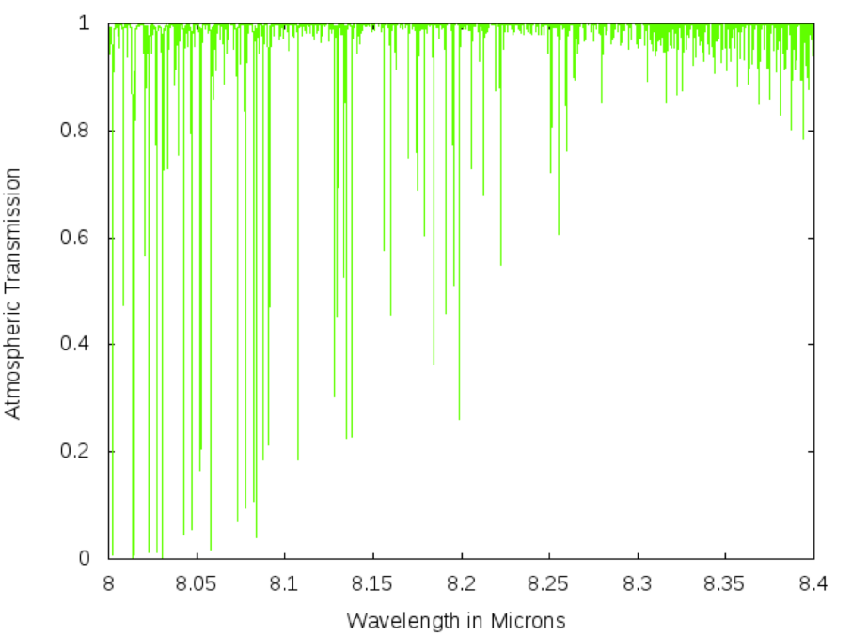
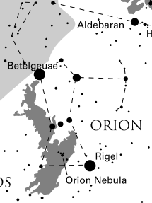
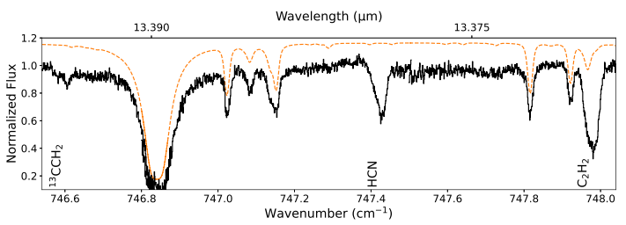
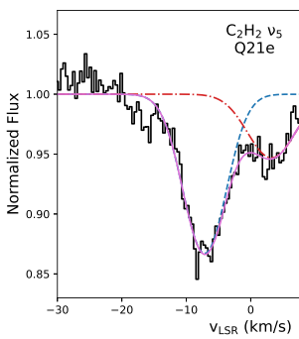
Observation
Absorption spectrum
LSR(Local Standard of Rest)
ATRAN
(Atmospheric TRANsmission model)
IRc2 : The brightest source among the 'IRc' sources in the KL nebula, a region of the Orion Molecular Cloud. (Interesting point : Its nature remains unclear)
Two kinematic components
(About velocities relative to the LSR)
LSR : Local Standard of Rest
Blue Clump (blueshifted)
−7.1 ± 0.7 km/s
Red Clump (redshifted)
+1.4 ± 0.5 km/s
Stahler, S. W., & Palla, F. (2008). The formation of stars. John Wiley & Sons.
Nickerson, Sarah, et al. "The mid-infrared molecular inventory toward orion IRc2." The Astrophysical Journal 945.1 (2023): 26.
https://atran.arc.nasa.gov/cgi-bin/atran/atran.cgi

Slide 5
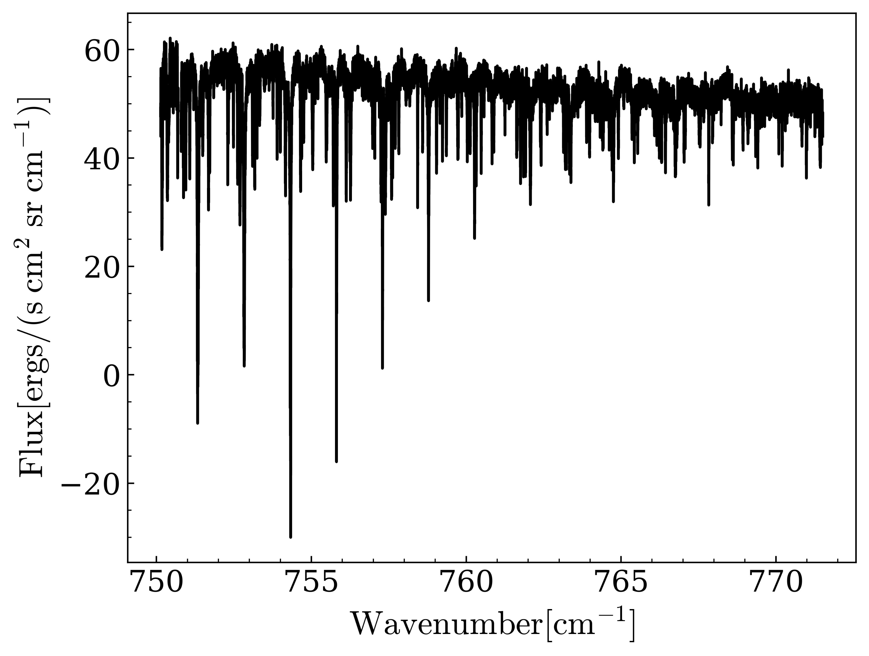
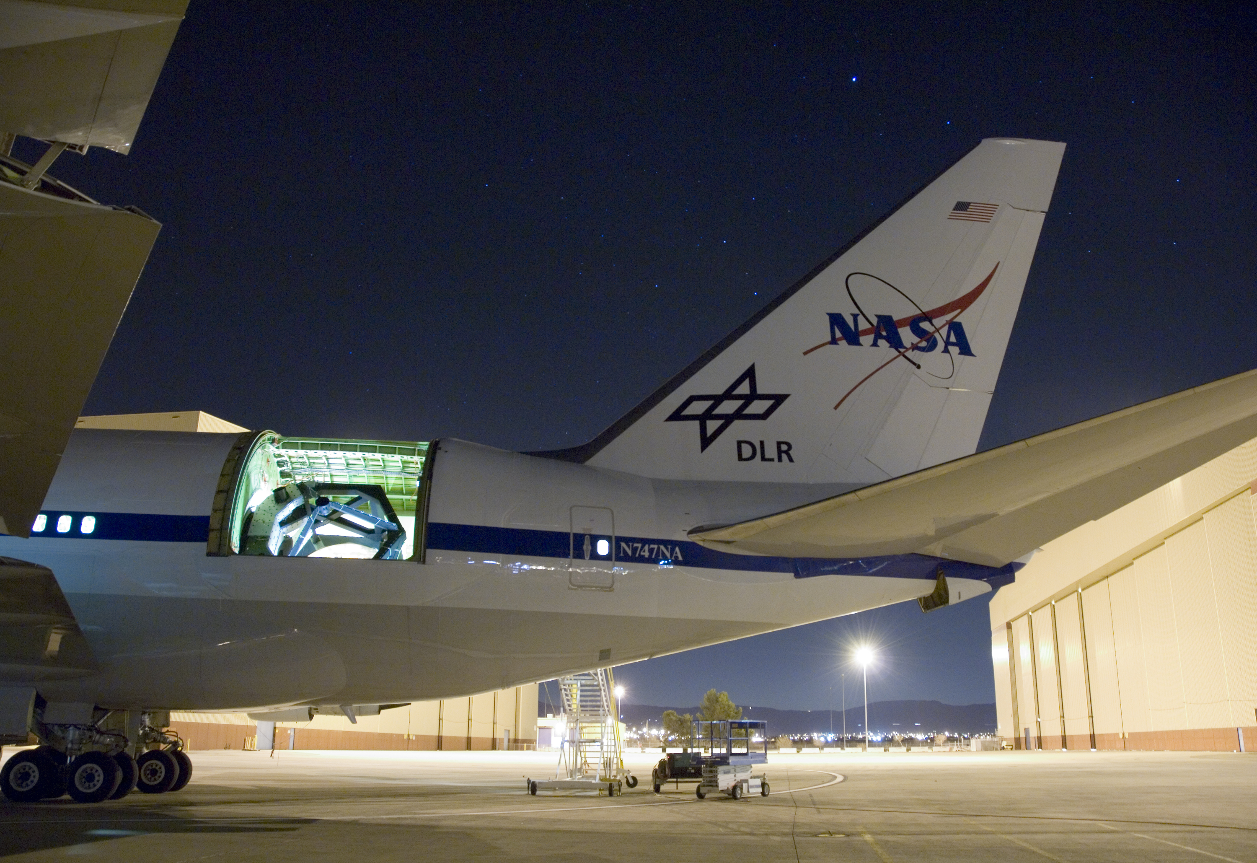
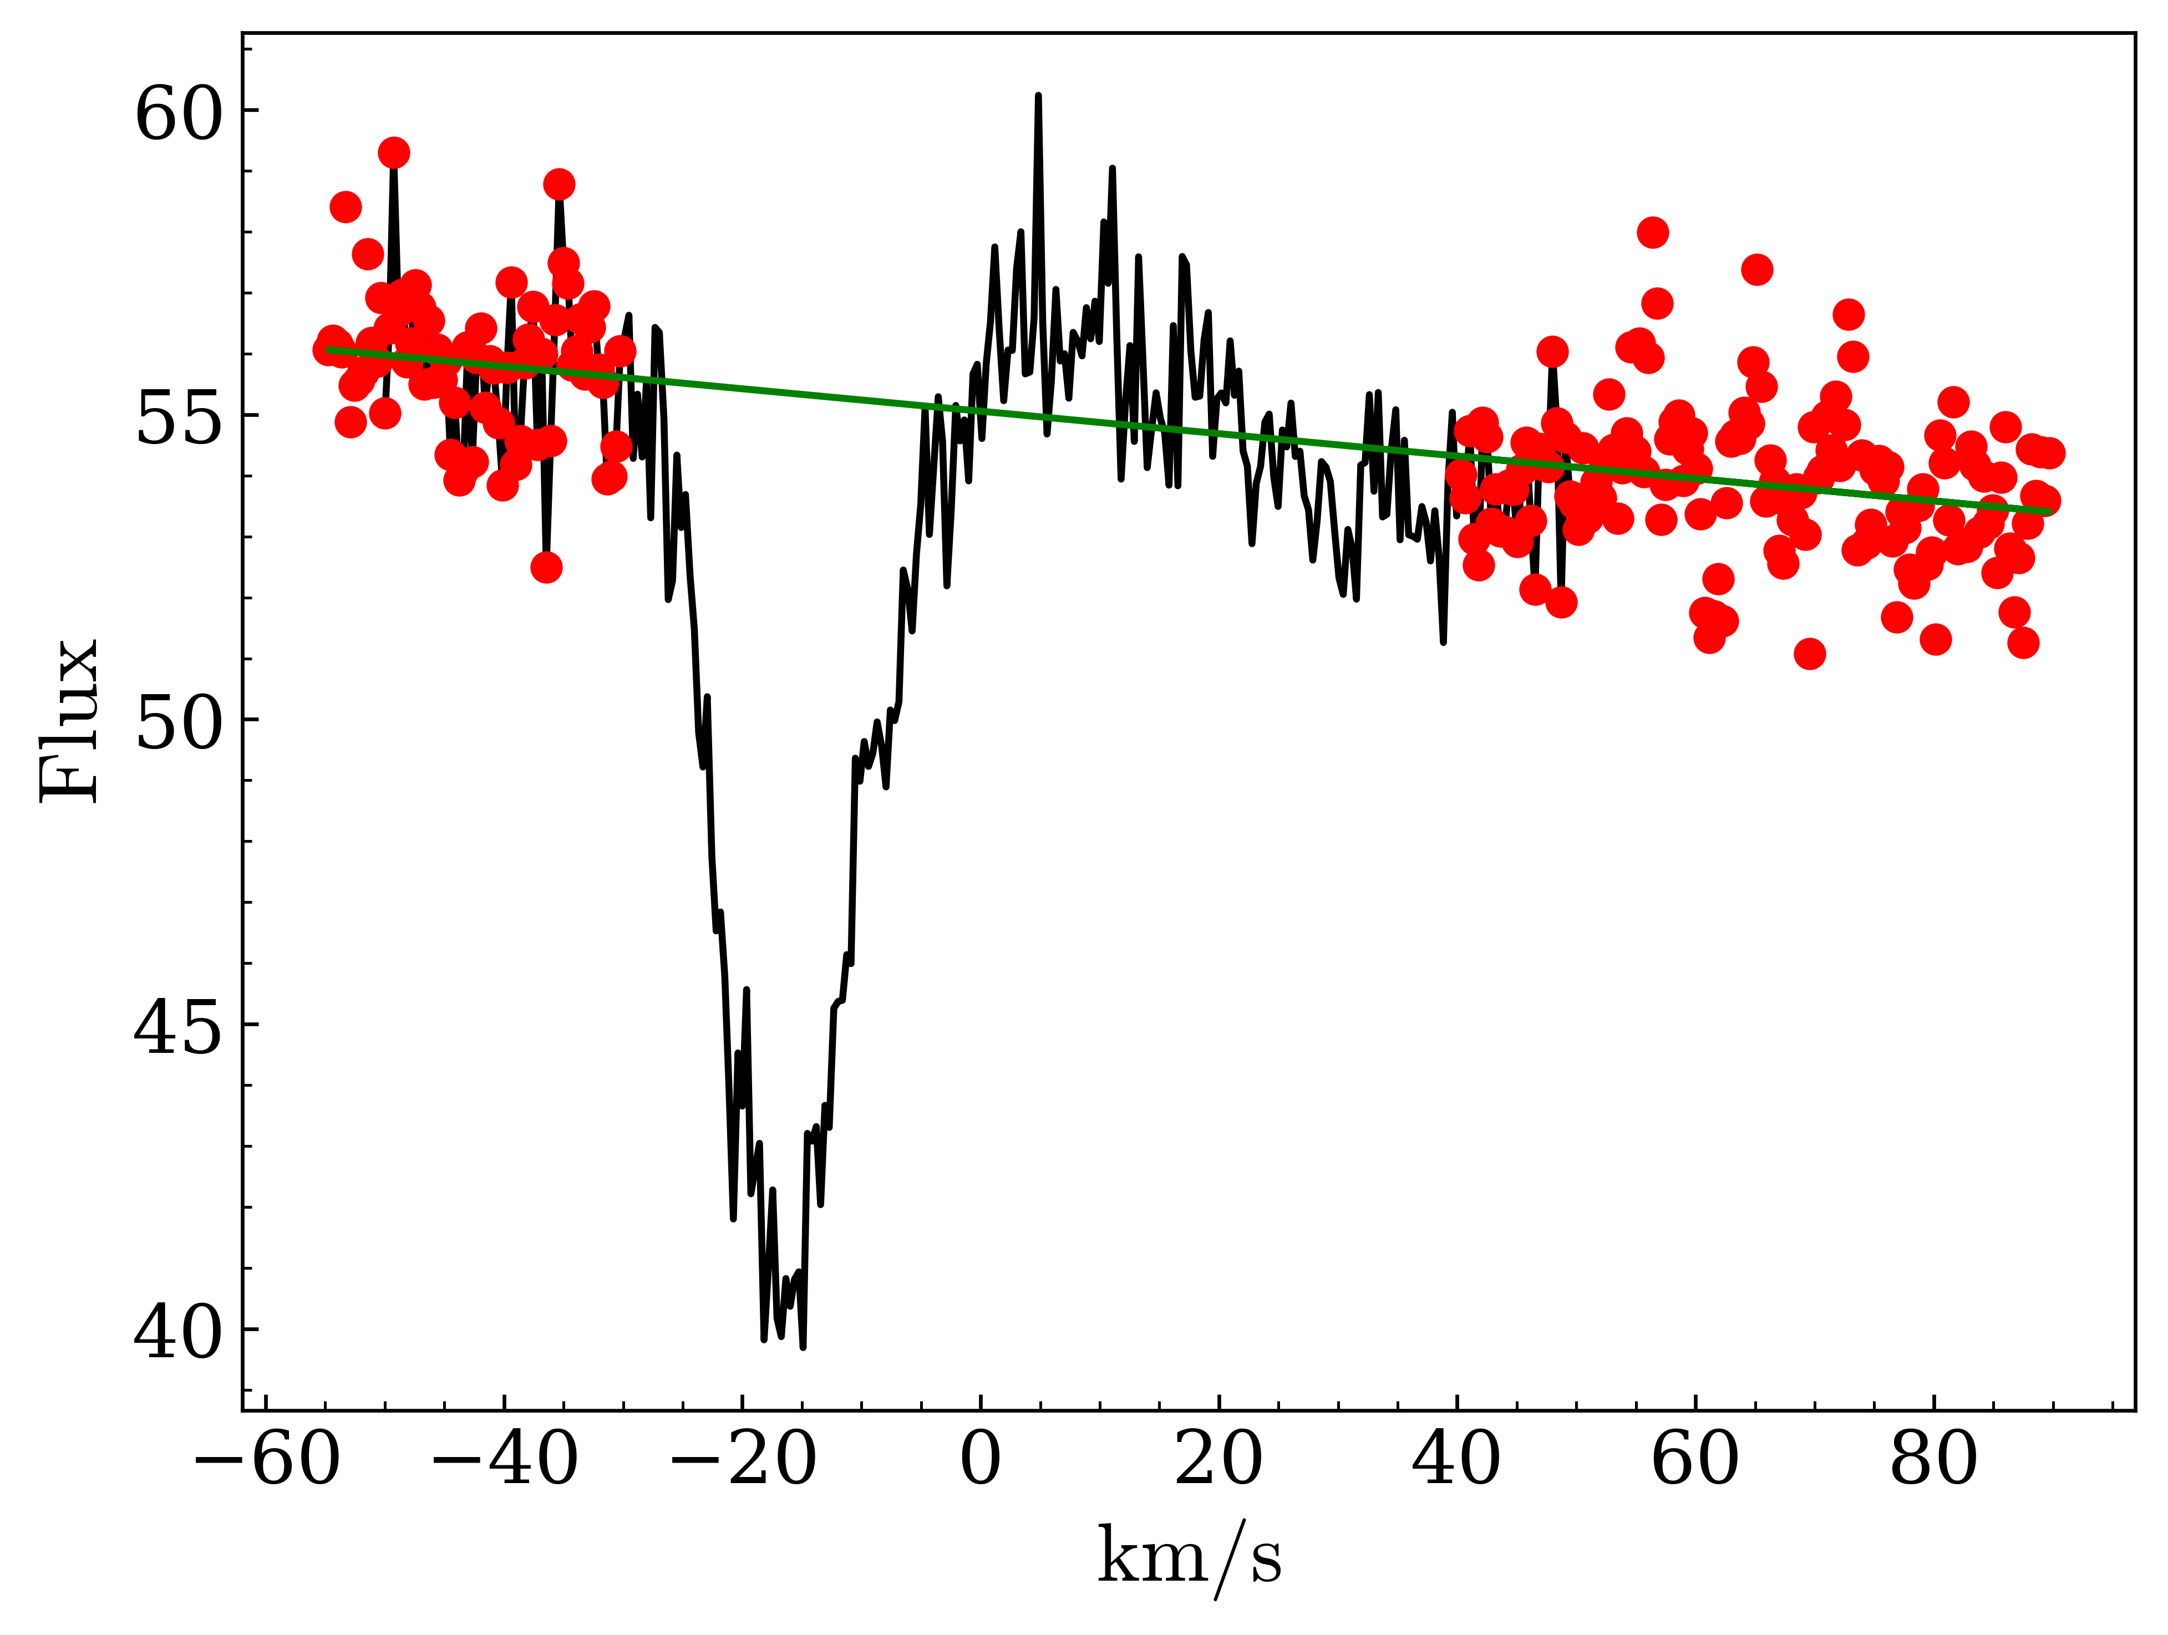
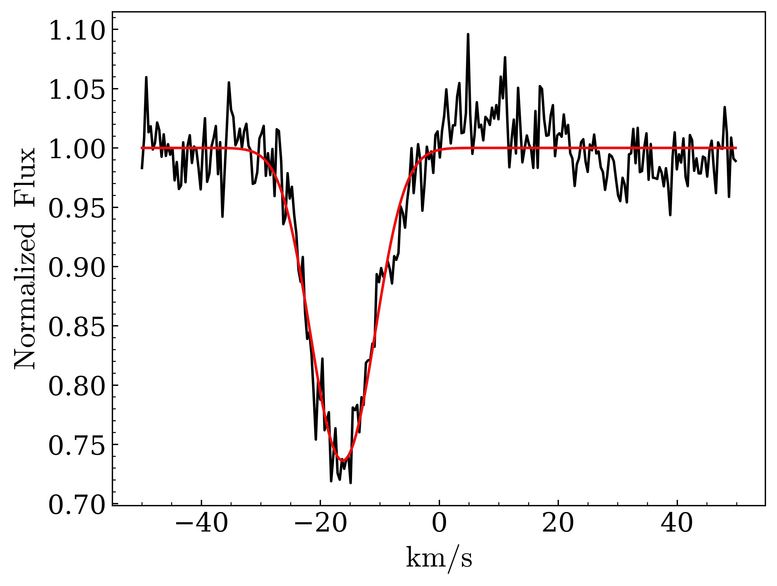
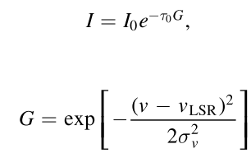
Observation
https://irsa.ipac.caltech.edu

Slide 6
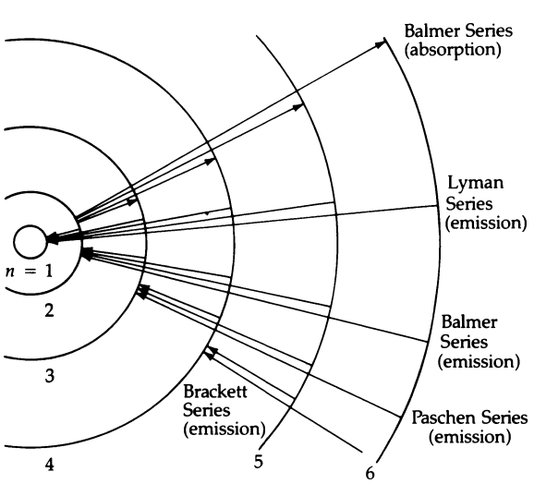
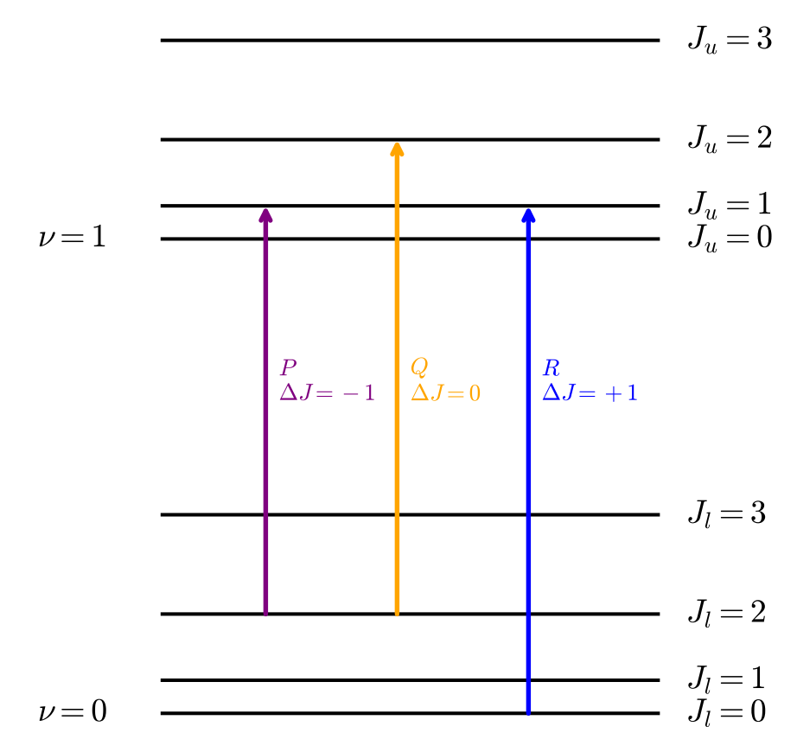
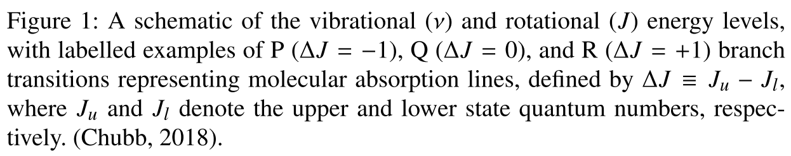
Spectroscopy
Atom
Molecule
The Bohr model for hydrogen. The orbitals are the stable energy levels of the electron, from n = 1 (ground state) and up.
Molecular spectroscopy is fundamentally important to constrain stellar nucleosynthesis and the chemical evolution of galaxies.
Atomic spectroscopy of stellar or interstellar gas does not allow us to discriminate between different isotopic species.
However, isotopic abundances are readily obtained by spectroscopy of molecular isotopologs.
Chubb, Katy L. Rotation-vibration spectra of linear acetylene for characterising astrophysical atmospheres. Diss. UCL (University College London), 2018.
Zeilik, M., & Gregory, S. (1998). Introductory astronomy and astrophysics.
Tang, X. D., et al. "ALMA view of the 12C/13C isotopic ratio in starburst galaxies." Astronomy & Astrophysics 629 (2019): A6.

Slide 7


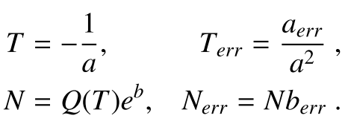
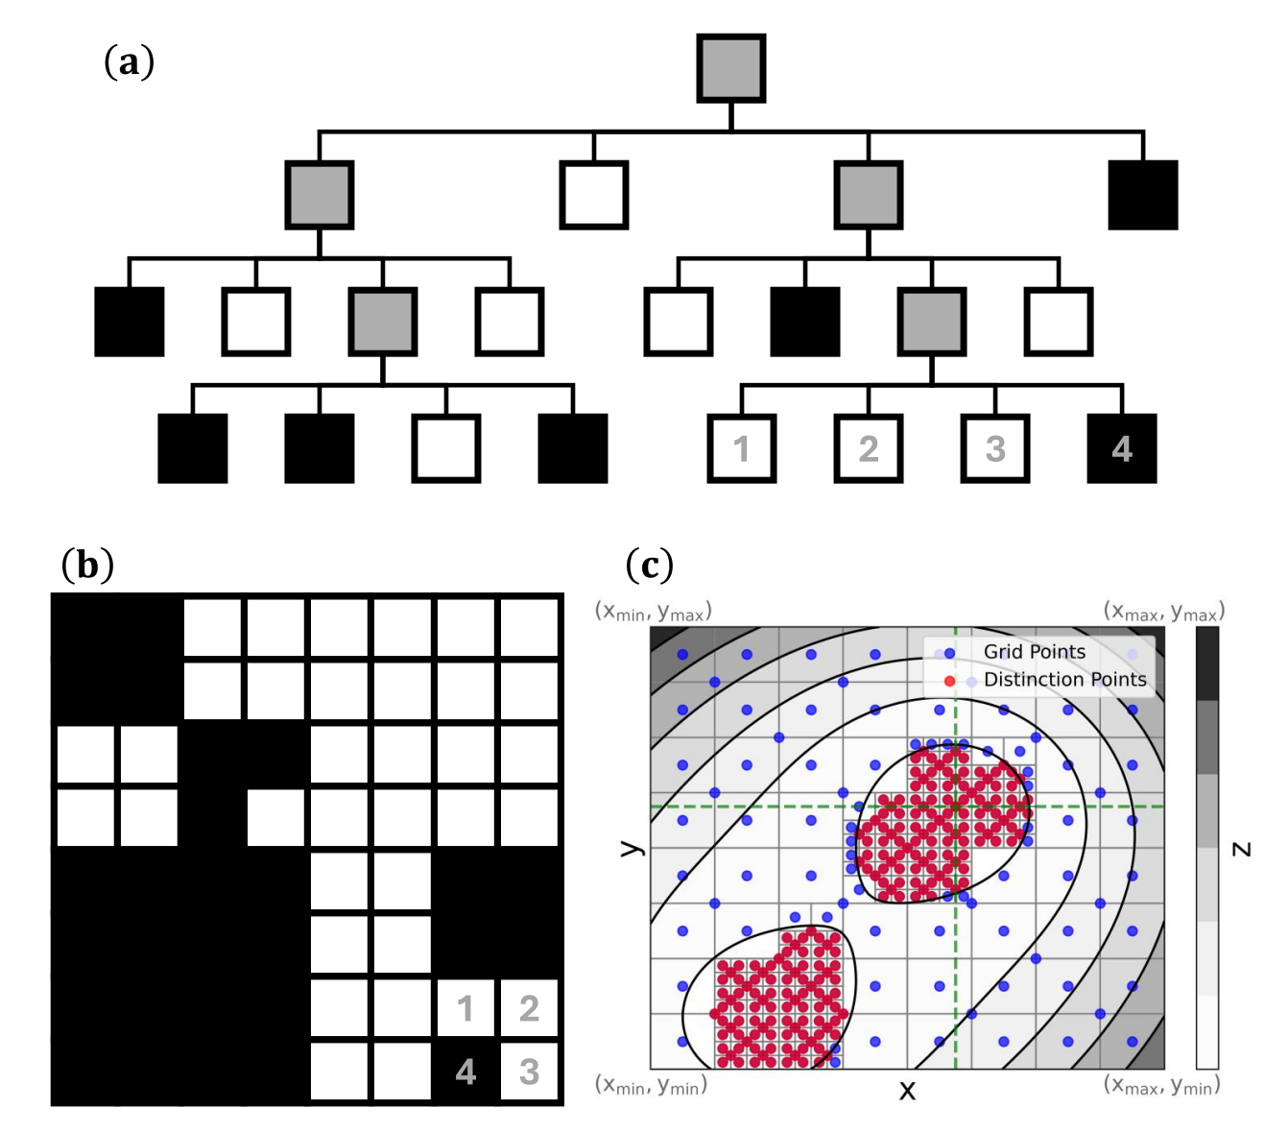
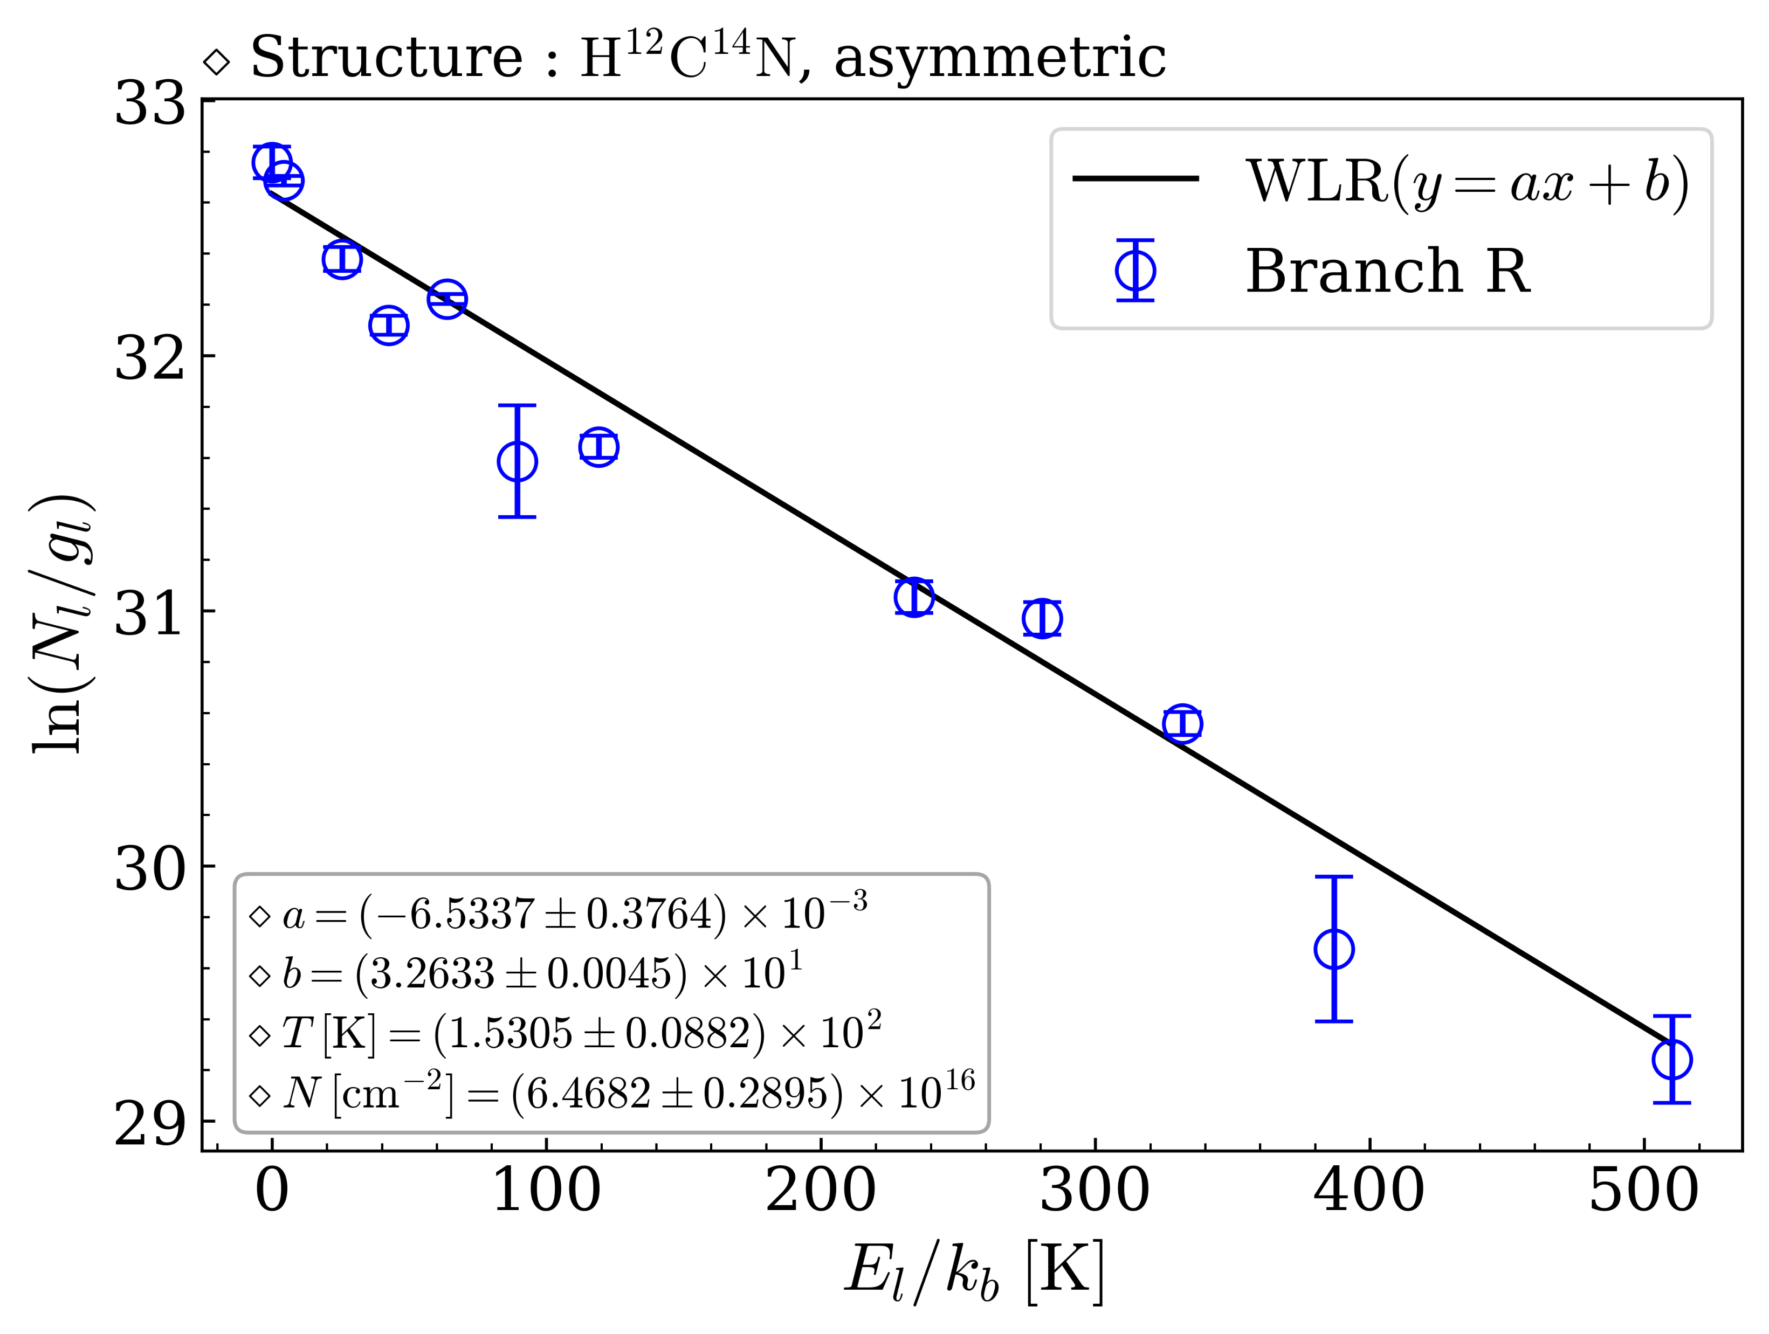


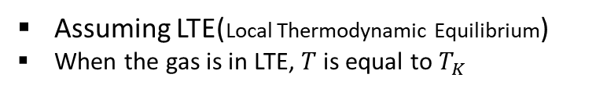
TOPSEGI (Python package)
Rotation Diagram (Traditional)
Quadtree : 2D-optimization algorithm(TOPSEGI)
Assuming LTE(Local Thermodynamic Equilibrium)
When the gas is in LTE, $T$is equal to $T_{K}$
$$\ln{\frac{N_{j}}{g_{j}}}=−\frac{1}{T_{ex}}\frac{E_{l}}{k}+\ln{\frac{N}{Q_{R}\left(T_{ex}\right)}}$$
$$N_{i}^{theo}=N_{i}^{theo}\left(N,T\right)$$
Goldsmith, P. F., & Langer, W. D. 1999, The AstrophysicalJournal, 517, 209
Nickerson, Sarah, et al. "The mid-infrared molecular inventory toward orion IRc2." The Astrophysical Journal 945.1 (2023): 26.

Slide 8


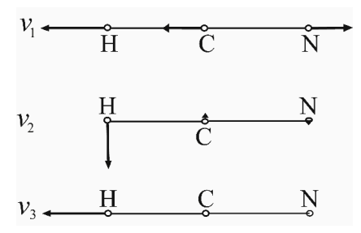
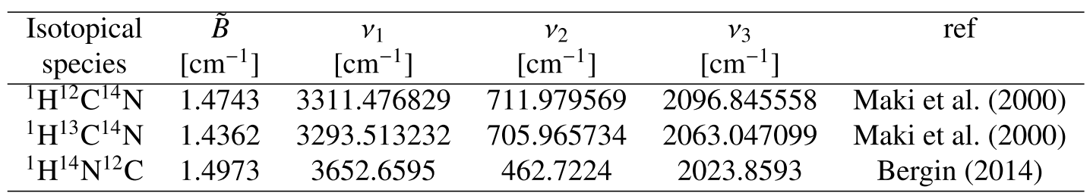
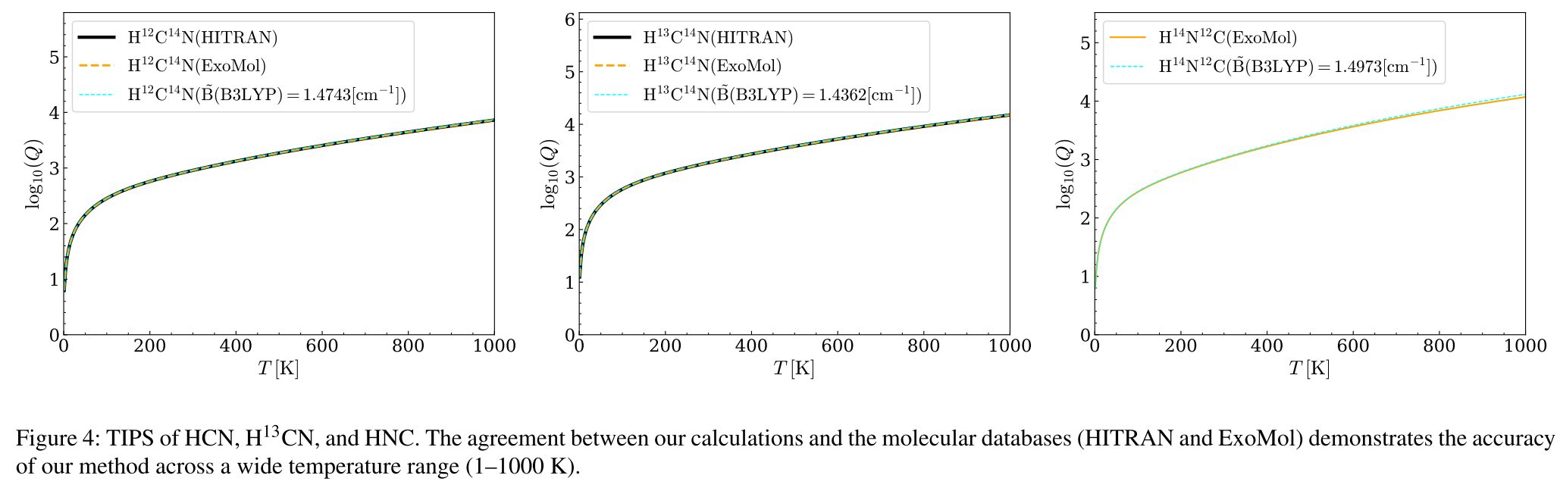



Molecular databases
high-resolution transmission molecular absorption database.
$HCN$
$H{}_{ }^{13}CN$
$HNC$
McQuarrie, D. A. (2008). Quantum chemistry. University Science Books.
Atkins, P. W., De Paula, J., & Keeler, J. (2023). Atkins' physical chemistry. Oxford university press.
Herman, Michel. "The acetylene ground state saga." Molecular Physics 105.17-18 (2007): 2217-2241.

Slide 9
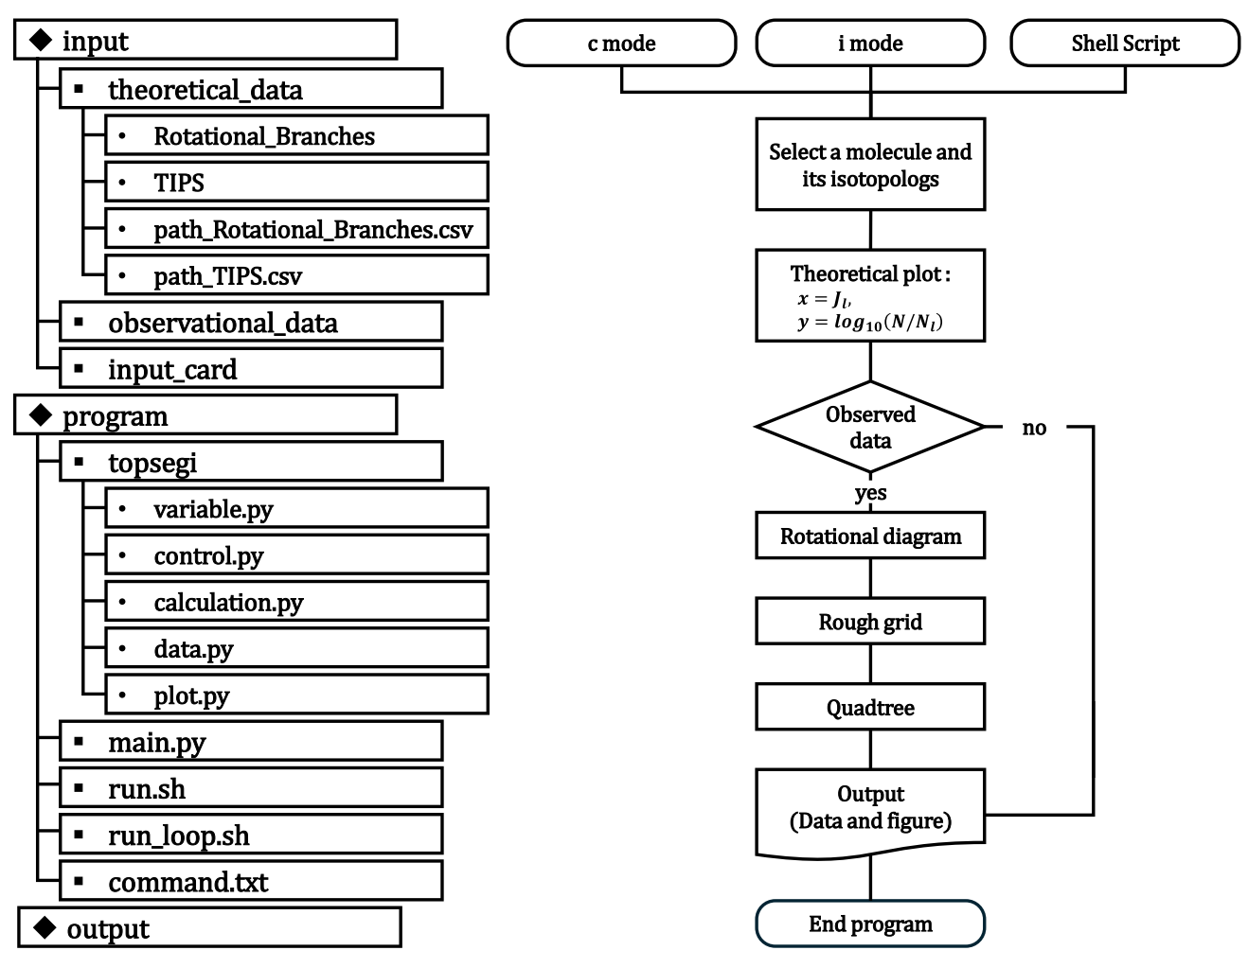
TOPSEGI (Python package)

Slide 10
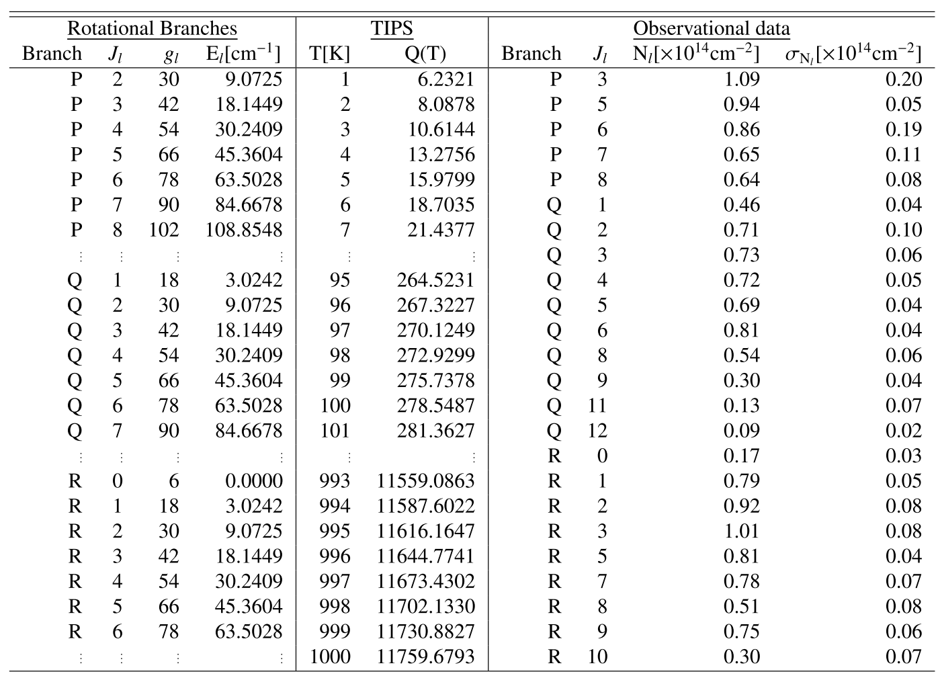
TOPSEGI (Python package)

Slide 11
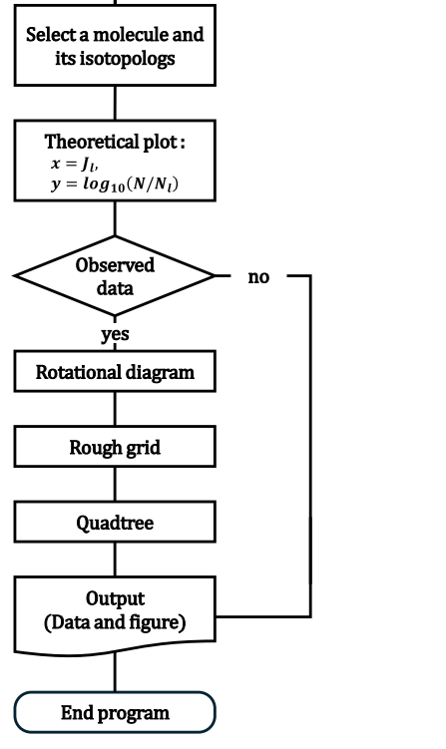
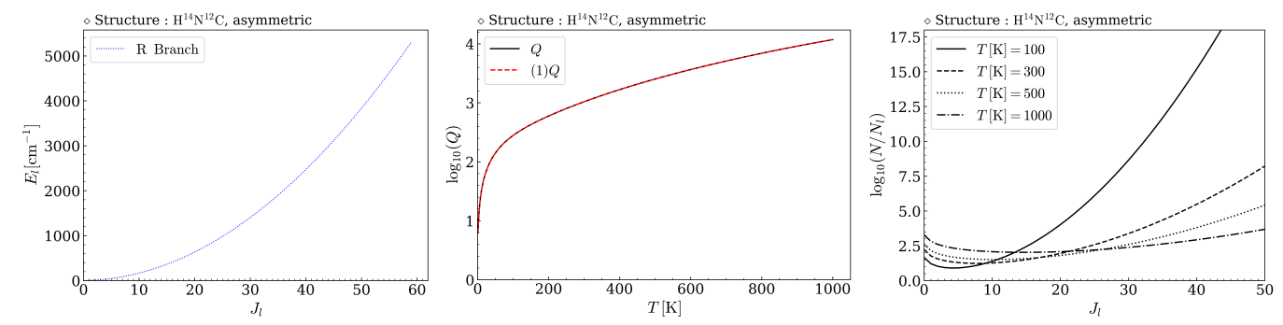
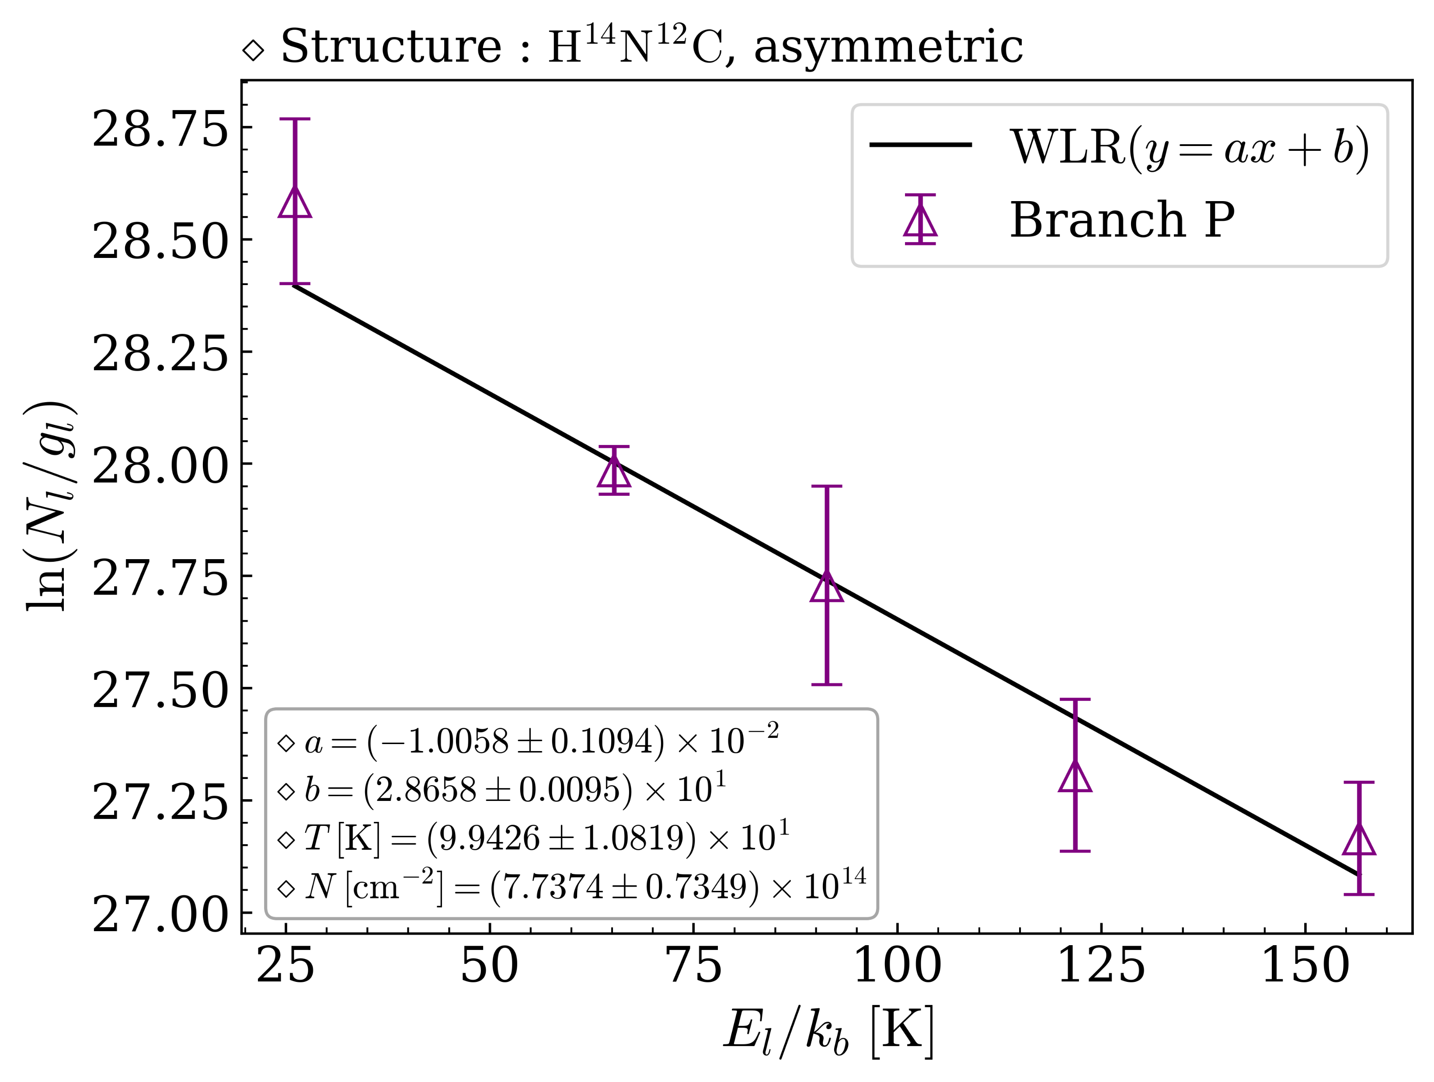
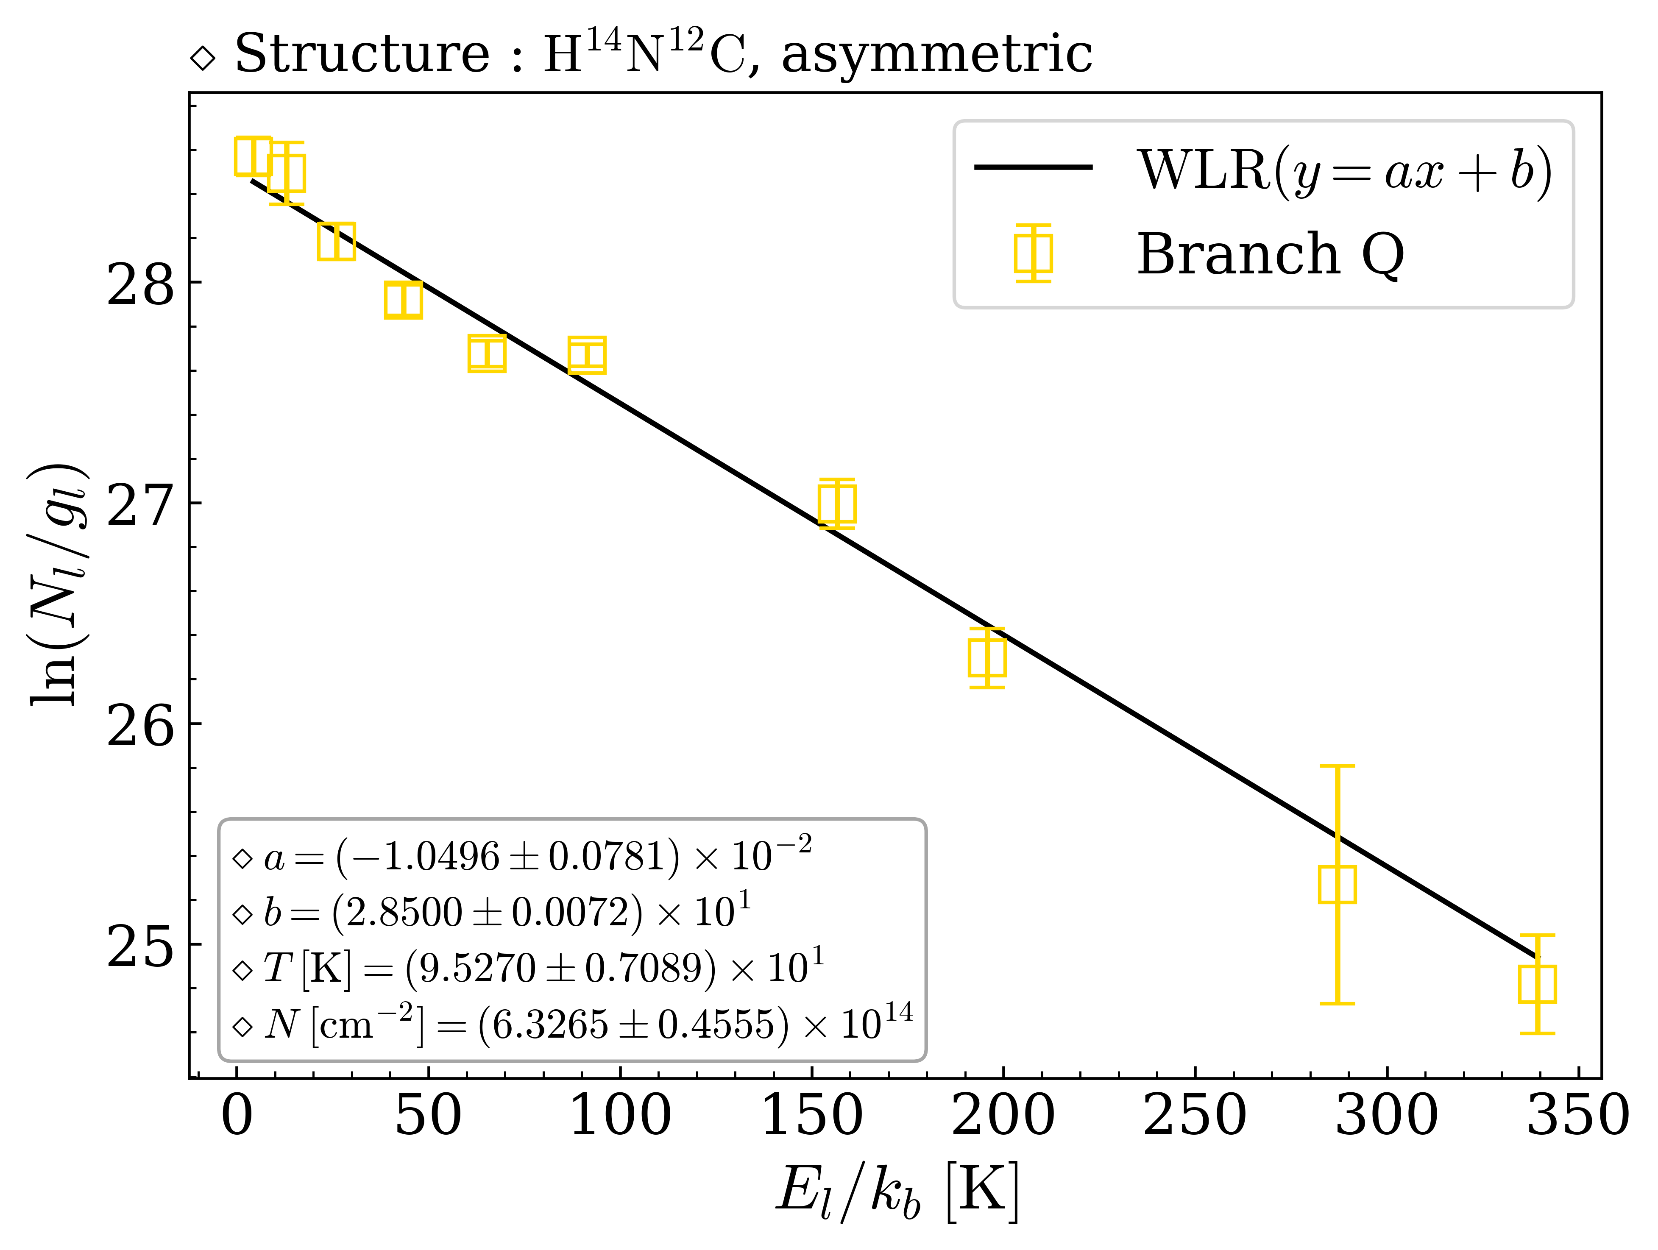
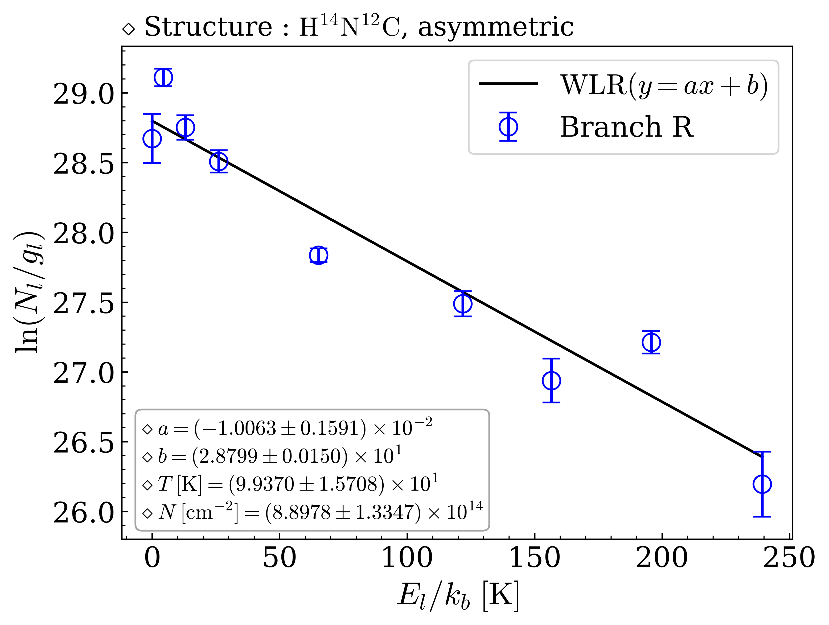
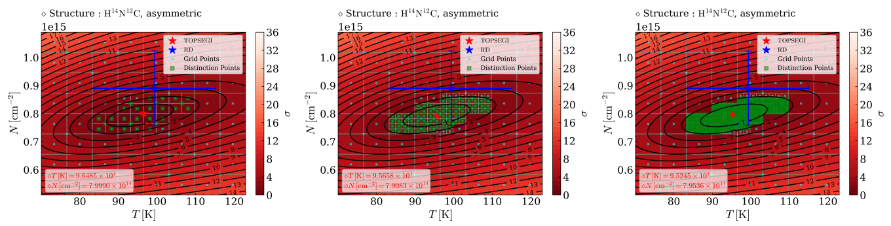
TOPSEGI (Python package)

Slide 12
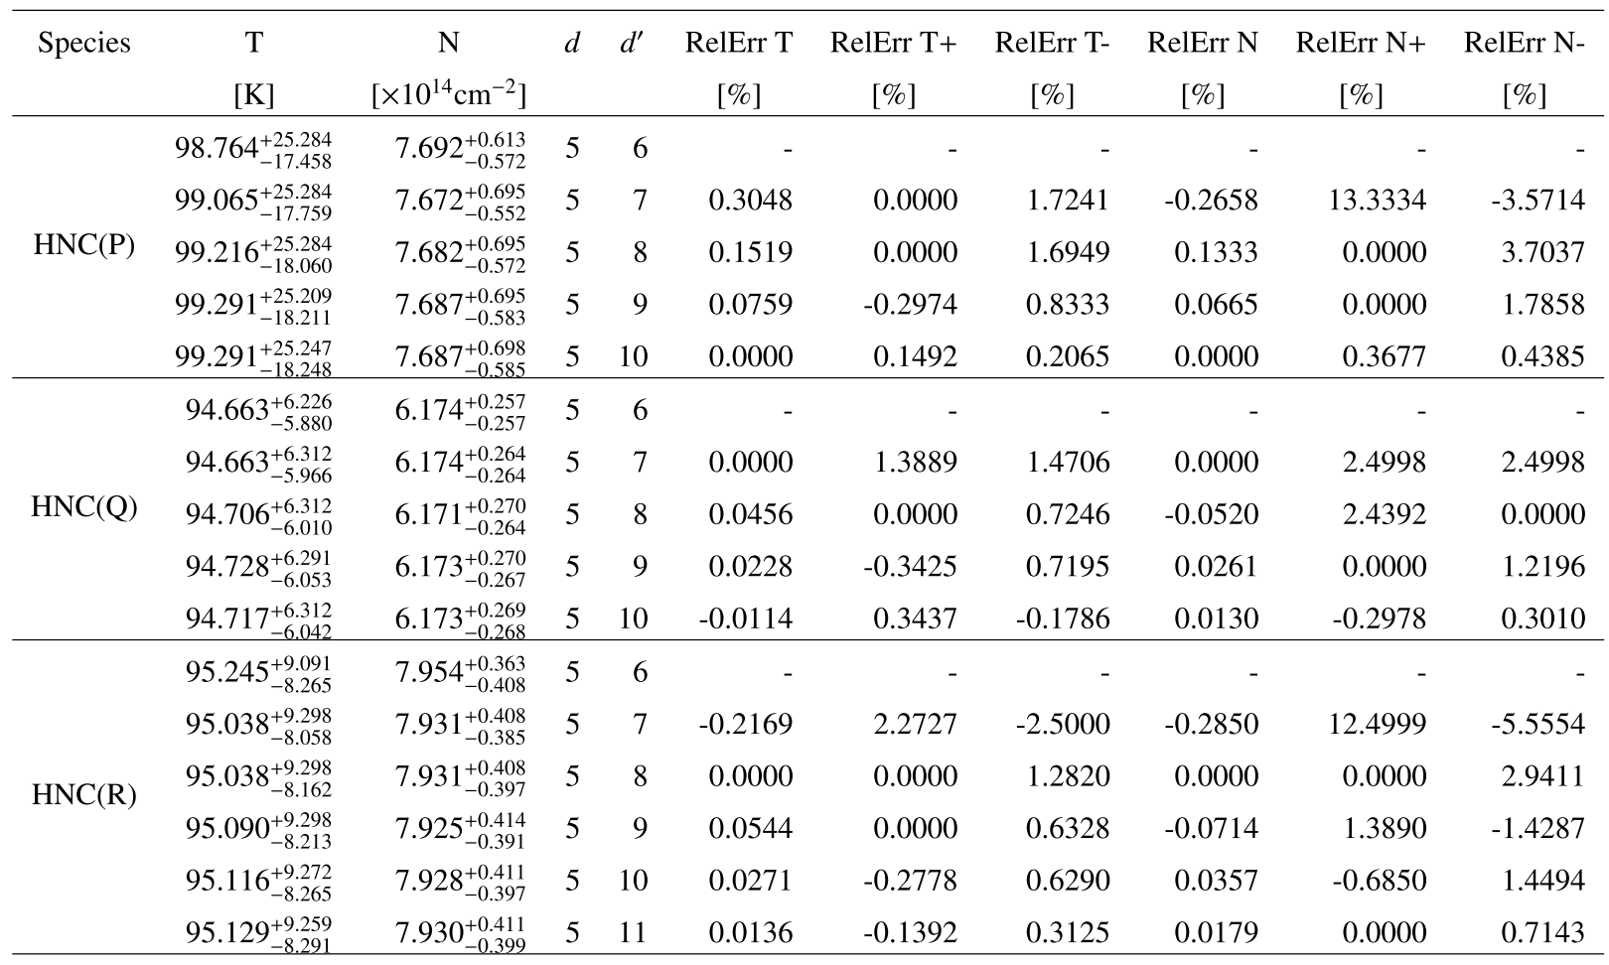
TOPSEGI (Python package)

Slide 13
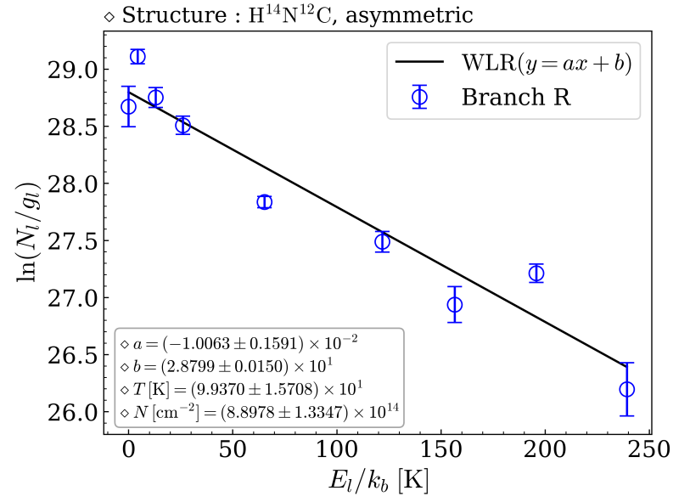
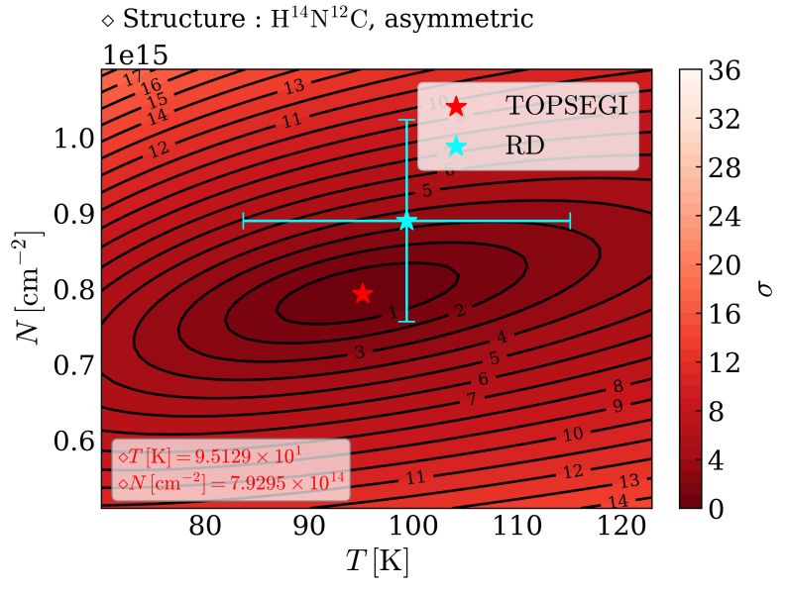
TOPSEGI (Python package)

Slide 14
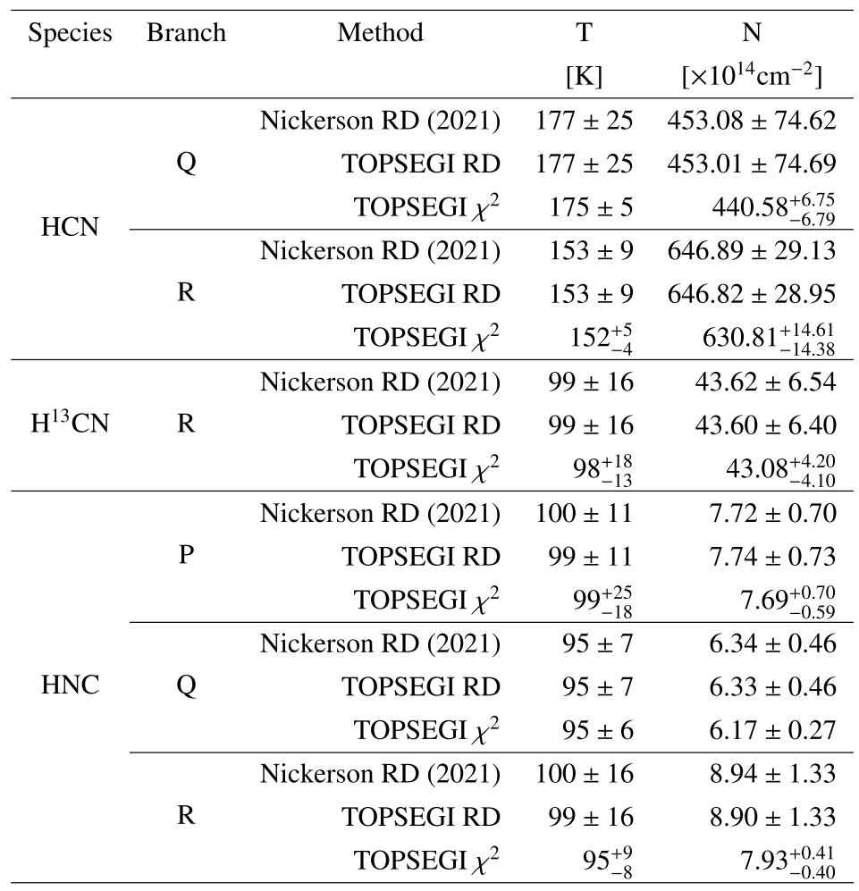
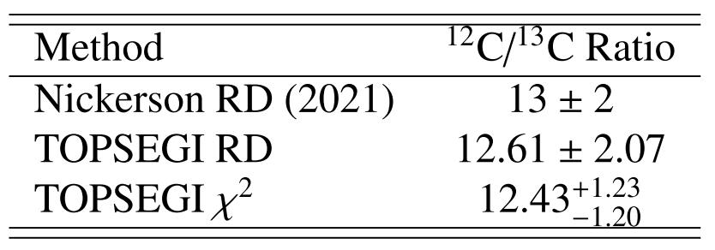
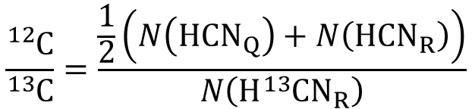
Result
$$\frac{{}_{ }^{12}C}{{}_{ }^{13}C}=\frac{\frac{1}{2}\left(N\left(HCN_{Q}\right)+N\left(HCN_{R}\right)\right)}{N\left(H{}_{ }^{13}CN_{R}\right)}$$
Nickerson, Sarah, et al. "The first mid-infrared detection of HNC in the interstellar medium: Probing the extreme environment toward the orion hot core." The Astrophysical Journal 907.1 (2021): 51.

Slide 15
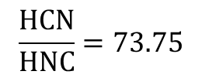
Result
TOPSEGI
$$\frac{HCN}{HNC}=73.75$$
Nickerson, Sarah, et al. "The first mid-infrared detection of HNC in the interstellar medium: Probing the extreme environment toward the orion hot core." The Astrophysical Journal 907.1 (2021): 51.

Slide 16

Result
Nickerson, Sarah, et al. "The first mid-infrared detection of HNC in the interstellar medium: Probing the extreme environment toward the orion hot core." The Astrophysical Journal 907.1 (2021): 51.
Herbst, E., Terzieva, R., & Talbi, D. (2000). Calculations on the rates, mechanisms, and interstellar importance of the reactions between C and NH2 and between N and CH2. Monthly Notices of The Royal Astronomical Society, 311(4), 869-876.

Slide 17

Future work
By 2021, 241 molecules (from 19 elements) were detected in the interstellar and circumstellar medium by astronomical observations.
HCN: Detected by Snyder & Buhl (1971).
HNC: Identified by Snyder & Buhl (1972),
confirmed by Blackman et al. (1976).
$C_{2}H_{2}$: Detected by Ridgway et al (1976).
McGuire, B. A. (2022). 2021 census of interstellar, circumstellar, extragalactic, protoplanetary disk, and exoplanetary molecules. The Astrophysical Journal Supplement Series, 259(2), 30.

Slide 18



Future work
McGuire, B. A. (2022). 2021 census of interstellar, circumstellar, extragalactic, protoplanetary disk, and exoplanetary molecules. The Astrophysical Journal Supplement Series, 259(2), 30.

Slide 19

Summary
We have presented a precision analysis of the ${}_{ }^{12}C/{}_{ }^{13}C$ isotopic ratio in the Orion IRc2 using high-resolution mid-infrared ro-vibrational spectra of $HCN, H{}_{ }^{13}CN and HNC$.
Excitation temperatures and total column densities were derived using two complementary methods: the conventional RD technique and a two-dimensional $χ^{2}$ minimization approach.
The final isotopic ratio from the $χ^{2}$ analysis was ${12.43}_{−1.20}^{+1.23}$, compared to $12.61±2.07$ from the RD method.
The uncertainty was reduced by approximately 42%, confirming the robustness of the statistical approach.
This study focused on Orion IRc2, the methodology could be readily applied to other environments such as planets, carbon star and ISM.
Future work
we plan to expand the study to other molecules and their isotopologs in space.

Slide 20
Thank you for your attention

