Slide 1
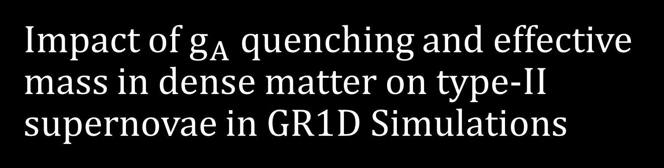
Impact of $g_{A}$ quenching and effective mass in dense matter on type-II supernovae in GR1D Simulations
YoungSo Choi
(OMEG Institute and Department of Physics, Soongsil University)
In collaboration with
Dukjae Jang^{(a),} and Myung-Ki Cheoun^{(a)}
^{(a)} OMEG Institute and Department of Phhysics, Soongsil University
Notes:
46초

Slide 2
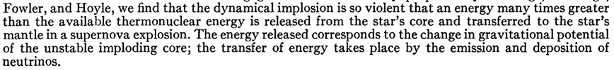
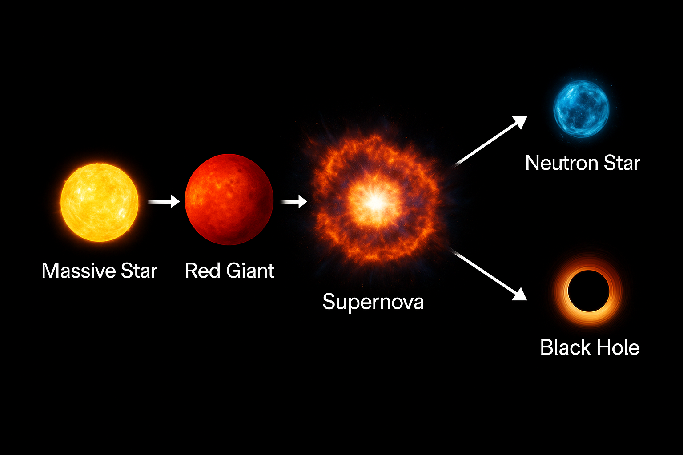
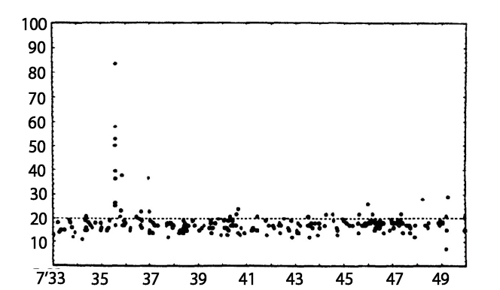
Supernovae and neutrino
Before SN1987A, scientists expected that neutrino account for almost 99% of supernova energy,
From SN1987A, supernovae neutrino detected by Kamiokande-II.
But still Core collapse supernovae(CCSN) neutrino data is not enough…
Colgate, Stirling A., and Richard H. White. No. UCRL-7777. Lawrence Radiation Lab., Univ. of California, Livermore, 1964.
Neutrino events observed in
Kamiokande detectors from SN1987A
Notes:
minute/number
Supernovae is the stage of massive star evolution, and provide evidence for the formation of heavy nuclei.
Photon의 cross section은 klein nishina-tamm fomular?
2분
Neutrino was expected that play in import roles in supernovae mechanism, but it is not detected until Supernovae 1987A .
Neutrino detected at 1987A, So we know that studying supernovae neutrino is essential for understanding the core-collapse supernovae.
Still Core collapse supernovae(CCSN) neutrino data is not enough.
When neutrinos from other CCSN are observed, they can be compared with the already simulated neutrino data.

Slide 3
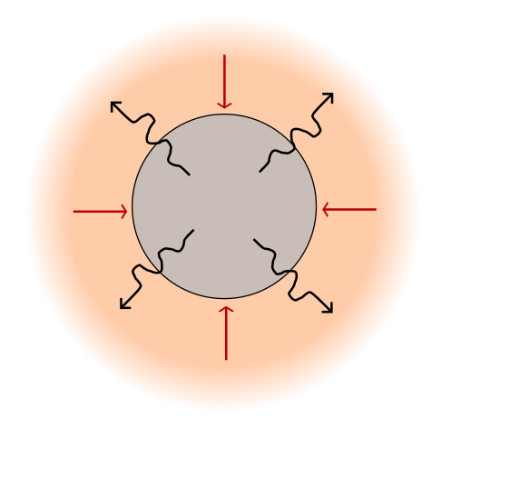
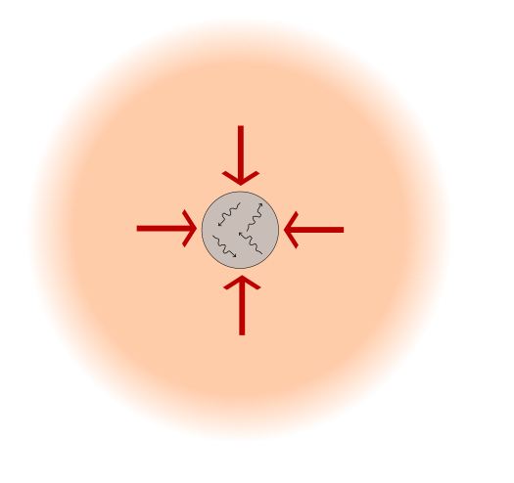
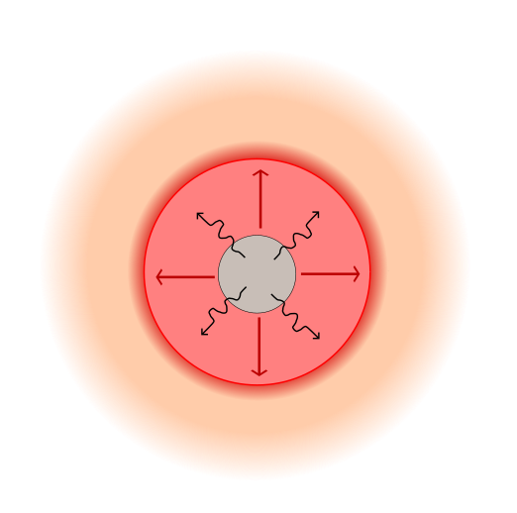
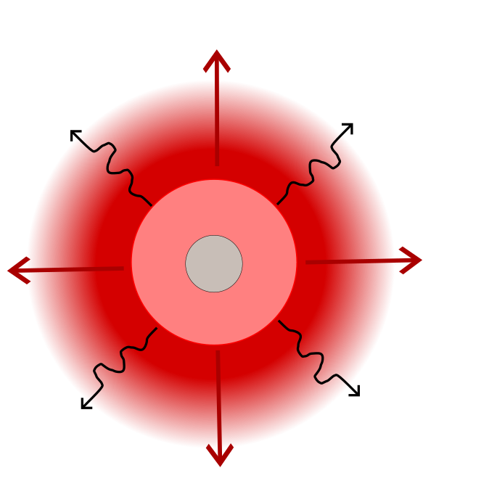
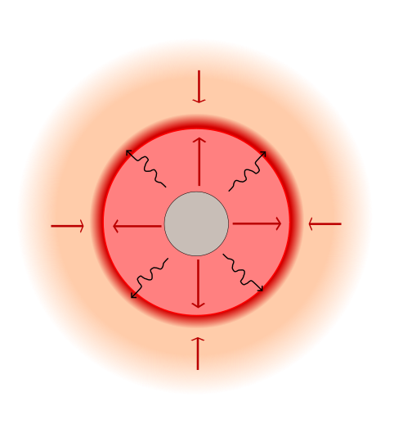











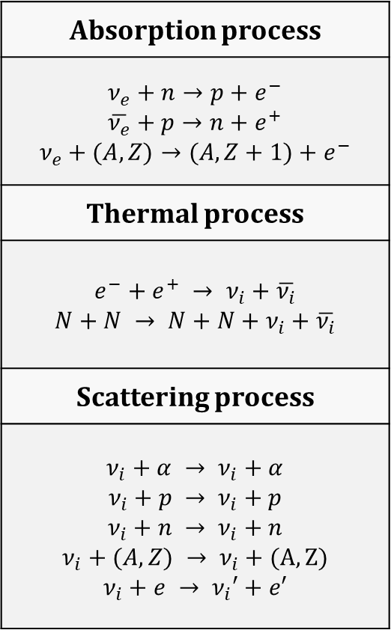



Evolution of type-II Supernovae
Gravity
1. Core collapse
and electron capture
2. Electron trapping
and compression until $n_{s}$
3. Bounce+Neutrino escape
(0ms~)
Absorption process
$$ν_{e}+n→p+e^{−}$$ $$\overline{ν_{e}}+p→n+e^{+}$$ $$ν_{e}+(A,Z)→(A,Z+1)+e^{−}$$
Thermal process
$$e^{−}+e^{+} → ν_{i}+\overline{ν_{i}}$$ $$N+N → N+N+ν_{i}+\overline{ν_{i}}$$
Scattering process
$$ν_{i}+α → ν_{i}+α$$ $$ν_{i}+p → ν_{i}+p$$ $$ν_{i}+n → ν_{i}+n$$ $$ν_{i}+(A,Z) → ν_{i}+(A,Z)$$ $$ν_{i}+e → ν_{i}′+e′$$
$ν_{e}$
$ν_{e}$
Fe core
$ν_{e}$
Neutron core
$ν_{e}$
$ν_{i}$
$ν_{i}$
5. Supernovae
(50ms ~)
4. Thermal neutrino process
and neutrino heating
(3ms ~)
6. Net Neutrino cooling
(150ms ~)
Accretion Front
$ν_{i}$
$ν_{i}$
$ν_{i}$
$ν_{i}$
Neutron star
$ν_{i}$
$ν_{i}$
Notes:
I will explain supernovae’s mechasim by 6 step simply.
When massive star create stable iron core, radiation pressure became weak, so starting core collapse.’
Neutronization burst
During core collapse, electron capture happening, and some neutrino are trapping in Fe to Neutron core.
When Neutron core reach at degeneracy pressure, the shortwave propagate to outside, called bounce.
After shockwave propagate, thermal neutrino process happen at high energy region, and neutrino give energy at that high energy region, called neutrino heating.
When Enough energy is stored, then supernovae.

Slide 4
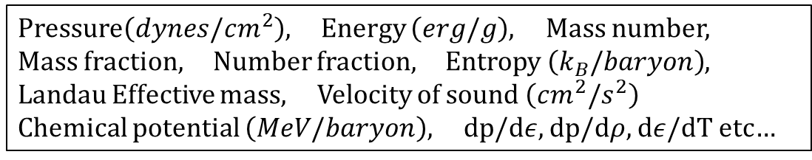

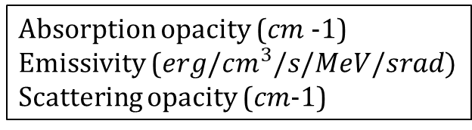
Compose.obspm.fr
Stellar initial profile
Mass (g), Radial coordinate (cm), Temperature (K),
Density (g/cm3), Radial velocity (cm/s), Fraction
Angular velocity (rad/s)
input
compose.exe
input
Woosley, S. E., and Thomas A. Weaver. No. UCRL-ID--122106. Lawrence Livermore National Lab., CA (United States), 1995.
output
Pressure$\left(dynes/cm^{2}\right)$, Energy $\left(erg/g\right)$, Mass number,
Mass fraction, Number fraction, Entropy $\left(k_{B}/baryon\right)$,
Landau Effective mass, Velocity of sound $\left(cm^{2}/s^{2}\right)$
Chemical potential $\left(MeV/baryon\right)$, dp/d$ε$, dp/d$ρ$, d$ε$/dT etc…
Equation of State.h5
input
input
Nulib.exe
output
Absorption opacity ($cm$-1)
Emissivity ($erg/cm^{3}/s/MeV/srad)$
Scattering opacity ($cm$-1)
Opacity.h5
input
Neutrino luminosity, Neutrino RMS energy,
Electron Fraction, Entropy, Density,
Temperature, Pressure etc…
GR1D.exe
${}^{1}$O’Connor, E. 2015, ApJS 219, 24.
Notes:
2분 5초

Slide 5
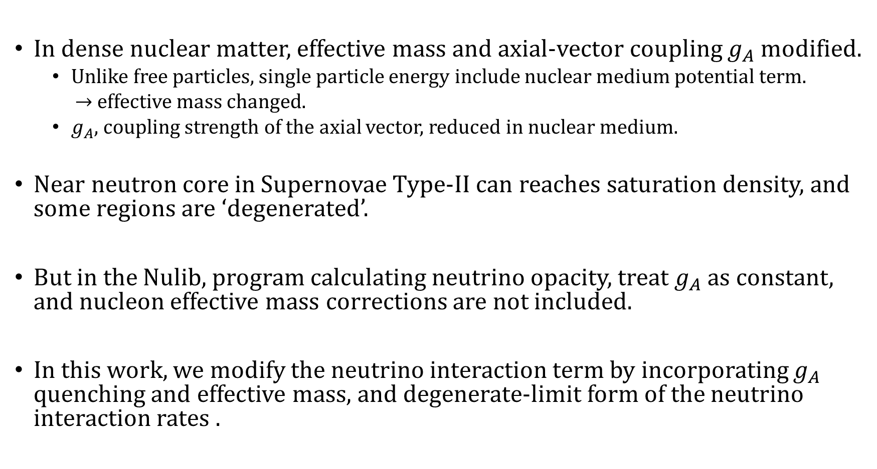
Motivation
In dense nuclear matter, effective mass and axial-vector coupling $g_{A}$ modified.
Unlike free particles, single particle energy include nuclear medium potential term.
$→$ effective mass changed.
$g_{A}$, coupling strength of the axial vector, reduced in nuclear medium.
Near neutron core in Supernovae Type-II can reaches saturation density, and some regions are ‘degenerated’.
But in the Nulib, program calculating neutrino opacity, treat $g_{A}$ as constant, and nucleon effective mass corrections are not included.
In this work, we modify the neutrino interaction term by incorporating $g_{A}$ quenching and effective mass, and degenerate-limit form of the neutrino interaction rates .
Notes:
Current : 상호작용하는 입자들이랑 gauge boson이랑 어떻게 결합하는지를 나타낸 opeartor같은것
2분은 넘음

Slide 6
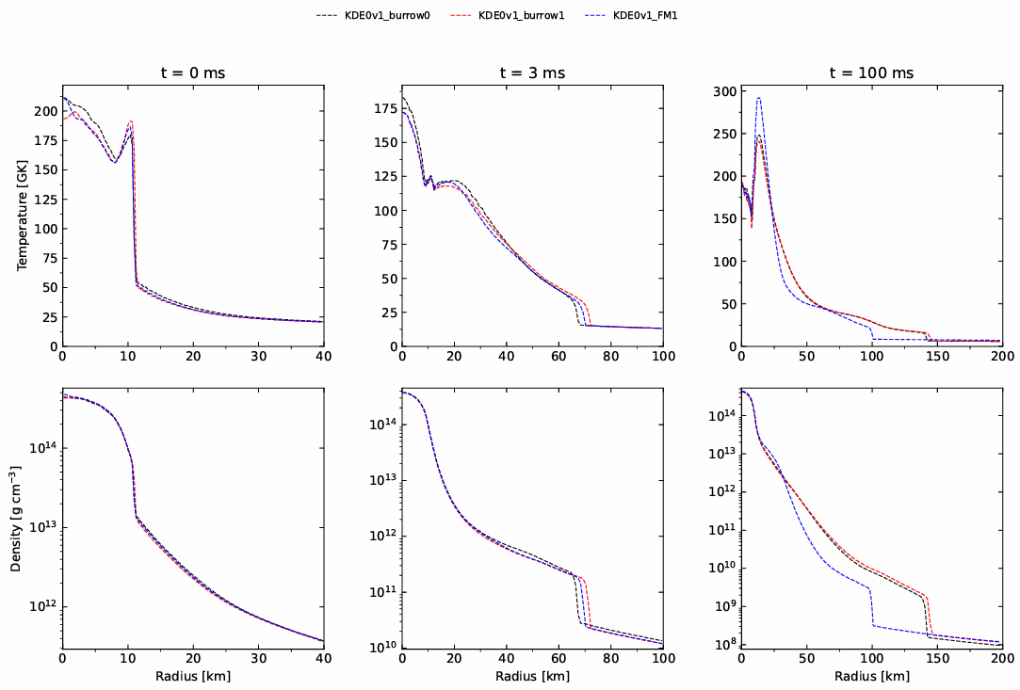
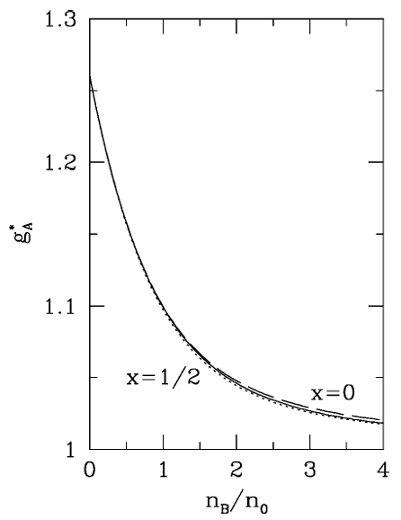

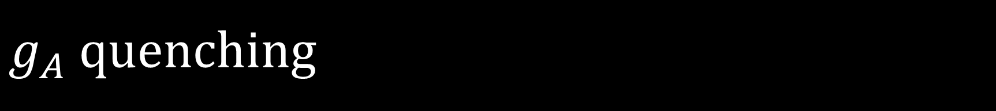
$g_{A}$ quenching
$\left\langle N\left(p_{2}\right) | {\vec{A}}_{μ}^{a} | N\left(p_{1}\right)\right\rangle =\overline{u}\left(p_{2}\right)\frac{1}{2}{\vec{τ}}^{a}\left[γ_{μ}γ_{5}g_{A}+q_{μ}γ_{5}h_{A}\left(a^{2}\right)\right]u\left(p_{1}\right)$
$→$ nucleon coupling to the axial vector current matrix element
$g_{A}≈1.27$ in free space
In dense nuclear matter, axial vecor current modified
$→$ $g_{A}$ is reduced
We use the effective parametrization
$$g_{A}^{∗}≅g_{A}\left(1−\frac{n_{Baryon}}{4.15\left(n_{0}+n_{Baryon}\right)}\right)$$
Within 1% accuracy for all $n_{Baryon}<4.5n_{0}$
Carter & Prakash, Phys. Lett. B 525, 249 (2002)
Notes:
왜 nucleon의 u는 spinor h는 formfactor. 앞쪽 term은 gammamu gamma5는 dirac bilinear에 따르면 axial-vecor. 뒤쪽은 gmu가 gammamu랑 비슷하게 된다고?
parit하면 –가 되서 vector. 근데
1분 반

Slide 7
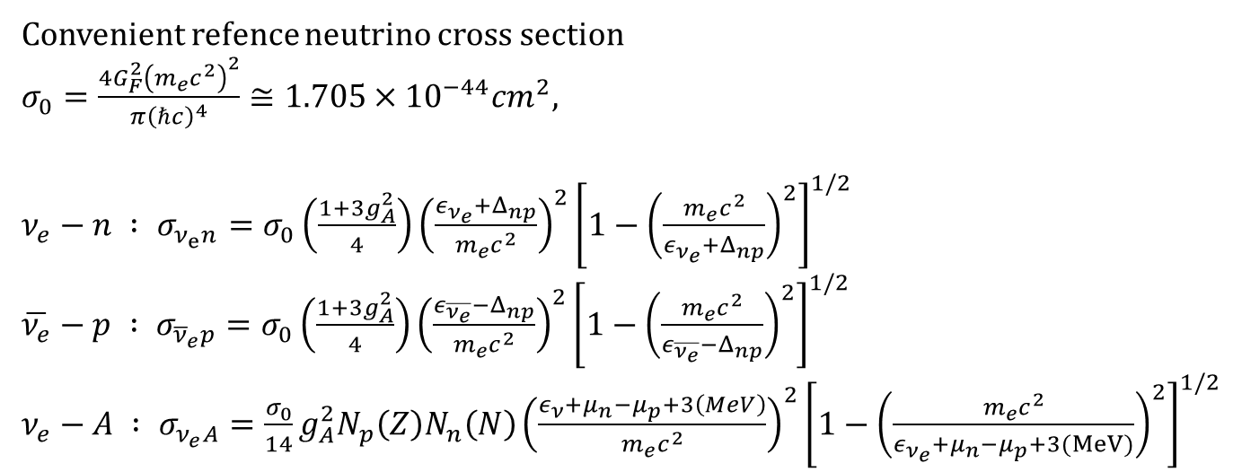

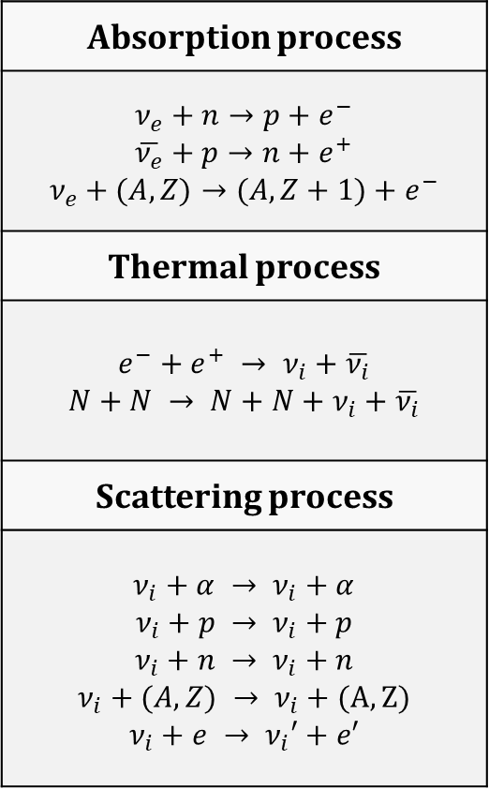
$g_{A}$ quenching
Absorption process
$$ν_{e}+n→p+e^{−}$$ $$\overline{ν_{e}}+p→n+e^{+}$$ $$ν_{e}+(A,Z)→(A,Z+1)+e^{−}$$
Thermal process
$$e^{−}+e^{+} → ν_{i}+\overline{ν_{i}}$$ $$N+N → N+N+ν_{i}+\overline{ν_{i}}$$
Scattering process
$$ν_{i}+α → ν_{i}+α$$ $$ν_{i}+p → ν_{i}+p$$ $$ν_{i}+n → ν_{i}+n$$ $$ν_{i}+(A,Z) → ν_{i}+(A,Z)$$ $$ν_{i}+e → ν_{i}′+e′$$
Convenient refence neutrino cross section
$σ_{0}=\frac{4G_{F}^{2}{\left(m_{e}c^{2}\right)}^{2}}{π{\left(ℏc\right)}^{4}}≅1.705×{10}^{−44}cm^{2},$
$ν_{e}−n : σ_{ν_{e}n}=σ_{0}\left(\frac{1+3g_{A}^{2}}{4}\right){\left(\frac{ε_{ν_{e}}+Δ_{np}}{m_{e}c^{2}}\right)}^{2}{\left[1−{\left(\frac{m_{e}c^{2}}{ε_{ν_{e}}+Δ_{np}}\right)}^{2}\right]}^{1/2}$
$\overline{ν_{e}}−p : σ_{{\overline{ν}}_{e}p}=σ_{0}\left(\frac{1+3g_{A}^{2}}{4}\right){\left(\frac{ε_{\overline{ν_{e}}}−Δ_{np}}{m_{e}c^{2}}\right)}^{2}{\left[1−{\left(\frac{m_{e}c^{2}}{ε_{\overline{ν_{e}}}−Δ_{np}}\right)}^{2}\right]}^{1/2}$
$ν_{e}−A : σ_{ν_{e}A}=\frac{σ_{0}}{14}g_{A}^{2}N_{p}\left(Z\right)N_{n}\left(N\right){\left(\frac{ε_{ν}+μ_{n}−μ_{p}+3\left(MeV\right)}{m_{e}c^{2}}\right)}^{2}{\left[1−{\left(\frac{m_{e}c^{2}}{ε_{ν_{e}}+μ_{n}−μ_{p}+3(MeV)}\right)}^{2}\right]}^{1/2}$
A. Burrows, S. Reddy, and T. A. Thompson, Nucl. Phys. A 777, 356–394 (2006).
$g_{A}^{∗}≅g_{A}\left(1−\frac{n_{Baryon}}{4.15\left(n_{0}+n_{Baryon}\right)}\right)$
Notes:
왜 밀도가 올라가면 ga가 감소되냐. Pion-dynamics랑 연관 되어있다고 하는데. 그리고 chiral symmetry breaking을 쓴다고 하는데. 아마 non-dense matter에서는 라그랑지안에서 sigma, omega, rho가 0이라는 뜻인가. Omega는 주변 baryon에서 repulsive potential 그런거라고 한다.
1분 50초

Slide 8
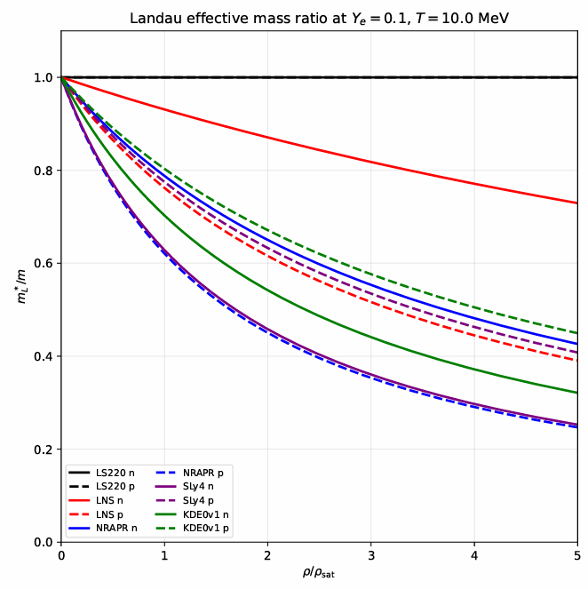
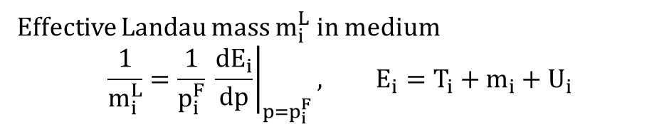
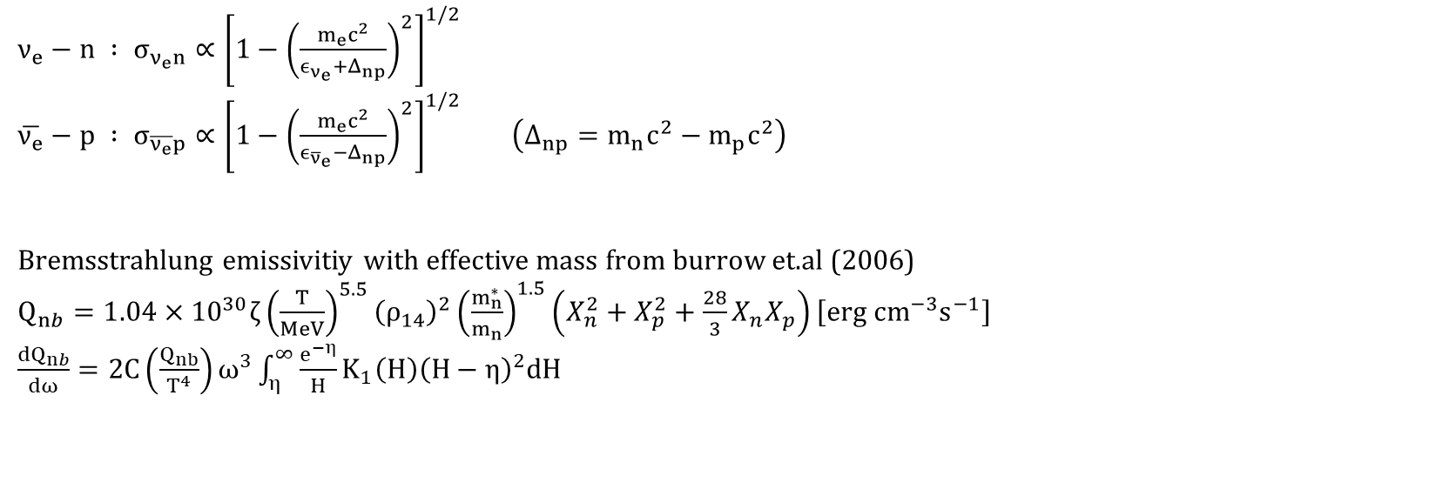
Effective mass
Effective Landau mass $m_{i}^{L}$ in medium
$$\frac{1}{m_{i}^{L}}=\frac{1}{p_{i}^{F}} {\left.\frac{dE_{i}}{dp}\right|}_{p=p_{i}^{F}}, E_{i}=T_{i}+m_{i}+U_{i}$$
$ν_{e}−n : σ_{ν_{e}n}∝{\left[1−{\left(\frac{m_{e}c^{2}}{ϵ_{ν_{e}}+Δ_{np}}\right)}^{2}\right]}^{1/2}$
$\overline{ν_{e}}−p : σ_{\overline{ν_{e}}p}∝{\left[1−{\left(\frac{m_{e}c^{2}}{ϵ_{{\overline{ν}}_{e}}−Δ_{np}}\right)}^{2}\right]}^{1/2}$ $\left(Δ_{np}=m_{n}c^{2}−m_{p}c^{2}\right)$
Bremsstrahlung emissivitiy with effective mass from burrow et.al (2006)
$Q_{nb}=1.04×{10}^{30}ζ{\left(\frac{T}{MeV}\right)}^{5.5}{\left(ρ_{14}\right)}^{2}{\left(\frac{m_{n}^{∗}}{m_{n}}\right)}^{1.5}\left(X_{n}^{2}+X_{p}^{2}+\frac{28}{3}X_{n}X_{p}\right)\left[erg cm^{−3}s^{−1}\right]$
$\frac{dQ_{nb}}{dω}=2C\left(\frac{Q_{nb}}{T^{4}}\right)ω^{3}\int_{η}^{∞}{\frac{e^{−η}}{Η}K_{1}\left(Η\right){\left(Η−η\right)}^{2}dΗ}$
Schneider, Andre da Silva, Luke F. Roberts, and Christian D. Ott. Physical Review C 96.6 (2017): 065802.
Lattimer, James M., and F. Douglas Swesty. Nuclear Physics A 535.2 (1991): 331-376.
Notes:
Effective mass 왜 effective mass가 다를까. Eos마다 skyrme parameter가 다 다르고, 그래서 internal energy density 공식도 좀 많이 다름.
1분 40초

Slide 9
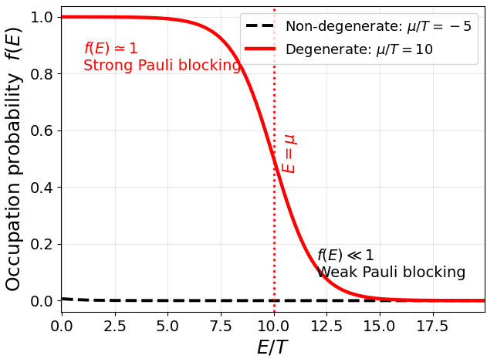
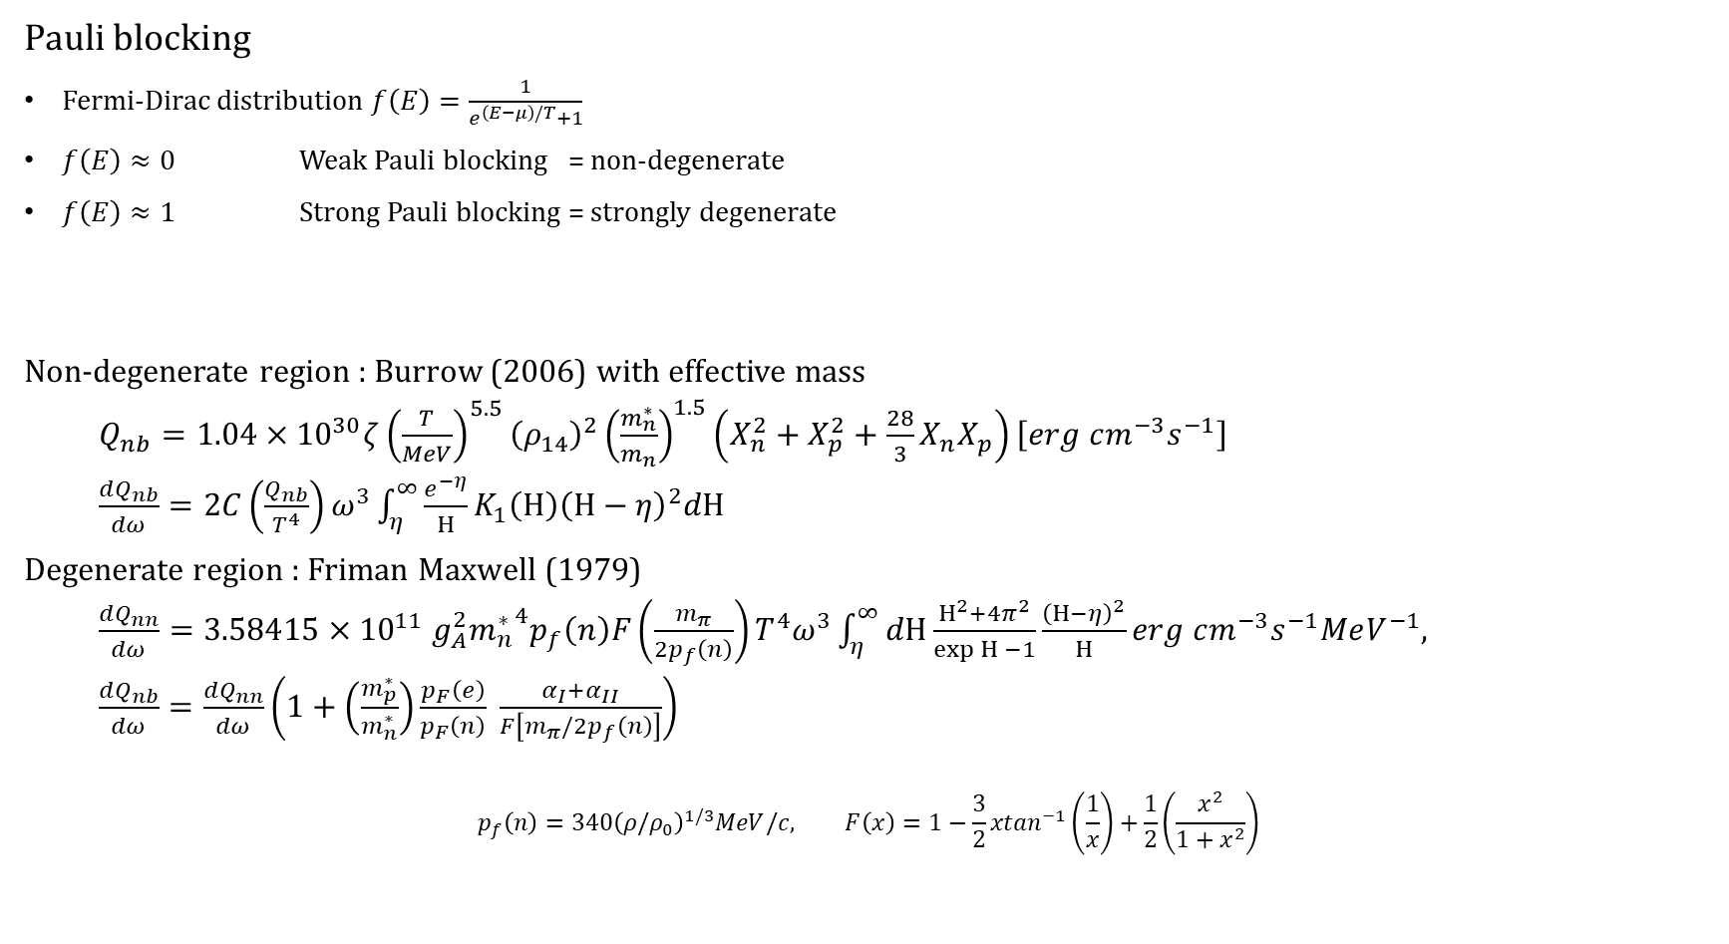
Degenerate bremsstrahlung form
Pauli blocking
Fermi-Dirac distribution $f\left(E\right)=\frac{1}{e^{\left(E−μ\right)/T}+1}$
$f\left(E\right)≈0$ Weak Pauli blocking = non-degenerate
$f\left(E\right)≈1$ Strong Pauli blocking = strongly degenerate
Non-degenerate region : Burrow (2006) with effective mass
$Q_{nb}=1.04×{10}^{30}ζ{\left(\frac{T}{MeV}\right)}^{5.5}{\left(ρ_{14}\right)}^{2}{\left(\frac{m_{n}^{∗}}{m_{n}}\right)}^{1.5}\left(X_{n}^{2}+X_{p}^{2}+\frac{28}{3}X_{n}X_{p}\right)\left[erg cm^{−3}s^{−1}\right]$
$\frac{dQ_{nb}}{dω}=2C\left(\frac{Q_{nb}}{T^{4}}\right)ω^{3}\int_{η}^{∞}{\frac{e^{−η}}{Η}K_{1}\left(Η\right){\left(Η−η\right)}^{2}dΗ}$
Degenerate region : Friman Maxwell (1979)
$\frac{dQ_{nn}}{dω}=3.58415×{10}^{11} g_{A}^{2}{m_{n}^{∗}}^{4}p_{f}\left(n\right)F\left(\frac{m_{π}}{2p_{f}\left(n\right)}\right)T^{4}ω^{3}\int_{η}^{∞}{dΗ\frac{Η^{2}+4π^{2}}{\exp{Η} −1}\frac{{\left(Η−η\right)}^{2}}{Η}}erg cm^{−3}s^{−1}MeV^{−1},$
$\frac{dQ_{nb}}{dω}=\frac{dQ_{nn}}{dω}\left(1+\left(\frac{m_{p}^{∗}}{m_{n}^{∗}}\right)\frac{p_{F}\left(e\right)}{p_{F}\left(n\right)} \frac{α_{I}+α_{II}}{F\left[m_{π}/2p_{f}\left(n\right)\right]}\right)$
$$p_{f}\left(n\right)={340\left(ρ/ρ_{0}\right)}^{1/3}MeV/c, F\left(x\right)=1−\frac{3}{2}xtan^{−1}\left(\frac{1}{x}\right)+\frac{1}{2}\left(\frac{x^{2}}{1+x^{2}}\right)$$
Notes:
F(E) = occupation probability 에너지 E를 가진 양자상태가 점유되어있을 확률
2분 20초

Slide 10
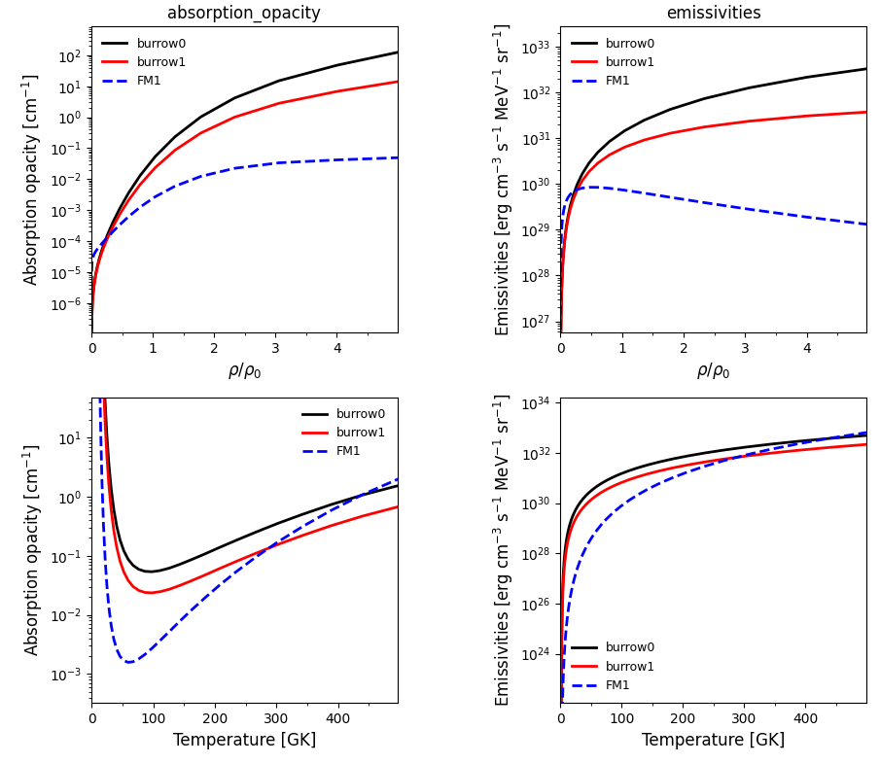
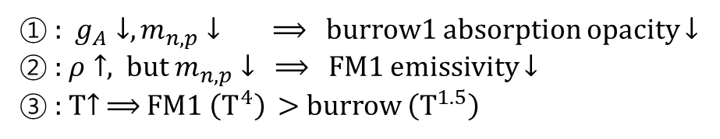
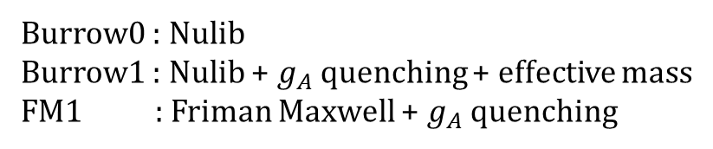
Nulib opacity
1
Burrow0 : Nulib
Burrow1 : Nulib + $g_{A}$ quenching + effective mass
FM1 : Friman Maxwell + $g_{A}$ quenching
2
① : $g_{A}↓, m_{n,p}↓ ⟹$ burrow1 absorption opacity $↓$
② : $ρ↑$, but $m_{n,p}↓$ $⟹$ FM1 emissivity $↓$
③ : T$↑$ $⟹$ FM1 $\left(T^{4}\right)$ $>$ burrow $\left(T^{1.5}\right)$
3
Notes:
Burrow0에서 burrow1로 떨어지는건 ga때문. 밀도 고정 FM1이 높은 온도에서 올라가는건 Q는 5.5제곱이지만 dQ/domega에서 4로 나눠서이고 FM은 4제곱이라서.
Abs가 줄긴 했는데 어짜피 abs는 emissivity 의존이라서 결국 emissivity가 더 중요함
Emssivity에서 EM per rho가 떨어지는 이유는 애초에 FM식에서 밀도의존성이 매우 떨어지기 때문.

Slide 11
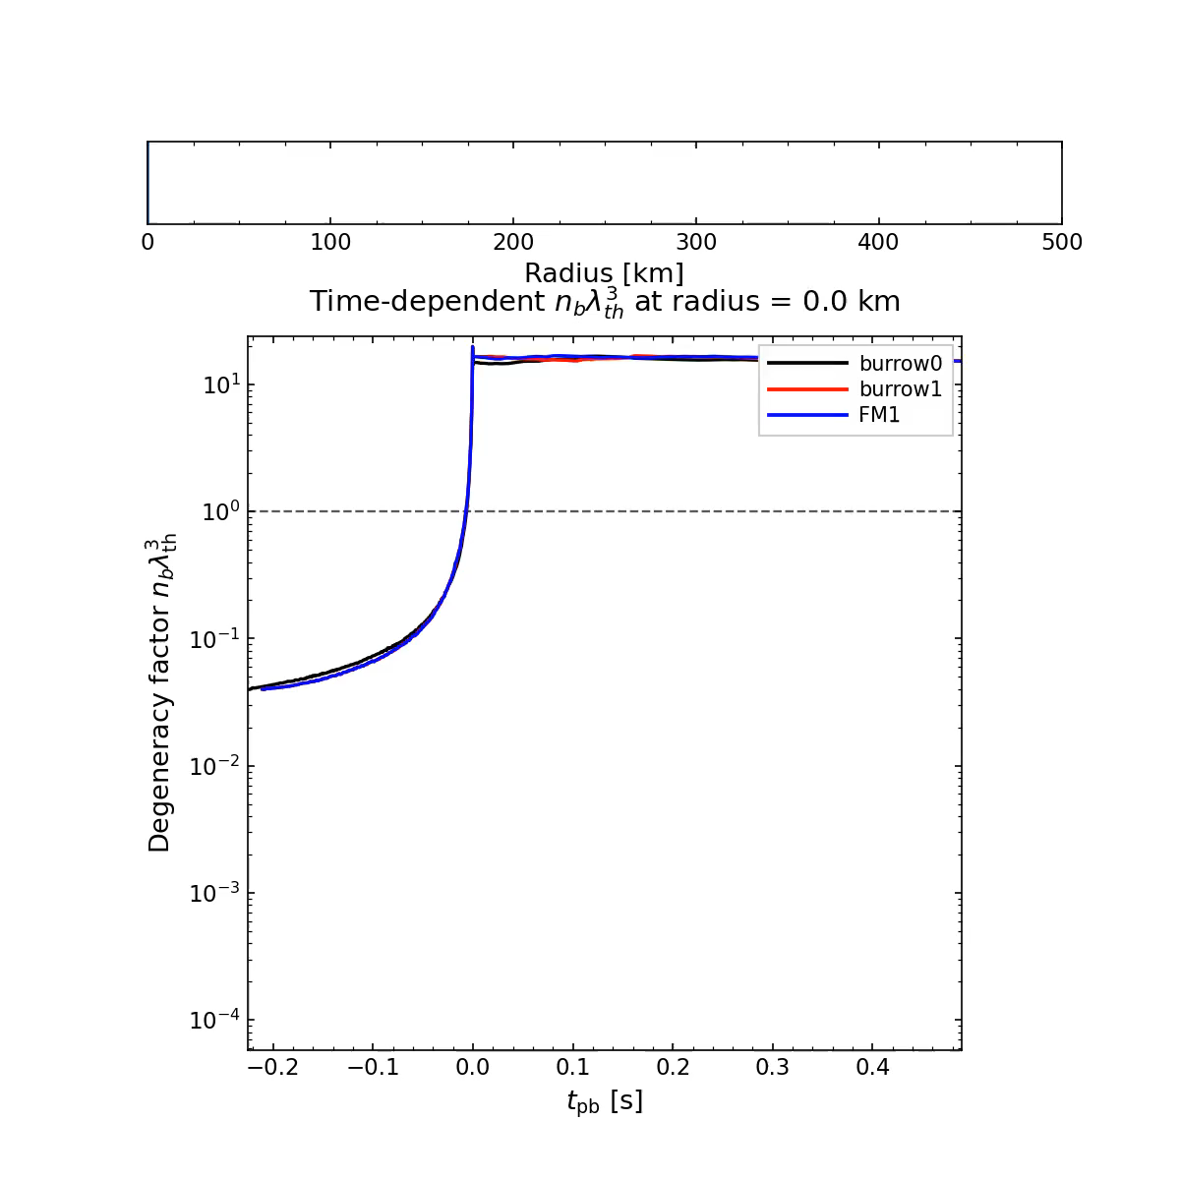
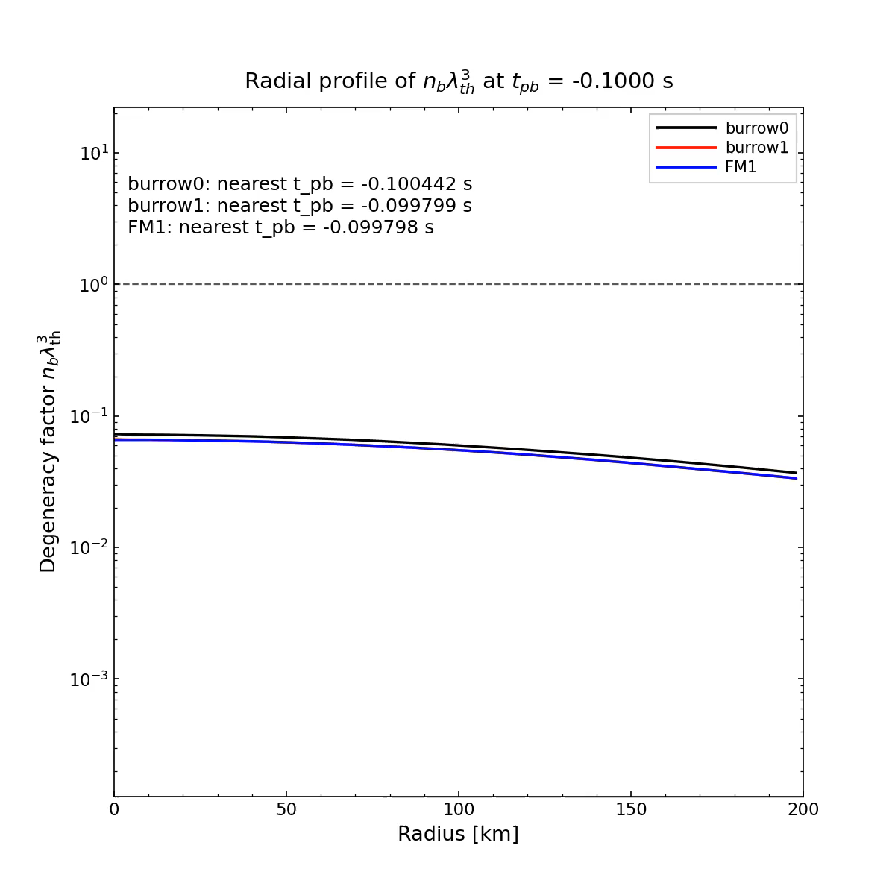

Degeneracy factor
Degeneracy factor $η_{i}=\frac{μ_{i}−m_{i}−U_{i}}{T}$
$e^{η_{i}}≈n_{i}λ_{T}^{3}=n_{i}{\left(\frac{2πℏ^{2}}{mT}\right)}^{\frac{3}{2}}$
Approximate
$n_{i}λ_{T}^{3}<1→$ non-degenerate
$n_{i}λ_{T}^{3}>1→$ degenerate
The degeneracy factor increase toward the center $→$inner core is strongly degenerate.
Notes:
튀어나온건 accretion front인가
밀도가 증가하면.

Slide 12
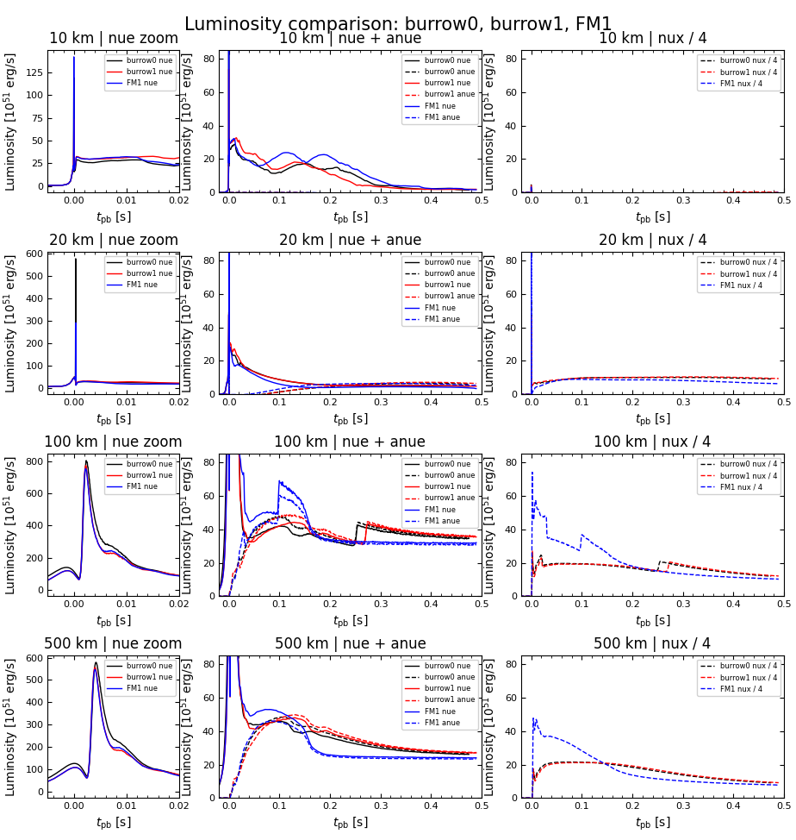
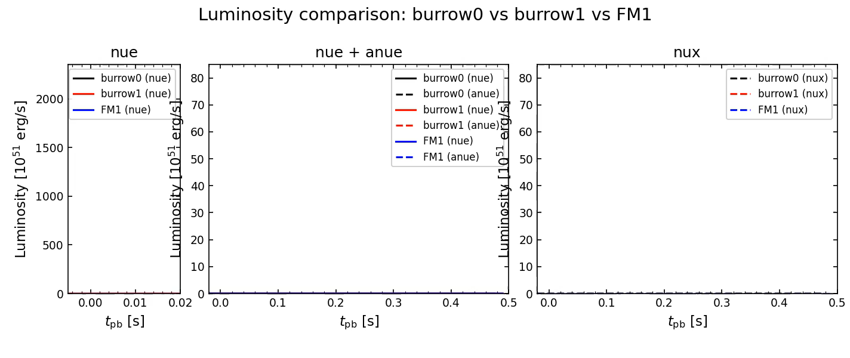
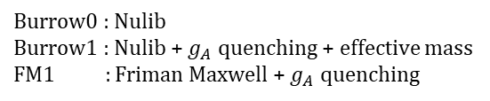
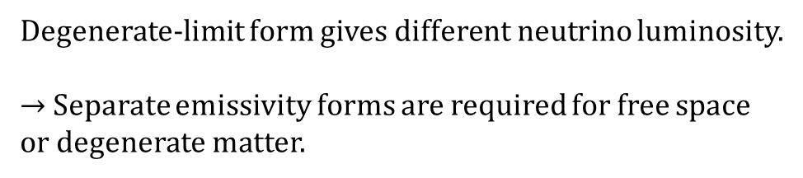
Luminosity per time
Burrow0 : Nulib
Burrow1 : Nulib + $g_{A}$ quenching + effective mass
FM1 : Friman Maxwell + $g_{A}$ quenching
Degenerate-limit form gives different neutrino luminosity.
$→$ Separate emissivity forms are required for free space or degenerate matter.

Slide 13
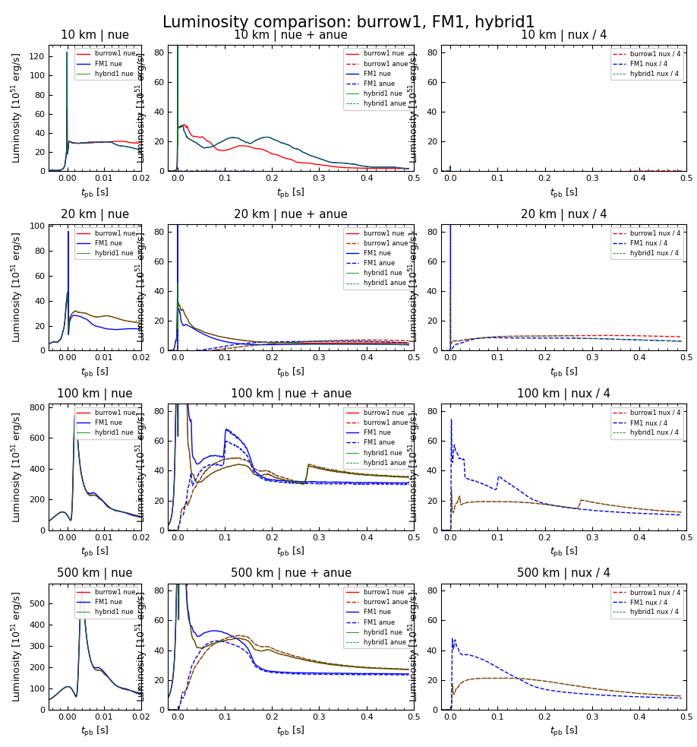
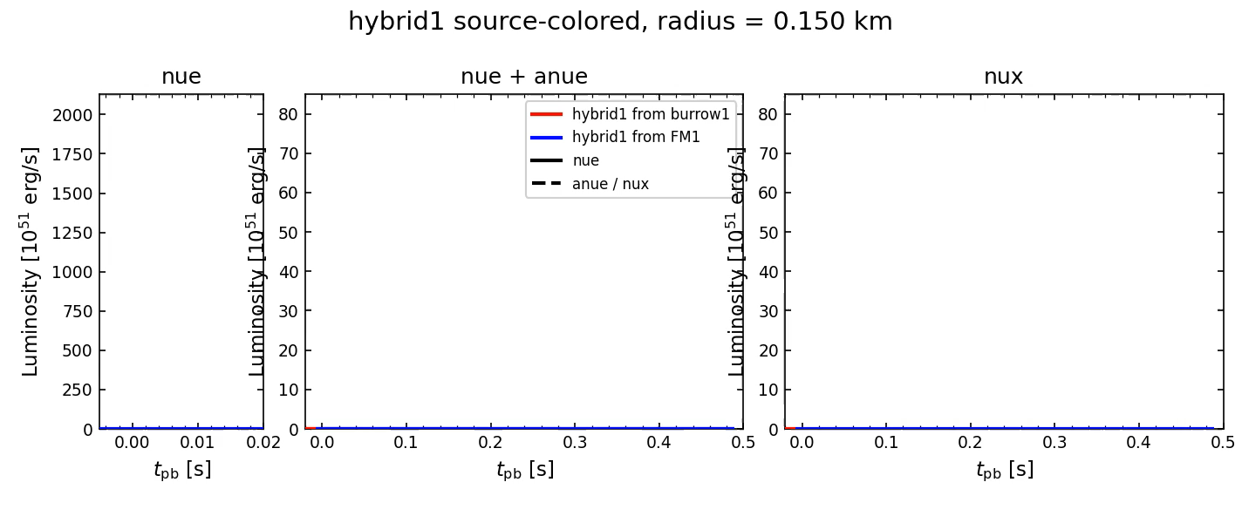
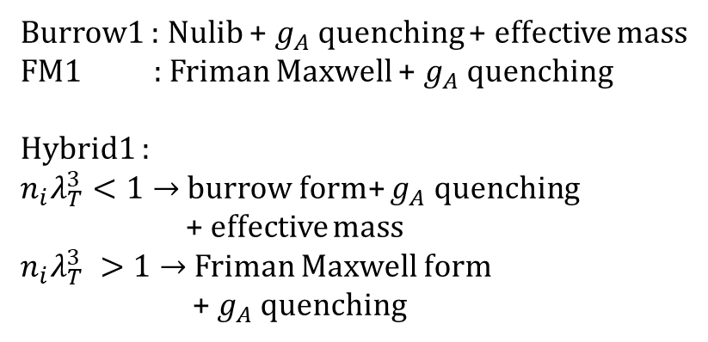
KDE0v1_burrow1_FM1_hybrid1
Burrow1 : Nulib + $g_{A}$ quenching + effective mass
FM1 : Friman Maxwell + $g_{A}$ quenching
Hybrid1 :
$n_{i}λ_{T}^{3}<1→$ burrow form+ $g_{A}$ quenching
+ effective mass
$n_{i}λ_{T}^{3} >1→$ Friman Maxwell form
+ $g_{A}$ quenching
Notes:
위의 그래프는 50k0km

Slide 14
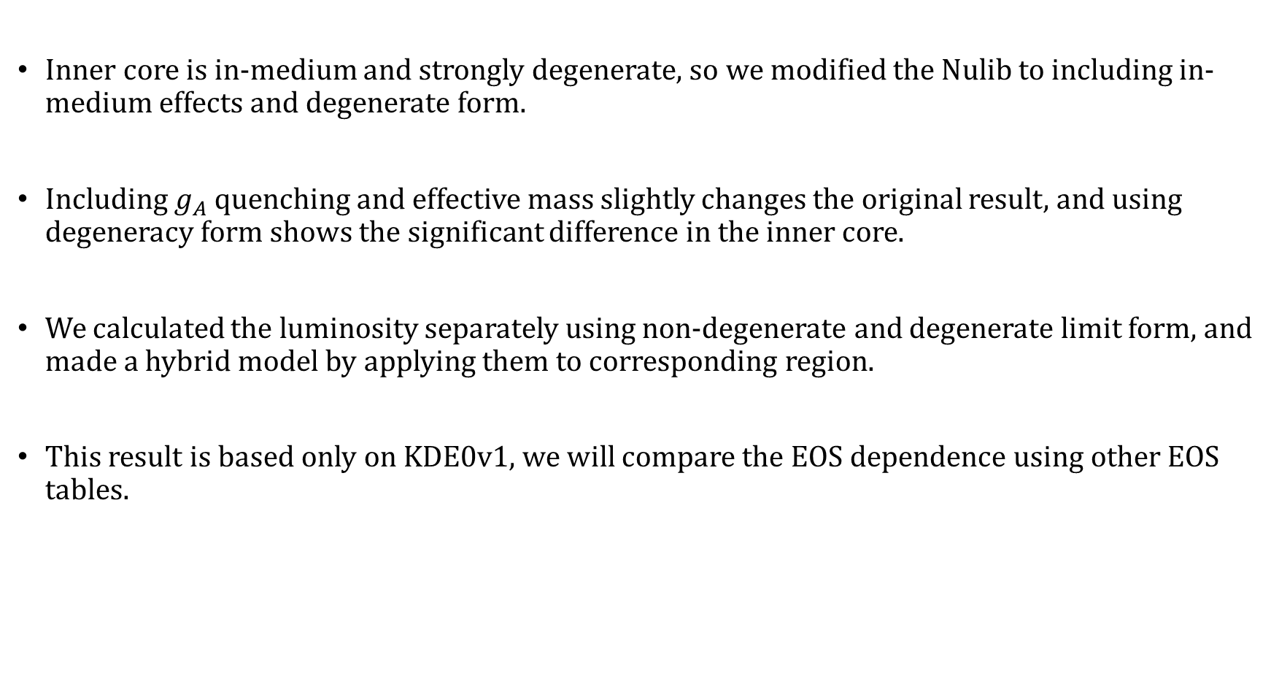
Summary
Inner core is in-medium and strongly degenerate, so we modified the Nulib to including in-medium effects and degenerate form.
Including $g_{A}$ quenching and effective mass slightly changes the original result, and using degeneracy form shows the significant difference in the inner core.
We calculated the luminosity separately using non-degenerate and degenerate limit form, and made a hybrid model by applying them to corresponding region.
This result is based only on KDE0v1, we will compare the EOS dependence using other EOS tables.

Slide 15
Thank you for attention

Slide 16
References
O’Connor, Evan. "An open-source neutrino radiation hydrodynamics code for core-collapse supernovae." The Astrophysical Journal Supplement Series 219.2 (2015): 24.
Friman, B. L., and O. V. Maxwell. "Neutrino emissivities of neutron stars." Astrophysical Journal, Part 1, vol. 232, Sept. 1, 1979, p. 541-557. 232 (1979): 541-557.
Burrows, Adam, Sanjay Reddy, and Todd A. Thompson. "Neutrino opacities in nuclear matter." Nuclear Physics A 777 (2006): 356-394.
Carter, G. W., and M. Prakash. "The quenching of the axial coupling in nuclear and neutron-star matter." Physics Letters B 525.3-4 (2002): 249-254.
Schneider, Andre da Silva, Luke F. Roberts, and Christian D. Ott. "Open-source nuclear equation of state framework based on the liquid-drop model with Skyrme interaction." Physical Review C 96.6 (2017): 065802.
Woosley, S. E., and Thomas A. Weaver. The evolution and explosion of massive Stars II: Explosive hydrodynamics and nucleosynthesis. No. UCRL-ID--122106. Lawrence Livermore National Lab., CA (United States), 1995.

Slide 17
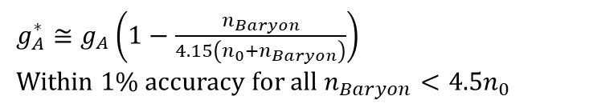
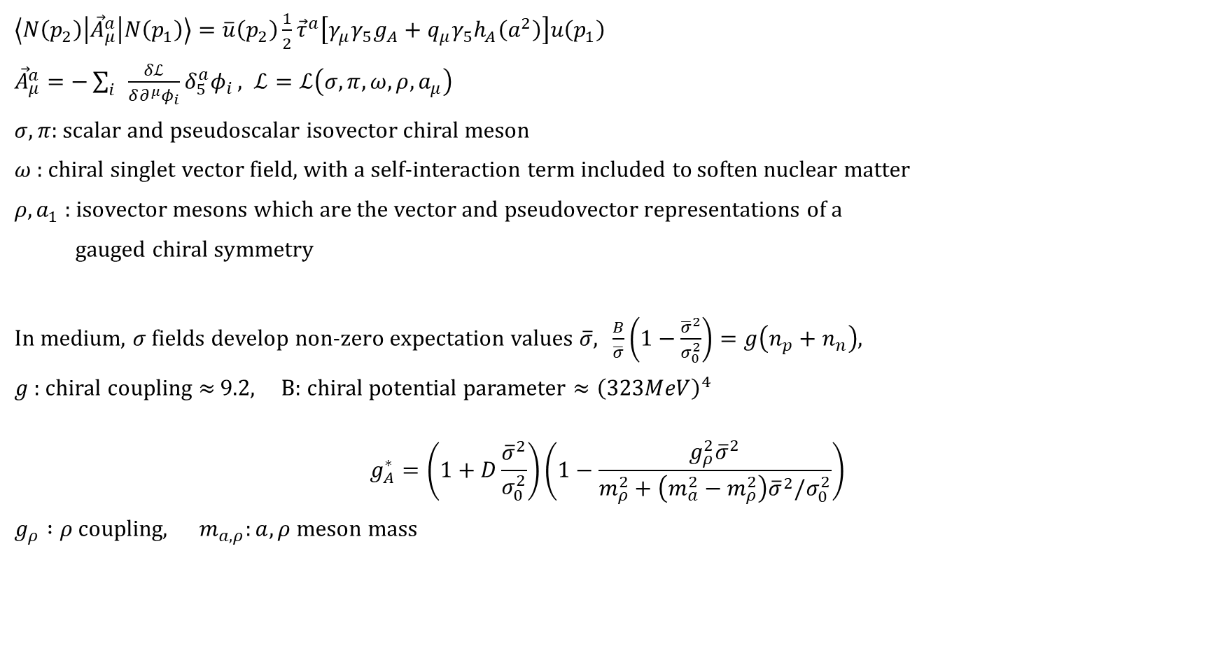
$g_{A}$ quenching
$\left\langle N\left(p_{2}\right) | {\vec{A}}_{μ}^{a} | N\left(p_{1}\right)\right\rangle =\overline{u}\left(p_{2}\right)\frac{1}{2}{\vec{τ}}^{a}\left[γ_{μ}γ_{5}g_{A}+q_{μ}γ_{5}h_{A}\left(a^{2}\right)\right]u\left(p_{1}\right)$
${\vec{A}}_{μ}^{a}=−\sum_{i}{\frac{δℒ}{δ∂^{μ}φ_{i}}δ_{5}^{a}φ_{i}}, ℒ=ℒ\left(σ, π, ω, ρ, a_{μ}\right)$
$σ, π$: scalar and pseudoscalar isovector chiral meson
$ω$ : chiral singlet vector field, with a self-interaction term included to soften nuclear matter
$ρ, a_{1}$ : isovector mesons which are the vector and pseudovector representations of a
gauged chiral symmetry
In medium, $σ$ fields develop non-zero expectation values $\overline{σ}$, $\frac{B}{\overline{σ}}\left(1−\frac{{\overline{σ}}^{2}}{σ_{0}^{2}}\right)=g\left(n_{p}+n_{n}\right)$,
$g$ : chiral coupling $≈$ 9.2, B: chiral potential parameter $≈{\left(323MeV\right)}^{4}$
$$g_{A}^{∗}=\left(1+D\frac{{\overline{σ}}^{2}}{σ_{0}^{2}}\right)\left(1−\frac{g_{ρ}^{2}{\overline{σ}}^{2}}{m_{ρ}^{2}+\left(m_{a}^{2}−m_{ρ}^{2}\right){\overline{σ}}^{2}/σ_{0}^{2}}\right)$$
$g_{ρ} :ρ$ coupling, $m_{a,ρ}:a,ρ$ meson mass
Carter & Prakash, Phys. Lett. B 525, 249 (2002)
$g_{A}^{∗}≅g_{A}\left(1−\frac{n_{Baryon}}{4.15\left(n_{0}+n_{Baryon}\right)}\right)$
Within 1% accuracy for all $n_{Baryon}<4.5n_{0}$
Notes:
hA = form factor tau : isospin pauli matrix A : axial current
\detala : change in each field under an axial transformation
Sigma_0 = 102MeV

Slide 18
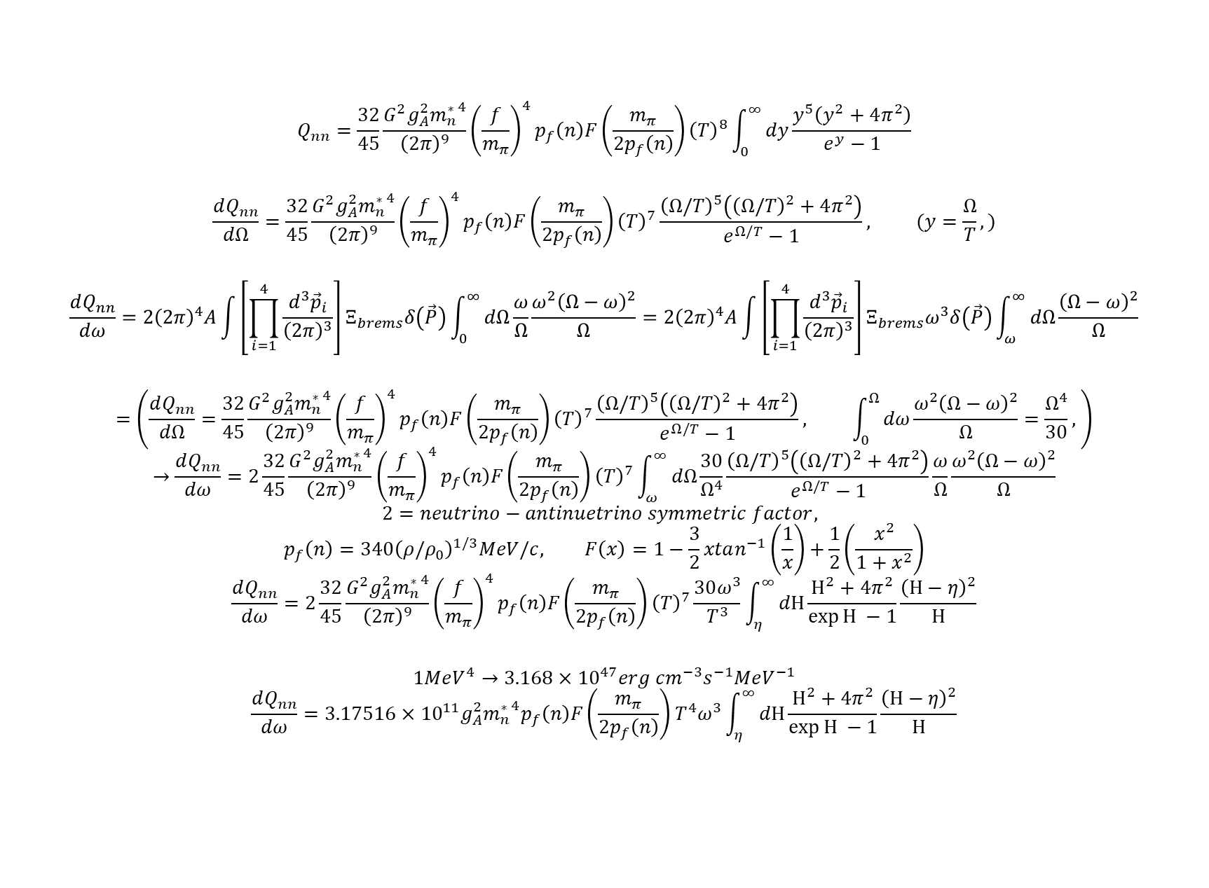
$$Q_{nn}=\frac{32}{45}\frac{G^{2}g_{A}^{2}{m_{n}^{∗}}^{4}}{{\left(2π\right)}^{9}}{\left(\frac{f}{m_{π}}\right)}^{4}p_{f}\left(n\right)F\left(\frac{m_{π}}{2p_{f}\left(n\right)}\right){\left(T\right)}^{8}\int_{0}^{∞}{dy\frac{y^{5}\left(y^{2}+4π^{2}\right)}{e^{y}−1}}$$
$$\frac{dQ_{nn}}{dΩ}=\frac{32}{45}\frac{G^{2}g_{A}^{2}{m_{n}^{∗}}^{4}}{{\left(2π\right)}^{9}}{\left(\frac{f}{m_{π}}\right)}^{4}p_{f}\left(n\right)F\left(\frac{m_{π}}{2p_{f}\left(n\right)}\right){\left(T\right)}^{7}\frac{{\left(Ω/T\right)}^{5}\left({\left(Ω/T\right)}^{2}+4π^{2}\right)}{e^{Ω/T}−1}, (y=\frac{Ω}{T},)$$
$$\frac{dQ_{nn}}{dω}=2{\left(2π\right)}^{4}A\int{\left[\prod_{i=1}^{4}{\frac{d^{3}{\vec{p}}_{i}}{{\left(2π\right)}^{3}}}\right]Ξ_{brems}δ\left(\vec{P}\right)\int_{0}^{∞}{dΩ\frac{ω}{Ω}\frac{ω^{2}{\left(Ω−ω\right)}^{2}}{Ω}}}=2{\left(2π\right)}^{4}A\int{\left[\prod_{i=1}^{4}{\frac{d^{3}{\vec{p}}_{i}}{{\left(2π\right)}^{3}}}\right]Ξ_{brems}ω^{3}δ\left(\vec{P}\right)\int_{ω}^{∞}{dΩ\frac{{\left(Ω−ω\right)}^{2}}{Ω}}}$$
$$=\left(\frac{dQ_{nn}}{dΩ}=\frac{32}{45}\frac{G^{2}g_{A}^{2}{m_{n}^{∗}}^{4}}{{\left(2π\right)}^{9}}{\left(\frac{f}{m_{π}}\right)}^{4}p_{f}\left(n\right)F\left(\frac{m_{π}}{2p_{f}\left(n\right)}\right){\left(T\right)}^{7}\frac{{\left(Ω/T\right)}^{5}\left({\left(Ω/T\right)}^{2}+4π^{2}\right)}{e^{Ω/T}−1}, \int_{0}^{Ω}{dω\frac{ω^{2}{\left(Ω−ω\right)}^{2}}{Ω}}=\frac{Ω^{4}}{30}, \right)$$
$$→\frac{dQ_{nn}}{dω}=2\frac{32}{45}\frac{G^{2}g_{A}^{2}{m_{n}^{∗}}^{4}}{{\left(2π\right)}^{9}}{\left(\frac{f}{m_{π}}\right)}^{4}p_{f}\left(n\right)F\left(\frac{m_{π}}{2p_{f}\left(n\right)}\right){\left(T\right)}^{7}\int_{ω}^{∞}{dΩ\frac{30}{Ω^{4}}\frac{{\left(Ω/T\right)}^{5}\left({\left(Ω/T\right)}^{2}+4π^{2}\right)}{e^{Ω/T}−1}\frac{ω}{Ω}\frac{ω^{2}{\left(Ω−ω\right)}^{2}}{Ω}}$$
$$2=neutrino−antinuetrino symmetric factor,$$
$$p_{f}\left(n\right)={340\left(ρ/ρ_{0}\right)}^{1/3}MeV/c, F\left(x\right)=1−\frac{3}{2}xtan^{−1}\left(\frac{1}{x}\right)+\frac{1}{2}\left(\frac{x^{2}}{1+x^{2}}\right)$$
$$\frac{dQ_{nn}}{dω}=2\frac{32}{45}\frac{G^{2}g_{A}^{2}{m_{n}^{∗}}^{4}}{{\left(2π\right)}^{9}}{\left(\frac{f}{m_{π}}\right)}^{4}p_{f}\left(n\right)F\left(\frac{m_{π}}{2p_{f}\left(n\right)}\right){\left(T\right)}^{7}\frac{30ω^{3}}{T^{3}}\int_{η}^{∞}{dΗ\frac{Η^{2}+4π^{2}}{\exp{Η} −1}\frac{{\left(Η−η\right)}^{2}}{Η}}$$
$$1MeV^{4}→3.168×{10}^{47}erg cm^{−3}s^{−1}MeV^{−1}$$
$$\frac{dQ_{nn}}{dω}=3.17516×{10}^{11}g_{A}^{2}{m_{n}^{∗}}^{4}p_{f}\left(n\right)F\left(\frac{m_{π}}{2p_{f}\left(n\right)}\right)T^{4}ω^{3}\int_{η}^{∞}{dΗ\frac{Η^{2}+4π^{2}}{\exp{Η} −1}\frac{{\left(Η−η\right)}^{2}}{Η}}$$

Slide 19
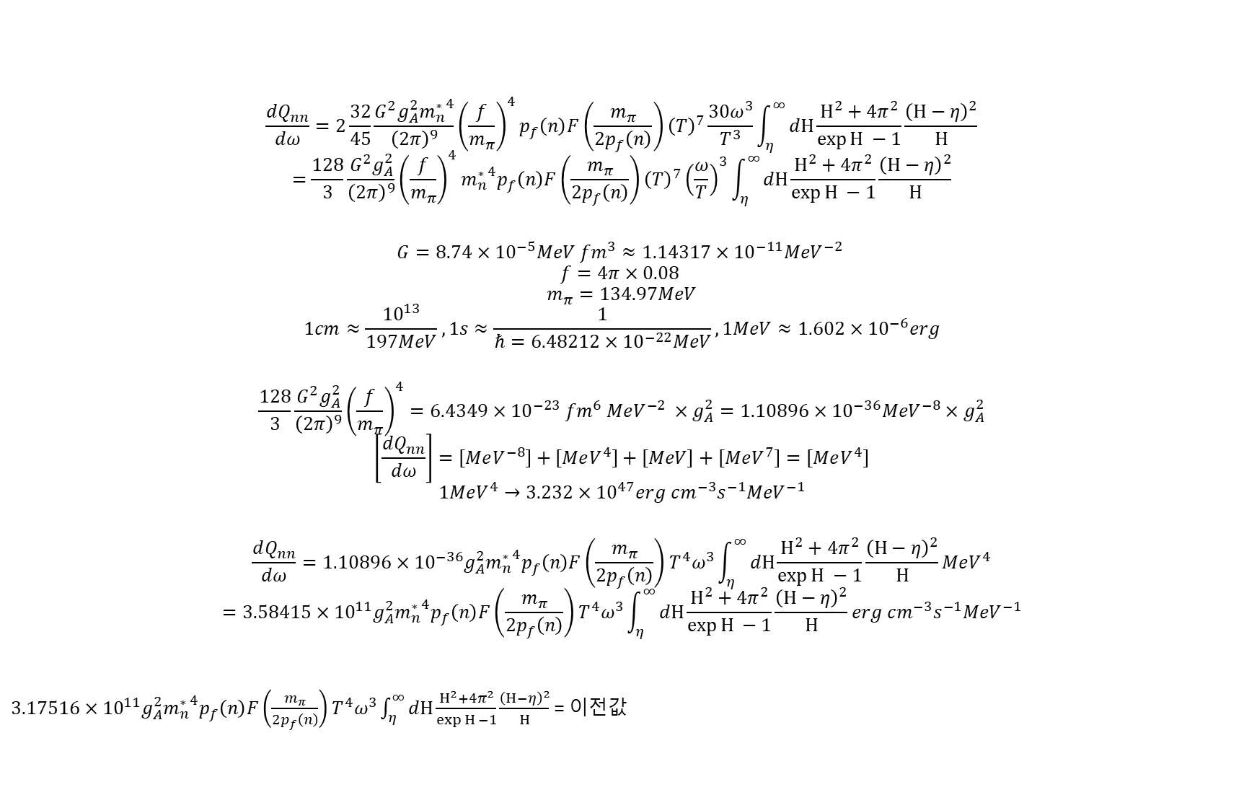
$$\frac{dQ_{nn}}{dω}=2\frac{32}{45}\frac{G^{2}g_{A}^{2}{m_{n}^{∗}}^{4}}{{\left(2π\right)}^{9}}{\left(\frac{f}{m_{π}}\right)}^{4}p_{f}\left(n\right)F\left(\frac{m_{π}}{2p_{f}\left(n\right)}\right){\left(T\right)}^{7}\frac{30ω^{3}}{T^{3}}\int_{η}^{∞}{dΗ\frac{Η^{2}+4π^{2}}{\exp{Η} −1}\frac{{\left(Η−η\right)}^{2}}{Η}}$$
$$=\frac{128}{3}\frac{G^{2}g_{A}^{2}}{{\left(2π\right)}^{9}}{\left(\frac{f}{m_{π}}\right)}^{4}{m_{n}^{∗}}^{4}p_{f}\left(n\right)F\left(\frac{m_{π}}{2p_{f}\left(n\right)}\right){\left(T\right)}^{7}{\left(\frac{ω}{T}\right)}^{3}\int_{η}^{∞}{dΗ\frac{Η^{2}+4π^{2}}{\exp{Η} −1}\frac{{\left(Η−η\right)}^{2}}{Η}}$$
$$G=8.74×{10}^{−5}MeV fm^{3}≈1.14317×{10}^{−11}MeV^{−2}$$
$$f=4π×0.08$$
$$m_{π}=134.97MeV$$
$$1cm≈\frac{{10}^{13}}{197MeV}, 1s≈\frac{1}{ℏ=6.48212×{10}^{−22}MeV}, 1MeV≈1.602×{10}^{−6}erg$$
$$\frac{128}{3}\frac{G^{2}g_{A}^{2}}{{\left(2π\right)}^{9}}{\left(\frac{f}{m_{π}}\right)}^{4}=6.4349×{10}^{−23} fm^{6} MeV^{−2} ×g_{A}^{2}=1.10896×{10}^{−36}MeV^{−8}×g_{A}^{2}$$
$$\left[\frac{dQ_{nn}}{dω}\right]=\left[MeV^{−8}\right]+\left[MeV^{4}\right]+\left[MeV\right]+\left[MeV^{7}\right]=\left[MeV^{4}\right]$$
$$1MeV^{4}→3.232×{10}^{47}erg cm^{−3}s^{−1}MeV^{−1}$$
$$\frac{dQ_{nn}}{dω}=1.10896×{10}^{−36}g_{A}^{2}{m_{n}^{∗}}^{4}p_{f}\left(n\right)F\left(\frac{m_{π}}{2p_{f}\left(n\right)}\right)T^{4}ω^{3}\int_{η}^{∞}{dΗ\frac{Η^{2}+4π^{2}}{\exp{Η} −1}\frac{{\left(Η−η\right)}^{2}}{Η}}MeV^{4}$$
$$=3.58415×{10}^{11}g_{A}^{2}{m_{n}^{∗}}^{4}p_{f}\left(n\right)F\left(\frac{m_{π}}{2p_{f}\left(n\right)}\right)T^{4}ω^{3}\int_{η}^{∞}{dΗ\frac{Η^{2}+4π^{2}}{\exp{Η} −1}\frac{{\left(Η−η\right)}^{2}}{Η}}erg cm^{−3}s^{−1}MeV^{−1}$$
$3.17516×{10}^{11}g_{A}^{2}{m_{n}^{∗}}^{4}p_{f}\left(n\right)F\left(\frac{m_{π}}{2p_{f}\left(n\right)}\right)T^{4}ω^{3}\int_{η}^{∞}{dΗ\frac{Η^{2}+4π^{2}}{\exp{Η} −1}\frac{{\left(Η−η\right)}^{2}}{Η}}$ = 이전값

Slide 20
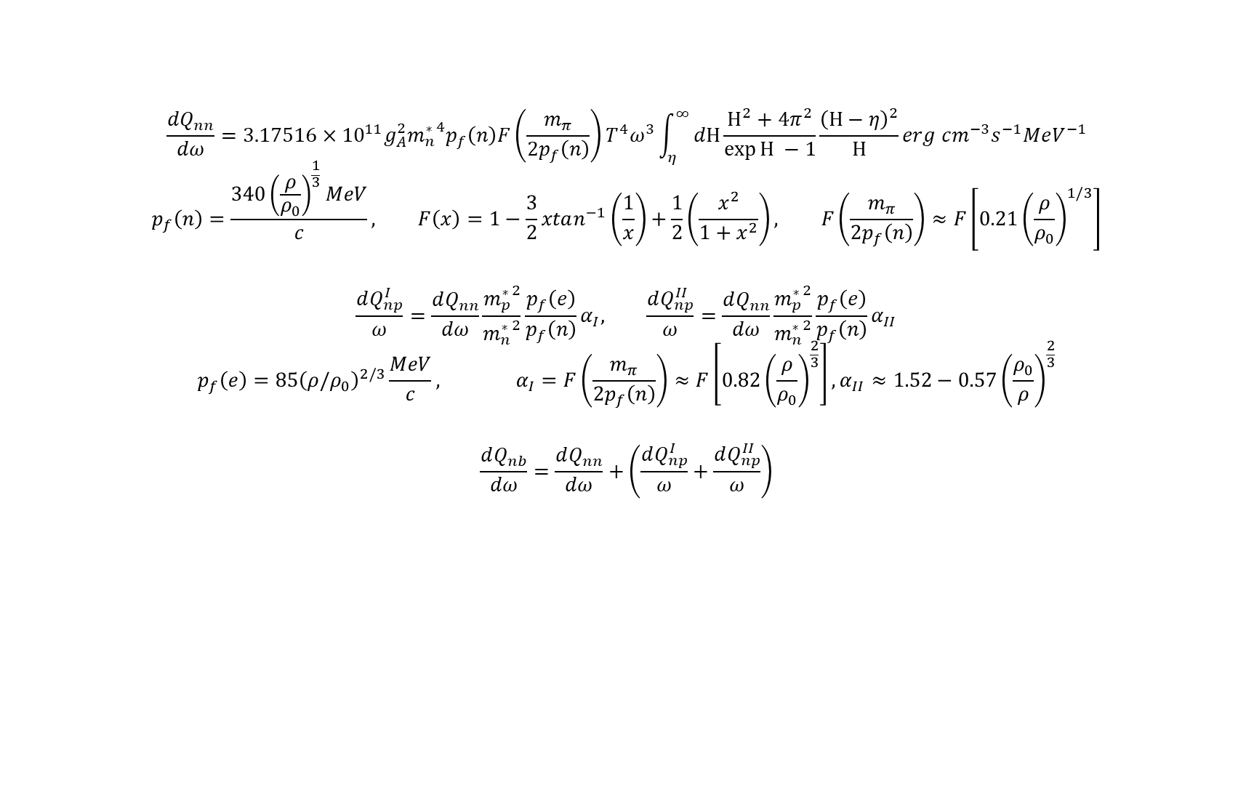
$$\frac{dQ_{nn}}{dω}=3.17516×{10}^{11}g_{A}^{2}{m_{n}^{∗}}^{4}p_{f}\left(n\right)F\left(\frac{m_{π}}{2p_{f}\left(n\right)}\right)T^{4}ω^{3}\int_{η}^{∞}{dΗ\frac{Η^{2}+4π^{2}}{\exp{Η} −1}\frac{{\left(Η−η\right)}^{2}}{Η}}erg cm^{−3}s^{−1}MeV^{−1}$$
$$p_{f}\left(n\right)=\frac{{340\left(\frac{ρ}{ρ_{0}}\right)}^{\frac{1}{3}}MeV}{c}, F\left(x\right)=1−\frac{3}{2}xtan^{−1}\left(\frac{1}{x}\right)+\frac{1}{2}\left(\frac{x^{2}}{1+x^{2}}\right), F\left(\frac{m_{π}}{2p_{f}\left(n\right)}\right)≈F\left[0.21{\left(\frac{ρ}{ρ_{0}}\right)}^{1/3}\right]$$
$$\frac{dQ_{np}^{I}}{ω}=\frac{dQ_{nn}}{dω}\frac{{m_{p}^{∗}}^{2}}{{m_{n}^{∗}}^{2}}\frac{p_{f}\left(e\right)}{p_{f}\left(n\right)}α_{I}, \frac{dQ_{np}^{II}}{ω}=\frac{dQ_{nn}}{dω}\frac{{m_{p}^{∗}}^{2}}{{m_{n}^{∗}}^{2}}\frac{p_{f}\left(e\right)}{p_{f}\left(n\right)}α_{II}$$
$$p_{f}\left(e\right)={85\left(ρ/ρ_{0}\right)}^{2/3}\frac{MeV}{c}, α_{I}=F\left(\frac{m_{π}}{2p_{f}\left(n\right)}\right)≈F\left[0.82{\left(\frac{ρ}{ρ_{0}}\right)}^{\frac{2}{3}}\right],α_{II}≈1.52−0.57{\left(\frac{ρ_{0}}{ρ}\right)}^{\frac{2}{3}}$$
$$\frac{dQ_{nb}}{dω}=\frac{dQ_{nn}}{dω}+\left(\frac{dQ_{np}^{I}}{ω}+\frac{dQ_{np}^{II}}{ω}\right)$$

Slide 21
KDE0v1 Temp, density profile
Notes:
Emissivity 떨어져서 FM1이 100ms에서 올랐나

