Slide 1
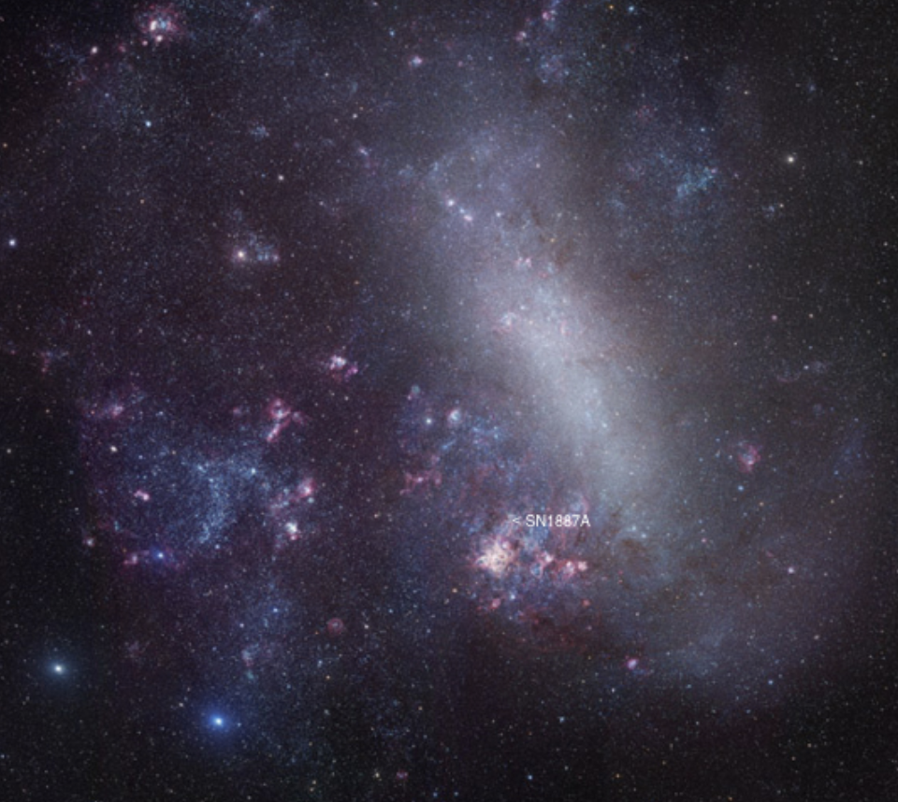

A parametric model for the SN1987A neutrinos
Giulia Ricciardi
Università di Napoli Federico II and INFN, Sezione di Napoli, Italy
NNN26 · Chung-Ang University, Seoul · 29 October 2026
Notes:
NNN26: 20 minutes including questions. The talk, slides 1–16, is timed at 15 minutes, leaving 5 for questions; be at slide 8 by 6:30, at slide 12 by 10:00 and at slide 15 by 13:00. The KIAS slides left out of this talk open the backup (18–23).
0.25 min. Thank the organisers. The collaborators and the two papers are on the next slide.

Slide 2
Outline
1
Premise on neutrinos from core collapse SN1987A; setting the stage
2
Goal: Getting info on the ν̄_{e} flux; How: building a parametric model
3
Added bonus 1 improving the accuracy of times of arrival 39 years later
4
Added bonus 2 a closer look to the first detected antineutrino: it could be a neutrino
5
Summary and conclusion
Notes:
Section: INTRODUCTION
0.5 min.
Five clicks: one part at each click.
Say: "First, a premise on the neutrinos from core collapse and SN1987A, to set the stage. Our goal is information on the electron antineutrino flux, and the way is a parametric model. Then two added bonuses: the times of arrival, made more accurate 39 years later, and a closer look at the first detected antineutrino, which could be a neutrino. I will close with a summary."

Slide 3





The collaboration
Riccardo Maria Bozza
Vigilante di Risi
Veronica Oliviero
Giulia Ricciardi
Francesco Vissani
Dipartimento di Fisica E. Pancini, Università di Napoli Federico II and INFN, Sezione di Napoli, Italy
ICTP-AP, University of Chinese Academy of Sciences, 100190 Beijing, China
Université de Haute-Alsace, rue des Frères Lumière, 68093 Mulhouse Cedex, France
Dipartimento di Fisica E. Pancini, Università di Napoli Federico II and INFN, Sezione di Napoli, Italy
INFN, Laboratori Nazionali del Gran Sasso, 67100 Assergi, L'Aquila, Italy
The flux of electron antineutrinos from supernova SN1987A data
R. M. Bozza, V. di Risi, G. Matteucci, V. Oliviero, G. Ricciardi, F. Vissani
JCAP 05 (2025) 027 · arXiv:2501.09445
A High-Precision Statistical Analysis of the SN1987A Neutrino Temporal Distribution
R. M. Bozza, V. di Risi, V. Oliviero, G. Ricciardi, F. Vissani
arXiv:2605.06401 · to be published in EPJC
Code: github.com/VOliviero/SN1987A_Analysis
Notes:
Section: INTRODUCTION
0.25 min.
Say: "This is joint work with Riccardo Maria Bozza, also in Naples, Vigilante di Risi, Veronica Oliviero and Francesco Vissani. Giuseppe Matteucci joined us for the first paper."
On the slide, the affiliations: di Risi at ICTP-AP in Beijing, Oliviero at the Université de Haute-Alsace in Mulhouse, Vissani at the Gran Sasso laboratories.
The first paper, in JCAP, is a global fit of the 29 events with a physically motivated model of the electron antineutrino flux. The second, to be published in EPJC, aligns the clocks of the three detectors and tests the nature of the first event. The analysis code is public.

Slide 4

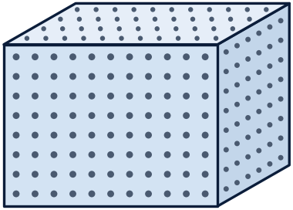

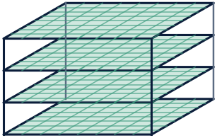
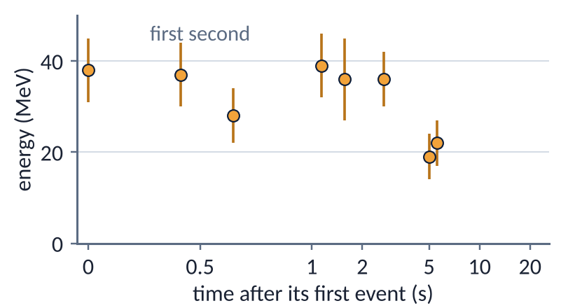
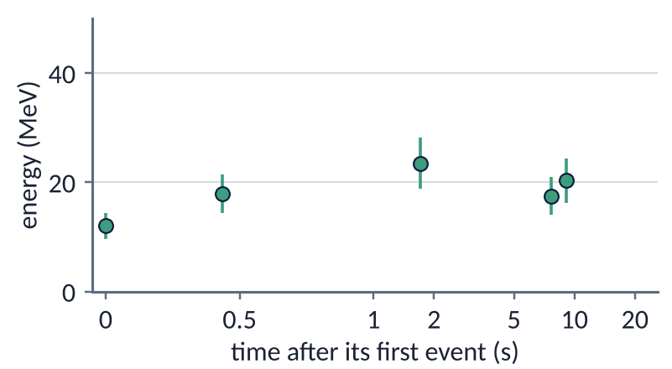
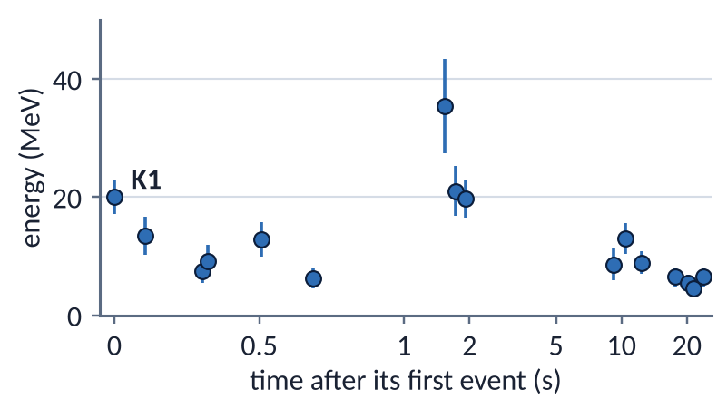
SN1987A in the Large Magellanic Cloud: 29 events in 24 seconds
IMB
Fairport, Ohio, USA
Baksan
Caucasus, USSR
Kamiokande-II
Kamioka mine, Japan
IMB
Water Cherenkov
≈ 8000 t of water
8 events
Baksan
Liquid scintillator
≈ 300 t, in layers
5 events
Kamiokande-II
Water Cherenkov
≈ 3000 t of water
16 events
Detectors drawn to the same scale. t = 0 at its first event, time linear to 1 s, then logarithmic; energies with 1σ errors; analysis window 30 s.
The controversial LSD (Mont Blanc) events not used.
Notes:
Section: SN1987A · 23 FEBRUARY 1987
0.75 min. For this audience the collapse needs no introduction; if asked: the stages of the collapse, backup 24; the energy in three phases, backup 25.
Say: "On 23 February 1987 the neutrinos of a supernova in the Large Magellanic Cloud, 168,000 light-years away, reached the Earth: the first neutrinos ever detected from another galaxy. Three detectors in the Northern Hemisphere saw them, through the Earth: 29 events in 24 seconds, about two dozen of them neutrinos from the supernova, the rest background. They are still the only neutrinos ever detected from a supernova."
Say: "We treat all 29 events as inverse beta decays of electron antineutrinos, or as background." (Why inverse beta decay: backup 18.)
The map: where the 29 events were recorded, from west to east.
IMB, in the Morton salt mine at Fairport, Ohio: a water Cherenkov detector with about 8000 t of water; 8 events. Baksan, in the Caucasus, then in the Soviet Union: layers of liquid-scintillator modules, about 300 t; 5 events. Kamiokande-II, in the Kamioka mine, Japan: a water Cherenkov detector with about 3000 t of water; 16 events.
The water Cherenkov detectors measure the energy and the direction of each positron; Baksan measures the energy only.
SN1987A is in the southern sky: at 7:35 UT it was below the horizon at all three sites, so the neutrinos crossed the Earth, 4300 km to Kamiokande-II, 8600 km to IMB and 10,500 km to Baksan (EPJC table 3). The wavefront reached Kamiokande-II 7 ms before IMB and Baksan 3 ms after, well below the 50 ms of the IMB clock.
The panels: the raw data before any model. Each panel is one detector on its own clock, with t = 0 at its first event; time is linear up to 1 s, then logarithmic. Eleven of the 29 events fall in the first second.
About 6.6 background events are expected, 5.6 of them in Kamiokande-II, 1.0 in Baksan, none in IMB. No event is removed by hand: the likelihood weighs each event as signal or background.
Point at K1, the first Kamiokande-II event, at 20 MeV: it comes back in the second paper.
If asked about LSD: the two LSD events inside the 30 s window are excluded because their background is not published (JCAP, footnote 2); the five events 4 h 43 min earlier have no clear counterpart in the other detectors.
Observation papers: Kamiokande-II, PRL 58 (1987) 1490 and PRD 38 (1988) 448; IMB, NIM A 264 (1988) 28 and PRD 37 (1988) 3361; Baksan, PLB 205 (1988) 209.

Slide 5
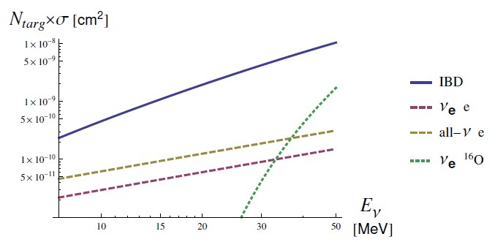
What detectors see: ν̄_{e} through inverse beta decay (IBD)
≈ 100 ×
IBD over elastic scattering on an electron at 10–20 MeV, per target
Targets × cross section per kiloton of water: IBD on free protons, elastic scattering on electrons (ν_{e}, and all flavours),
ν_{e} on ¹⁶O. Charged-current reactions on ¹⁶O have thresholds of 11–15 MeV and matter only above about 30 MeV.
F. Vissani, J. Phys. G 42 (2015) 013001
We assume that all 29 events are IBD
Notes:
Section: SN1987A
1.5 min. Say: "Of all these neutrinos, what does a water or scintillator detector see? Mostly electron antineutrinos, through inverse beta decay on free protons."
The figure (Vissani 2015) shows the number of targets times the cross section, per kiloton of water. Inverse beta decay on the free protons dominates at all supernova energies: at 10–20 MeV its cross section is about a hundred times that of elastic scattering on an electron, and even with five times more electrons than free protons, and all flavours together, elastic scattering is about ten times smaller. Charged-current reactions on oxygen have thresholds of 11 MeV (ν̄e) and 15 MeV (νe) and matter only above about 30 MeV.
The positron carries the antineutrino energy, Ee ≈ Eν − 1.3 MeV, and is emitted almost isotropically: the detectors measure the ν̄e spectrum event by event, and the angles are a test of the hypothesis.
So we assume that all 29 events are IBD, with an up-to-date IBD cross section (Ricciardi, Vignaroli, Vissani, JHEP 08 (2022) 212). In the likelihood each event can still be background. One event, K1, is discussed in the second paper.

Slide 6
Why revisit the 29 events?
A parametric model, rather than a simulation
Simulations
  still lack an accurate estimate of their uncertainties
  reliance on hypotheses not fully consolidated, or on details at risk of reconsideration
Parametric model
  Few parameters with a physical meaning: easy to interpret, and to compare with simulations
  Adaptable to future data: Hyper-K, JUNO, DUNE and IceCube
ON THIS BASIS, THREE IMPROVEMENTS ON EARLIER ANALYSES
1
Better models
2
All the information
3
Better statistical analysis
A smooth rise until t_{max} ≈ 100 ms, as in simulations, then accretion and cooling; earlier fits started accretion at its peak; use of updated
IBD cross section
Time, energy and angle of every event, background included: no event is removed a priori
Unbinned likelihood; errors from the Δχ² profiles; goodness of fit with Kolmogorov–Smirnov and Cramér–von Mises tests
G. R., N. Vignaroli, F. Vissani, JHEP 08 (2022) 212
Notes:
Section: FIRST PAPER · THE ANTINEUTRINO FLUX · JCAP 05 (2025) 027
1 min. Say: "Why go back to 29 events, almost forty years later? They are still the only neutrinos from a stellar collapse, and they deserve the best analysis we can do. The basis is a parametric model."
Four clicks: the parametric model, then the three improvements, one at a time.
Why a parametric model (JCAP section 2.1): models derived from ab initio simulations would be preferable in principle, but the simulations still fail to provide an accurate estimate of their uncertainty. A model motivated by the physics, with parameters able to describe the theoretical uncertainties, lets the analysis proceed without relying on hypotheses that are not fully consolidated, or on quantitative details at risk of reconsideration. Parameters with a physical meaning are easy to interpret, and the results can be compared with simulations afterwards. The same framework is adaptable to future observations: from the next Galactic supernova, Hyper-Kamiokande, JUNO, DUNE and IceCube will record thousands of events, and will see the initial rise of the signal.
On this basis, three improvements on earlier analyses.
Better models: simulations show that the signal rises over the first ~100 ms, then accretion and cooling follow. The models most used in data analysis assume quasi-thermal spectra, neglect accretion or describe it partially, and the reference fits (Loredo and Lamb 2002, Pagliaroli et al. 2009) start accretion at the luminosity peak, with a discontinuity at the onset. The IBD cross section is the most accurate to date (Ricciardi, Vignaroli, Vissani, JHEP 08 (2022) 212).
All the information: the time, energy and angle of every event, with the background of each detector, and no event excluded a priori. The response of each detector is rebuilt from the published data.
Better statistical analysis: one unbinned Poisson likelihood with times, energies, angles and background; best fit and 1σ intervals from the profile Δχ²; the significance of accretion with ξn0 = 0 on the boundary; goodness of fit with the Kolmogorov–Smirnov and Cramér–von Mises tests. Python and Mathematica codes cross-check each other.
The next slides follow one thread: the model and its time profile (slide 5; the two phases and the spectra in backups 19–20), the global fit, with the best fit, the accretion test and the goodness of fit (slide 6; the expected signal and the detector response in backup 21), and what the results tell us about the collapse (slide 7).

Slide 7
Five ingredients in forty years of analyses
The five ingredients
ES channel
Energy
Time
Angle
Oscillations
Clock differences: introduced in 1987–88 for Kamiokande-II and IMB only, without errors. Not in the table: Li, Beacom, Roberts and Capozzi 2024.
Notes:
Section: BACKUP
Backup. EPJC table 4 condensed into a count. Three previous analyses reach four ingredients: Vissani et al. 2008, Pagliaroli et al. 2009, Dedin Neto et al. 2023. Check before using the historical framing: EPJC table 4 classifies Abbott et al. 1988 as an analysis with clock differences (RTO), while the JCAP (§4.2) credits the same work with introducing the delays. Li, Beacom, Roberts and Capozzi, PRD 109 (2024) 083025, is the closest recent work and is missing from the table.

Slide 8
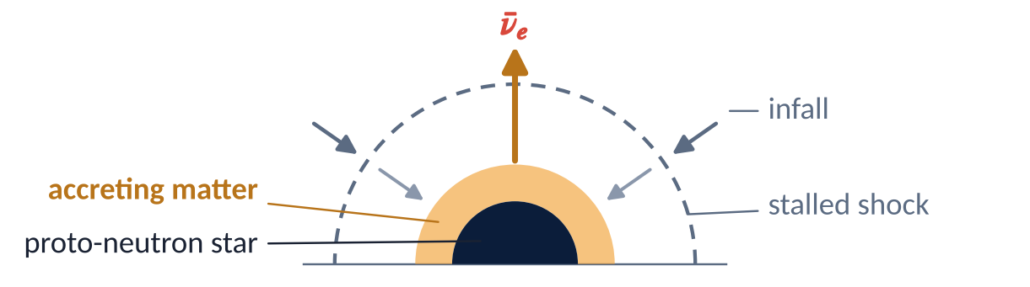
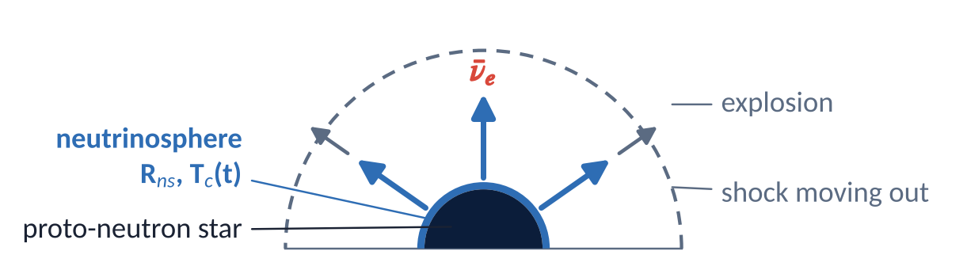
Where the ν̄_{e} come from: accretion, then cooling
Accretion · a fraction of a second
Matter falls onto the proto-neutron star until the explosion starts
e⁺ n → p ν̄_{e}
e⁻ p → n ν_{e}
10–20% share of the energy
Cooling · about ten seconds
Once the explosion starts, only the hot proto-neutron star radiates
e⁺ e⁻ → ν ν̄
N N → N N ν ν̄
80–90% share of the energy
Schematics not to scale.
Notes:
Section: FIRST PAPER · THE ANTINEUTRINO FLUX
1.5 min. One click: the cooling phase.
Say: "Where do the antineutrinos come from? First, accretion: for a fraction of a second, matter keeps falling through the stalled shock onto the proto-neutron star; in this hot matter, positrons captured on neutrons give electron antineutrinos, and electrons captured on protons give electron neutrinos. Accretion carries 10 to 20% of the energy. Then cooling: once the explosion starts, the infall stops, and only the hot proto-neutron star radiates, for about ten seconds, neutrinos of all flavours, from pair annihilation and nucleon bremsstrahlung among other processes: 80 to 90% of the energy. Each component has its parameters, in red on the next two slides: for accretion, the mass of the neutrons involved and a decay time; for cooling, the radius, the temperature and a decay time."
Accretion (JCAP §2.1): Nn = ξn M⊙/mn neutrons of the outer core, exposed to the flux of hot positrons; iron is dissociated there, so the fraction of free neutrons is Yn = 0.6. The positron temperature Ta = 0.6 T0 stays constant; the ratio matches the mean energies of the two phases (JCAP eq. 2.8).
Cooling (JCAP §2.1): a sphere of constant radius Rns at temperature Tc(t).
The shares of the energy, 10–20% for accretion and 80–90% for cooling, with about 1% for the neutronization burst, are those of Pagliaroli, Vissani, Costantini and Ianni, Astropart. Phys. 31 (2009) 163 (backup 26).
ξn0 and T0 are the values at the peak of the emission, t = tmax (JCAP §2.2). Five free parameters: ξn0, τa, Rns, T0, τc, in red on slides 8 and 9.
In the model the two components start together and both rise until tmax; cooling outlasts accretion (JCAP figure 1: mainly accretion, then cooling only). The bands show the two stages, not two sources separated in time.
The schematics are not to scale: the stalled shock lies at 100–200 km, the proto-neutron star is a few tens of kilometres across.

Slide 9
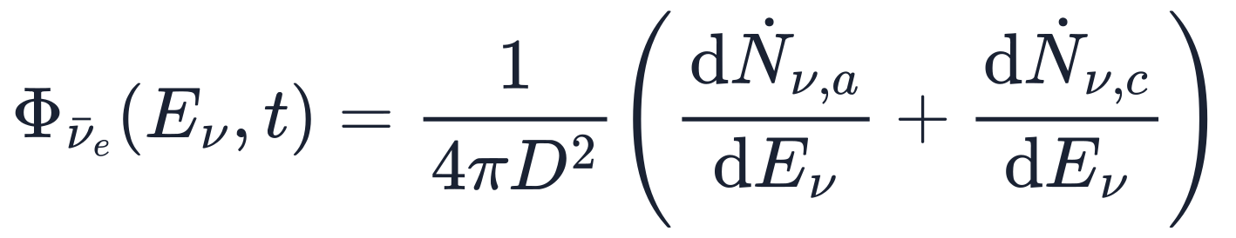
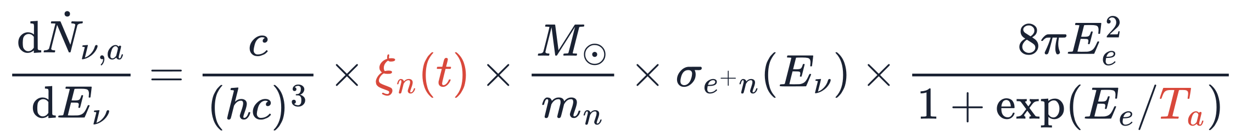
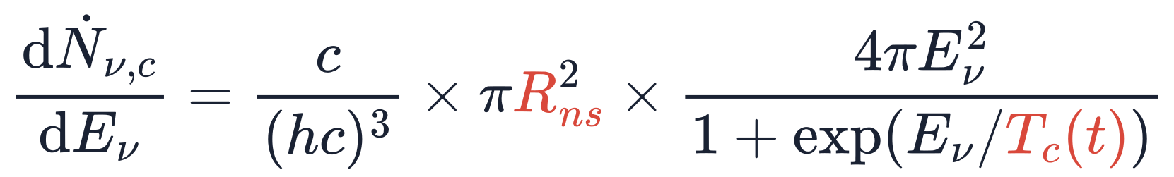
The ν̄_{e} flux at Earth: two emission spectra
D = 51.4 kpc, the distance of SN1987A
Accretion
e⁺n → p ν̄_{e} on the free neutrons of the accreting matter; the capture cross section makes the spectrum non-thermal
Cooling
Fermi–Dirac emission from a sphere of radius R_{ns} at temperature T_{c}
F. Vissani and A. Gallo Rosso, Symmetry 13 (2021) 1851
Notes:
Section: FIRST PAPER · THE ANTINEUTRINO FLUX
1.25 min.
Say: "The flux at Earth is the sum of two emission spectra, divided by 4πD². Accretion: positron capture on neutrons, e⁺n → pν̄e, with a spectrum that is not thermal, because of the capture cross section. Cooling: a thermal, Fermi–Dirac spectrum from a sphere of radius Rns. In red, the radius Rns, the positron temperature Ta and the two factors ξn(t) and Tc(t), which carry the time dependence: next slide."
The flux at Earth is the sum of the two emission rates divided by 4πD², with D = 51.4 kpc (JCAP eq. 2.5).
Accretion (JCAP eq. 2.3): Nn = ξn M⊙/mn neutrons of the outer core, exposed to the flux of hot positrons of temperature Ta; ξn is the neutron mass in solar masses, Ee the positron energy, σe⁺n the positron-capture cross section.
Cooling (JCAP eq. 2.2): a Fermi–Dirac spectrum from a sphere of radius Rns at temperature Tc.
The model is that of F. Vissani and A. Gallo Rosso, Symmetry 13 (2021) 1851.

Slide 10
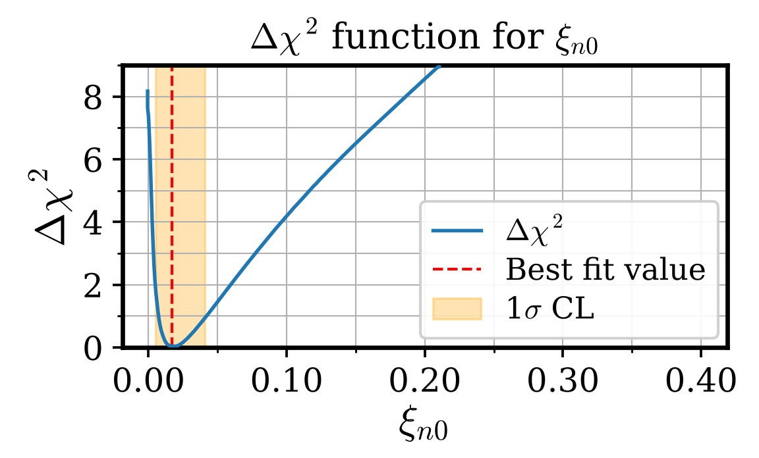
Statistical analysis
1
Global fit
2
Is accretion needed?
3
Goodness of fit
χ² minimised over 8 free parameters, the 5 of the emission and the 3 delays; 1σ interval where the profile χ² rises by 1
Fit repeated with ξ_{n0} = 0, cooling only: the rise of χ² measures the evidence; ξ_{n0} = 0 lies on the boundary of the allowed range
Kolmogorov–Smirnov and Cramér–von Mises tests: the times, energies and angles of the events against the best-fit model
R_{ns}
T₀
τ_{c}
ξ_{n0}
τ_{a}
Distributions: p-values on the whole sample
 | KS | CvM
Times | 82.8% | 88.4%
Energies | 50.7% | 77.7%
Angles | 5.5% | 2.0%
t_{k}
t_{i}
t_{b}
Delays: from the arrival of the first ν̄_{e} on Earth to the first event in Kamiokande-II, IMB and Baksan
ξ_{n0} = 0, circled: χ² is higher by 8.2
than at the best fit
Kolmogorov–Smirnov and Cramér–von Mises tests. With the parameters fitted to the same data, the p-values are optimistic.
Cooling alone
p = 0.2–0.8%
Notes:
Section: FIRST PAPER · THE ANTINEUTRINO FLUX
1.5 min. Two clicks: the accretion test, then the goodness of fit.
Say: "The statistical analysis rests on one unbinned Poisson likelihood per detector: the probability of seeing no events other than the observed ones, times, for each event, the background or the signal at its measured time, energy and angle. The time of each event is its time on the detector's clock plus a delay, fitted, between the arrival of the first antineutrino and the first event. With this likelihood we do three things. We find the best fit of the eight parameters, the five of the emission and the three delays, and their errors: one sigma is where the profile χ² rises by one."
Click 1. Say: "We ask whether accretion is needed, by repeating the fit without it. Here is the profile of the accretion parameter: without accretion, at its left end, the χ² is higher by 8.2. Cooling alone is disfavoured, at about 2.5 sigma."
Click 2. Say: "And we test the goodness of the fit on the times, energies and angles. The times follow the model through both phases. The energies agree on the whole sample, with the known tension between a cooler Kamiokande-II and a hotter IMB. The angles are the weak point, with p-values of 2 to 6 percent."
The expected signal in each detector, with the response functions rebuilt from the published data and the Kamiokande-II threshold lowered from 7.5 to 4.5 MeV, so that the low-energy events K13 to K16 stay in the sample: backup 21 (the functions: backup 34). With K13–K16 the Kamiokande-II angles improve.
Likelihood (JCAP eq. 4.2, written out in backup 27): unbinned and Poissonian, one per detector. e^(−f_live N_tot): no events other than the observed ones, with N_tot integrated over 0–30 s (JCAP eq. 3.5). For IMB f_live = 0.9055 (dead time and muons) and the factor e^(S τd) accounts for the 35 ms of dead time after each event; for Kamiokande-II and Baksan f_live = 1 and τd = 0. Bj/2 + S: background or signal at the energy, angle and time of event j. tj = td + δtj (JCAP eq. 4.3).
Estimation (JCAP §4.1–4.2): the profile likelihood, minimising rather than marginalising, which is computationally lighter; for SN1987A no substantial difference from marginalisation is expected (Pagliaroli et al. 2009). Flat priors (JCAP eq. 4.4, backup 33). The intervals at Δχ² = 1 are 1σ. The profile of τc (JCAP figure 7), with its asymmetric interval: backup 27.
Accretion test (JCAP §5.4 and footnote 10): Δχ² = 8.2 between cooling alone (ξn0 = 0) and cooling plus accretion. ξn0 = 0 lies on the boundary of the allowed region, so under the null hypothesis the test statistic is the mixture ½δ + ½χ²m, with m = 1 (one parameter fixed) or 2 (ξn0 and τa removed): p = 0.21% and 0.83%, that is 2.4–2.9σ one-sided. Say "about 2.5 sigma"; avoid "accretion at 99%": a p-value belongs to the null hypothesis. Pagliaroli et al. 2009 found Δχ² = 9.8–14.7 for their models. If asked: τa is not defined when ξn0 = 0 (Davies' problem), so neither mixture is strictly justified; a toy Monte Carlo under the null hypothesis, or the Davies bound, is the rigorous answer, and a quick estimate gives p ≈ 0.006, inside the range. Details: backup 42.
p-values on the whole sample (JCAP §5.6): times KS 82.8%, CvM 88.4% (JCAP figure 8, backup 29); energies 50.7% and 77.7%; angles 5.5% and 2.0%. By detector (JCAP table 5, backup 35): IMB energies 4.4–10.9%; Kamiokande-II angles 38.0–49.0% with K13–K16, 7.0–11.9% without them. The same values as a chart, with the 5% threshold: backup 43. The counts, 29 observed against 31.1 expected: backup 29. How the two tests work: backup 52.
Angles: less problematic than in earlier analyses (Krivoruchenko 1989, Malgin 1998, Costantini, Ianni and Vissani 2004), but not entirely satisfactory; JCAP attributes the deviation to the particular data set (§5.6). The conclusion of the paper: the description of the flux is quite reliable, particularly the temporal distribution.
Caveat for experts: the p-values use parameters fitted to the same data, so they are optimistic; the good values for the times are not strong evidence by themselves.
The angles return in the second paper, with K1. If asked about the old "forward peaking": in 1988 Kamiokande-II revised the direction of K2 and the anomaly decreased.
Two codes: Python and Mathematica, developed in parallel, give results consistent to high precision (JCAP §4.1).

Slide 11
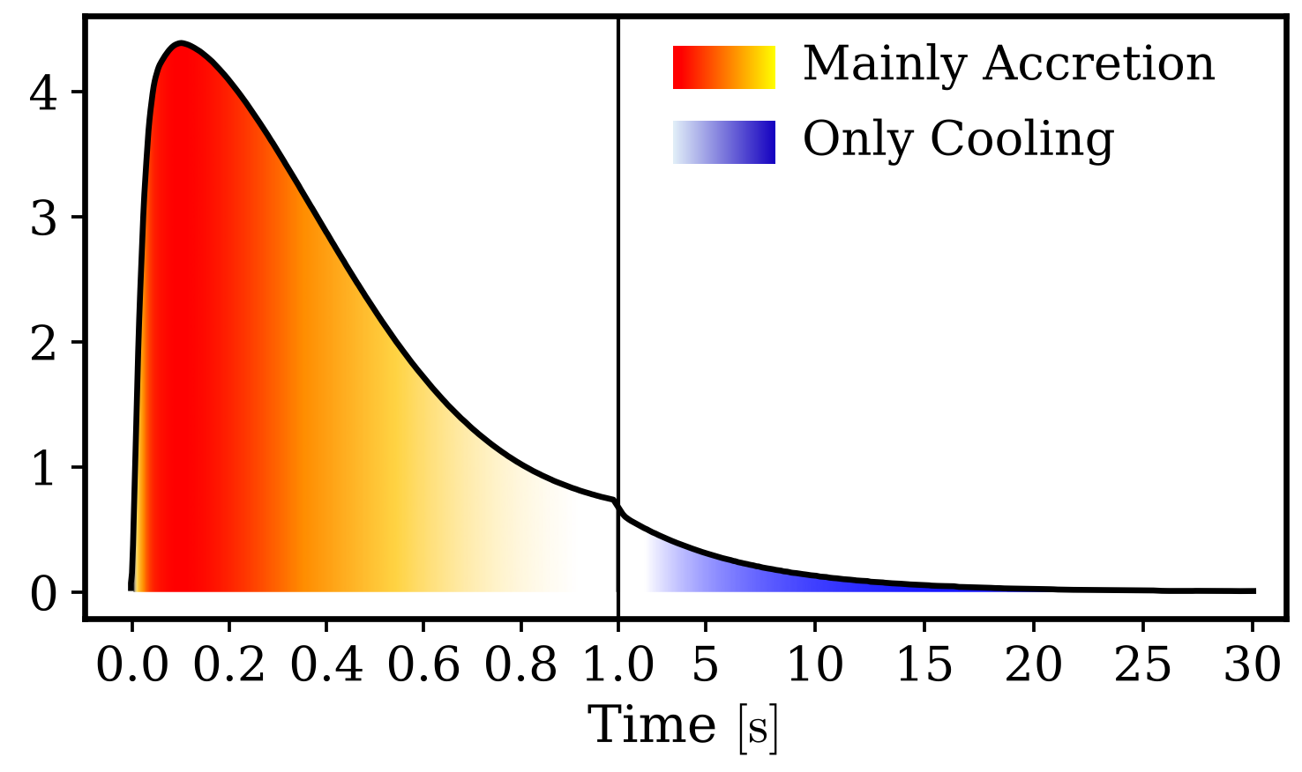
Physical conclusions: what the 29 events tell us
Best fit and 1σ | R_{ns} | T₀ | τ_{c} | ξ_{n0} | τ_{a} | t_{k} | t_{i} | t_{b}
 | 17 (+6/−5) km | 4.6 (+0.5/−0.4) MeV | 5.6 (+1.8/−1.3) s | 0.018 (+0.025/−0.011) | 0.52 (+0.24/−0.15) s | 35 (+65/−24) ms | 43 (+102/−29) ms | 54 (+152/−41) ms
From the Δχ² profile. χ² = 263.5 at the minimum. The delays are uncorrelated with the emission parameters.
7–11 s
Cooling of the proto-neutron star
Thermal ν̄_{e} emission: 95% of the expected events fall in this window, as in some recent simulations
Luminosity (10⁵² erg/s)
0.03 M⊙
Accretion before the explosion
ν̄_{e} from a neutron atmosphere around the proto-neutron star, thinner than in earlier fits (0.14 M⊙)
35–54 ms
Delays of the first events
Each known to about 0.1 s: the key to the clocks of the three detectors
The ν̄_{e} luminosity of the best fit: mainly accretion (red to yellow) in the first second, then cooling only (blue).
Simulations: Fiorillo et al., PRD 108 (2023) 083040. Earlier fits: Pagliaroli et al. 2009.
Notes:
Section: FIRST PAPER · THE ANTINEUTRINO FLUX
1.5 min. Three clicks: the three findings, one at a time.
Say: "What do the 29 events tell us about the collapse? At the top, the best fit with its one-sigma errors: the cooling of a source of about 17 kilometres, 4.6 MeV at the peak, with a decay time of 5.6 seconds; accretion with a decay time of half a second; and the three delays, of a few tens of milliseconds. Here is the antineutrino luminosity they give: mainly accretion in the first second, then cooling only. A hot proto-neutron star cooled by emitting thermal antineutrinos: 95% of the expected events fall within 7 to 11 seconds, as in some recent simulations. Before the explosion, for about half a second, accretion: the antineutrinos came from a neutron atmosphere around the proto-neutron star of about three hundredths of a solar mass, thinner than earlier fits found. And the first event in each detector came a few tens of milliseconds after the first antineutrino, each delay known to about a tenth of a second: this is the key to the second paper. The neutrinos of the first second probe what happens before the explosion begins."
Rns = 17 (+6/−5) km comes from the profile in JCAP figure 7: the +0.7/−0.5 km printed in JCAP eq. (5.1), and repeated in EPJC eq. (5), is a factor-10 typo, confirmed with the coauthors. If asked "17 km is larger than a neutron star": it is the effective radius of the neutrinosphere during cooling, averaged over seconds, and 12 km lies within 1σ.
Correlations (JCAP table 4): Rns with T0 −0.82, ξn0 with T0 −0.81, Rns with ξn0 +0.60. The same number of events can come from a larger, cooler source or from a smaller, hotter one; the energies of the events limit the trade-off. The delays are practically uncorrelated with the emission parameters, so the timing of the two phases is little affected by the rest (JCAP §5.1).
Cooling: 95% of the expected events fall within 10.8 s (Kamiokande-II), 7.3 s (IMB) and 9.8 s (Baksan) (JCAP eqs. 5.6–5.8), in agreement with some of the simulations of Fiorillo et al., PRD 108 (2023) 083040, in particular those with a 1.62 M⊙ neutron star and no convection. The neutron star itself, long sought, now has direct evidence: JWST emission lines from a compact object (Fransson et al., Science 383 (2024) 898, JCAP ref. 81).
Accretion: ξn0 = 1.8%, that is Ma = ξn0 M⊙/Yn with Yn = 0.6, about 0.03 M⊙: the mass exposed to the positron flux, not the accreted mass. JCAP §6: during accretion the ν̄e are produced by a neutron atmosphere around the nascent proto-neutron star, thinner than expected from previous analyses. Pagliaroli et al. 2009 (model IIIB) found 0.14 M⊙, with very similar luminosity curves (JCAP figure 6): the value is model dependent; part of the difference comes from the oscillations included in the earlier fits (JCAP footnote 11).
Delays (in the row at the top): 35, 43 and 54 ms for Kamiokande-II, IMB and Baksan, with uncertainties of about 0.1 s (JCAP §6).
Mean energy, if asked: for a Fermi–Dirac spectrum with zero chemical potential ⟨E⟩ = 3.15 T, so about 14.5 MeV at the peak (our arithmetic, not in the papers).
The luminosity axis is in units of 10⁵² erg/s: JCAP figure 1 prints 10⁵³, but JCAP figure 6 and the cooling formula give a peak of about 4 × 10⁵² erg/s (to be confirmed with the coauthors).
The last sentence of the Say, no longer on the slide, follows JCAP §5.4: the neutrinos recorded at the beginning of the emission are an irreplaceable diagnostic tool of what happens before the beginning of the explosion. Then on to slide 8.

Slide 12
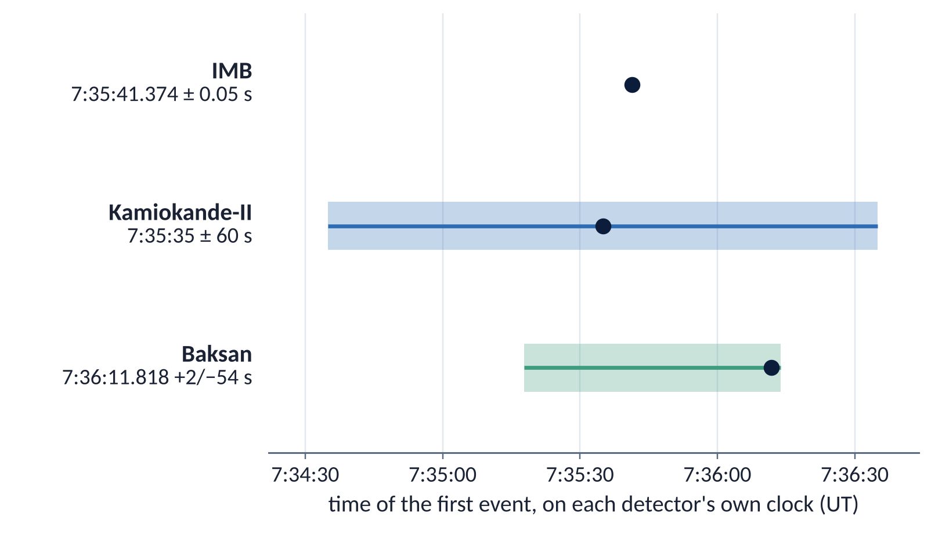
First detected neutrino: synchronise detectors’ clocks a posteriori
The neutrinos reached all three detectors at the same instant, up to a few ms of travel through the Earth.
But detectors’ clocks not synchronised.
Only IMB recorded an accurate absolute time (to 50 ms); Kamiokande-II and Baksan to about a minute.
Inside each detector the relative times are precise.
Notes:
Section: SECOND PAPER · THE CLOCKS · arXiv:2605.06401, to be published in EPJC
1 min. Three clicks: the title, the text on the left, then the figure.
Click 1. Say: "The first paper fitted one delay per detector, between the arrival of the neutrinos and its first event. The second paper uses these delays to solve an old problem: the three detectors were not synchronised."
Click 2. Say: "The neutrinos reached the three detectors at the same instant. But each detector timed its events with its own clock, and only IMB had an accurate absolute time."
Click 3. Say: "So the first event came at 7:35:41 Universal Time, give or take a minute depending on which detector you ask."
The published times of the first event (EPJC table 1): IMB 7:35:41.374 ± 0.05 s; Kamiokande-II 7:35:35 ± 60 s; Baksan 7:36:11.818 +2/−54 s. Only IMB had an accurate absolute time; within each detector the relative times are precise.

Slide 13
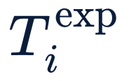
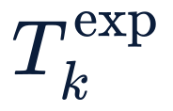
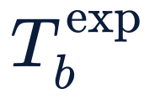
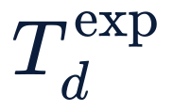
Intrinsic time offset (ITO): delay of first neutrino detection
neutrino arrival, not observed
ITO = (random) delay t_{i}
delay t_{i}
I1
from the global fit
IMB
IMB
t_{i} = 43 (+102/−29) ms
own clock ±0.05 s
first event 7:35:41.374 UT
delay t_{k}
K1
Kamiokande-II
Kamiokande-II
t_{k} = 35 (+65/−24) ms
own clock ±60 s
first event 7:35:35 UT
delay t_{b}
B1
Baksan
Baksan
t_{b} = 54 (+152/−41) ms
own clock +2/−54 s
first event 7:36:11.818 UT
= time of the first detected neutrino event, as reported by each experiment (d = i, k, b)
To scale with the central values; each difference has an error of about 0.1 s.
10 ms
Notes:
Section: SECOND PAPER · THE CLOCKS · arXiv:2605.06401, to be published in EPJC
1 min.
Say: "The first paper fitted one delay per detector, between the arrival of the neutrinos and its first event. The second paper uses these delays to solve an old problem: the three detectors were not synchronised. The neutrinos reached the three detectors at the same instant. But each detector timed its events with its own clock, and only IMB had an accurate absolute time." (The problem in a figure: backup 22.)
Say: "The arrival of the first neutrino is not observed. In each detector the first event follows it after a stochastic delay, which we estimate in the global fit: a few tens of milliseconds, with a long tail, because the first event can come late but never before the signal starts."
Sentence 3: "In each detector the first event came a random delay after that instant, and the global fit of the first paper estimates this delay from the detector's events and the model's time profile."
The JCAP fit gives ti = 43 (+102/−29) ms, tk = 35 (+65/−24) ms, tb = 54 (+152/−41) ms, in the order of the figure. The errors come from the likelihood profile (Δχ² = 1; JCAP figure 4, backup 36): they are asymmetric and are never symmetrised. Fewer events, a longer and more uncertain delay: 16 events in Kamiokande-II, 8 in IMB, 5 in Baksan.
On its own, a delay depends on the rise of the signal, which the data do not resolve. In the EPJC the delays are called ITOs.
Under each first event, T_d^exp: its time as reported by the experiment, on the detector's own clock (EPJC table 1; d = i, k, b): 7:35:41.374 UT for IMB, 7:35:35 UT for Kamiokande-II, 7:36:11.818 UT for Baksan.

Slide 14
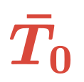
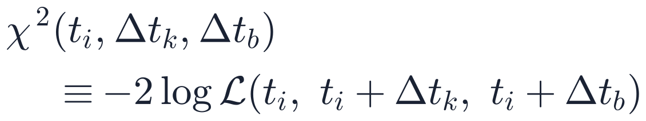
Relative time offsets (RTO)
Δt_{k} = t_{k} − t_{i}
Δt_{b} = t_{b} − t_{i}
The IMB time as the common timeline
neutrino arrival, not observed
Non-Gaussian: each ITO has an asymmetric likelihood with a long tail,
Robust: a slower or faster rise shifts the three delays together; the differences hardly move (ms)
Hence a profile for each difference: the same χ², written in (t_{i}, Δt_{k}, Δt_{b}) and minimised over all the other parameters; 1σ where Δχ² = 1.
delay t_{i}
I1
IMB
own clock ±0.05 s
first event 7:35:41.374 UT
delay t_{k}
K1
Kamiokande-II
own clock ±60 s
first event 7:35:35 UT
Δt_{k}
delay t_{b}
B1
Baksan
own clock +2/−54 s
first event 7:36:11.818 UT
Δt_{b}
To scale with the central values; each difference has an error of about 0.1 s.
10 ms
Notes:
Section: SECOND PAPER · THE CLOCKS
1 min.
Say: "The arrival time of the first neutrino, T̄0, is not observed, but it is common to the three detectors, so it cancels in the difference of two delays. That difference is the time between the first events, independent of the detector clocks."
T̄0, beside the top of the red dashed line: the time at which the first neutrino, not detected, arrives at IMB (EPJC eq. 8). Neglecting the size of the Earth, the three detectors are treated as co-located with IMB, with a common T̄0 (EPJC eqs. 8–9): one dashed line for all three. The transit times, a few ms (the wavefront reached Kamiokande-II 7 ms before IMB, Baksan 3 ms after; EPJC eq. 10), enter only the absolute times of slide 11. Its value, from the convolution of EPJC appendix A: T̄0 = 7:35:41.292 (+0.072/−0.117) UT; the arrival on Earth is T0 = T̄0 − 36 ms (EPJC eq. 11, slide 11).
Robust: a slower or faster rise (tmax) shifts all three delays together, and the differences hardly at all: at most 21 ms for tmax from 50 to 200 ms (EPJC table 2).
Non-Gaussian: each delay has an asymmetric likelihood with a long tail (JCAP figure 5): the first event can come late, never before the signal. Errors add in quadrature only for Gaussian variables, so the interval of a difference must come from its own likelihood.
The procedure (EPJC eq. 6 and figure 1): the same χ², written in (ti, Δtk, Δtb); for each value of Δtk it is minimised over all the other parameters, which gives the profile likelihood; best fit at its minimum, 1σ where Δχ² = 1. The best fit of a difference is the difference of the best fits: the profile adds the interval, and the full distribution needed for the absolute times (EPJC appendix A).
If asked: combining the JCAP errors in quadrature, upper with lower, gives −8 (+71/−105) ms and +11 (+155/−110) ms, within 2 ms of EPJC eq. (7): at fixed tmax the delays are almost uncorrelated. The non-Gaussian shape matters for the absolute times: the convolution of EPJC appendix A gives T̄0 = 7:35:41.292 UT, the plain subtraction Ti − ti gives 41.331, 40 ms later.
If asked "isn't this just a change of variables?": "Same likelihood, the right variables: the differences between the delays are what the data actually determine." The common part of the delays is degenerate with tmax; the differences are not. In the EPJC the differences are called RTOs.

Slide 15
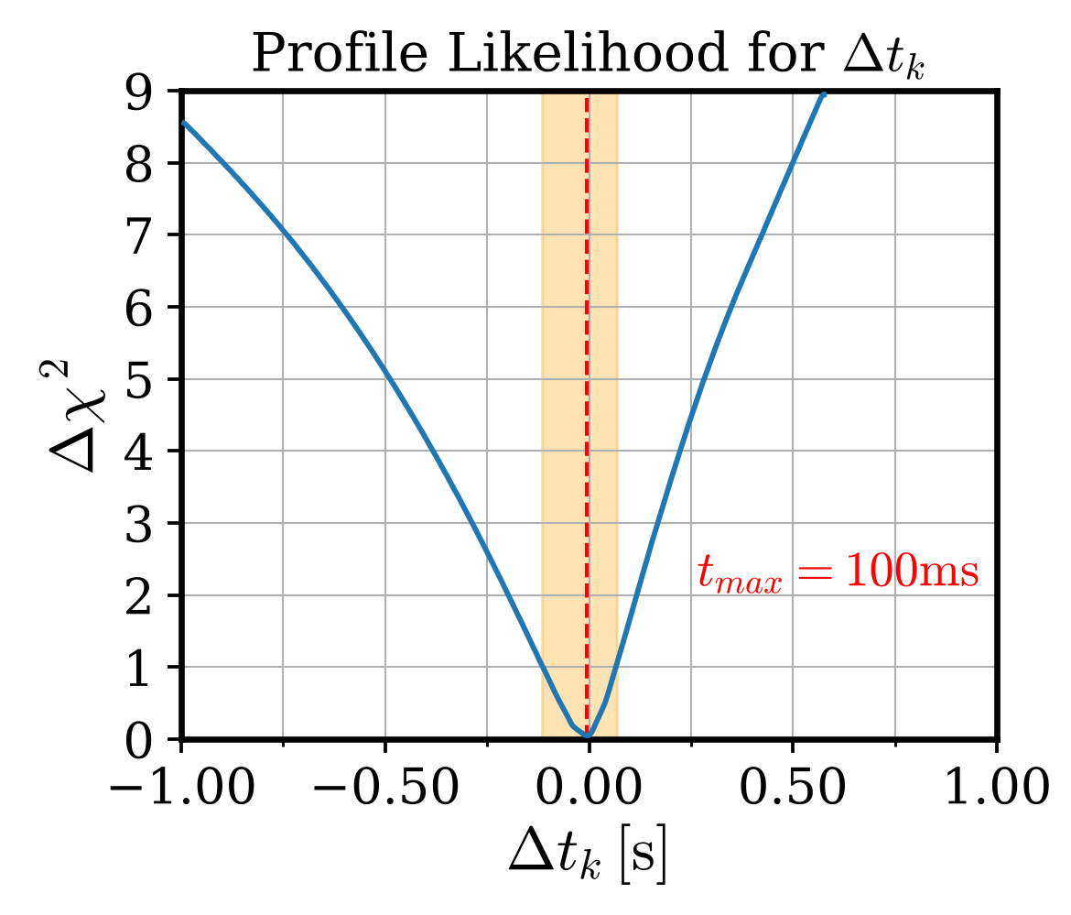
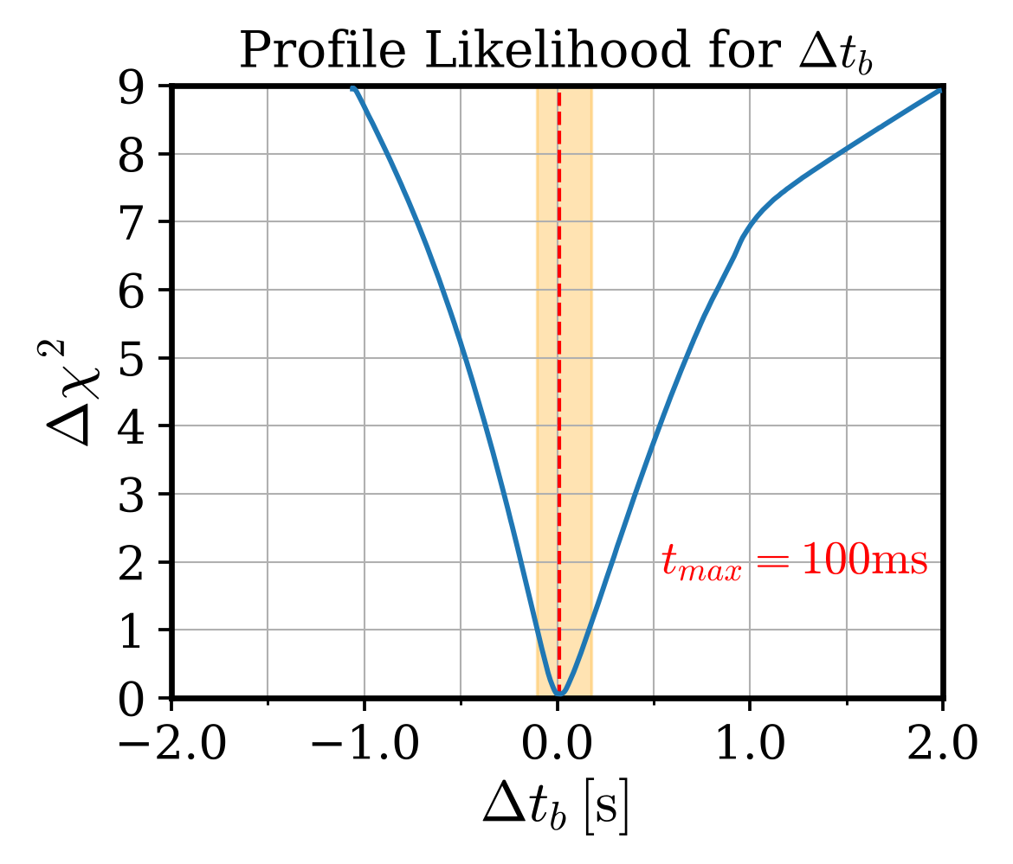
Combined statistical analysis ITO and RTO
I1 at 7:35:41.374 UT ± 0.05 s
Δt_{k} = −7 ms
Kamiokande-II after IMB: +73/−107 ms
Δt_{b} = +10 ms
Baksan after IMB: +157/−112 ms
Both zero within about 0.1 s.
The profiles of the two differences: the best fit at the minimum,
the 1σ interval where Δχ² ≤ 1 (orange band).
Adding each difference to the IMB time puts K1 and B1 on the IMB clock, to about 0.1 s instead of a minute.
Transit through the Earth, included.
Notes:
Section: SECOND PAPER · THE CLOCKS
0.75 min.
Say: "The IMB absolute time is known to fifty milliseconds. Adding the estimated differences places the first events of Kamiokande-II and Baksan on the IMB time scale. Both differences are compatible with zero within about a tenth of a second."
On the left, the profiles of the two differences (EPJC figure 1): the best fit at the minimum, the 1σ interval where Δχ² ≤ 1, in orange. Both are asymmetric, like the delays they come from.
Results (EPJC eq. 7): Δtk = −7 (+73/−107) ms, Δtb = +10 (+157/−112) ms. With tmax between 50 and 200 ms the central values move by at most 21 ms and the errors grow by about a third (EPJC table 2; on slide 9).
Footnote: transit through the Earth. Kamiokande-II was reached 7 ms before IMB, Baksan 3 ms after: included, but below the 50 ms of the IMB clock.
The novelty: the first error on the differences, and the first value for Baksan.

Slide 16
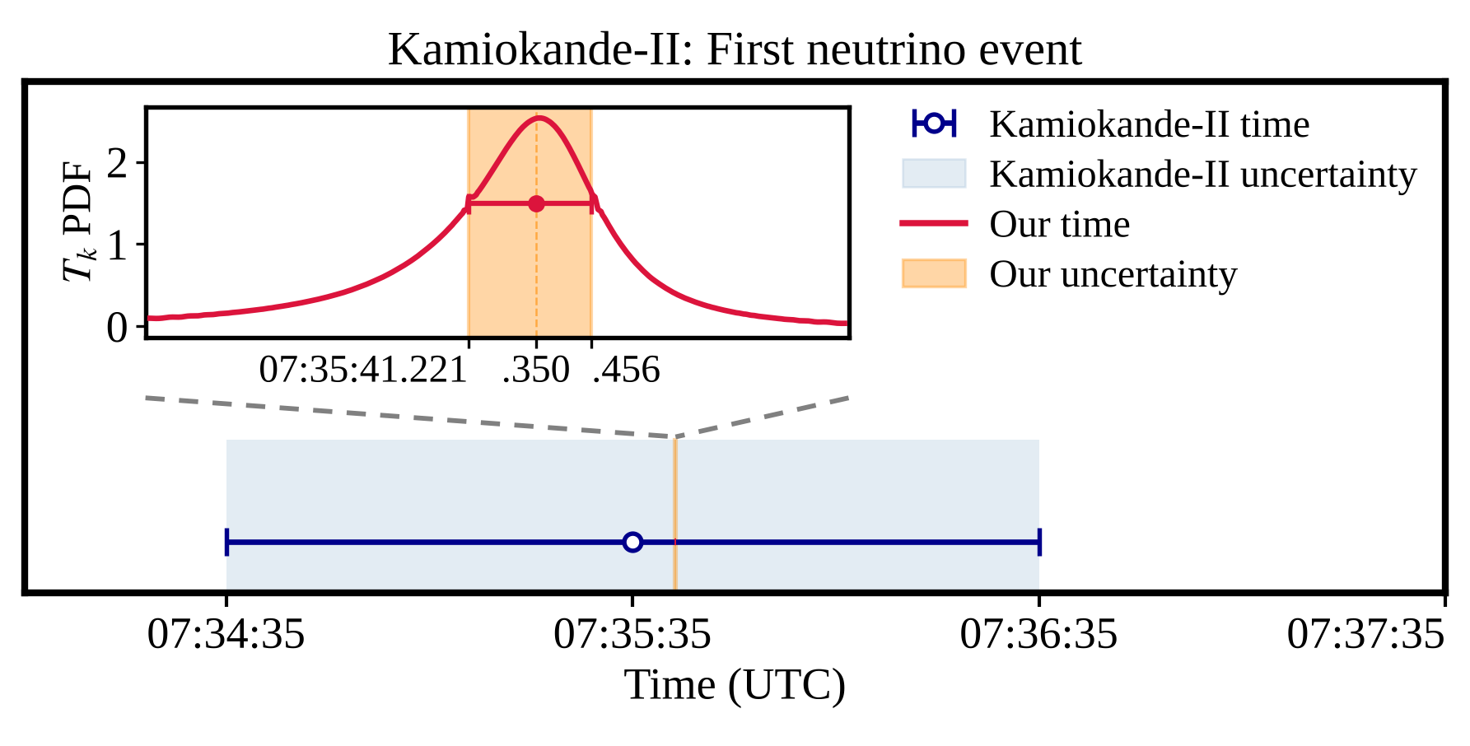
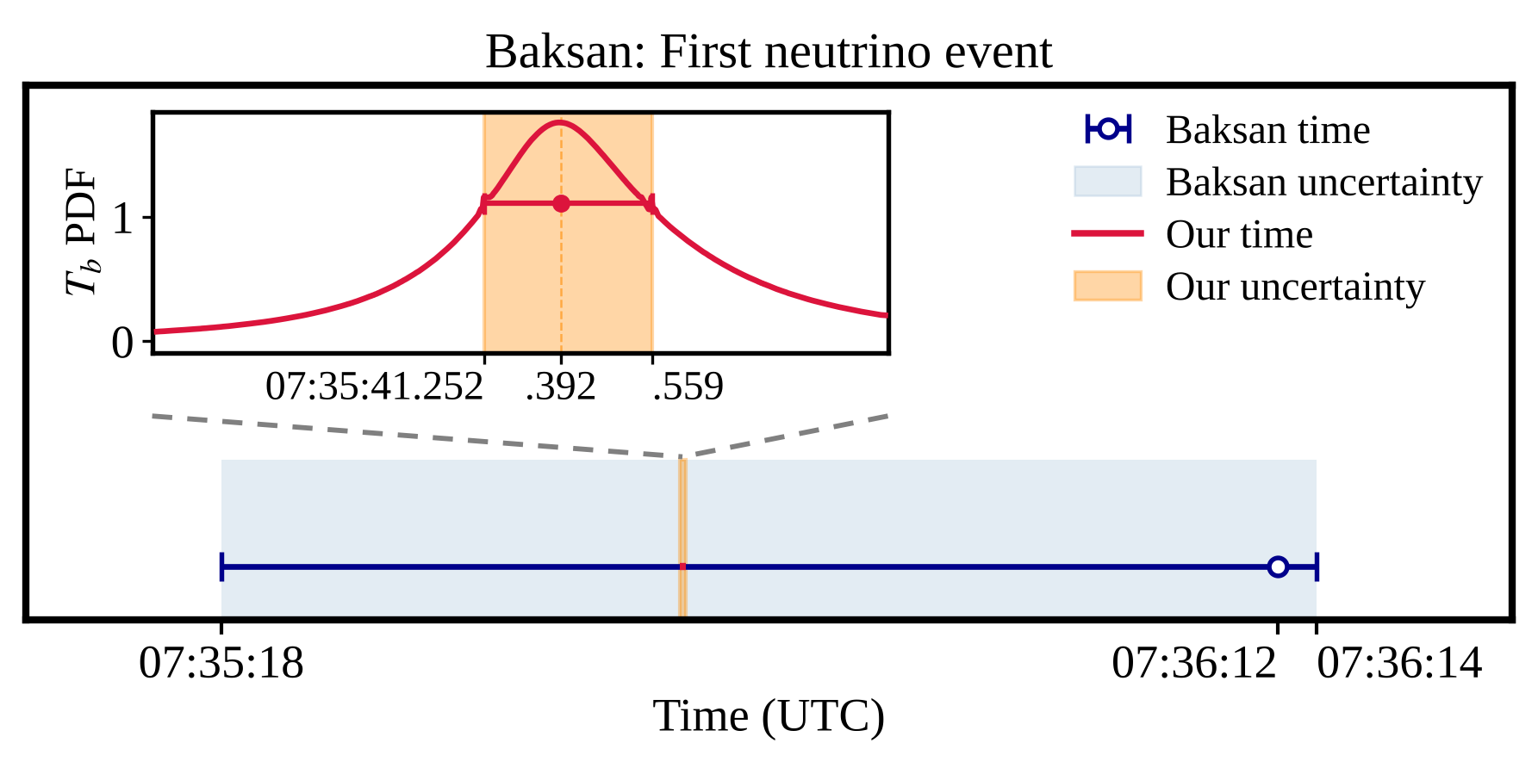
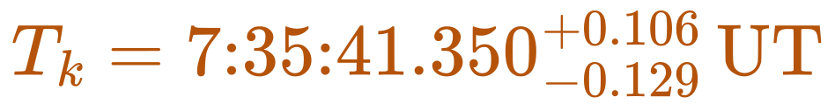
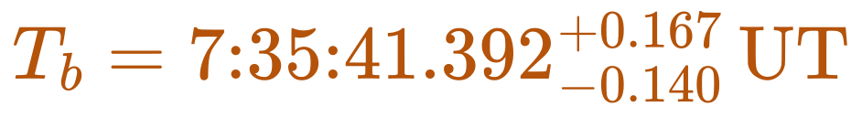
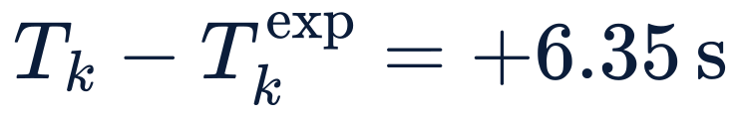
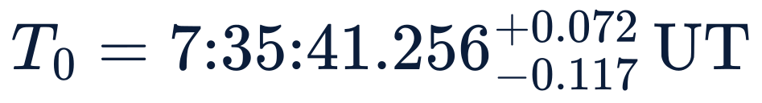
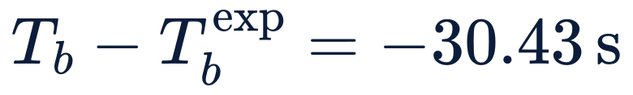
The IMB clock as the common reference
Time of the first event with the detector-clock uncertainty (light blue band);
our estimate on the IMB clock with its uncertainty (orange band; inset: probability density).
K1
B1
Clock corrections, within errors
Arrival on Earth first neutrino
on the IMB clock
on the IMB clock
includes transit time
Kamiokande-II · Baksan
Notes:
Section: SECOND PAPER · THE CLOCKS
0.75 min.
Say: "Kamiokande-II's clock was six seconds behind and Baksan's thirty seconds ahead, both within their quoted errors. After the alignment, both are known to about a tenth of a second instead of a minute."
The figure is EPJC figure 2: for Kamiokande-II (left) and Baksan (right), the published time of the first event with the uncertainty of the detector clock (light blue band), and our estimate on the IMB clock with its uncertainty (orange band); the inset shows the probability density of our estimate.
Sentence 5: "Adding these differences to the IMB time puts Kamiokande-II and Baksan on the IMB clock, with an uncertainty of about a tenth of a second instead of a minute."
On the IMB clock (EPJC eqs. 12–13): K1 at 7:35:41.350 (+0.106/−0.129) UT, B1 at 7:35:41.392 (+0.167/−0.140) UT. Corrections: add 6.350 s to all Kamiokande-II times, subtract 30.426 s from all Baksan times. These are offsets of the clocks, not the RTOs of slide 10: T_k − T_k^exp = 7:35:41.350 − 7:35:35.000 = +6.350 s and T_b − T_b^exp = 7:35:41.392 − 7:36:11.818 = −30.426 s, within the quoted errors, ±60 s and +2/−54 s; the RTOs, −7 and +10 ms, only place K1 and B1 relative to I1. A factor of about 500 for Kamiokande-II (60 s to 0.12 s) and about 350 for Baksan (54 s to 0.15 s).
The arrival on Earth, 7:35:41.256 (+0.072/−0.117) UT, uses the IMB delay and so depends more on the rise. To our knowledge, it is the first high-precision estimate of the absolute arrival time of the SN1987A neutrinos.
The first, second and fourth cards at the bottom are EPJC eqs. 12, 13 and 11; the third gives the clock offsets in the same notation. T_k and T_b are the times of K1 and B1 on the IMB clock, corrected for the transit times relative to IMB (δt_k ≈ 7 ms, δt_b ≈ −3 ms; EPJC eq. 10). T_0 is the arrival of the first neutrino on Earth: T_0 = T̄_0 − δT_i, where T̄_0 is its arrival at IMB and δT_i = (R + L_i/2)/c = 36 ms is the transit from the point where the wavefront first touched the Earth to IMB.
What it assumes: a common source; the time profile of the model (between tmax = 50 and 200 ms the differences move by at most 21 ms); the IMB clock correct to 50 ms; all events treated as IBD or background, K1 included. The second half of the paper tests this last assumption.

Slide 17
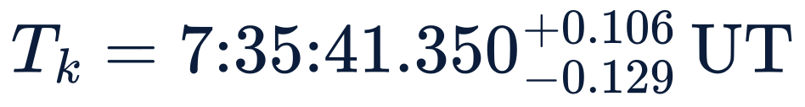
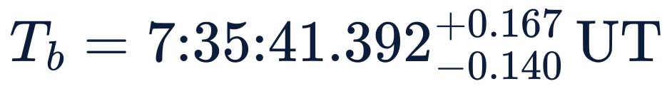
On the common clock, K1 is the most likely first event
K1 (Kamiokande-II)
I1 (IMB)
B1 (Baksan)
To scale with the central values; the errors, 0.05 to 0.17 s, are larger than the gaps.
10 ms
θ: angle from the direction of the supernova
Why K1 attracted attention
Its time: on the common clock, the most likely first event.
Its direction: close to the supernova, while IBD positrons are almost isotropic. The Kamiokande-II and IMB events are too forward-peaked for IBD, and K1 is the best candidate for elastic scattering, ν e⁻ → ν e⁻.
About even odds: Kamiokande-II recorded the most events, so its first event tends to follow the arrival with the shortest delay.
Forward excess: Krivoruchenko, Z. Phys. C 44 (1989) 633; Malgin, Nuovo Cim. C 21 (1998) 317. K1 as ES: Costantini, Ianni, Vissani, PRD 70 (2004) 043006; Vissani, Pagliaroli, Astron. Lett. 35 (2009) 1
Notes:
Section: SECOND PAPER · THE FIRST EVENT · arXiv:2605.06401, to be published in EPJC
0.75 min.
At the top, the first events on the common clock, in time order and to scale with the central values: K1 at T_k = 7:35:41.350 (+0.106/−0.129) UT (EPJC eq. 12), I1 at T_i = 7:35:41.374 ± 0.050 UT, on the IMB clock itself (EPJC eq. 1, table 1), B1 at T_b = 7:35:41.392 (+0.167/−0.140) UT (EPJC eq. 13); T_k and T_b include the transit times. K1 comes 24 ms before I1, B1 18 ms after it; the errors, 0.05 to 0.17 s, are larger than these gaps, so the order is not certain: the chart on the right gives the probabilities. The first neutrino reached the Earth at T_0 = 7:35:41.256 (+0.072/−0.117) UT (EPJC eq. 11, slide 11).
Say: "On the common clock, the first events come in the order K1, I1, B1, but the errors are larger than the gaps."
On the common clock, which of the 29 events came first? Our own estimate, with flat priors and the transit included: K1 about 0.5, I1 about 0.3, B1 about 0.2. It comes mainly from the larger number of Kamiokande-II events, the argument of the delays.
Say "the most likely first event, at about even odds", never "K1 was the first event".
The formula below the timeline gives K1's energy, 20.0 ± 2.9 MeV, and its angle from the direction of the supernova, 18° ± 18° (JCAP table 1).
Why K1 attracted attention, two reasons. Its time: on the common clock, the most likely first event. Its direction: K1 has 20 MeV and points 18° ± 18° from the supernova; an electron scattered by a neutrino keeps the neutrino direction, while an IBD positron is emitted almost isotropically. The angular distribution of the Kamiokande-II and IMB events has long been known to be too forward-peaked for IBD (Krivoruchenko 1989; Malgin 1998; JCAP refs. [41, 67, 83]), and K1 is the best candidate for elastic scattering (Costantini, Ianni, Vissani 2004; Vissani and Pagliaroli 2009). Previous estimates gave K1 an ES probability of about 30%, from partial assessments in the accretion phase alone (EPJC introduction).
Why only K1: at 10–20 MeV the elastic-scattering cross section is about two orders of magnitude below that of IBD, so only a few of the 29 events could be ES, and a posteriori analyses find K1 the only one compatible (Vissani 2015).
Note: the test that follows uses the delay tk from the JCAP fit, not the common clock.

Slide 18
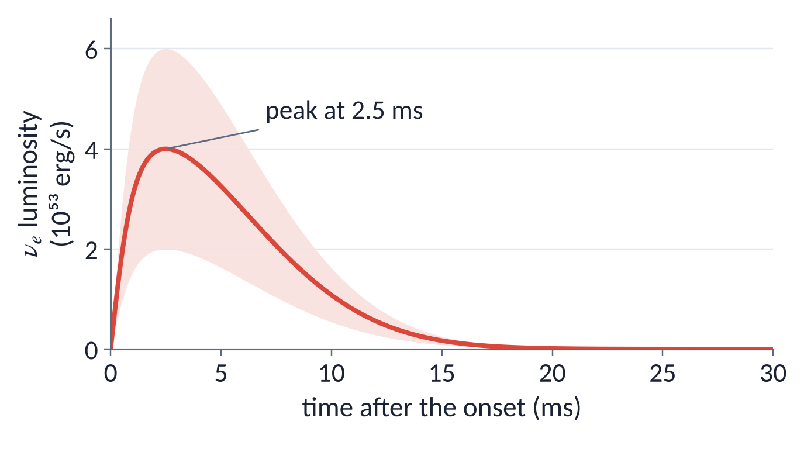
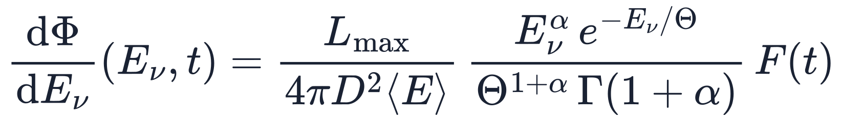
The neutronization burst: a 10 ms flash of ν_{e}
The hypothesis to test: K1 comes from the burst and is an elastic scattering, not an inverse beta decay
Two hypotheses for K1
ES from the burst
ν e⁻ → ν e⁻
IBD from accretion
ν̄_{e} p → e⁺ n
compared on the time, energy and direction of K1
If K1 came from the neutronization burst, it would be a neutrino, not an antineutrino:
the first one ever detected from a supernova.
L_{max} = (4 ± 2)×10⁵³ erg/s, peak ν_{e} luminosity
α = 5, pinched spectrum
F(t): peak at 2.5 ms
Spectrum and luminosity from simulations
Notes:
Section: SECOND PAPER · THE FIRST EVENT
1 min.
Say: "A few milliseconds after the bounce, the shock crosses the neutrinosphere and the electron neutrinos made behind it escape at once, in about 10 ms: the neutronization burst. Inverse beta decay cannot see it; elastic scattering on electrons can." (The energy in three phases: backup 25.)
Say: "We test more than the time of K1. The hypothesis is that K1 comes from the burst and is an electron scattered by a neutrino, rather than a positron from the inverse beta decay of an accretion antineutrino. The two hypotheses are compared on the time, the energy and the direction of K1."
Say: "If K1 came from the burst, it would be a neutrino, not an antineutrino: the first one ever detected from a supernova."
The card at the top right: the two hypotheses with their reactions, ES from the burst, ν e⁻ → ν e⁻, and IBD from accretion, ν̄e p → e⁺ n, the channel assumed for every event in the global fit. Each gives a likelihood for K1 (slide 14; backup 23); the burst model, figure and formula, sets the ES one.
The burst model (EPJC §3.1): a pinched spectrum, α = 5, with mean energy 13 MeV, close to the maximum expected during the burst, so that the likelihood of ES is not underestimated. Peak luminosity Lmax = (4 ± 2)×10⁵³ erg/s, and the same time function F, with the peak at 2.5 ms and τ = 8.2 ms.
The burst radiates about 3×10⁵¹ erg, as if it shone for 7.5 ms at Lmax. Peak flux at Earth: 6.1×10¹⁰ νe cm⁻² s⁻¹.
The pink band is the range of Lmax, from 2 to 6×10⁵³ erg/s, with the same time profile; the line is the central value, 4×10⁵³ erg/s.

Slide 19
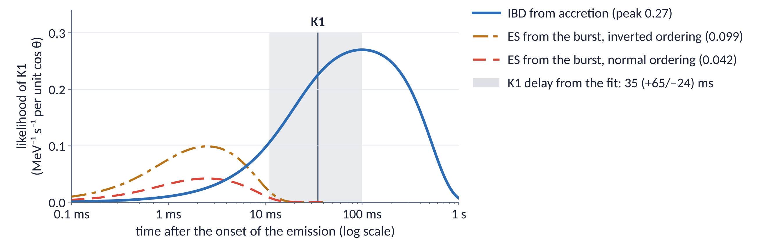
K1: 3–6 times more likely an IBD event than ES
Notes:
Section: SECOND PAPER · THE FIRST EVENT
1.25 min.
Say: "Before reaching us, the burst νe change flavour: only the MSW effect acts, and they leave the star as ν3 in normal ordering or ν2 in inverted ordering. So only a fraction Pee, 2% or 30%, arrives as νe, and the others scatter six times less: hence the two ES curves." (Backup 51 for questions.)
Say: "K1 is three to six times more likely to be an ordinary inverse beta decay than an electron scattered by a burst neutrino."
The numbers: for the energy and direction of K1, the likelihood under each hypothesis is the expected event rate at those values, after the energy and angular response of Kamiokande-II (EPJC eq. 21): a density in energy, time and cos θ, hence MeV⁻¹ s⁻¹ per unit cos θ. Their ratio is a likelihood ratio, and the units cancel.
How: the likelihood under each hypothesis as a function of time. The onset of the burst relative to the ν̄e signal is not known, so each curve is maximised over time: a conservative upper bound for ES. Central burst parameters: ES 0.042 (NO) and 0.10 (IO), IBD 0.27, background negligible. Ratios 6 and 3.
Careful: at the fitted delay of K1, 35 ms, the burst is already over, and IBD is about 0.22 there; the ratios would be 5.2 and 2.2.
Say "disfavoured by a factor of 3 to 6 with the central burst model", never "excluded".
Figure: EPJC figure 3, redrawn with the code of the EPJC repository, github.com/VOliviero/SN1987A_Analysis (ElasticScattering.ipynb), with the printed values.
What would change the verdict (a brighter burst, Pee ≈ 1, a measured onset time): backup 23.

Slide 20
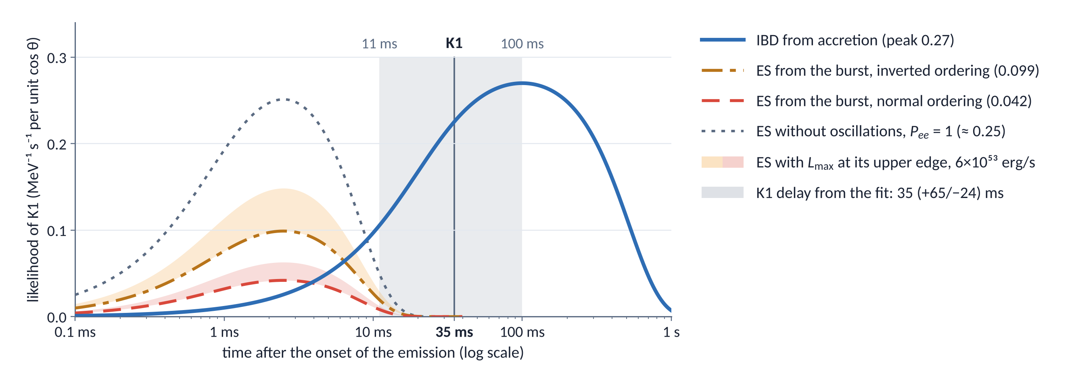
What it would take to change the verdict
1
A brighter burst
2
P_{ee} ≈ 1
3
A measured onset time
ES grows linearly with L_{max}
Without flavour conversion ES ≈ 0.25 against 0.27 for IBD: no discrimination.
The two hypotheses compared at the actual time of K1
Notes:
Section: SECOND PAPER · THE FIRST EVENT
2.5 min.
The EPJC indicates three ways to change the verdict. A brighter burst: the ES rate is linear in Lmax, and at the upper edge, 6×10⁵³ erg/s, the ratios drop to 4.3 (NO) and 1.8 (IO). New oscillation effects giving Pee ≈ 1: without flavour conversion ES would be about 0.25 against 0.27 for IBD, no discrimination at all. A measured onset time, which removes the freedom to place the burst.
In the figure: the dotted grey curve is ES with Pee = 1. The onset has no curve of its own: the grey band, the delay of K1 from the fit, from 11 to 100 ms with the best value 35 ms (in bold on the axis), is what we know today of the time of K1 after the onset, and a measured onset would shrink it to a line. The verdict could then go either way (from the curves of the figure): at 35 ms ES is about zero and IBD 0.22; at 2.5 ms, the peak of the burst, IBD is only 0.026, below ES (0.042 NO, 0.099 IO).
So flavour conversion decides. Combining the upper edge of Lmax with the fitted delay of K1, the ratios become 3.5 (NO) and 1.5 (IO): in normal ordering, say "at least 3.5".
Say: "A hypothesis becomes a quantitative bound. At the next supernova, with the onset time known to a millisecond, the bound will become a measurement."

Slide 21
The next Galactic supernova: the same tools, better detectors
1
The parametric model
2
ES or IBD, event by event
one global fit of the time, energy and angle of every event
the likelihood of each event under each channel, as for K1
More events 10⁴–10⁵ IBD in Hyper-Kamiokande, 29 events in 1987
the errors shrink as 1/√N, and accretion is measured
The light curve IceCube, Hyper-Kamiokande
the rise is fitted, no longer fixed at t_{max} = 0.1 s
Energy resolution JUNO, about 3%/√E
the spectra fix the temperature, and with it the radius
All flavours JUNO, ν–p scattering; DUNE, ν_{e} on argon
the same parametric model for every flavour, not only ν̄_{e}
Direction water Cherenkov: about 10³ ES in Hyper-Kamiokande
ES electrons keep the neutrino direction; IBD positrons do not
Neutron tagging gadolinium in water, scintillators
an IBD event is identified by the capture of its neutron
The burst measured DUNE, ν_{e} on argon
ES computed from the measured burst, not from a simulation
The onset to a millisecond neutrinos or gravitational waves
the two hypotheses compared at the actual time of each event
The same tools become precision tools: a global fit of time, energy and angle, the onset in each detector from the data, each event weighed under each channel. With t = 0 known to a millisecond, from the neutrinos or from gravitational waves, the bound on the first event becomes a measurement.
Hyper-Kamiokande, IceCube: SNEWS 2.0, New J. Phys. 23 (2021) 031201. JUNO: J. Phys. G 43 (2016) 030401. DUNE: EPJC 81 (2021) 423. Neutron tagging: Beacom, Vagins, PRL 93 (2004) 171101. Onset: Hansen, Lindner, Scholer, PRD 101 (2020) 123018. SN1987A: JCAP 05 (2025) 027.
Notes:
Section: OUTLOOK
1.25 min. Two clicks: the test between ES and IBD, then the message.
Say: "Both parts of our approach can be used as they are at the next Galactic supernova, and each improvement of the detectors sharpens one step. The parametric model: with tens of thousands of events the errors shrink as one over the square root of N, and accretion is measured; the light curve fits the rise, which today we have to fix; the energy resolution of JUNO fixes the temperature, and with it the radius; JUNO and DUNE extend the model to all flavours."
Click 1. Say: "The test between elastic scattering and inverse beta decay, event by event. In water the direction sets elastic scattering apart; neutron tagging identifies inverse beta decay; DUNE measures the burst instead of simulating it; and with the onset known to a millisecond, the two hypotheses are compared at the actual time of each event."
Click 2. Say: "The same tools become precision tools. And with t = 0 known to a millisecond, the bound on the first event becomes a measurement."
The parametric model, step by step. More events: for a supernova at 10 kpc Hyper-Kamiokande records 10⁴–10⁵ IBD (SNEWS 2.0, New J. Phys. 23 (2021) 031201), against 29 events in 1987, 6.6 of them expected from background; the statistical errors shrink as 1/√N, by a factor of 20–70, and accretion, today preferred with cooling alone at p = 0.2–0.8%, is measured with its mass and duration. The light curve: IceCube records the collective rise of the photomultiplier rates, 10⁵–10⁶ photoelectrons with millisecond resolution, mostly from IBD in the ice; the rise, fixed today at tmax = 0.1 s because the data cannot fit it together with the delays, becomes a parameter, and the delay in each detector measures the onset there. Energy resolution: about 3%/√E in JUNO, with E in MeV (J. Phys. G 43 (2016) 030401); the spectra fix the temperature, today correlated with the radius (−0.82) and with the accreting mass (−0.81) (JCAP table 4, slide 7). All flavours: elastic ν–p scattering in JUNO (about 2000 events, neutral current, mostly νμ,τ and their antiparticles) and νe on argon in DUNE (several hundred to several thousand events; EPJC 81 (2021) 423) extend the parametric description from ν̄e to every flavour, and with it to the total energy emitted.
ES or IBD, step by step. Direction: in water the ES electron keeps the direction of the neutrino, while the IBD positron is almost isotropic; with about 10³ ES events among 10⁴–10⁵ IBD, Hyper-Kamiokande separates the two channels statistically, and ES becomes a measured component of the fit. Neutron tagging: the IBD neutron is captured, on gadolinium in water, with a γ cascade of about 8 MeV (Beacom and Vagins, PRL 93 (2004) 171101; in Super-Kamiokande since 2020), or on hydrogen in a scintillator, with a 2.2 MeV γ about 200 μs after the positron (JUNO); ES has no neutron. The burst measured: today the burst parameters come from simulations (slide 13); DUNE measures the νe of the burst on argon, so the ES likelihood rests on data; since Pee depends on the ordering, the size of the burst also tests it (our remark). The onset to a millisecond: 0.6–1.2 ms for Hyper-Kamiokande, 0.9–1.1 ms for IceCube, 1.7–3.8 ms for JUNO (Hansen, Lindner, Scholer, PRD 101 (2020) 123018, Monte Carlo over 18 models), 1.5 ms for DUNE (SNEWS 2.0, table 1); EPJC §3.3: gravitational waves from the collapse would fix the onset of the neutronization peak to a millisecond. The two hypotheses for each event are then compared at its actual time, not at the maxima of their curves (the third way of backup 23).
SN1987A, for comparison: the fitted delays t_k = 35 (+65/−24) ms, t_i = 43 (+102/−29) ms, t_b = 54 (+152/−41) ms (JCAP §5.1), the onset to about 0.1 s. Today the clocks are synchronized by GPS, so the delays fitted in each detector measure the onset there, instead of correcting the clocks.
The event numbers depend on the supernova model: the ranges cover the models used in those papers.

Slide 22
Conclusions
1
2
3
One model for all 29 events
One clock for three detectors
K1 is probably not a burst neutrino
A physically motivated model of the ν̄_{e} flux describes times, energies and angles.
The data prefer an accretion phase: cooling alone has p = 0.2–0.8%.
From the global fit, the clocks of Kamiokande-II and Baksan are aligned with IMB a posteriori.
From about a minute to about 0.1 s.
Inverse beta decay is favoured over elastic scattering by a factor of 3 to 6.
At the next Galactic supernova, with t = 0 known to a millisecond, the same tools become precision tools
Notes:
Section: CONCLUSIONS
0.75 min. The three messages.
1. A physically motivated parametric model describes the 29 events in time, energy and angle; the data prefer an accretion phase, and cooling alone has p = 0.2–0.8% (JCAP).
2. From the global fit we estimate the delay of the first event in each detector; from their differences we synchronise Kamiokande-II and Baksan with IMB a posteriori, from about a minute to about 0.1 s (1σ) (EPJC).
3. K1 is probably not a neutrino from the neutronization burst: inverse beta decay is favoured by a factor of 3 to 6 (EPJC).
Closing: "One parametric model describes all twenty-nine neutrinos. With it we align the clocks to a tenth of a second, and ask a sharp question about the first event. The next supernova will answer it at the millisecond, if we are ready to read it."

Slide 23
감사합니다!
Notes:
Questions, about 5 minutes. On the slide, 감사합니다! (gamsahamnida), "thank you!" in Korean. Thank the audience and take questions.
Backup slides follow. First, the KIAS slides left out of this talk: inverse beta decay (18), accretion and cooling (19), the flux at Earth (20), the expected signal and the detector response (21), the clock problem in a figure (22), what would change the verdict on K1 (23). Then the stages of the collapse and the energy in three phases (24–25); the first paper in full (comparing with data, statistical analysis, results, validity, physical conclusions; 26–30); the three phases in the model, robustness, priors, detector response, goodness of fit by detector, the delay and difference profiles, robustness to tmax, absolute times, positions, previous analyses, mass ordering, significance (31–42); the p-values as a chart (43); the slides of the second paper in their earlier version (44–50); the MSW slide (51) and the two goodness-of-fit tests (52).

Slide 24
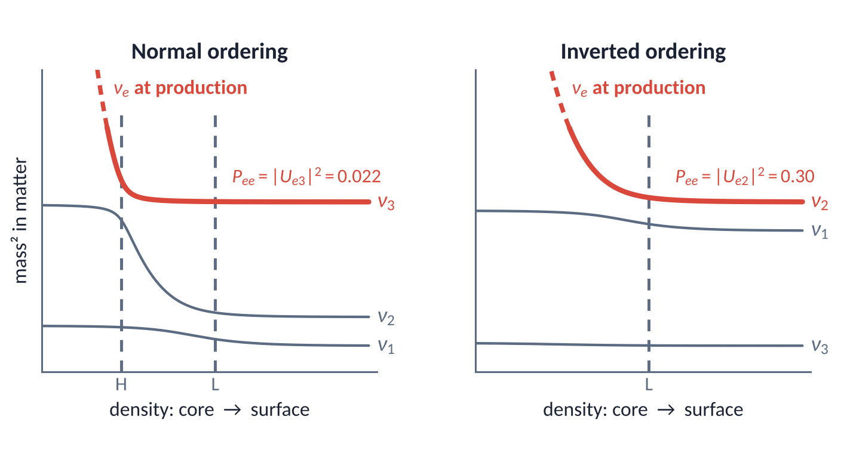
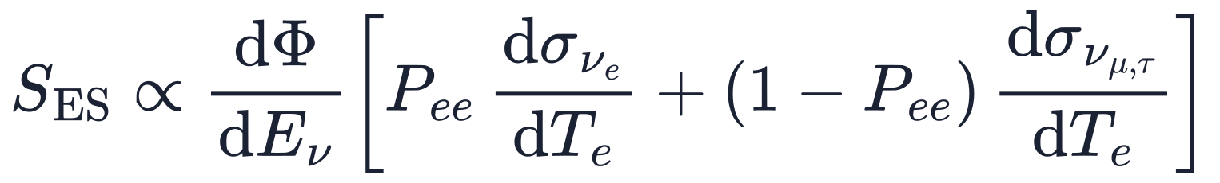
During the burst only MSW acts: P_{ee} is fixed by the mass ordering
Why only MSW
Almost pure ν_{e}: without ν̄_{e}, neutrino–neutrino interactions drive neither collective nor fast flavour conversion
The shock is still near the core: the resonance layers keep the smooth density profile of the progenitor, so the conversion is adiabatic
ν_{e}, the heaviest state in dense matter, leaves the star as the heaviest mass eigenstate:
P_{ee} = 0.022
P_{ee} = 0.30
Levels of mass² in matter, not to scale; grey dashed lines: the H and L resonance layers. The levels never cross, so ν_{e} stays on the top level.
normal ordering: ν₃
sin²θ₁₃
inverted ordering: ν₂
cos²θ₁₃ sin²θ₁₂
At Kamiokande-II mostly ν_{μ,τ} arrive, with an ES cross section about 6 times smaller:
Normal ordering is preferred: Δχ² = 9.4, about 3σ; about 4σ with the first JUNO data (preliminary).
Notes:
Backup for slide 14: flavour conversion during the burst, moved from the talk.
Say: "During the burst the flux is almost pure νe, and only the MSW effect acts. The νe leave the star as a mass eigenstate: ν3 in normal ordering, ν2 in inverted ordering."
Why only MSW, two reasons. First, collective oscillations need neutrinos and antineutrinos together, and fast flavour conversions need a crossing in the angular distribution of the electron lepton number: with an almost pure νe flux neither develops. Second, during the burst the shock is still at 100–200 km, while for 15 MeV the resonances lie at ρ ≈ 2×10³ g/cm³ (H, Δm²31) and ρ ≈ 25 g/cm³ (L, Δm²21), much farther out: they see the density profile of the progenitor, which varies slowly, so the conversion is adiabatic. Shock and turbulence effects reach the resonances only after 1–2 s.
The figure: the eigenvalues of the mass matrix in matter, from the core to the surface, not to scale. At production the matter term dominates and νe is the heaviest state. The grey dashed lines mark the H and L resonances, where two levels come closest. The red dashed stretch at the top left shows that the νe level does not end at the frame: it goes on towards higher density, up to the point of production. The levels never cross, so νe stays on the top level: in normal ordering it passes the H and then the L resonance and leaves as ν3; in inverted ordering it leaves as ν2. Hence Pee = |Ue3|² = sin²θ13 = 0.022 in normal ordering and Pee = |Ue2|² = cos²θ13 sin²θ12 = 0.296 in inverted ordering (EPJC eq. 22).
EPJC §3.2 quotes a review: "From the point of view of flavor evolution, the neutronization-burst represents a unique phase. Only the MSW effect appears to influence the neutrino spectra." The reference is unresolved in the draft (a question mark in the PDF): check it in the bibliography. The same picture in Dighe, arXiv:0912.4167: in iron-core supernovae, such as SN1987A, the collective effects are over before the MSW resonances; O-Ne-Mg cores are the exception.
At Earth the burst arrives mostly as νμ,τ, whose cross section on electrons is about six times smaller than that of νe: the ES rate is suppressed, more in normal ordering (EPJC eq. 19, the formula at the bottom). The detector side: the rate is folded with the Kamiokande-II energy response and an angular response with non-Gaussian tails, δθ = 18° for K1 (EPJC eqs. 20–21), the most accurate ES estimate for K1 so far.
Mass ordering: Δχ² = 9.4 in favour of normal ordering (April 2026), about 3σ; about 4σ including 207.2 days of JUNO data, preliminary.
If asked about the Earth crossing: the neutrinos crossed the Earth before reaching the detectors, 4300 km for Kamiokande-II, in the crust and upper mantle (EPJC table 3, backup 39), and the EPJC does not include regeneration in the Earth. In normal ordering the burst arrives as ν3 and the Earth does not matter; in inverted ordering Pee rises from 0.30 to about 0.33 at 20 MeV, and the ratio drops from 2.7 to about 2.5 (our three-flavour calculation with a layered crust and mantle profile; not in the EPJC).

Slide 25
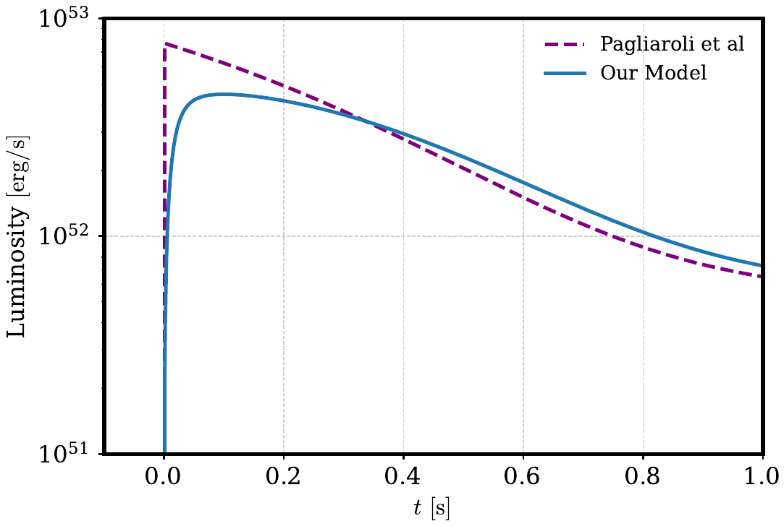


What is robust and what is model-dependent
Robust
The preference for an accretion phase, Δχ² = 8.2, and the luminosity curve: two fits with different masses give almost the same curve.
Model-dependent
The accreting mass: M_{a} ≈ 0.03 M⊙ here, 0.14 M⊙ in Pagliaroli et al. 2009
The flux is an effective one, without explicit oscillations
The times hold for t_{max} = 100 ms: the rise is not resolved yet
Two fits, M_{a} = 0.03 and 0.14 M⊙, almost the same luminosity: the data fix the luminosity, the mass depends on the assumptions. JCAP fig. 6
Notes:
Section: BACKUP
Backup, for questions on what depends on the model.
Robust: the preference for accretion, and the luminosity curve. The figure compares our fit with model IIIB of Pagliaroli et al. 2009: the accreting mass differs by a factor of five, 0.03 against 0.14 M⊙, and yet the two luminosity curves are almost the same. The data fix the luminosity; the mass depends on the assumptions of the model. A factor of about 1.5 comes from the treatment of oscillations (JCAP footnote 11). Ma is the mass of the region exposed to the positron flux, not the accreted mass.
The flux is an effective one, without explicit oscillations. And the times hold for tmax = 100 ms: the data do not resolve the rise yet; the χ² changes by about 1.5 between 10 and 100 ms (JCAP figure 3).
If asked whether Δχ² = 8.2 is robust to tmax or to single events (K1, I1 and I2, K13–K16): "We have not done that test yet; it is the next check on our list."

Slide 26
Crash course on the stages of a core-collapse supernova
1
Burning
A star above 8 M⊙ burns up to an iron core of about 1.4 M⊙: fusing iron releases no energy.
H → He → C → Ne → O → Si → Fe
H
He
2
Infall: Core Collapsing, about 100 ms
Photodissociation and electron captures take away pressure: the core collapses and turns neutron-rich.
C, O
O, Ne, Mg
Si
γ + ⁵⁶Fe → 13 α + 4 n
γ + ⁴He → 2 p + 2 n
e⁻ p → n ν_{e}
Fe
after the bounce:
proto-neutron star
and shock wave
3
Trapping
The core becomes opaque to neutrinos: they are trapped.
ρ ≈ 10¹² g/cm³
4
Bounce
The repulsive nuclear force stops the infall: the inner core bounces and launches a shock wave.
a massive star before the collapse (not to scale)
ρ_{nuc} ≈ 3 × 10¹⁴ g/cm³
THE SHOCK
launched at the bounce
stalled by neutrino losses and nuclear breakup
revived by neutrino heating
the star explodes
Notes:
Backup for slide 3: the stages of the collapse, moved from the talk.
Say, if shown: "Before the neutrinos, how a massive star dies, in four steps and a shock."
Five clicks: the four steps, one at a time, then the shock. The star appears with the first step, the proto-neutron star on the right with the bounce.
Burning: a star above about 8 solar masses holds against gravity with the pressure of nuclear burning: H, He, C, Ne, O and Si, in shorter and shorter stages, build an onion of shells around a core of iron-group nuclei. Iron has the largest binding energy per nucleon, so fusing it releases no energy: the iron core, about 1.4 solar masses, is held up by the pressure of degenerate electrons.
Collapse: the photodissociation of iron (γ + ⁵⁶Fe → 13α + 4n), and then of helium (γ + ⁴He → 2p + 2n), absorbs energy, and electron captures on protons and nuclei (e⁻p → nνe) remove electrons. The pressure drops and the core collapses in about a tenth of a second; it becomes neutron-rich: the neutronization.
Trapping: above about 10¹² g/cm³ the mean free path of the neutrinos becomes so short that their diffusion time exceeds the collapse time: they are trapped in the core.
Bounce: at nuclear density, about 3 × 10¹⁴ g/cm³, the nuclear force becomes repulsive and the matter very stiff: the infall stops abruptly, the inner core overshoots and bounces, and a shock wave is launched into the infalling outer core.
The shock (bottom strip): it loses energy breaking up the iron nuclei and through neutrino losses, and stalls at 100–200 km. Neutrino heating behind it revives it after a few hundred milliseconds, and the star explodes. The energy released is the binding energy of the newborn neutron star: next slide.

Slide 27
Neutrinos carry away 99% of the energy, in three phases
Neutronization burst ν_{e} only
Accretion mostly ν_{e} and ν̄_{e}
Cooling all flavours
e⁻ p → n ν_{e}
e⁺ n → p ν̄_{e}
e⁻ p → n ν_{e}
e⁺ e⁻ → ν ν̄
N N → N N ν ν̄
80–90%
≈ 10 s
≈ 0.5 s
10–20%
≈ 10 ms
≈ 1%
Energy fractions from G. Pagliaroli, F. Vissani, M. L. Costantini and A. Ianni, Astropart. Phys. 31 (2009) 163; durations as in simulations.
Notes:
Backup for slides 3 and 13: the energy of the collapse in three phases, moved from the talk; the reactions and the shares of accretion and cooling are on backup 19.
Say, if shown: "Almost all the energy of the collapse leaves as neutrinos, in three phases: at the top each phase with its reactions; below, its share of the energy and how long it lasts, on a log scale."
The energy is the binding energy of the newborn neutron star, about 3 × 10⁵³ erg: about 99% is radiated as neutrinos of all flavours, about 1% becomes kinetic energy of the explosion, and less than 0.01% light.
Neutronization burst, about 10 ms: as the shock crosses the neutrinosphere and moves into less dense matter, the νe made by electron captures on the protons freed behind the shock escape at once. Peak luminosity about 4 × 10⁵³ erg/s, a few 10⁵¹ erg in all, about 1% of the energy. It is made of νe: inverse beta decay cannot see it.
Accretion, about half a second: matter falls through the stalled shock onto the proto-neutron star. In the hot accreting mantle, positron captures on neutrons give ν̄e (e⁺n → pν̄e) and electron captures on protons give νe. About 10–20% of the energy.
Cooling, about ten seconds: the proto-neutron star cools and contracts, emitting neutrinos of all flavours from thermal processes, e⁺e⁻ annihilation and nucleon bremsstrahlung among them; they diffuse out over seconds and carry 80–90% of the energy.
The fractions are those of Pagliaroli, Vissani, Costantini and Ianni, Astropart. Phys. 31 (2009) 163; the bars show the middle of each range. The detectors of 1987 saw mostly ν̄e through inverse beta decay, so the 29 events come from accretion and cooling.

Slide 28
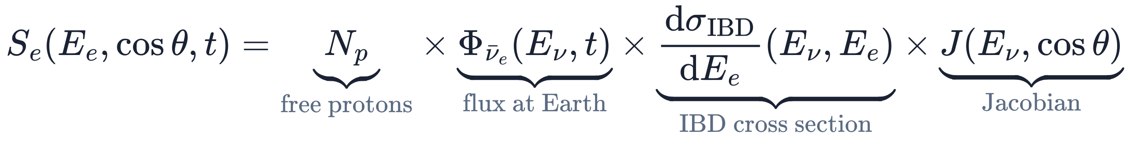
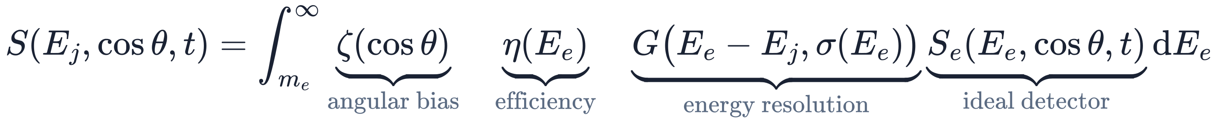
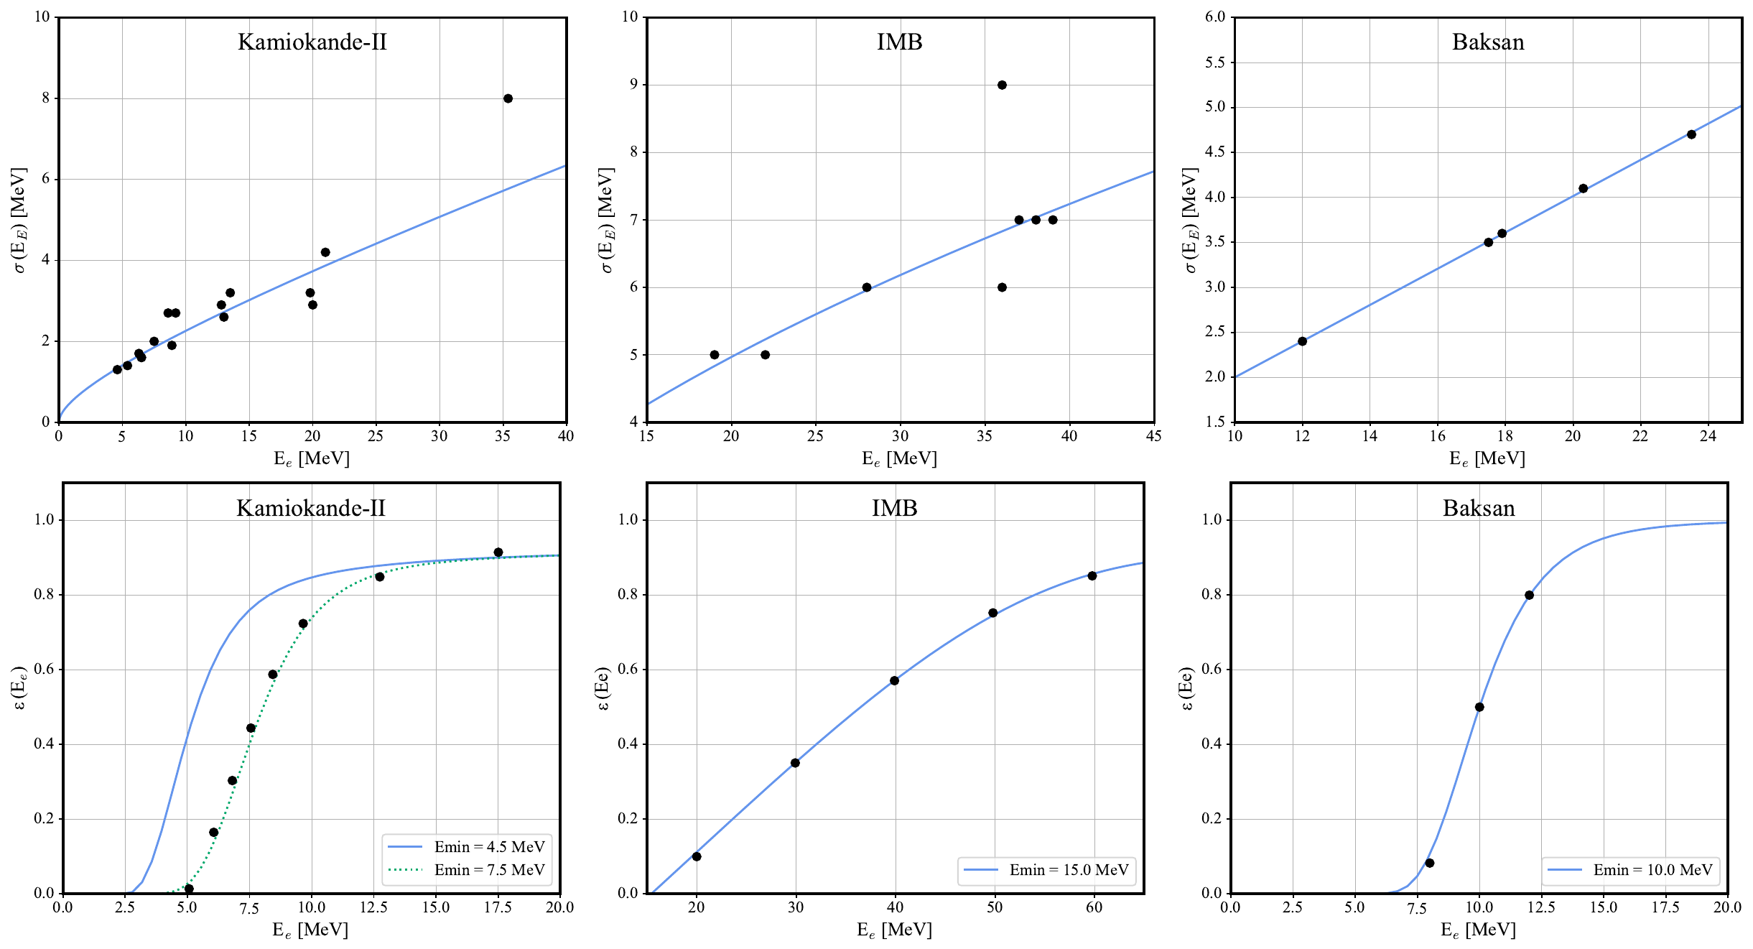
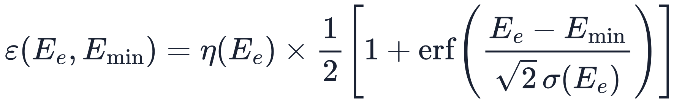
Comparing with data: the signal expected in each detector
Ideal detector
triply differential in time, energy and angle · JCAP eq. (3.2)
Real detector
what is recorded, at the measured energy E_{j} · JCAP eq. (3.4)
Response functions, rebuilt from the published data
Resolution σ(E_{e}): fitted to the energy errors of the events (top)
Total efficiency, from the extrapolated intrinsic efficiency η(E_{e}): it reproduces the values published by the collaborations (bottom)
E_{min} = 4.5 MeV for Kamiokande-II, not 7.5: K13–K16 stay in the sample, and the fit weighs them as signal or background
Resolution (top) and total efficiency (bottom) of the three detectors: curves used in the fit, points from the data. JCAP fig. 2
Detector response: Jegerlehner, Neubig, Raffelt, PRD 54 (1996) 1194; Vissani, J. Phys. G 42 (2015) 013001. IBD cross section: Ricciardi, Vignaroli, Vissani, JHEP 08 (2022) 212
Notes:
Section: BACKUP
Backup: the comparison with the data (backup 21) as it was until 25 October, with JCAP figure 2, the formula of the total efficiency and the Kamiokande-II threshold.
Say: "To compare the model with the data, we compute what each detector should have recorded. An ideal detector would see the positrons of inverse beta decay: the number of free protons, times the flux at Earth, times the cross section, times a Jacobian. This signal is triply differential, in time, in energy and in the cosine of the scattering angle. A real detector records it through its response: angular bias, efficiency and energy resolution. Not all of these functions were published, so we rebuilt them from the data. The resolution is fitted to the energy errors of the events; the intrinsic efficiency is extrapolated, and the total efficiency, which includes the threshold, reproduces the values published by the collaborations. For Kamiokande-II we lower the threshold from 7.5 to 4.5 MeV: the four low-energy events K13 to K16 stay in the sample, and the fit decides whether they look like signal or background."
Ideal detector (JCAP eq. 3.2): Np free protons (JCAP table 2: 1.430, 4.546 and 0.188 × 10³² for Kamiokande-II, IMB and Baksan); the IBD cross section of Ricciardi, Vignaroli and Vissani, JHEP 08 (2022) 212; J is the Jacobian of the differential flux.
Real detector (JCAP eq. 3.4): Ej is the measured positron energy (Ei in the paper; here j labels the events, as in the likelihood of the next slide). The Gaussian kernel G has width σ(Ee).
Response functions (JCAP §3.3 and table 3): σ(Ee) = σstat √(Ee/10 MeV) + σsyst (Ee/10 MeV), with 1.27 and 1.0 MeV for Kamiokande-II, 3.3 and 0.2 MeV for IMB, 2.0 (Ee/10 MeV) MeV for Baksan. Intrinsic efficiency η from Vissani 2015 (a typo for IMB corrected); η = 1 for Baksan, a scintillator. Thresholds Emin: 4.5, 15 and 10 MeV. Angular bias: only IMB, ζ = 1 + 0.1 cos θ, because 25% of its readout channels were not working.
Total efficiency (JCAP eq. 3.6): ε = η × [1 + erf((Ee − Emin)/(√2 σ))]/2. With the threshold at 4.5 MeV the whole dataset and the background enter a posteriori, not a priori (JCAP §3.2). In the bottom left panel, the two curves: 4.5 MeV (ours) and 7.5 MeV (the collaboration's, points). Small variations of these functions do not change the fit (JCAP §3.2).
The table of the response functions: backup 34.

Slide 29
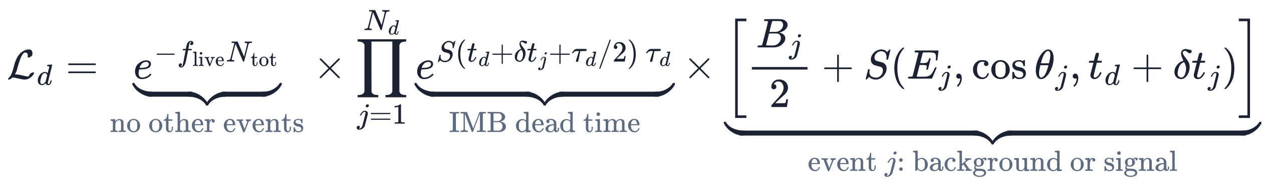
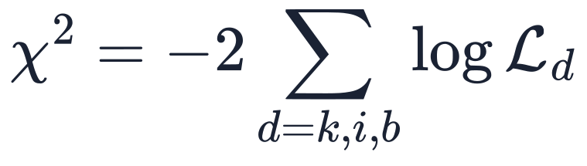
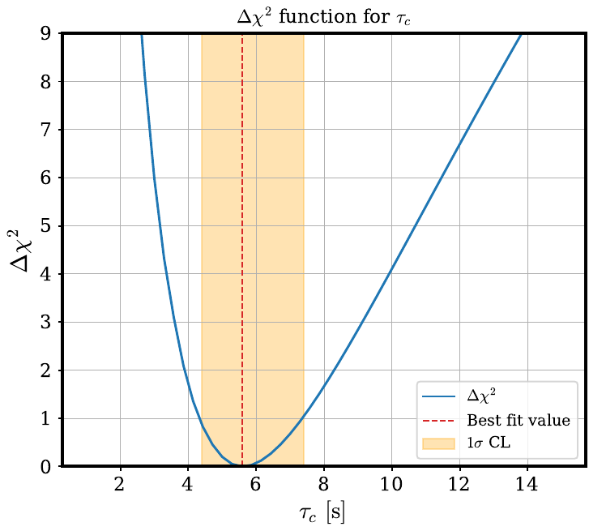
Statistical analysis: one likelihood for all 29 events
summed over Kamiokande-II, IMB and Baksan
t_{d}: delay of the first event in detector d, fitted; δt_{j}: time of event j after that event; B_{j}: background rate; f_{live}, τ_{d}: live fraction and dead time, different from 1 and 0 only for IMB
1
Best fit and errors
χ² minimised over 8 free parameters, the 5 of the emission and the 3 delays; 1σ interval where the profile χ² rises by 1 (right)
2
Is accretion needed?
the fit repeated with ξ_{n0} = 0, cooling only: the rise of χ² measures the evidence; ξ_{n0} = 0 lies on the boundary of the allowed range
3
Goodness of fit
Kolmogorov–Smirnov and Cramér–von Mises tests: the times, energies and angles of the events against the best-fit model
Profile of τ_{c}: at each value, χ² minimised over the other parameters; 1σ band in orange. JCAP fig. 7
Every step computed with two independent codes, in Python and in Mathematica (JCAP §4.1).
Notes:
Section: BACKUP
Backup: the statistical analysis as it was until 25 October, with the likelihood and the χ² written out (JCAP eqs. 4.1–4.2). Slide 6 now has the three analyses with their results.
Say: "The statistical analysis rests on one unbinned Poisson likelihood per detector: the probability of seeing no events other than the observed ones, times, for each event, the background or the signal at its measured time, energy and angle. The time of each event is its time on the detector's clock plus a delay, fitted, between the arrival of the first antineutrino and the first event. The χ² is minus twice the log of the product over the three detectors. With it we do three things. We find the best fit and the errors: one sigma is where the profile χ² rises by one, as here for the cooling time. We ask whether accretion is needed, by repeating the fit without it. And we test the goodness of the fit on the times, energies and angles."
Likelihood (JCAP eq. 4.2): unbinned and Poissonian, one per detector. e^(−f_live N_tot): no events other than the observed ones, with N_tot integrated over 0–30 s (JCAP eq. 3.5). For IMB f_live = 0.9055 (dead time and muons) and the factor e^(S τd) accounts for the 35 ms of dead time after each event; for Kamiokande-II and Baksan f_live = 1 and τd = 0. Bj/2 + S: background or signal at the energy, angle and time of event j. tj = td + δtj (JCAP eq. 4.3).
Estimation (JCAP §4.1–4.2): the profile likelihood, minimising rather than marginalising, which is computationally lighter; for SN1987A no substantial difference from marginalisation is expected (Pagliaroli et al. 2009). Flat priors (JCAP eq. 4.4, backup 33). The intervals at Δχ² = 1 are 1σ.
Is accretion needed: the result is on the next slide; the statistics with a parameter on the boundary, in backup 42. Goodness of fit: the results in backup 29.
Two codes: Python and Mathematica, developed in parallel, give results consistent to high precision (JCAP §4.1).

Slide 30
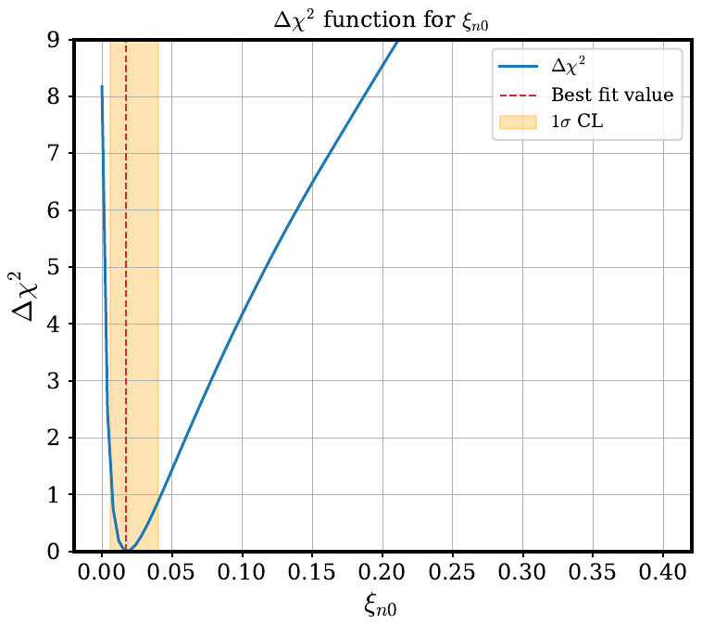
Results: the best fit, and cooling alone is disfavoured
 | Best fit and 1σ
R_{ns} | 17 (+6/−5) km †
T₀ | 4.6 (+0.5/−0.4) MeV
τ_{c} | 5.6 (+1.8/−1.3) s
ξ_{n0} | 0.018 (+0.025/−0.011)
τ_{a} | 0.52 (+0.24/−0.15) s
t_{k} | 35 (+65/−24) ms
t_{i} | 43 (+102/−29) ms
t_{b} | 54 (+152/−41) ms
Cooling alone
ξ_{n0} = 0, circled: χ² is higher by 8.2 than at the best fit.
ξ_{n0} = 0 is the edge of the allowed range: Δχ² follows ½δ + ½χ²_{m}, with m = 1 or 2.
Profile of ξ_{n0}, 1σ band in orange. JCAP fig. 5
† From the Δχ² profile, JCAP fig. 7. χ² = 263.5 at the minimum. Largest correlations: R_{ns}–T₀ −0.82, ξ_{n0}–T₀ −0.81; the delays are uncorrelated with the emission parameters (JCAP table 4).
p = 0.2–0.8%
cooling alone disfavoured
A p-value of the null hypothesis, cooling alone; not a probability for accretion. JCAP §5.4 and footnote 10
Notes:
Section: BACKUP
Backup: the results as they were until 25 October. Slide 6 now has the accretion test, slide 7 the best fit.
Say: "The results. On the left, the best fit with its one-sigma errors: the cooling of a source of about 17 kilometres, 4.6 MeV at the peak, with a decay time of 5.6 seconds; accretion with a decay time of half a second; and the three delays, of a few tens of milliseconds. On the right, the profile of the accretion parameter: without accretion, at its left end, the χ² is higher by 8.2. Cooling alone is disfavoured, at about 2.5 sigma."
Rns = 17 (+6/−5) km comes from the profile in JCAP figure 7: the +0.7/−0.5 km printed in JCAP eq. (5.1), and repeated in EPJC eq. (5), is a factor-10 typo, confirmed with the coauthors. If asked "17 km is larger than a neutron star": it is the effective radius of the neutrinosphere during cooling, averaged over seconds, and 12 km lies within 1σ.
Correlations (JCAP table 4): Rns with T0 −0.82, ξn0 with T0 −0.81, Rns with ξn0 +0.60. The same number of events can come from a larger, cooler source or from a smaller, hotter one; the energies of the events limit the trade-off. The delays are practically uncorrelated with the emission parameters, so the timing of the two phases is little affected by the rest (JCAP §5.1).
Accretion test (JCAP §5.4 and footnote 10): Δχ² = 8.2 between cooling alone (ξn0 = 0) and cooling plus accretion. ξn0 = 0 lies on the boundary of the allowed region, so under the null hypothesis the test statistic is the mixture ½δ + ½χ²m, with m = 1 (one parameter fixed) or 2 (ξn0 and τa removed): p = 0.21% and 0.83%, that is 2.4–2.9σ one-sided. Say "about 2.5 sigma"; avoid "accretion at 99%": a p-value belongs to the null hypothesis. Pagliaroli et al. 2009 found Δχ² = 9.8–14.7 for their models. If asked: τa is not defined when ξn0 = 0 (Davies' problem), so neither mixture is strictly justified; a toy Monte Carlo under the null hypothesis, or the Davies bound, is the rigorous answer, and a quick estimate gives p ≈ 0.006, inside the range. Details: backup 42.
Mean energy, if asked: for a Fermi–Dirac spectrum with zero chemical potential ⟨E⟩ = 3.15 T, so about 14.5 MeV at the peak (our arithmetic, not in the papers).

Slide 31
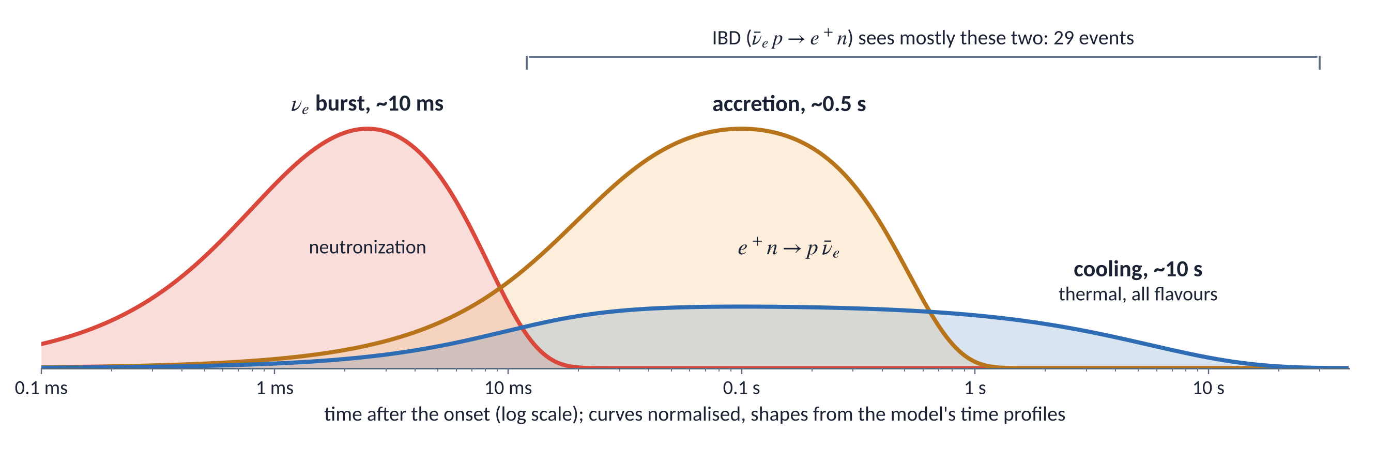
The three phases in the time profiles of the model
The burst is made of ν_{e}: inverse beta decay cannot see it, an electron scattered by a ν_{e} could. The burst returns in the second paper, with K1.
Notes:
Section: BACKUP
Backup, for questions on the phases of the neutrino emission.
Three phases. The νe burst, about 10 ms, released when the shock crosses the neutrinosphere (neutronization). Accretion, about half a second: ν̄e from positron capture on neutrons, e⁺n → p ν̄e. Cooling, about ten seconds: thermal emission of all flavours from the proto-neutron star.
The detectors of 1987 see mainly inverse beta decay, ν̄e p → e⁺ n, so they see accretion and cooling. The burst could show up only as an electron scattered by a νe: it returns in the second paper, with K1.
Curves normalised; shapes from the time profiles of the model.

Slide 32
Fit parameters and priors
Parameter | Prior range | Best fit and 1σ
R_{ns} | 1 – 100 km | 17 (+6/−5) km
T₀ | 2 – 6 MeV | 4.6 (+0.5/−0.4) MeV
ξ_{n0} | 0 – 40% | 0.018 (+0.025/−0.011)
τ_{a} | 0.1 – 1 s | 0.52 (+0.24/−0.15) s
τ_{c} | 1 – 10 s | 5.6 (+1.8/−1.3) s
t_{max} | 10 – 200 ms | fixed at 100 ms
t_{k}, t_{i}, t_{b} | 0 – 0.5 s each | 35 (+65/−24), 43 (+102/−29), 54 (+152/−41) ms
Flat priors (JCAP eq. 4.4)
Errors from the Δχ² profiles, minimised over all other parameters
t_{max} scanned in 10–200 ms: χ² changes by about 1.5 (JCAP fig. 3)
One combined χ² for the three detectors
Notes:
Section: BACKUP
Backup. JCAP eq. (4.4): the prior ranges. The tmax prior is 10–200 ms. Best fit at tmax = 100 ms, χ² = 263.5.

Slide 33
Detector response: the functions used in the fit
 | Kamiokande-II | IMB | Baksan
Free protons N_{p} | 1.430 × 10³² | 4.546 × 10³² | 0.188 × 10³²
Threshold E_{min} | 4.5 MeV (collaboration: 7.5 MeV) | 15 MeV | 10 MeV
Intrinsic efficiency η(E_{e}) | 0.93 [1 − 0.2 MeV/E_{e} − (2.5 MeV/E_{e})²] | 0.379 x − 6×10⁻³ x⁴ + 10⁻³ x⁵, with x = E_{e}/15 MeV − 1 | 1
Resolution σ(E_{e}) in MeV | 1.27 (E_{e}/10 MeV)^{1/2} + 1.0 E_{e}/10 MeV | 3.3 (E_{e}/10 MeV)^{1/2} + 0.2 E_{e}/10 MeV | 2.0 E_{e}/10 MeV
Angular bias ζ(cos θ) | 1 | 1 + 0.1 cos θ: 25% of the readout channels were not working | 1 (directions not measured)
Live fraction, dead time | 1, none | 0.9055, 35 ms after each event | 1, none
Background in 30 s | 5.6 events | 0.0 events | 1.0 event
JCAP tables 2 and 3, §3.3 and footnote 12. η from Vissani, J. Phys. G 42 (2015) 013001, with a typo corrected for IMB; σ fitted to the energy errors of the events; total efficiency ε = η [1 + erf((E_{e} − E_{min})/(√2 σ))]/2 (JCAP eq. 3.6, fig. 2).
Notes:
Section: BACKUP
Backup for questions on the detector response (JCAP §3). Backup 26 shows the resolution and the total efficiency of the three detectors (JCAP fig. 2); this table gives the functions. The free protons follow from the mass and composition of each detector (JCAP eq. 3.3, table 2). Baksan is a scintillator, so η = 1. The IMB angular bias follows the prescription of the IMB collaboration.

Slide 34
Goodness of fit by detector
CvM / KS p-value (%) | Times | Energies | Angles
Baksan | 77.8 / 77.9 | 55.0 / 57.3 | not available
IMB | 89.4 / 91.1 | 10.9 / 4.4 | 5.9 / 11.9
Kamiokande-II, all events | 60.9 / 45.6 | 18.3 / 15.9 | 38.0 / 49.0
Kamiokande-II without K13–K16 |  |  | 7.0 / 11.9
Whole sample | 88.4 / 82.8 | 77.7 / 50.7 | 2.0 / 5.5
JCAP table 5 and §5.6. The IMB energies carry the known tension with Kamiokande-II; on the whole sample opposite deviations compensate. Parameters fitted to the same data make all these p-values optimistic.
Notes:
Section: BACKUP
Backup. Per-detector tests from JCAP table 5 (Cramér–von Mises / Kolmogorov–Smirnov). Whole-sample values from JCAP §5.6.

Slide 35
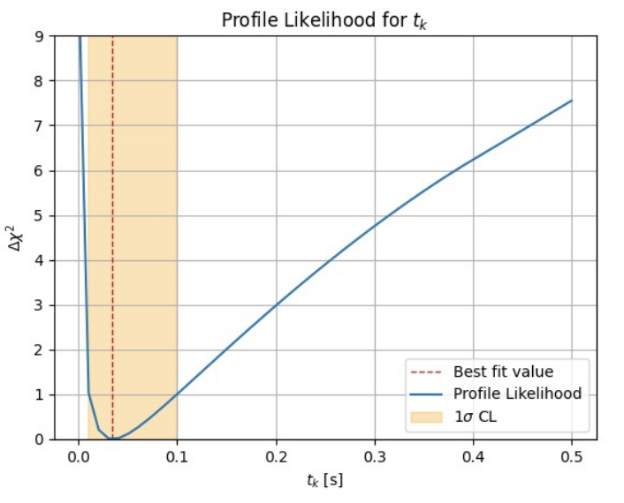
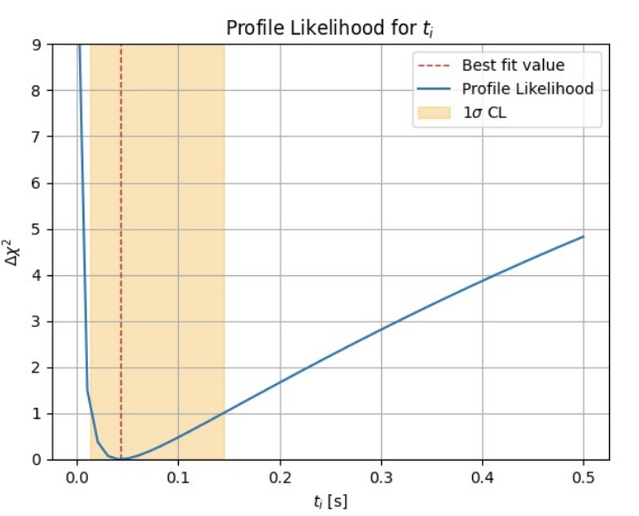



The delays and their differences: likelihood profiles
t_{k} = 35 (+65/−24) ms
t_{i} = 43 (+102/−29) ms
t_{b} = 54 (+152/−41) ms
Δt_{k} = −7 (+73/−107) ms
Δt_{b} = +10 (+157/−112) ms
Top: JCAP fig. 4. Bottom: EPJC fig. 1. Orange bands: 1σ (Δχ² = 1). Symmetrised Gaussians would give ±79 and ±117 ms, off by 30–40 ms on one side.
Notes:
Section: BACKUP
Backup. Delays from JCAP figure 4, differences from EPJC figure 1. The differences of the delay best fits give −8 and +11 ms (paper −7 and +10); the quadrature of the asymmetric half-widths gives +71/−105 and +155/−110 ms, close to the profiles, because the delays are uncorrelated with each other.

Slide 36
The differences hardly depend on t_{max}
t_{max} | 50 ms | 100 ms | 150 ms | 200 ms
Δt_{k} (ms) | −2 (+56/−92) | −7 (+73/−107) | −11 * (+90/−122) | −15 (+107/−139)
Δt_{b} (ms) | +2 (+143/−92) | +10 (+157/−112) | +21 (+171/−134) | +31 (+184/−156)
≤ 21 ms
≈ 30%
Conservative absolute times, errors widened: T_{k} = 7:35:41.345 (+0.129/−0.153) UT, T_{b} = 7:35:41.412 (+0.197/−0.173) UT.
shift of the central values over 50–200 ms
wider errors to cover the whole range
EPJC table 2. * Printed as −0.117 s, almost certainly −0.011 s: to be corrected in the proofs.
Notes:
Section: BACKUP
Backup. EPJC table 2 and the end of EPJC §2.2: covering the whole tmax range means widening Δtk by +34/−32 ms and Δtb by +27/−44 ms, about 30%.

Slide 37


Positions and path lengths through the Earth
 | Latitude | Longitude | LST at T_{i} | L_{d} | δt_{d}
IMB | 41.756° | −81.286° | 12h 21m 12.24s | 8600 km | reference
Kamiokande-II | 36.4225° | 137.3153° | 2h 55m 36.55s | 4300 km | +7 ms
Baksan | 43° 16′ 32″ | 42° 41′ 25″ | 20h 37m 6.55s | 10500 km | −3 ms
Sanduleak −69° 202: RA 5h 35m 27.92s, Dec −69° 16′ 11.07″, D = 51.4 kpc. The wavefront reached Kamiokande-II first, then IMB, then Baksan; corrections of a few ms, below the 50 ms of the IMB clock.
Notes:
Section: BACKUP
Backup. EPJC table 3 and figure 4. LST from USNO sidereal time at Ti. Path lengths agree within 1% with earlier estimates. If asked about Earth matter effects: in NO the burst arrives as ν3 and the Earth does not matter; in IO Pee rises from 0.30 to about 0.33 at 20 MeV (our estimate, to be verified).

Slide 38
Mass ordering and the sensitivity of the K1 verdict
IBD / ES likelihood ratio | Normal ordering | Inverted ordering
Central burst, maxima over time | 6 | 3
IBD at the fitted delay of K1 (35 ms) | 5.2 | 2.2
L_{max} at its upper edge, 6×10⁵³ erg/s | 4.3 | 1.8
Both of the above | 3.5 | 1.5
No flavour conversion (P_{ee} = 1) | ≈ 1 | ≈ 1
Normal ordering preferred: Δχ² = 9.4, about 3σ (April 2026); about 4σ with 207.2 days of JUNO data (preliminary)
NO: ν_{e} → ν₃, P_{ee} = 0.022. IO: ν_{e} → ν₂, P_{ee} = 0.296
IBD peaks at about 0.1 s; at 35 ms the burst is already over
EPJC §2.4 and §3.3; the rows with the delay of K1 and the combined row are our own estimates.
Notes:
Section: BACKUP
Backup for the questions on the ordering and on the robustness of the factor 3–6. In NO say "at least 3.5" rather than quoting sigmas; never "excluded".

Slide 39

Significance with a parameter on the boundary
Null hypothesis: cooling alone, ξ_{n0} = 0, on the boundary of the parameter space
Test statistic distributed as ½δ(0) + ½χ²_{m}, m = 1 or 2 (JCAP footnote 10): p = 0.0021 and 0.0083 for Δχ² = 8.2
τ_{a} is not defined when ξ_{n0} = 0 (Davies' problem): neither mixture is strictly justified
The rigorous answer is a toy Monte Carlo under the null hypothesis, or the Davies bound; a quick estimate gives p ≈ 0.006, inside the range
One-sided: 2.4–2.9σ. The 98.8% in the JCAP conclusions would need Δχ² ≈ 7.5
Notes:
Section: BACKUP
Backup for the statisticians in the audience. JCAP footnote 10 and ref. [78].

Slide 40
Times and energies fit well; angles remain the weak point
Times
With the delays from the fit, the three detectors share one time axis, and the combined distribution follows the model (JCAP fig. 8).
Energies
Good on the whole sample; IMB alone gives 4.4–10.9%, the known tension between a cooler Kamiokande-II and a hotter IMB.
Angles
2–6%: less problematic than in earlier analyses, but not entirely satisfactory.
Earlier analyses of the angles: Krivoruchenko 1989, Malgin 1998, Costantini, Ianni and Vissani 2004. With parameters fitted to the same data, these p-values are optimistic.
Notes:
Section: BACKUP
Backup for slide 6: the p-values on the whole sample as a chart, with the 5% threshold.
Whole sample (JCAP §5.6): times KS 82.8%, CvM 88.4% (JCAP figure 8); energies 50.7% and 77.7%; angles 5.5% and 2.0%. By detector (backup 35): IMB energies 4.4–10.9%.
Caveat for experts: the p-values use parameters fitted to the same data, so they are optimistic; the good values for the times are not strong evidence by themselves.
The angles return in the second paper, with K1. If asked about the old "forward peaking": in 1988 Kamiokande-II revised the direction of K2 and the anomaly decreased.

Slide 41



Kolmogorov–Smirnov and Cramér–von Mises tests
Data: F_{n}(x), the fraction of the n events with a value up to x (time, energy or angle)
Model: F(x), the same fraction expected from the best fit, with the detector response and the background
Kolmogorov–Smirnov: the largest gap between the curves
Cramér–von Mises: the squared gap over the whole range
p-value: the probability of a larger value if the model is true
Times: the model with background (blue) and the cumulative fraction of the 29 events (dashed), on one time axis with the fitted delays; KS 82.8%, CvM 88.4%. JCAP fig. 8
With parameters fitted to the same events, F is closer to the data than a fixed model: the standard p-values are optimistic.
Notes:
Section: BACKUP
Backup for slide 6: how the two goodness-of-fit tests work (JCAP §5.6).
Say, if asked: "Both tests compare two cumulative distributions: the fraction of the observed events below each value, and the same fraction expected from the best-fit model, with the detector response and the background. Kolmogorov–Smirnov takes the largest gap between the two curves; Cramér–von Mises integrates the squared gap over the whole range. The p-value is the probability of a larger value if the model is true. For the times, here on one axis with the fitted delays, the two curves stay close: 83 and 88 percent."
What is compared (JCAP §5.6): the theoretical time, energy and angle distributions, computed from the observed signal of JCAP eq. 3.4 at the best-fit parameters, plus the background; the empirical ones, from the events of JCAP table 1. For the angles of Kamiokande-II, two versions: with K13–K16 and without them (threshold 7.5 MeV); see backup 35.
Formulas, with the n values in increasing order x1 ≤ … ≤ xn: Dn = max over i of max[i/n − F(xi), F(xi) − (i − 1)/n]; W² = 1/(12n) + Σi [F(xi) − (2i − 1)/(2n)]². Both depend only on the values F(xi), so they do not change under a monotonic change of variable: the log time scale of the figure does not matter.
If F is fixed in advance and continuous, the distribution of Dn and W² under the model is the same for any F, and standard tables give the p-values. Here F uses parameters fitted to the same events, so it lies closer to the data than a fixed model would, and the standard p-values are too high. A toy Monte Carlo would give the exact ones: samples drawn from the best fit, each refitted and tested again.
Kolmogorov–Smirnov is most sensitive near the middle of a distribution, where Fn fluctuates most; Cramér–von Mises adds up the gaps everywhere. So the two can differ: energies KS 50.7%, CvM 77.7%; angles KS 5.5%, CvM 2.0%, which points to a deviation spread over the whole range of angles rather than one large gap (our reading, not in the paper).
Values (JCAP §5.6): whole sample, times KS 82.8%, CvM 88.4%; energies 50.7% and 77.7%; angles 5.5% and 2.0%. By detector: backup 35 (JCAP table 5); as a chart, with the 5% threshold: backup 43.

