Slide 1
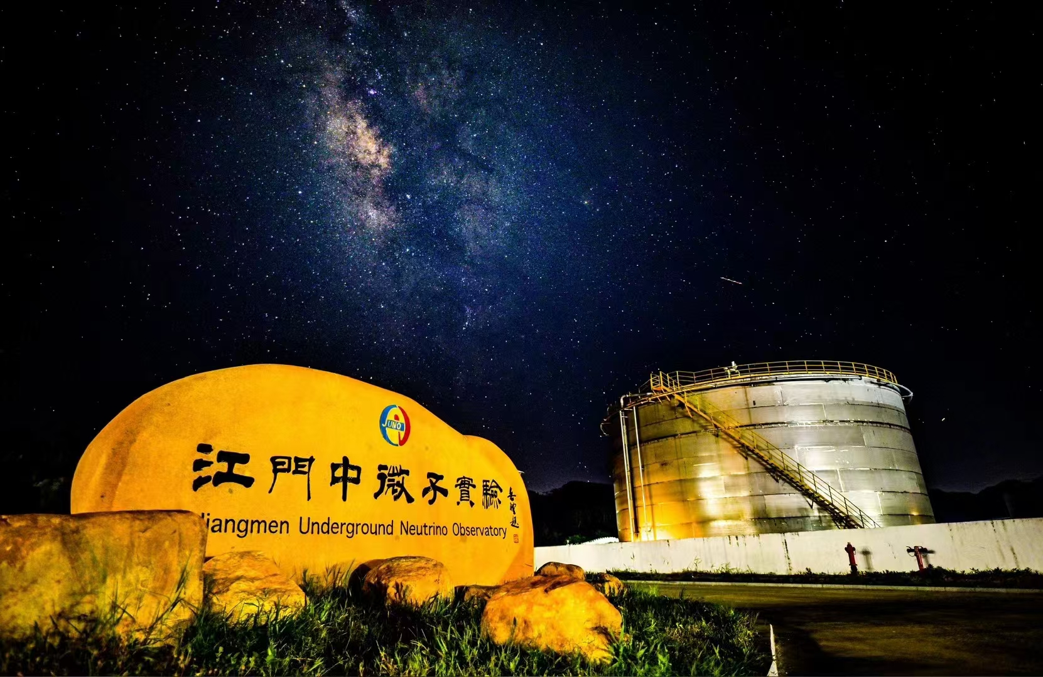
The JUNO Detector and its Physics Results
NNN26 · 25th International Workshop on Next Generation Nucleon Decay and Neutrino Detectors
Cong Guo （IHEP）
On behalf of the JUNO Collaboration
Chung-Ang University, Seoul, Republic of Korea · October 28–30, 2026
Cong Guo · IHEP · NNN26 Seoul · Page 1

Slide 2
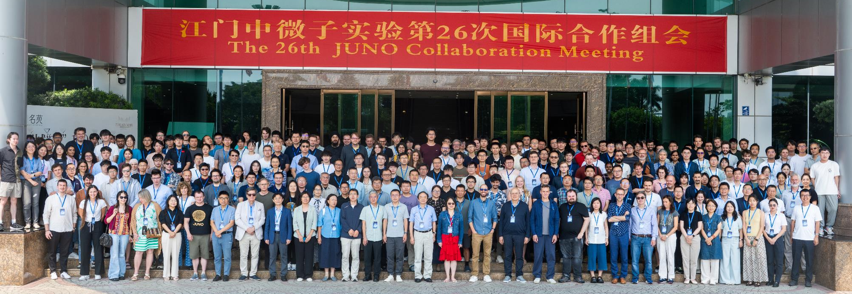
JUNO Project and the Collaboration
Project firstly approved in China in 2013 and later in other countries. Civil construction started in 2015.
Collaboration established in 2014, now >700 collaborators from 70 institutions in 16 countries/regions.
Country | Institute | Country | Institute | Country | Institute
Armenia | YerPhI | China | SDU | Italy | INFN-CT
Belgium | ULB | China | SJTU | Italy | INFN-FE
Chile | SAPHIR | China | SUSTech | Italy | INFN-LNF
Chile | UNAB | China | SYSU | Italy | INFN-MI
China | BISEE | China | THU | Italy | INFN-MIB
China | CDUT | China | UCAS | Italy | INFN-PD
China | CNPRI | China | WHU | Italy | INFN-PG
China | CUGB | China | WuYiU | Italy | INFN-Roma3
China | DGUT | China | XJTU | Pakistan | PINSTECH (PAEC)
China | ECUT | China | XMU | Russia | JINR
China | GXU | China | ZZU | Slovakia | FMFI-UK
China | HIT | Czech | Charles U. | Taiwan-China | NCTU
China | HunanU | Finland | JyU | Taiwan-China | NKNU
China | IGGCAS | France | CPPM | Taiwan-China | NTU
China | IHEG-CAGS | France | IJCLab | Taiwan-China | NTUT
China | IHEP | France | IPHC | Thailand | CHULA
China | IMP | France | LP2iB | Thailand | NARIT
China | JNU | France | Subatech | Thailand | SUT
China | JXNU | Germany | EKUT | U.K. | U. Liverpool
China | KNRC | Germany | GSI | U.K. | U. Warwick
China | Nankai U. | Germany | U. Hamburg | USA | UC-Irvine
China | NCEPU | Germany | JGUMainz | USA | UMD-G
China | NJU | Germany | RWTH-AC
China | RNCG | Germany | TUM
+Observers: USTC, Peking Uni., Jilin Uni., Beijing Normal Uni., CIAE (China), PUC, UEL (Brazil)
Cong Guo · IHEP · NNN26 Seoul · Page 2

Slide 3
Outline
01
Detector Design & Performance
JUNO overview, central detector, veto system, TAO satellite, current status
02
Latest Physics Results
Reactor antineutrinos, mass ordering, geo-neutrinos
03
Upgrade Plans & Future Program
0νββ searches with isotope loading
The JUNO Detector and its Physics Results · NNN26 2026
Cong Guo · IHEP · NNN26 Seoul · Page 3

Slide 4
01
Detector Design & Performance
Cong Guo · IHEP · NNN26 Seoul · Page 4

Slide 5
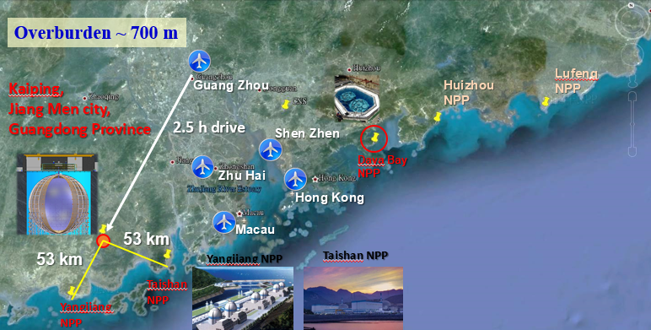
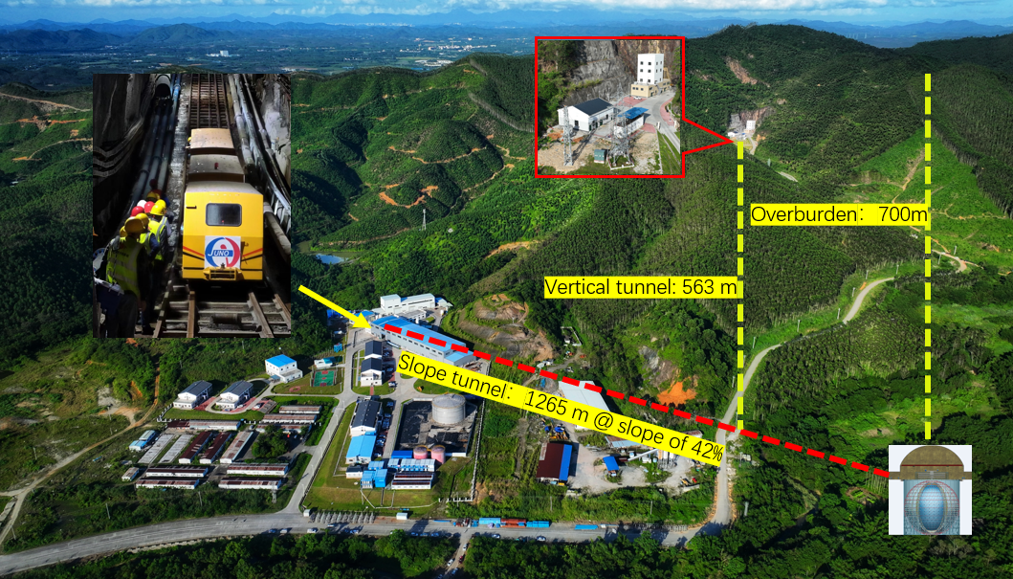
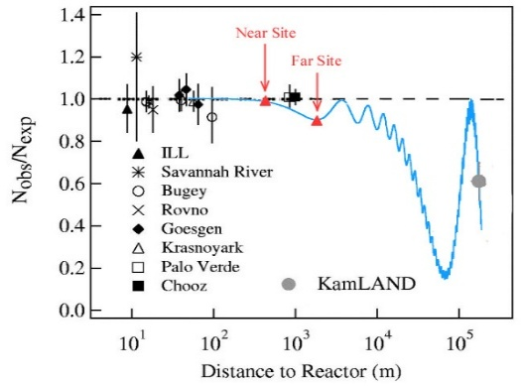
JUNO: Location & Primary Physics Goal
Overburden: 650m
Overburden: 650 m
252 km
JUNO
Daya Bay
17.4GW_{th}
9.2GW_{th}
Use reactor neutrinos to determine the mass ordering (sign of Δm²₃₂), independent of matter effects and CP phase；
Equal distance to two reactor power plants for doubling the ν flux；
With an overburden of 650 m, reducing the muon rate to 4 mHz/m² with an average energy of 207 GeV;
Cong Guo · IHEP · NNN26 Seoul · Page 5
Notes:
The baseline was specifically chosen to sit at the first solar oscillation maximum, where the spectral distortion due to mass ordering effects is maximal.

Slide 6
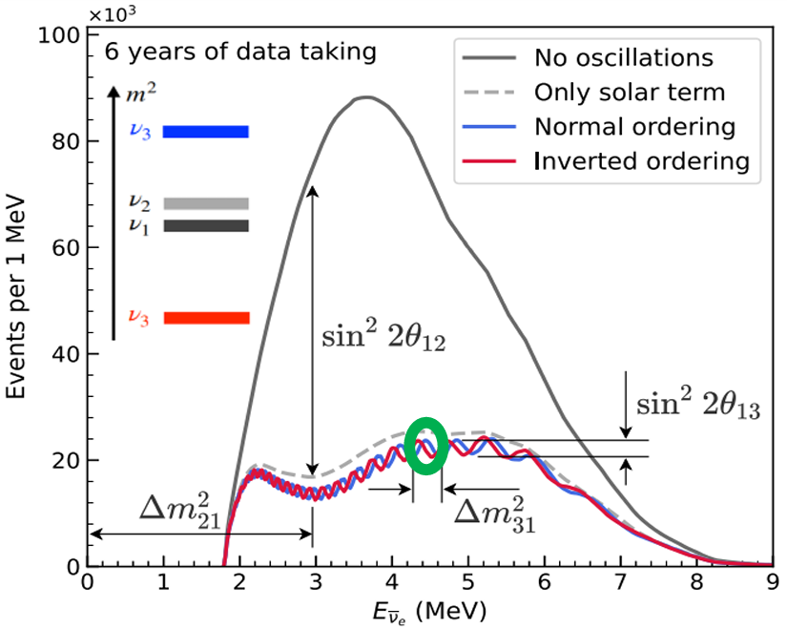
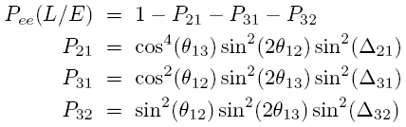
JUNO: An unique approach to determine neutrino mass ordering
KEY PARAMETERS
Large statistics
  20 ktons of LS
3%@1MeV energy resolution
  LS light yield >1200 P.E./MeV
  LS attenuation length > 20m
  PMT coverage 75%
1% energy scale uncertainty
  Four complementary calibration systems
Low background
  A “clean” central detector
  Veto detector
Cong Guo · IHEP · NNN26 Seoul · Page 6

Slide 7
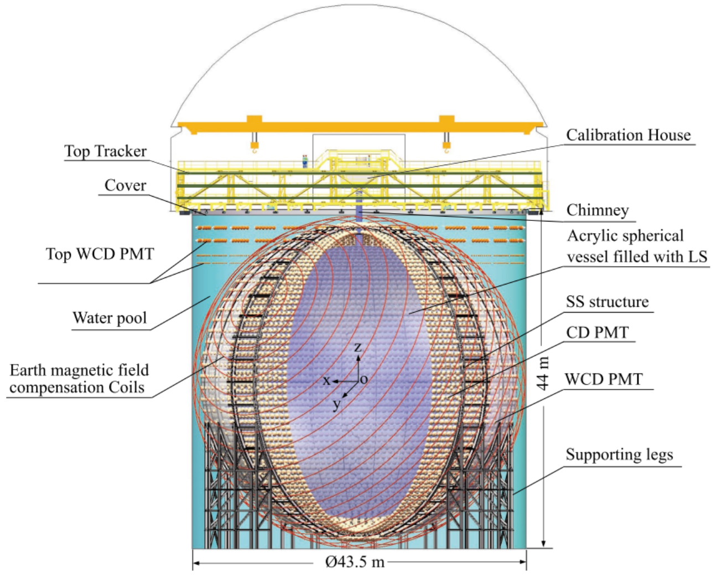
JUNO Detector
Central Detector:
  20 ktons of LS + Acrylic Sphere;
  17612 20” PMT + 25600 3 ” PMT;
    Coverage: 78%;
Veto Detector:
  Water Cherenkov detector
    41 ktons of ultrapure water;
    2404 20”PMT + 348 20”PMT + 600 8”PMT;
    Earth magnetic field compensation coils;
  Top tracker detector
    Plastic scintillator covering ~half of the WP;
AS: ID35.4m
SSS: ID40.1m
Cong Guo · IHEP · NNN26 Seoul · Page 7

Slide 8
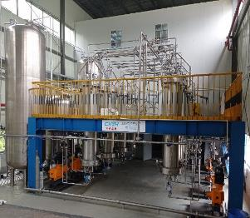
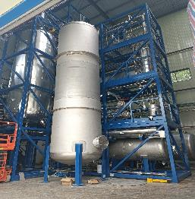
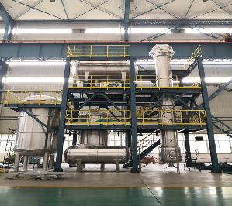
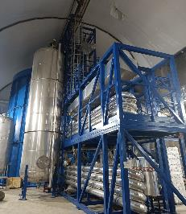
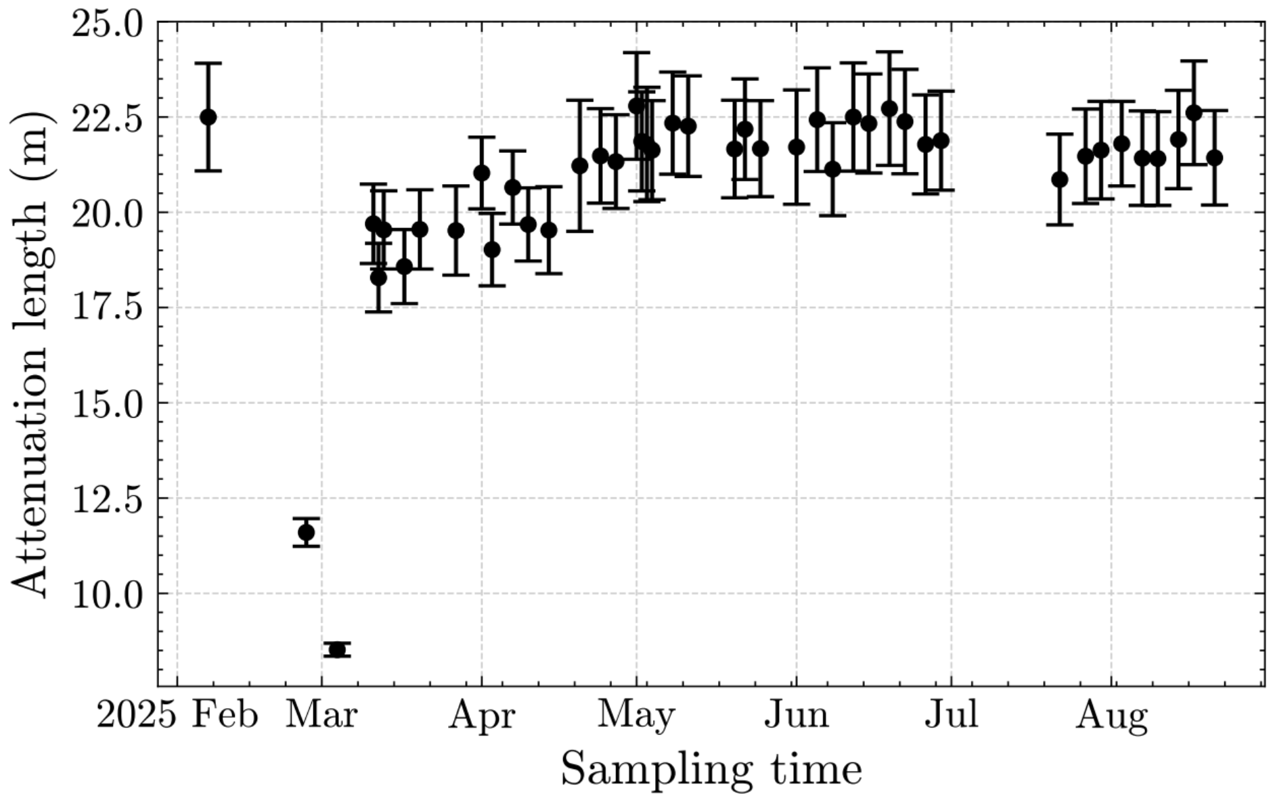
Liquid scintillator
1) Al₂O₃ for optical transparency
2) Distillation for radiopurity
3) Water extraction to remove radioactive impurities
4) Gas stripping to remove Rn and O₂
For optimal transparency and light yield:
  Recipe: LAB + 2.5g/L PPO + 3 mg/L bis-MSB + 0.005% BHT;
  Production: Four purification plants + LS Mixing ;
  Auxiliary device: HPN plant + UPW system;
  Background: U/Th < 10⁻¹⁶g/g, Rn<1mBq/m³;
Weighted Attenuation length: 20.6 m
Cong Guo · IHEP · NNN26 Seoul · Page 8

Slide 9
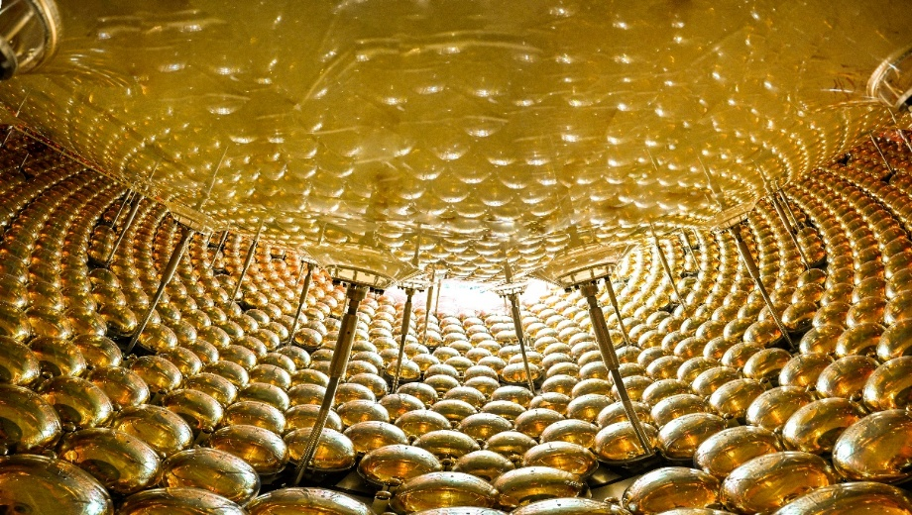
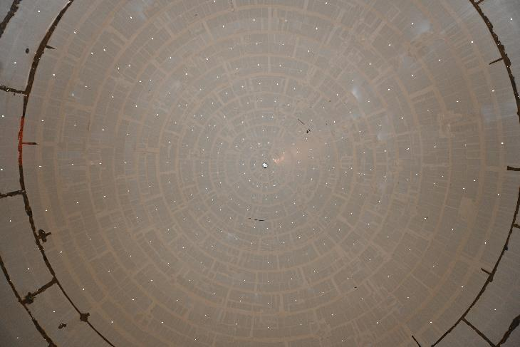
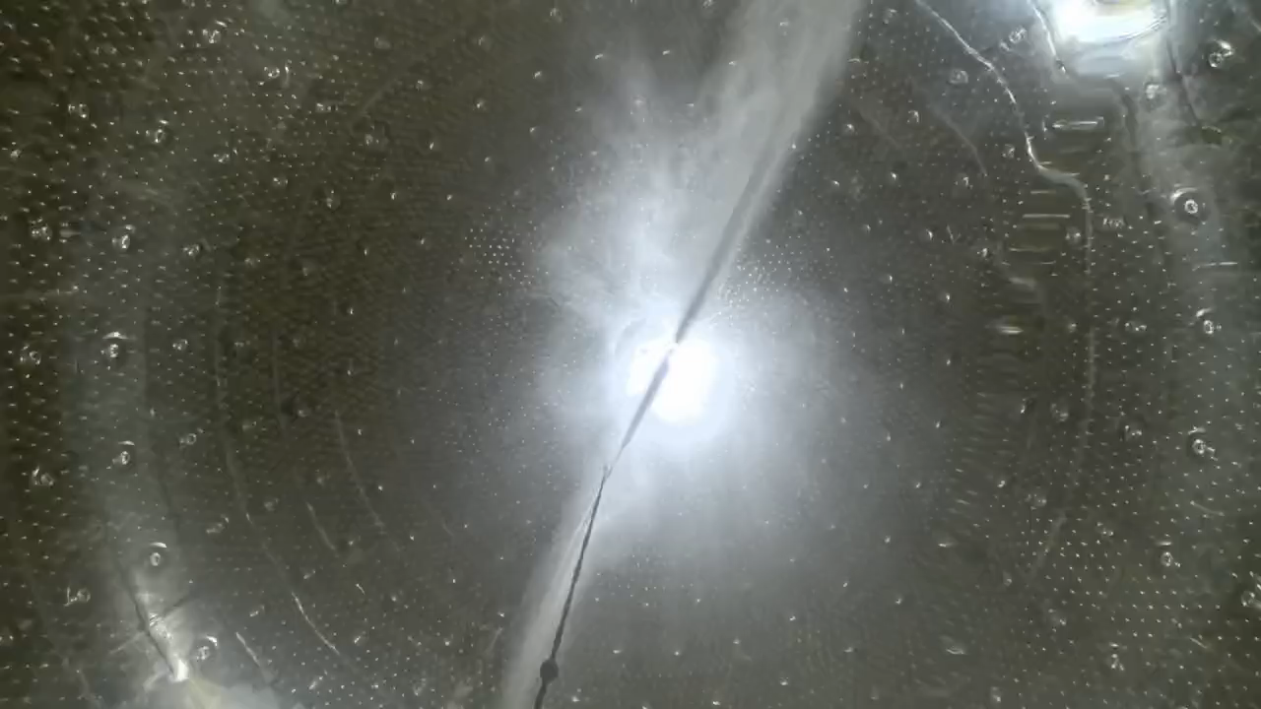
Central detector
263 Acrylic panels thermally pressed and machined to the spherical shape, bonded together in-situ through PMMA polymerization;
SS structure to hold the acrylic tank and PMTs, through steel bars with springs and rotating heads;
Clearance between PMTs is ~3 mm, to maximize coverage;
Water soluble paper film on acrylic to stop Rn decay daughters, high-pressured UPW is used to remove dust and paper film before water filling ;
  Resistivity~18 MΩ*cm, U/Th < 10⁻¹⁵ g/g, Rn < 10mBq/m³ ；
Cong Guo · IHEP · NNN26 Seoul · Page 9

Slide 10
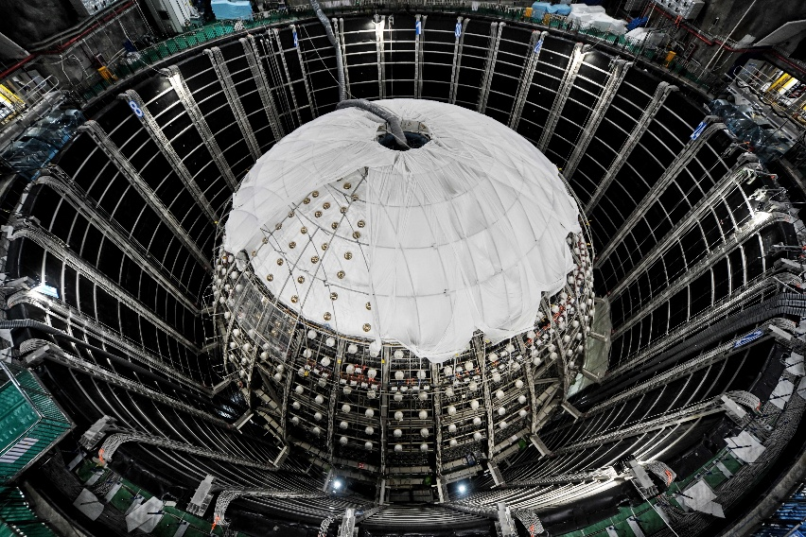
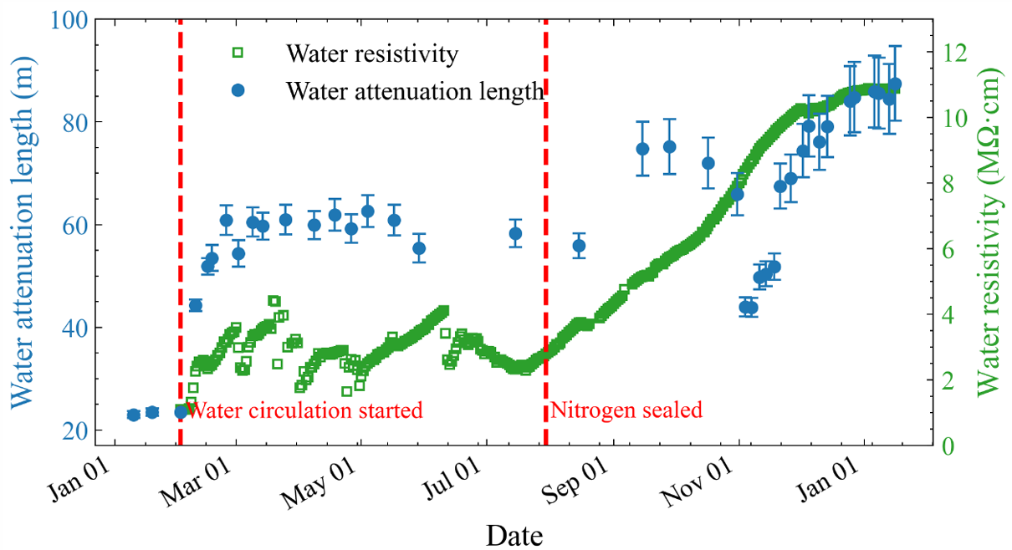
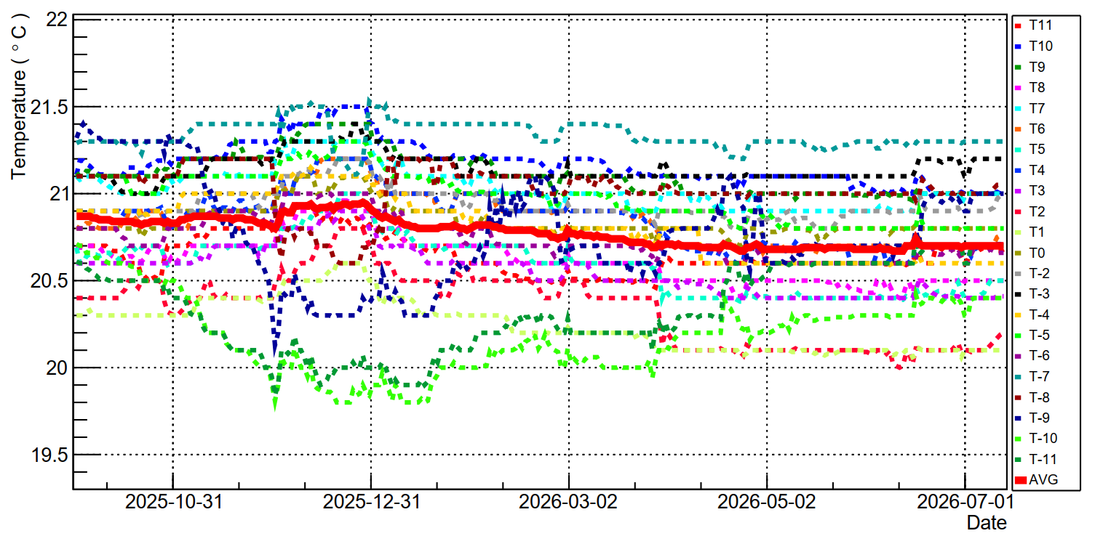
Water Cherenkov detector
The WCD uses 41 ktons UPW to tag muon and passive shielding;
The water in the WCD is circulated and purified by an UPW system at a flow rate of ~100 t/h;
Muon trigger rate in CD ~5 Hz, in Water Pool (only) ~4 Hz；
Muon detection efficiency of CD through-going muons > 99.5%；

Slide 11
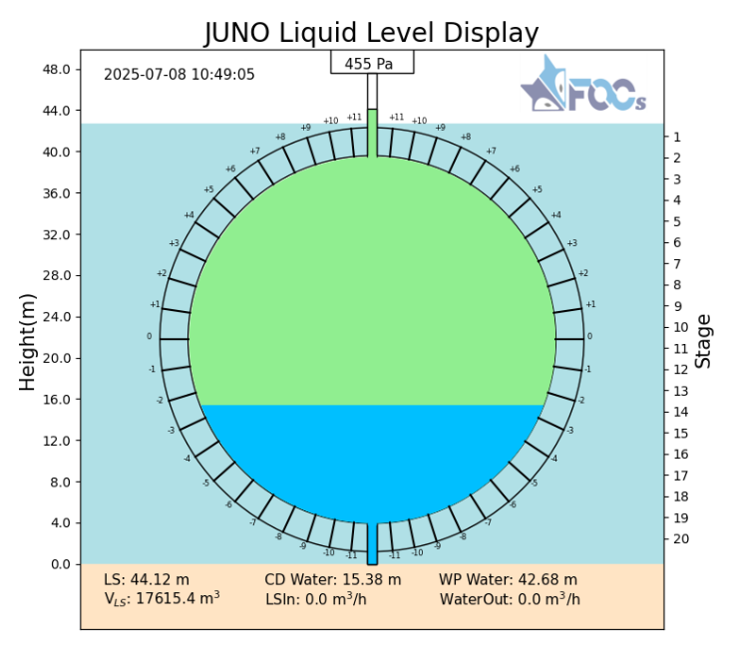
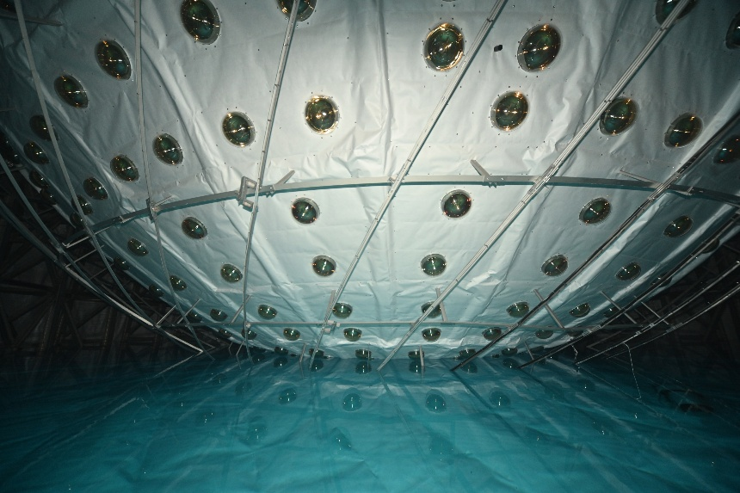
Detector filling
End of
water filling
Expected end of
LS filling
Dec 18, 2024
Feb 8, 2025
Mixed phase
Water phase
Start of
water filling
Feb 1, 2025
Start of
LS filling
Aug 22, 2025
UPW filled in CD:
  ²²⁶Ra < 10 μBq/m³；
  ²²²Rn < 10mBq/m³;
The LS filling speed is 7 m³/h;
LS in the CD: 23231.6 m³ ;
Water in the pool: 41225.1 m³;
Cong Guo · IHEP · NNN26 Seoul · Page 10

Slide 12
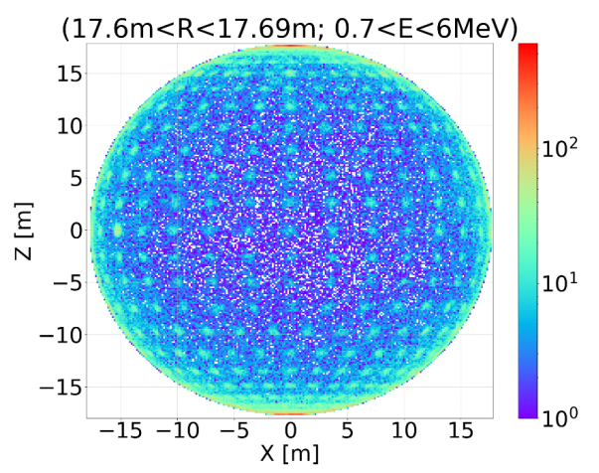
A very clean detector
For reactor neutrinos: (r < 17.2m & E > 0.7MeV)
  Clearly see the steel structure: acrylic surface background from dust is limited ➔ washing is effective
  Single event rate: < 6 Hz (design 7.2 Hz)
  Background simulation includes LS, PMTs, steel structure, acrylic and water (including Rn) ➔ Good agreement with data
LS purity:
Fiducial volume | ²³⁸U [10⁻¹⁷ g/g] | ²³²Th [10⁻¹⁷ g/g] | ²¹⁰Po [10⁴ cpd/kt]
 |  |  | Initial | Present (Jun. 1)
r < 16.5 m (+ remove top hot spot) | 3.6±0.1 | 1.4±0.1 | 4.80±0.1 | 2.0±0.1
Cong Guo · IHEP · NNN26 Seoul · Page 11

Slide 13
02
Latest Physics Results
Cong Guo · IHEP · NNN26 Seoul · Page 12

Slide 14
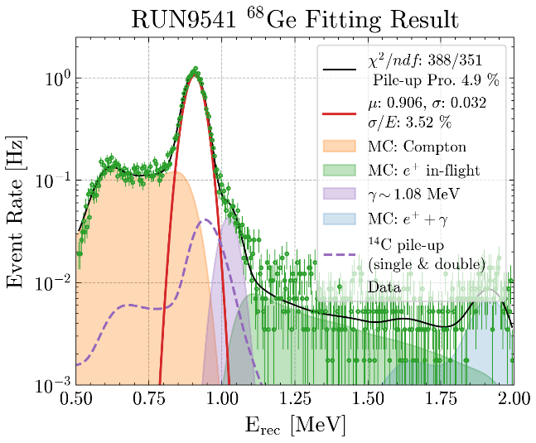
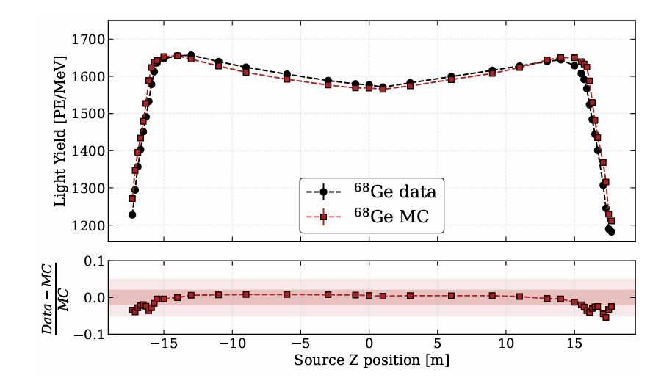
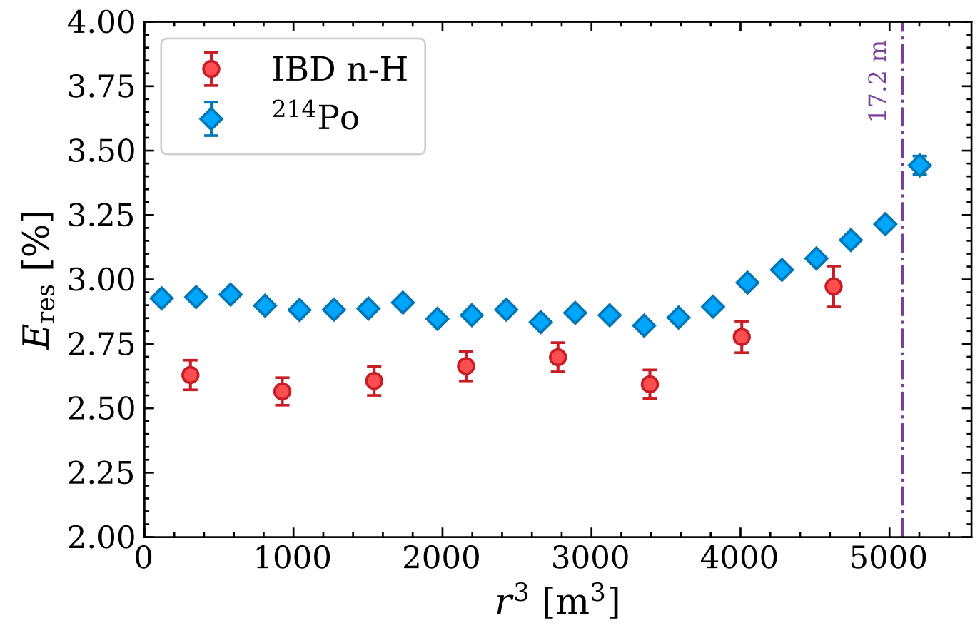
Light yield and energy resolution
Light yield at the detector center is ~1600 P.E./MeV for ⁶⁸Ge and ~1785 P.E./MeV for neutrons, in good agreement with MC;
Energy resolution for ⁶⁸Ge is ~3.5% @ 2× 0.511 MeV at the center, slightly worse than the expected 3.1%;
Energy resolution for α from ²¹⁴Po is ~2.9% @0.93MeV;
⁶⁸Ge
Cong Guo · IHEP · NNN26 Seoul · Page 13

Slide 15
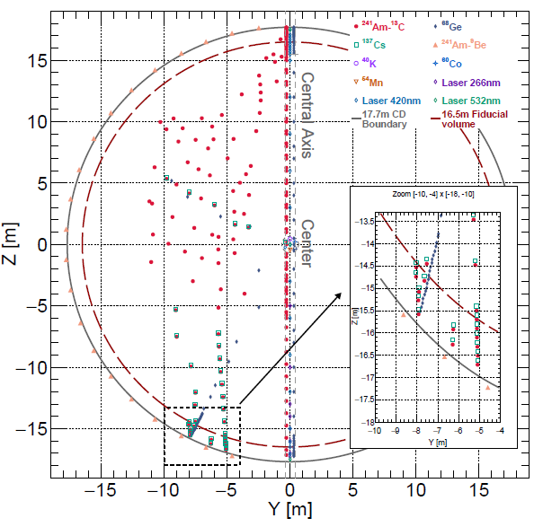
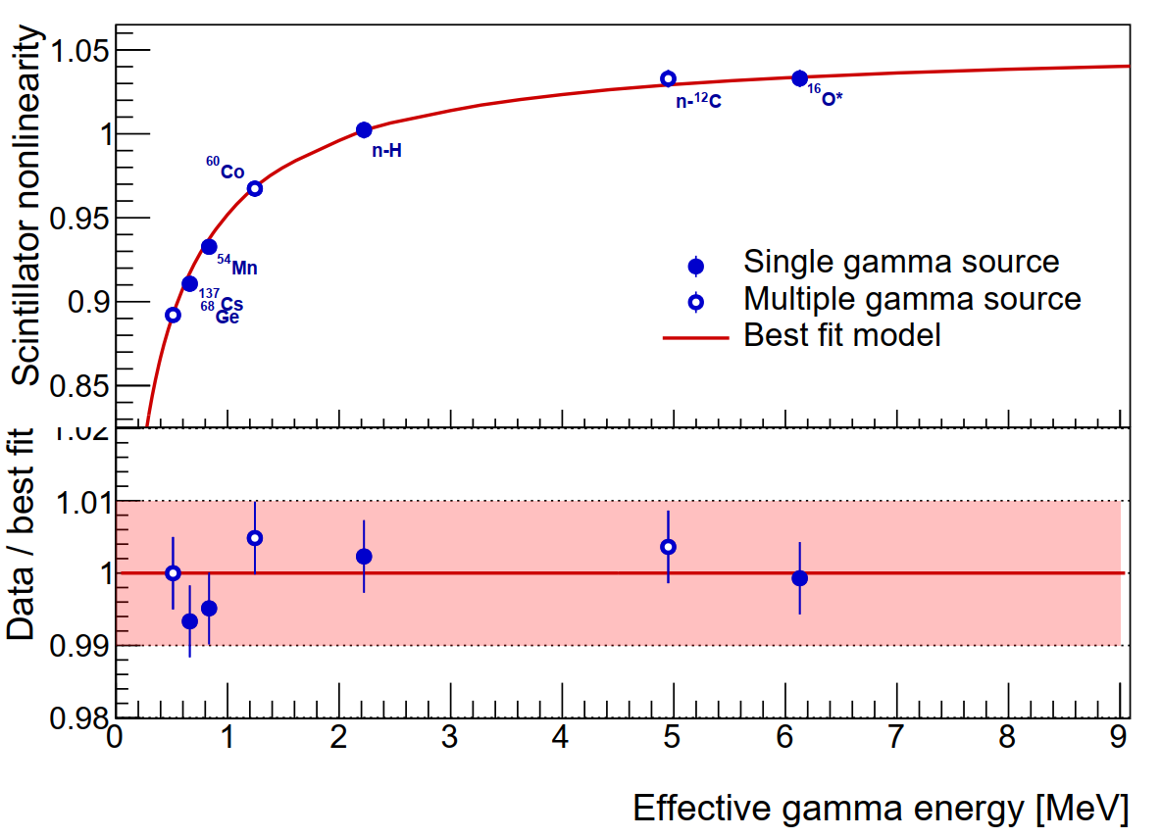
Calibration and energy uncertainty
Four complementary subsystems, Automated Calibration Unit (1D), Cable Loop Systems (2D), Guide Tube Calibration System (2D), and Remotely Operated Vehicle (3D);
Performed calibration:
  1D (ACU, central axis): ¹³⁷Cs, ⁵⁴Mn, ⁴⁰K, ⁶⁸Ge, ⁶⁰Co, Am-C, Am-Be, sensors, laser
  2D (CLS, vertical plane): Am-C, ⁶⁸Ge, ¹³⁷Cs
  3D using cosmogenic backgrounds:
    Bi-Po214 from Rn decays, spallation neutrons, other cosmogenic isotopes
Non-linearities of LS and electronics are determined by calibration sources at the center: ⁶⁸Ge, ¹³⁷Cs, ⁵⁴Mn, ⁴⁰K, ⁶⁰Co, Am-C, and Am-Be;
Uncertainty < 1%;
γ @Detector center
Cong Guo · IHEP · NNN26 Seoul · Page 15

Slide 16
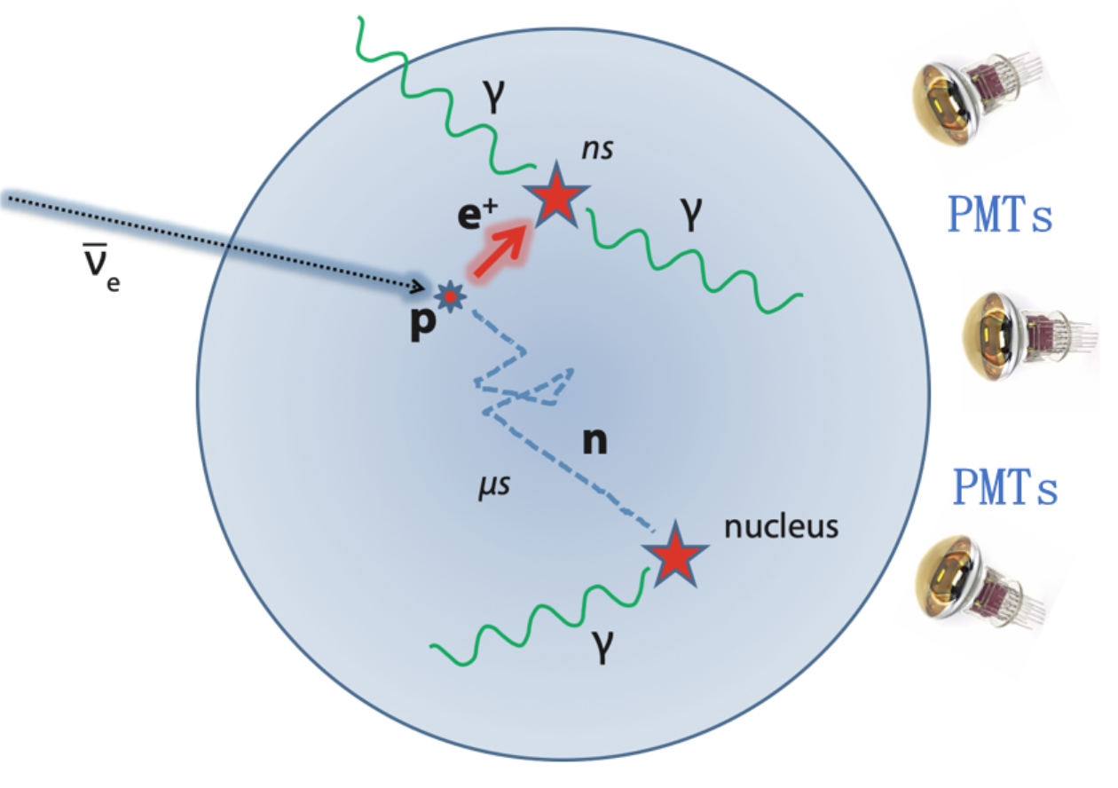
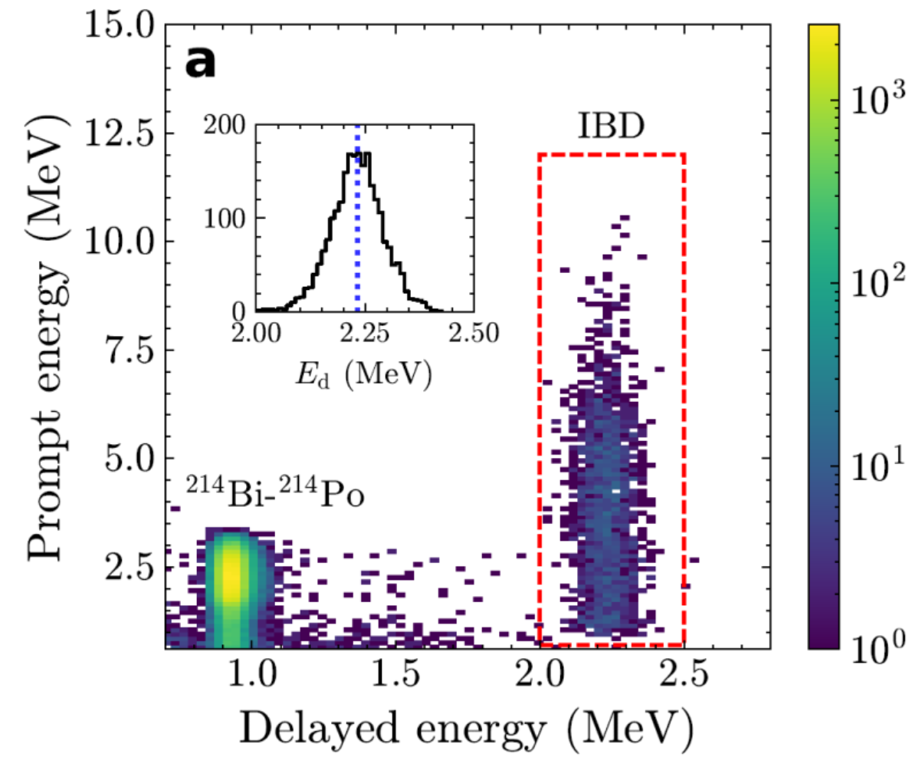
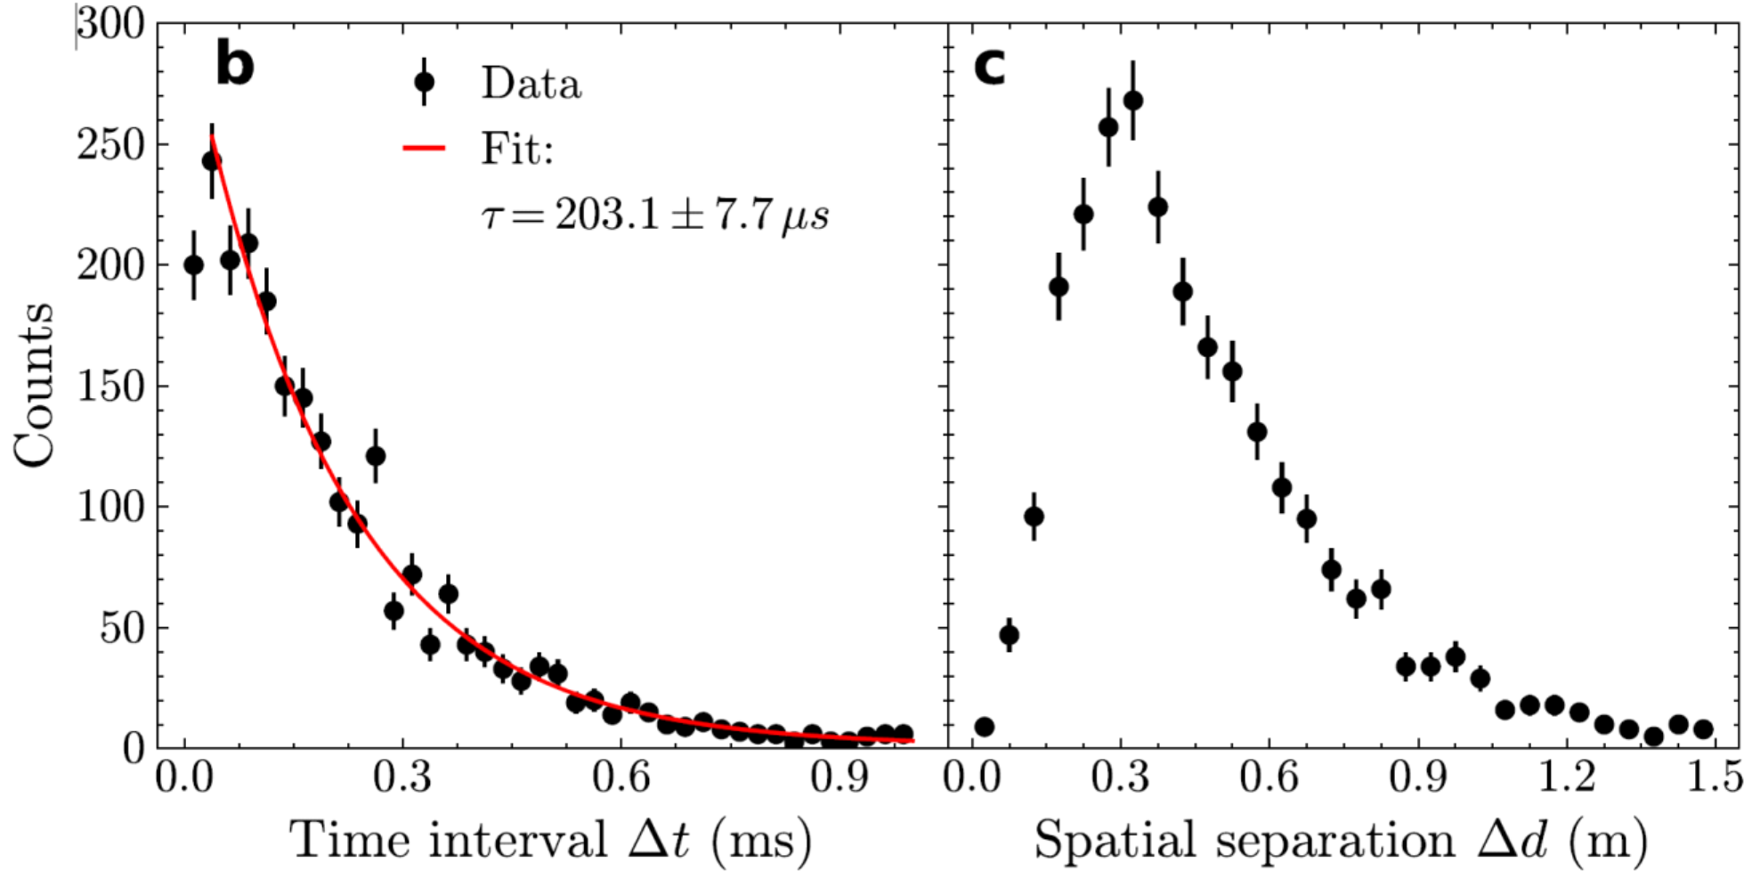
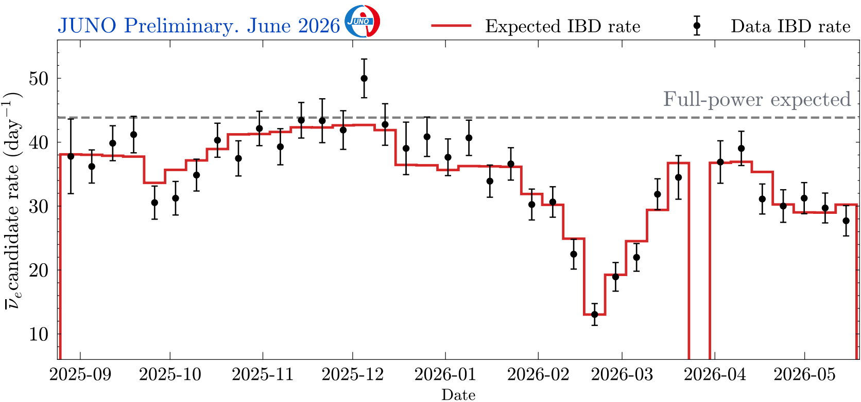
Reactor neutrino selection
Prompt and delayed coincidence in time, space with energy features;
Measured reactor neutrino event rate consistent with expectation;
Total live time is 207.2 days;
Cong Guo · IHEP · NNN26 Seoul · Page 16

Slide 17
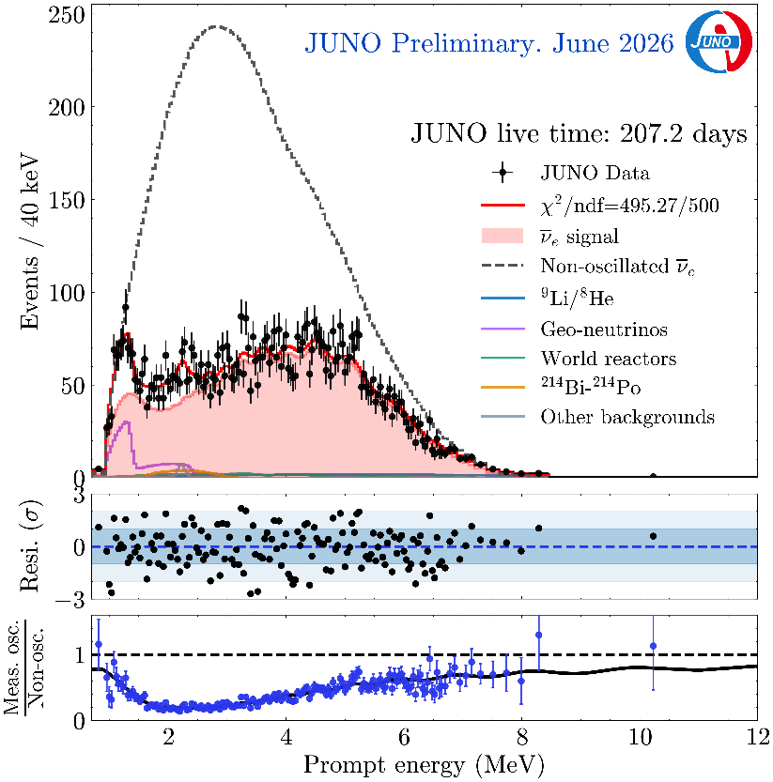
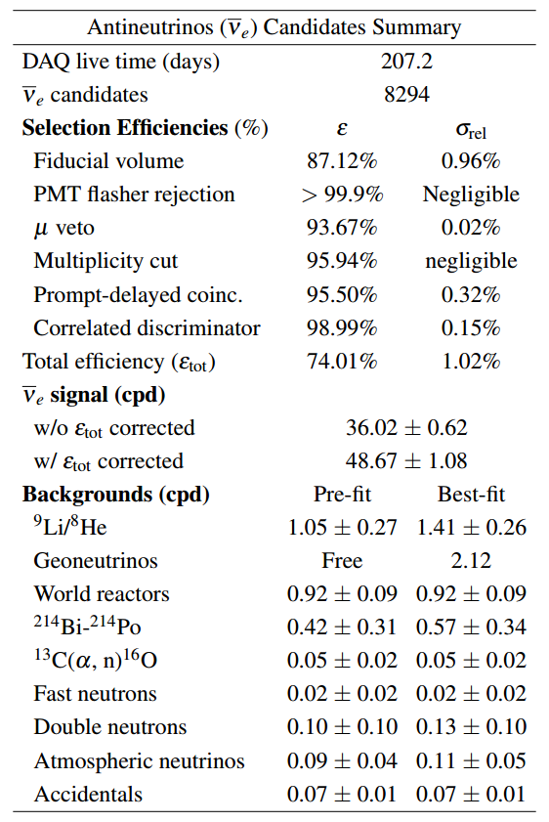
Measured reactor neutrino spectrum
Fitting constrained by the near detector spectra from JUNO-TAO measurement results and Daya Bay measurement result (PRL 130 16, 161802)
Cong Guo · IHEP · NNN26 Seoul · Page 17

Slide 18
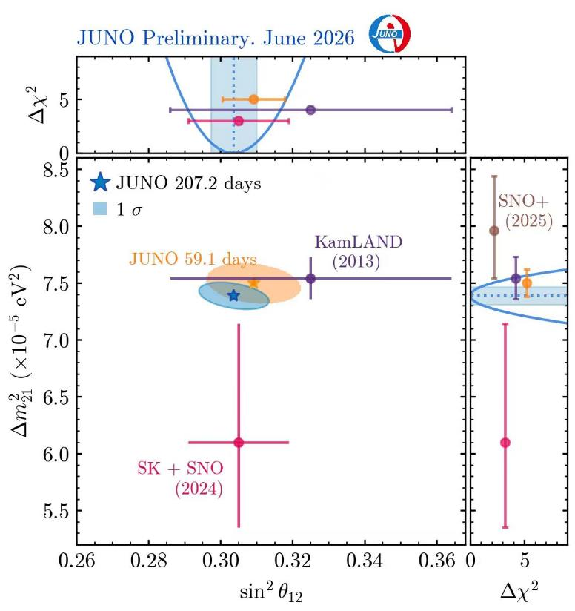
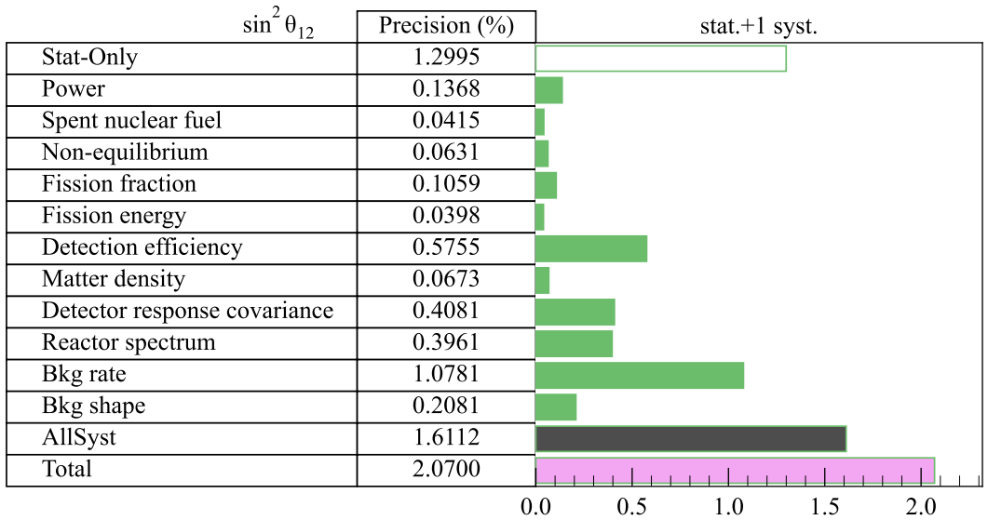
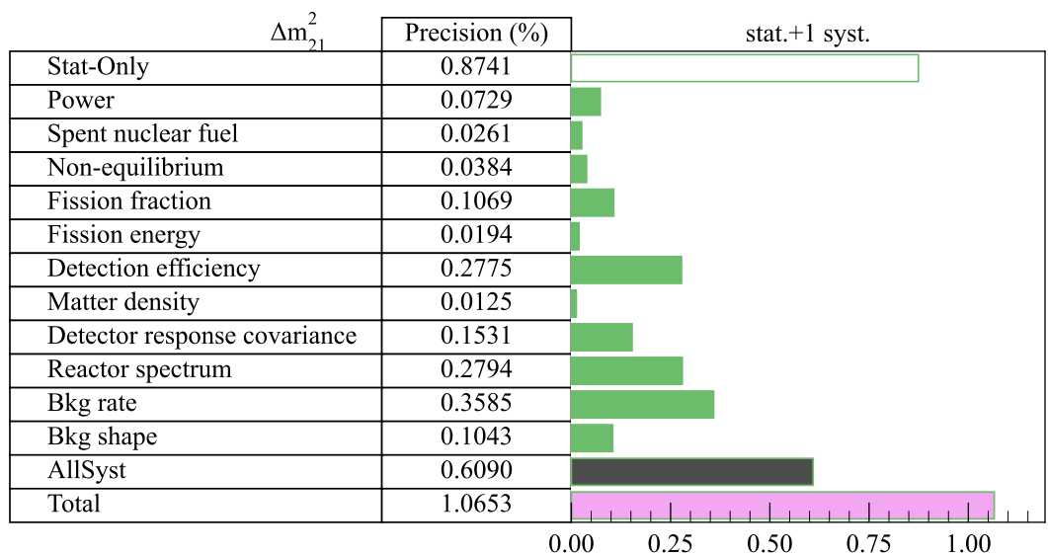
Results of the solar oscillation parameters
Even though the statistical uncertainty is dominant, systematic errors become important:
  ²¹⁴Bi bkg. and detection eff. can be improved
Δm²₂₁ | 7.388±0.078 (1.60% →1.06%)
sin²θ₁₂ | 0.3036±0.0064 (2.8%→2.1%)
Cong Guo · IHEP · NNN26 Seoul · Page 18

Slide 19
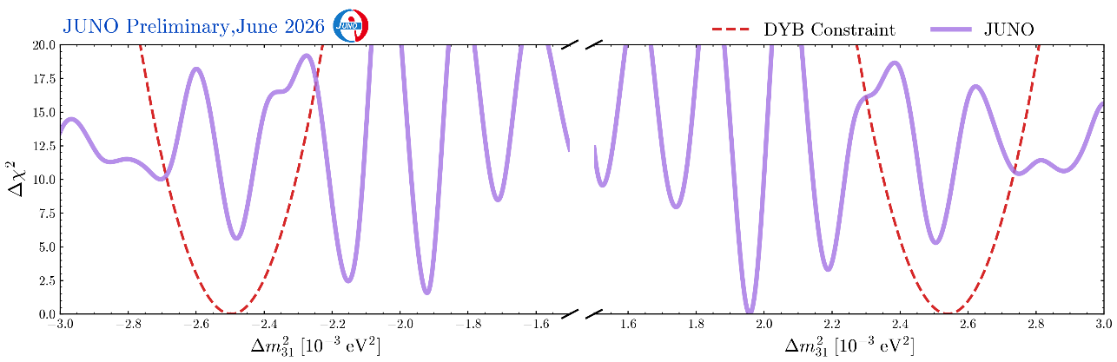
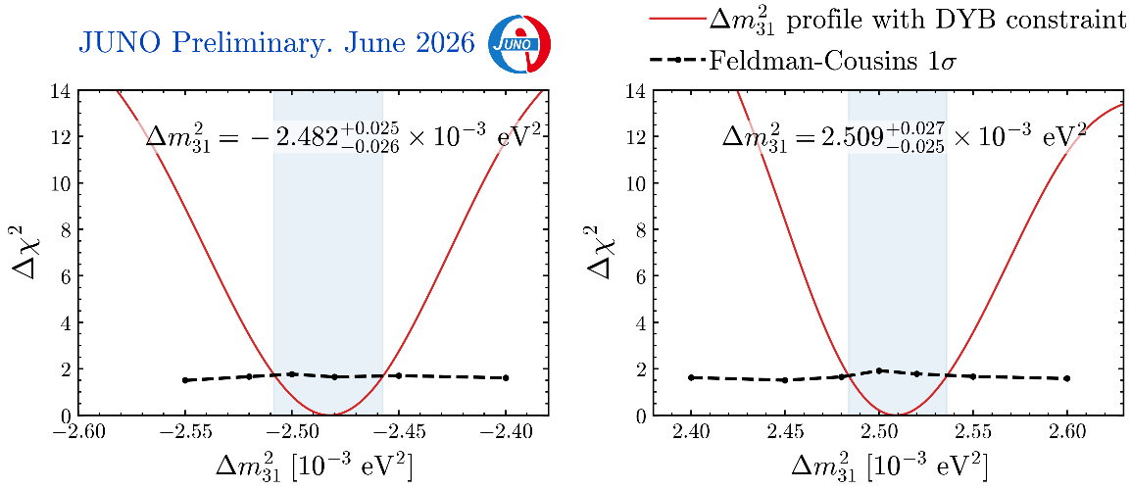
Result of Δm²₃₁
Due to statistical fluctuations, JUNO only profiles of Δm²₃₁ have multiple minimal；
The final minimum for each mass ordering is obtained by using the Δm²₃₁ constraint from the Daya Bay result (PRL 130 16, 161802)；
Feldman-Cousins (FC) method is used to determine the 1σ range of Δm²₃₁：~1% precision achieved；
[-1.05%，+1.00%]
[-1.00%，+1.08%]
Cong Guo · IHEP · NNN26 Seoul · Page 19

Slide 20
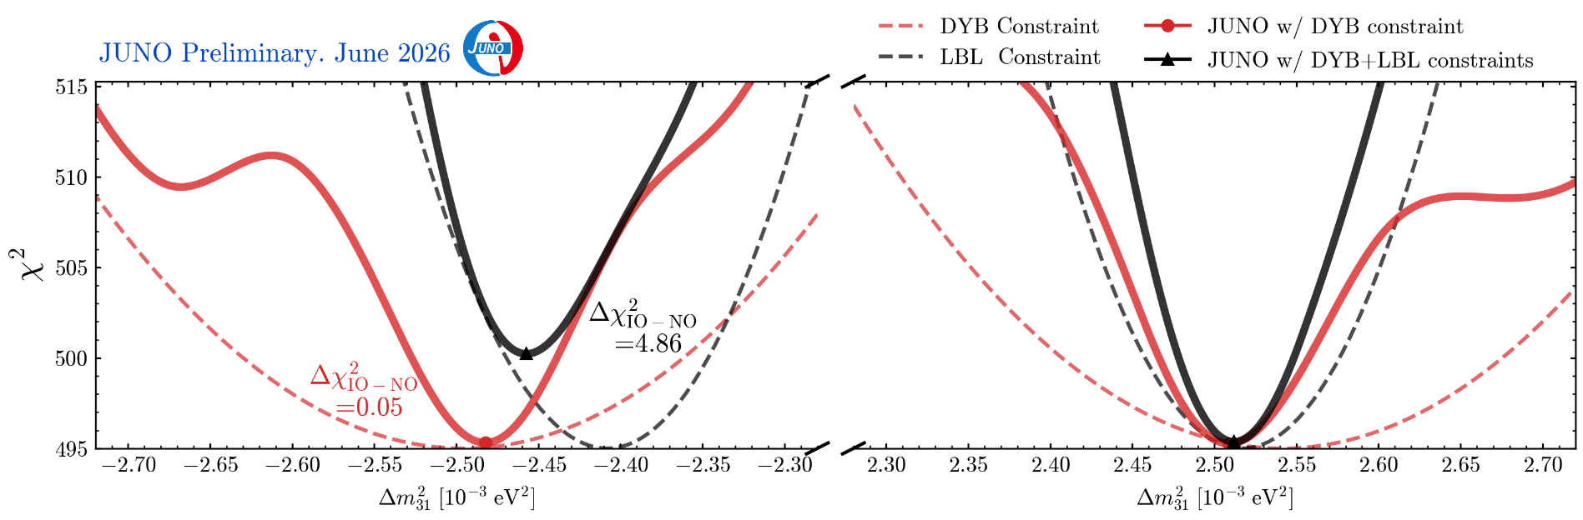
Adding Constraint from NuFit-LBL
Δm²₃₁ from reactor and accelerator neutrinos should align at the right mass ordering[1]
Adopt the NuFit-LBL results from [2]: normal mass ordering is favored at Δχ² = 4.86
[1] H. Nunokawa, S. Parke and R.Z. Funchal, Phys. Rev. D 72 (2005) 013009; Y. F. Li et al., Phys. Rev. D 88, 013008 (2013)
[2] NuFIT 6.0 (JHEP 12 (2024) 216 [arXiv:2410.05380]), www.nu-fit.org and M. Maltoni private communication
Cong Guo · IHEP · NNN26 Seoul · Page 20

Slide 21
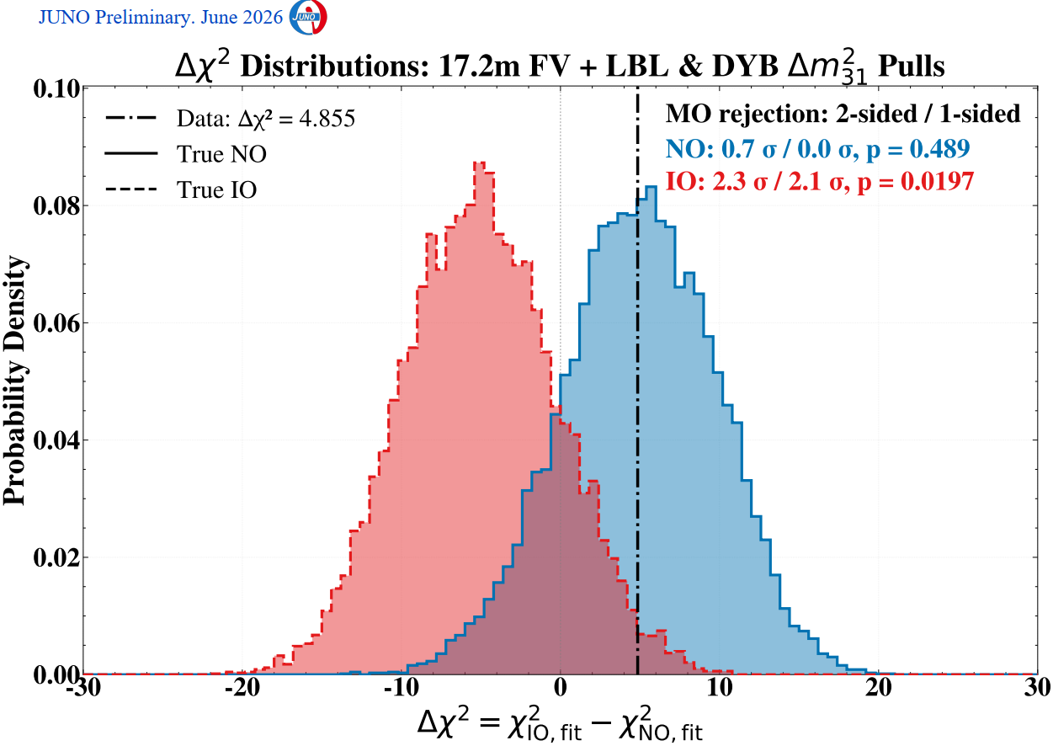
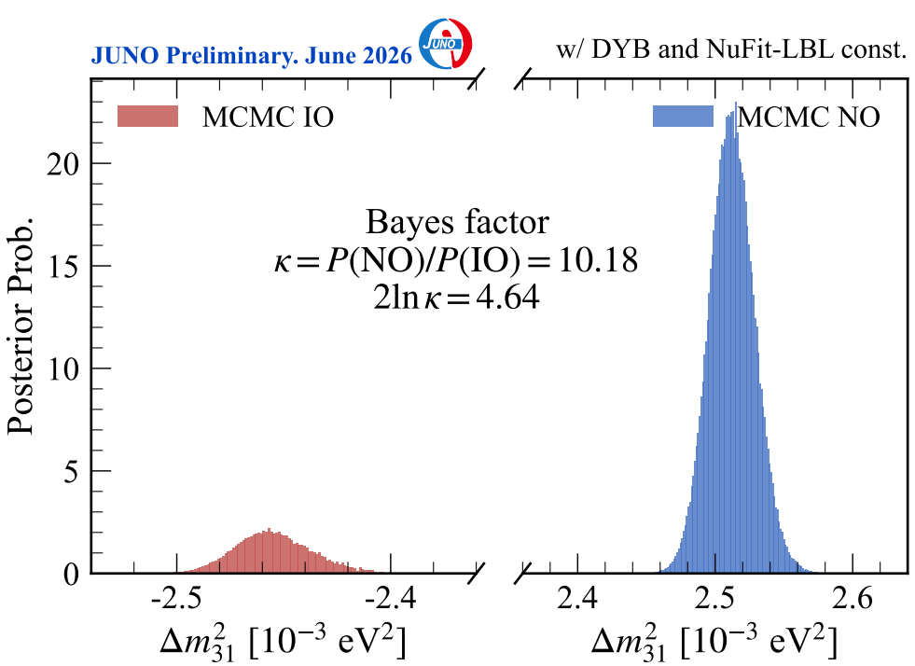
Neutrino Mass Ordering Significance
Frequentist approach using pseudo exp. to convert Δχ² to significance
Influence of δ_{CP} considered (scanned)
Normal Ordering is favored at 2.1σ (one-sided)
Bayesian approach using Markov Chain Monte Carlo(MCMC) method
Normal Ordering is favored with a Bayes factor of 10.18 ➔ 2ln k= 4.64 Consistent with the frequentist Δχ²
Cong Guo · IHEP · NNN26 Seoul · Page 21

Slide 22
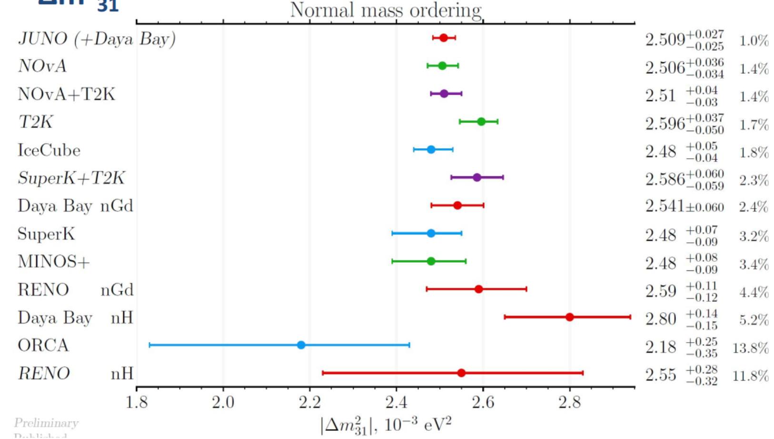
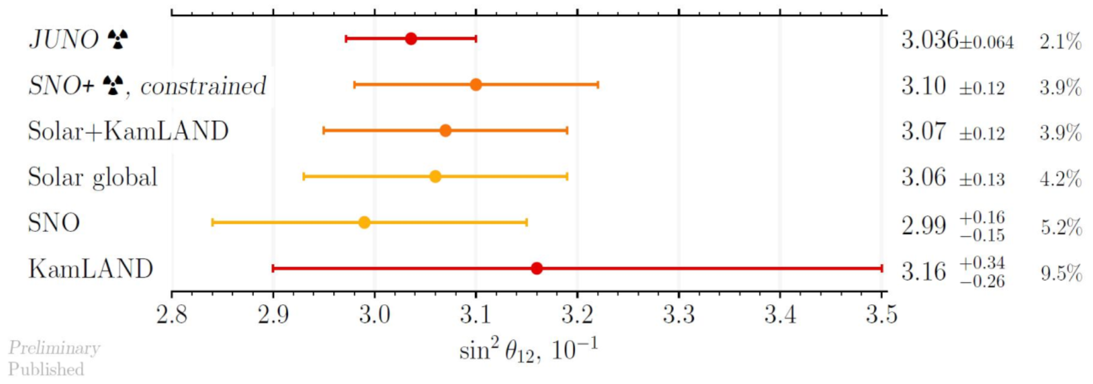
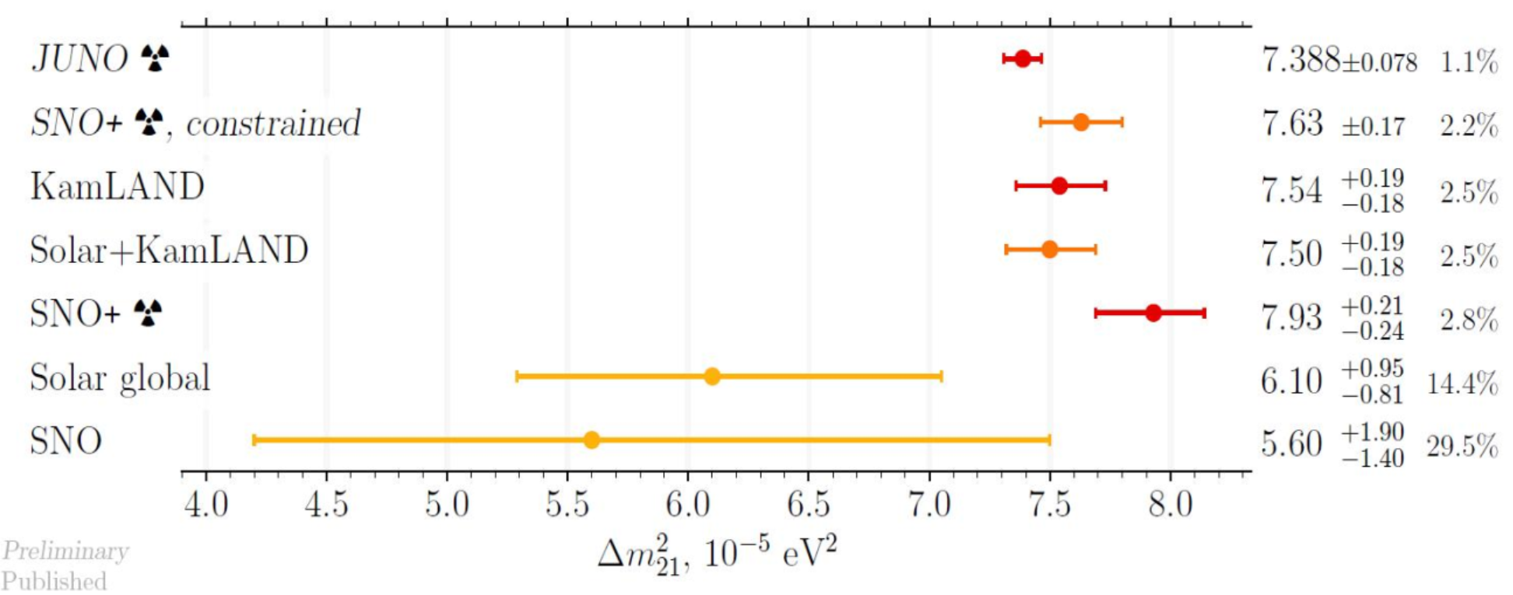
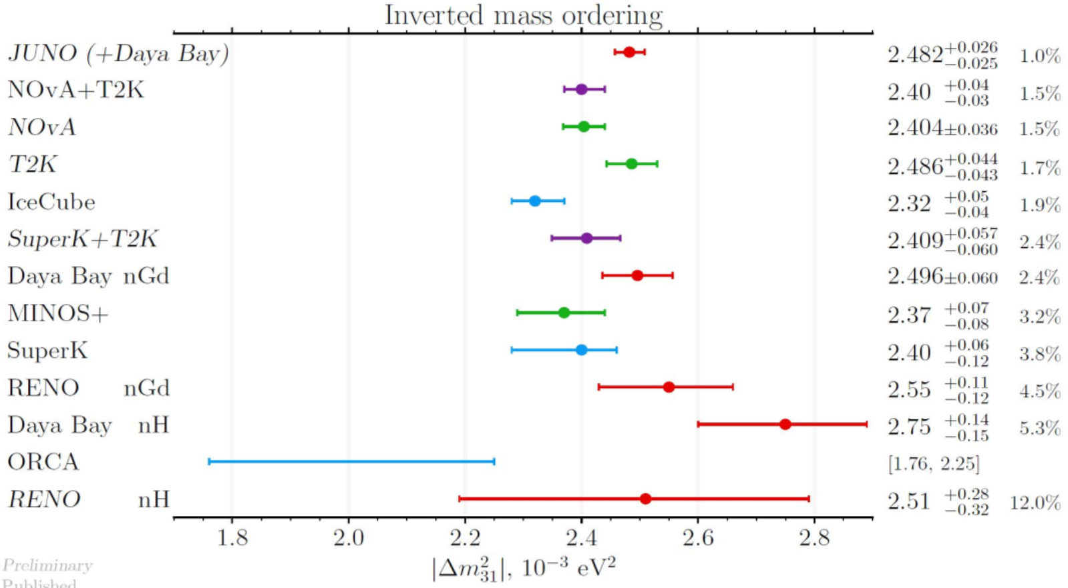
Comparison of Results on Oscillation Parameters
Δm²₃₁
sin²2θ₁₂
Δm²₂₁
Results from JUNO have smallest uncertainties
Cong Guo · IHEP · NNN26 Seoul · Page 22

Slide 23
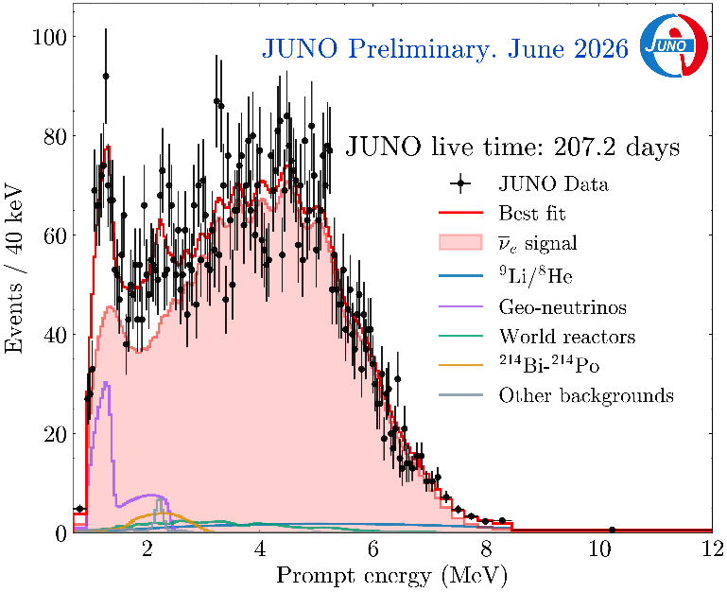
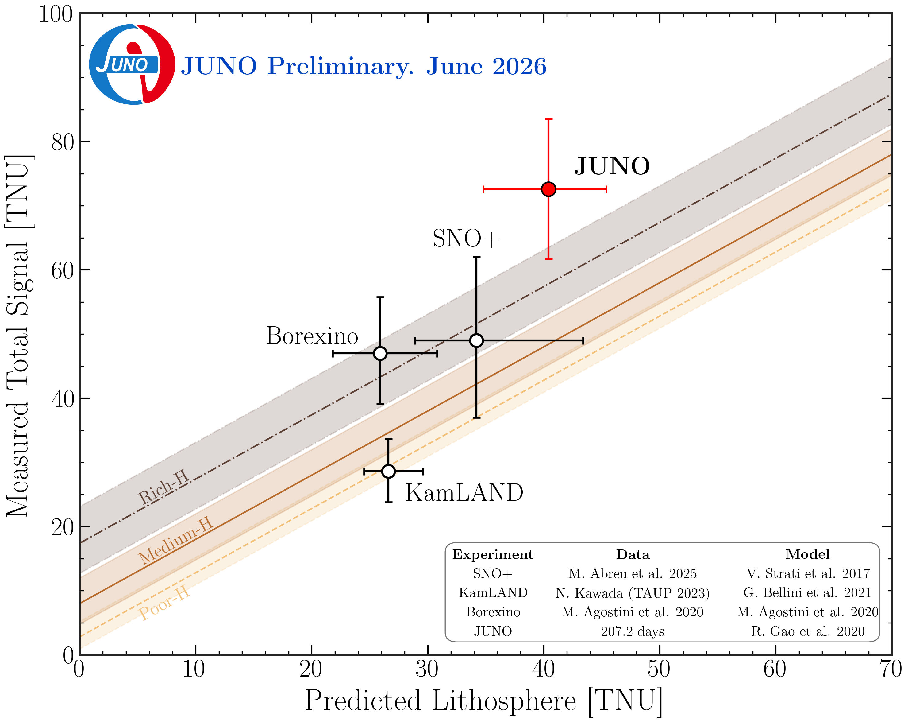
Results on Geo-neutrinos
Fits are performed without constraint on geo-neutrino flux, but with 3.4(±10%) U/Th ratio
  Constraining the geo-nu flux does not change oscillation results;
Clear geo-nu signals at 1-3 MeV, giving a flux of 73 ± 11 TNU;
  Largest geo-neutrino samples so far, and most precise measurement
JUNO result is higher than expectation from existing models, but not statistically significant;
Need more JUNO data and more refined geological model predictions;
Cong Guo · IHEP · NNN26 Seoul · Page 23

Slide 24
Life is not always easy!
Cong Guo · IHEP · NNN26 Seoul · Page 24

Slide 25
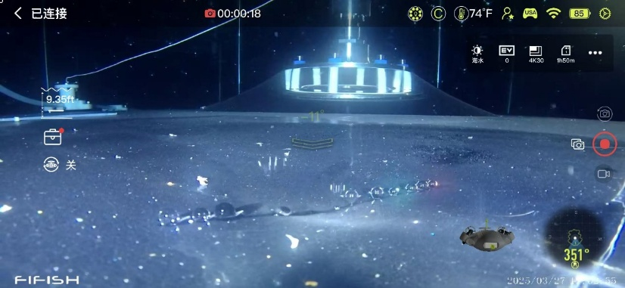
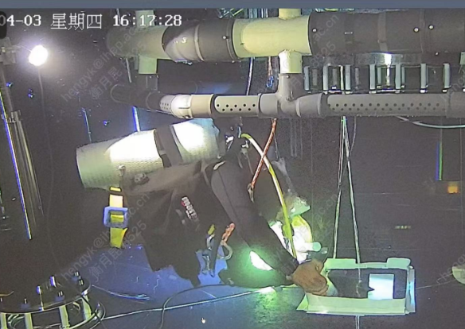
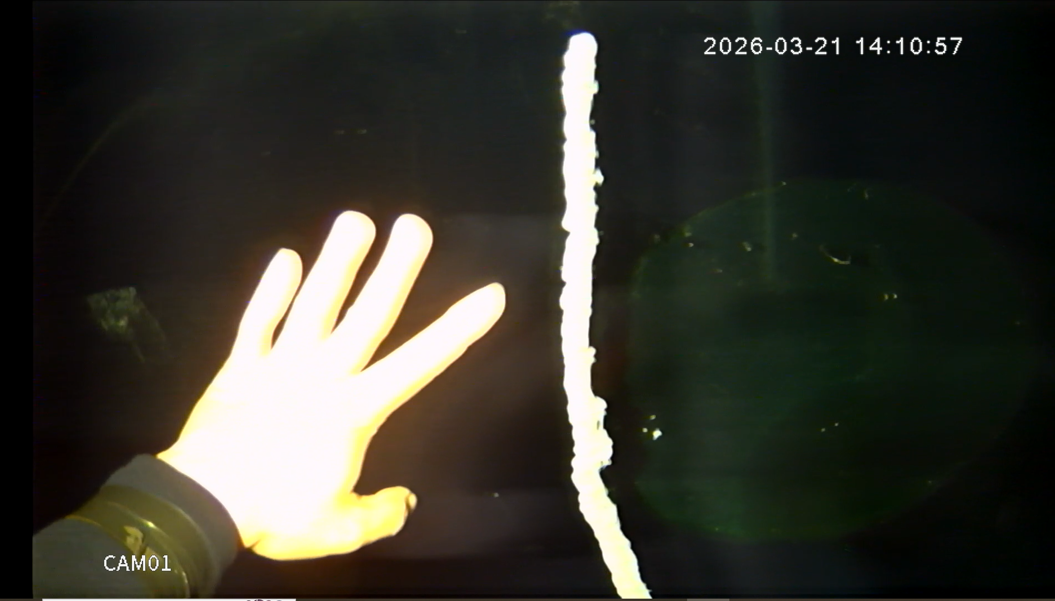
Cracks on the Acrylic Tank
However, a LS leak to water happened on March 21, 2025:
  Abnormal trigger rate observed and confirmed by under water robot;
  Leak was stopped within 1 week using epoxy and tape by divers;
  Further repair by epoxy and acrylic plate to reduce the stress (pulling open the crack) by 50% ;
Another leak of water to LS happened on March 19, 2026:
  Experienced divers were called to stop the leak within 2 days;
  Further repair in the following two days ;
  A total of ~1Bq ²²²Rn went into LS, 13 days of data excluded;
  No other increase of radioactive backgrounds in LS;
Main structure is safe, stress within expectations;
epoxy
Cong Guo · IHEP · NNN26 Seoul · Page 25

Slide 26
03
Upgrade Plans & Future Program
Cong Guo · IHEP · NNN26 Seoul · Page 26

Slide 27


JUNO-ββ
Once mass ordering is determined (~2030), JUNO will be upgraded for ββ-decays, in addition to existing capabilities；
¹³⁰Te/¹³⁶Xe will be loaded into the LS;
R&D about the Te/Xe-LS is under going;
Insert a balloon/Directly filled with ¹³⁶Xe-loaded LS(or ¹³⁰Te) into the JUNO detector
Cong Guo · IHEP · NNN26 Seoul · Page 27

Slide 28

Summary
The JUNO detector and TAO are successfully built and operating smoothly;
Initial performance shows that the detector works well as designed;
Precision of solar oscillation parameters further improved by a factor of 1.3-1.5;
First measurement on Δm²₃₁ achieved a precision of ~1% ;
With external constraint, Normal Mass Ordering is favored at ~2.1σ(one-sided);
First geo-neutrino results yield a flux of 73 ± 11 TNU;
JUNO will be working for 30 years and it will be upgraded to 0νββ searching experiment at ~2030;
Thanks for your attention!
Cong Guo · IHEP · NNN26 Seoul · Page 28

