Slide 1


TAMBO: Latest Status and Future Prospects
J. Bazo for the TAMBO Collab.
Pontificia Universidad Católica del Perú
jbazo@pucp.edu.pe
28/10/2026

Slide 2
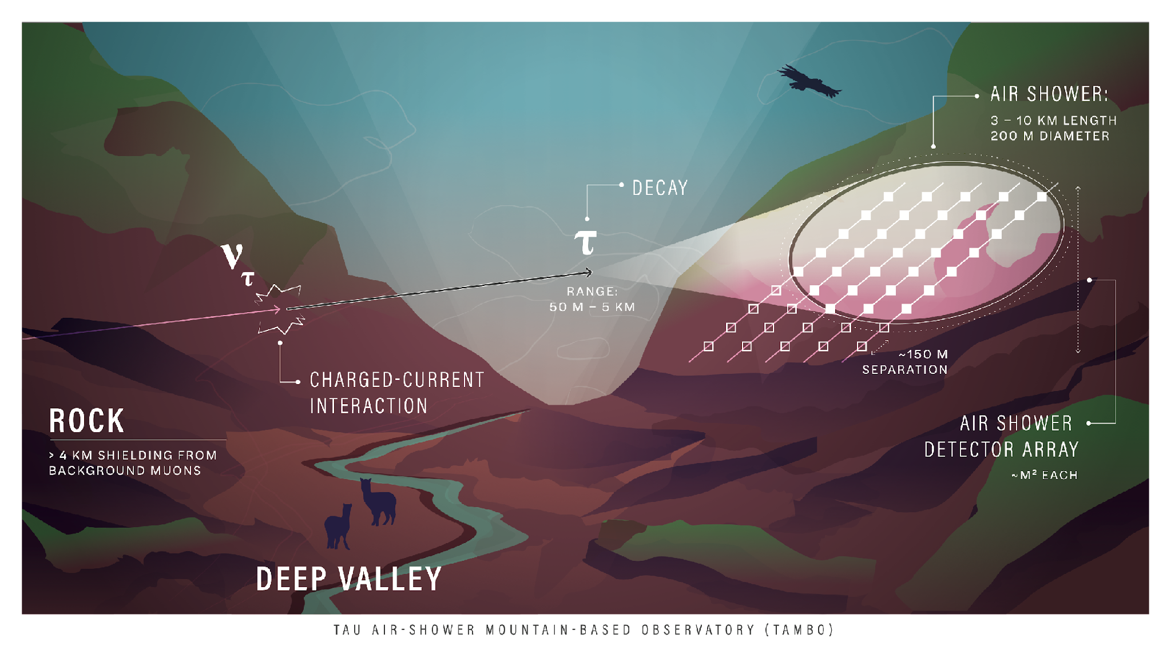

Slide 3
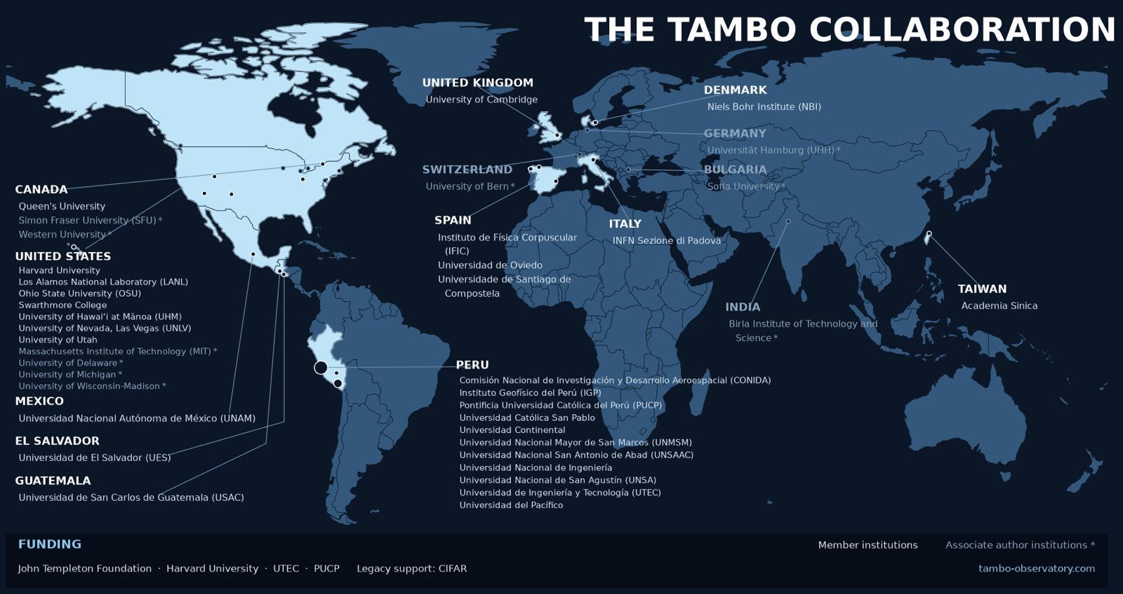
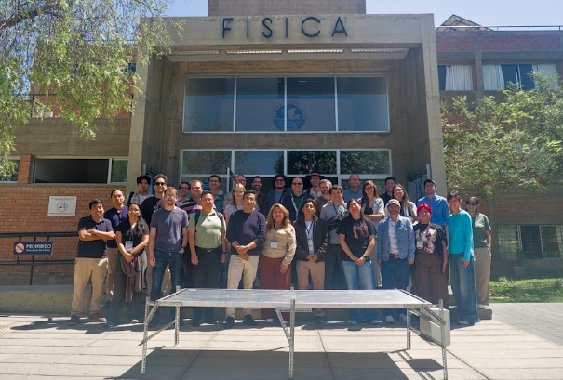
https://www.tambo-observatory.com/

Slide 4
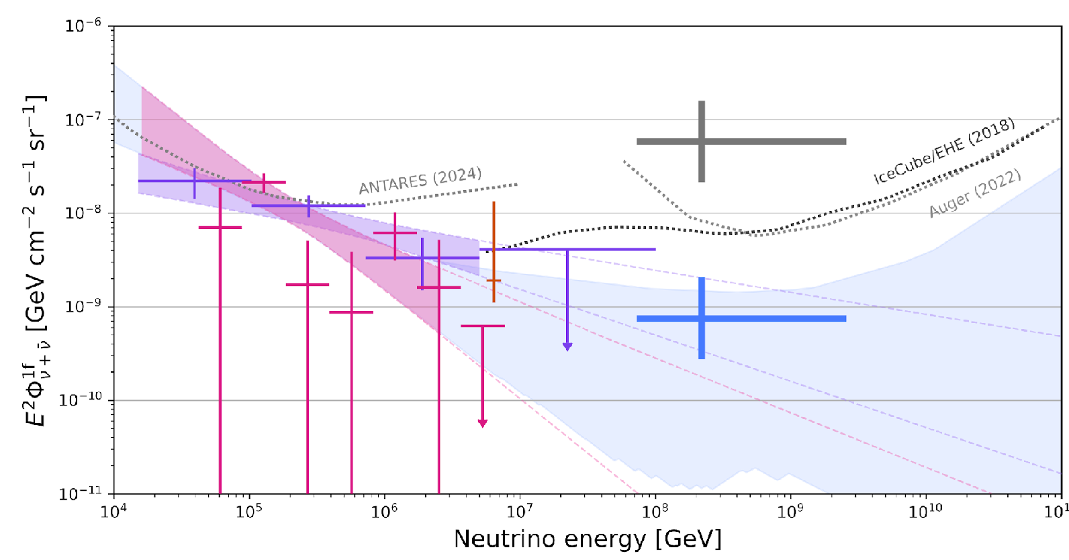
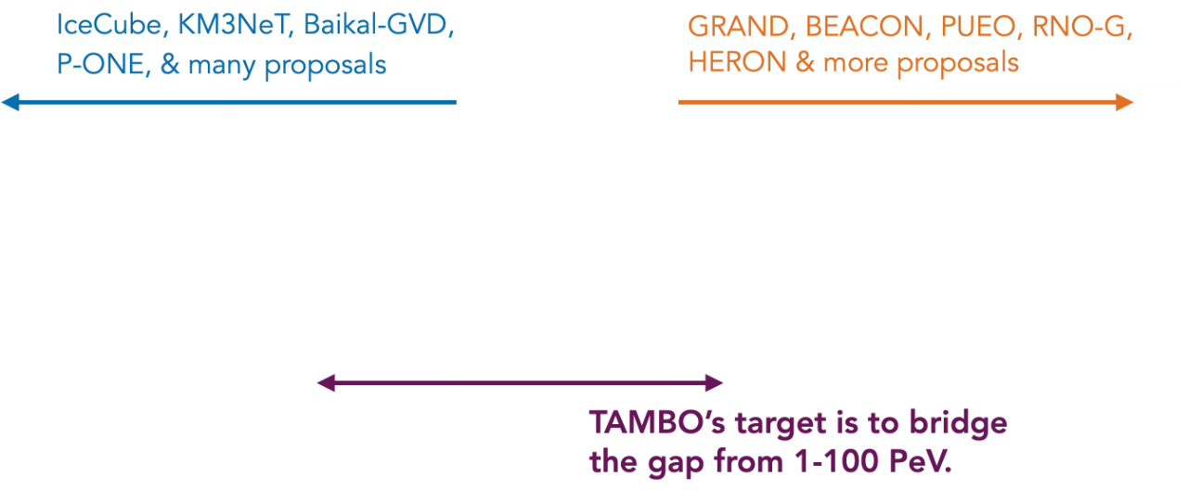
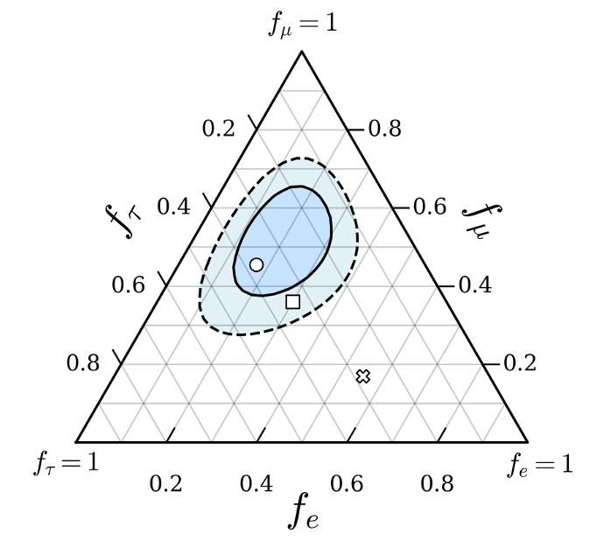
Science with TAMBO
Astrophysical neutrino flux: 1 - 100 PeV.
Discover new sources of astrophysical neutrinos.
Neutrino flavor composition with ultra-long baseline.
Muon content of air showers at different altitudes.
KM3NeT, Phys. Rev. X 15, 031016
TAMBO & other next-gen telescopes, 1-100 PeV

Slide 5
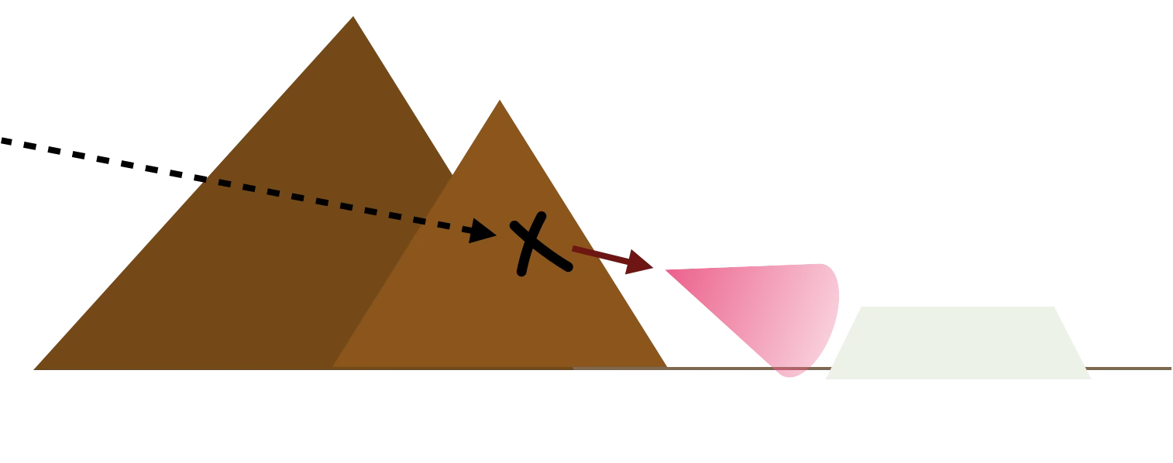
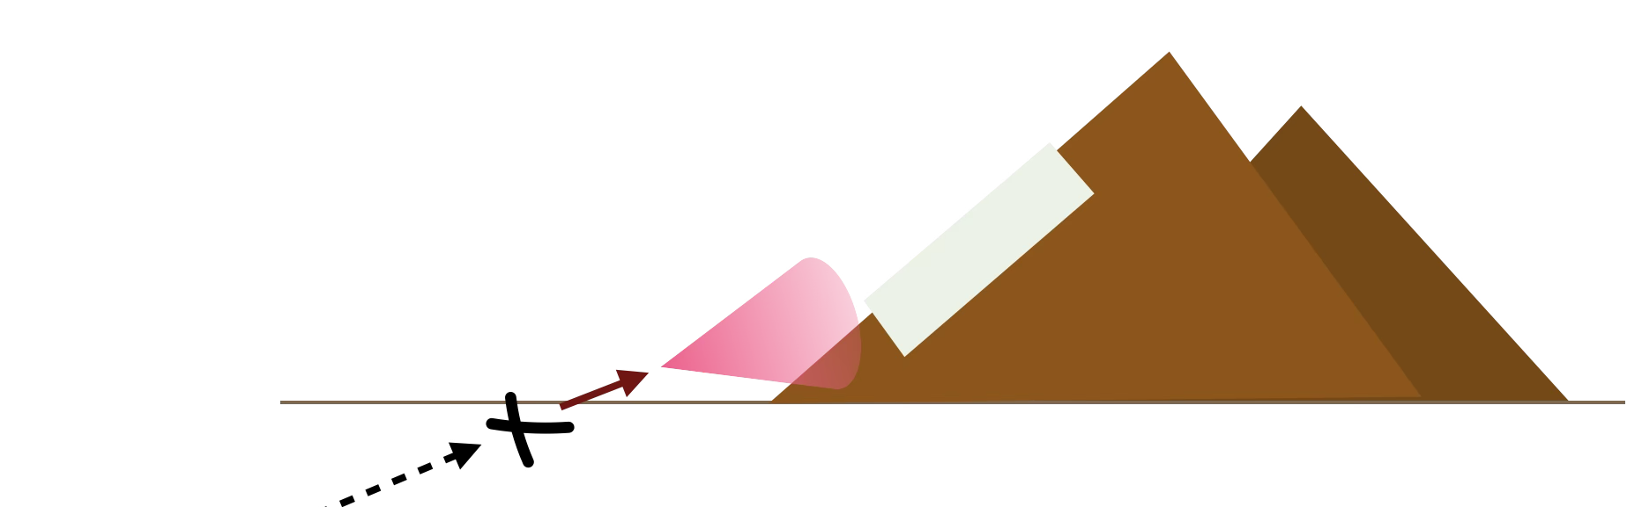
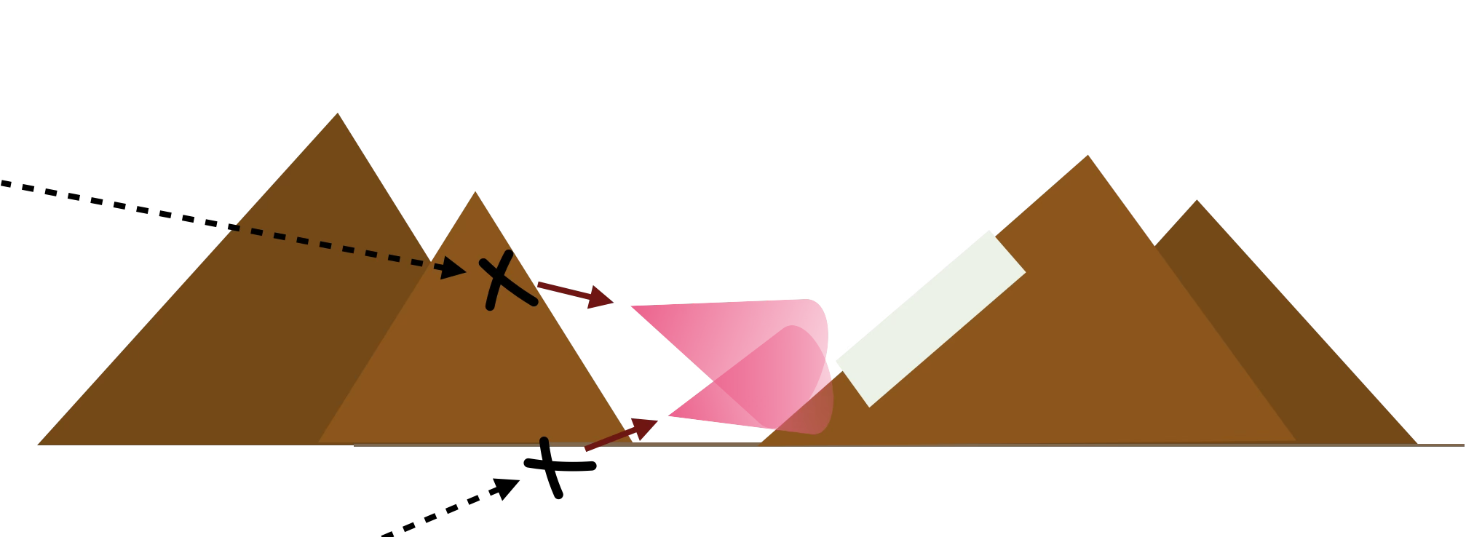
The Geometry
Sensitive to down-going
Sensitive to up-going
A canyon detector is sensitive to up- and down-going

Slide 6
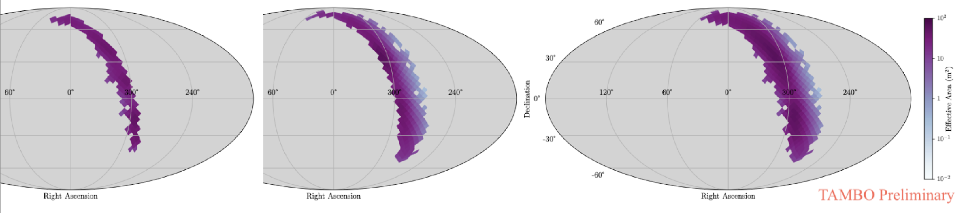
Sky Coverage
Increased by 50%
Down-going
Up-going
Full acceptance

Slide 7
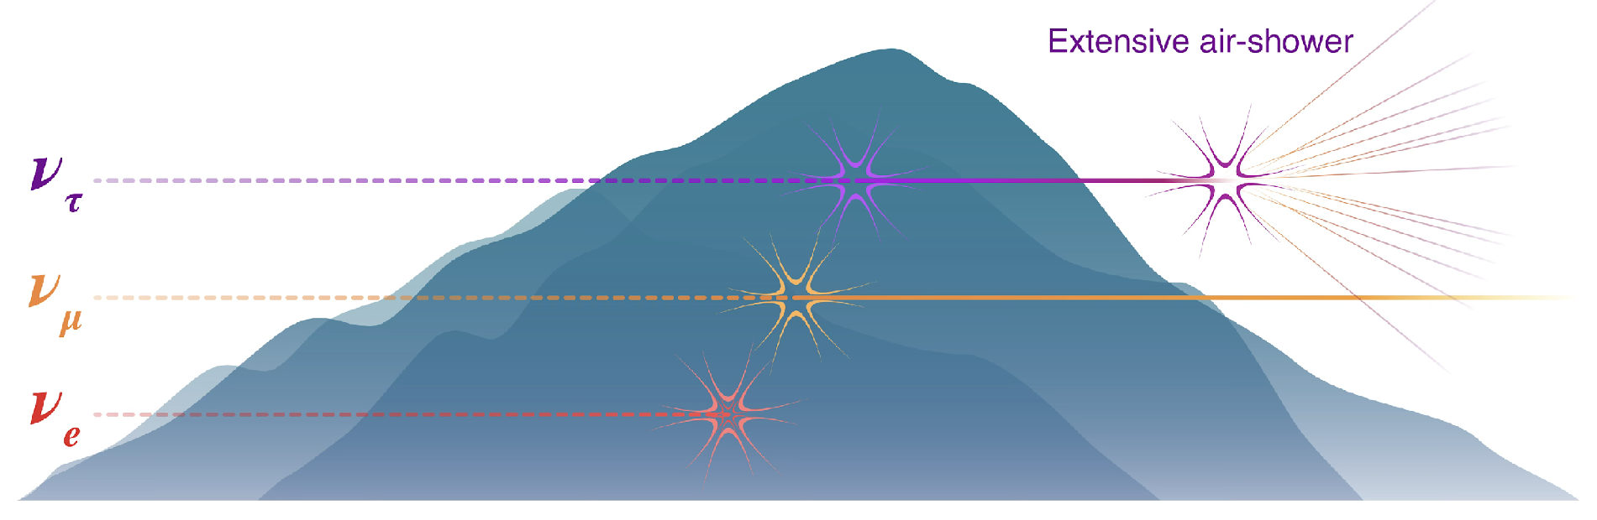
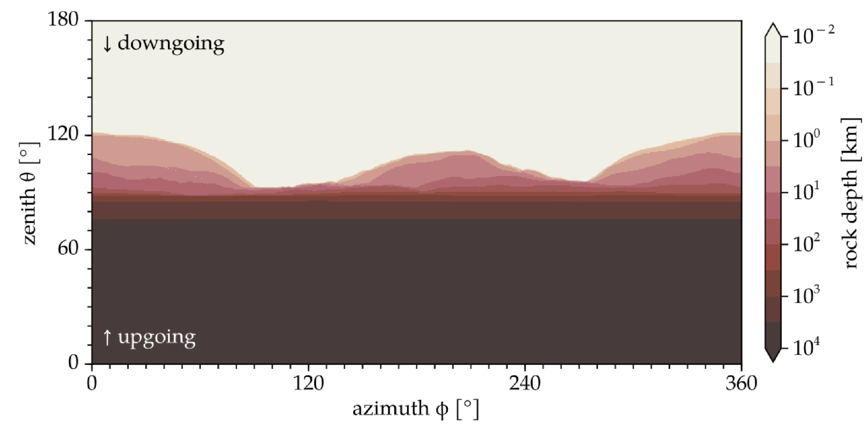
Tau neutrinos & background
Mountain shield
Electrons shielded by canyon
Muons are very good at retaining energy
Only 𝛕 efficient at creating shower
Down-going cosmic rays
Earth-skimming neutrinos

Slide 8
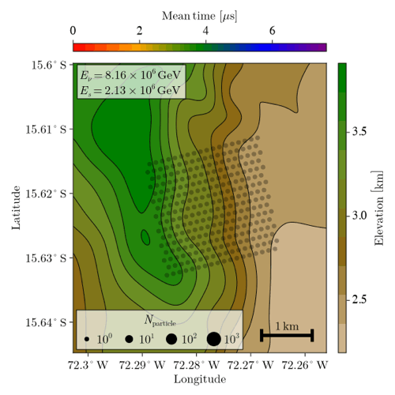
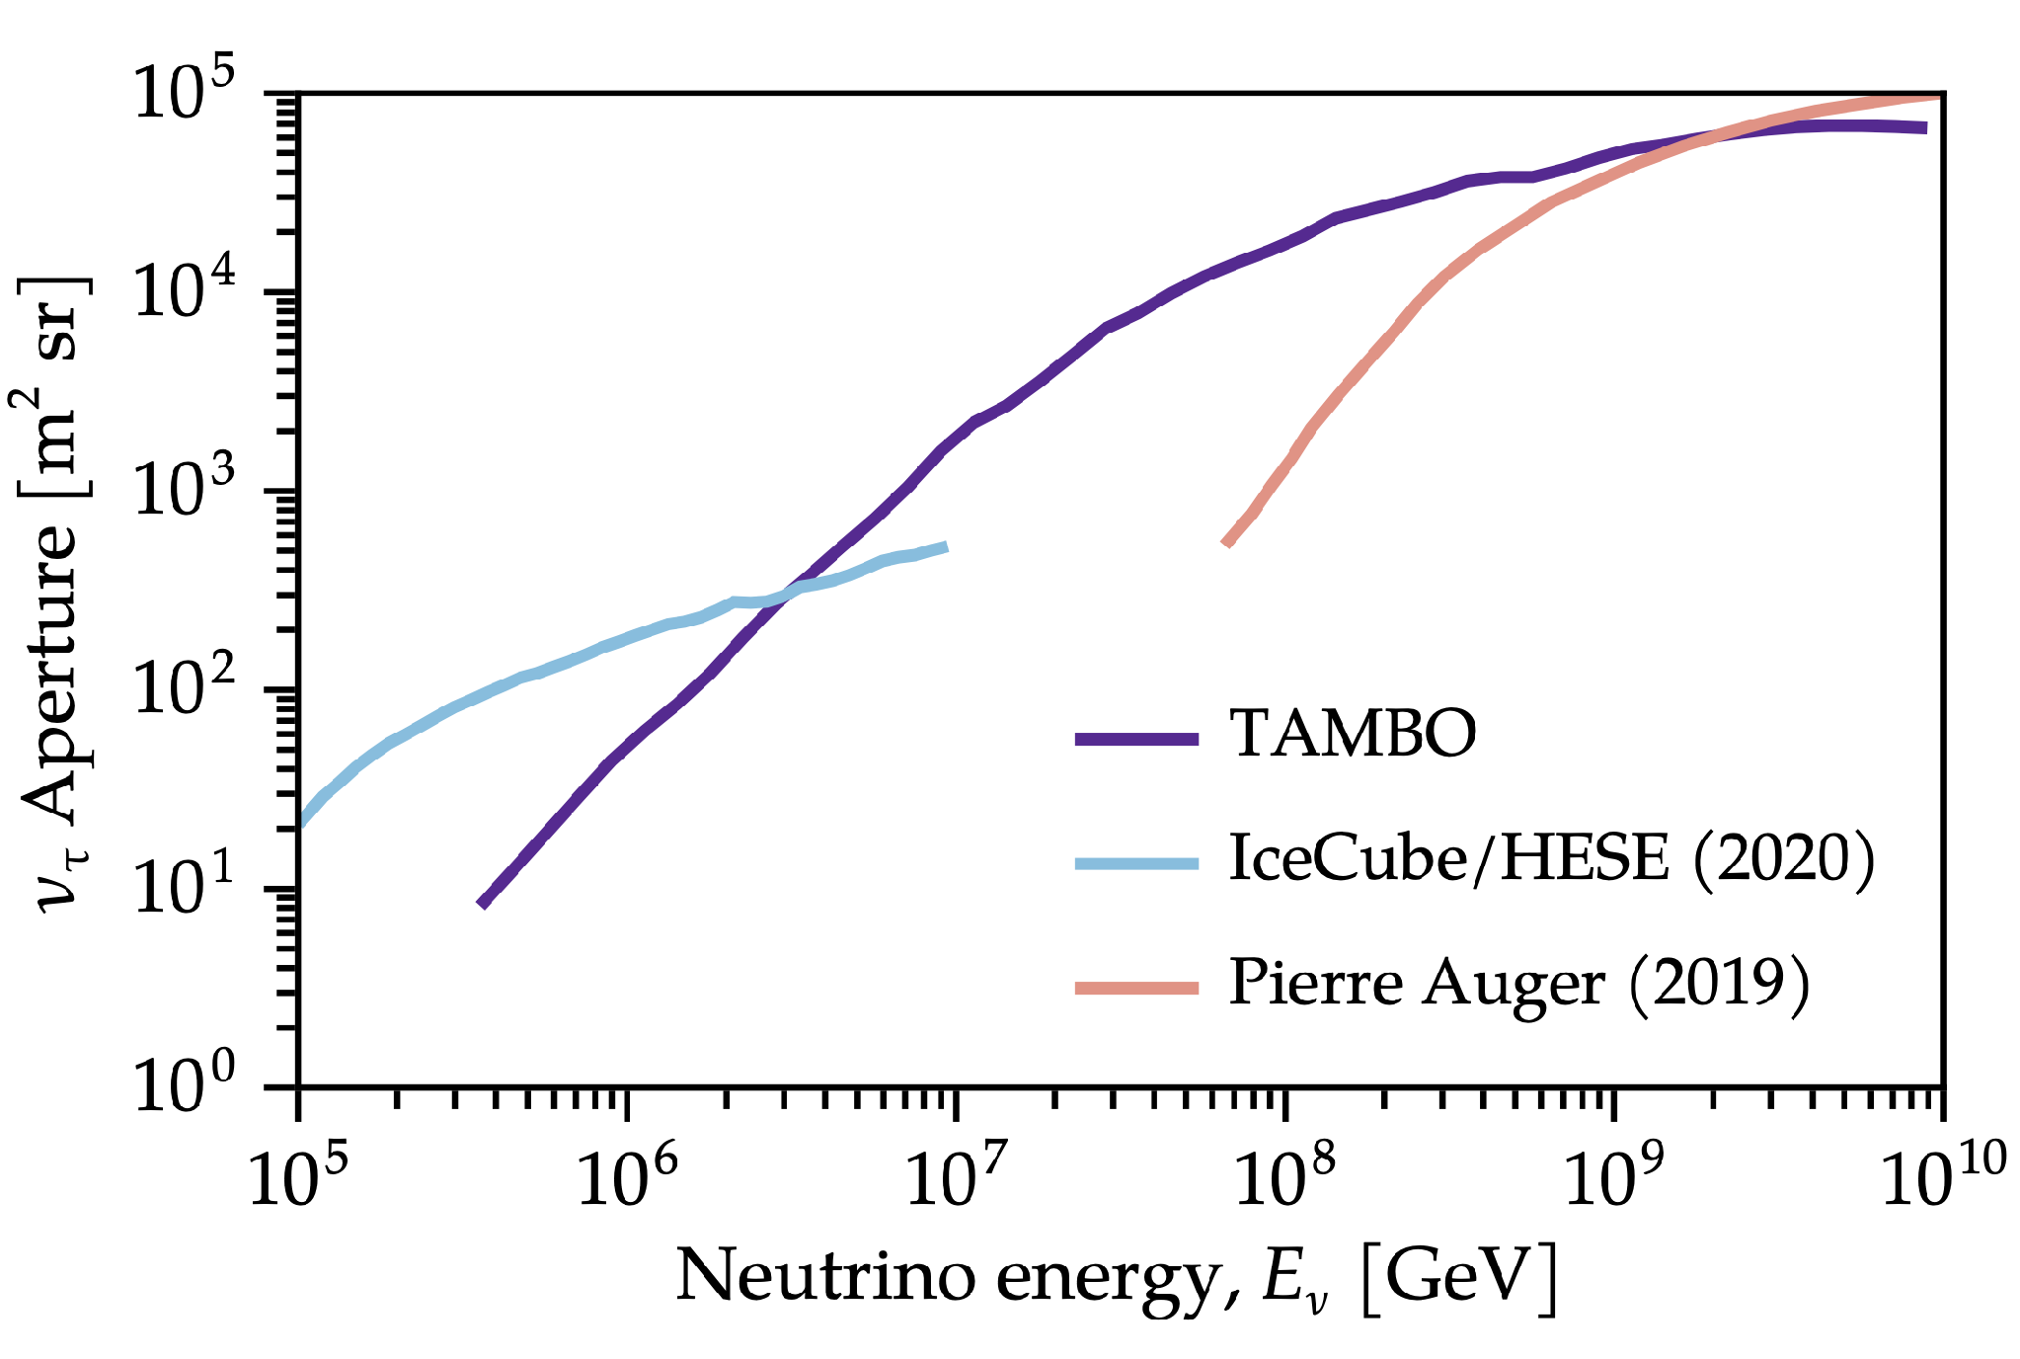
Simulations

Slide 9
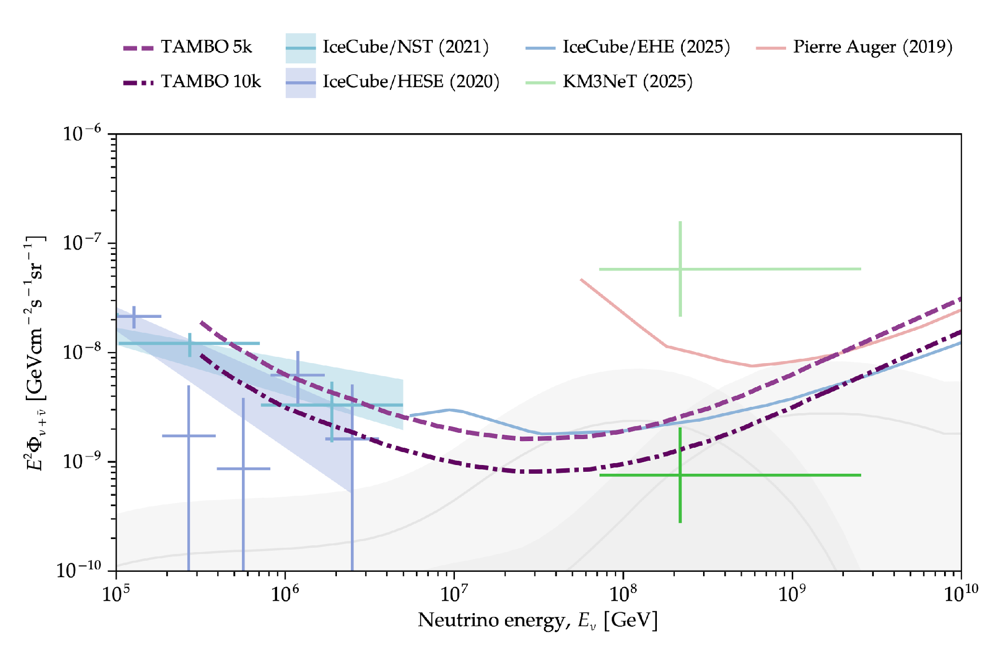
Sensitivity

Slide 10
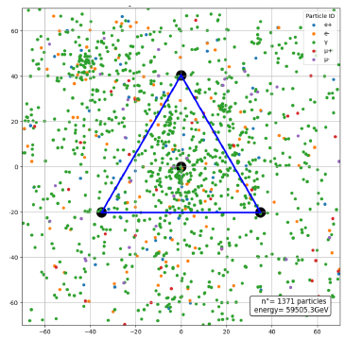
TAMBO-4: a testbed for TAMBO (latest status)
Detector prototype array of 4 detector units for TAMBO.
Test different technologies for DAQ and Comms.
Test shower reconstruction performance
Measure cosmic rays at sea level
CORSIKA simulation of ~60 TeV proton

Slide 11
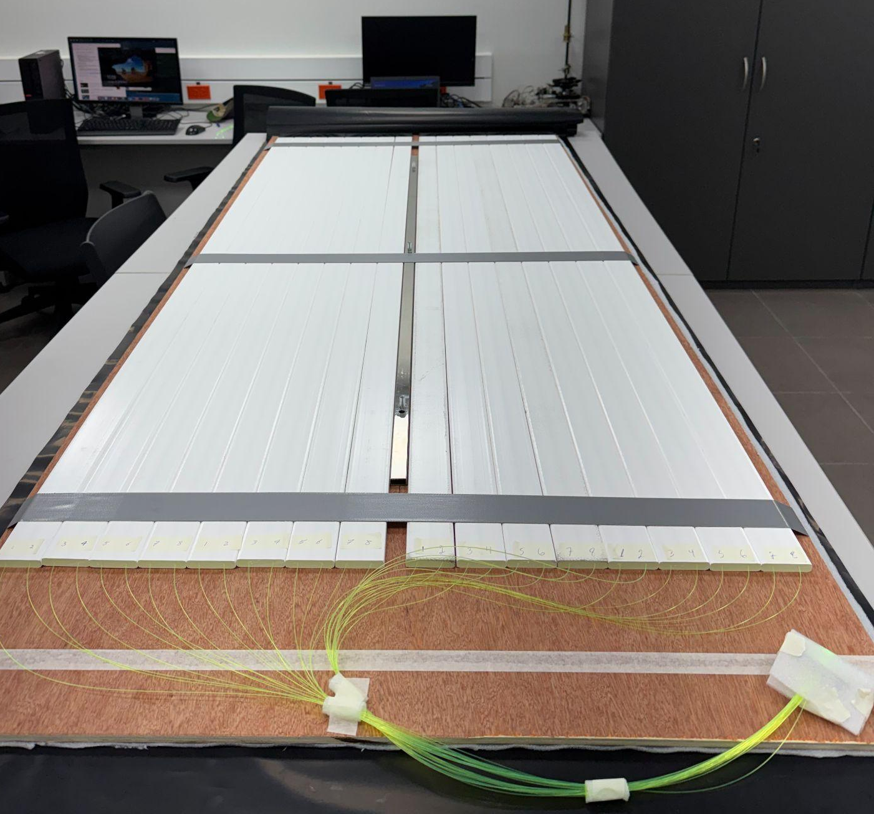
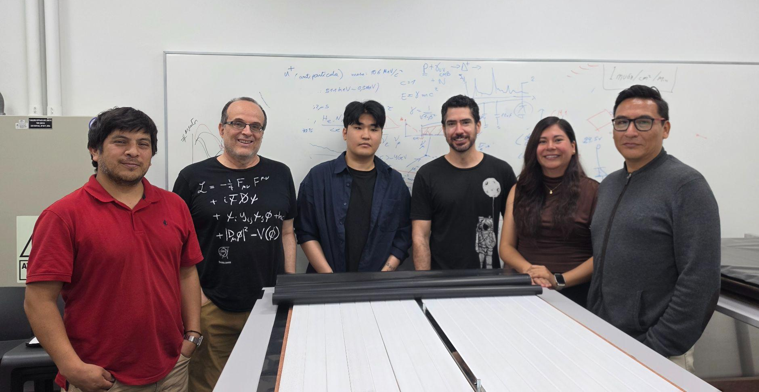
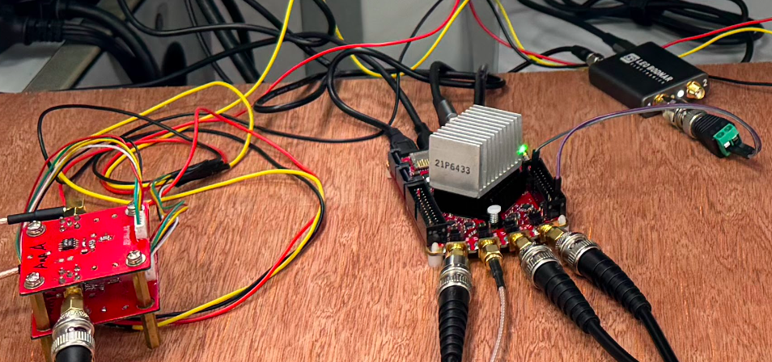
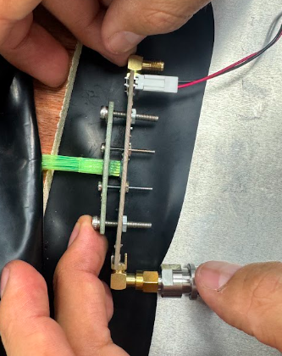
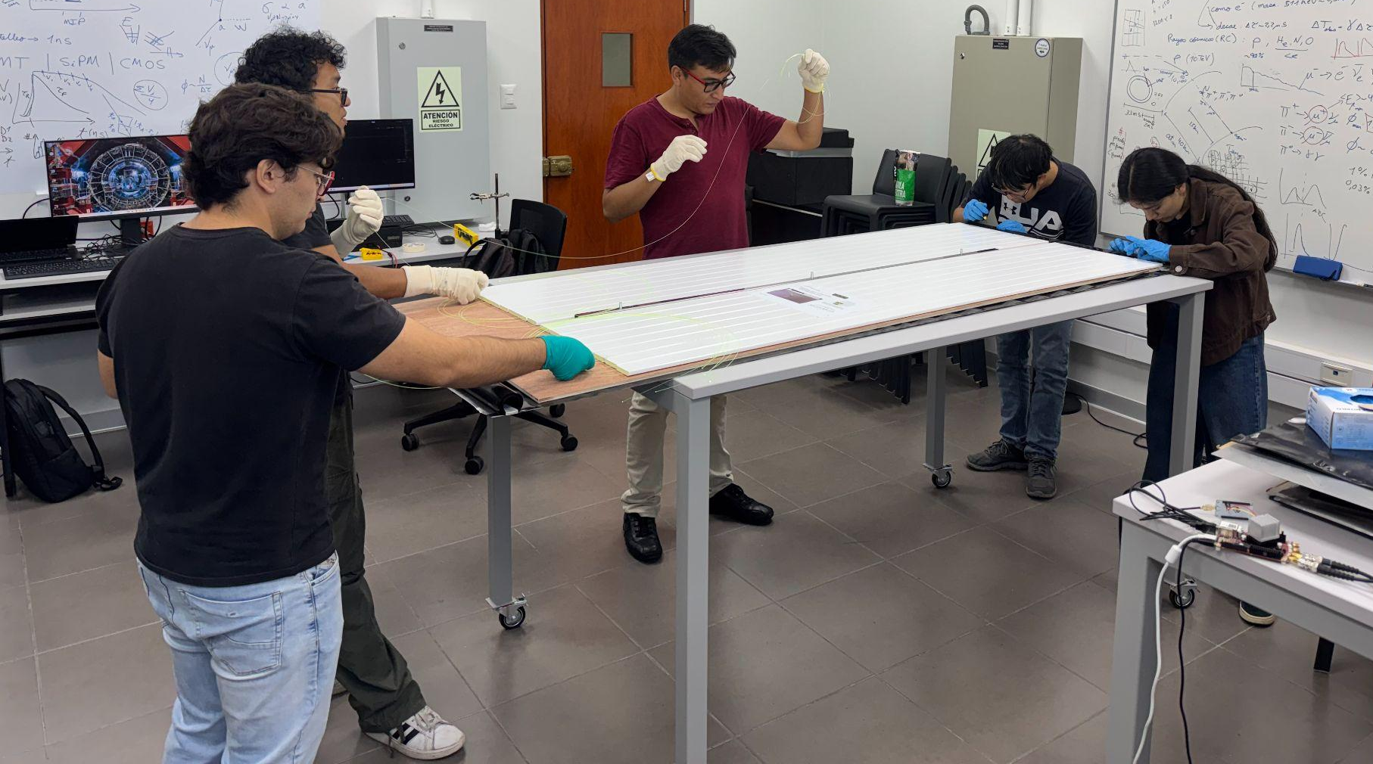
TAMBO-4: Panel construction at HEP-PUCP Lab
Amplifier+RedPitaya+GPS
16 Plastic Scintillator bars (185cmx5cm) + WLSFiber+SiPM

Slide 12
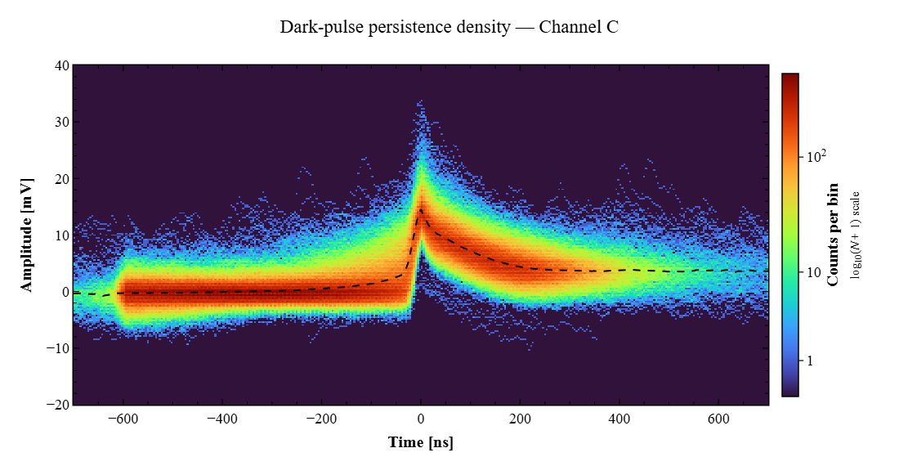
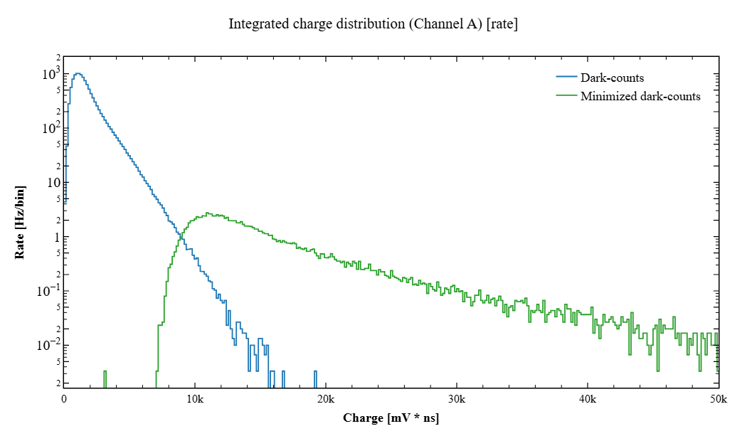
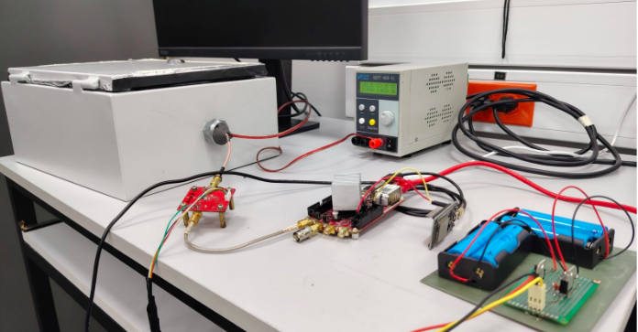
TAMBO-4: SiPM dark count characterization
Preliminary

Slide 13
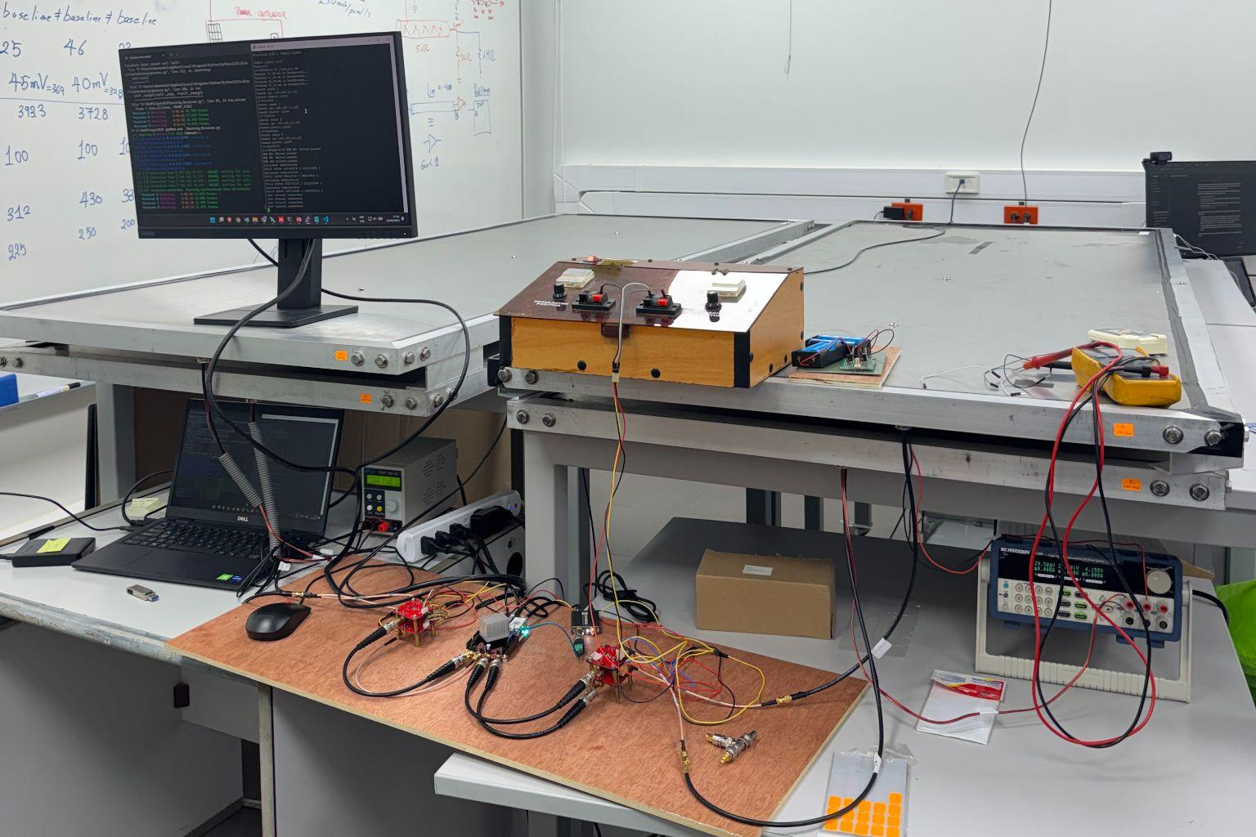
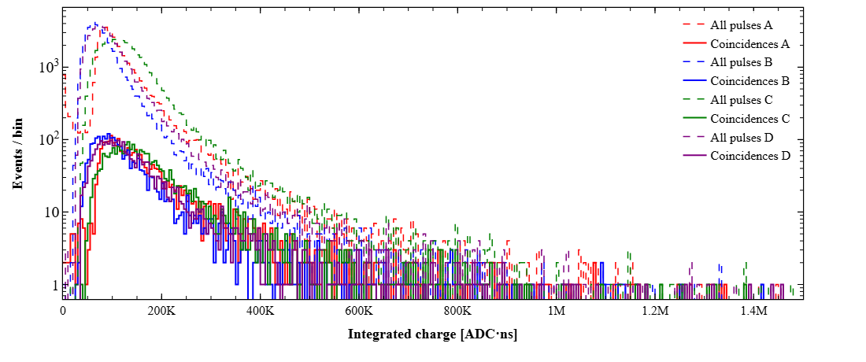
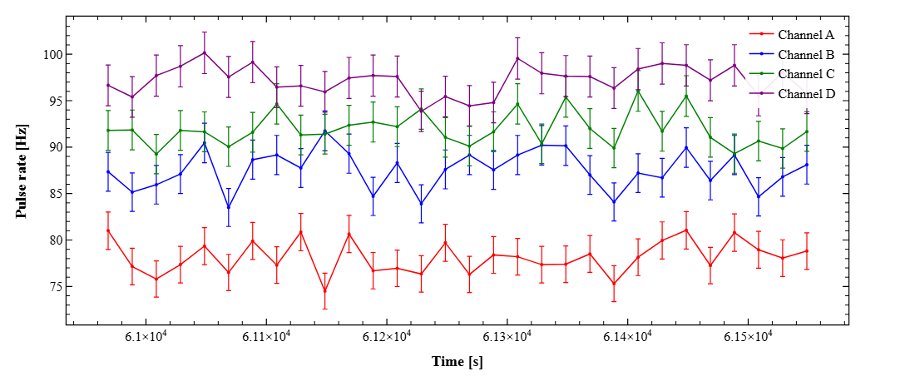
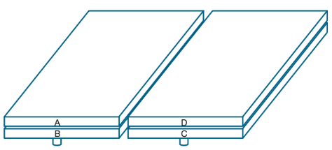
TAMBO-4: 2-panel coincidence measurement
Preliminary

Slide 14
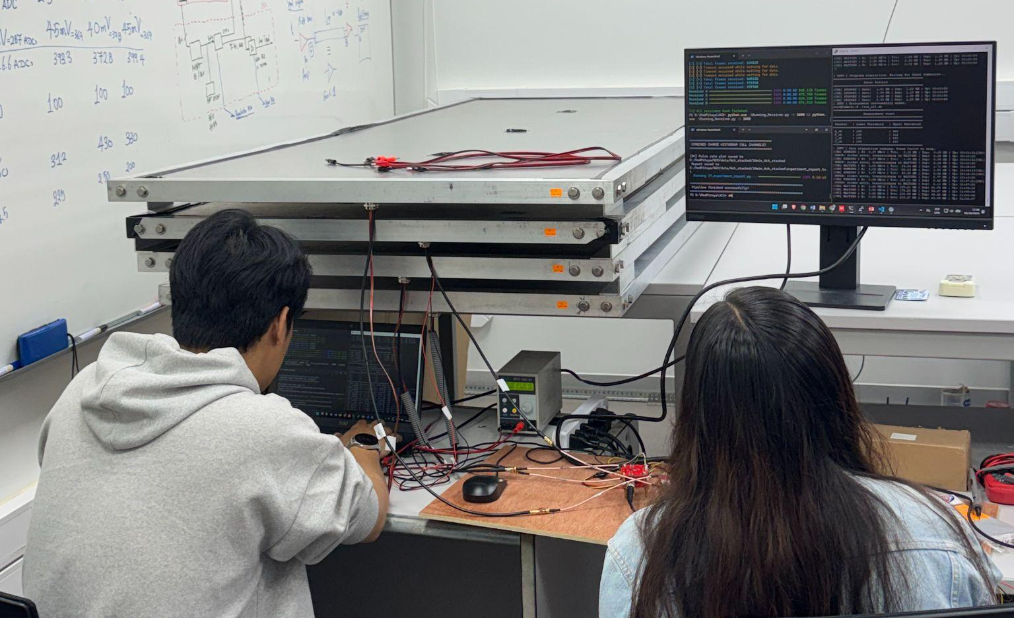
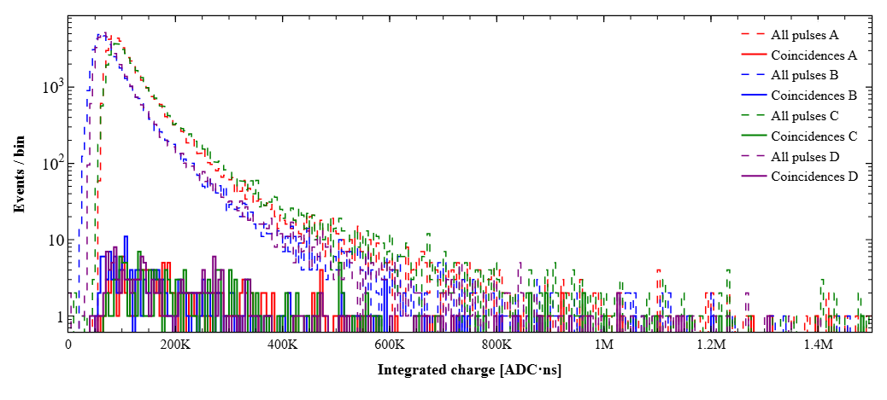
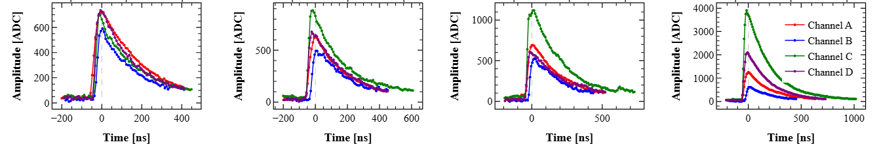
TAMBO-4: 4-panel coincidence measurement
Preliminary

Slide 15
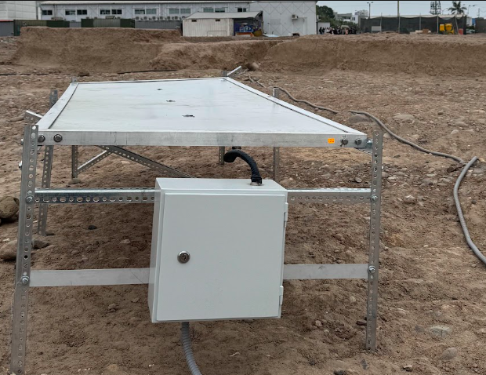
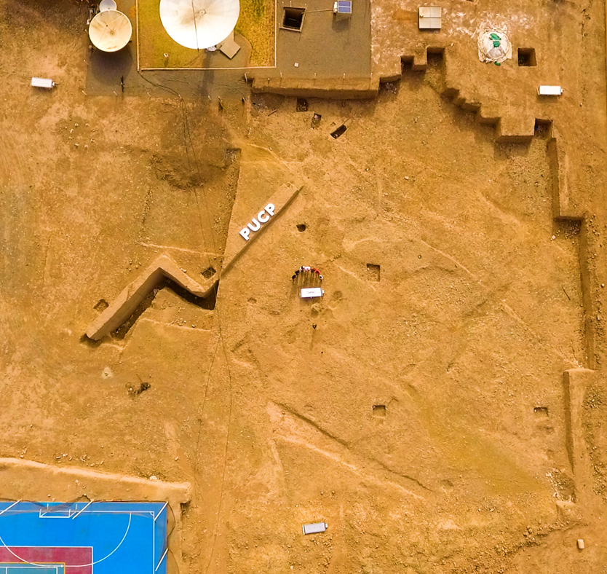
TAMBO-4: array prototype deployment at PUCP Campus
Detector unit

Slide 16
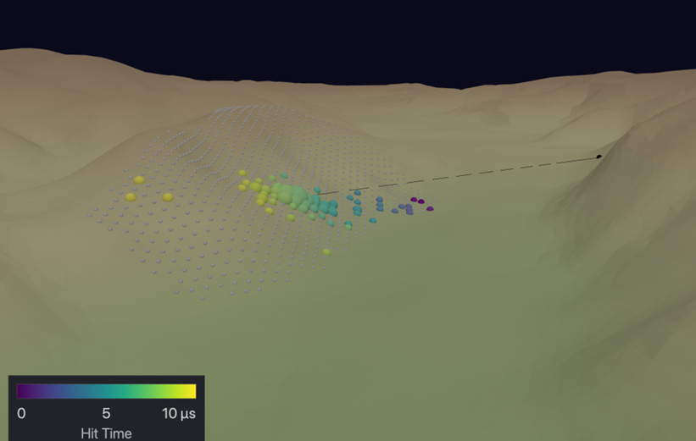
TAMBO: Future Prospects
(short term, funded) TAMBO-10: test final design detector unit array at PUCP Campus and later deploy at Arequipa site.
(medium term, funded) TAMBO-100: deployment at Arequipa site for Cosmic rays physics.
(long term) TAMBO: discover astrophysical sources with tau neutrinos.
15 PeV τ from 52 PeV ν_{τ}

Slide 17
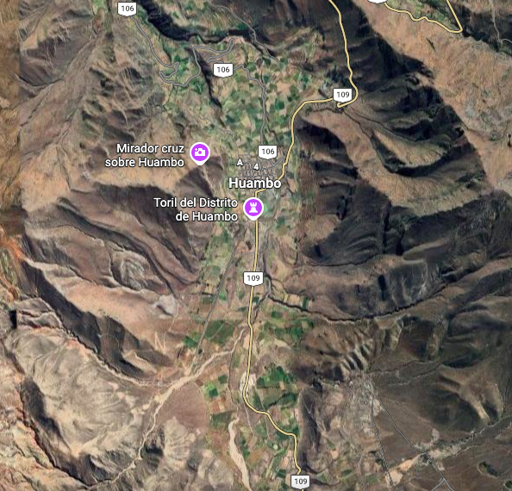
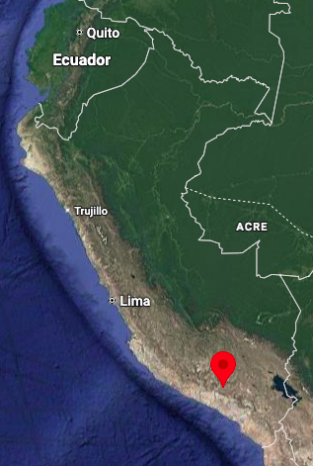
TAMBO-100: deployment in Arequipa-Perú
Responsible siting
Requirements:
Fit ~100 panels with ~125m spacing
Max slope 35°
Opposite face 3-8 km away
Possible site: Huambo, 3300 m.a.s.l.

Slide 18
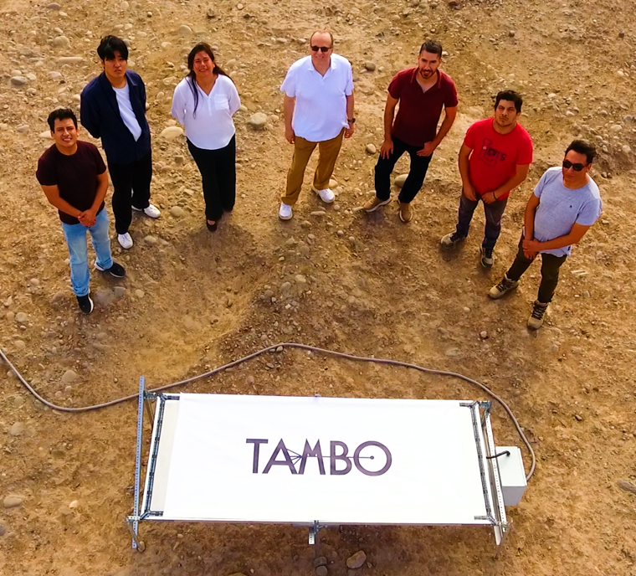


Thanks!
https://www.tambo-observatory.com/
New collaborators are welcomed!
TAMBO promotional video

