Slide 1
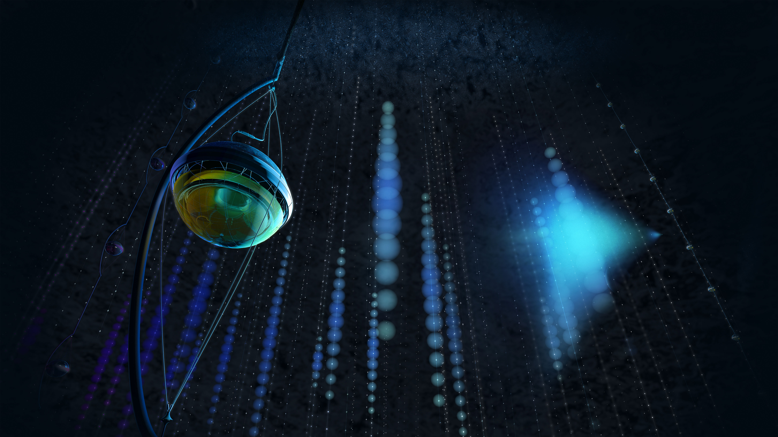

The IceCube Upgrade
Projections and Status
Juan Pablo Yáñez
NNN Workshop
Seoul, Korea
October 2026
j.p.yanez@ualberta.ca

Slide 2
IceCube pre-Upgrade
15 years of full detector data

Slide 3
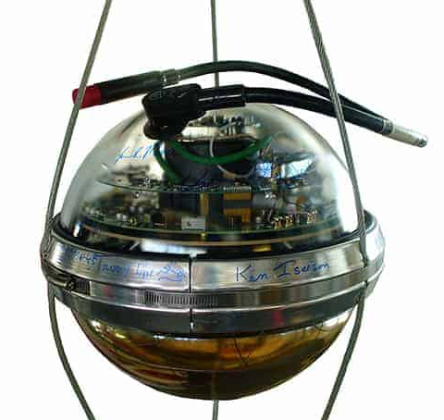
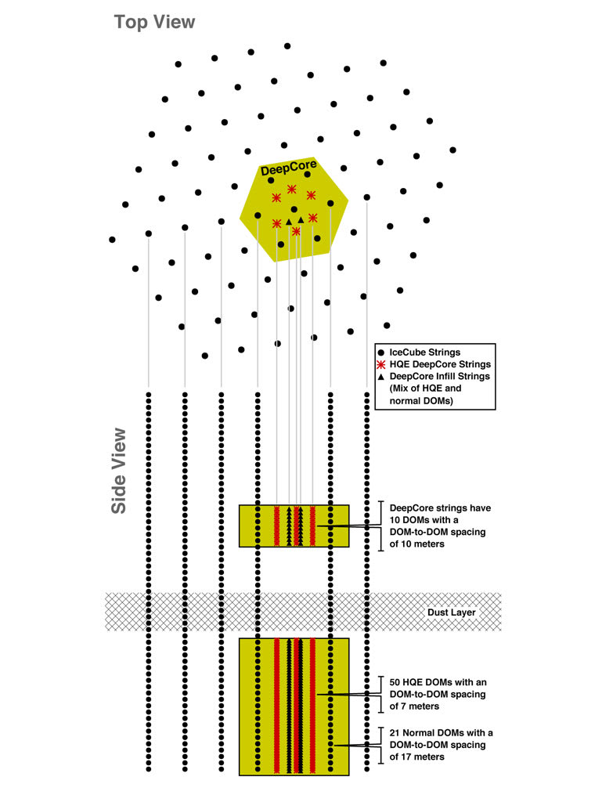
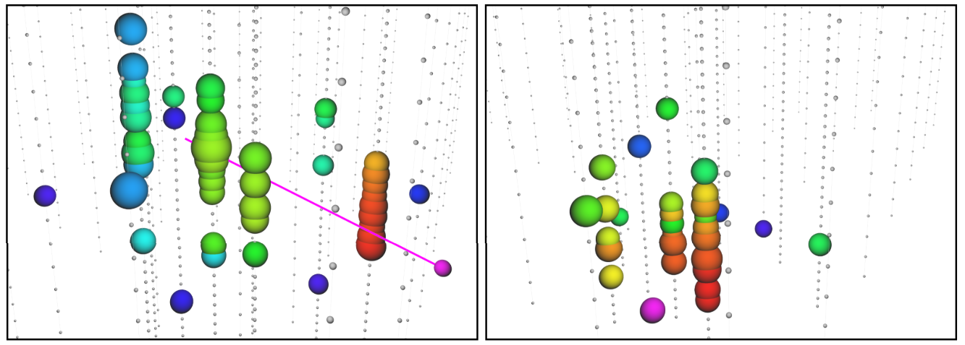
The tens of GeV realm
GeV events in DeepCore
Color indicates time (red=early, blue=late). Sphere size is proportional to number of photons observed.

Slide 4
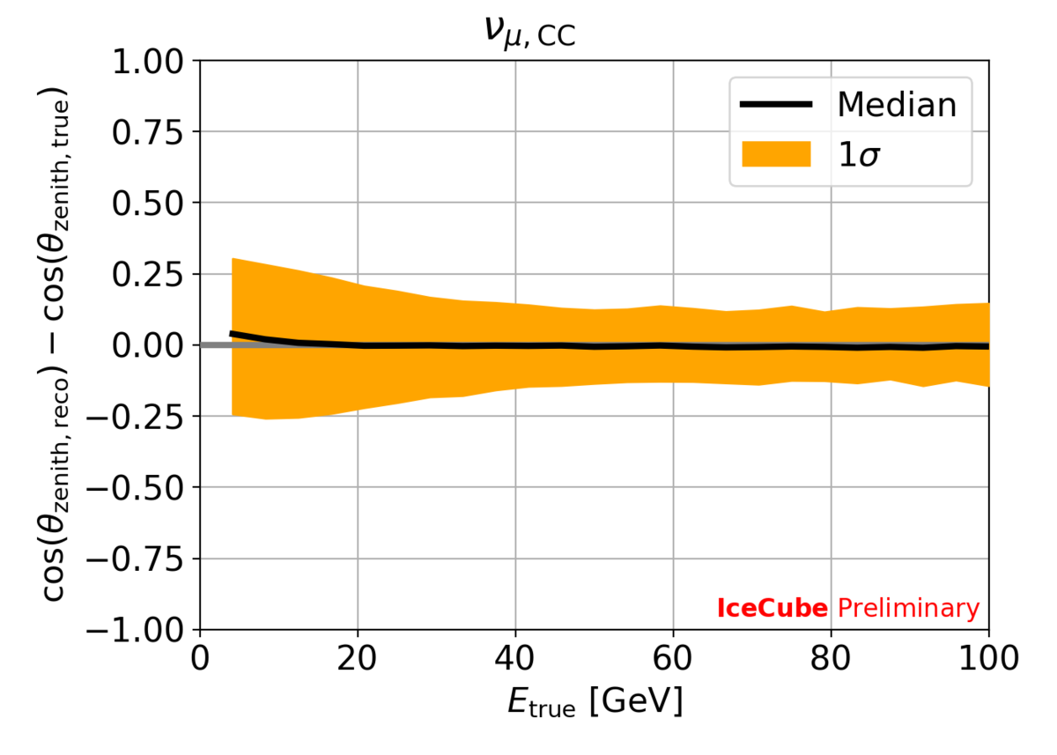
The tens of GeV realm
Reconstructing flavor, direction and energy with tens of modules
Data going down to a few GeV, albeit with limited resolution
GeV events in DeepCore
Color indicates time (red=early, blue=late). Sphere size is proportional to number of photons observed.

Slide 5
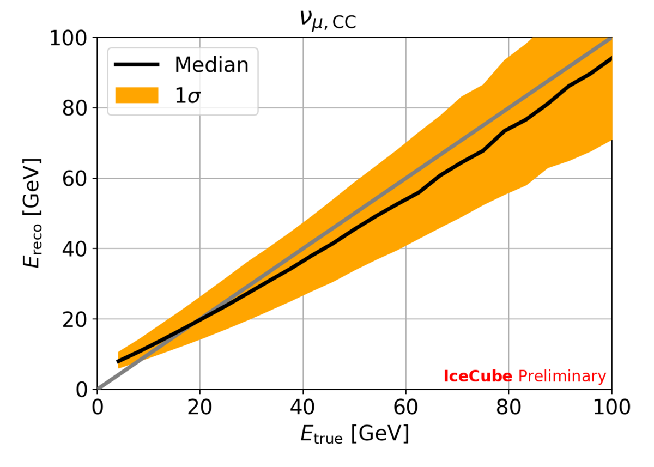
The tens of GeV realm
Reconstructing flavor, direction and energy with tens of modules
Data going down to a few GeV, albeit with limited resolution
GeV events in DeepCore
Color indicates time (red=early, blue=late). Sphere size is proportional to number of photons observed.

Slide 6
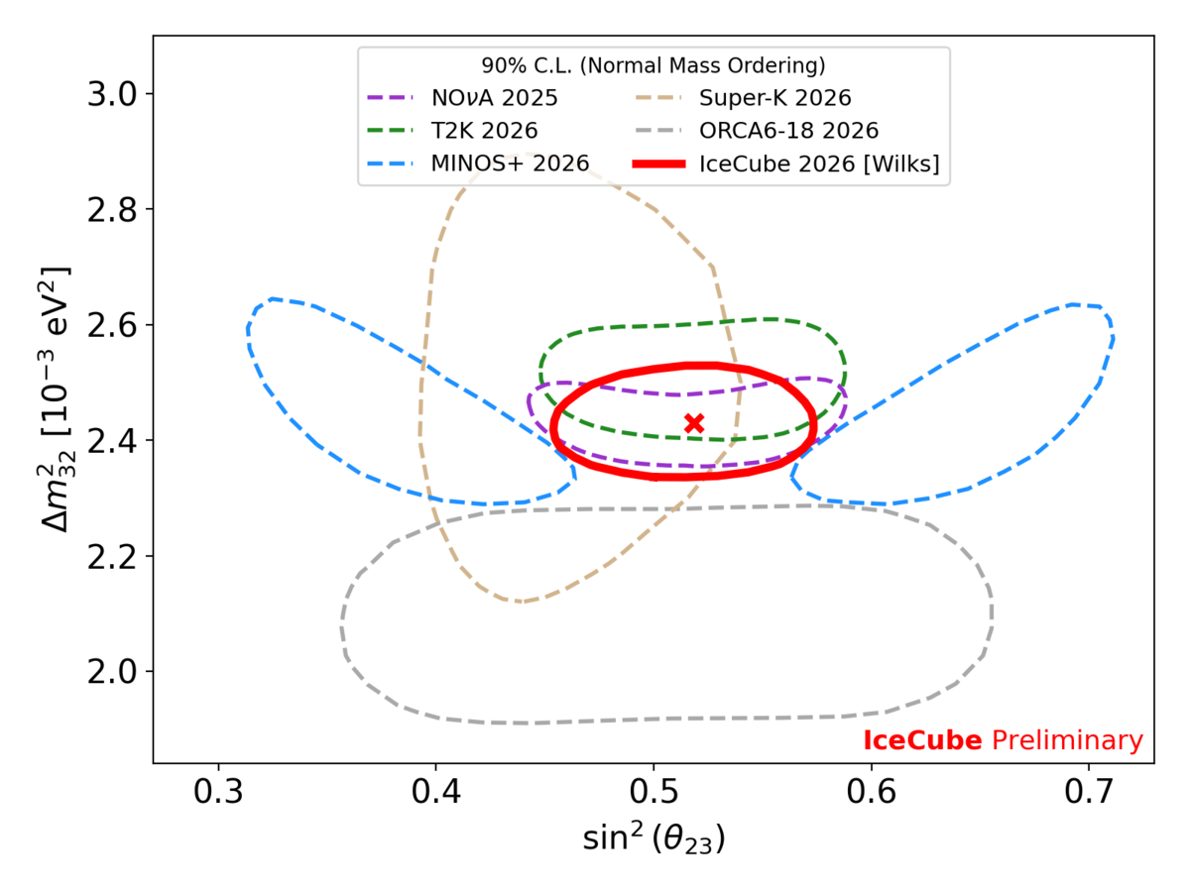
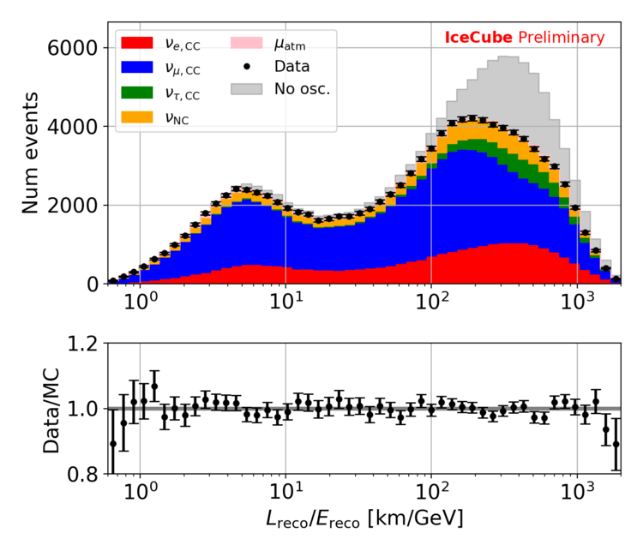
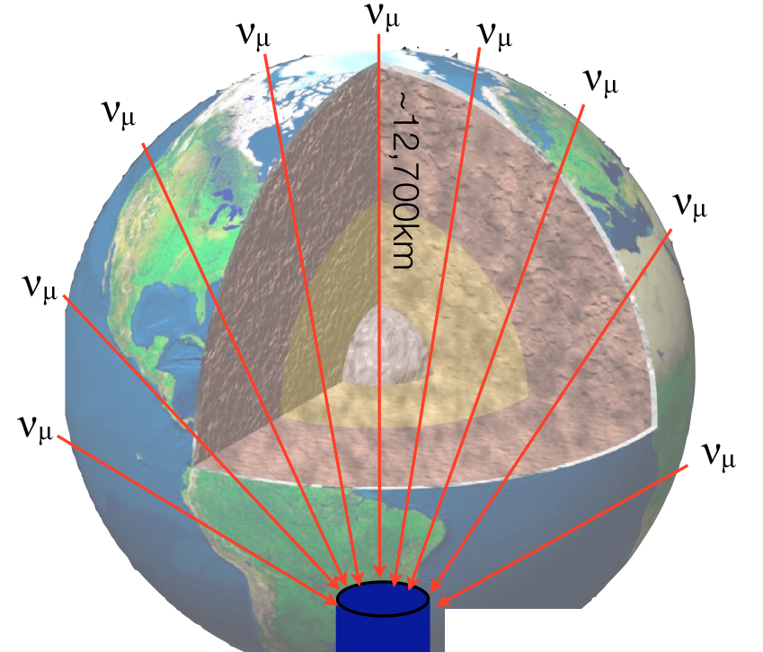
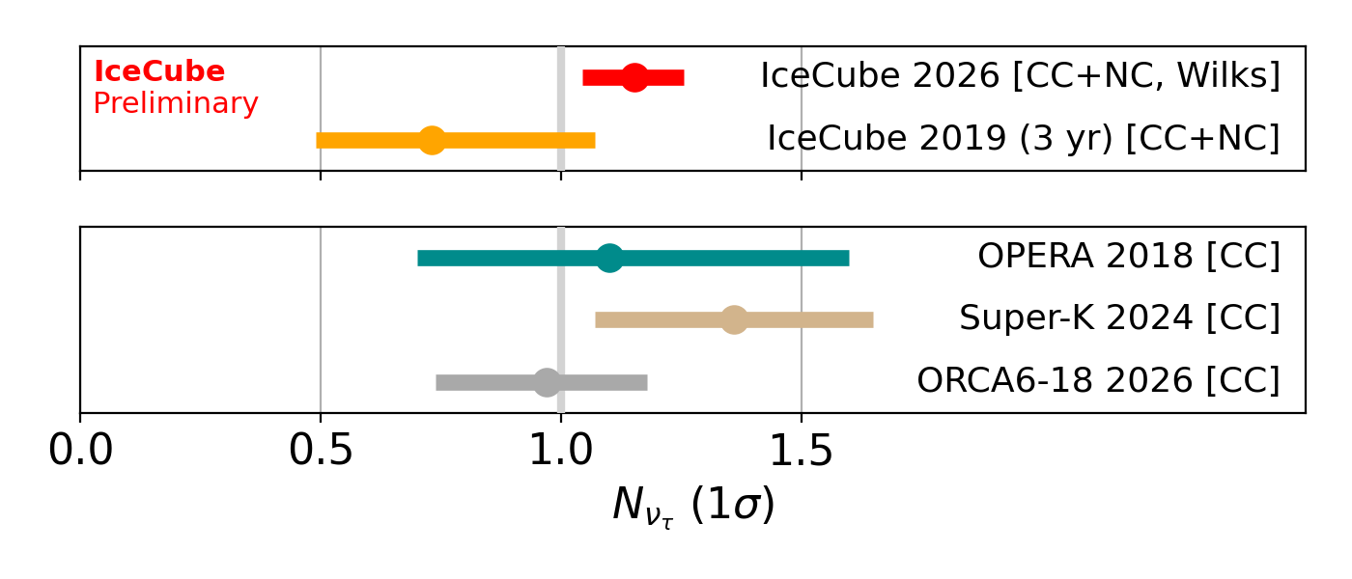

Latest DC results – Oscillations
11.1 years of data
108k atmospheric neutrino events
$$Pν_{μ}→ν_{μ}≃1−\sin^{2}{2θ_{23}} \sin^{2}\left(\frac{Δm_{32}^{2}}{4E}L\right)$$
Publication in preparation

Slide 7
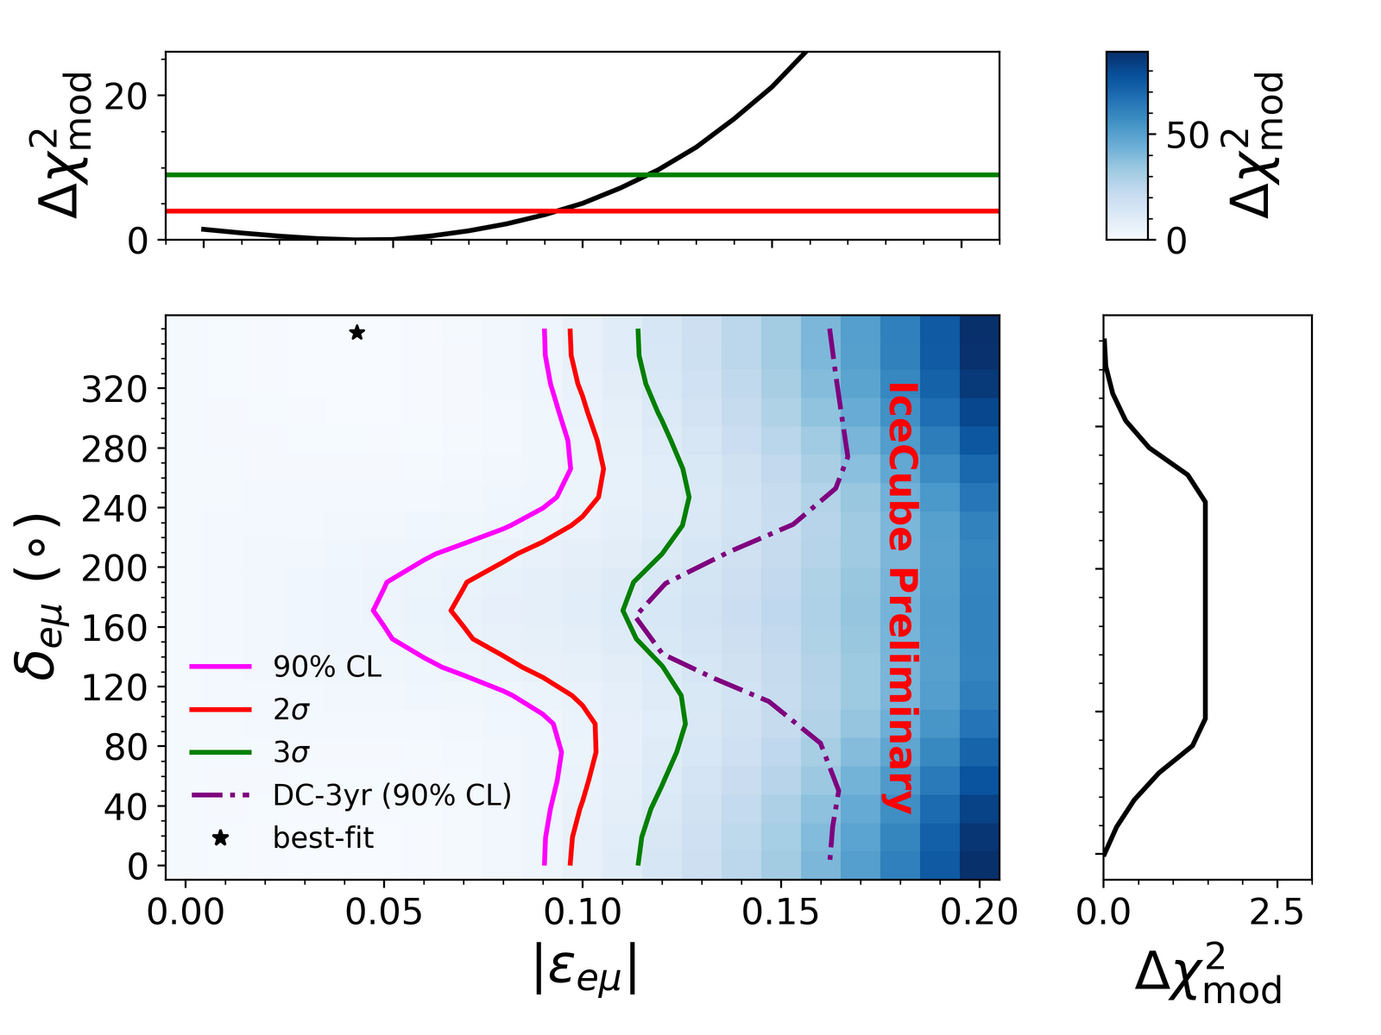
Latest DC results – NSI’s
11.1 years of data
108k atmospheric neutrino events
New – IceCube 2026
$$Pν_{μ}→ν_{μ}≃1−\sin^{2}{2θ_{23}} \sin^{2}\left(\frac{Δm_{32}^{2}}{4E}L\right)$$
Publication in preparation

Slide 8
Latest DC results – NSI’s
NSI solutions to the T2K/NOvA discrepancy
Chatterjee & Palazzo, PRL 126, 051801
Denton et al, PRL 126, 051802
11.1 years of data
108k atmospheric neutrino events
$$Pν_{μ}→ν_{μ}≃1−\sin^{2}{2θ_{23}} \sin^{2}\left(\frac{Δm_{32}^{2}}{4E}L\right)$$
Publication in preparation

Slide 9
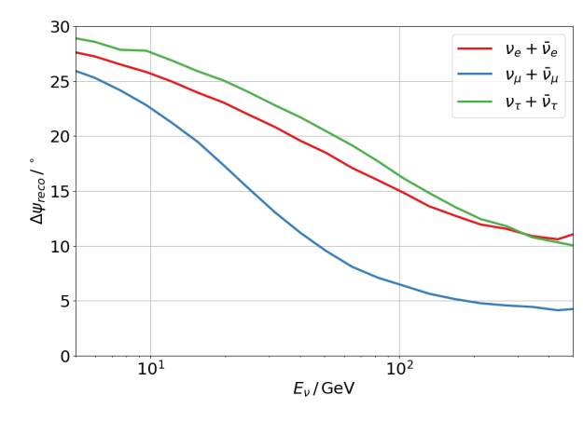
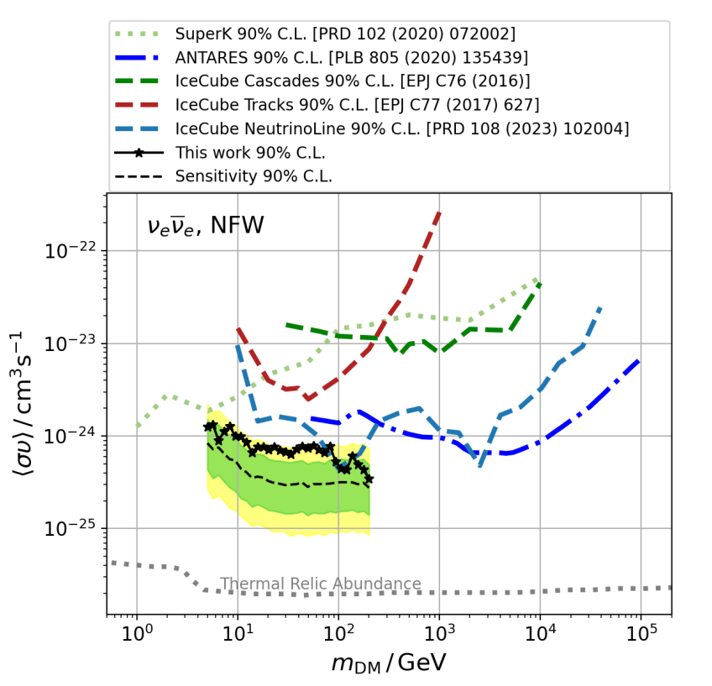
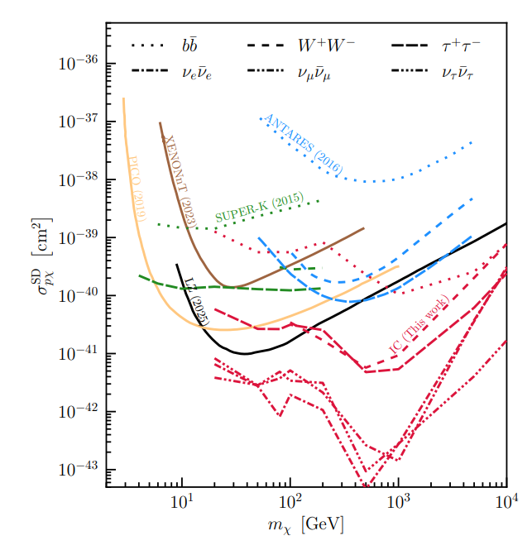
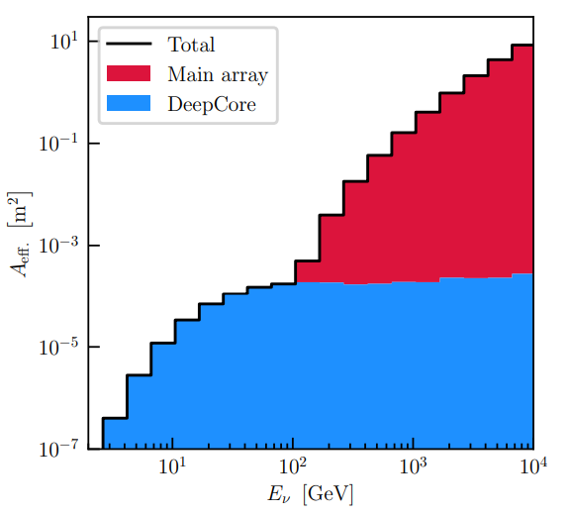


Latest DC results – Dark Matter
Galactic Center
The Sun
Phys.Rev.D 113 (2026) 12, 122004
arXiv:2507.08457 [hep-ex]

Slide 10
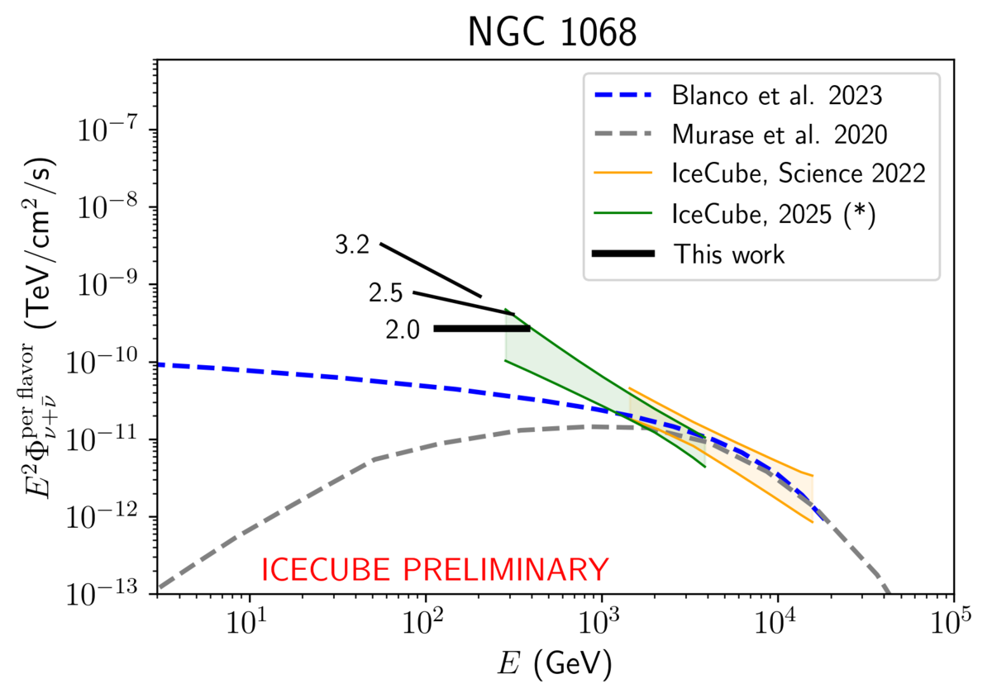
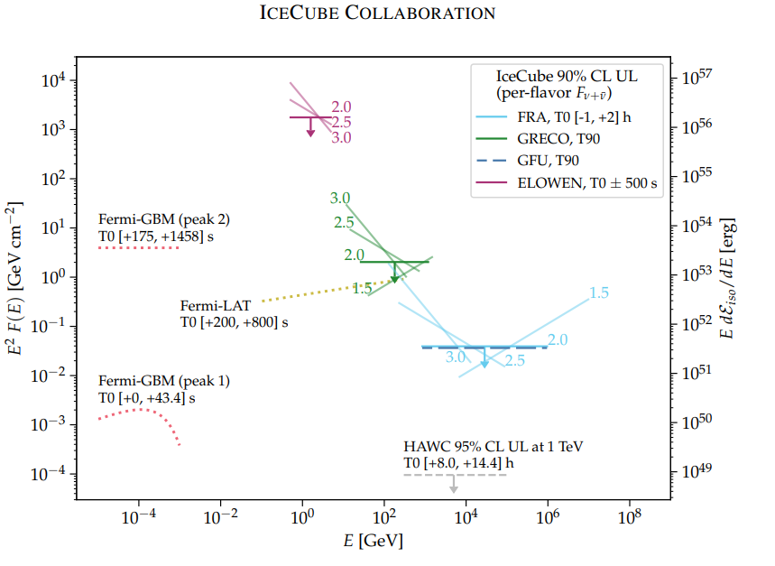
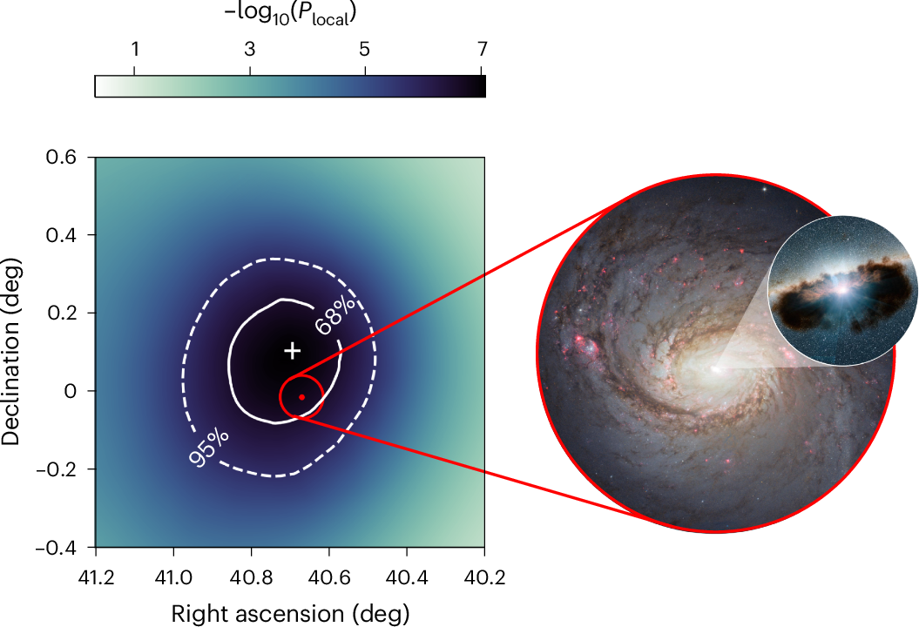

Latest DC results – “Low Energy” Astronomy
Limits on time-integrated $ν$ flux from GRB 221009A
ApJL 946 L26 (2023)

Slide 11
The upgraded IceCube detector
Deployed in 2025/2026 Pole season

Slide 12
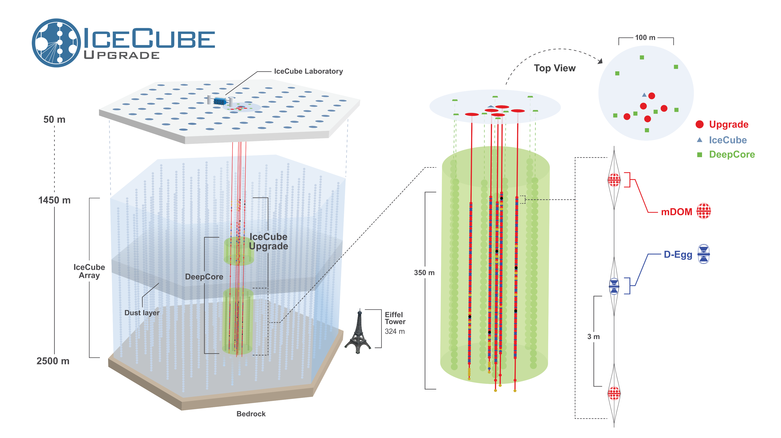

Slide 13
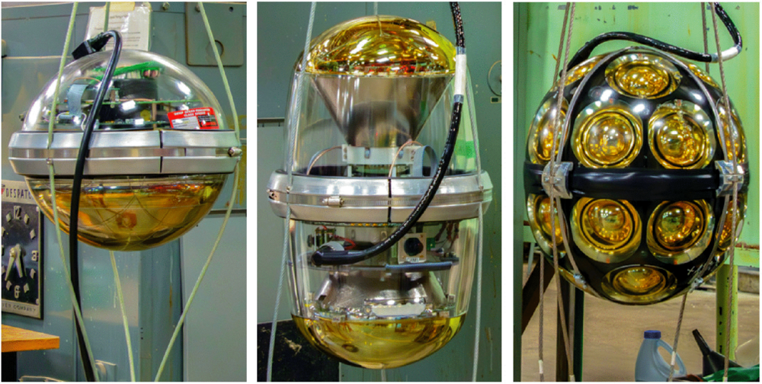
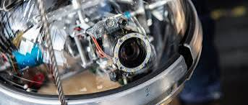
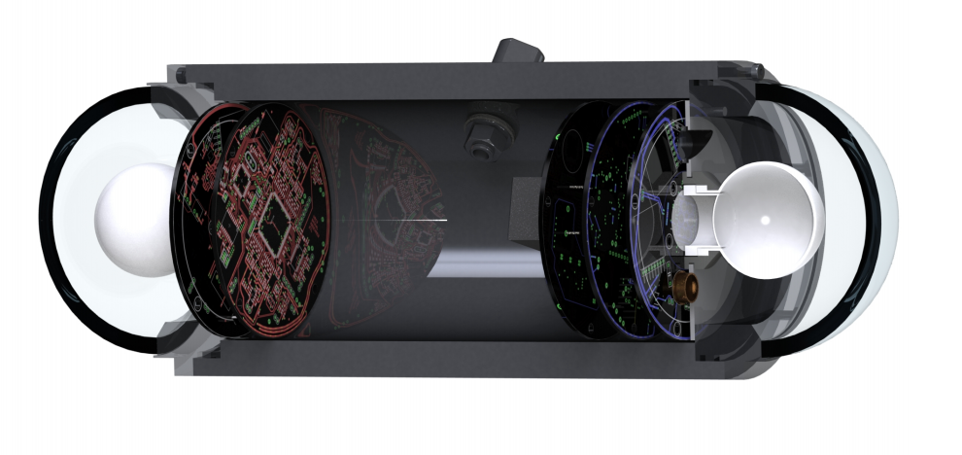
The modules of the Upgrade

Slide 14
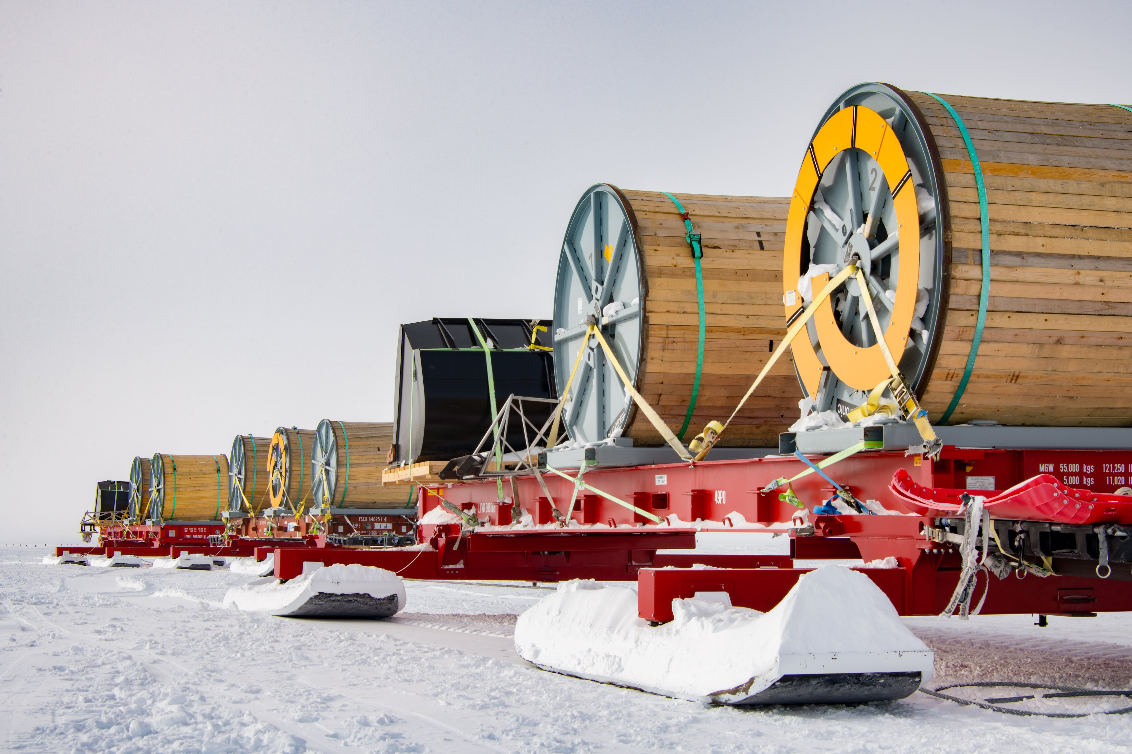
Credit: Yuya Makino, IceCube/NSF

Slide 15
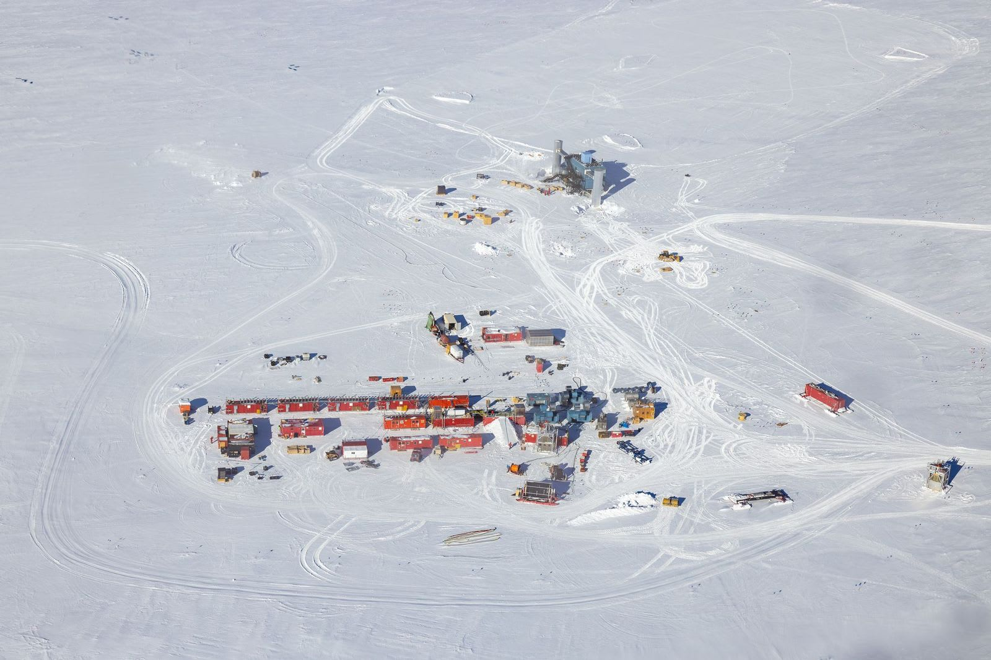
IceCube Upgrade drill camp, 2024.
Credit: Michael Rayne/ASC-ARFF

Slide 16
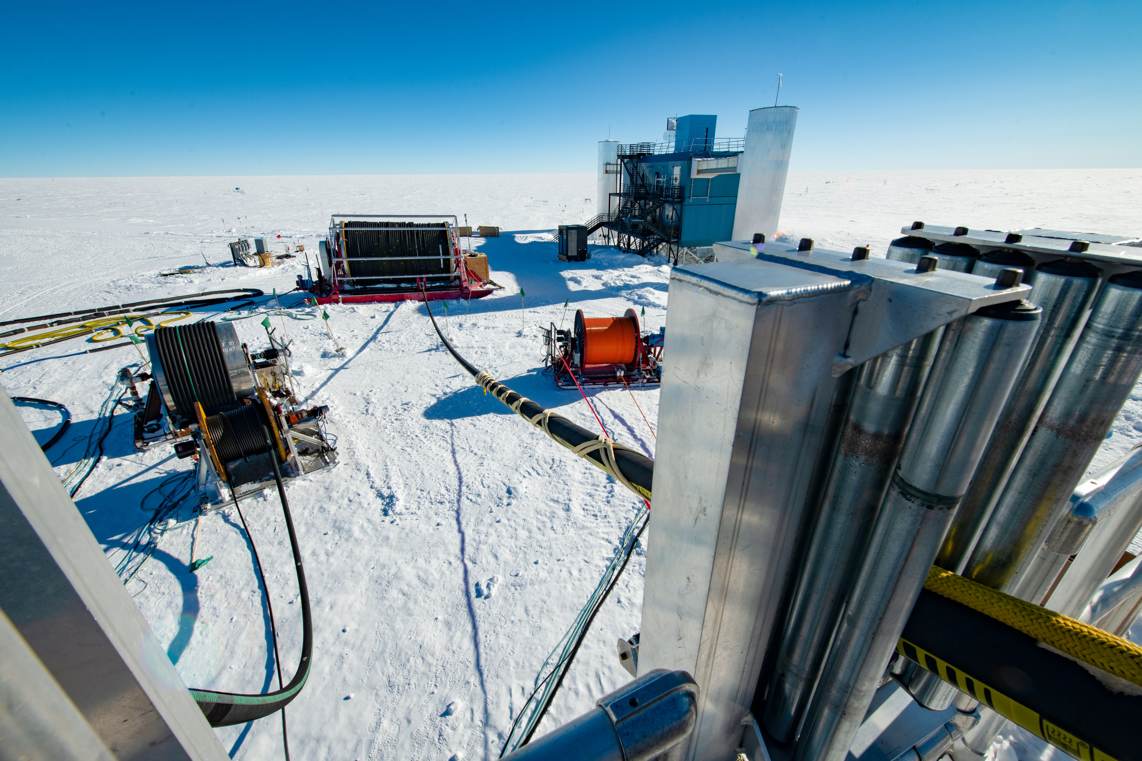
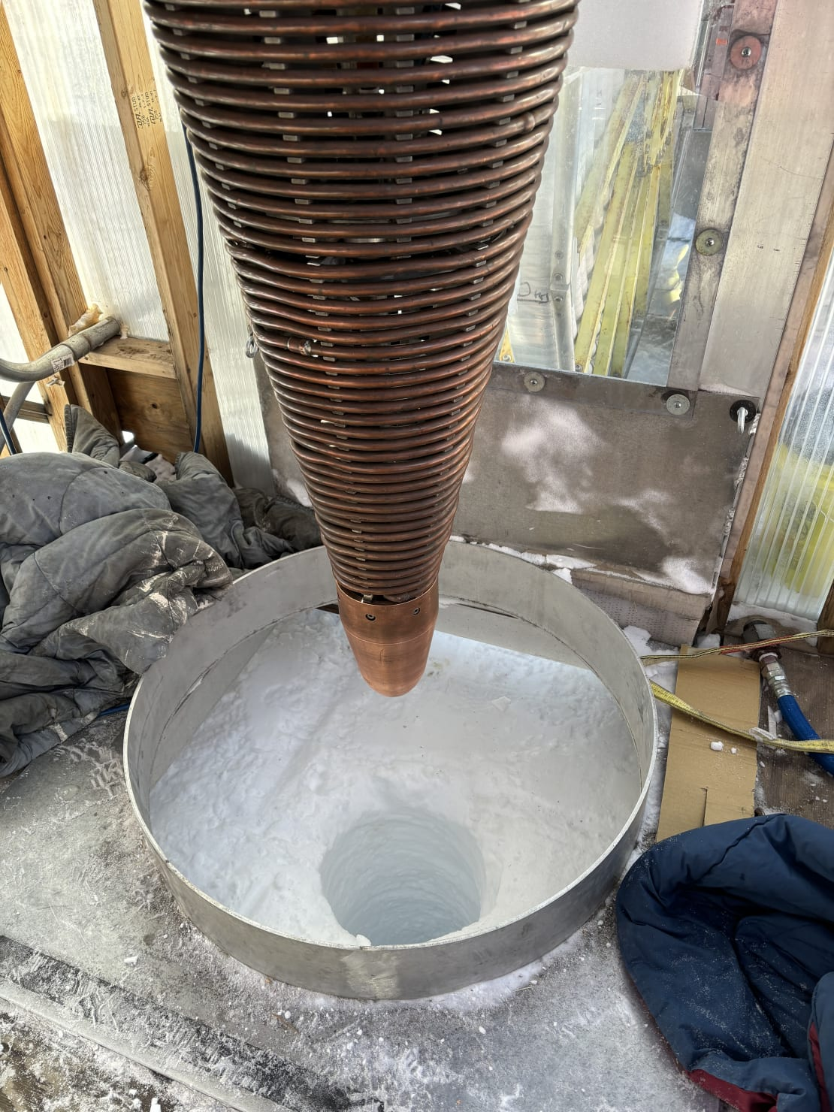
Credit: Yuya Makino, IceCube/NSF
Credit: Kurt Studt, IceCube/NSF

Slide 17
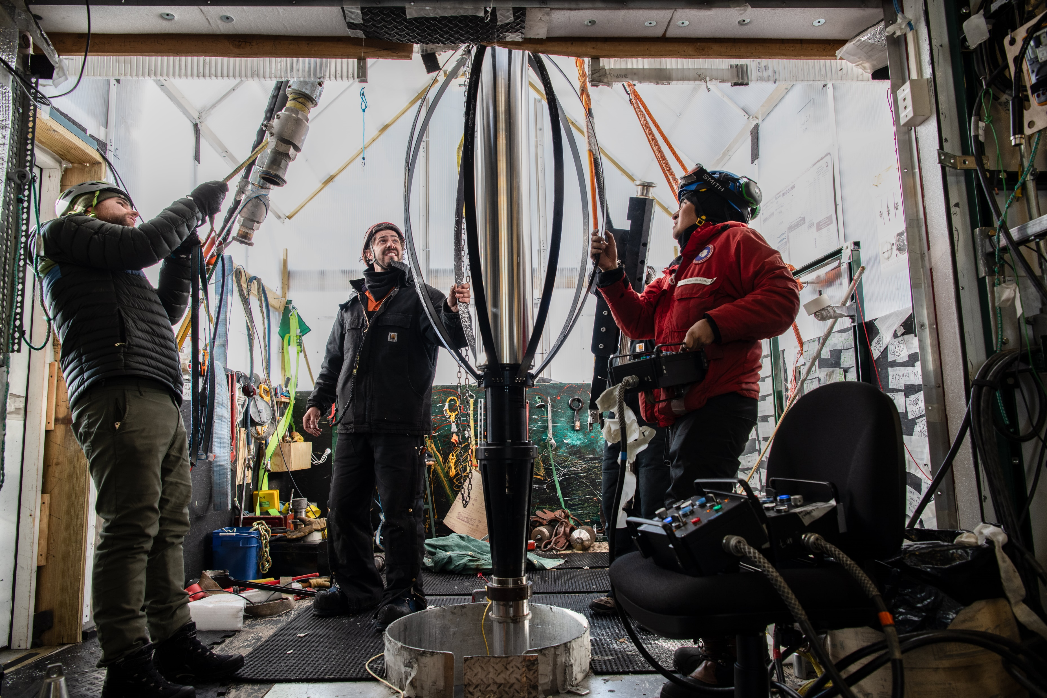
Credit: Yuya Makino, IceCube/NSF

Slide 18
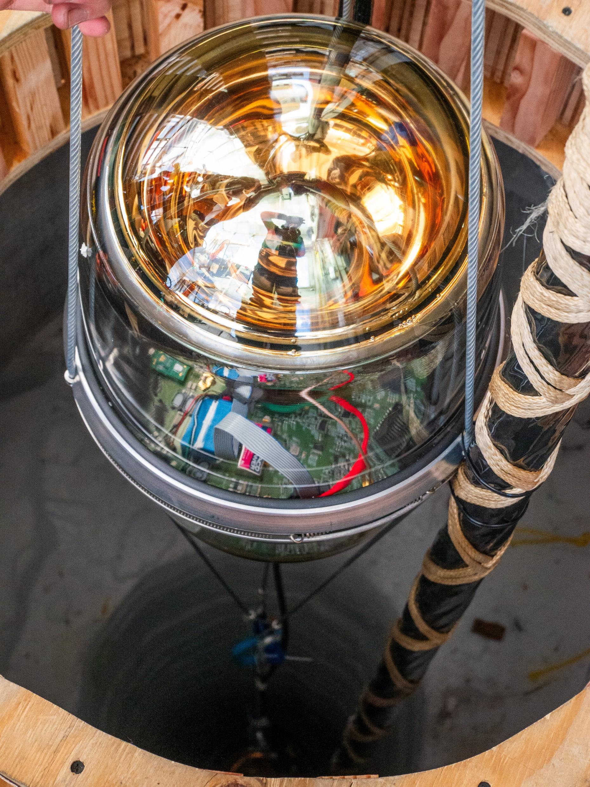
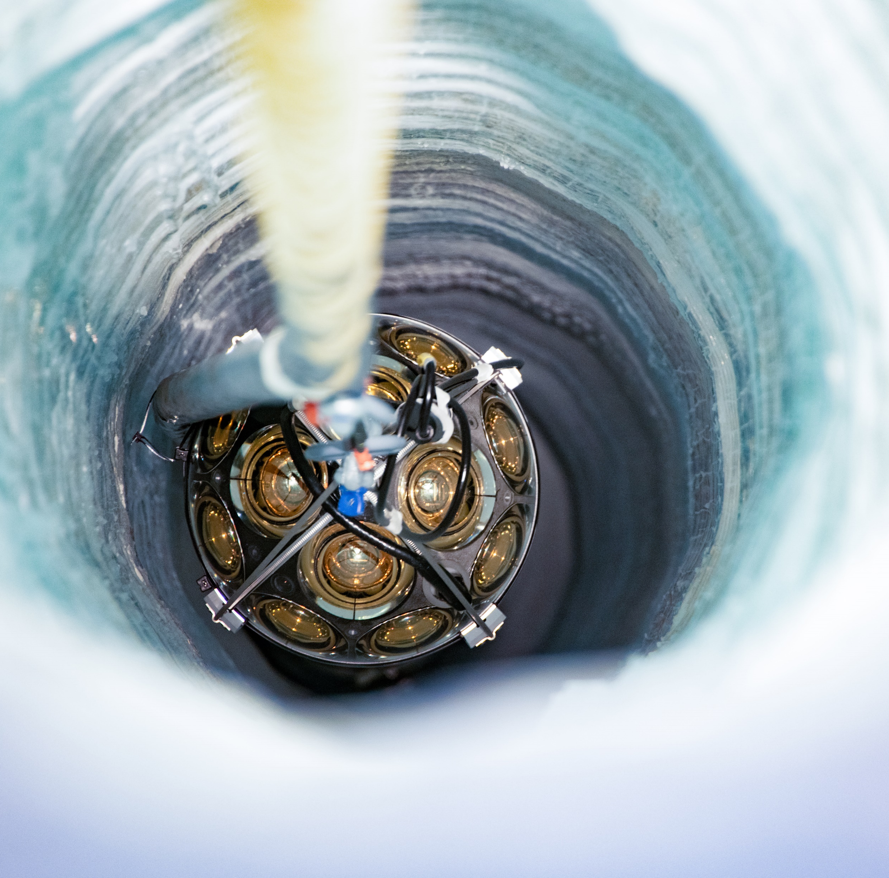
Credit: Aya Ishihara, IceCube/NSF
Credit: Yuya Makino, IceCube/NSF

Slide 19
Summary of deployment
Drilled 6 of 7 planned holes
  Issue with drill on hole #6 → hole #7 was not attempted
  Lost one string during re-freezing
  Big success after 15 years of no deep drilling at the SP!
New instrumentation:
  505 optical modules across five strings
    Majority are multi-PMT modules, other novel designs
  64 special / calibration devices
    Cameras, collimated beams, isotropic light emitters, acoustic modules, a seismometer

Slide 20
First look at
IceCube Upgrade data
All images preliminary

Slide 21
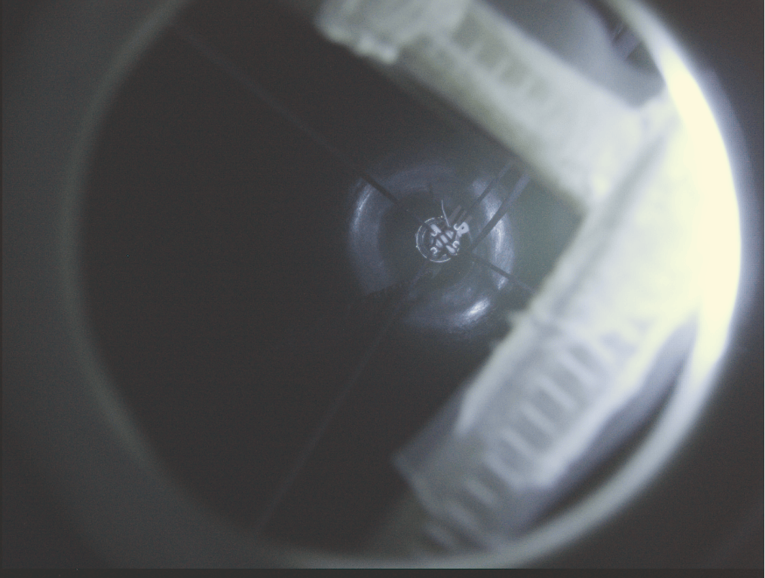
Cameras

Slide 22
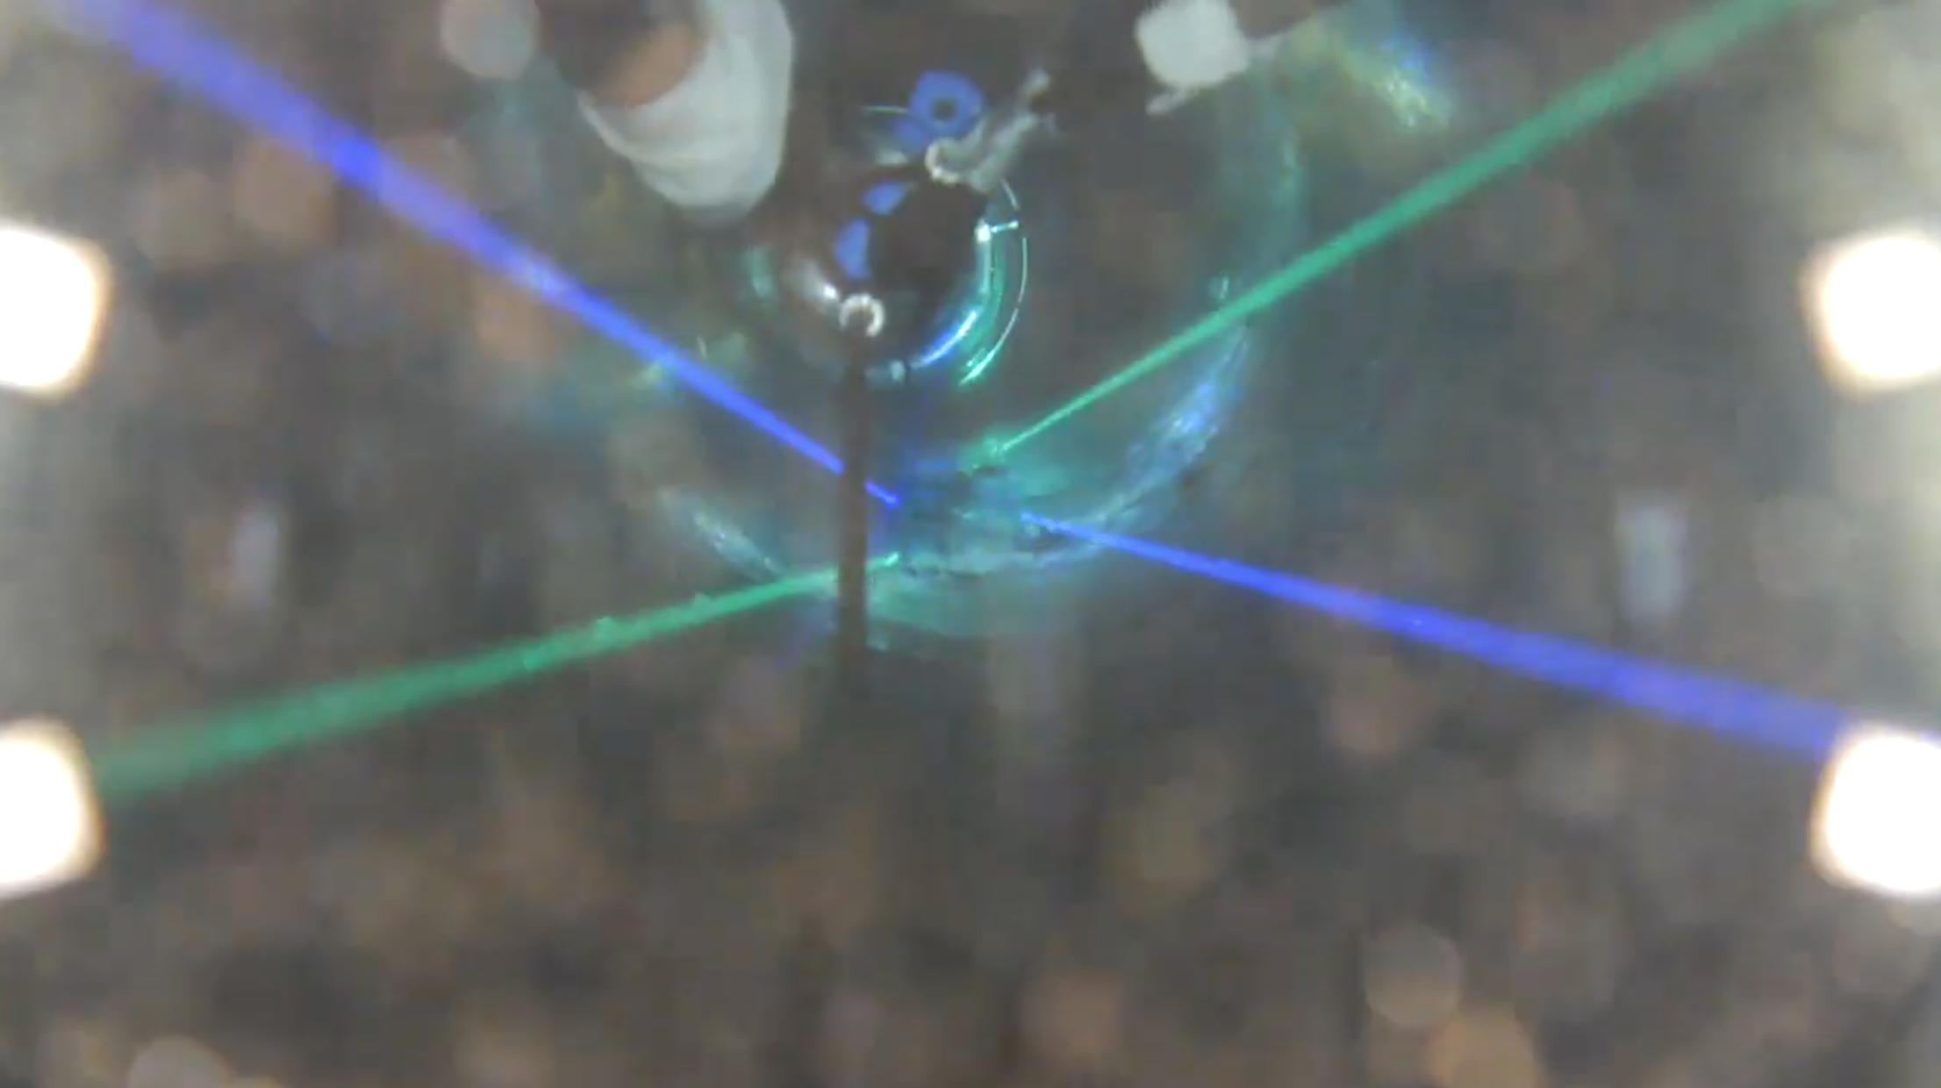
Cameras

Slide 23
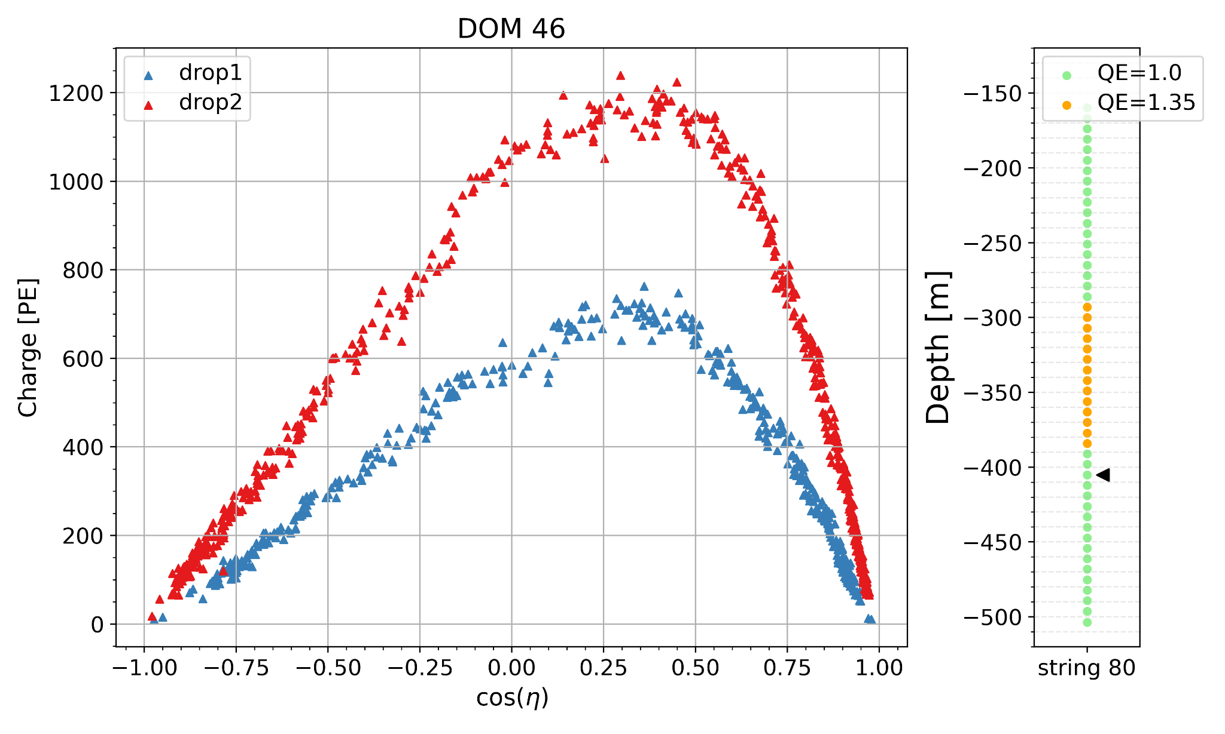
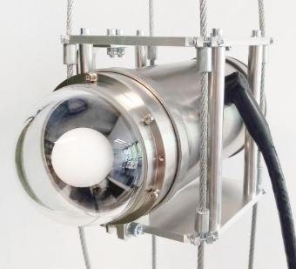
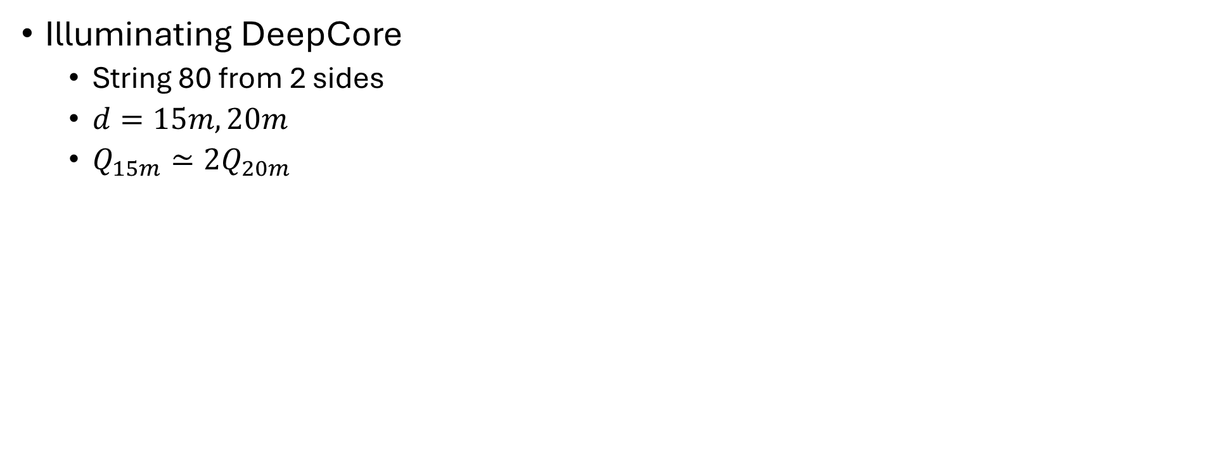
POCAM during drop
In-situ angular acceptance
Illuminating DeepCore
  String 80 from 2 sides
  $d=15m, 20m$
  $Q_{15m}≃2Q_{20m}$
IceCube Preliminary

Slide 24
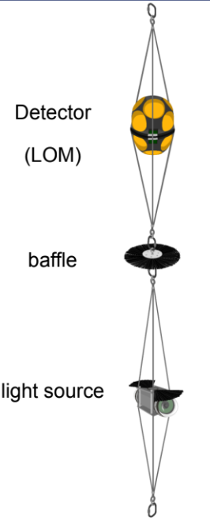
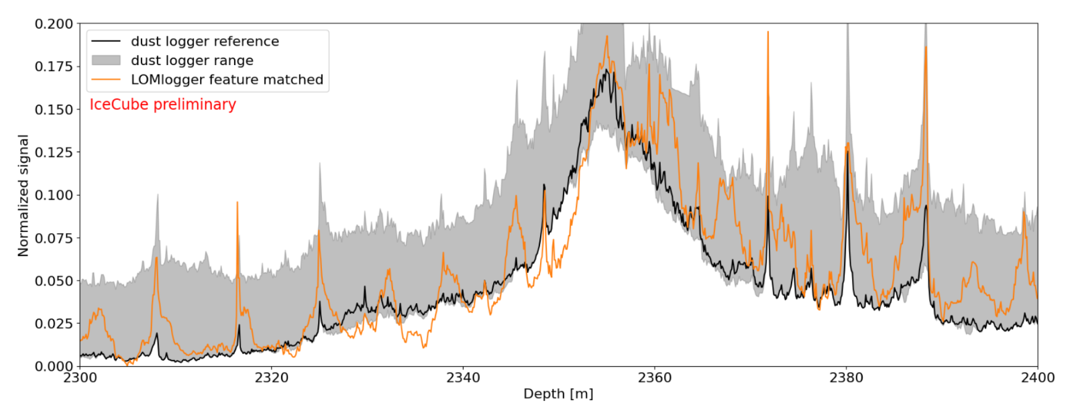
LOMLogger – stratigraphy measurements
“Dust logger” ran on different holes in previous years
LOMLogger dropped in instrumented holes, matching their results for display

Slide 25
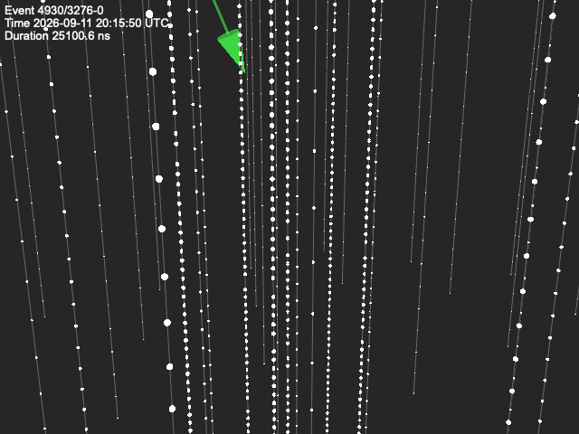
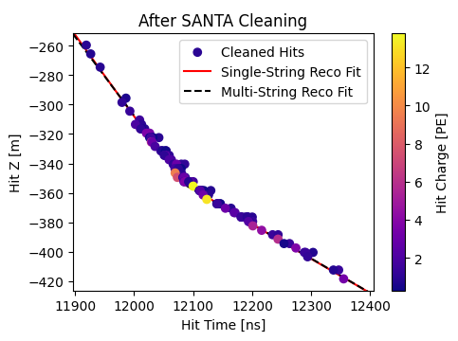
Muons in the upgrade
IceCube Preliminary

Slide 26
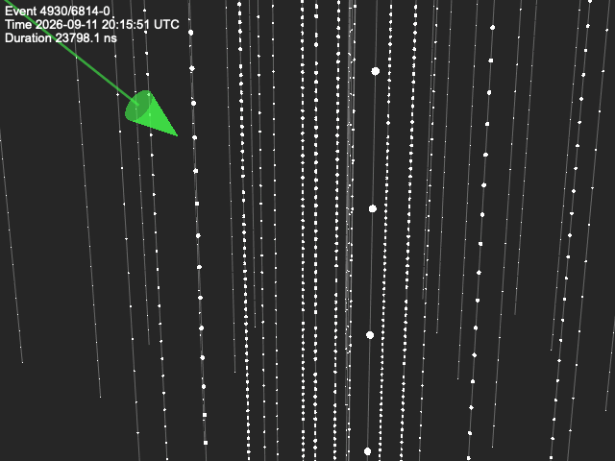
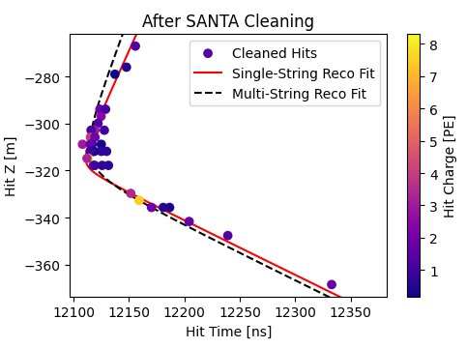
Muons in the upgrade
IceCube Preliminary

Slide 27
Expected impact of upgrade data
After 3-5 years of operation

Slide 28
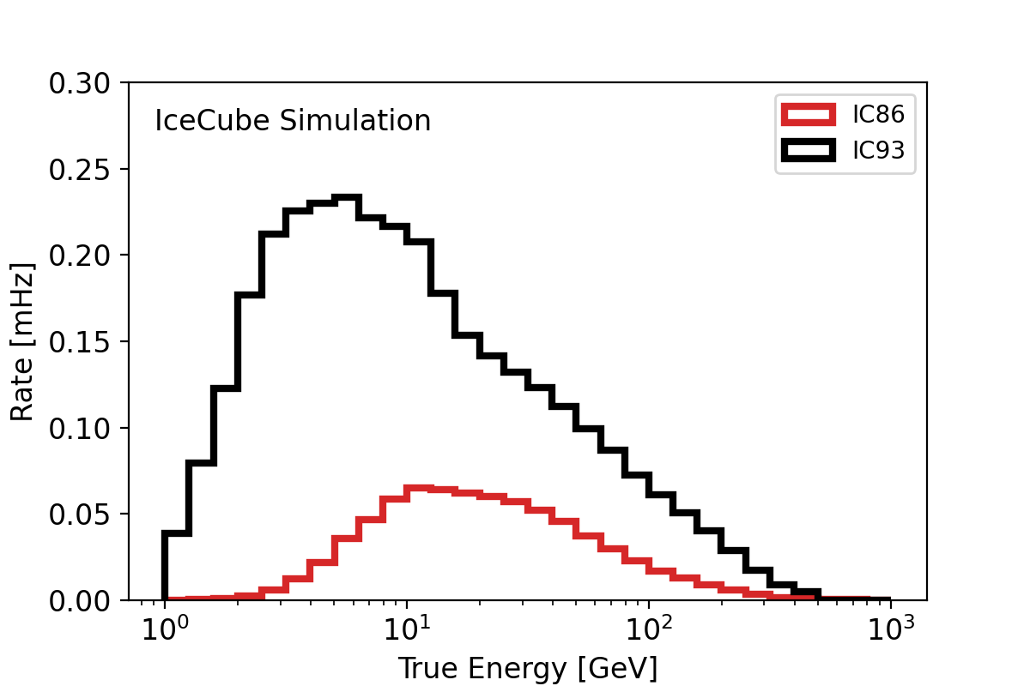
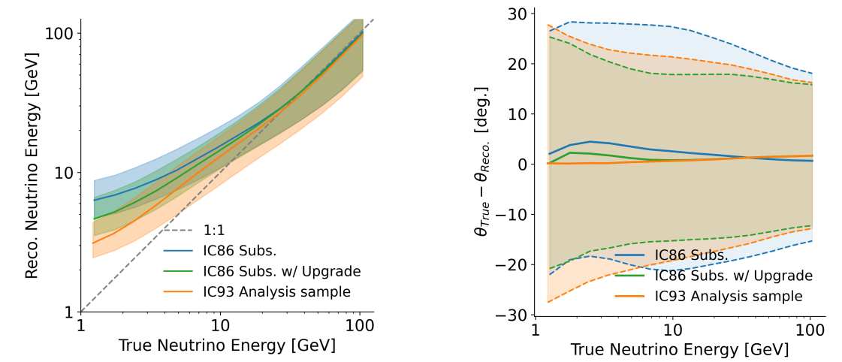
Expected response
More low energy events & better reconstructions

Slide 29
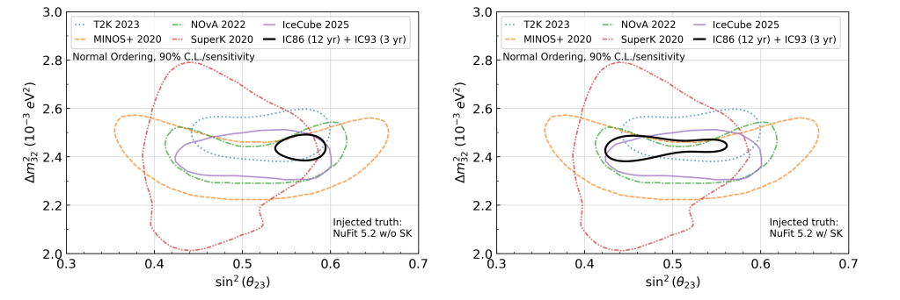
Projections: standard oscillations
PRD 113 072009 (arXiv:2509.13066)

Slide 30
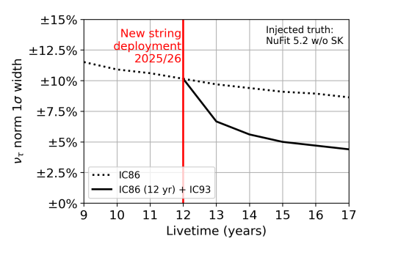

Projections: $ν_{τ}$ appearance
PRD 113 072009 (arXiv:2509.13066)

Slide 31
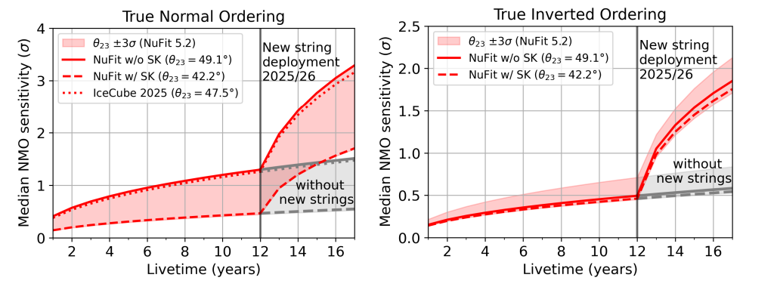
Projections: Neutrino Mass Ordering
PRD 113 072009 (arXiv:2509.13066)

Slide 32
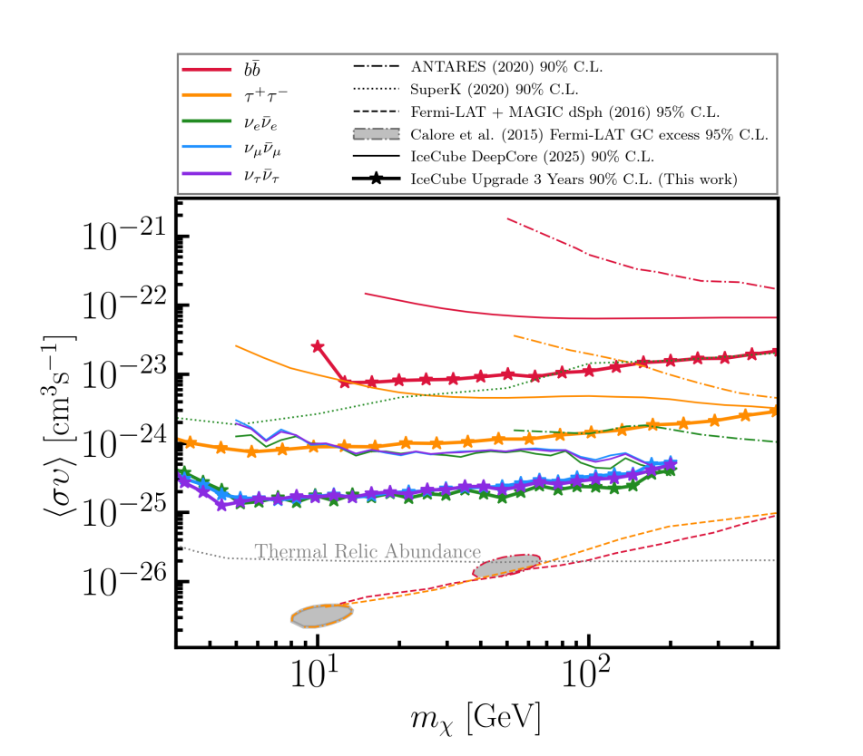
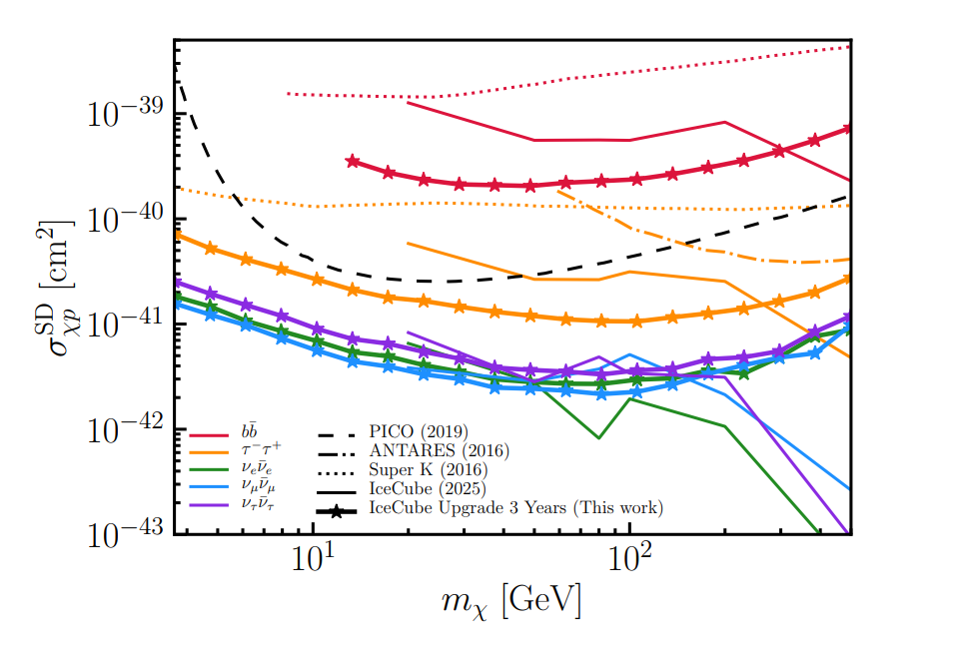
Projections: Dark Matter
Galactic Center
The Sun
arXiv:2605.06600 [hep-ex]

Slide 33
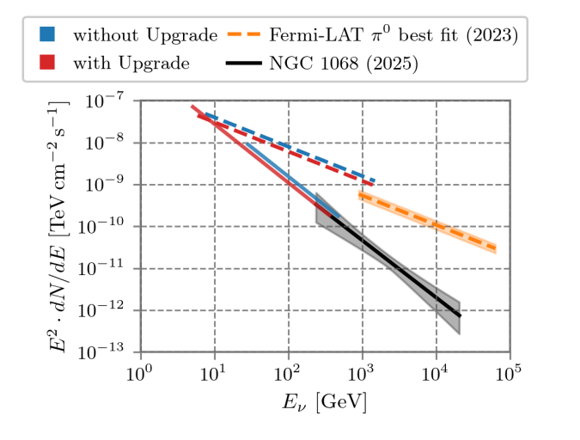
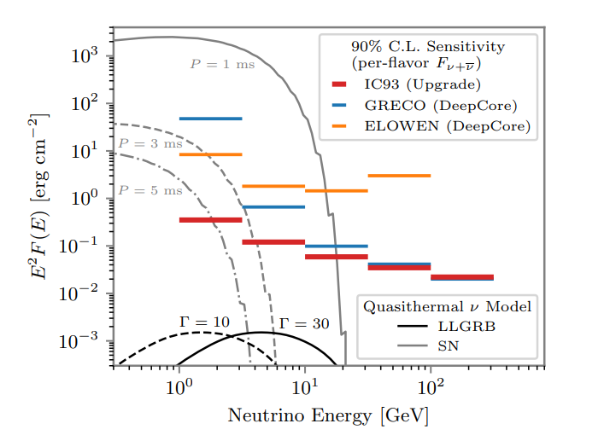
Projections: Neutrino Sources
NGC 1068 & Galactic Plane – steady sources
Sensitivity to transients T=1000s
IceCube Preliminary
arXiv:2608.28395 [astro-ph.HE]

Slide 34
Summary & Outlook
IceCube has received an upgrade
  5 strings
  505 new sensors
  64 special / calibration devices
  Integration with IceCube DAQ ongoing
Publications on physics potential
  Neutrino oscillations: PRD 113 072009 (arXiv:2509.13066)
  Dark matter: arXiv:2605.06600
  Neutrino astronomy: arXiv:2608.28395

Slide 35
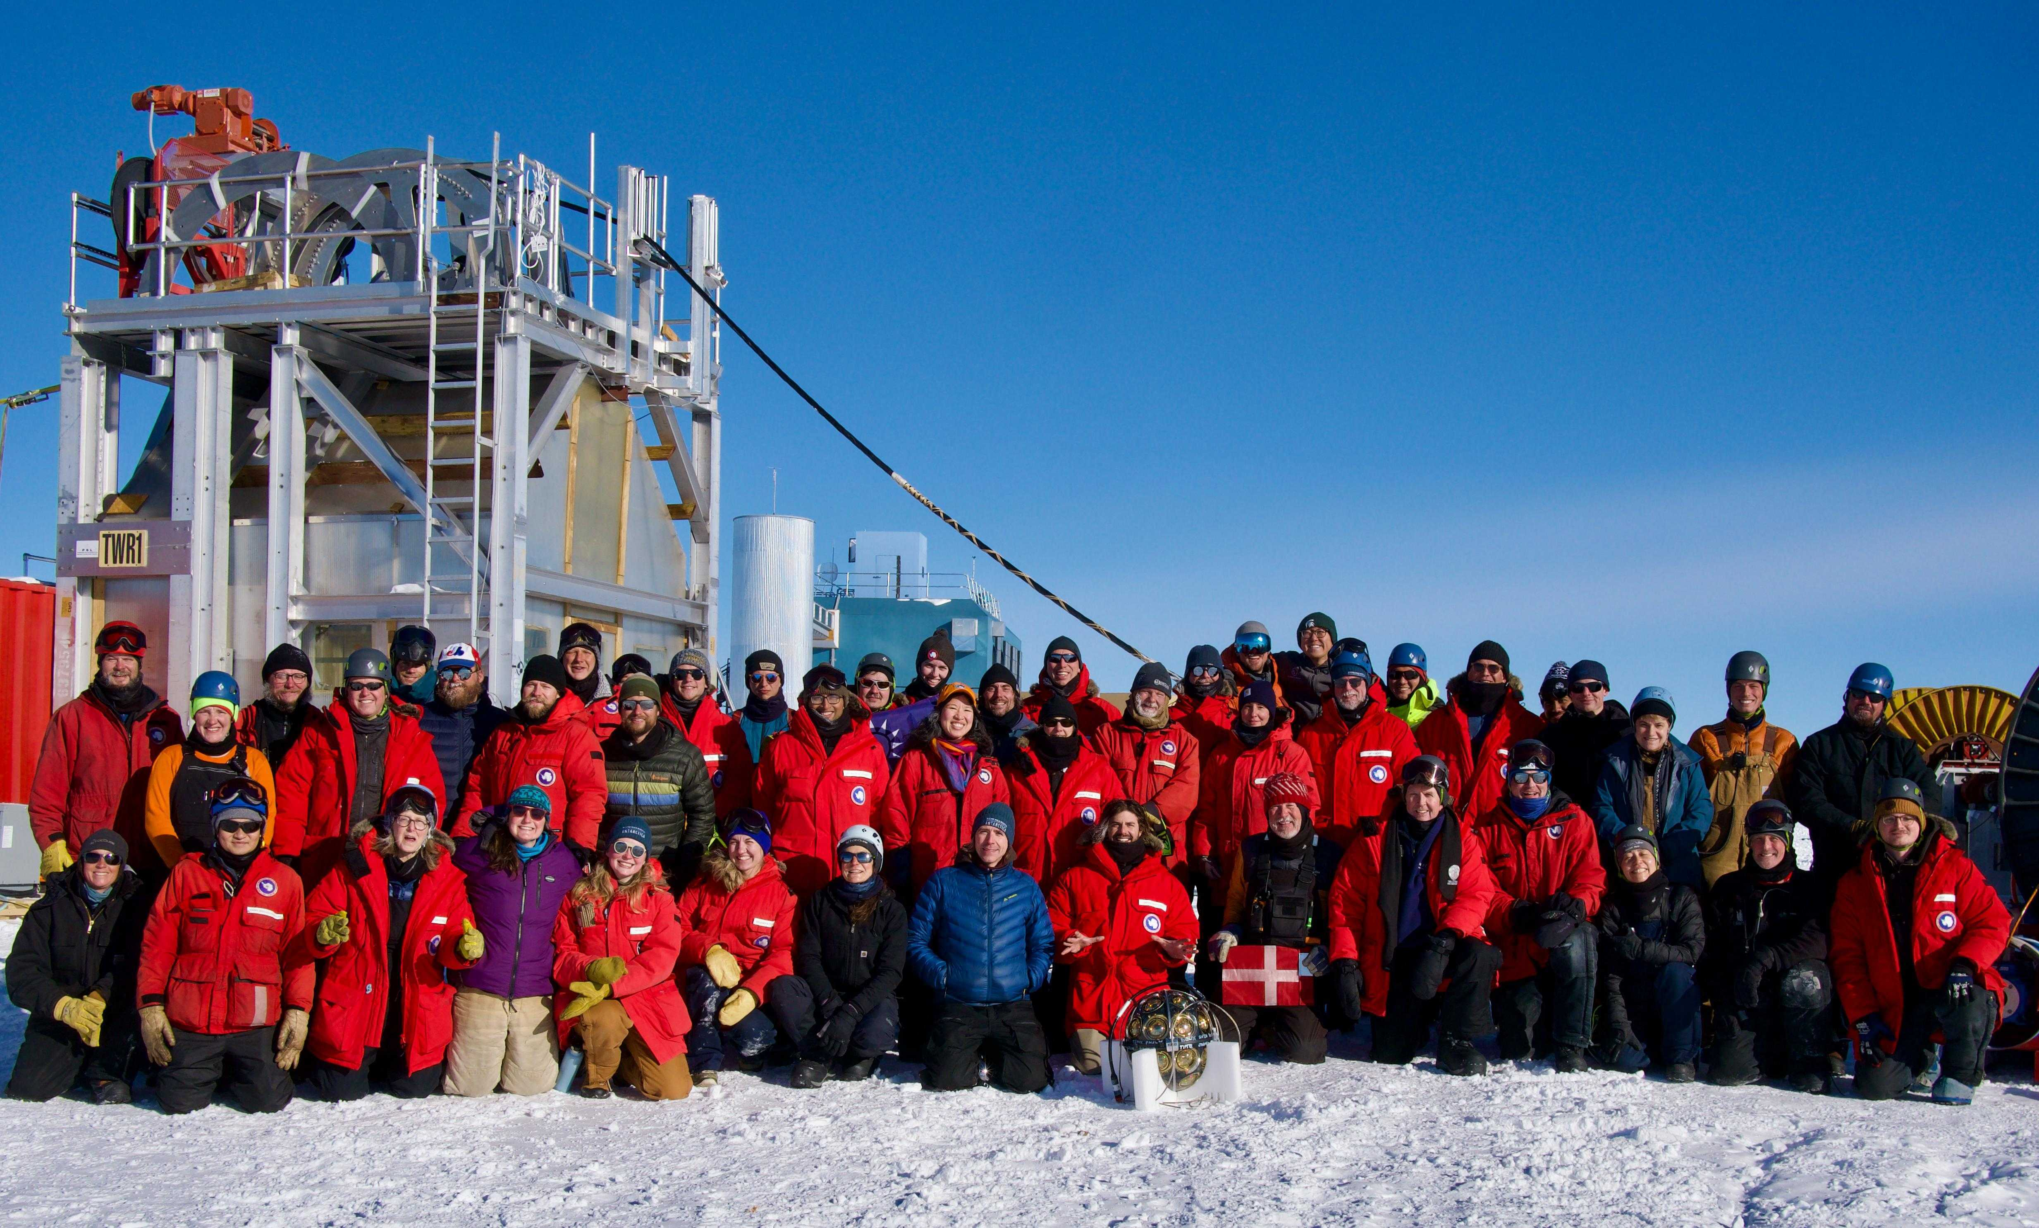

Slide 36
Additional material

Slide 37





Atmospheric $ν$ studies
Most flux from decay of $π^{±}$ and $K^{±}$
  Beam of $ν_{e}$, $ν_{μ}$ (+ antineutrinos)
Event information: energy E & direction L
  Well suited to measure $ν$ oscillations

Slide 38

NMO combining datasets
Phys. Rev. D 101, 032006

Slide 39



Atmospheric $ν$ studies: oscillations
Well suited for measuring flavor transitions from oscillations
$$Pν_{μ}→ν_{μ}≃1−\sin^{2}{2θ_{23}} \sin^{2}\left(\frac{Δm_{32}^{2}}{4E}L\right)$$
arXiv:1509.08404 [hep-ex]

Slide 40

Atmospheric $ν$ studies: oscillations
Well suited for measuring flavor transitions from oscillations
Can measure appearance channel simultaneously
Deviations from 3-flavor mixing are sensitive to BSM models
  Sterile neutrinos, non-standard interactions, $ν$decoherence
$$Pν_{μ}→ν_{μ}≃1−\sin^{2}{2θ_{23}} \sin^{2}\left(\frac{Δm_{32}^{2}}{4E}L\right)$$

Slide 41


Atmospheric neutrino data
$$ν_{μ}$$
$$ν_{e}$$
DeepCore IceCube
Color indicates time (red=early, blue=late). Sphere size is proportional to number of photons observed.
Notes:
This is what we are working with. The detector is beautifully simple. Understanding the data can be challenging.
The DeepCore pictures have a ~150m height, the IC one is about 600m

Slide 42
Atmospheric neutrino data
GeV events in DeepCore for $ν$ oscillations
$$ν_{μ}$$
$$ν_{e}$$
DeepCore IceCube
Color indicates time (red=early, blue=late). Sphere size is proportional to number of photons observed.
Notes:
This is what we are working with. The detector is beautifully simple. Understanding the data can be challenging.
The DeepCore pictures have a ~150m height, the IC one is about 600m

Slide 43


Atmospheric neutrino data
$$Pν_{μ}→ν_{μ}≃1−\sin^{2}{2θ_{23}} \sin^{2}\left(\frac{Δm_{32}^{2}}{4E}L\right)$$
$$ν_{μ}$$
$$ν_{e}$$
DeepCore IceCube
Color indicates time (red=early, blue=late). Sphere size is proportional to number of photons observed.
Notes:
This is what we are working with. The detector is beautifully simple. Understanding the data can be challenging.
The DeepCore pictures have a ~150m height, the IC one is about 600m

Slide 44


Analysis strategy for oscillations
Data selection:
- Atm. $μ$ reduction
- Event quality
Reconstruction:
- Energy & direction
- Topology
Experimental data
Comparison of data and MC histograms
(LLH or $χ^{2}$)
Physics result
Event simulation (MC variations)
Compute bin counts from MC
- Detector response & medium
- Flux and xsec uncertainties
- Physics hypothesis
Detector calibration

Slide 45

Interaction types
DeepCore

Slide 46

Improvements: simulation

Slide 47


Improvements: analysis
Revamped noise cleaning
  Using hit/no-hit only
  Relying on leading edge time
  Narrow signal time window
  Optimized old algorithms
DynEdge reco (GNN)
  Faster processing
  Slightly better resolution
Tighter quality cuts
  Containment, nhit, $μ$rejection

Slide 48


Results

Slide 49

Data/MC agreement post-fit in 1D

Slide 50

Data/MC in full space

Slide 51



Zoom in: regions with highest signal strength

Slide 52

NuTau signal

Slide 53


Likelihood profiles

Slide 54



Latest DC results – sterile states
arXiv:2407.01314 [hep-ex]

Slide 55



Parameterizing calibration information
Fischer, Naab, Trettin
arXiv:2305.02257
Detector-related systematics dominate uncertainty
  Multiple strategies to account for their impact
MC production
  MC at multiple parameter combinations
  MC with smoothly varying parameters
Parameterization
  Gradients obtained from binned MC expectation
  Event-wise weights from PDFs obtained with ML
Latest addition:
  Birefringence in the ice crystals
IceCube, PRD 108, 012014 (2023)
IceCube, The Cryosphere 18 (2024) 1, 75-102
Notes:
You learn the probability distribution for the properties of an event given some detector conditions. Then you can reweight it.

Slide 56



Projections in L/E space
$$Pν_{μ}→ν_{μ}≃1−\sin^{2}{2θ_{23}} \sin^{2}\left(\frac{Δm_{32}^{2}}{4E}L\right)$$
All final-level data shown
Strong $ν_{μ}$ deficit
Small $ν_{τ}$ appearance
Full analysis done in a 3D-space of $E, cosθ, PID$

Slide 57



The signature of $ν$ oscillations
$$Pν_{μ}→ν_{μ}≃1−\sin^{2}{2θ_{23}} \sin^{2}\left(\frac{Δm_{32}^{2}}{4E}L\right)$$
Latest oscillation analysis, publication in preparation

