Slide 1

Neutrino Oscillations:
From Discovery to the Precision Era
27 Oct. 2026
Chung Ang University
Sin Kyu Kang
Seoul National University of Science and Technology

Slide 2
Outline
Brief introduction to neutrinos & Neutrino oscillations
Recent experimental results
Theoretical issues
-origin of neutrino mixing and CP violation
-new physics detectable in neutrino oscillation
Conclusion

Slide 3
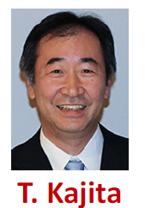


Big discoveries of the past two decades:
- Neutrinos are massive
- Leptons mix
established by the observation of neutrino oscillations
1998 Super-Kamiokande: atmospheric ν_{μ} disappearance
2002 SNO: solar ν_{e} → ν_{μ,τ} (charged and neutral currents)
2002 KamLAND: reactor anti-ν_{e} disappearance (LMA solution)
2012 Daya Bay, RENO: θ₁₃ ≠ 0
Evidence of new physics beyond the Standard Model, which has massless neutrinos

Slide 4
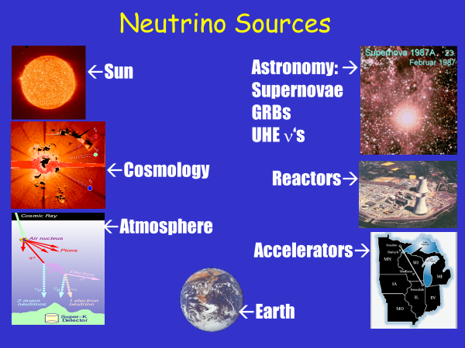
Productions of Neutrinos
Energies, baselines, and sensitivities
Source | Energy | Baseline | Main sensitivity
Sun | 0.1–20 MeV | 1.5 ×10⁸ km | θ₁₂, Δm²₂₁, MSW
Reactor (short) | 1–10 MeV | ~1–2 km | θ₁₃, |Δm²_{ee}|
Reactor (medium/long) | 1–10 MeV | 50–200 km | θ₁₂, Δm²₂₁, MO
Atmosphere | 0.1GeV–TeV | 15–12700km | θ₂₃, Δm²₃₁, MO
Accelerator | 0.3–5 GeV | 295–1300km | θ₂₃, Δm²₃₂, δ_{CP},,MO
Supernova | 10–50 MeV | ~10 kpc | MO, collective effects
Different sources probe different mixing angles, Δm², matter densities, and flavors;
→ their consistency is itself a test of the 3-flavor picture.

Slide 5
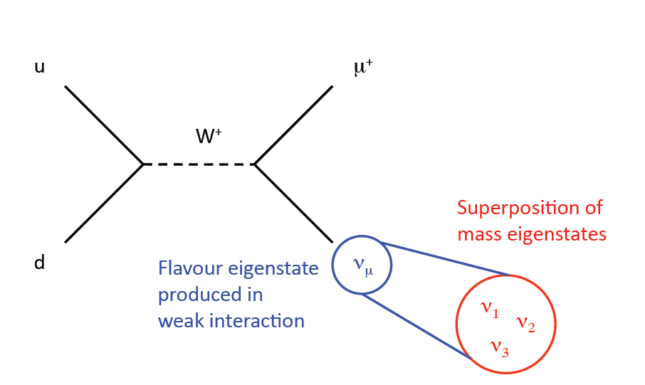
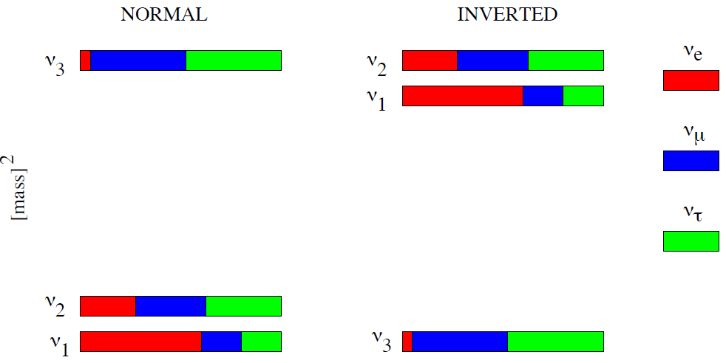
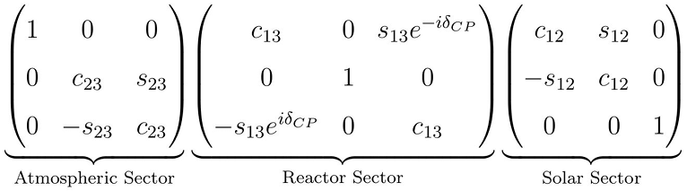
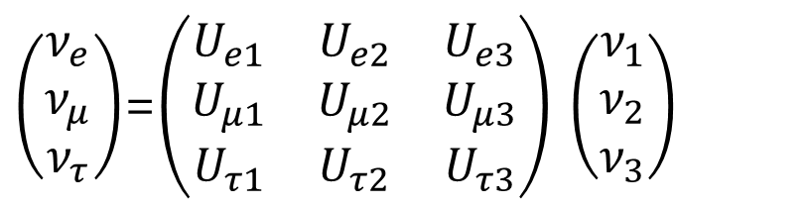
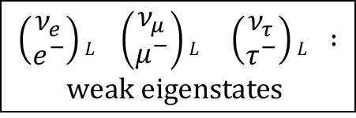
Neutrino Mixing
$$\left(\begin{matrix}ν_{e} \\ e^{−}\end{matrix}\right)L \left(\begin{matrix}ν_{μ} \\ μ^{−}\end{matrix}\right)L \left(\begin{matrix}ν_{τ} \\ τ^{−}\end{matrix}\right)L :$$
$$weak eigenstates$$
mixing matrix
$\left(\begin{matrix}ν_{e} \\ ν_{μ} \\ ν_{τ}\end{matrix}\right)$=$\left(\begin{matrix}U_{e1} & U_{e2} & U_{e3} \\ U_{μ1} & U_{μ2} & U_{μ3} \\ U_{τ1} & U_{τ2} & U_{τ3}\end{matrix}\right)$ $\left(\begin{matrix}ν_{1} \\ ν_{2} \\ ν_{3}\end{matrix}\right)$
mass
eigenstates
- Specific parameterization of lepton mixing matrix
$U_{PMNS}$=

Slide 6
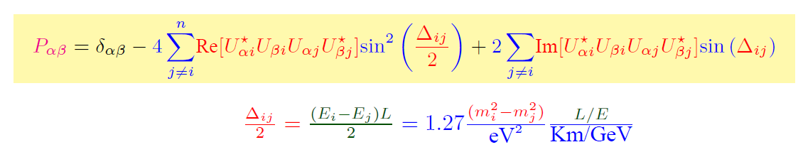
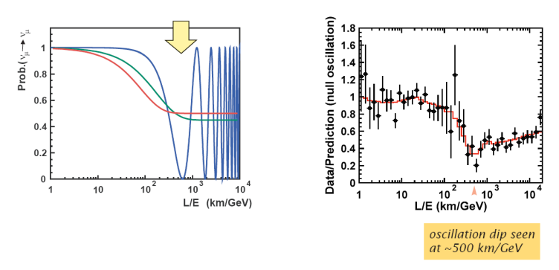
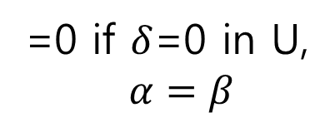
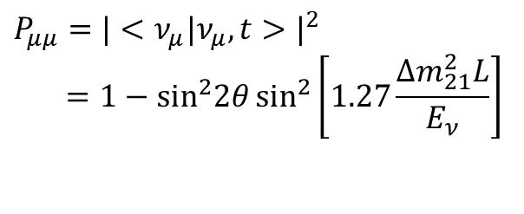
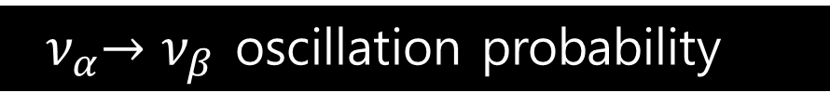
Oscillation Probability in Vacuum
=0 if $δ$=0 in U,
$α=β$
${ ν}_{α}→ν_{β}$ oscillation probability :
2-flavor oscillation
$$P_{μμ}=|<ν_{μ}|ν_{μ},t>|^{2} \\ =\text{1}−\text{si}{\text{n}}^{2}2θ\sin^{2}\left[1.27\frac{Δm_{21}^{2}L}{E_{ν}}\right]$$

Slide 7












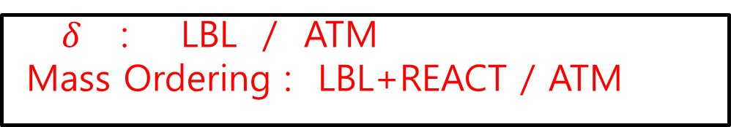

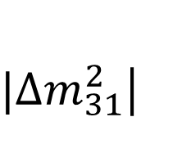

From ν oscillation exps. we can determine
$|∆m_{31}^{2}$|
$$∆m_{21}^{2}$$
ATM + REACT + LBL
$$θ_{12}$$
KamLAND + SOL + JUNO
$$θ_{23}$$
ATM + LBL
$$θ_{13}$$
REACT
$δ$ : LBL / ATM
Mass Ordering : LBL+REACT / ATM
(partially) unknown

Slide 8
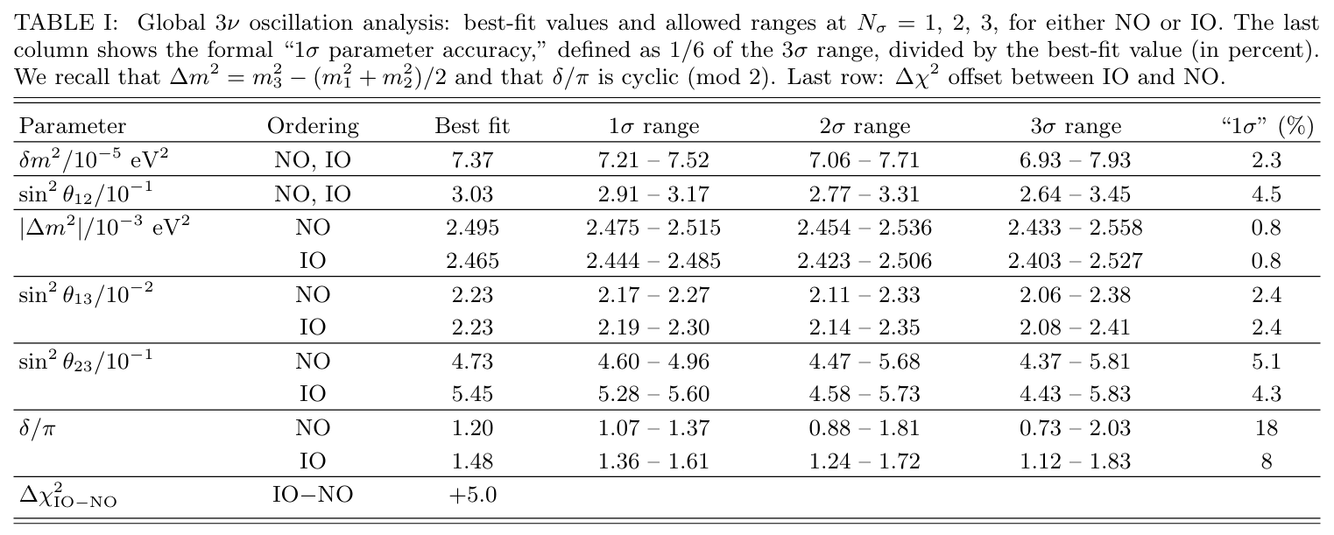
How precisely determined?

Slide 9
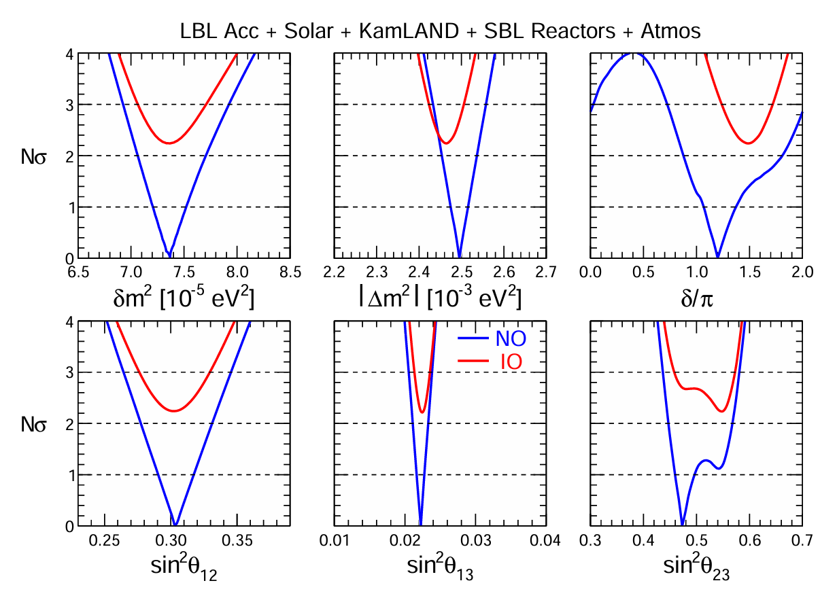

How precisely determined?

Slide 10
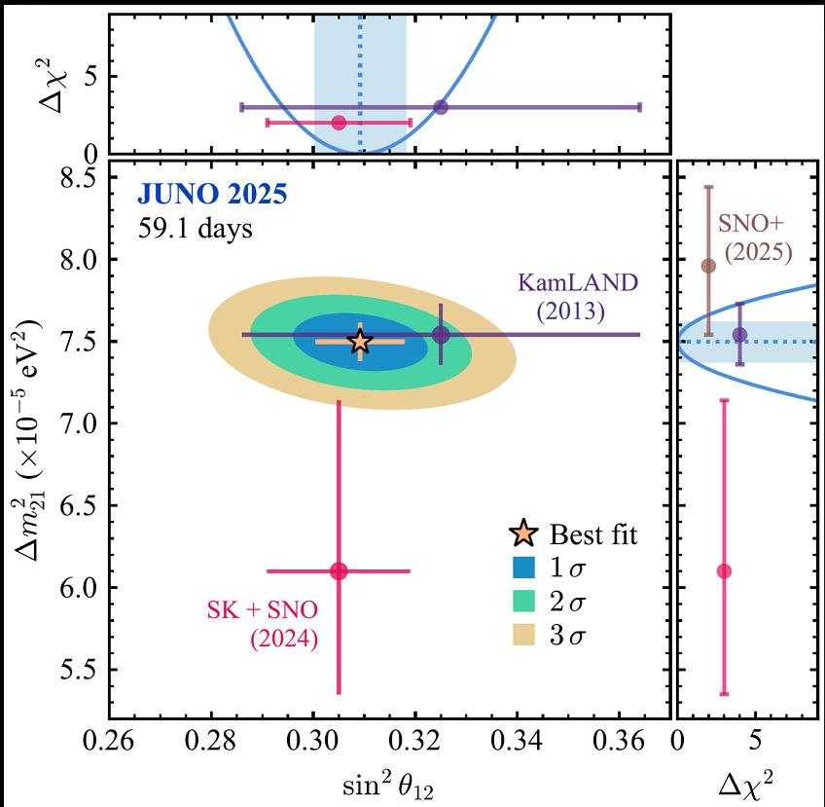
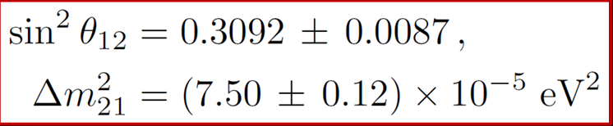
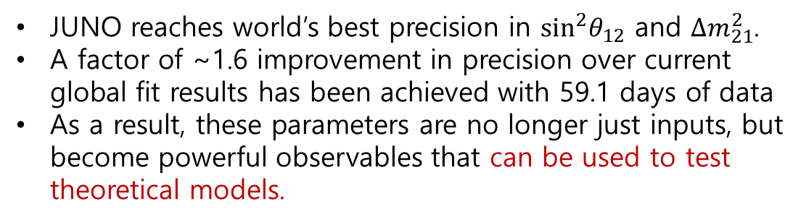
Highlight of the 1st JUNO Results
Oscillation Parameters
JUNO reaches world’s best precision in $\sin^{2}θ_{12}$ and $Δm_{21}^{2}$.
A factor of ~1.6 improvement in precision over current global fit results has been achieved with 59.1 days of data
As a result, these parameters are no longer just inputs, but become powerful observables that can be used to test theoretical models.

Slide 11
Neutrino Physics Enters the Precision Era
Neutrino oscillation parameters are now measured with high precision.
Some parameters are determined at the percent level.
Different experiments provide complementary measurements.
Precision measurements allow us to test the three-flavor picture,
neutrino mass and flavor models, and new physics.
OPEN QUESTIONS
Mass ordering , δ_{CP.}
θ₂₃ octant
Absolute mass
Dirac or Majorana?
….
Notes:
Deck slide 2 (source document: New opening slide (precision era) | 1.5 min)
[한국어 발표자 노트]
중성미자 진동 물리가 발견 단계에서 정밀 측정 단계로 넘어왔음을 대표 수치로 보여 주는 장입니다. 표는 하나의 global fit이 아니라 각 실험의 대표적인 1σ(또는 68% credible) 결과를 모은 것입니다. 질량 분할의 단위는 eV²입니다.
Δm²21과 θ12는 2026년 9월 29일 공개된 JUNO의 최신 207.2일 결과입니다. 원자로 신호로 측정한 solar-sector 매개변수라는 점을 짧게 언급합니다.
Atmospheric splitting도 JUNO와 Daya Bay의 결합으로 약 1% 정밀도에 도달했습니다. 인용한 Δm²31 = +2.509(+0.027/−0.025)×10⁻³ eV²는 NO를 가정한 값이며, Daya Bay 제약으로 올바른 minimum을 선택한 결과입니다(IO에서는 −2.482(+0.025/−0.026)×10⁻³ eV²). 독립적인 T2K–NOvA 공동분석에서도 Δm²32 = 2.43(+0.04/−0.03)×10⁻³ eV², 즉 약 1–2% 정밀도입니다.
θ23에는 octant ambiguity가 남아 있기 때문에 다른 혼합각과 같은 의미로 정밀도를 비교하기 어렵습니다. 표의 5–9%는 비대칭 오차를 중심값으로 나눈 대략적인 크기입니다.
Mass ordering에 대해서는 JUNO가 장기선 결과와 결합하여 NO를 최소 2.1σ(one-sided) 선호하지만, 이를 확정적인 결정으로 표시하지 않는 것이 정확합니다. 오른쪽 Open questions 상자에 질량순서, δCP, θ23 octant, 절대질량, Dirac/Majorana 성질을 남겨 둔 이유입니다.
마무리 문장으로 넘어갑니다. 정밀 측정이 이제 질량·flavor·새 물리에 대한 정밀 검정이 되고 있다는 것이 이 발표 전체의 출발점이며, 다음 장에서 정밀도로 물을 수 있는 네 가지 질문을 제시합니다.
[Source and figure details]
[R01] JUNO Collaboration, Measurement of Neutrino Oscillation Parameters at JUNO and Indication of the Neutrino Mass Ordering, arXiv:2609.37895 (29 Sep 2026). Abstract checked 23 Oct 2026: sin²θ12 = 0.3036 ± 0.0064; Δm²21 = (7.388 ± 0.078)×10⁻⁵ eV²; Δm²31 = +2.509(+0.027/−0.025)×10⁻³ eV² (NO), −2.482(+0.025/−0.026)×10⁻³ eV² (IO); NO preferred at ≥2.1σ one-sided with LBL constraints; Bayes factor 10.18.
[R30] Daya Bay Collaboration, Precision measurement of reactor antineutrino oscillation at kilometer-scale baselines by Daya Bay, PRL 130 (2023) 161802; arXiv:2211.14988 — final nGd analysis, sin²2θ13 = 0.0851 ± 0.0024.
[R02] T2K and NOvA Collaborations, Joint neutrino oscillation analysis from the T2K and NOvA experiments, Nature 646 (2025) 818; arXiv:2510.19888 — sin²θ23 = 0.56(+0.03/−0.05); Δm²32 = 2.43(+0.04/−0.03)×10⁻³ eV² (NO).

Slide 12
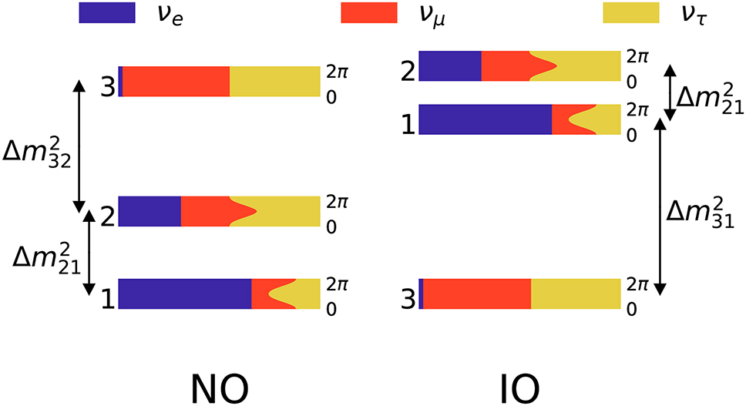
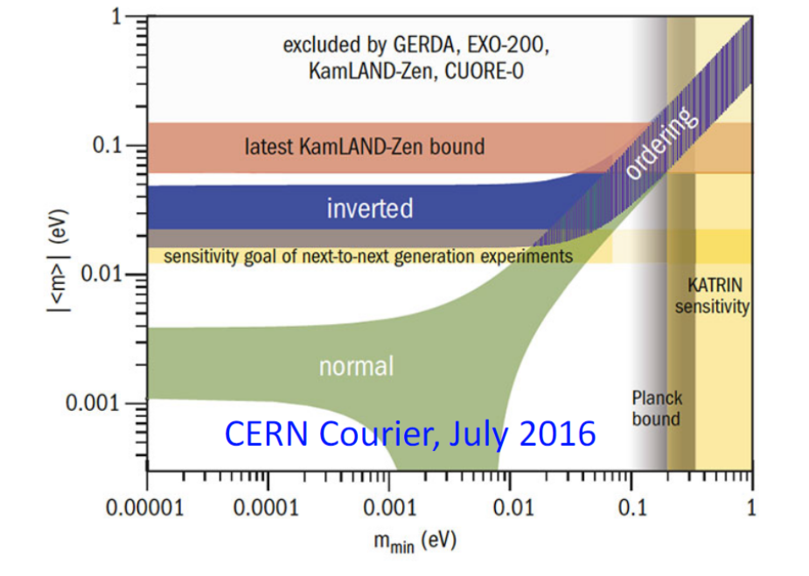

Remark on Neutrino Mass Ordering
Why is MO important ?
It can settle the neutrino mass matrix, a key input for the theory of neutrino mass and mixing.
It is a vital ingredient for measuring CPV: the matter effect in LBL experiments mimics or hides a CP asymmetry
It is a vital ingredient for 0νββ: for IO, |m_{ββ}| ≳ 0.015 eV is within reach of next-generation searches.
$∆m_{21}^{2}$=$m_{2}^{2}−m_{1}^{2}>0 (solar experiments)$
How can it be determined?
Matter effects: LBL beams, atmospheric and supernova ν
Vacuum interference: Fine oscillation patterns in reactor antineutrino spectra (JUNO).
Precision Δm²: Consistency between reactor and accelerator measurements
Cosmology: Σm_{ν} < 0.1 eV would disfavor IO

Slide 13
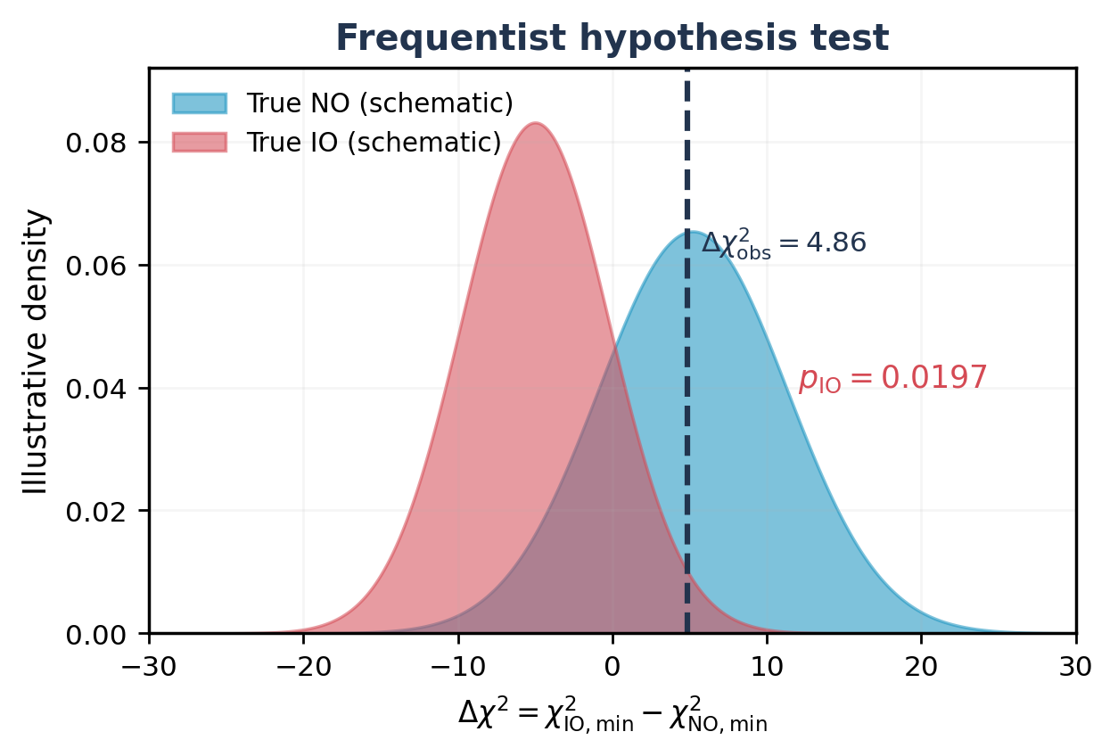
Precision Splittings Begin to Favor Normal Ordering
JUNO first results, 207.2-day analysis (arXiv:2609.37895)
JUNO + Daya Bay
Daya Bay resolves competing local minima in the JUNO fit; with this reactor constraint alone, both orderings fit almost equally well.
Δχ²(IO − NO) = 0.05
+ Long-baseline information
Reactor and accelerator Δm²₃₁ agree better for NO, so the NuFIT LBL Δm² constraint raises the difference.
Δχ²(IO − NO) = 4.86
How significant?
Frequentist: p(IO) = 0.0197 → 2.1σ
Bayesian: Bayes factor = 10.18 for NO
Test-statistic distributions for true NO / true IO are schematic; Δχ²_{obs} and p_{IO} are official (Fig. 8).
Precision Δm² already gives a ~2σ preference for normal ordering, not yet decisive.
Notes:
ENGLISH SPEAKER NOTES
The new 207.2-day JUNO dataset provides about 1% precision in the atmospheric mass-squared splitting. The Daya Bay constraint chooses the physically relevant local minimum. The red JUNO-plus-Daya-Bay result is nearly neutral about ordering: the difference in chi-square is only 0.05. A NuFIT long-baseline disappearance constraint on the atmospheric mass splitting is then introduced, and this changes the ordering difference to 4.86. Importantly, the curves in this slide are an illustrative redrawing of published Figure 7, not an extraction of the official likelihood points.
한국어 발표자 메모
JUNO의 대기 질량제곱차 정밀도는 약 1%입니다. Daya Bay 제약은 여러 local minima 가운데 물리적으로 적절한 해를 고르는 역할을 합니다. JUNO+Daya Bay만으로는 NO와 IO 차이가 0.05로 거의 없습니다. 장기선 제약을 넣으면 Δχ²가 4.86이 됩니다. 곡선은 논문 Fig.7을 설명하기 위한 개념적 재구성이며 수치 최소값은 공식 결과입니다.

Slide 14
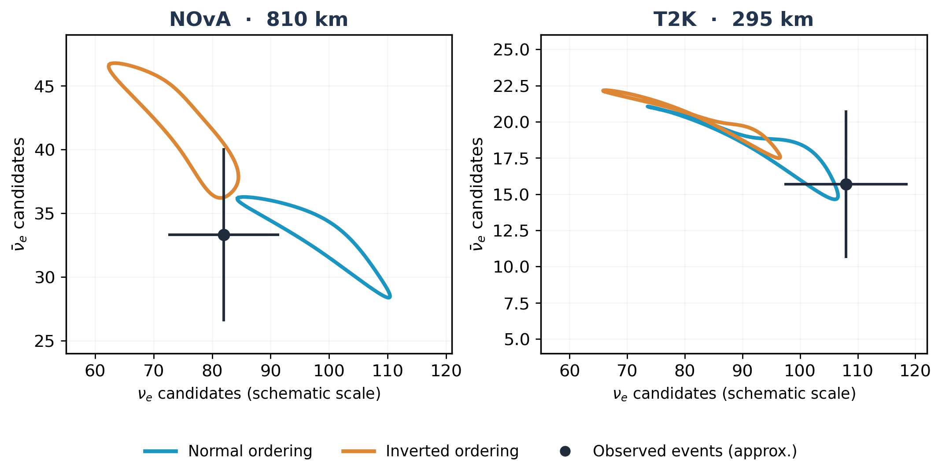
T2K + NOvA: Is the Ordering Still Ambiguous?
(First official joint oscillation analysis, Nature 646 (2025))
NOvA (810 km): larger matter effect
NO and IO predictions are well separated, but the observed rates lie where the predictions overlap.
T2K (295 km): complementary CP
Smaller matter effect; favors negative δ_{CP}, little power on the ordering.
Bayes factor (IO/NO) = 1.3
(standard reactor θ₁₃ prior)
No significant preference for either ordering from the beams alone
Notes:
ENGLISH SPEAKER NOTES
The official Nature Figure 1 is a bi-event plot: total observed and predicted neutrino-versus-antineutrino electron appearance counts. The model predictions trace paths as delta_CP varies, with different paths for normal and inverted ordering. NOvA has a larger matter effect and hence greater separation between the two alternatives, but the data fall near the overlap. T2K provides different sensitivity, especially to delta_CP. The official joint analysis reports a Bayes factor only 1.3 favoring inverted ordering with the reactor theta_13 constraint, which is not significant. This slide uses a visual retracing of the original figure, not the exact published plot coordinates.
한국어 발표자 메모
Nature 2025의 Fig.1에서 파랑은 NO, 주황은 IO, 검은 점은 측정입니다. NOvA에서는 두 예측 곡선이 더 분리되지만 실제 측정점은 중첩 영역 부근입니다. T2K는 물질효과가 작고 CP phase에 대한 보완정보를 줍니다. 결합 결과의 Bayes factor IO/NO=1.3은 결정적이지 않습니다. 그림은 원도표의 주요 구조를 따라 다시 그린 것으로 정확한 사건수 입력이 아닙니다.

Slide 15
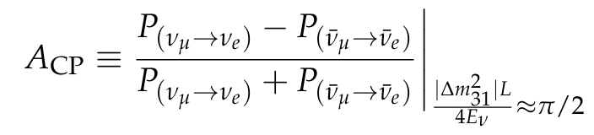
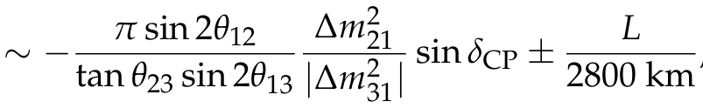
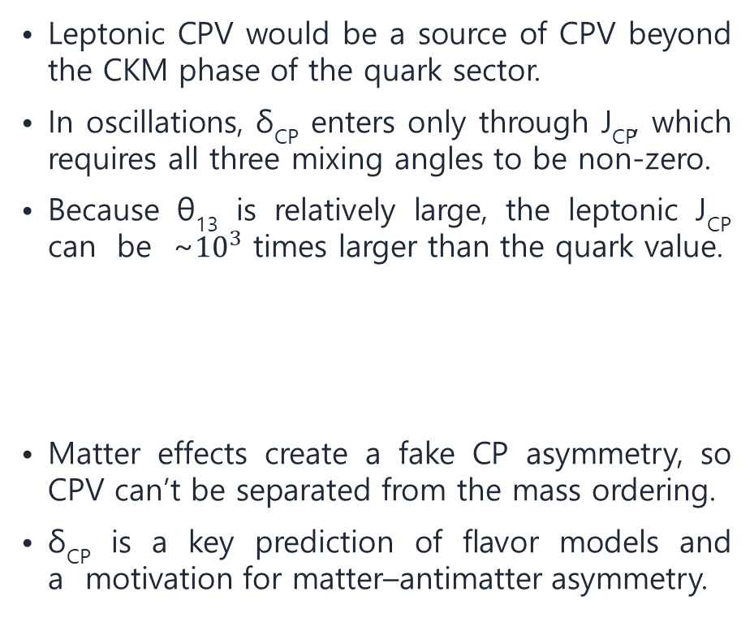
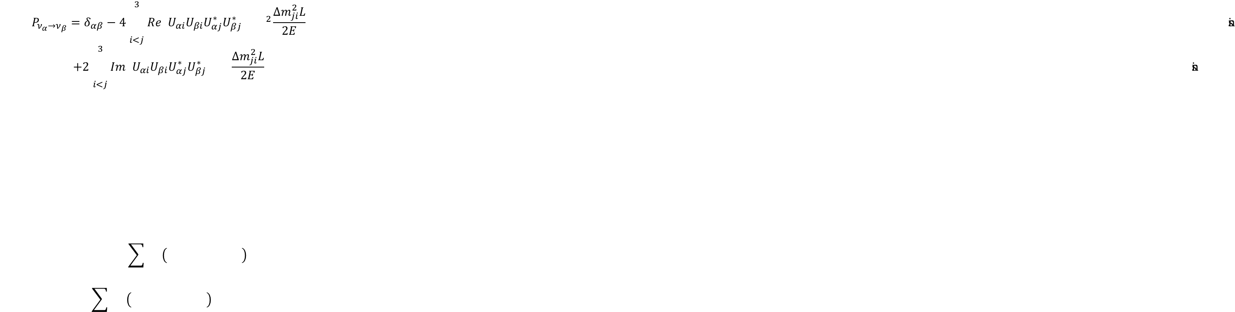
Why Leptonic CP Violation Matters
Leptonic CPV would be a source of CPV beyond the CKM phase of the quark sector.
In oscillations, δ_{CP} enters only through J_{CP}, which requires all three mixing angles to be non-zero.
Because θ₁₃ is relatively large, the leptonic J_{CP} can be ~${10}^{3}$ times larger than the quark value.
Matter effects create a fake CP asymmetry, so CPV can’t be separated from the mass ordering.
δ_{CP} is a key prediction of flavor models and a motivation for matter–antimatter asymmetry.
$$P_{ν_{α}→ν_{β}}=δ_{αβ}−4\sum_{i<j}^{3}{Re\left(U_{αi}U_{βi}U_{αj}^{∗}U_{βj}^{∗}\right)}\sin^{2}{\frac{Δm_{ji}^{2}L}{2E}}$$
$$+2\sum_{i<j}^{3}{Im\left(U_{αi}U_{βi}U_{αj}^{∗}U_{βj}^{∗}\right)}\sin{\frac{Δm_{ji}^{2}L}{2E}}$$
Leptons (current angles, |sin δ| = 1) | J^{max} ≈ 0.033
Quarks (CKM) | J ≈ 3 × 10⁻⁵
Leptonic CP violation could be large, but it must be disentangled from matter effects and the ordering.
Sources: [R01] JUNO Collab., arXiv:2609.37895 · [R30] Daya Bay Collab., PRL 130 (2023) 161802 · [R31] Particle Data Group, PRD 110 (2024) 030001
Notes:
Deck slide 14 (source document: New slide (CP violation 1/3) | 1.5 min)
[한국어 발표자 노트]
질량순서에 이어 남은 또 하나의 축퇴인 CP 위상을 독립 주제로 다룹니다. 먼저 왜 중요한지를 정리합니다. 쿼크 부문의 CKM 위상 이외에 CP 대칭을 깨는 새로운 원천이 될 수 있다는 점이 가장 기본적인 동기입니다.
진동에서 δCP는 Jarlskog 불변량 J_CP를 통해서만 나타나며, 세 혼합각이 모두 0이 아니어야 관측 가능합니다. 현재 혼합각(JUNO θ12, Daya Bay θ13, sin²θ23 ≈ 0.45–0.56)을 넣으면 |sin δ| = 1일 때 J_max ≈ 0.033이며, 이는 이 리뷰에서 계산한 값입니다. 쿼크 부문의 J ≈ 3×10⁻⁵(PDG)보다 약 천 배 큽니다. θ13이 비교적 크기 때문입니다.
가속기 appearance 채널에서 ν와 ν̄의 확률 차이가 진공에서는 J_CP에 비례하지만, 실제 실험에서는 지구 물질효과가 가짜 CP 비대칭을 만듭니다. 그래서 CP 측정은 질량순서 및 물질효과와 분리할 수 없습니다. 다음 장의 결과가 ordering에 따라 달라지는 이유입니다.
이론적으로 δCP는 flavor 모형의 핵심 예측량입니다. 물질–반물질 비대칭과의 연결은 동기로만 한 문장 언급하고, leptogenesis 자체는 발표 범위에서 제외했다고 말합니다.
[Source and figure details]
J_max ≈ 0.033: computed for this review from sin²θ12 = 0.3036 (JUNO, arXiv:2609.37895), sin²2θ13 = 0.0851 (Daya Bay, PRL 130 (2023) 161802), sin²θ23 = 0.45–0.56.
Quark-sector Jarlskog invariant J ≈ 3×10⁻⁵: Particle Data Group, PRD 110 (2024) 030001.

Slide 16
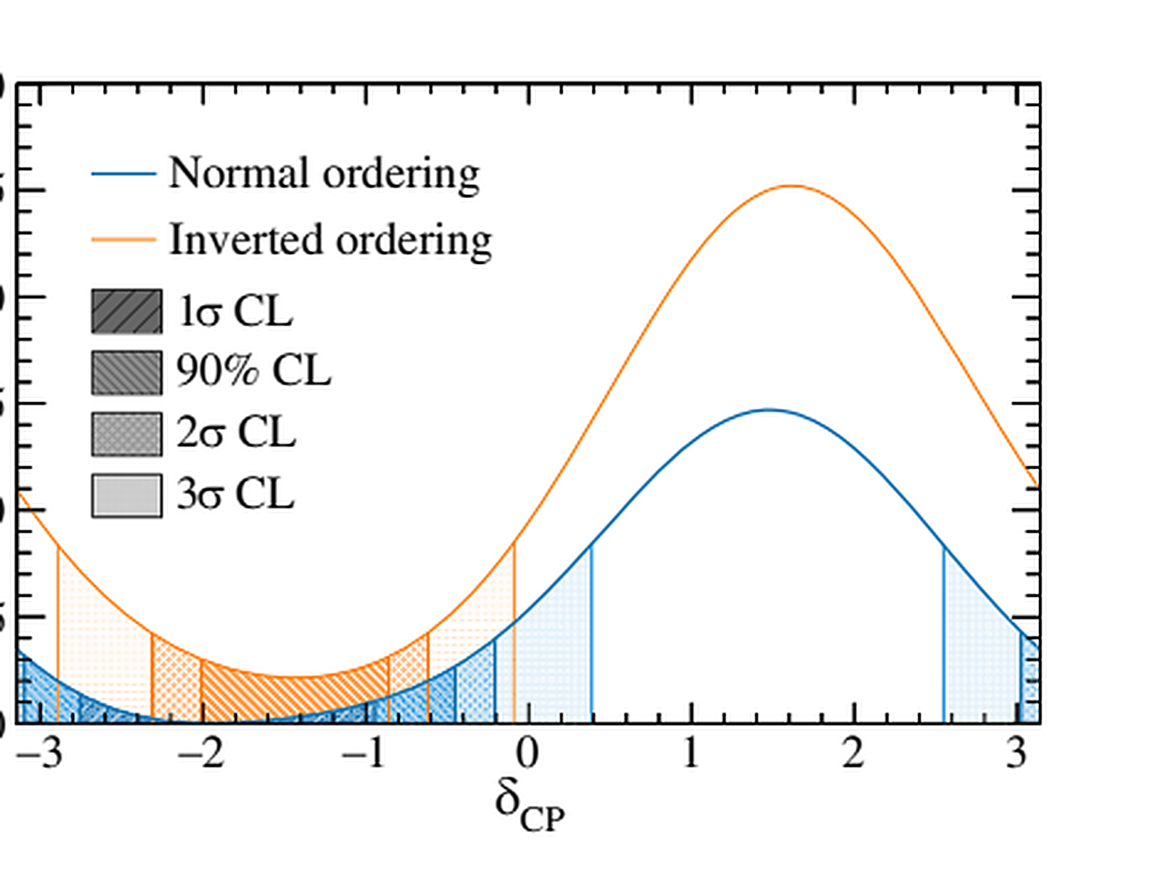
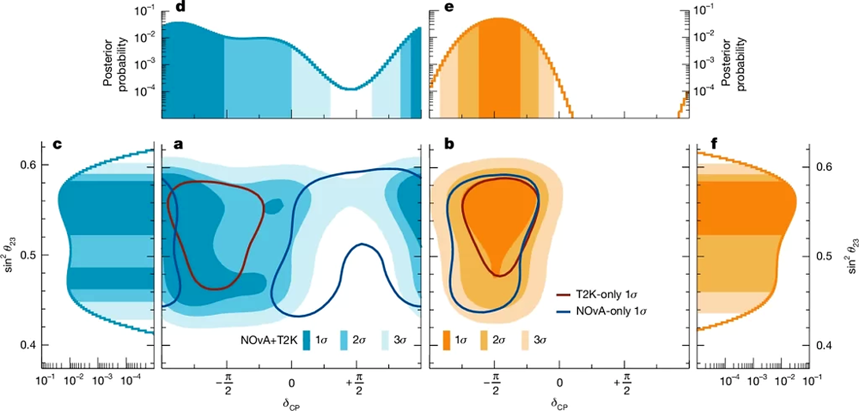
Current CPV Hints Depend on the Mass Ordering
T2K frequentist
T2K + NOvA joint — Bayesian
Phys. Rev. Lett. 135, 261801 (2025), Fig. 4
Nature 646, 818–824 (2025), Fig. 3
NO: best fit near δ_{CP} ≈ −π/2, but CP conservation is not robustly excluded
IO: δ_{CP} = 0 and π excluded at 3σ
2026 update (21.4 × 10²¹ POT, first Gd-loaded SK data):
CP conservation excluded at 90% C.L. (PRL134,2025)
No ordering preference (Bayes factor IO/NO = 1.3)
IO: J_{CP} = 0 excluded at 3σ; NO: CP conservation allowed
T2K + SK joint fit: J_{CP} = 0 excluded at 1.9σ
No ordering-independent evidence of leptonic CP violation has yet been established.
Notes:
ENGLISH SPEAKER NOTES
The left image is the original T2K frequentist delta-CP profile published in Physical Review Letters 135, 261801. For normal ordering, the analysis excludes delta=0 at 90% confidence, but delta=pi is not robustly excluded after systematic robustness tests. Hence, CP violation is not established in normal ordering. For inverted ordering, both CP-conserving values are excluded at three sigma within the T2K analysis.
The right image is Fig. 3 from the official 2025 T2K–NOvA Nature joint paper, showing the broad NO solution and narrow IO solution in delta CP and theta23. The paper's separate Fig. 4 shows that J_CP=0 is excluded by a three-sigma Bayesian credible interval for IO only, under either prior tested. The joint fit does not strongly determine the mass ordering. These individual and joint results are different data combinations and should not be added as independent significance levels. The 2026 NOvA standalone publication is a distinct analysis and is not automatically included in the 2025 Nature combination.
한국어 발표자 메모
왼쪽은 T2K 2025 PRL 공식 Fig.4, 오른쪽은 Nature 2025 공동분석 공식 Fig.3입니다. Nature Fig.4의 Jcp=0 배제는 IO를 가정할 때에만 성립합니다. T2K 단독과 T2K+NOvA 공동 likelihood는 서로 다른 분석입니다. NO에서는 CP 보존을 확정적으로 배제하지 못한다는 점을 강조합니다.

Slide 17
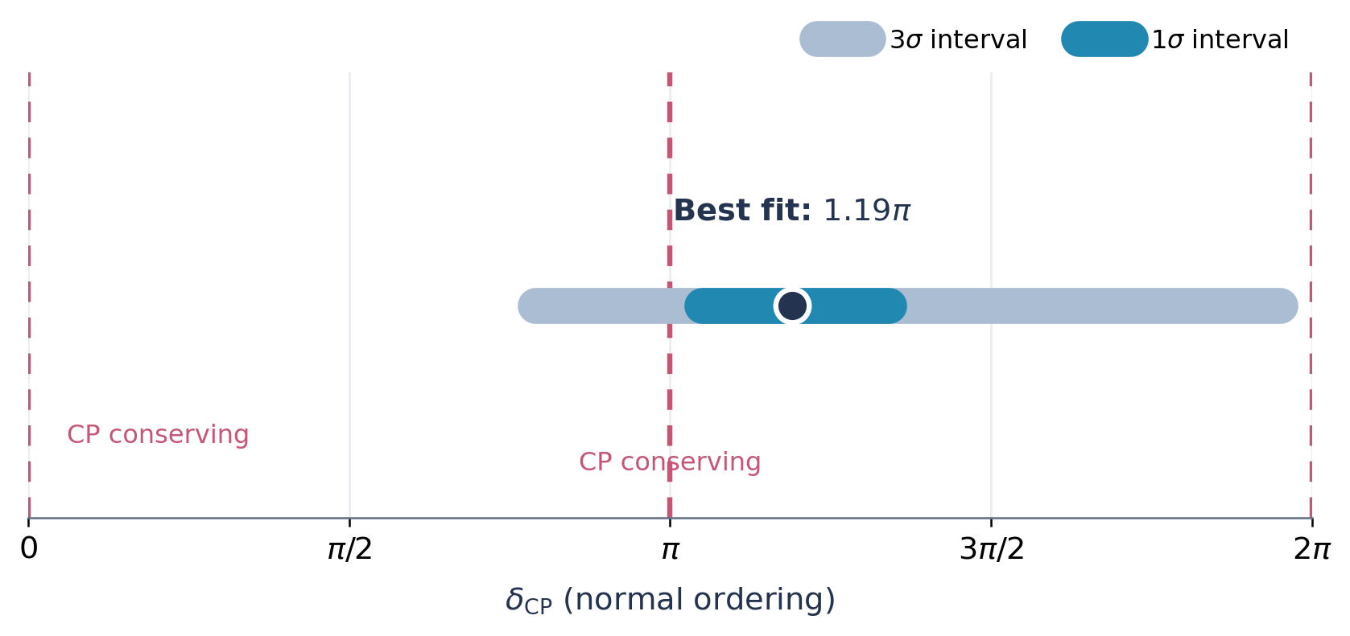
Global Fits: CP Conservation Remains Allowed
Bari global fit, Release 2026.a (preliminary) — allowed δ_{CP} range
Normal ordering; LBL + solar + reactors + atmosphere
Best fit: δ_{CP}/π = 1.19
3σ range [0.79, 1.95]
CP conservation requires δ_{CP} = 0 or π (J_{CP} = 0):
δ_{CP} = 0: disfavored at 3.2σ
δ_{CP} = π: only 1.4σ — still fits reasonably well
Numbers are Bari 2026.a; NuFIT 6.1 publishes its own Δχ²(J_{CP}) profiles for NO and IO.
A CP-violating best fit is not a discovery: both CP-conserving values must be excluded.
Bari global fit Release 2026.a, global-nu.org/results.html (15 Oct. 2026; preliminary, not peer-reviewed) · 6.1 (data through Nov. 2025), nu-fit.org/node/309
Notes:
ENGLISH SPEAKER NOTES
This slide separates a published global analysis (NuFIT 6.1, data through November 2025) from the more recent Bari 2026.a preliminary release of 15 October 2026. The official NuFIT 6.1 Jarlskog profile can be accessed via the reference URL https://www.nu-fit.org/sites/default/files/v61.fig-chisq-viola.jpg. The figures actually embedded in this slide are original, editable visualizations of the numerical Bari 2026.a values; they are NOT extracted NuFIT likelihood plots. The Bari normal-ordering best fit is delta/pi=1.19 with one-sigma approximately 1.05–1.34 and three-sigma approximately 0.79–1.95. The same preliminary profile reports Delta chi-square values of 10.48 at delta=0 and 1.90 at delta=pi relative to the unconstrained best fit. The nominal square-root values of 3.2 and 1.4 sigma apply to the separate values of delta; they are NOT an independently calibrated discovery significance. We must test the composite CP-conserving hypothesis allowing either point and account for the ordering, nuisance parameters and statistical conventions. NuFIT and Bari are not identical combinations of data and must not be merged naively. No conclusive CP-violation discovery has been established.
한국어 발표자 메모
NuFIT6.1(2025)은 공개 global fit이고, Bari 2026.a는 논문 작성 중인 preliminary입니다. 이 슬라이드 그래프는 Bari 공식 홈페이지의 수치를 재시각화한 것이며 NuFIT likelihood 원본이라고 표기하지 않았습니다. δ=0의 3.2시그마와 δ=π의 1.4시그마를 구분하고, CP 보존 두 가능성 모두 배제해야 CPV 발견이라고 말할 수 있음을 강조합니다. Bayesian credible interval과 frequentist significance를 혼용하지 않습니다.

Slide 18
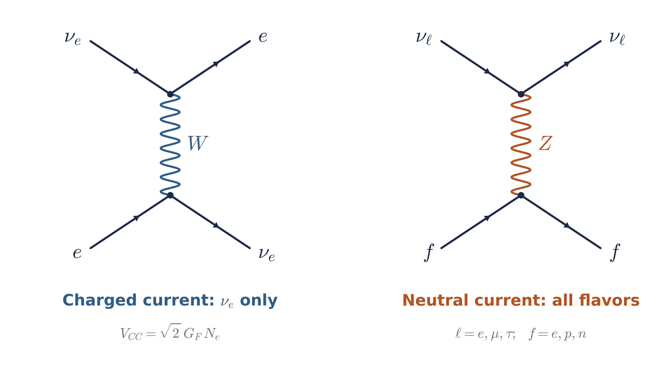
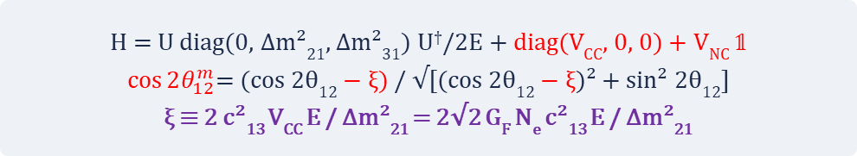
Matter Effects: Coherent Forward Scattering
Theory background | Wolfenstein (1978); Mikheyev–Smirnov (1985)
In matter, neutrinos undergo coherent forward scattering on electrons, protons, and neutrons, which gives them a flavor-dependent effective potential.
Only ν_{e} has charged-current (W-exchange) scattering on electrons: V_{CC} = √2 G_{F} N_{e}.
Neutral-current (Z-exchange) scattering is identical for all active flavors (V_{NC} = −G_{F} N_{n}/√2 in neutral matter): a common phase, relevant only for sterile neutrinos or NSI.
In the solar (1,2) sector, V_{CC} rotates the mixing angle; the MSW resonance occurs at ξ = cos 2θ₁₂.
- Left: W exchange with electrons, felt only by ν_{e}.
- Right: Z exchange with f = e, p, n, identical for all active flavors;
in neutral matter the e and p contributions cancel.
H = U diag(0, Δm²₂₁, Δm²₃₁) U†/2E + diag(V_{CC}, 0, 0) + V_{NC} 𝟙
$\cos{2θ_{12}^{m}}$= (cos 2θ₁₂ − ξ) / √[(cos 2θ₁₂ − ξ)² + sin² 2θ₁₂]
ξ ≡ 2 c²₁₃ V_{CC} E / Δm²₂₁ = 2√2 G_{F} N_{e} c²₁₃ E / Δm²₂₁
Notes:
Deck slide 5 (source document: Matter-effect basics | 1.5 min)
[Speaker notes (English)]
In matter, neutrinos undergo coherent forward scattering, which acts like a flavor-dependent refractive index. Only electron neutrinos have charged-current, W-exchange scattering on electrons, giving the potential root-two G_F N_e. Neutral-current, Z-exchange scattering on electrons, protons and neutrons is identical for all three active flavors; in neutral matter the electron and proton contributions cancel and only the neutron term remains. Because it is common to all active flavors, it is a phase proportional to the identity and does not affect oscillations among them; it matters only for sterile neutrinos or non-standard interactions. The energy-dependent charged-current term modifies the effective mixing and can produce a resonance, the MSW effect.
[한국어 발표자 노트]
물질효과의 기본 원리를 정리합니다. 진동에 영향을 주는 것은 운동량 전달이 없는 간섭성 전방 산란이며, 그 효과는 굴절률처럼 flavor에 따라 다른 유효 potential로 나타납니다. 비간섭성 산란의 단면적은 매우 작아 무관합니다.
왼쪽 도표: 전자와의 W 교환(전하 전류)은 νe만 겪으며 V_CC = √2 G_F N_e를 줍니다. 오른쪽 도표: 전자·양성자·중성자와의 Z 교환(중성 전류)은 세 활성 flavor에 똑같이 작용합니다. 전기적으로 중성인 물질에서는 전자와 양성자의 NC 기여가 상쇄되고 V_NC = −G_F N_n/√2만 남습니다.
V_NC는 해밀토니안의 단위행렬 항이므로 활성 중성미자 사이의 진동에는 영향을 주지 않습니다. sterile 중성미자가 있거나 flavor에 의존하는 NSI가 있을 때만 의미가 있습니다. 따라서 MSW 효과를 만드는 것은 νe의 CC 항뿐입니다.
'유효 질량'이라는 표현은 직관적 설명입니다. 질량행렬에 대응시키면 A = 2√2 G_F N_e E만큼 질량제곱이 바뀐 것처럼 작용하지만 에너지에 의존합니다. 물질 potential은 Wolfenstein(1978)이, 공명 증폭은 Mikheyev–Smirnov(1985)가 제안했습니다.
아래 수식 상자의 둘째·셋째 줄이 다음 장과의 연결 고리입니다. 태양의 (1,2) sector에서 V_CC는 혼합각을 cos 2θ12^m으로 바꾸고, ξ = 2c13² V_CC E/Δm²21이 cos 2θ12와 같아지는 곳이 MSW 공명입니다. 다음 장에서 이 각을 이용해 생존확률 P_ee와 그 저에너지·고에너지 극한을 보입니다.
[Source and figure details]
[R56] L. Wolfenstein, PRD 17 (1978) 2369. [R57] S. P. Mikheyev, A. Yu. Smirnov, Sov. J. Nucl. Phys. 42 (1985) 913.
Figure: Feynman diagrams drawn for this presentation (no reuse restrictions).

Slide 19
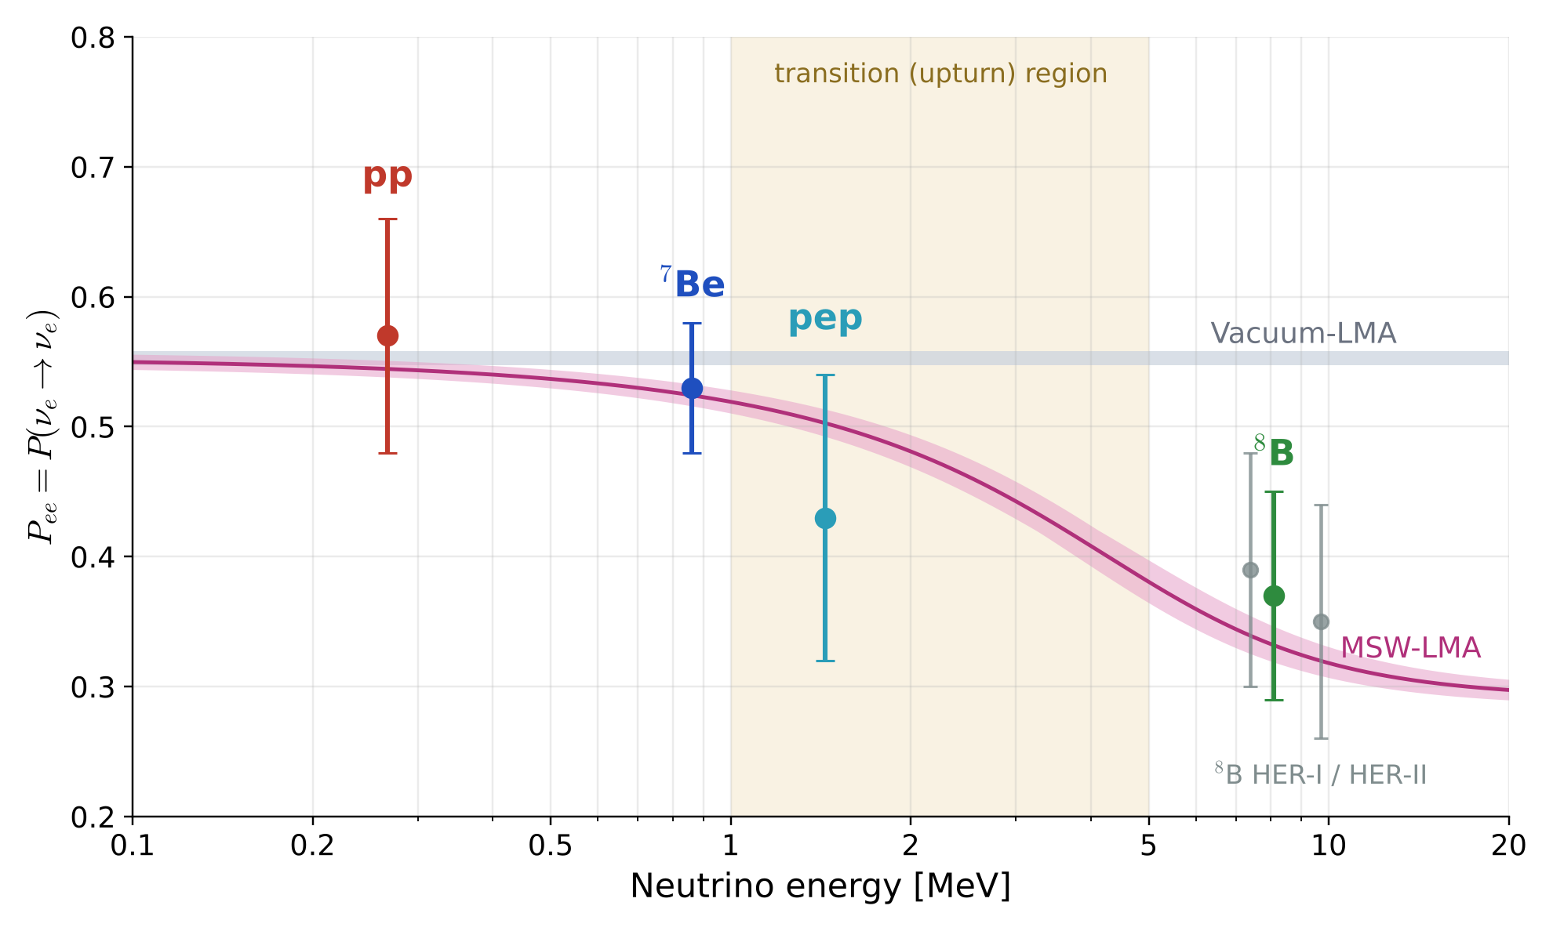
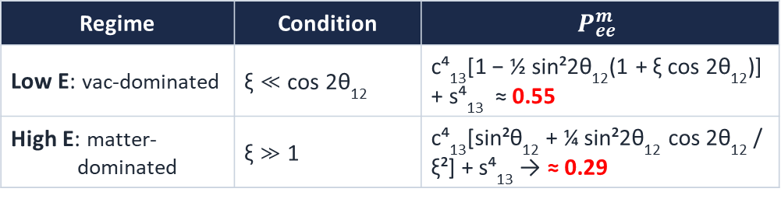

Solar Survival Probability: From Vacuum to Matter
$$P_{ee}^{m}={\frac{c_{13}^{4}}{2}(1+\cos{2θ_{12}\cos{2θ_{12}^{m})+}}s}_{13}^{4}$$
band calculated with JUNO 2026 parameters
ξ = 2√2 G_{F} N_{e} c²₁₃ E / Δm²₂₁
≈ 0.206 A_{MSW} c²₁₃ (E / 1 MeV)(ρY_{e} / 100 g cm⁻³)
Regime | Condition | $$P_{ee}^{m}$$
Low E: vac-dominated | ξ ≪ cos 2θ₁₂ | c⁴₁₃[1 − ½ sin²2θ₁₂(1 + ξ cos 2θ₁₂)] + s⁴₁₃ ≈ 0.55
High E: matter- dominated | ξ ≫ 1 | c⁴₁₃[sin²θ₁₂ + ¼ sin²2θ₁₂ cos 2θ₁₂ / ξ²] + s⁴₁₃ → ≈ 0.29
Upturn status: fitting P_{ee}(E) with exponential, quadratic, or cubic forms, SK favors a distorted (upturn) spectrum over a flat one at 1.2σ; with SNO, 2.1σ (SK-IV, PRD 109 (2024) 092001; arXiv:2512.19887).
Calculated for this presentation: MSW-LMA band with JUNO 2026 sin²θ₁₂ and Δm²₂₁ (±1σ), Daya Bay θ₁₃, ρY_{e} = 85–105 g cm⁻³; gray band, vacuum-LMA. Points: Borexino Phase II (HZ-SSM), Nature 562 (2018) 505.
With reactor-fixed parameters the MSW curve has no free parameters; the 1–5 MeV region tests the size of the matter potential.
Sources: [R52] Borexino Collab., Nature 562 (2018) 505 · [R07] Super-K Collab., PRD 109 (2024) 092001 · [R38] Super-K Collab., arXiv:2512.19887 · [R01] JUNO Collab., arXiv:2609.37895 · [R30] Daya Bay Collab., PRL 130 (2023) 161802
Notes:
Deck slide 6 (source document: MSW survival probability | 2 min)
[Speaker notes (English)]
Applying the matter mixing angle to solar neutrinos: an electron neutrino produced at the solar core with the matter angle theta-twelve-m leaves the Sun adiabatically, and the phases average over the Sun–Earth distance. The day-time survival probability is then c13 to the fourth times one half of one plus cos 2 theta-12 times cos 2 theta-12-m, plus s13 to the fourth. The parameter xi compares the matter potential with the vacuum term. For xi much smaller than cos 2 theta-12, at low energy, we recover the vacuum average, about 0.55, with a small linear correction. For xi much larger than one, at high energy, P_ee approaches sin-squared theta-12, about 0.29. The resonance at the production point is near 2 MeV. The band on the right uses the 2026 JUNO parameters and is now very narrow, so the MSW curve has essentially no free parameters. The Borexino points confirm both limits, but the transition region between 1 and 5 MeV, the upturn, is still poorly measured: fitting the energy dependence of P_ee with exponential, quadratic or cubic forms, Super-K favors a distorted spectrum over a flat one at only 1.2 sigma, and 2.1 sigma together with SNO. Fitting a scale factor A_MSW on the matter potential tests whether it has the Standard Model size.
[한국어 발표자 노트]
앞 장의 물질 속 혼합각을 태양 중성미자에 적용한 결과입니다. 생성 지점에서 cos 2θ12^m으로 생성된 νe가 단열적으로 태양을 빠져나오고, 태양–지구 거리에서 위상이 평균되므로 낮 시간 생존확률은 P_ee = c13⁴ · ½(1 + cos 2θ12 cos 2θ12^m) + s13⁴가 됩니다. D는 밤의 지구 재생효과를 넣지 않았다는 뜻입니다.
ξ는 진동 길이와 굴절 길이의 비입니다. ρY_e ≈ 100 g/cm³인 태양 중심에서 ξ = cos 2θ12 ≈ 0.39가 되는 공명 에너지는 약 2 MeV입니다. ξ ≪ cos 2θ12인 저에너지에서는 진공 평균값 약 0.55에서 ξ에 비례해 조금 내려가고, ξ ≫ 1인 고에너지에서는 sin²θ12에 1/ξ² 보정이 붙어 약 0.29로 수렴합니다. 두 극한식은 cos 2θ12^m을 ξ의 1차, 1/ξ의 2차까지 전개해 얻습니다.
A_MSW는 물질 potential의 크기를 곱하는 인자로, 표준모형에서는 1입니다. 태양 데이터로 A_MSW를 fit하면 물질 potential이 표준 크기인지 직접 검사할 수 있습니다.
오른쪽 그림은 이 발표를 위해 계산했습니다. JUNO 2026의 sin²θ12와 Δm²21을 ±1σ, Daya Bay θ13, ⁸B 생성 영역의 ρY_e = 85–105 g/cm³ 범위로 계산한 띠입니다. 원자로가 매개변수를 고정했기 때문에 띠가 매우 좁아졌다는 점을 강조합니다. 측정점은 Borexino Phase II의 최종 P_ee(HZ 태양모형 가정)이며, Borexino는 2021년 운영을 마쳤습니다. ⁸B는 Borexino 값이고 회색 점은 HER-I/II의 두 에너지 구간입니다. 1–5 MeV 전이 영역에서는 pep 점 하나 외에 측정이 거의 없다는 점이 upturn 문제의 핵심입니다.
주황 상자: SK는 ⁸B 스펙트럼에서 P_ee(E)를 지수·이차·삼차 함수로 fit하여, 왜곡된(upturn이 있는) 스펙트럼을 평평한 스펙트럼보다 1.2σ 선호합니다. SNO와 결합하면 2.1σ입니다. 즉 MSW가 예측하는 upturn은 아직 약하게만 보였고, 관측된 upturn은 원자로 Δm²21로 예측한 곡선보다 다소 완만한 경향이 있습니다. A_MSW를 fit하면 물질 potential의 크기를 직접 검사할 수 있습니다.
[Source and figure details]
[R52] Borexino Collaboration, Comprehensive measurement of pp-chain solar neutrinos, Nature 562 (2018) 505 — P_ee (HZ-SSM): pp 0.57 ± 0.09 (0.267 MeV), ⁷Be 0.53 ± 0.05 (0.862 MeV), pep 0.43 ± 0.11 (1.44 MeV), ⁸B HER 0.37 ± 0.08 (8.1 MeV); HER-I 0.39 ± 0.09 (7.4 MeV), HER-II 0.35 ± 0.09 (9.7 MeV).
[R01] JUNO, arXiv:2609.37895 — sin²θ12 = 0.3036 ± 0.0064, Δm²21 = (7.388 ± 0.078)×10⁻⁵ eV². [R30] Daya Bay, PRL 130 (2023) 161802 — sin²2θ13 = 0.0851 ± 0.0024.
Figure: calculated for this presentation; adiabatic two-flavor MSW with θ13 factors, constant production density (no radial averaging), no Earth regeneration. Replaces the earlier Borexino-era band (arXiv:2105.13858).
Upturn significance: arXiv:2512.19887 (SK-IV, Measurement of the solar neutrino interaction rate below 3.49 MeV), Sec. I — 'SK favors the existence of an upturn by 1.2σ. Together with SNO, the significance increases to 2.1σ', citing SK-IV full-period paper PRD 109 (2024) 092001 [R07]. Fit forms (exponential, quadratic, cubic) as described in arXiv:2405.07900 (Latest results from Super-Kamiokande). Relevant figures: arXiv:2512.19887 Fig. 12 (P_ee(E) bands), arXiv:2405.07900 Fig. 4 (SK+SNO fitted P_ee).

Slide 20
Where Matter Effects Matter
Environment | What the matter effect determines or tests | Current experimental status (October 2026)
Sun (MeV, Δm²₂₁) | Sign of Δm²₂₁; θ₁₂ < 45°; shape of the MSW transition; standard potential and NSI | SNO CC/NC: P_{ee} ≈ 0.3 at high energy; Borexino pp and ⁷Be: P_{ee} ≈ 0.55 (vacuum-like); upturn favored over a flat spectrum at only ~1.2σ (SK) and ~2.1σ (SK+SNO)
Earth, solar ν (MeV, Δm²₂₁) | Regeneration of ν_{e} at night; Δm²₂₁ probed in matter | SK I–IV: A_{DN} = (−2.86 ± 0.85 ± 0.32)%, evidence at ~3.2σ; solar-only Δm²₂₁ = 6.10 vs. JUNO 7.388 (×10⁻⁵ eV²), a ~1.5σ difference
Earth, atmospheric ν (GeV, Δm²₃₁) | Sign of Δm²₃₁ (ordering); θ₂₃ octant; μ–τ NSI; Earth’s e density | SK: Δχ²(IO−NO) = 5.2; ORCA: no significant preference; combined atmospheric reanalyses ~3σ for NO (not official); DeepCore reanalysis: −0.0094 < ε_{μτ} < 0.0079 (90%)
Long-baseline beams (295–1300 km) | Separating intrinsic CP violation from the matter-induced ν/ν̄ asymmetry; ordering | T2K+NOvA: no strong ordering preference; CP conservation excluded at 3σ only if IO; NOvA NSI: |ε_{eμ}| ≲ 0.3, |ε_{eτ}| ≲ 0.4 (90%)
Supernova (very high density) | Ordering through the ν_{e} neutronization burst; collective ν–ν oscillations | SN 1987A: about two dozen events, no flavor information; awaiting a Galactic supernova (DUNE, Hyper-K, JUNO, IceCube)
Reactor at 52.5 km (reference) | Matter effect small but included at JUNO precision; ordering from vacuum interference | JUNO: Δm²₂₁ to 1.1%, sin²θ₁₂ to 2.1%; NO preferred at ≥ 2.1σ with external Δm²₃₁ constraints
Vacuum oscillations measure magnitudes; matter effects determine signs and test the interaction itself.
Sources: [R53] SNO Collab., PRC 88 (2013) 025501 · [R52] Borexino Collab., Nature 562 (2018) 505 · [R07] Super-K Collab., PRD 109 (2024) 092001 · [R54] Super-K Collab., arXiv:2311.05105 · [R02] T2K & NOvA Collabs., Nature 646 (2025) 818 · [R01] JUNO Collab., arXiv:2609.37895
Notes:
Deck slide 5 (source document: New slide (matter-effect overview) | 2 min)
[Speaker notes (English)]
Before going into details, here is where matter effects matter. Vacuum disappearance measures magnitudes, |Δm²| and sin²2θ; the signs and octants come from matter effects. In the Sun, the MSW effect fixed the sign of Δm²21 and the θ12 octant, while the transition region, the upturn, is still only weakly seen. Crossing the Earth, solar neutrinos show the day–night regeneration at about 3σ. Atmospheric neutrinos crossing the mantle and core experience an MSW resonance for Δm²31 at a few GeV, which carries the ordering information; current combined analyses favor normal ordering at roughly 3σ, but not yet in an official joint result. In long-baseline beams, the matter-induced asymmetry must be separated from intrinsic CP violation, which is why the current CP hint depends on the ordering. A Galactic supernova would add a very high-density environment. JUNO, where matter effects are small, provides the vacuum reference. Every precise matter-effect measurement is also a test of non-standard interactions.
[한국어 발표자 노트]
본론에 들어가기 전에 물질효과가 중요한 다섯 환경과 현재 실험 상황을 한 장으로 정리합니다. 핵심 메시지는 진공 진동은 크기(|Δm²|, sin²2θ)를 재고, 부호와 octant 같은 방향 정보는 물질효과가 준다는 것, 그리고 정밀한 물질효과 측정은 곧 표준 상호작용(√2 G_F N_e)과 NSI의 검사라는 것입니다.
태양: 태양 MSW가 Δm²21 > 0과 θ12 < 45°를 정했습니다. 고에너지 P_ee ≈ 0.3(SNO CC/NC), 저에너지 P_ee ≈ 0.55(Borexino pp, ⁷Be)는 확인되었지만, 그 사이 전이(upturn)는 평평한 모양 대비 약 1.2σ(SK), 2.1σ(SK+SNO)의 약한 선호에 그칩니다. 지구 통과 태양 중성미자: SK day–night 비대칭 약 3.2σ로 지구 물질효과의 증거이며, 그 크기가 solar–reactor Δm²21 차이(약 1.5σ)의 원인입니다.
대기 중성미자: 맨틀과 핵을 통과하며 Δm²31의 MSW 공명이 수 GeV에서 일어나고, ν와 ν̄ 중 어느 쪽이 증폭되는지가 질량순서를 정합니다. SK 단독 Δχ² ≈ 5.2, ORCA는 아직 선호가 없고, 공개자료 결합 재분석은 약 3σ로 NO를 선호합니다(공식 결과 아님). DeepCore 재분석은 ε_μτ를 10⁻² 수준으로 제한합니다.
장기선 빔: 물질이 만드는 가짜 CP 비대칭 때문에 ordering과 δCP가 얽혀 있어, T2K+NOvA는 IO일 때만 CP 보존을 3σ에서 배제합니다. NOvA는 같은 데이터로 ε_eμ, ε_eτ를 제한합니다. 초신성은 극한 밀도의 물질효과와 집단 진동을 보여 줄 수 있지만 SN 1987A의 약 24개 사건으로는 flavor 정보가 없습니다.
마지막 행은 비교 기준입니다. JUNO는 물질효과가 작아 진공 매개변수의 기준점이 되며, 질량순서 정보는 진공 간섭에서 옵니다. 다만 이 방법도 태양 MSW가 정한 Δm²21의 부호를 전제로 합니다. 이후 Part 1–3이 이 표의 행들을 차례로 자세히 다룹니다.
[Source and figure details]
[R53] SNO, PRC 88 (2013) 025501 (CC/NC). [R52] Borexino, Nature 562 (2018) 505 (pp, ⁷Be, pep, ⁸B P_ee). [R07] SK-IV solar, PRD 109 (2024) 092001 (day–night, spectrum).
[R54] SK I–V atmospheric, arXiv:2311.05105 — Δχ²(IO−NO) = 5.23 (MC expectation 1.53). [R55] KM3NeT/ORCA 715 kt·y, PoS(ICRC2025)1092 — no significant ordering preference (Bayes factor 1.18 for IO). [R13] Jin et al., arXiv:2610.12208 — independent combined atmospheric reanalysis.
[R16] Krishnamoorthi et al., PRD 114 (2026) 075009. [R02] T2K+NOvA, Nature 646 (2025) 818. [R43] NOvA NSI, PRL 133 (2024) 201802. [R01] JUNO, arXiv:2609.37895.
SN 1987A: about two dozen events in Kamiokande-II, IMB and Baksan (standard historical count).

Slide 21
Theory Meets Experiment: Testable Predictions
Why is lepton mixing so different from quark mixing?
Flavor symmetry: what it predicts for θ₁₂, θ₂₃ and δ_{CP}
How precise oscillation experiments can test these predictions
New physics in neutrino oscillation

Slide 22
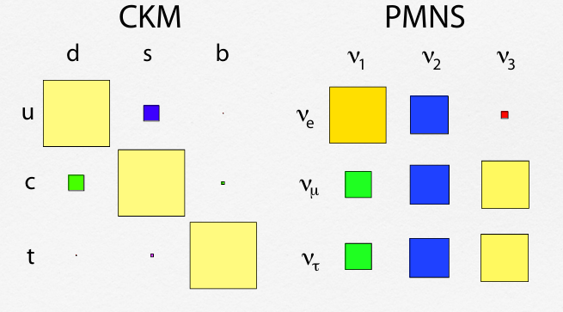
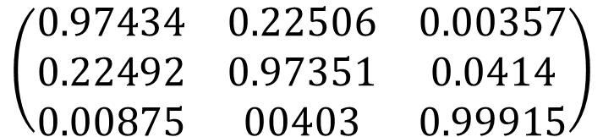
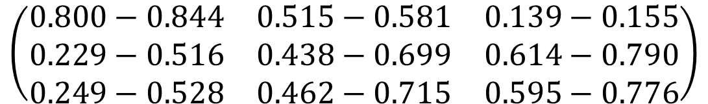


Lepton Mixing Is Very Different from Quark Mixing
Magnitudes of mixing-matrix elements from 3ν global fits
$$\left(\begin{matrix}0.800−0.844 & 0.515−0.581 & 0.139−0.155 \\ 0.229−0.516 & 0.438−0.699 & 0.614−0.790 \\ 0.249−0.528 & 0.462−0.715 & 0.595−0.776\end{matrix}\right)$$
${|U}_{PMNS}|$=
$$\left(\begin{matrix}0.97434 & 0.22506 & 0.00357 \\ 0.22492 & 0.97351 & 0.0414 \\ 0.00875 & 00403 & 0.99915\end{matrix}\right)$$
$${|V}_{CKM}|=$$
PDG(2016)

Slide 23

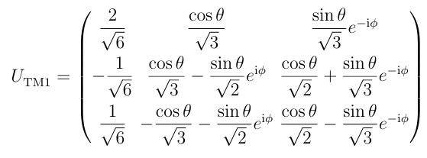
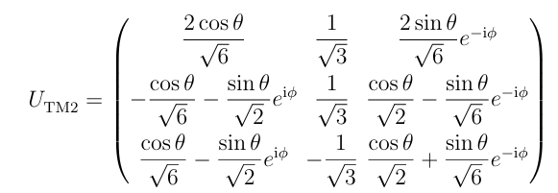
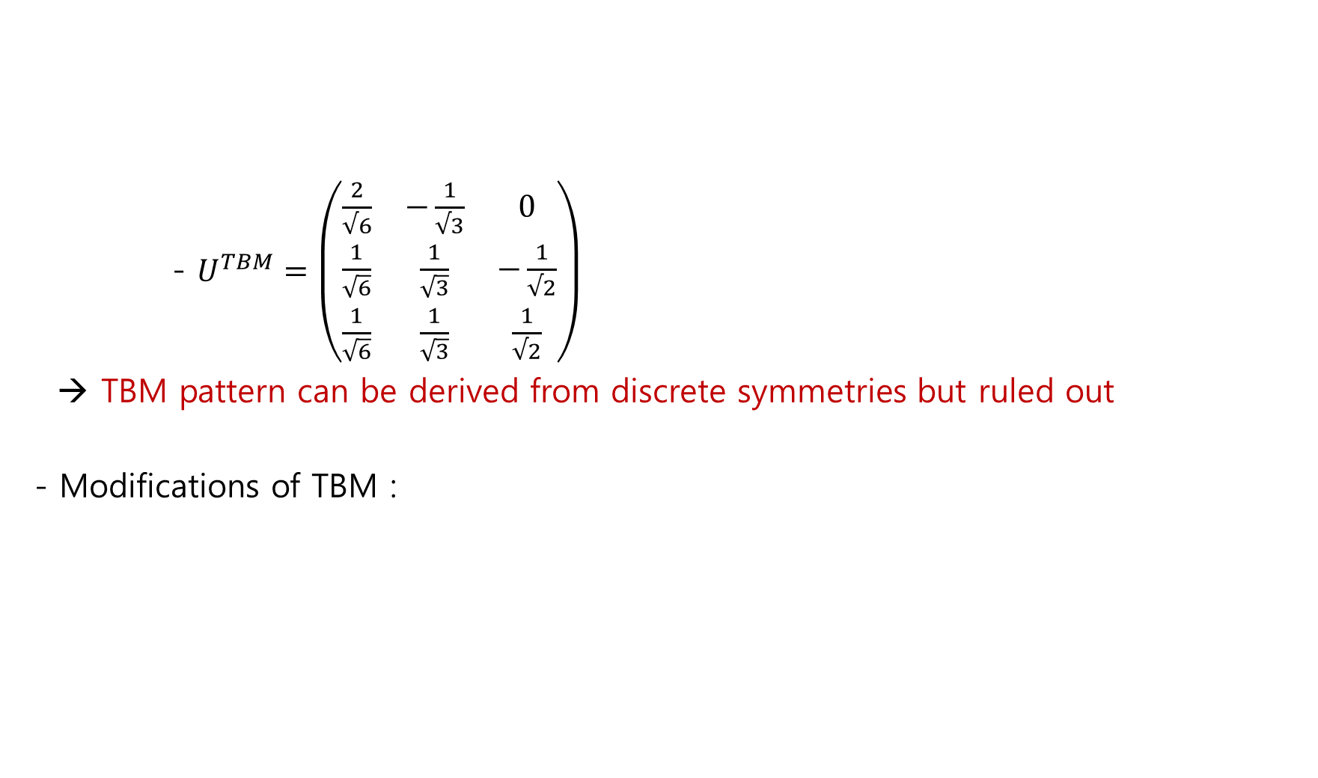
- $U^{TBM}=\left(\begin{matrix}\frac{2}{√6} & −\frac{1}{√3} & 0 \\ \frac{1}{\sqrt{6}} & \frac{1}{\sqrt{3}} & −\frac{1}{√2} \\ \frac{1}{\sqrt{6}} & \frac{1}{\sqrt{3}} & \frac{1}{√2}\end{matrix}\right)$
→ TBM pattern can be derived from discrete symmetries but ruled out
- Modifications of TBM :
Tri-bimaximal Mixing: A Hint of Discrete Symmetry
Before measuring $θ$_{13 ,} tri-bimaximal mixing (TBM) hypothesis :
Harrison & Perkins & Scott (2002)

Slide 24
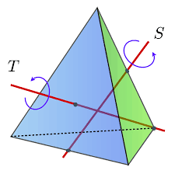
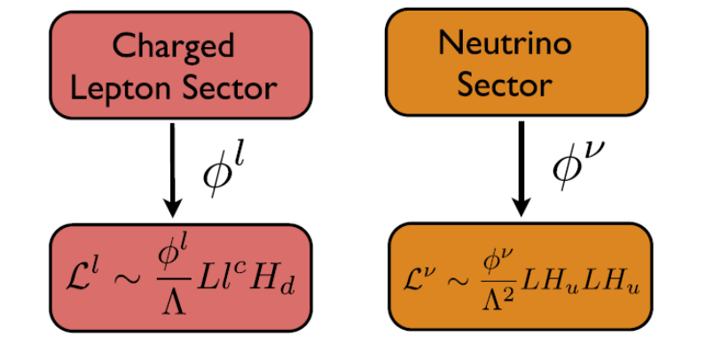

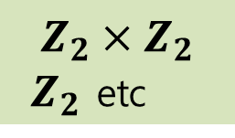
A₄ has subgroups: three Z₂, four Z₃, one Z₂×Z₂
A₄ is spontaneously broken to subgroups:
i) Neutrino sector preserves Z_{2,} Z₂×Z_{2…}
ii) Charged lepton sector preserves Z₃
Origin of Mixing Patterns: Residual Discrete Symmetries
G(A₄)
$$Z_{2}×Z_{2}$$
$Z_{2}$ etc
$Z_{3}$
(arXiv: 1402.4271 King, Merle, Morisi, Simizu, Tanimoto)

Slide 25

JUNO θ₁₂ Already Tests Flavor-Symmetry Predictions
There exist correlations between the angles :
JUNO vs. symmetry predictions
A₅
TM₁
TM₂
JUNO
TBM
JUNO 207.2 days (prelim.): sin²θ₁₂ = 0.3036 ± 0.0064
Pattern | sin²θ₁₂ | vs JUNO
TM₁ (1st TBM column) | 0.318 | ≈ 2.2σ
TBM | 1/3 | 4.6σ (and θ₁₃ ≠ 0)
TM₂ (|U_e2|² = 1/3) | 0.341 | ≈ 5.8σ
Some modular A₅ cases | ≈ 0.269 | outside 3σ
0.26
0.28
0.30
0.32
0.34
0.36
sin²θ₁₂
Bands: JUNO 207.2 d (prelim.) 0.3036 ± 0.0064, 1σ and 3σ.
Dashed: predictions with θ₁₃ from Daya Bay.
Sin²2θ₁₃ | 0.0851 ± 0.0024 (Daya Bay)
A discrete symmetry is established by correlations among θ₁₂, θ₁₃, θ₂₃ and δ, not by large angles.
Some predictions are disfavored !
Notes:
Sigma values are simple single-parameter Gaussian comparisons with the JUNO 207-day preliminary value, using sin^2 theta13 from Daya Bay. TM1: cos^2 theta12 cos^2 theta13 = 2/3 gives 0.318. TM2: |U_e2|^2 = 1/3 gives 0.341. The message: large angles alone are compatible with anarchy; a symmetry shows up only as exact correlations, including theta23–delta, which DUNE and Hyper-K will test.

Slide 26
Quark-Lepton Complementarity (Raidal(2004), Minakata & Smirnov(2004), Kang , Kim & Lee (2005) …)
Latest data
JUNO : sin²θ₁₂ = 0.3036 ± 0.0064, so θ₁₂ = 33.44° ± 0.40°
With θc ≈ 12.96° (PDG |V_us|): → θ₁₂ + θc = 46.40° ± 0.40°, 3.5σ from 45° (exact QLC)
Companion relation θ₂₃ + θc≈ 45° predicts θ₂₃ ≈ 42.6° → the lower octant
Physical meaning
GUT hint : QLC implies M_e ∝ M_dᵀ (SU(5), Pati–Salam, SO(10))
the Cabibbo angle becomes a universal flavor parameter.
Correlated θ₁₃ : The same structure gives sin θ₁₃ ≈ λ/√2, i.e. θ₁₃ ≈ 9.2° vs. 8.5° measured.
What survives: Clebsch factors (Georgi–Jarlskog), θ₁₃ᵉ ≠ 0, or RG running from M_GUT,
unless QLC is an accident.
Exact QLC is disfavored at 3.5σ. The 1.4° offset is now a measurement of GUT-scale flavor structure.
[1] JUNO 59.1 d: arXiv:2511.14593 (Nature 2026); 207.2 d preliminary, quoted in arXiv:2608.21521 [2] PDG 2025, |V_us| and Cabibbo angle
Notes:
Key number: theta12 plus thetaC = 46.40 ± 0.40 degrees, 3.5 sigma from exact QLC. QLC arises from bimaximal neutrino mixing corrected by a CKM-like charged-lepton rotation, natural when M_e is tied to M_d in SU(5), Pati–Salam or SO(10). The minimal version predicts |cos delta| larger than 1 at the JUNO central value, so it needs extra ingredients: Clebsch factors, theta13^e, or RG running. Note the companion relation points to the lower octant, which links to the next slide.

Slide 27
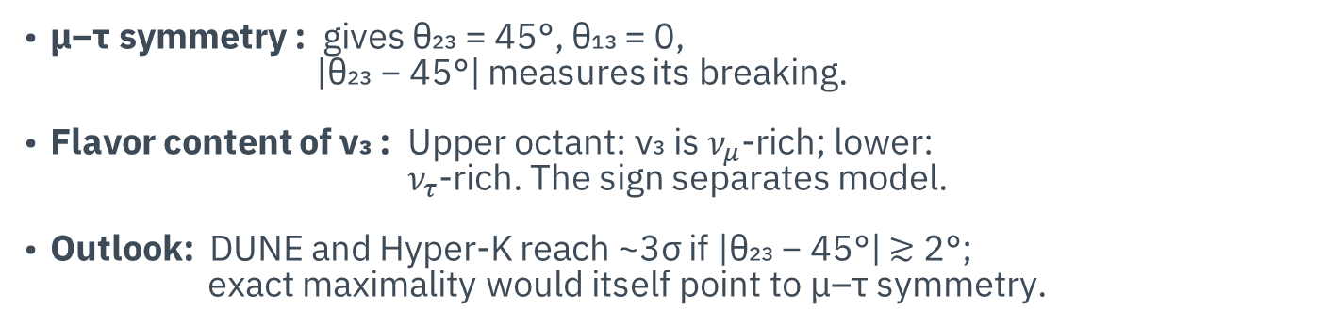
The θ₂₃ octant: measuring μ–τ symmetry breaking
Latest data: global fits still disagree
Where the octant question sits
Global fit | Octant information
NuFIT 6.0 (Sept 2024) | No clear preference
PDG 2025 fit | sin²θ₂₃ = 0.553 (+0.016/−0.024): upper
Bari 2025 (NO) | Lower octant favored at 1.1σ
Bari 2026 (prelim.) | θ₂₃ = 45° disfavored by only ≃0.3σ
Lower octant
Upper octant
μ–τ: 0.5
PDG 2025
QLC: 0.459
0.40
0.45
0.50
0.55
0.60
Physical meaning
sin²θ₂₃
μ–τ symmetry : gives θ₂₃ = 45°, θ₁₃ = 0,
|θ₂₃ − 45°| measures its breaking.
Flavor content of ν₃ : Upper octant: ν₃ is $ν_{μ}$-rich; lower:
$ν_{τ}$-rich. The sign separates model.
Outlook: DUNE and Hyper-K reach ~3σ if |θ₂₃ − 45°| ≳ 2°;
exact maximality would itself point to μ–τ symmetry.
Shaded: |θ₂₃ − 45°| ≲ 2°, where the DUNE/Hyper-K octant reach falls below ~3σ (approx.). QLC point from θ₂₃ ≈ 42.6°.
The octant is not a nuisance parameter: its sign and size measure μ–τ breaking and fix half of δ.
[1] NuFIT 6.0, arXiv:2410.05380 [2] PDG 2025 [3] Capozzi et al., arXiv:2503.07752 [4] Bari global fit 2026 (preliminary, 15 Oct 2026)
Notes:
Disappearance measures sin^2(2 theta23), which is octant-blind; the octant comes from nu_e appearance, proportional to sin^2 theta23, and from atmospheric nu_e data, and it is entangled with delta and the mass ordering. That is why different fits flip the octant. Physics: maximal mixing means mu–tau symmetry; the deviation measures its breaking; the sign tells whether nu3 is mu- or tau-rich and separates model classes; sum rules tie theta23 − 45 degrees to cos delta. QLC predicts the lower octant.

Slide 28
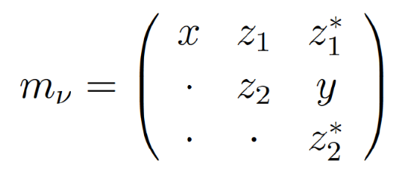

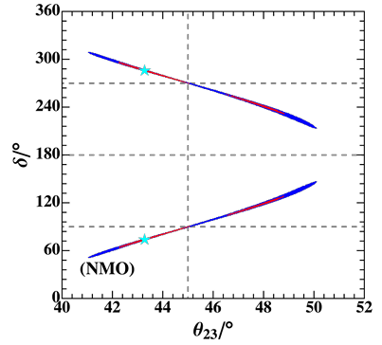
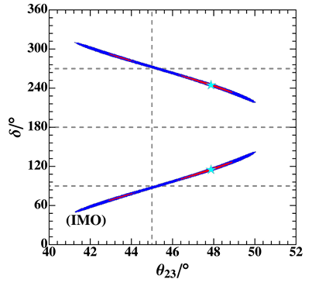
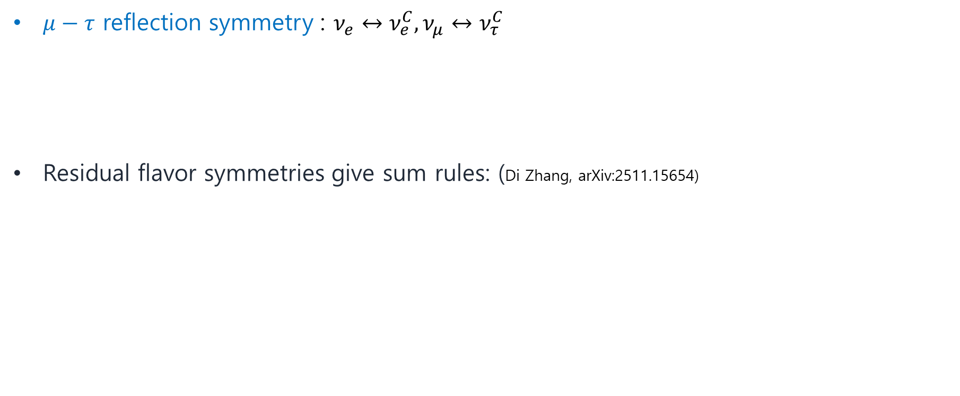

Theory Predicts for δ_{CP}
$μ−τ$ reflection symmetry : $ν_{e}↔ν_{e}^{C}, ν_{μ}↔ν_{τ}^{C}$
Residual flavor symmetries give sum rules: (Di Zhang, arXiv:2511.15654)
$$δ=±\frac{π}{2} \& θ_{23}=\frac{π}{4}$$
(Grimus, Lavoura, PRB578(2004))
A precise δ_{CP} turns flavor symmetries from fits into predictions that can fail.
Sources: [R36] S. T. Petcov, Nucl. Phys. B 892 (2015) 400 · [R37] Harrison, Scott, PLB 547 (2002) 219 · [R27] Ding, Li, Lu, Petcov, JHEP 07 (2026) 256 · [R01] JUNO 207.2 d (preliminary)
Notes:
Deck slide 16 (source document: New slide (CP violation 3/3) | 1.5 min)
[한국어 발표자 노트]
이론은 δCP를 어떻게 예측하는가를 보여 줍니다. 대표적인 방법은 neutrino 부문의 잔여 대칭이 주는 혼합 패턴(TBM, BM, GR, HG)에 charged-lepton 보정을 더한 경우의 sum rule입니다. 이때 cos δ는 측정된 세 혼합각과 패턴의 θ12^ν로 결정됩니다(Petcov 2015).
표의 숫자는 이 리뷰에서 계산한 것입니다. JUNO sin²θ12 = 0.3036, Daya Bay sin²θ13 ≈ 0.0218, sin²θ23 = 0.45–0.56의 중심값만 사용했고 오차 전파, RG 효과, 추가 보정은 넣지 않았습니다. cos δ만 정해지므로 δ와 −δ(=360°−δ)가 모두 예측입니다. BM은 |cos δ| > 1이 되어 이 보정 방식으로는 해가 없습니다. 참고로 TBM의 경우 sin²θ12의 ±1σ 변화가 δ를 약 98°–104°로 이동시킵니다.
μ–τ reflection(일반화 CP) 대칭은 θ23 = 45°와 δ = ±90°를 예측합니다. 현재 sin²θ23 ≈ 0.55와 NO의 δ ≈ 180° 근처 best fit은 이 예측과 긴장 관계에 있지만, IO의 δ ≈ 270°와는 잘 맞습니다. 아직 결론을 내릴 단계는 아닙니다.
modular 및 일반화 CP 모형은 θ23–δCP 상관 곡면을 예측하며, 뒤의 flavor symmetry 부분(29–30번)에서 다시 다룹니다. DUNE과 Hyper-K가 δCP를 정밀하게 측정하면 이 예측들이 실제로 반증 가능한 시험이 된다는 점으로 마무리합니다.
[Source and figure details]
[R36] S. T. Petcov, Nucl. Phys. B 892 (2015) 400; arXiv:1405.6006 — sum rule cos δ = tanθ23/(sin2θ12 sinθ13)[cos2θ12^ν + (sin²θ12 − cos²θ12^ν)(1 − cot²θ23 sin²θ13)].
Predicted δ values computed for this review (central values only): TBM ±(98–101)°, GRA ±(73–75)°, GRB ±(103–107)°, HG ±(59–64)°, BM no solution, for sin²θ23 = 0.45–0.56.
[R37] P. F. Harrison, W. G. Scott, PLB 547 (2002) 219 — μ–τ reflection symmetry.
[R27] Ding, Li, Lu, Petcov, JHEP 07 (2026) 256 — discrete flavour and CP symmetries in light of JUNO.

Slide 29
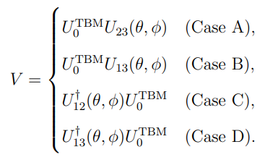
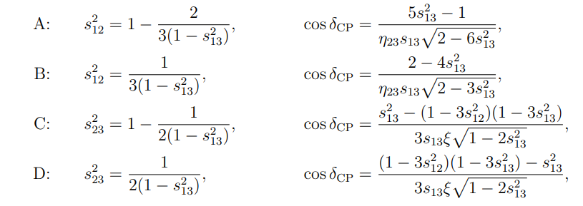


Theory Predicts for δ_{CP}
New sum rules from TBM-Based Mixing (Ahn, Kang, Ramos, Tanimoto : Phys.Rev.D 106 (2022))
Notes:
Deck slide 16 (source document: New slide (CP violation 3/3) | 1.5 min)
[한국어 발표자 노트]
이론은 δCP를 어떻게 예측하는가를 보여 줍니다. 대표적인 방법은 neutrino 부문의 잔여 대칭이 주는 혼합 패턴(TBM, BM, GR, HG)에 charged-lepton 보정을 더한 경우의 sum rule입니다. 이때 cos δ는 측정된 세 혼합각과 패턴의 θ12^ν로 결정됩니다(Petcov 2015).
표의 숫자는 이 리뷰에서 계산한 것입니다. JUNO sin²θ12 = 0.3036, Daya Bay sin²θ13 ≈ 0.0218, sin²θ23 = 0.45–0.56의 중심값만 사용했고 오차 전파, RG 효과, 추가 보정은 넣지 않았습니다. cos δ만 정해지므로 δ와 −δ(=360°−δ)가 모두 예측입니다. BM은 |cos δ| > 1이 되어 이 보정 방식으로는 해가 없습니다. 참고로 TBM의 경우 sin²θ12의 ±1σ 변화가 δ를 약 98°–104°로 이동시킵니다.
μ–τ reflection(일반화 CP) 대칭은 θ23 = 45°와 δ = ±90°를 예측합니다. 현재 sin²θ23 ≈ 0.55와 NO의 δ ≈ 180° 근처 best fit은 이 예측과 긴장 관계에 있지만, IO의 δ ≈ 270°와는 잘 맞습니다. 아직 결론을 내릴 단계는 아닙니다.
modular 및 일반화 CP 모형은 θ23–δCP 상관 곡면을 예측하며, 뒤의 flavor symmetry 부분(29–30번)에서 다시 다룹니다. DUNE과 Hyper-K가 δCP를 정밀하게 측정하면 이 예측들이 실제로 반증 가능한 시험이 된다는 점으로 마무리합니다.
[Source and figure details]
[R36] S. T. Petcov, Nucl. Phys. B 892 (2015) 400; arXiv:1405.6006 — sum rule cos δ = tanθ23/(sin2θ12 sinθ13)[cos2θ12^ν + (sin²θ12 − cos²θ12^ν)(1 − cot²θ23 sin²θ13)].
Predicted δ values computed for this review (central values only): TBM ±(98–101)°, GRA ±(73–75)°, GRB ±(103–107)°, HG ±(59–64)°, BM no solution, for sin²θ23 = 0.45–0.56.
[R37] P. F. Harrison, W. G. Scott, PLB 547 (2002) 219 — μ–τ reflection symmetry.
[R27] Ding, Li, Lu, Petcov, JHEP 07 (2026) 256 — discrete flavour and CP symmetries in light of JUNO.

Slide 30




Theory Predicts for δ_{CP}
Ahn, Kang, PRD86 (2012)
Ahn, Kang, CSKim, PRD87 (2013)
Kang, Shimizu, Shunya Tanimoto, PTEP(2018)
Predictions from A4 symmetry-breaking model
Additional Matrix
Both normal and inverted mass hierarchies are possible.
Tri-maximal mixing: TM2
Notes:
Deck slide 16 (source document: New slide (CP violation 3/3) | 1.5 min)
[한국어 발표자 노트]
이론은 δCP를 어떻게 예측하는가를 보여 줍니다. 대표적인 방법은 neutrino 부문의 잔여 대칭이 주는 혼합 패턴(TBM, BM, GR, HG)에 charged-lepton 보정을 더한 경우의 sum rule입니다. 이때 cos δ는 측정된 세 혼합각과 패턴의 θ12^ν로 결정됩니다(Petcov 2015).
표의 숫자는 이 리뷰에서 계산한 것입니다. JUNO sin²θ12 = 0.3036, Daya Bay sin²θ13 ≈ 0.0218, sin²θ23 = 0.45–0.56의 중심값만 사용했고 오차 전파, RG 효과, 추가 보정은 넣지 않았습니다. cos δ만 정해지므로 δ와 −δ(=360°−δ)가 모두 예측입니다. BM은 |cos δ| > 1이 되어 이 보정 방식으로는 해가 없습니다. 참고로 TBM의 경우 sin²θ12의 ±1σ 변화가 δ를 약 98°–104°로 이동시킵니다.
μ–τ reflection(일반화 CP) 대칭은 θ23 = 45°와 δ = ±90°를 예측합니다. 현재 sin²θ23 ≈ 0.55와 NO의 δ ≈ 180° 근처 best fit은 이 예측과 긴장 관계에 있지만, IO의 δ ≈ 270°와는 잘 맞습니다. 아직 결론을 내릴 단계는 아닙니다.
modular 및 일반화 CP 모형은 θ23–δCP 상관 곡면을 예측하며, 뒤의 flavor symmetry 부분(29–30번)에서 다시 다룹니다. DUNE과 Hyper-K가 δCP를 정밀하게 측정하면 이 예측들이 실제로 반증 가능한 시험이 된다는 점으로 마무리합니다.
[Source and figure details]
[R36] S. T. Petcov, Nucl. Phys. B 892 (2015) 400; arXiv:1405.6006 — sum rule cos δ = tanθ23/(sin2θ12 sinθ13)[cos2θ12^ν + (sin²θ12 − cos²θ12^ν)(1 − cot²θ23 sin²θ13)].
Predicted δ values computed for this review (central values only): TBM ±(98–101)°, GRA ±(73–75)°, GRB ±(103–107)°, HG ±(59–64)°, BM no solution, for sin²θ23 = 0.45–0.56.
[R37] P. F. Harrison, W. G. Scott, PLB 547 (2002) 219 — μ–τ reflection symmetry.
[R27] Ding, Li, Lu, Petcov, JHEP 07 (2026) 256 — discrete flavour and CP symmetries in light of JUNO.

Slide 31


Theory Predicts for δ_{CP}
Ahn, Kang, PRD86 (2012)
Ahn, Kang, CSKim, PRD87 (2013)
Kang, Shimizu, Shunya Tanimoto, PTEP(2018)
Predictions from A4 symmetry-breaking model
Notes:
Deck slide 16 (source document: New slide (CP violation 3/3) | 1.5 min)
[한국어 발표자 노트]
이론은 δCP를 어떻게 예측하는가를 보여 줍니다. 대표적인 방법은 neutrino 부문의 잔여 대칭이 주는 혼합 패턴(TBM, BM, GR, HG)에 charged-lepton 보정을 더한 경우의 sum rule입니다. 이때 cos δ는 측정된 세 혼합각과 패턴의 θ12^ν로 결정됩니다(Petcov 2015).
표의 숫자는 이 리뷰에서 계산한 것입니다. JUNO sin²θ12 = 0.3036, Daya Bay sin²θ13 ≈ 0.0218, sin²θ23 = 0.45–0.56의 중심값만 사용했고 오차 전파, RG 효과, 추가 보정은 넣지 않았습니다. cos δ만 정해지므로 δ와 −δ(=360°−δ)가 모두 예측입니다. BM은 |cos δ| > 1이 되어 이 보정 방식으로는 해가 없습니다. 참고로 TBM의 경우 sin²θ12의 ±1σ 변화가 δ를 약 98°–104°로 이동시킵니다.
μ–τ reflection(일반화 CP) 대칭은 θ23 = 45°와 δ = ±90°를 예측합니다. 현재 sin²θ23 ≈ 0.55와 NO의 δ ≈ 180° 근처 best fit은 이 예측과 긴장 관계에 있지만, IO의 δ ≈ 270°와는 잘 맞습니다. 아직 결론을 내릴 단계는 아닙니다.
modular 및 일반화 CP 모형은 θ23–δCP 상관 곡면을 예측하며, 뒤의 flavor symmetry 부분(29–30번)에서 다시 다룹니다. DUNE과 Hyper-K가 δCP를 정밀하게 측정하면 이 예측들이 실제로 반증 가능한 시험이 된다는 점으로 마무리합니다.
[Source and figure details]
[R36] S. T. Petcov, Nucl. Phys. B 892 (2015) 400; arXiv:1405.6006 — sum rule cos δ = tanθ23/(sin2θ12 sinθ13)[cos2θ12^ν + (sin²θ12 − cos²θ12^ν)(1 − cot²θ23 sin²θ13)].
Predicted δ values computed for this review (central values only): TBM ±(98–101)°, GRA ±(73–75)°, GRB ±(103–107)°, HG ±(59–64)°, BM no solution, for sin²θ23 = 0.45–0.56.
[R37] P. F. Harrison, W. G. Scott, PLB 547 (2002) 219 — μ–τ reflection symmetry.
[R27] Ding, Li, Lu, Petcov, JHEP 07 (2026) 256 — discrete flavour and CP symmetries in light of JUNO.

Slide 32




Theory Predicts for δ_{CP}
L. Everett, R. Ramos, A. Rock, A. Stuart, arXiv:1912.10139
L. Delgadillo, L. Everett, R. Ramos, A. Stuart, PRD97(2018)
Notes:
Deck slide 16 (source document: New slide (CP violation 3/3) | 1.5 min)
[한국어 발표자 노트]
이론은 δCP를 어떻게 예측하는가를 보여 줍니다. 대표적인 방법은 neutrino 부문의 잔여 대칭이 주는 혼합 패턴(TBM, BM, GR, HG)에 charged-lepton 보정을 더한 경우의 sum rule입니다. 이때 cos δ는 측정된 세 혼합각과 패턴의 θ12^ν로 결정됩니다(Petcov 2015).
표의 숫자는 이 리뷰에서 계산한 것입니다. JUNO sin²θ12 = 0.3036, Daya Bay sin²θ13 ≈ 0.0218, sin²θ23 = 0.45–0.56의 중심값만 사용했고 오차 전파, RG 효과, 추가 보정은 넣지 않았습니다. cos δ만 정해지므로 δ와 −δ(=360°−δ)가 모두 예측입니다. BM은 |cos δ| > 1이 되어 이 보정 방식으로는 해가 없습니다. 참고로 TBM의 경우 sin²θ12의 ±1σ 변화가 δ를 약 98°–104°로 이동시킵니다.
μ–τ reflection(일반화 CP) 대칭은 θ23 = 45°와 δ = ±90°를 예측합니다. 현재 sin²θ23 ≈ 0.55와 NO의 δ ≈ 180° 근처 best fit은 이 예측과 긴장 관계에 있지만, IO의 δ ≈ 270°와는 잘 맞습니다. 아직 결론을 내릴 단계는 아닙니다.
modular 및 일반화 CP 모형은 θ23–δCP 상관 곡면을 예측하며, 뒤의 flavor symmetry 부분(29–30번)에서 다시 다룹니다. DUNE과 Hyper-K가 δCP를 정밀하게 측정하면 이 예측들이 실제로 반증 가능한 시험이 된다는 점으로 마무리합니다.
[Source and figure details]
[R36] S. T. Petcov, Nucl. Phys. B 892 (2015) 400; arXiv:1405.6006 — sum rule cos δ = tanθ23/(sin2θ12 sinθ13)[cos2θ12^ν + (sin²θ12 − cos²θ12^ν)(1 − cot²θ23 sin²θ13)].
Predicted δ values computed for this review (central values only): TBM ±(98–101)°, GRA ±(73–75)°, GRB ±(103–107)°, HG ±(59–64)°, BM no solution, for sin²θ23 = 0.45–0.56.
[R37] P. F. Harrison, W. G. Scott, PLB 547 (2002) 219 — μ–τ reflection symmetry.
[R27] Ding, Li, Lu, Petcov, JHEP 07 (2026) 256 — discrete flavour and CP symmetries in light of JUNO.

Slide 33





Searching for Non-Standard Interactions (NSI)
Existence of NSI indicates new physics beyond the SM
Effect of NSI in propagation can be presented through modification of matter potential
Even if no mixing in vacuum, $ν_{α}→ν_{β}$ can occur in matter & NSI
Complex phases of off-diag. could be new source of CPV
If $ε∝\frac{c^{2}}{Λ^{2}}$ , TeV scale NP leads to $ε$~0.01

Slide 34

2 σ Results from fit to oscillation data and COHERENT
(Esteban et al., 1805.04530)

Slide 35


NSI may affect neutrinos at the production point as well as detection point.
To see those effects, we use
$$δℒ_{NSI}^{CC}=−2\sqrt{2}\sum_{f,P}{ε_{αβ}^{fP}\left({\overline{ν}}_{α}γ^{μ}P_{L}l_{β}\right)}\left(\overline{f}γ_{μ}Pf^{′}\right)$$
(Farzan, Torotla,
Front.in Phys. 6 (2018))

Slide 36

New Atmospheric NSI Limits Are Strong and Conditional
Independent reanalysis | published 8 October 2026
Part 3 · New interactions
Independent DeepCore reanalysis of a 7.5-year high-purity ν_{μ} CC sample (NO is assumed):
−0.0094 < ε^{m}_{μτ} < 0.0079 at 90% C.L. for real ε^{m}_{μτ}.
−0.031 < ε^{m}_{ττ} − ε^{m}_{μμ} < 0.029 at 90% C.L.
One parameter is varied at a time;
complex-phase and joint-parameter fits require separate contours.
J. Krishnamoorthi, A. Kumar, S. K. Agarwalla, PRD 114 (2026) 075009, Fig. 1 (CC BY 4.0; crop only). Independent reanalysis; 90% C.L.; one parameter at a time; NO.
Atmospheric disappearance tightly tests the μ–τ sector under stated assumptions.
Sources: [R16] Krishnamoorthi, Kumar, Agarwalla, PRD 114 (2026) 075009 · [R17] Krishnamoorthi, Kumar, Agarwalla, PRD 114 (2026) 015007
Notes:
Deck slide 25 (source document: Slide 11 | 2 min)
[한국어 발표자 노트]
이 수치는 Krishnamoorthi, Kumar, Agarwalla의 PRD 114, 075009 (2026), arXiv:2512.22632v2의 출판판을 따릅니다. 초록의 구판에서는 diagonal 하한이 −0.030으로 검색되지만 최신 v2·출판판은 −0.031입니다. 이 작은 차이도 버전 관리가 필요한 이유입니다.
공식 IceCube collaboration 논문이 아니라 공개 golden sample을 분석한 독립 연구입니다. paper와 figure는 eight-year sample이라는 이름도 사용하지만 실제 livetime은 7.5년입니다. 제공된 detector-systematics response가 NO에 대해서만 존재하므로 분석은 NO 가정입니다. observed IO limit까지 수행했다고 말하지 않습니다.
real εμτ의 양수·음수는 위상 0과 π의 slice입니다. 그림은 타 실험의 convention을 이 논문에 맞춰 환산한 비교입니다. complex magnitude–phase 허용 영역과 구분합니다. 별도의 2026 eμ/eτ 연구는 νμ disappearance가 δCP에 약하게 의존하는 점을 사용해 beam appearance의 degeneracy와 상보적인 제약을 제시합니다. δ-free는 정확한 전 에너지 독립성이 아니라 이 sample에서 작게 억제됨을 뜻합니다.
[Source and figure details]
[R16] Krishnamoorthi, J., Kumar, Anil, Agarwalla, Sanjib Kumar. Stringent constraints on nonstandard neutrino interactions using high-purity νμ CC events in IceCube DeepCore. Phys.Rev.D 114 (2026) 075009; arXiv:2512.22632. https://arxiv.org/abs/2512.22632 | https://inspirehep.net/literature/3096041
[R17] Krishnamoorthi, J., Kumar, Anil, Agarwalla, Sanjib Kumar. δCP-free constraints on NSI parameters ϵeμ and ϵeτ using high-purity νμ CC events at IceCube DeepCore. Phys.Rev.D 114 (2026) 015007; arXiv:2604.16157. https://arxiv.org/abs/2604.16157 | https://inspirehep.net/literature/3146362
Figure file: F07_NSI_comparison.png. Fig. 1 on PDF page 2. Rectangular crop only; no data or axes changed; PNG rendered at 360 dpi and vector PDF retained.
Reuse: CC BY 4.0; https://creativecommons.org/licenses/by/4.0/. J Krishnamoorthi, A. Kumar and S. K. Agarwalla, Stringent constraints on nonstandard neutrino interactions using high-purity νμ CC events in IceCube DeepCore, Fig. 1; https://doi.org/10.1103/2n9h-csnl; CC BY 4.0; cropped.
Result check date: 23 October 2026 (KST).

Slide 37

NSI Can Mimic CP Violation
Theory illustration | chosen benchmark, not a fit
Part 3 · New interactions
An additional complex matter coupling can change ν_{e} appearance in a way that partly resembles a shift of δ_{CP}.
At the DUNE baseline, a benchmark ε_{eτ} = 0.15 with φ_{eτ} = π/2 raises the δ_{CP} = 0 spectrum so that it partly mimics δ_{CP} = −π/2.
Energy spectra, neutrino and antineutrino running, different baselines, atmospheric data, and scattering constraints help to separate them.
A CP-violation claim is strongest when both the standard fit and plausible new-interaction alternatives are tested.
Calculated for this presentation: constant-density three-flavor P(ν_{μ}→ν_{e}) at 1300 km with an illustrative complex ε_{eτ} = 0.15, φ_{eτ} = π/2. Not an NSI fit or a preferred value.
NSI can prevent determination of CP violating phase.
Spectral information and complementary detectors are essential to identify the source of a deviation.
Sources: [R43] NOvA Collab., PRL 133 (2024) 201802 · [R15] Coloma et al., JHEP 08 (2023) 032
Notes:
Deck slide 28 (source document: 2026 draft slide 18 (merged))
[Speaker notes (English)]
Here I show an illustrative DUNE baseline. The standard CP-conserving spectrum differs from the standard delta equals minus pi over two spectrum. A new complex epsilon e-tau interaction also changes the spectrum and may imitate some part of the CP-phase signal. The plot is a deliberate benchmark with epsilon equal to 0.15, not an experimental constraint or a best fit. A full broad-band analysis, including near detectors and other matter paths, can help disentangle the contributions.
[한국어 발표자 노트]
NSI 예시 값 εeτ=0.15는 임의 benchmark로 표시했습니다.
[Source and figure details]
Figure: calculated for this presentation (2026 draft deck); DUNE baseline 1300 km, constant density, benchmark εeτ = 0.15, φeτ = π/2.

Slide 38


Resolving tension in T2K & NoνA via NSI & CPV
S.Chatterjee, A. Palazzo, PRL126(2021)

Slide 39

Origin of NSI
ε from integrating out scalar of type II seesaw: $ε_{αβ}^{e}$∝${(m_{ν})}_{αβ}$ (Malinsky, Ohlsson, Zhang, 0811.3346)
ε from integrating out leptoquarks (Wise, Zhang, 1404.4663)
ε from integrating out charge +1 scalar singlet:
ε from loop effects, including secret neutrino interactions (Bischer, Rodejohann, Xu, 1807.08102)
ε from higher dimensional operators (Gavela et al., 0809.3451); within ﬂavor symmetry models have information on ﬂavor symmetry (Wang, Zhou, 1801.05656)
ε from integrating out Z’ (Heeck, Lindner, Rodejohann, Vogl, 1812.04067)

Slide 40

Opportunities for New Physics in oscillation
What causes deviation of standard oscillations
- Unitarity violation in $U_{PMNS}$
- light sterile neutrinos
- long-range forces
- Lorentz/CPT violation
- General neutrino interactions
- Neutrino decay etc.

Slide 41
Conclusions
Neutrino oscillations have been established by many experiments over a wide range of neutrino energies.
  → Neutrino physics has entered the precision era.
Precision measurements provide important tests of the three-flavor oscillation picture.
  → They also help us test theoretical models of neutrino mass and mixing,
  and probe new physics.
Many important questions remain open :
  Mass ordering, leptonic CP violation, the origin of neutrino mass and mixing, and possible new interactions.

Slide 42
Degeneracies Are a Physics Question
Theory interpretation
Part 3 · New interactions
The transformation H → −H* leaves oscillation probabilities invariant up to an irrelevant trace.
With NSI, a generalized ordering–solar-octant degeneracy can connect the LMA and LMA-Dark solutions.
Reactor disappearance alone does not fully fix the solar octant or remove arbitrary NSI degeneracies.
Solar propagation, scattering, accelerator, and atmospheric data constrain different directions.
P_{αβ}[H] = P_{αβ}[−H*]
(ε_{ee} − ε_{μμ}) → −(ε_{ee} − ε_{μμ}) − 2
Degeneracy | Complementary information
Ordering and new matter potential | Reactor interference + Earth / beam data
LMA and dark solar octant | Solar matter evolution + scattering
δ_{CP} and NSI phases | Channels and baselines with different dependences
Robust inference requires breaking degeneracies, not fixing them away.
Sources: [R15] Coloma et al., JHEP 08 (2023) 032 · [R18] Atzori Corona et al., Nucl. Phys. B 1031 (2026) 117635
Notes:
Deck slide 27 (source document: Slide 12 | 1.5 min)
[한국어 발표자 노트]
표준 상호작용 아래 reactor의 Δm²21와 θ12 정밀도는 매우 강력합니다. 그러나 vacuum disappearance의 leading term은 sin²2θ12이므로 θ12와 π/2−θ12를 구분하지 못합니다. 물질효과와 NSI 자유도를 함께 바꾸면 ordering을 뒤집어도 진동 확률을 보존하는 generalized degeneracy가 생깁니다.
εμμ를 뺀 convention에서 (εee−εμμ) → −(εee−εμμ)−2, (εττ−εμμ) → −(εττ−εμμ), off-diagonal εαβ → −εαβ\*와 vacuum parameter mapping이 함께 필요합니다. 서로 다른 조성의 물질에서 이 관계를 실현할 수 있는지는 εe,u,d 가정에 달려 있습니다.
LMA-Dark가 모든 모형에서 제거되었다고 단정하지 않습니다. 2023의 일반 electron+quark global analysis는 mediator 질량, up/down coupling 비율, detection 효과에 따라 살아남는 영역이 달라짐을 보였습니다. 이 기준 논문은 최신 2026 전 데이터 global fit이 아니며 2026 산란 연구의 축별 제약과 병치해 설명합니다.
[Source and figure details]
[R15] Coloma, Pilar, Gonzalez-Garcia, M.C., Maltoni, Michele, Pinheiro, João Paulo et al.. Global constraints on non-standard neutrino interactions with quarks and electrons. JHEP 08 (2023) 032; arXiv:2305.07698. https://arxiv.org/abs/2305.07698 | https://inspirehep.net/literature/2659681
[R18] Atzori Corona, M., Cadeddu, M., Cargioli, N., Cerulli, R. et al.. Phenomenological implications of the high-precision COHERENT germanium CEνNS data. Nucl.Phys.B 1031 (2026) 117635; arXiv:2605.07975. https://arxiv.org/abs/2605.07975 | https://inspirehep.net/literature/3153601
Result check date: 23 October 2026 (KST).

