Slide 1


SND@LHC
Current Status
Yeong Gyun Kim (GNUE)
October 2026
Notes:
Target time: 0:20. Elapsed at end: 0:20.
Today I will discuss the current status of SND at the LHC. I will first recall the physics motivation and the detector, then review the neutrino results and the progress with nuclear emulsions. I will also highlight the HTS-2 scanning campaign and finish with ongoing analyses and the approved detector upgrade.
Sources:

Slide 2
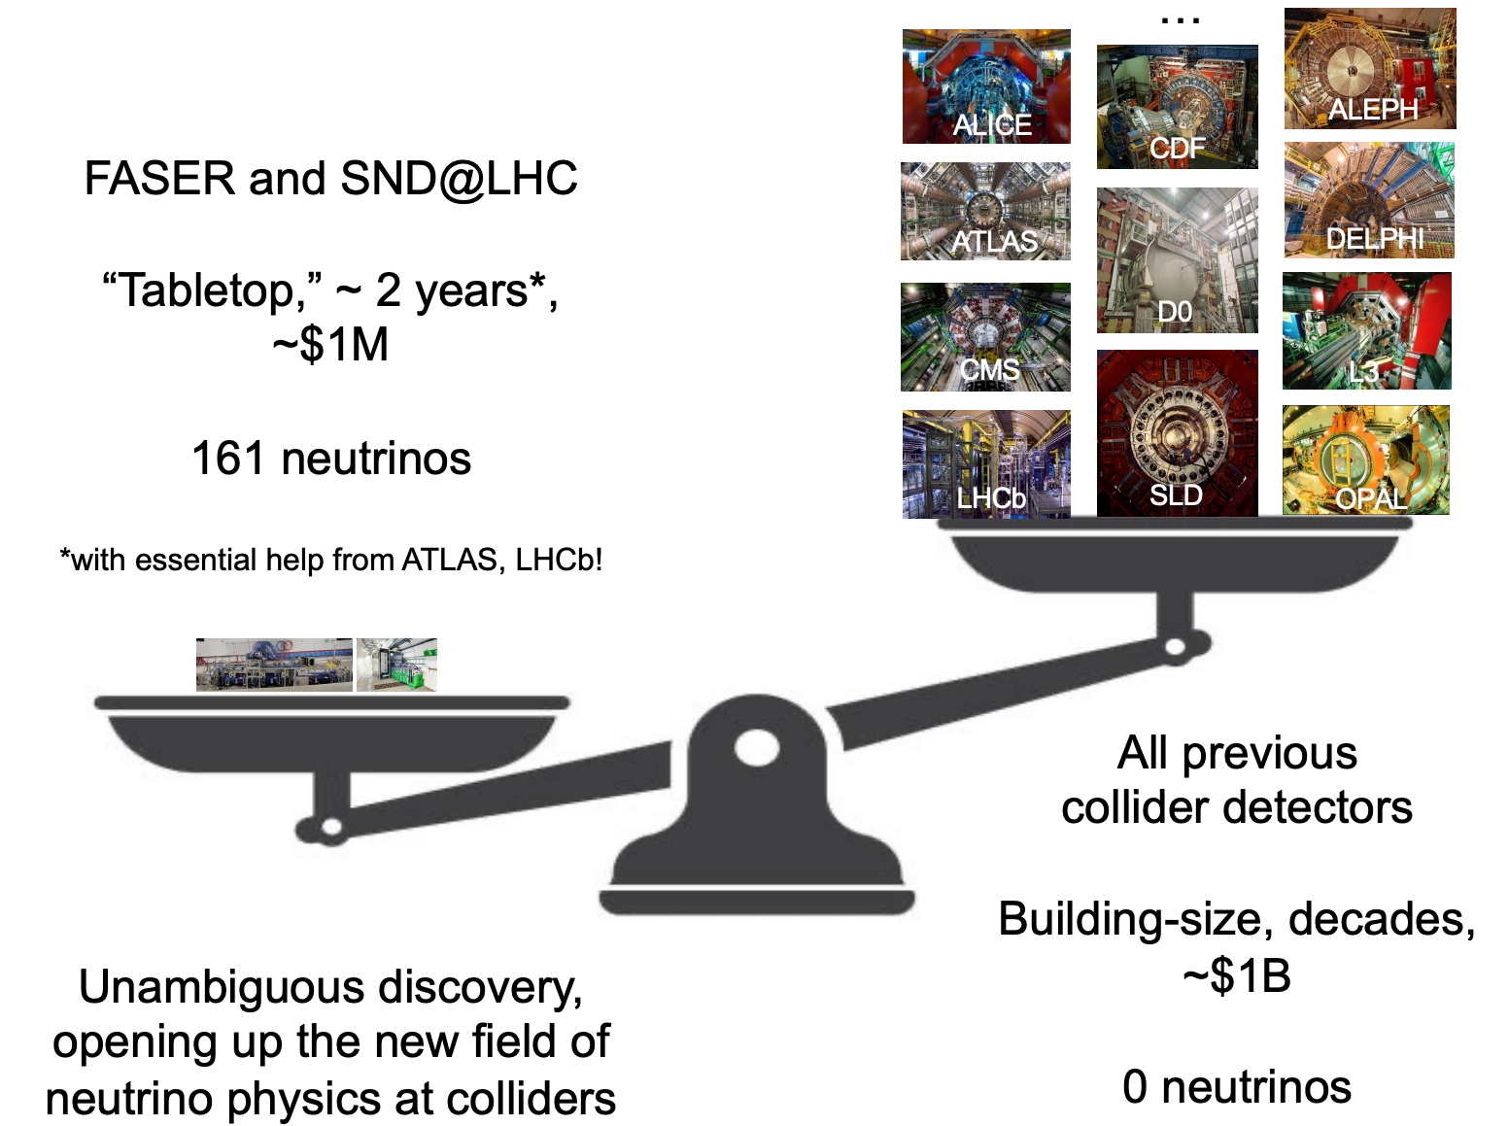
The Dawn of Collider Neutrino Physics
slide by J. Feng (2023)

Slide 3
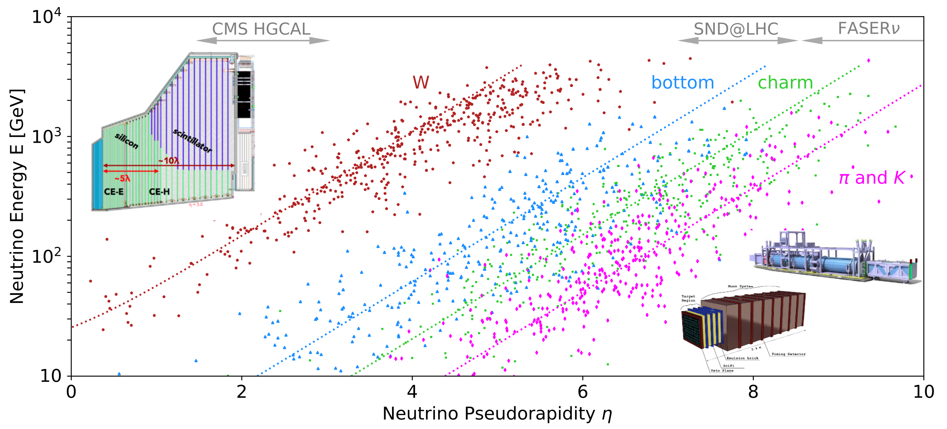
Neutrinos at the LHC
LHC neutrinos are produced through the decays of various particles
Forward neutrinos
from light and
heavy hadrons
P. Foldenauer, F. Kling
and P. Reimitz
arXiv:2108.05370

Slide 4
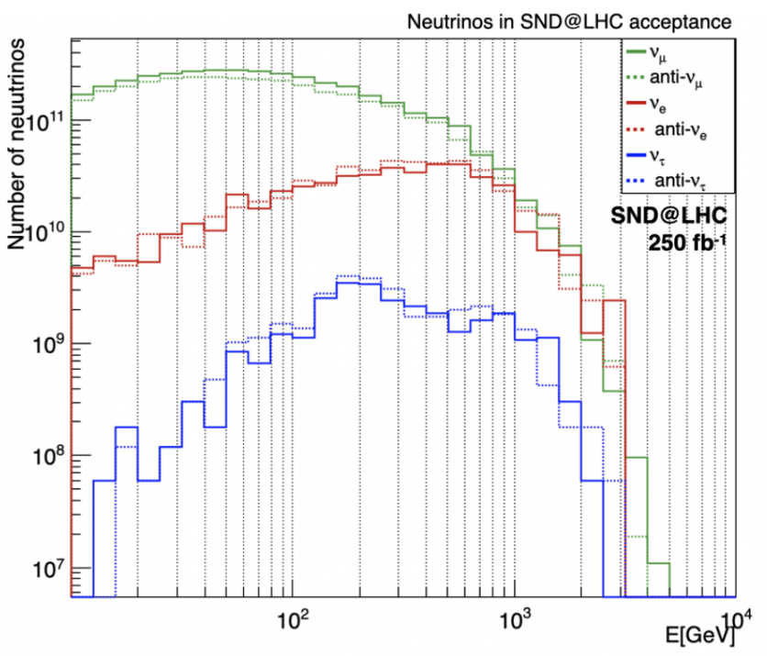
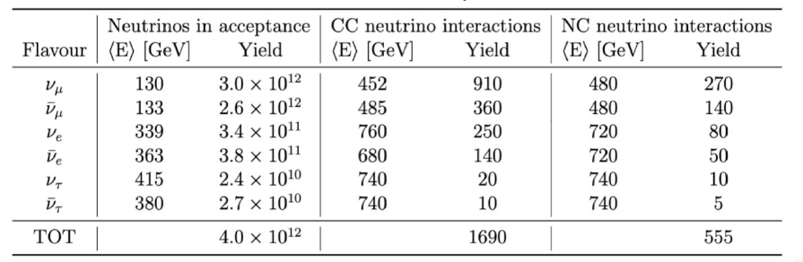
Neutrinos at the LHC
O(10¹²) neutrinos produced in the far forward direction (250 fb⁻¹ )
~1690 CC neutrino interactions, ~555 NC interactions (tungsten 830 kg)
O(10¹²)
NC/CC event ratio ~ 0.33 : a consistency test of SM

Slide 5
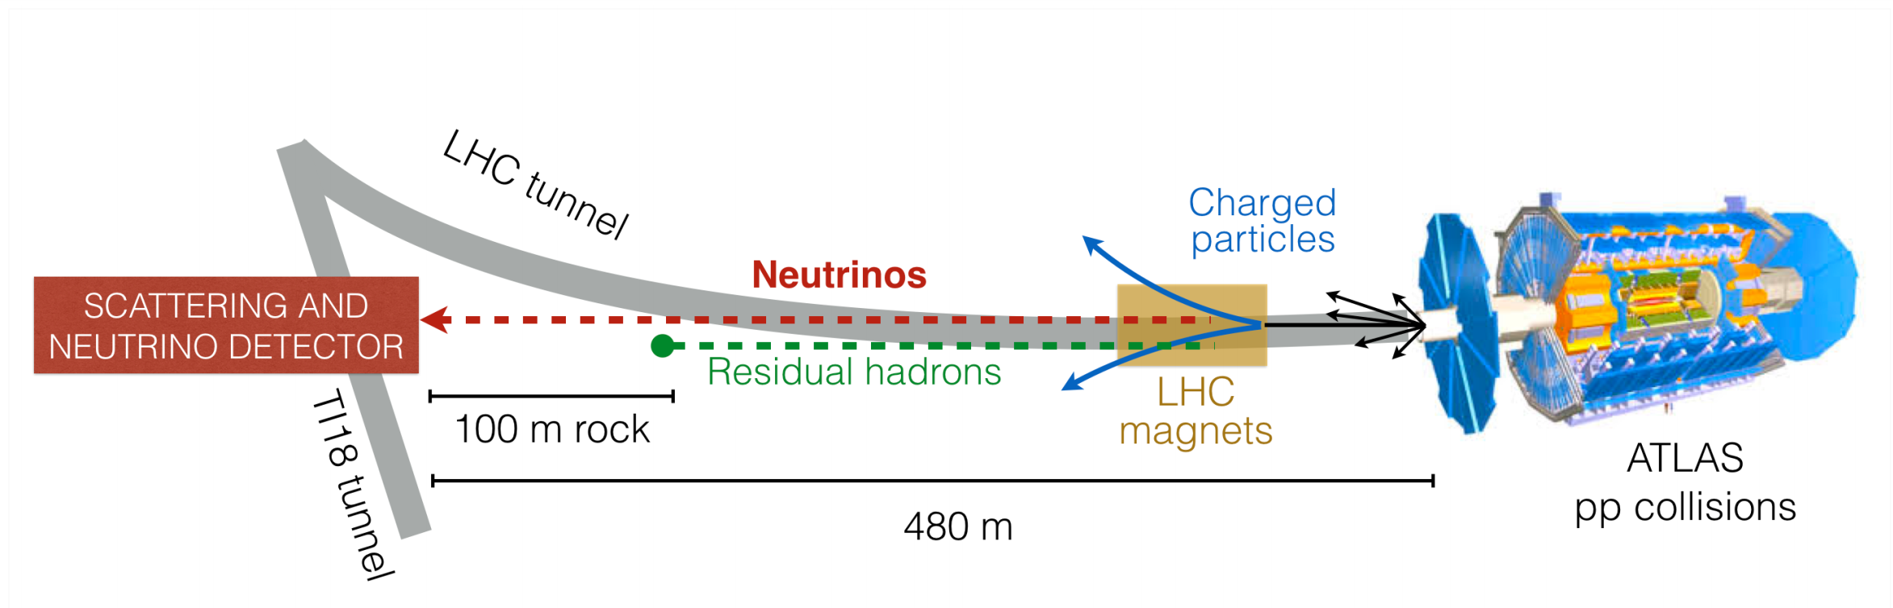
SND@LHC in TI18 tunnel
Scattering and Neutrino Detector at the LHC
480 m downstream of the ATLAS interaction point, slightly off the collision axis
The LHC magnets deflect charged particles. About 100 meters of rock absorb hadrons
Neutrinos and feebly interacting particles can reach the detector
The detector covers the pseudo-rapidity range 7.2 < η < 8.4 (previously unexplored region)

Slide 6
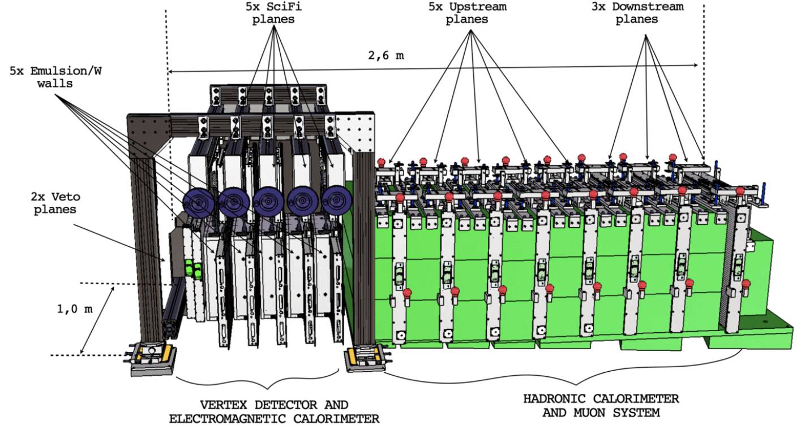
SND@LHC Detector
UPSTREAM VETO PLANES
planes of scintillator bars act as
a veto for charged particles
TARGET REGION (Vertex & ECAL)
Five walls of Emulsion Cloud Chamber
Each followed by a Scintillating Fiber
plane (timestamp)
MUON SYSTEM (& HCAL)
Eight iron slabs, each followed by
planes of scintillating bars
Three veto planes since 2024. Drift tubes added in 2025.

Slide 7
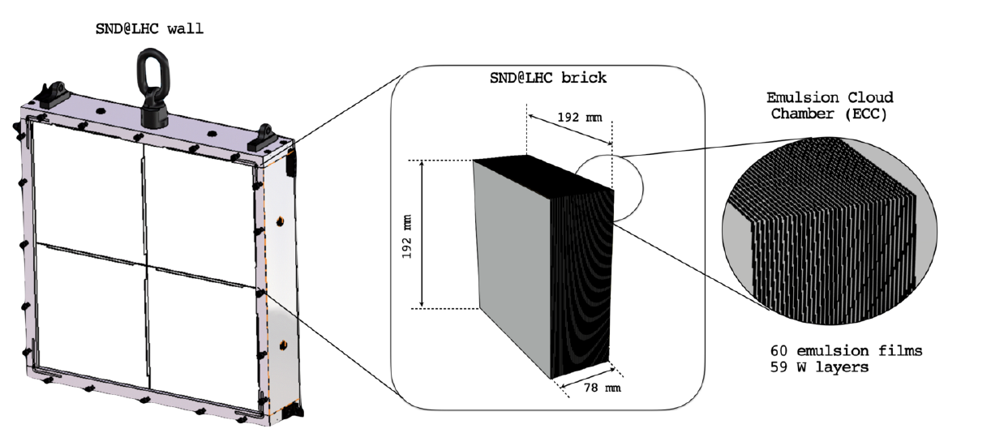
SND@LHC Detector
Each ECC(Emulsion Cloud Chamber) wall consists of four bricks
Each brick is made of emulsion films interleaved with tungsten plates

Slide 8
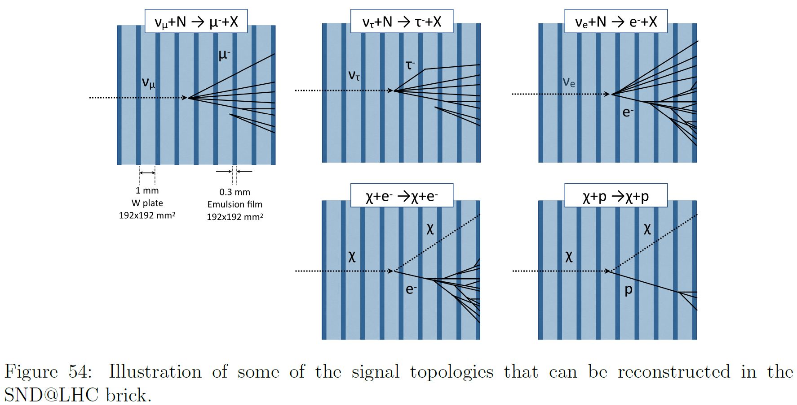
Event Reconstruction
Designed to distinguish between all three flavors of neutrinos
Charged Current
Interactions
Neutral Current
Interactions

Slide 9
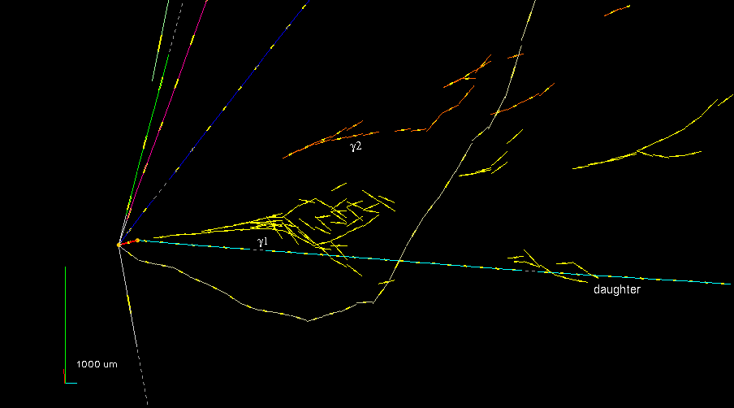
The First ν_{τ} Candidate in OPERA
Physics Letters B691 (2010) 138
𝜏 → 𝜌𝜈_{𝜏} with 𝜌 → 𝜋⁰ 𝜋 and 𝜋⁰ → 𝛾𝛾

Slide 10
Physics in SND@LHC
Charmed-hadron production in pp collisions
Lepton flavor universality in neutrino interactions
Measurement of the NC/CC ratio
Search for Feebly Interacting Particles

Slide 11

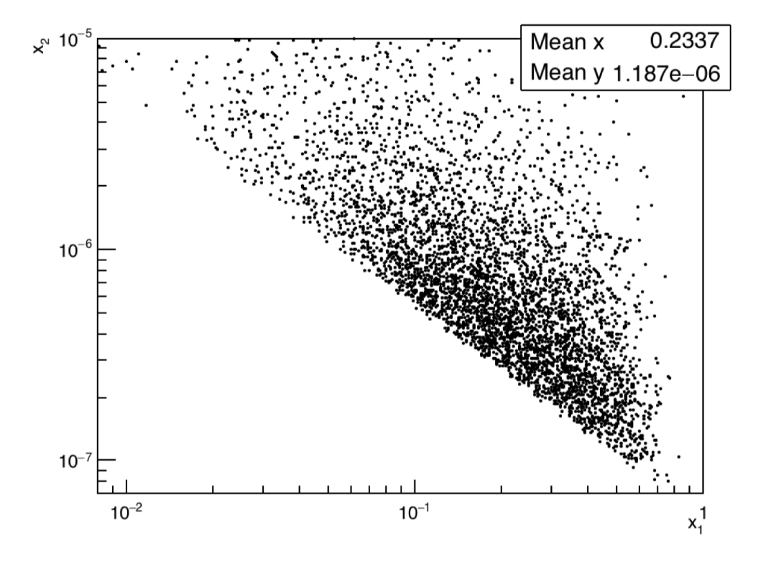
Charmed-hadron production at LHC
Electron neutrinos in 7.2<η<8.4 mainly originate from the decay of charmed hadrons produced in the LHC pp collisions.
Measurements of pp → ν_{e}X cross-section provide insight into the heavy-quark production in an unexplored domain.
The dominant partonic process for associated charm
production at the LHC is gluon-gluon scattering
Measurement of electron neutrinos can provide
valuable constraints on the gluon PDF in small x region
Correlation between momentum fractions x₁ and x₂
for events in the SND@LHC acceptance

Slide 12





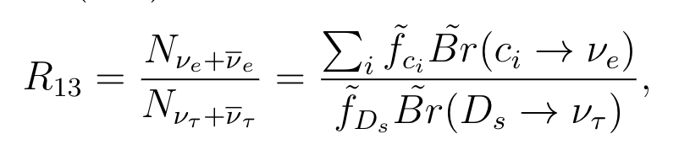
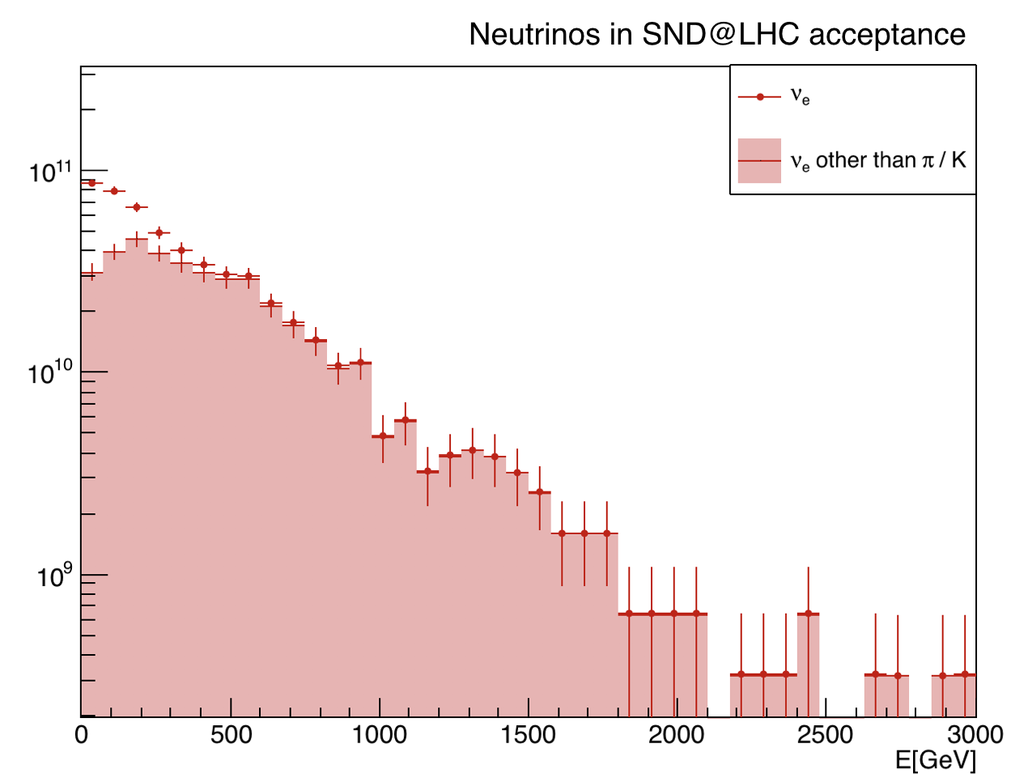
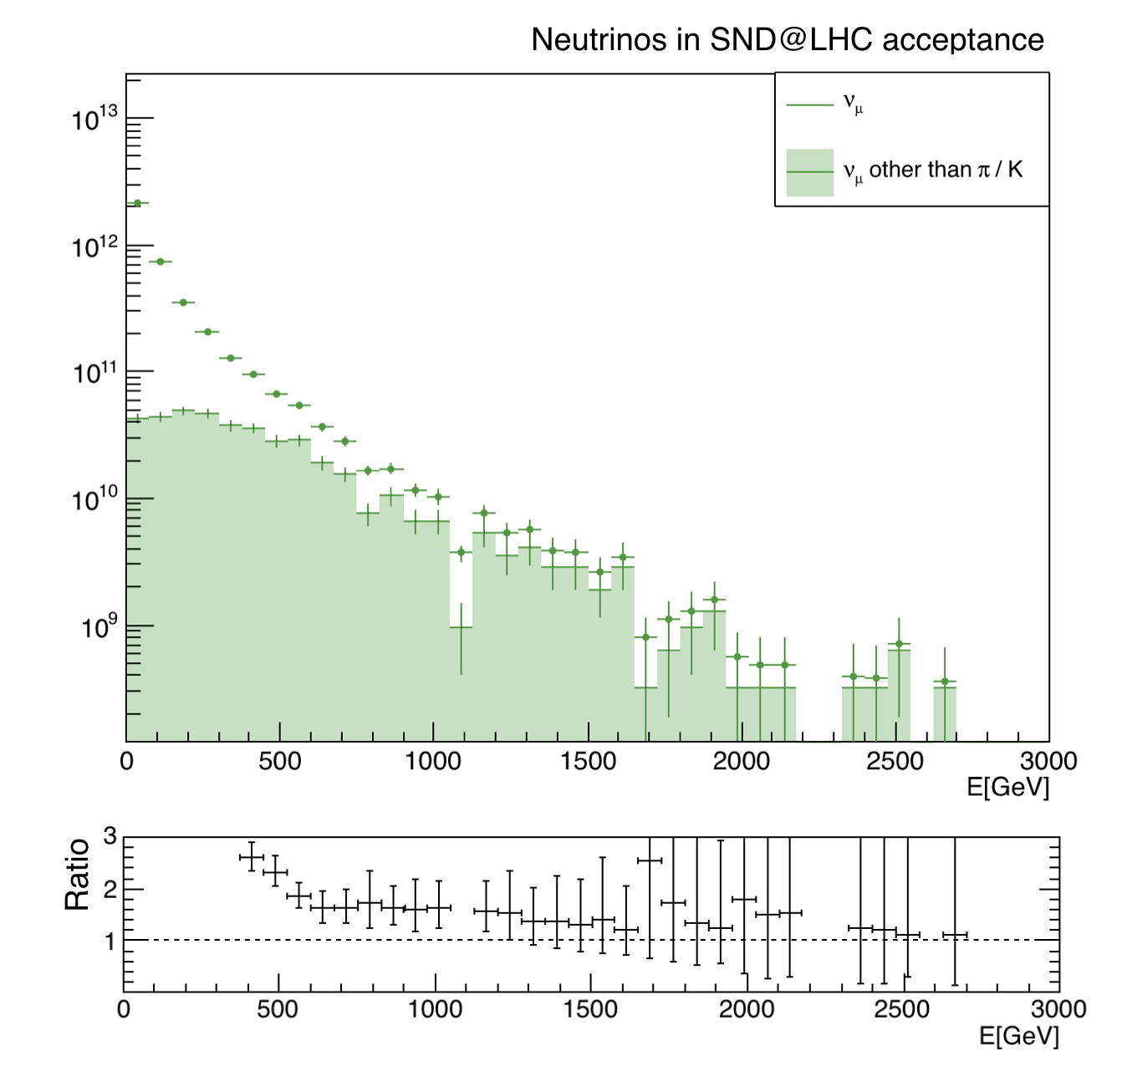

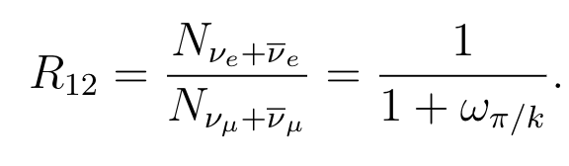
Lepton Flavor Universality
The ability of the SND@LHC to identify all three neutrino flavors offers a unique opportunity to test Lepton Flavor Universality in neutrino interactions
The ν_{e}/ν_{τ} ratio is sensitive to the ν-nucleon interaction cross section ratio of the two neutrino species.
contamination
from 𝜋/k
The measurement of the R₁₂ ratio
can be used as a test of the LFU
For E > 600 GeV

Slide 13


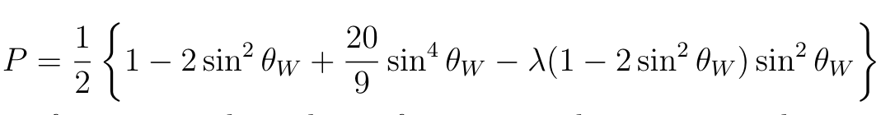
Measurement of the NC/CC ratio
Lepton identification for the three different flavors allows us to distinguish CC to NC interaction at SND@LHC.
If differential neutrino and anti-neutrino flux are equal,
the NC/CC ratio can be written as
In case of DIS, P can be written as
- SND@LHC plans to measure
this ratio as a consistency test
of the Standard Model
- The systematic uncertainty 10%
The statistical error 5%
(For a tungsten target λ=0.04)

Slide 14
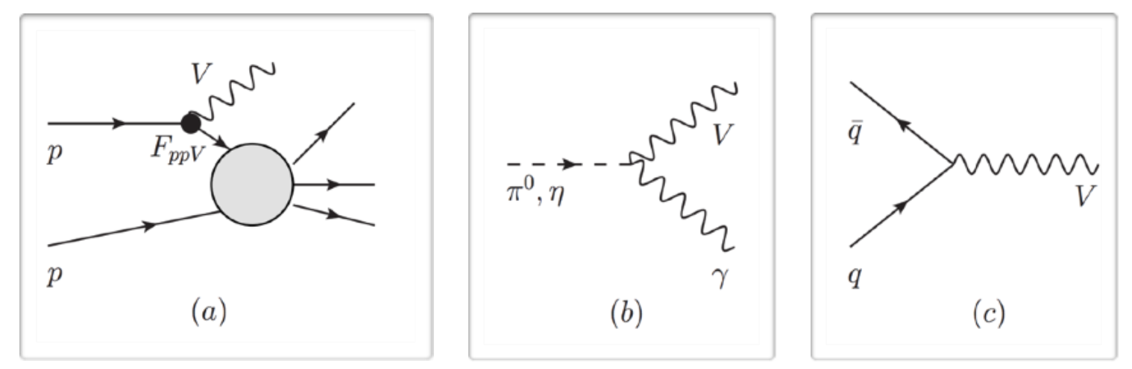
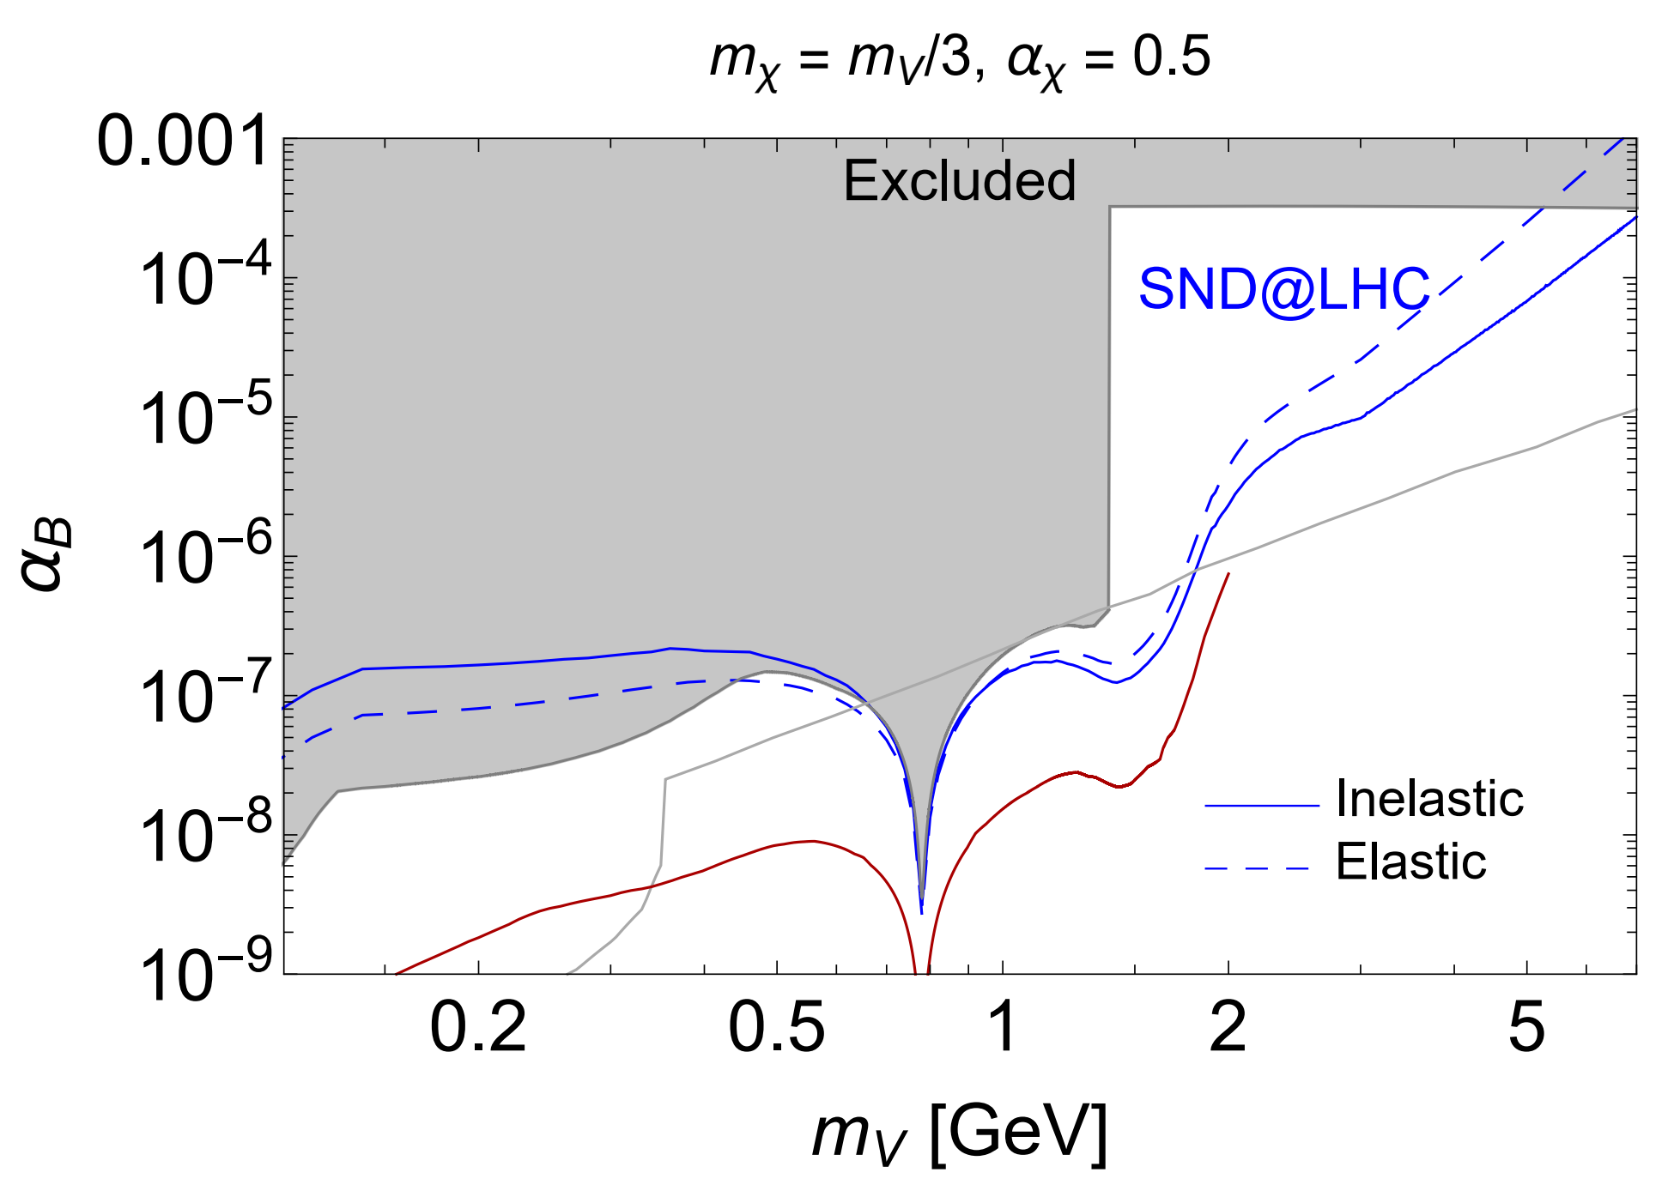
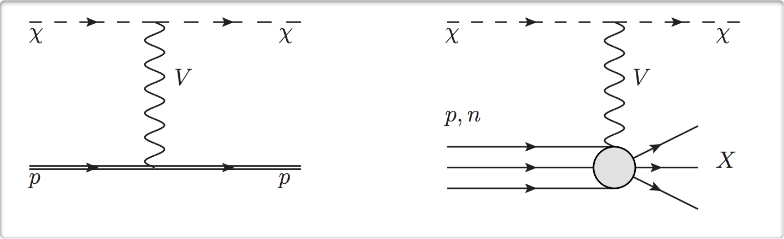
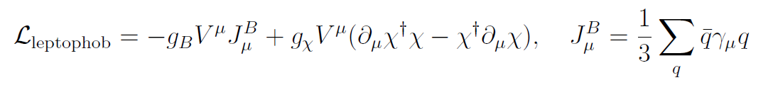
Search for Feebly Interacting Particles
SND@LHC will also be capable of exploring models with FIPs.
A Leptophobic DM model

Slide 15
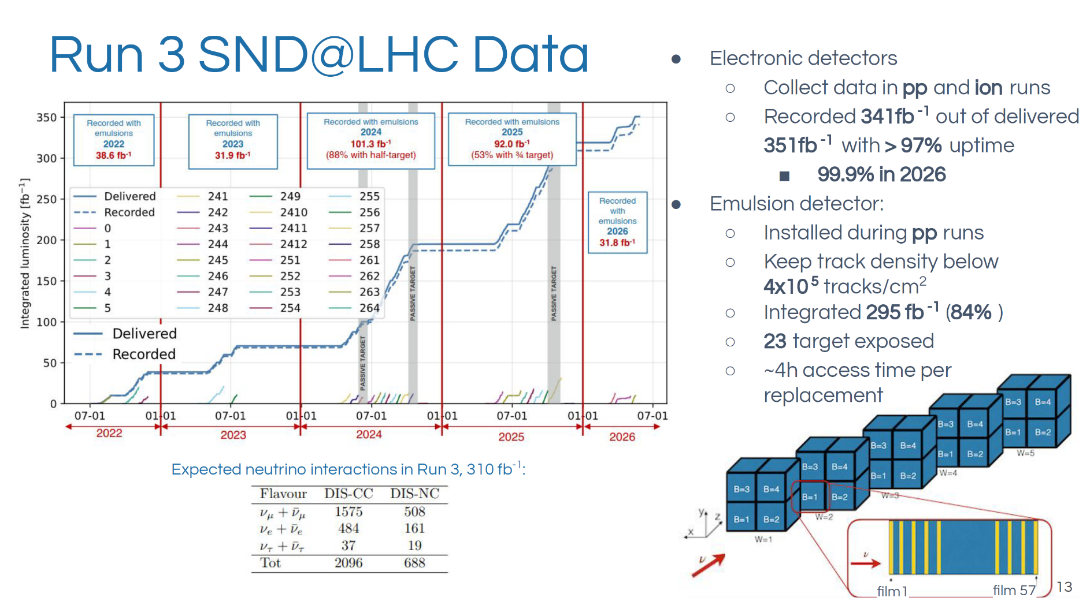

Slide 16
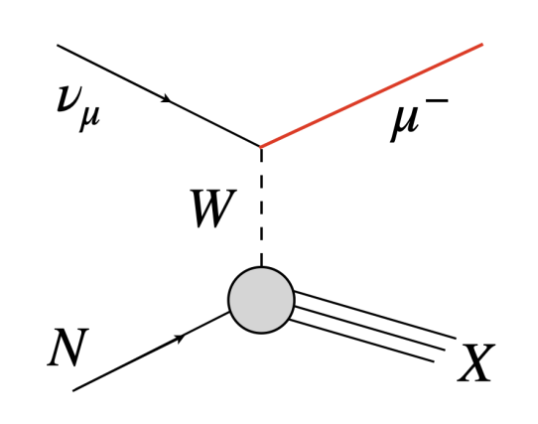
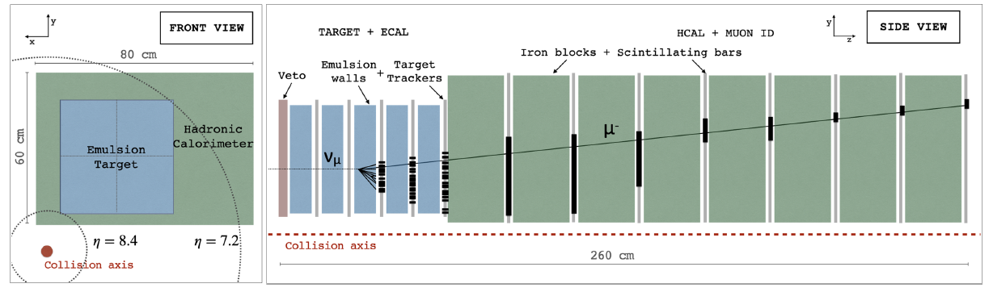
First collider ν_{μ} observation
Dominant CC process for muon neutrinos is deep inelastic scattering.
The signature of interaction : an isolated muon track in the muon system, associated with a hadronic shower (SciFi and HCAL)

Slide 17
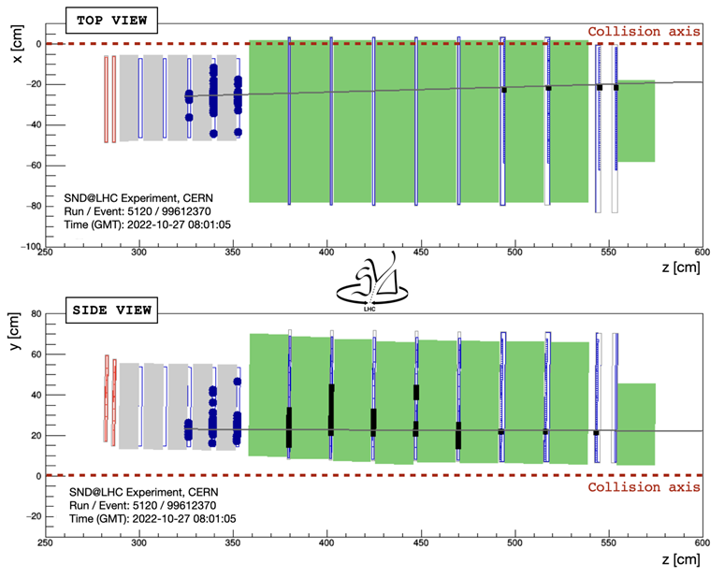
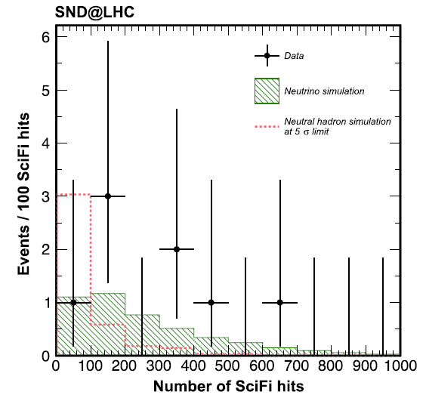
First collider ν_{μ} observation
2022 data: 36.8 fb⁻¹ at √s = 13.6 TeV. PRL 131, 031802 (2023)
8 ν_{μ} CC candidates (0.086 backgrounds), Significance 6.8 σ

Slide 18
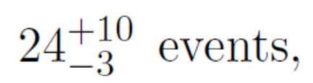

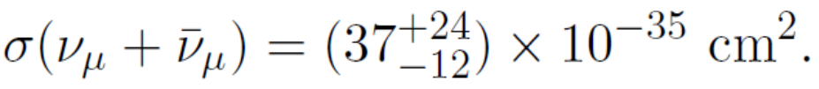
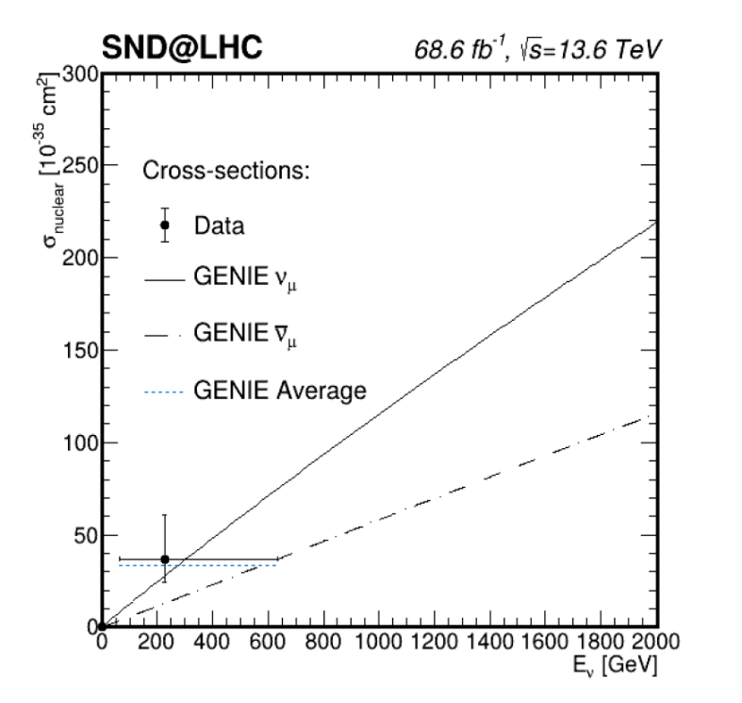
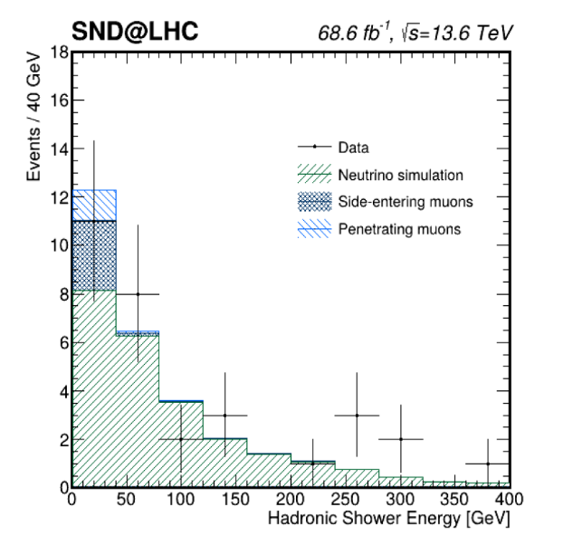
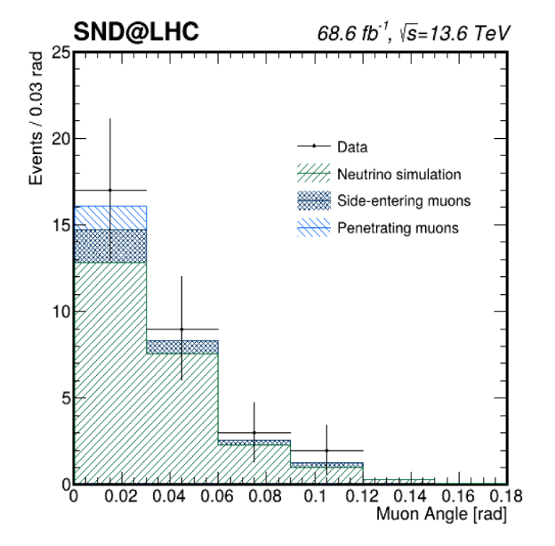
Muon-neutrino cross section
31 events observed in 68.6 fb⁻¹(2022-2023 data). arXiv : 2606.14669
Expected signal = 24 events, background = 5 events.
(Flux-averaged) measured cross section

Slide 19
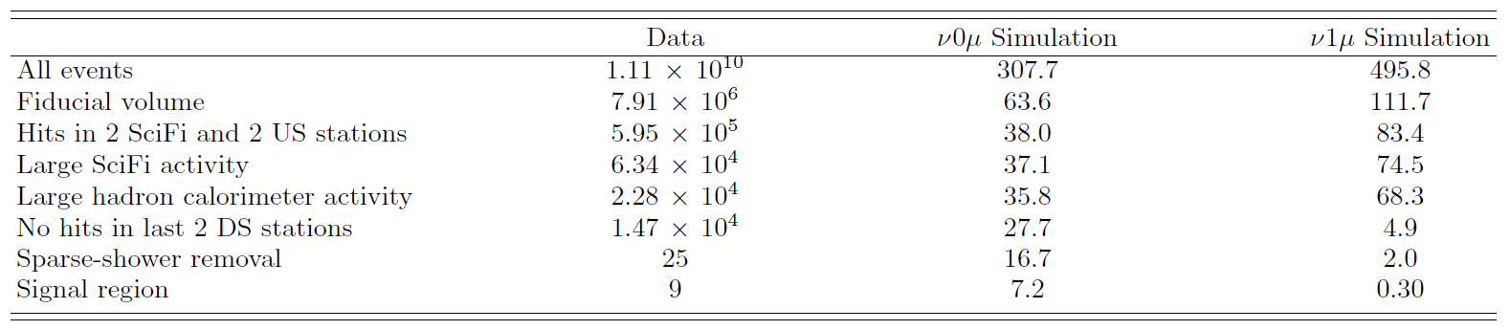
Neutrinos without final-state muons
Sensitive to charged-current interactions of ν_{e} and ν_{τ} as well as neutral-current interactions of all three neutrino flavors.
2022 and 2023 data sample : 68.6 fb⁻¹
Select muon-less shower-like events. PRL 134, 231802 (2025)

Slide 20
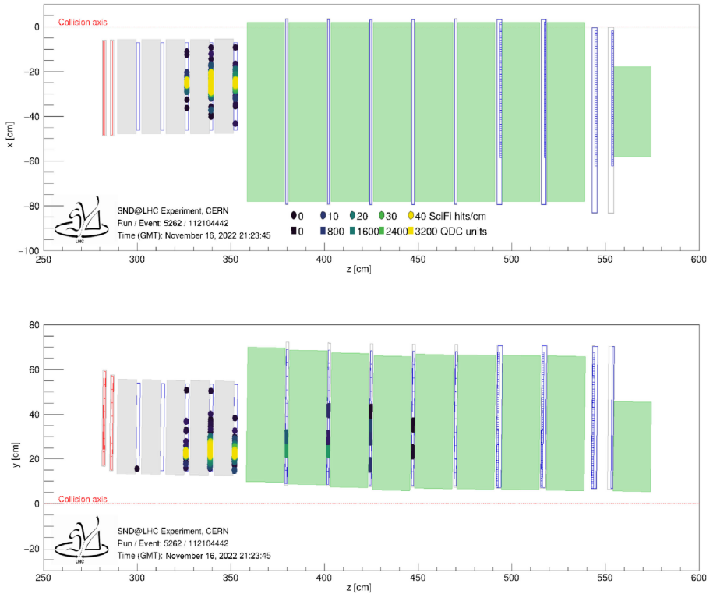
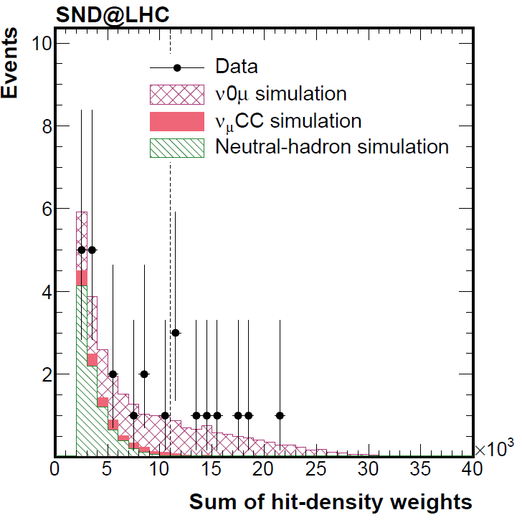
Neutrinos without final-state muons
Observed 9 events with 6.4 sigma significance
(Expected 7.2 signal events with 0.32 backgrounds)

Slide 21
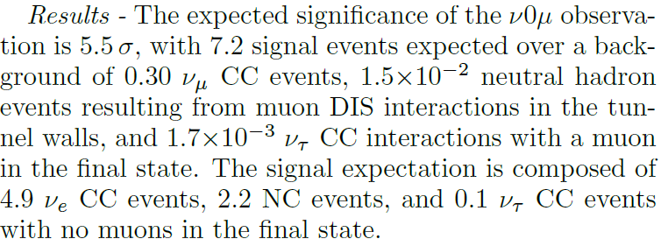
Neutrinos without final-state muons

Slide 22
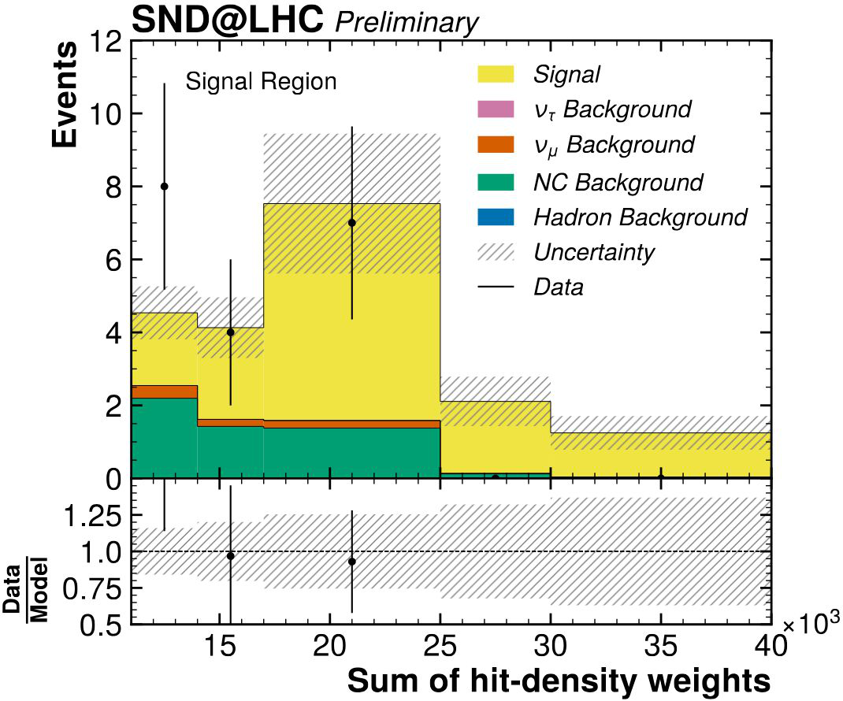
ν_{e} CC with electronic detectors
2022-2024 data: 170.6 fb⁻¹
19 observed candidates
Expected 13 ± 5 signal and
6 ± 1 background
Observed significance:
2.7σ (shape), 3.6σ (counting)
Preliminary. Shower modeling and
shape systematics are under study

Slide 23
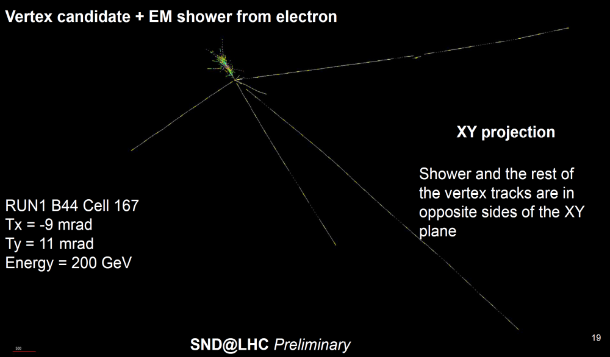
Search for ν_{e} CC with emulsion

Slide 24
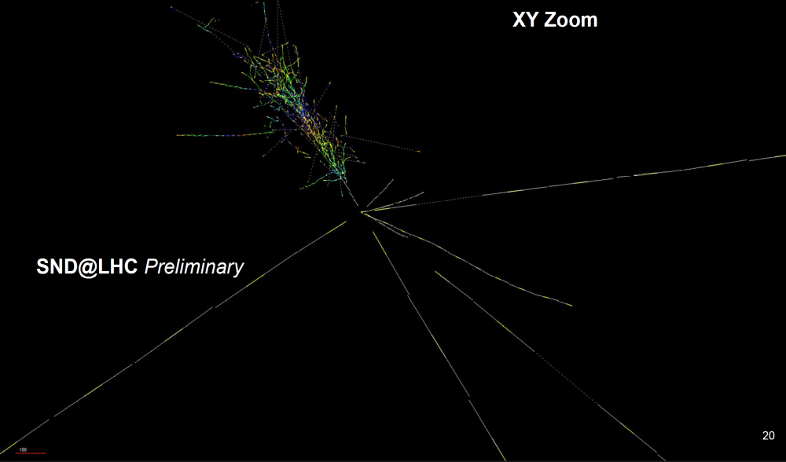
Search for ν_{e} CC with emulsion

Slide 25
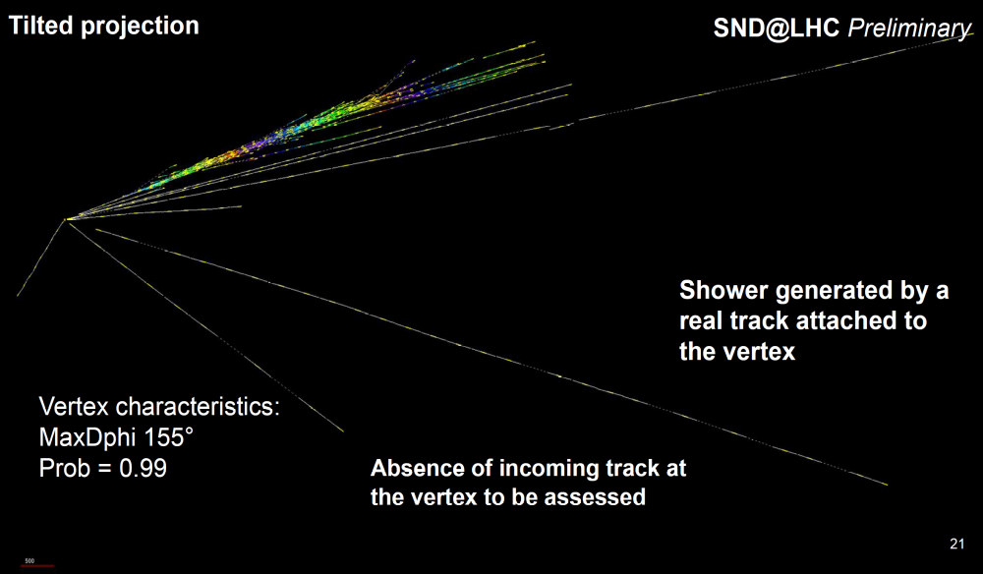
Search for ν_{e} CC with emulsion

Slide 26
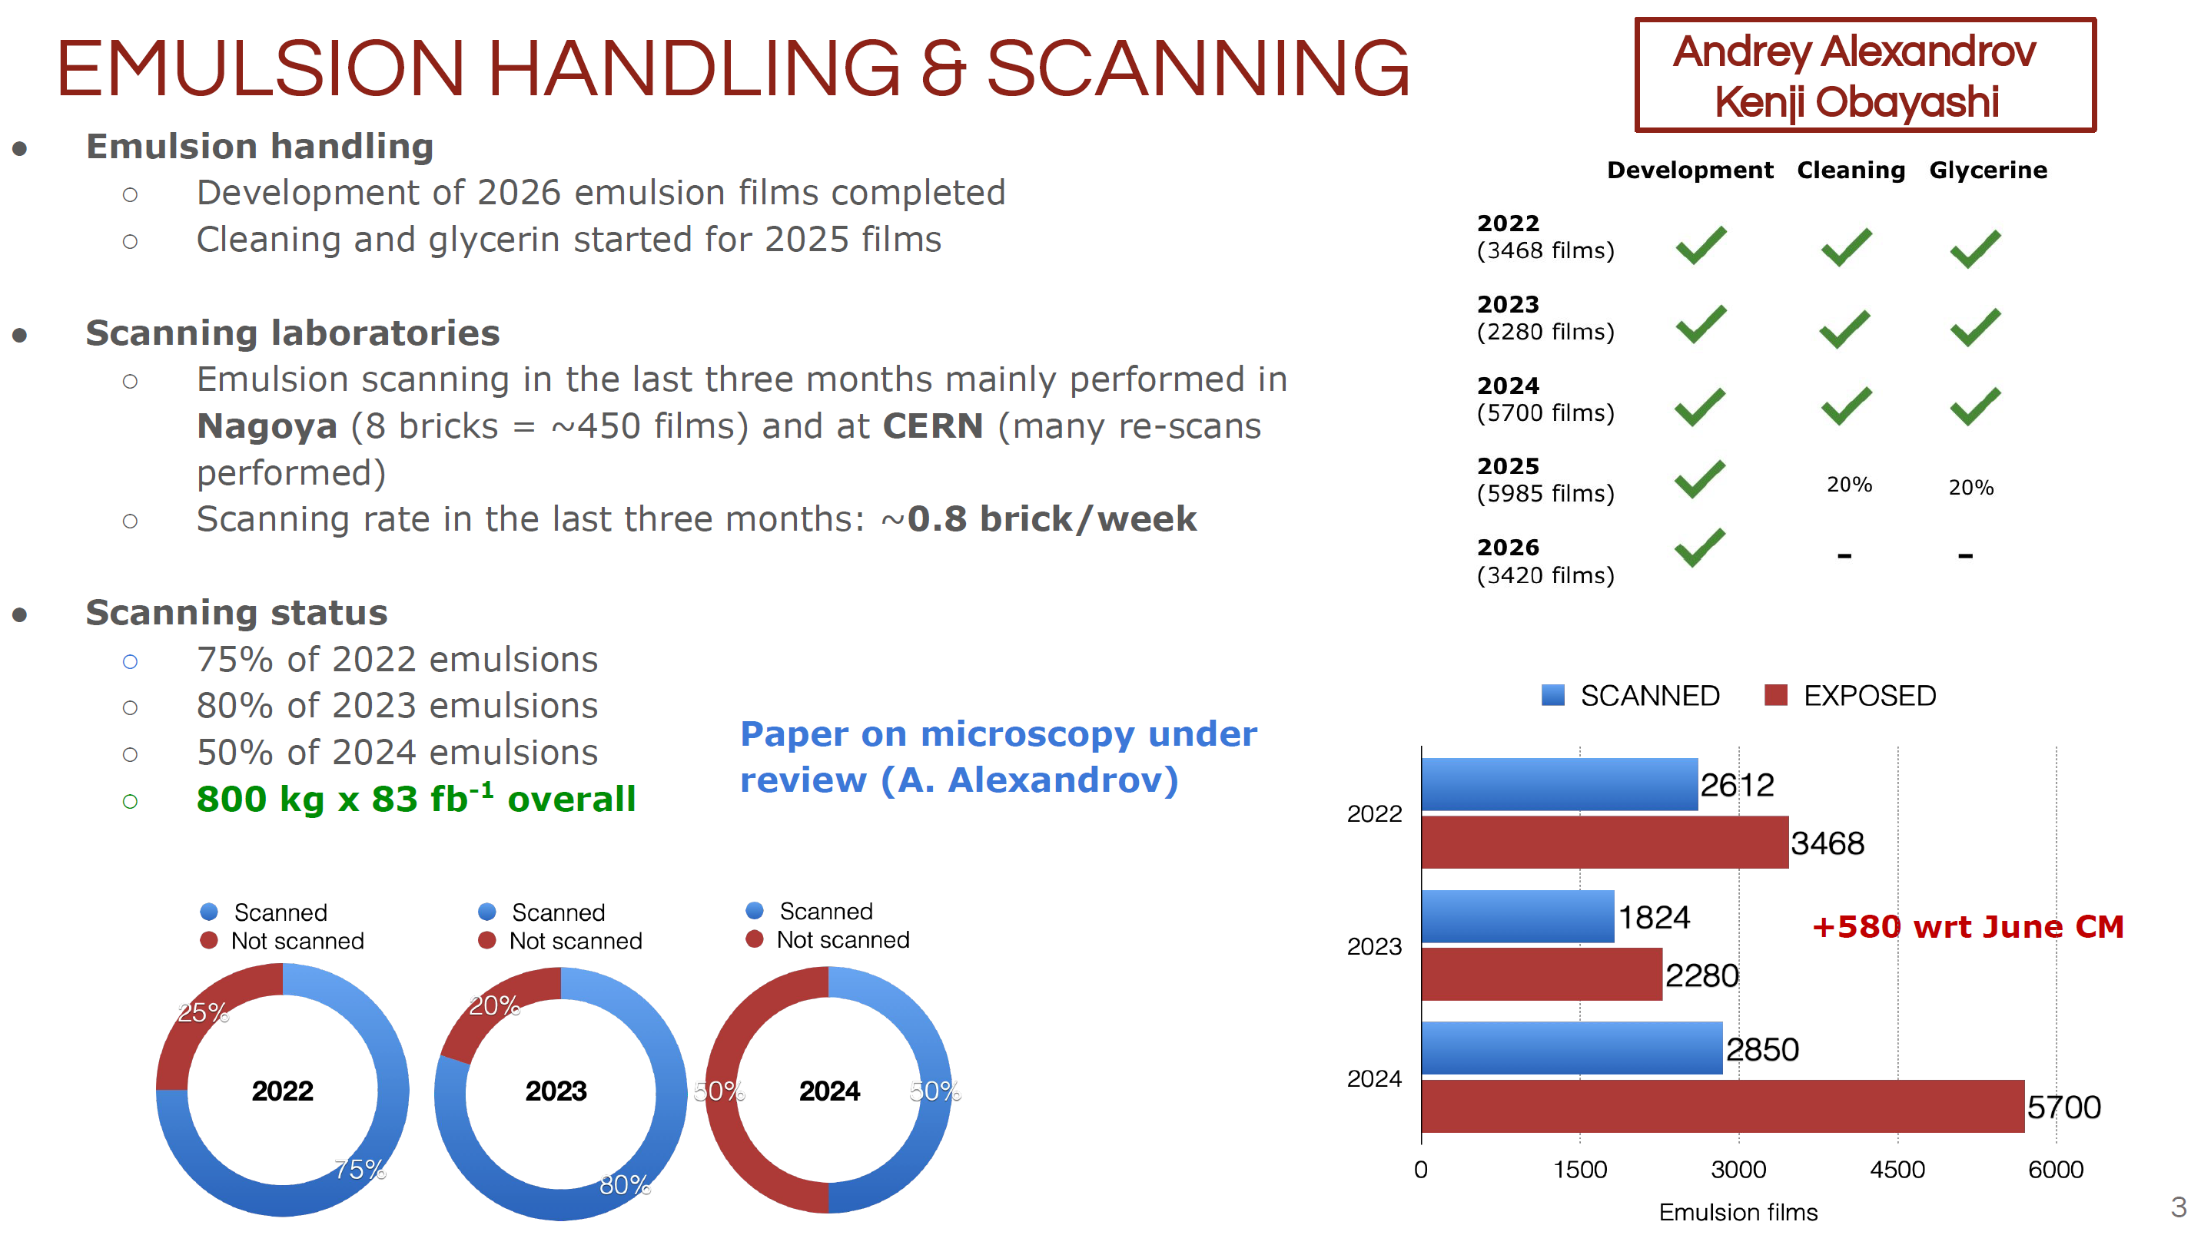

Slide 27
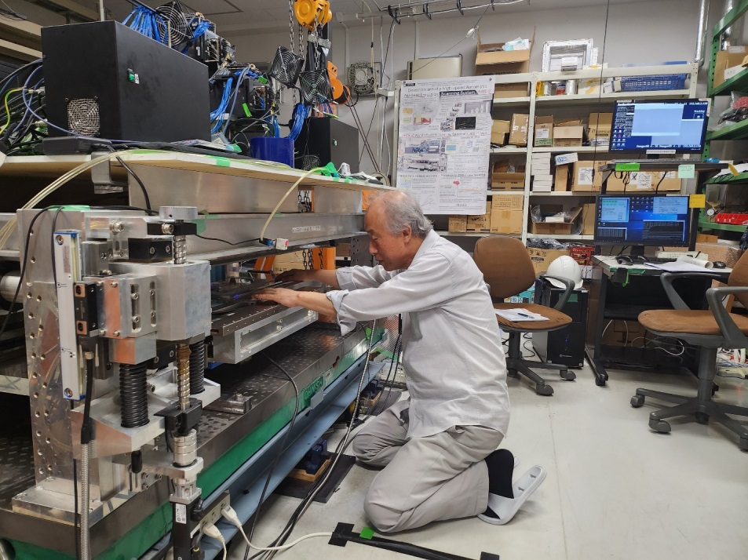
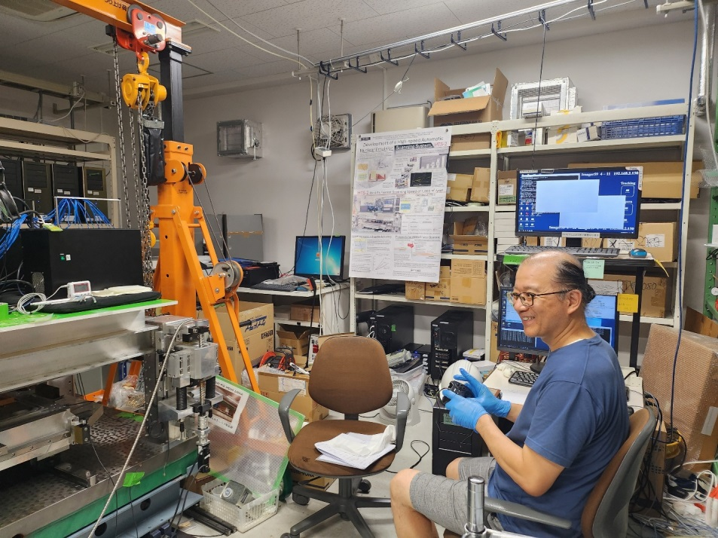
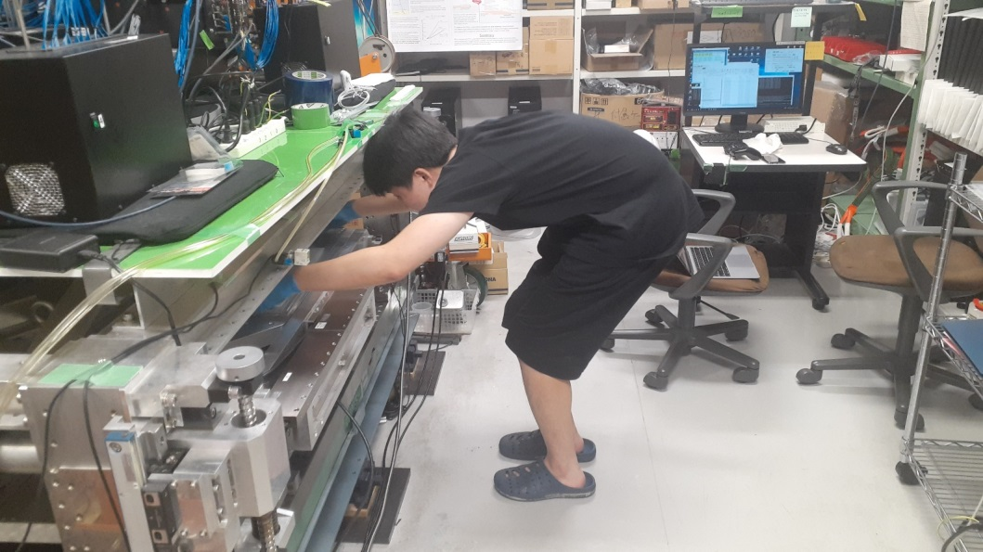
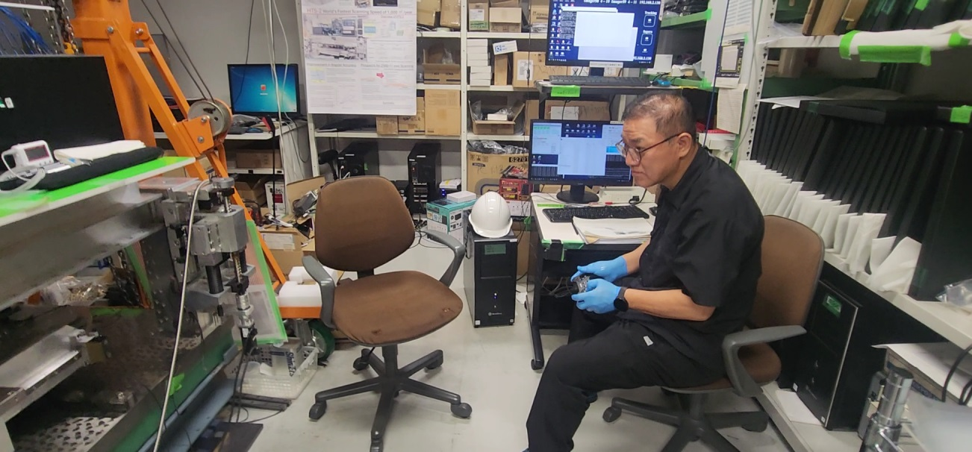
Emulsion scanning using HTS2 for SND@LHC
Notes:
저희 그룹 멤버들이 HTS2 를 사용하여 스캐닝하는 모습입니다.

Slide 28
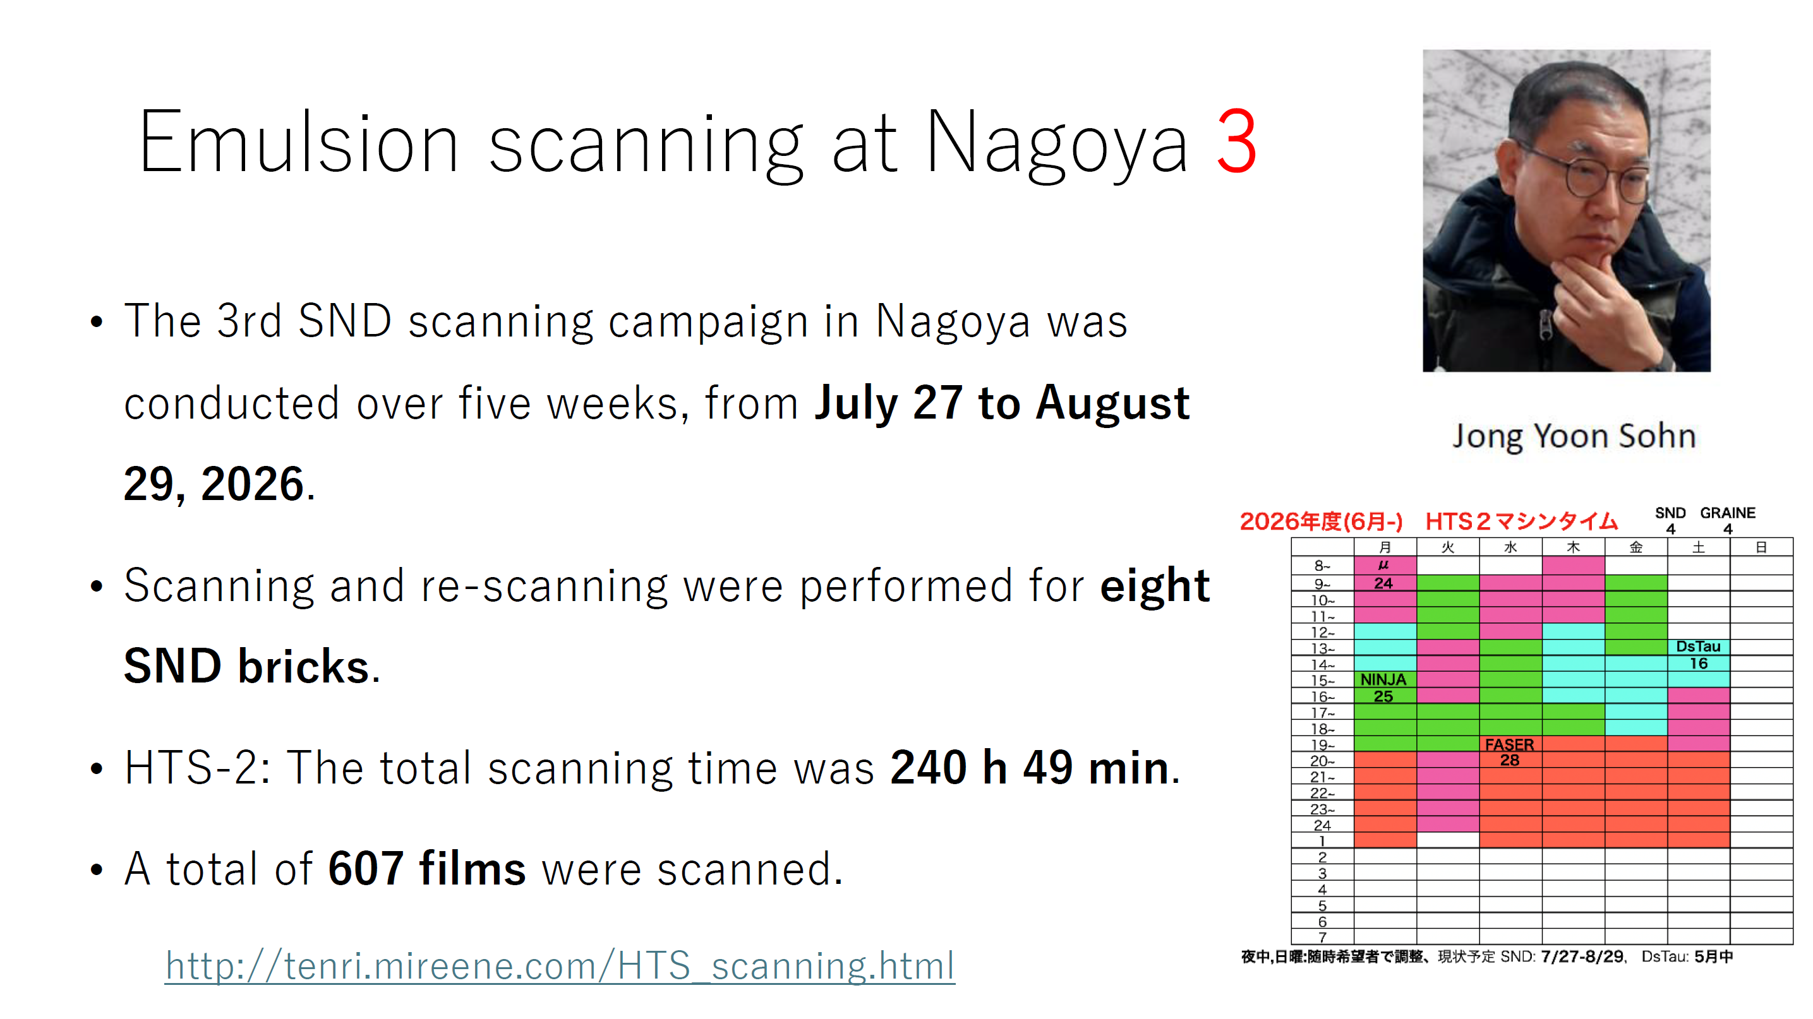

Slide 29
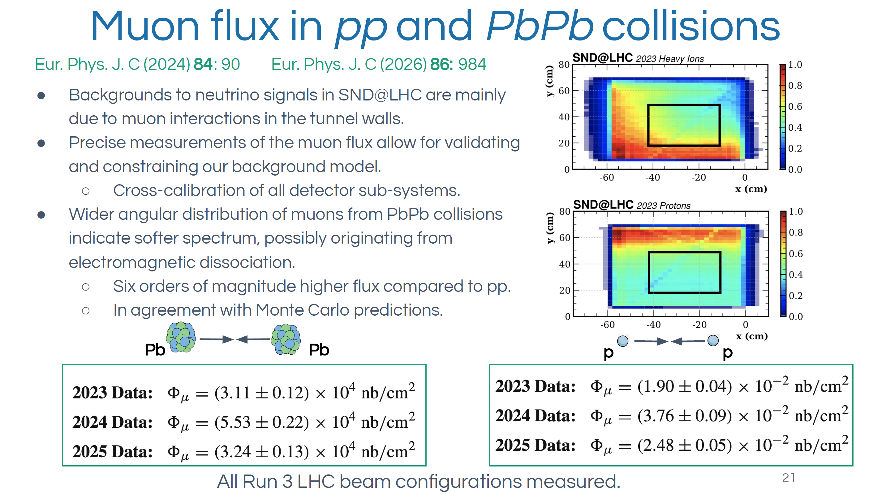

Slide 30
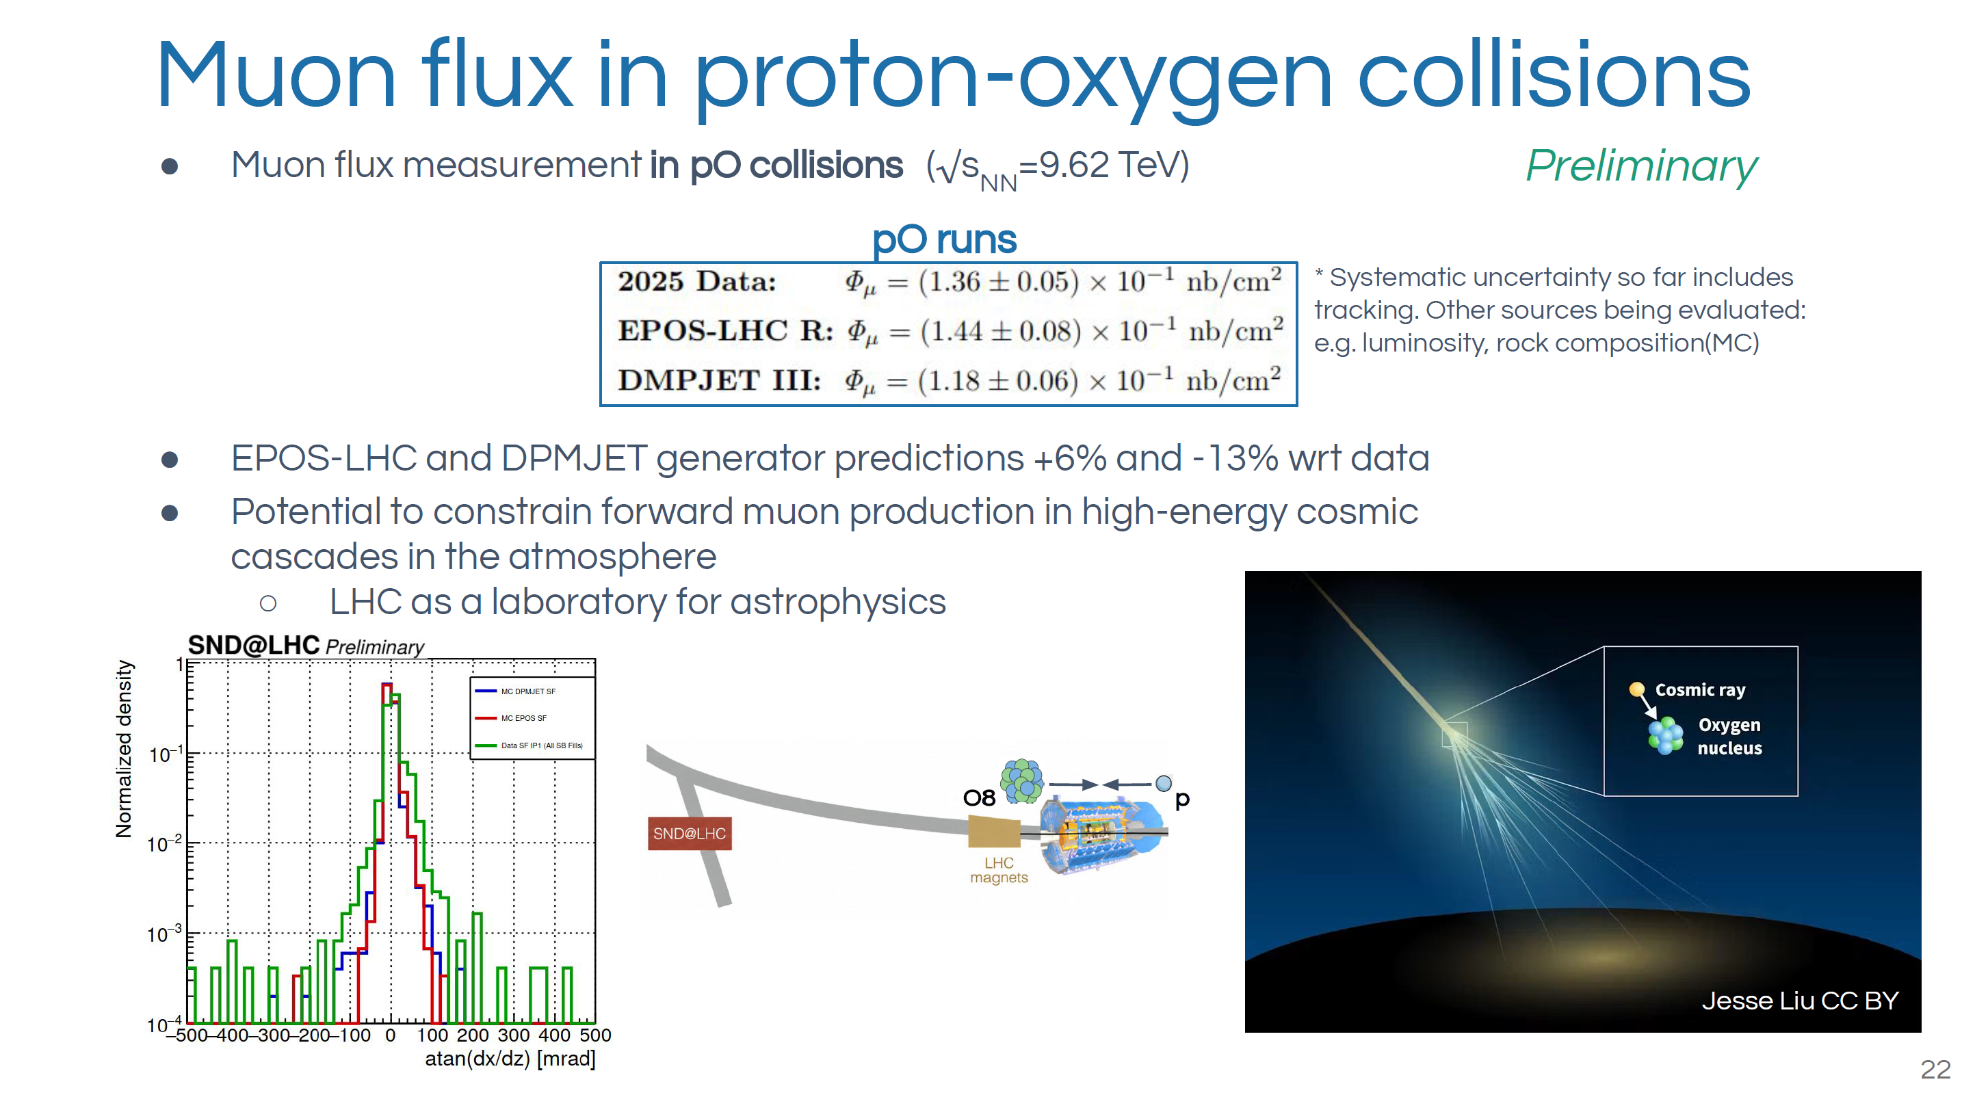

Slide 31
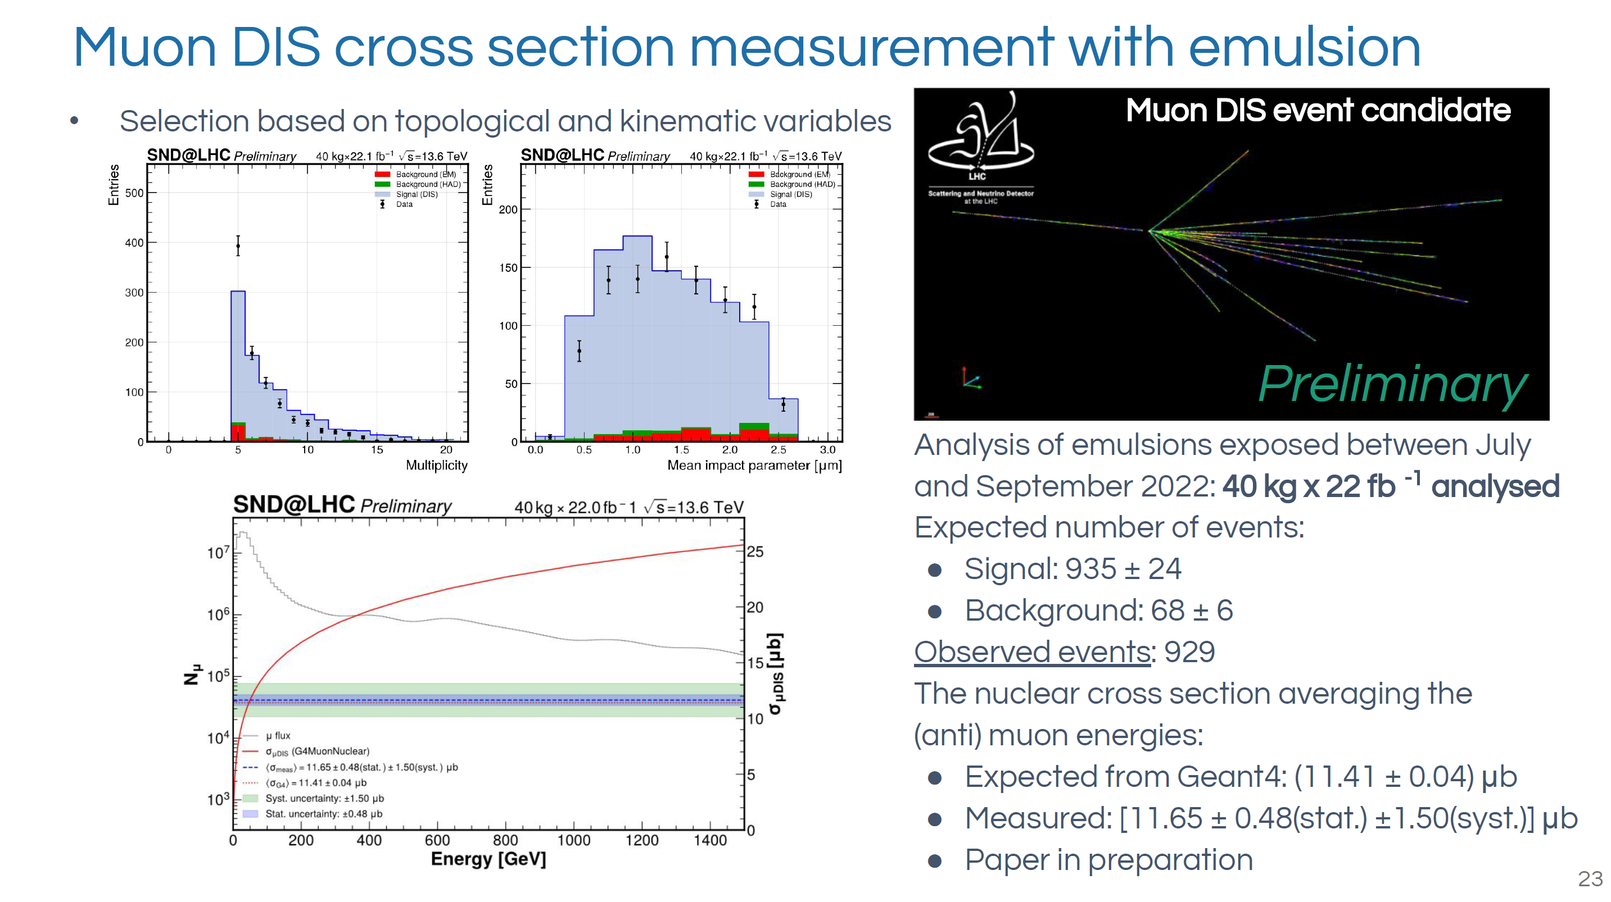

Slide 32
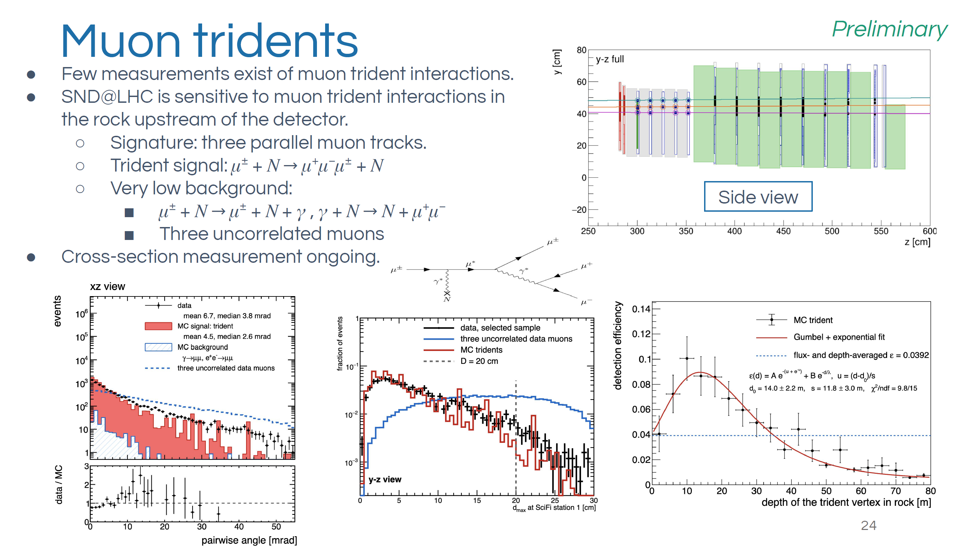

Slide 33
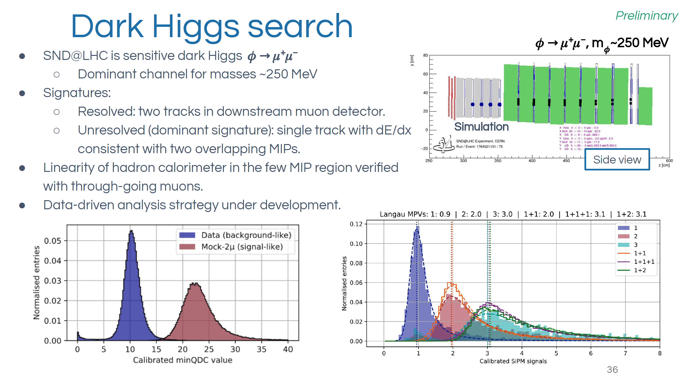

Slide 34
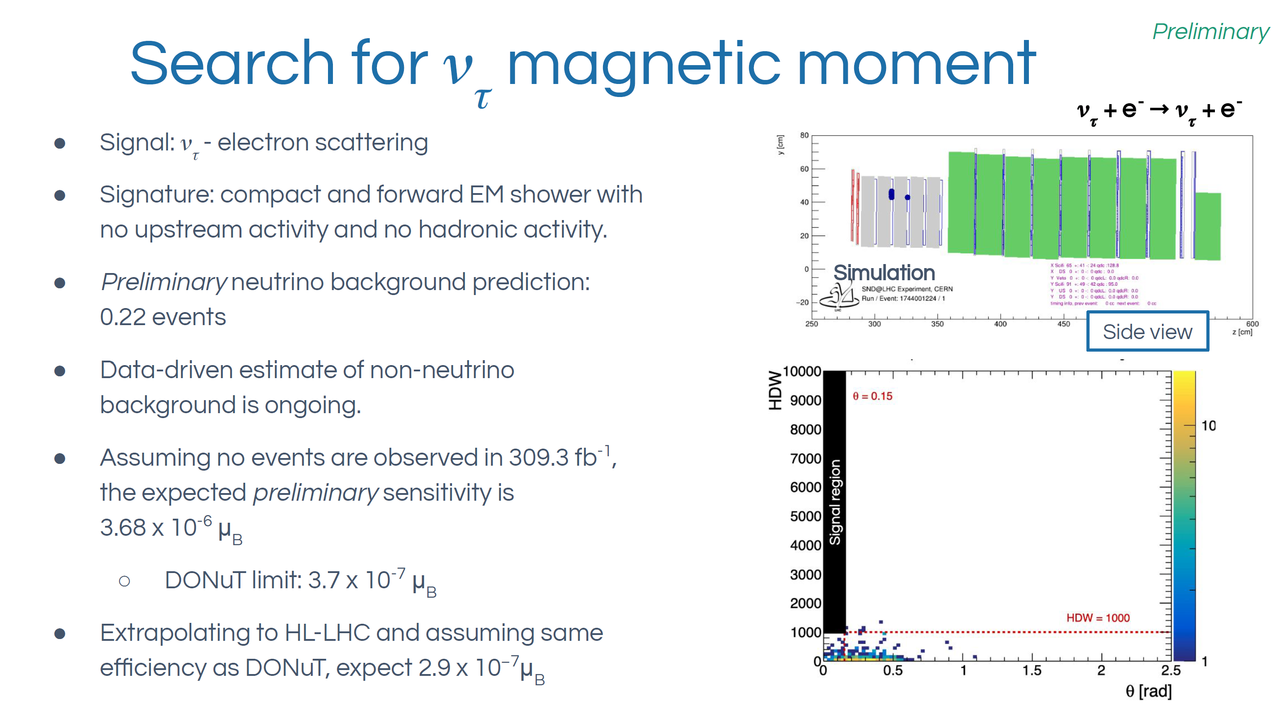

Slide 35
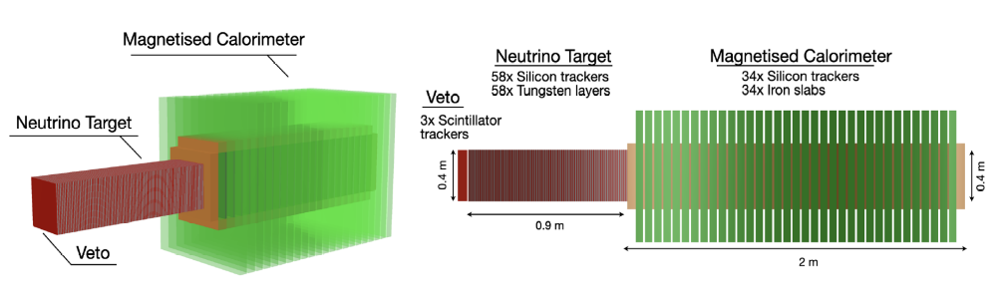
SND@LHC upgrade for HL-LHC
Silicon trackers will replace the emulsion films
Magnetised Calorimeter to measure muon momentum and charge
Potential to discover the tau anti-neutrino!

Slide 36
Summary
SND@LHC has observed muon neutrino charged-current interactions and measured their flux-averaged cross section on tungsten.
We now also have evidence for an electron neutrino component in the electronic detector data.
In parallel, the emulsion analysis is progressing, with promising electron neutrino candidates under study.
Our physics program also includes muon measurements and searches for physics beyond the Standard Model.
SND@LHC will be upgraded for the HL-LHC era, opening the way to identifying tau antineutrinos.

Slide 37
Backup

Slide 38



SND@LHC Collaboration
150 members, 24 Institutes in 14 Countries and CERN.
8 members, 4 Institutes in Korea.

Slide 39


Slide 40




Event Reconstruction

Slide 41


Tau Neutrinos
Charged current cross section

Slide 42

Neutrino-induced charm production
High-energy neutrino interactions produce charmed hadrons
Nuclear emulsion technology offers a unique possibility to identify charmed hadrons through the observation of a two vertex topology.
- Charmed-hadron production in
anti-neutrino interactions selects
the anti-strange quark in the nucleon.
- Measurement can be used to
measure the s-quark content of the nucleon,
thus providing important information for
many precision test of the SM.

Slide 43

Heavy Neutral Leptons
Production and subsequent decay of the particle N

