Slide 1
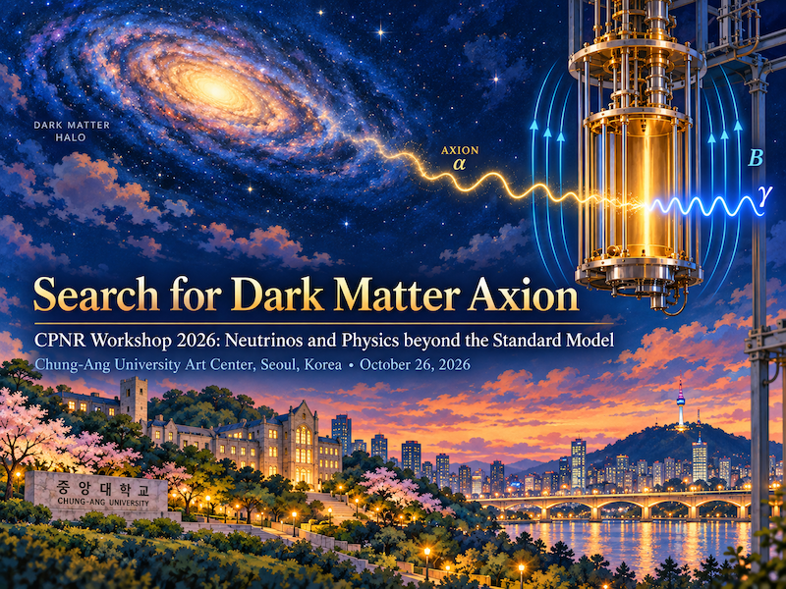
Mini-workshop on Cavities for Fundamental Physics
April 28, 2026 Tsung-Dao Lee Institute
SungWoo YOUN
Dark Matter Axion Group (DMAG)
Institute for Basic Science (IBS)

Slide 2


Dark Matter Axion

Slide 3
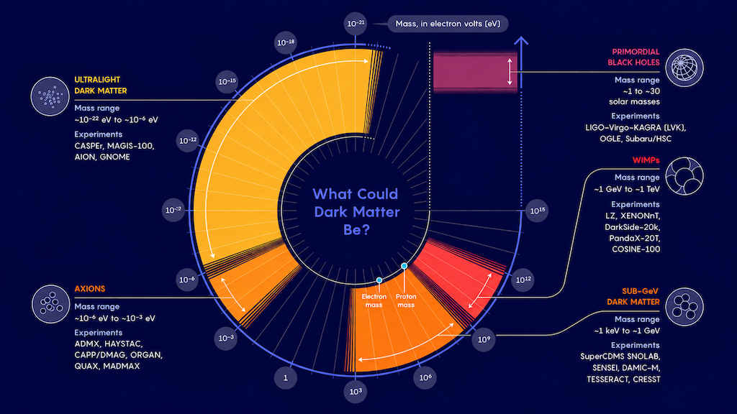
Dark matter candidates
Coherenetly oscillating waves
QCD
WIMP
Axion
Individual patricles
Strong CP problem
&
Dark matter mystery
Samuel Velasco/Quanta Magazine

Slide 4
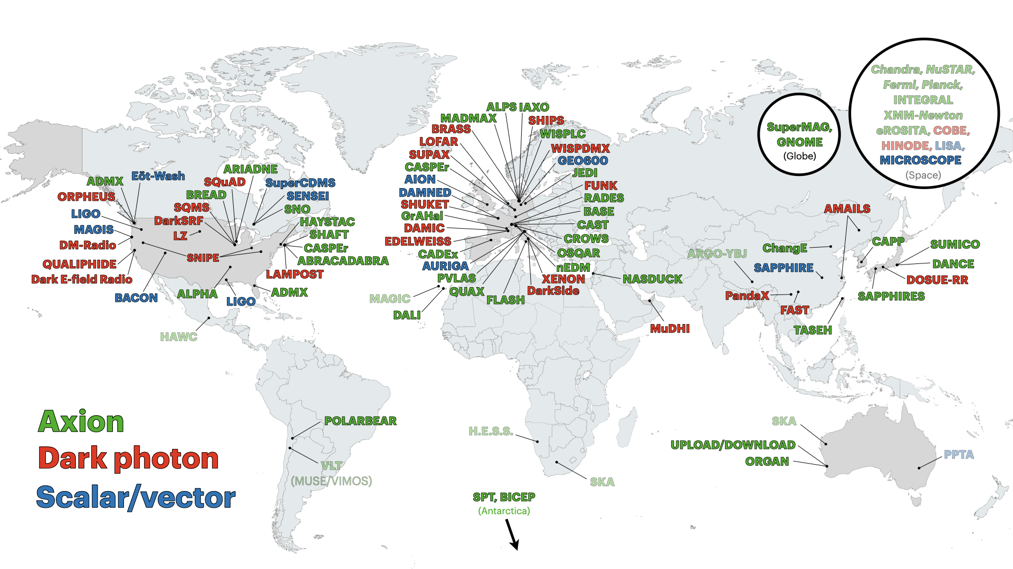
Experiment map
C. O’Hare (2020)
DMAG

Slide 5
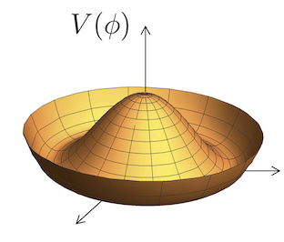
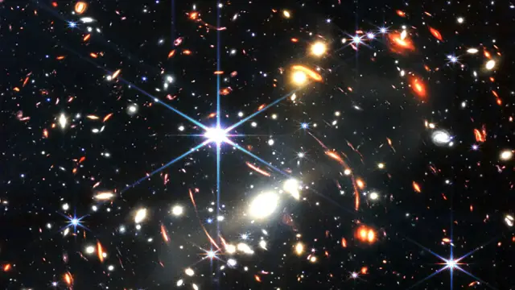
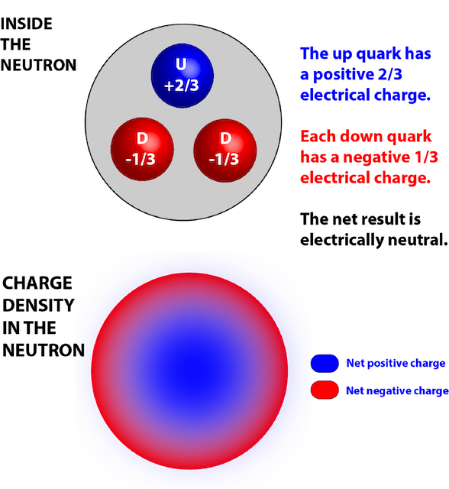
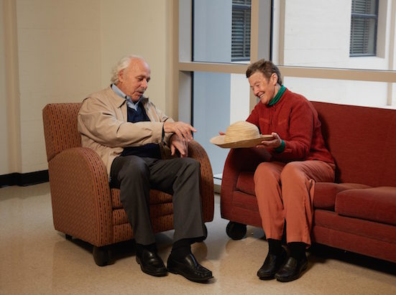
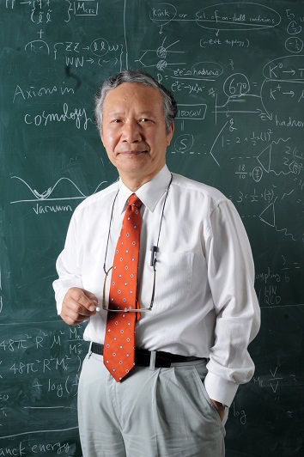
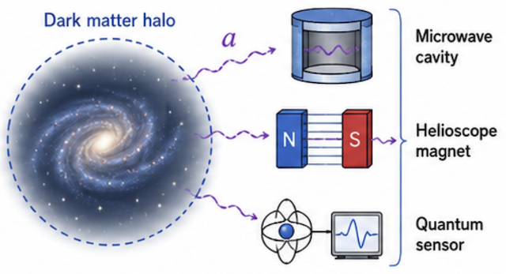

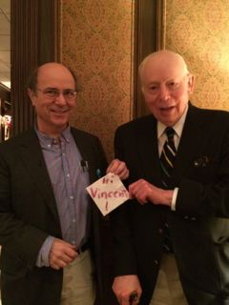
Why Axions? Why now?
Strong CP problem
PQ solution (1977)
Dark matter axion? (1983)
QCD
EXP
vs.
Neutron EDM
⇓
QCD axion (1978)
Invisible axion (1979)
Very light (sub-eV)
Weakly interacting
Early Universe
Axion = Particle Physics + Cosmology + Quantum sensing
Most underrated puzzle in all of physics ⟹ Most compelling targets in fundamental physics!

Slide 6
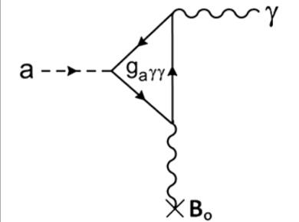
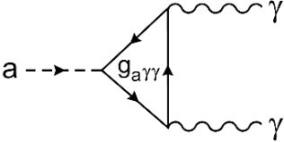
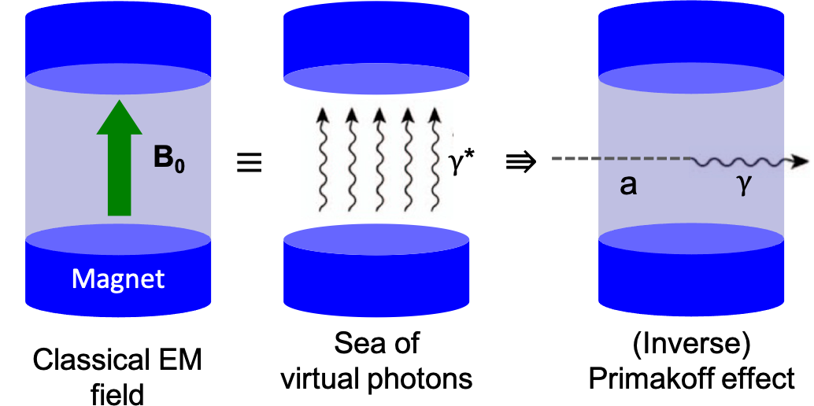
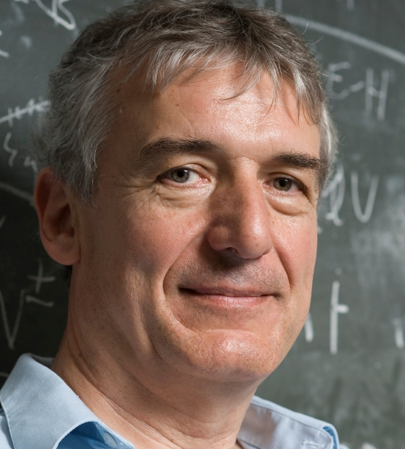
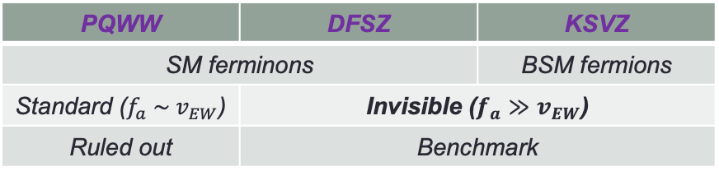
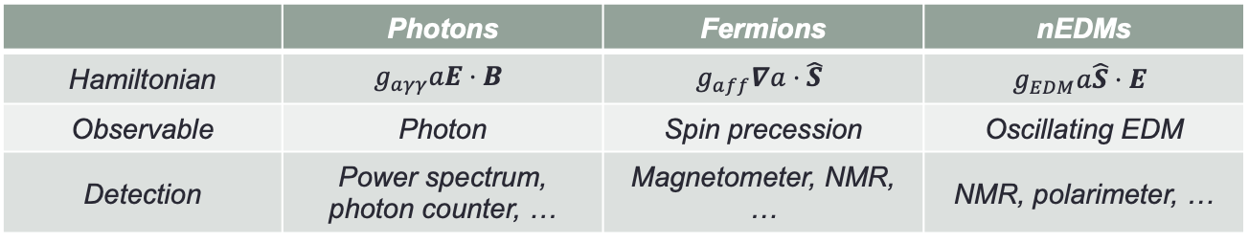
How to see it?
Axions couple with SM
Axion models
Detection principle
  Sikivie effect (1983)
  (Macroscopic Primakoff)
 | Photons | Fermions | nEDMs
Hamiltonian | $$g_{aγγ}aE⋅B$$ | $$g_{aff}∇a⋅\hat{S}$$ | $$g_{EDM}a\hat{S}⋅E$$
Observable | Photon | Spin precession | Oscillating EDM
Detection | Power spectrum, photon counter, … | Magnetometer, NMR, … | NMR, polarimeter, …
PQWW | DFSZ | KSVZ
SM ferminons |  | BSM fermions
Standard ($f_{a} \sim v_{EW}$) | Invisible ($f_{a}≫v_{EW}$)
Ruled out | Benchmark
Turning dark matter into light!

Slide 7
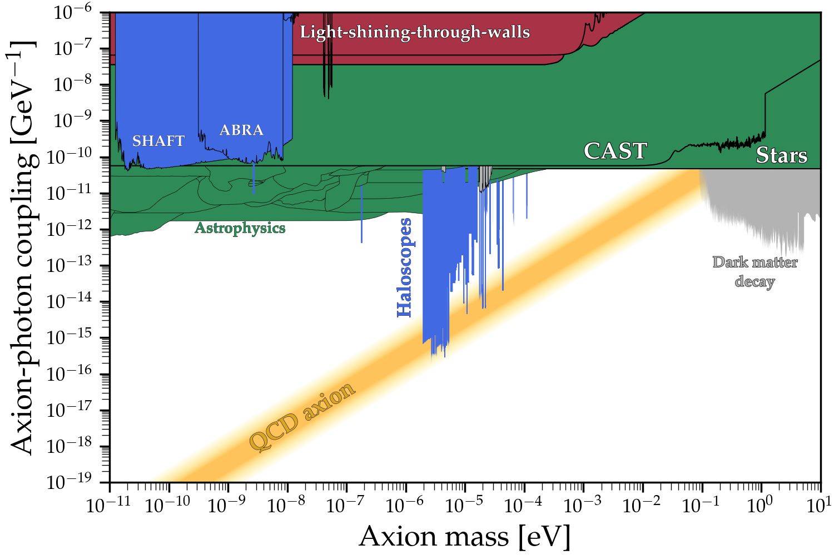
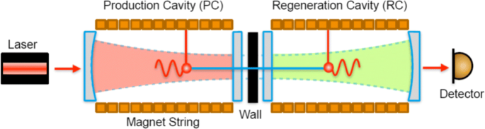
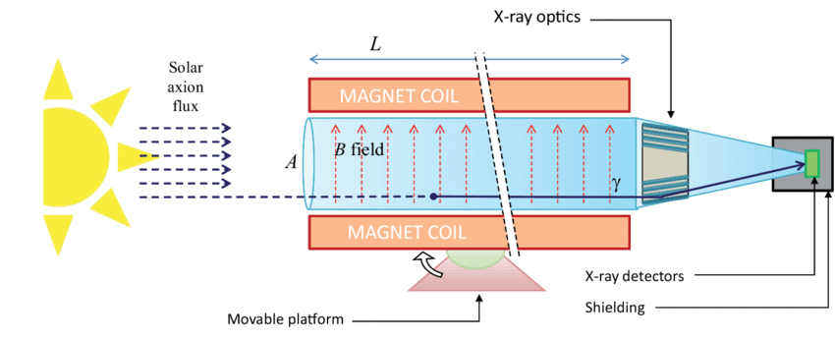
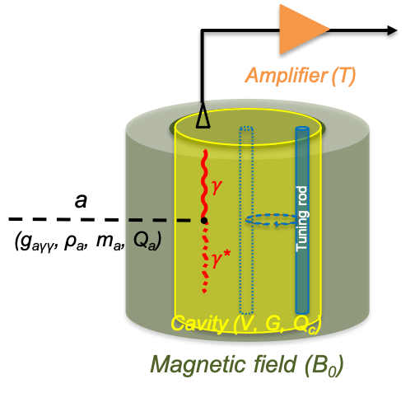


Axion search – current status
Cosmological
boundary
Astrophysical constraints
$μ$eV (GHz)
~10 photons/day
Helioscope (solar axion)
LSW (axion at lab)
~1 photon/day
$μ$eV (GHz)
Haloscope (DM axion)
~100 photons/sec

Slide 8
Cavity Haloscopes

Slide 9
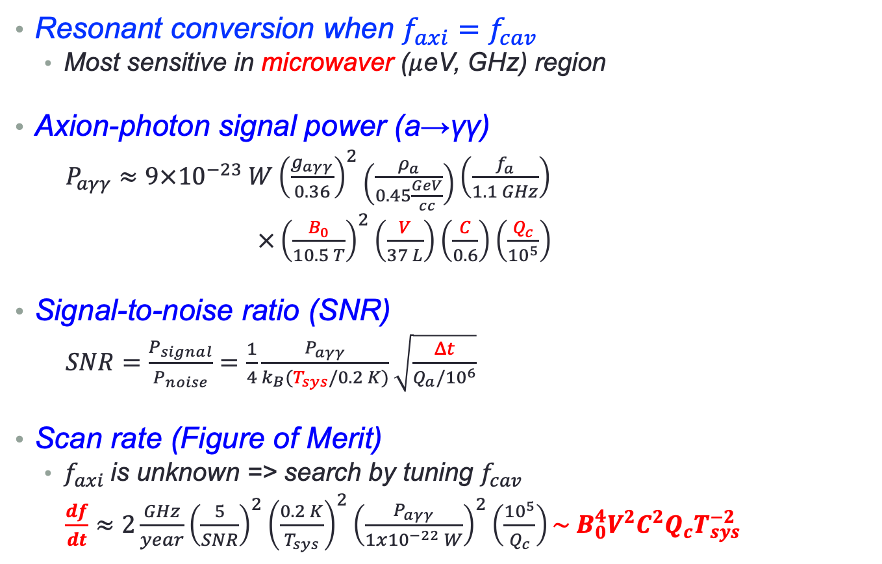
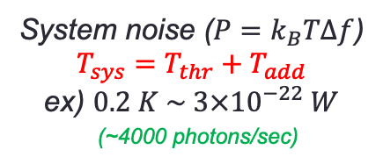
Cavity haloscope
Resonant conversion when $f_{axi}=f_{cav}$
  Most sensitive in microwaver ($μ$eV, GHz) region
Axion-photon signal power (a→γγ)
  $P_{aγγ}≈9×{10}^{−23} W{\left(\frac{g_{aγγ}}{0.36}\right)}^{2}\left(\frac{ρ_{a}}{0.45\frac{GeV}{cc}}\right)\left(\frac{f_{a}}{1.1 GHz}\right)$
  $×{\left(\frac{B_{0}}{10.5 T}\right)}^{2}\left(\frac{V}{37 L}\right)\left(\frac{C}{0.6}\right)\left(\frac{Q_{c}}{{10}^{5}}\right)$
Signal-to-noise ratio (SNR)
  $SNR=\frac{P_{signal}}{P_{noise}}=\frac{1}{4}\frac{P_{aγγ}}{k_{B}(T_{sys}/0.2 K)}\sqrt{\frac{Δt}{Q_{a}/{10}^{6}}}$
Scan rate (Figure of Merit)
  $f_{axi}$is unknown => search by tuning $f_{cav}$
  $\frac{df}{dt}≈2\frac{GHz}{year}{\left(\frac{5}{SNR}\right)}^{2}{\left(\frac{0.2 K}{T_{sys}}\right)}^{2}{\left(\frac{P_{aγγ}}{1x{10}^{−22} W}\right)}^{2}\left(\frac{{10}^{5}}{Q_{c}}\right)\sim B_{0}^{4}V^{2}C^{2}Q_{c}T_{sys}^{−2}$
(~100 photons/sec)
System noise ($P=k_{B}TΔf$)
$$T_{sys}=T_{thr}+T_{add}$$
ex) $0.2 K \sim 3×{10}^{−22} W$
(~4000 photons/sec)

Slide 10
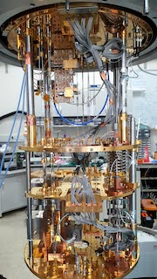
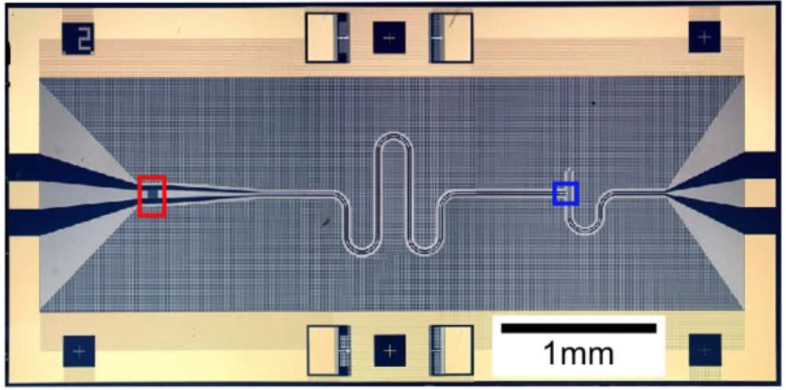
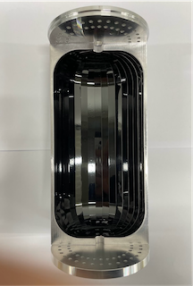
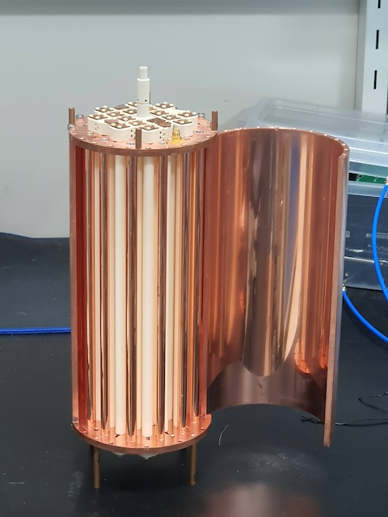
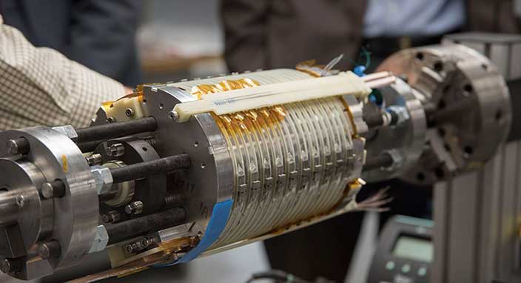

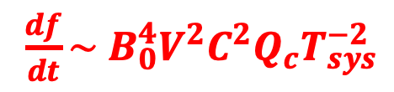


Cavity haloscope – in a nutshell
Leading sensitivity in the microwave region
Cryogenics T
$\frac{df}{dt}\sim B_{0}^{4}V^{2}C^{2}Q_{c}T_{sys}^{−2}$
Quantum noise limited amplifier T
P_{sig} ~ 10^{–23} W
(~100 photons/s)
Signal amplification
w/ minimal noise
Thermal noise reduction
$$a$$
$$γ$$
Tunable High-Q resonator
V, Q, C, Δf
High field Magnet B
$γ$*
Resonant enhancement f_{axion} = f_{cavity}
Boosting a→γγ conversion
Extreme conditions!
Signal enhancement

Slide 11
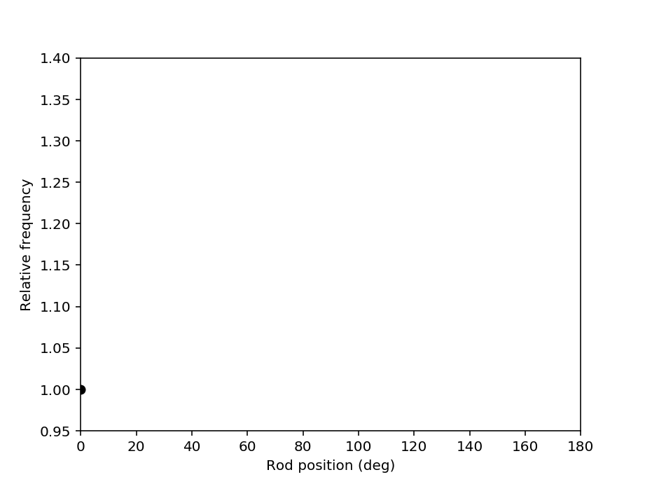
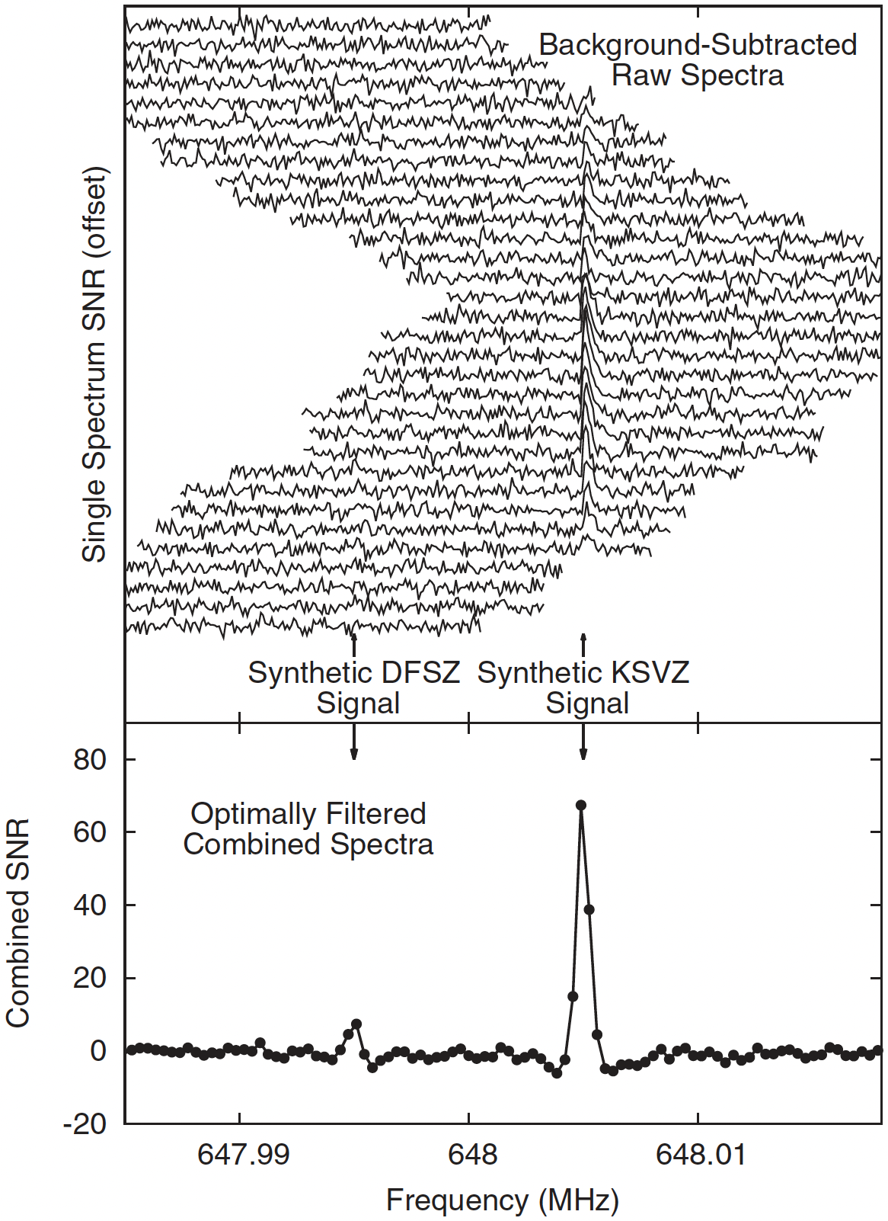

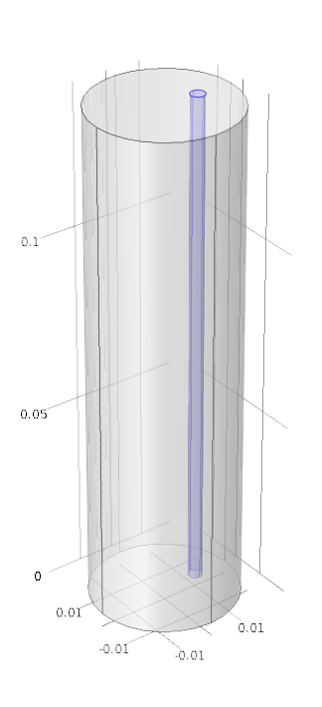
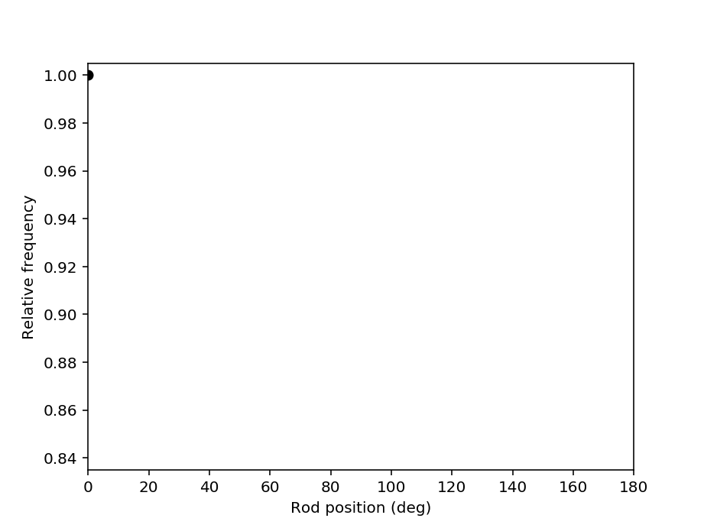

Freq. tuning and power spectrum
Conductor
Dielectric

Slide 12
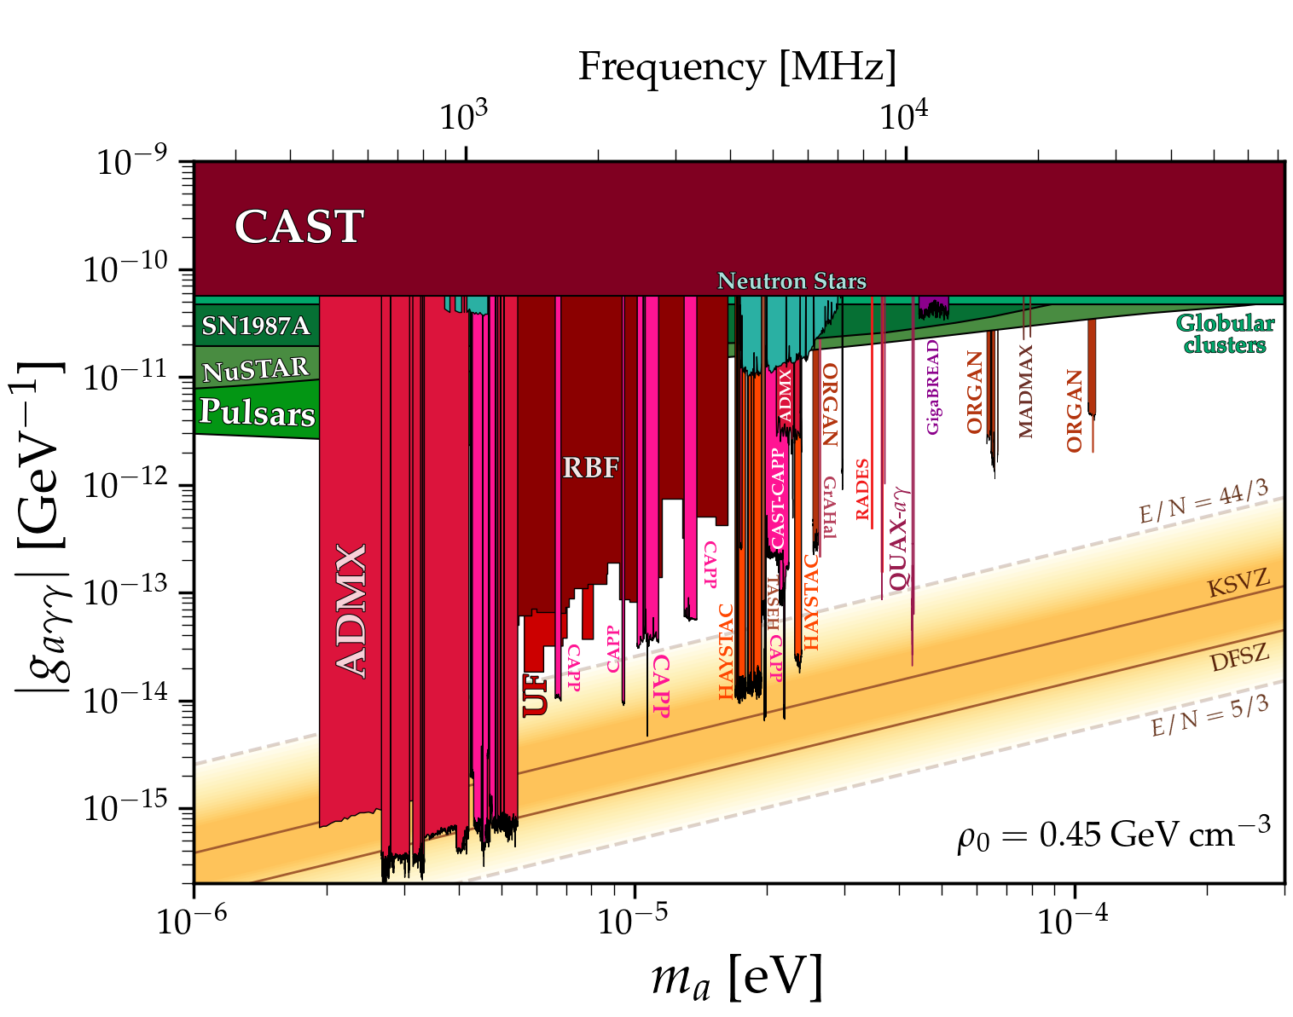
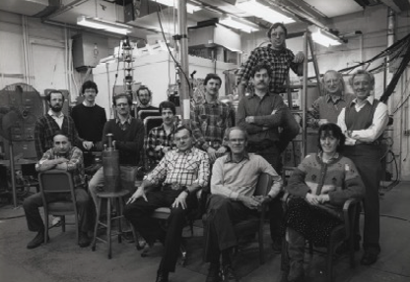
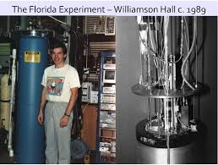
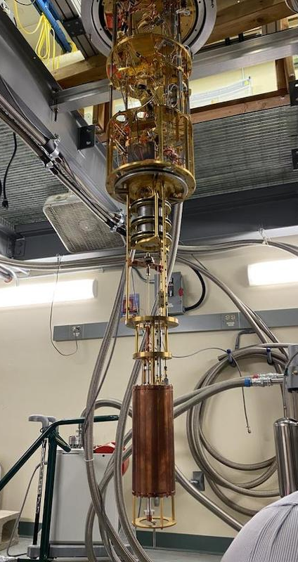
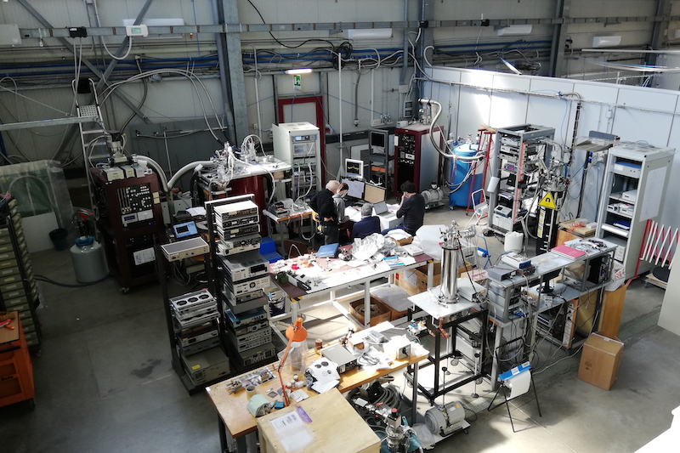
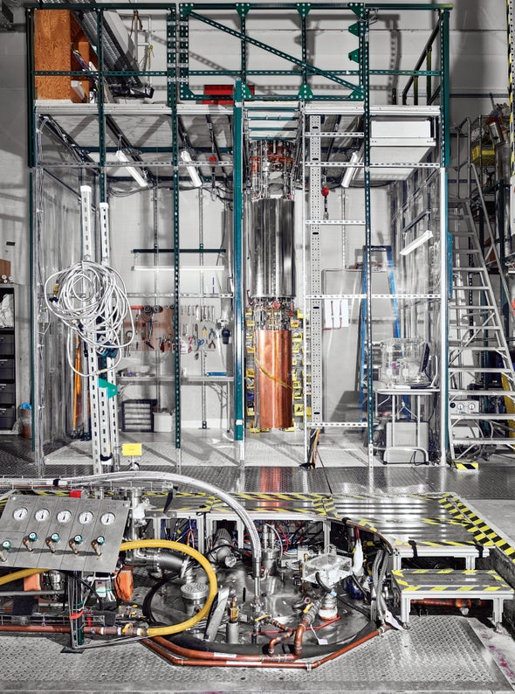
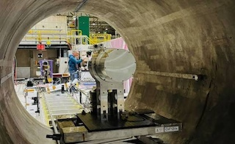
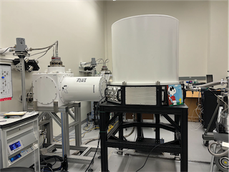
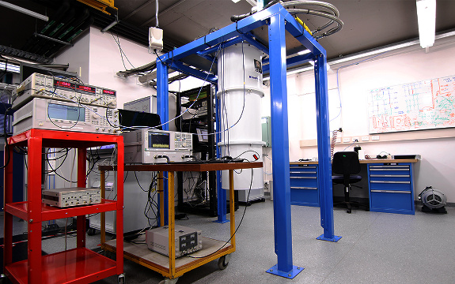
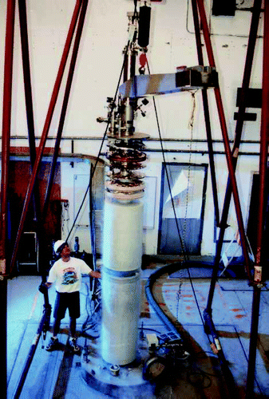
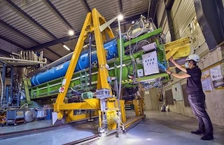
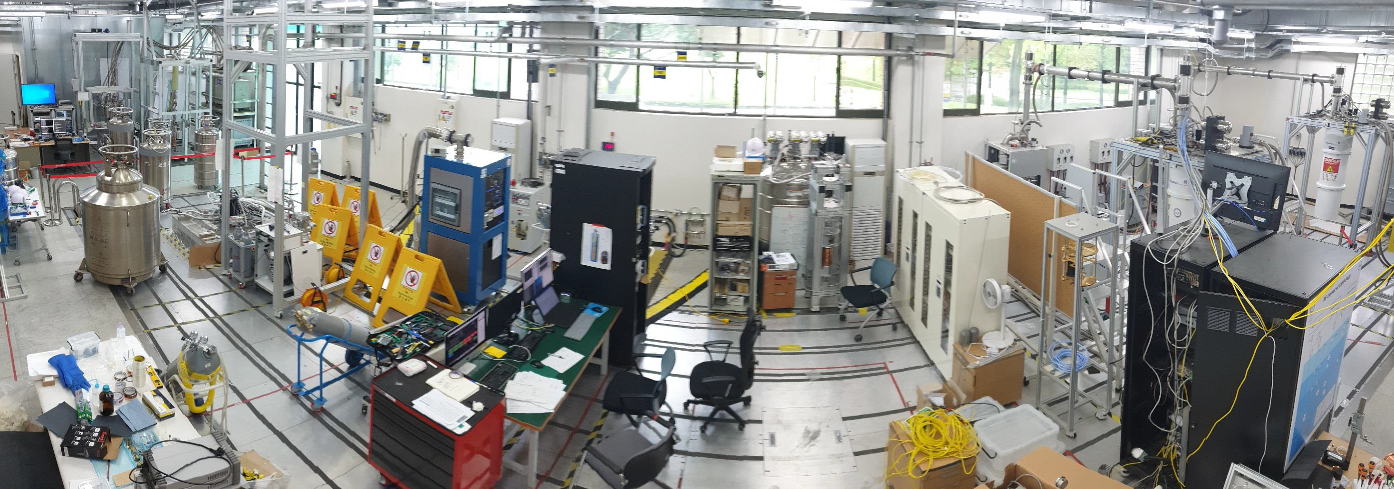
History of haloscopes

Slide 13
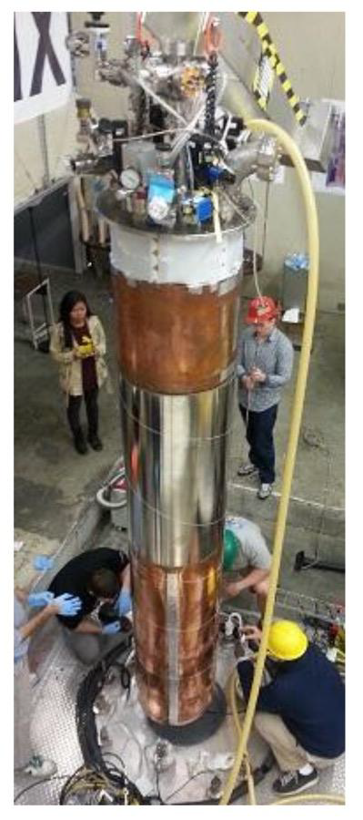
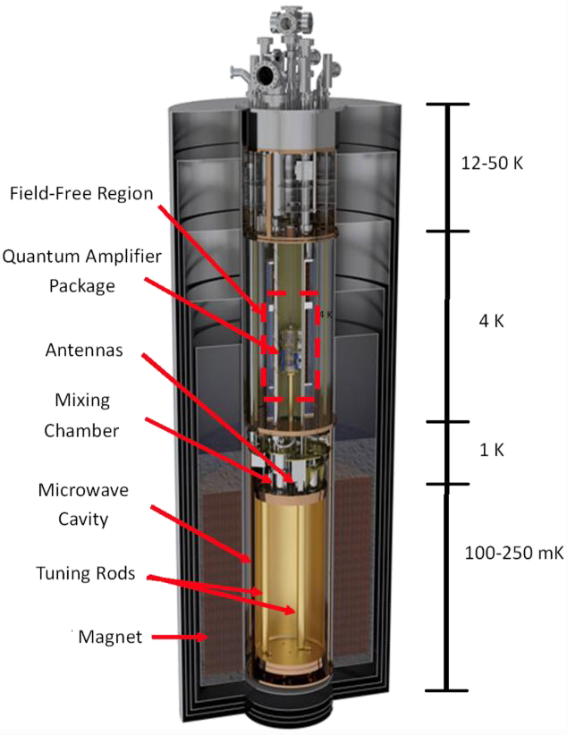
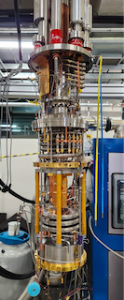

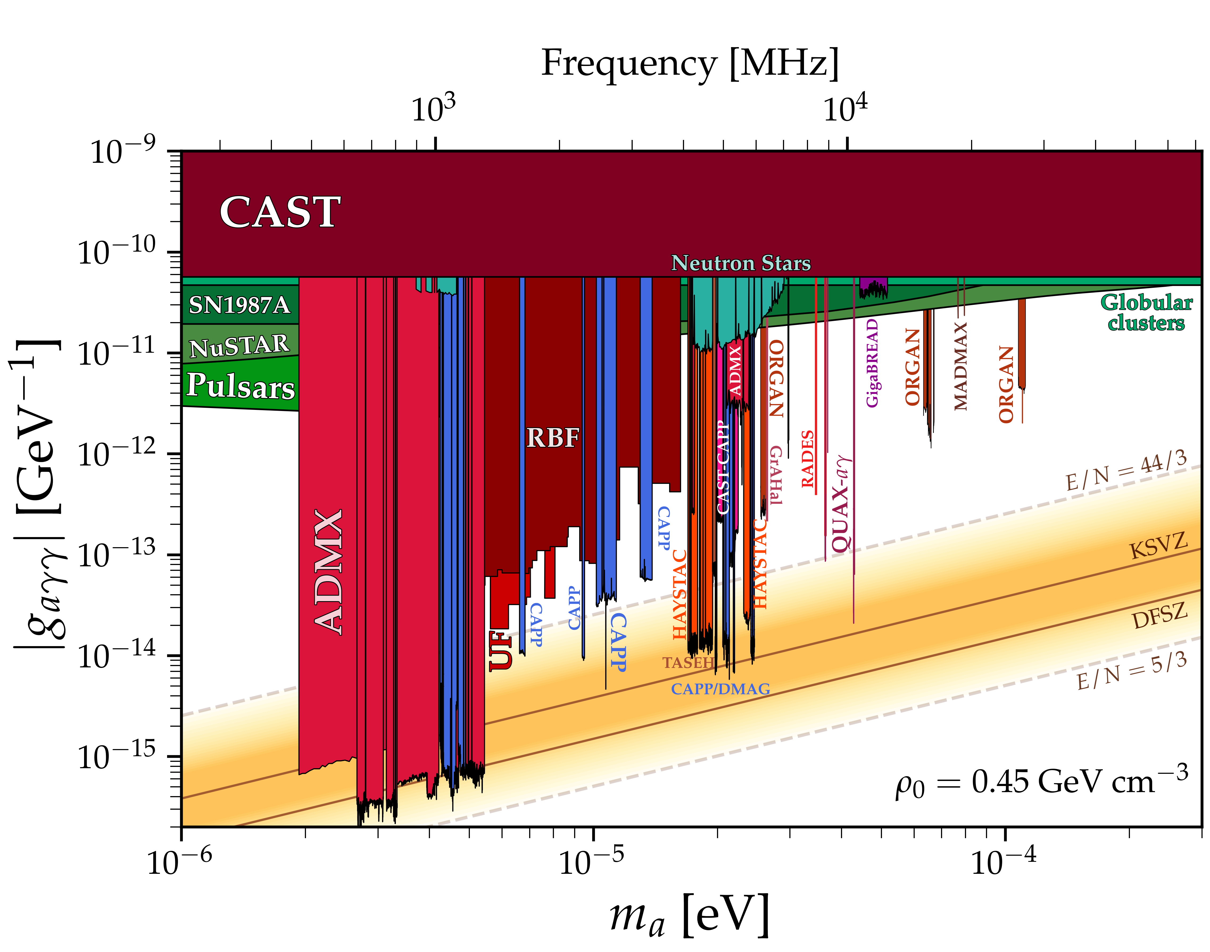
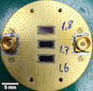
Leading haloscopes
ADMX
Magnet | 8T / 600mm
Cavity | Cu (150 L)
T_{phy} | 100 mK
Receiver | JPA
T_{sys} | 600 mK
CAPP⇒DMAG
Magnet | 12T / 320mm
Cavity | Cu/HTS (40 L)
T_{phy} | 30 mK
Receiver | JPA
T_{sys} | 200 mK

Slide 14
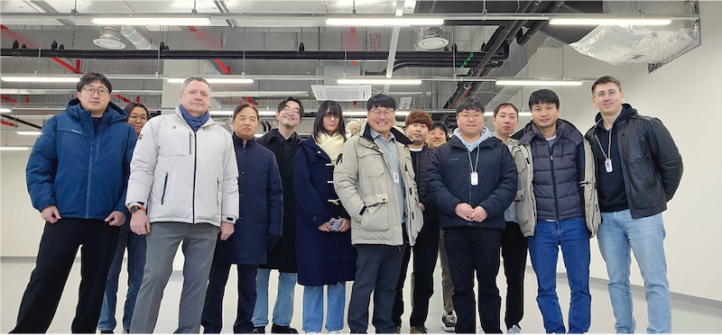
IBS-DMAG (2025 –)
Institute for Basic Science - Dark Matter Axion Group
13 researchers (3 foreighers, 2 women)

Slide 15





Equipment
$$\frac{df}{dt}\sim B^{4}V^{2}C^{2}Q_{L}T_{syst}^{−2}$$
Magnets
Refrigerators
Experiments
Manufacture | B_{max} [T] | Bore [mm]
Oxford | 12 | 320
AMI | 8 | 165
AMI | 12 | 96
AMI | 8 | 125
Manufacture | Model | T_{B} [mK]
Leiden | DRS1000 | 5
BlueFors | LD400 | 10
BlueFors | LD400 | 10
BlueFors | LD400 | 10
BlueFors | LD400 | 10
Name
DMAG-12TB
DMAG-8TB
DMAG-12T
DMAG-8T
Quantum Sensors
DMAG-12TB
DMAG-8TB
DMAG-12T
DMAG-8T
Conducting parallel experiments targeting different mass regions!
Notes:
Start, describe, discuss, make a few wards

Slide 16
R&D Activities

Slide 17







Superconducting cavities
$$\frac{df}{dt}\sim B^{4}V^{2}C^{2}Q_{L}T_{syst}^{−2}$$
PRD 99 101101 (2019)
$$Q≡ω\frac{U}{P_{d}}∝\frac{1}{R_{s}}∝σ$$
9 GHz
NbTi / Nb₃Sn
PRA 17 6 (2022)
AMSC
Higher critical field B_{C2}
&
High depinning frequency f_{dp}
TM010
TM011
ReBCO-based HTS
Stabilizer (Cu) 20 um
Protection layer (Ag) 2 um
Generation
Material
Manufacture
Volume [L]
Freq. [GHz]
Q @ 8 T
Application
1st
YBCO
AMSC
0.3
6.9
0.33 M
Demo.
2nd
GdBCO
Theva
1.5
2.3
0.5 M
Axion search
3rd
EuBCO + APC
Fujikura
1.5 | 0.2
2.2 | 5.4
3.5 M | 13 M
AQN search | Axion search
Superconducting
layer (GdBCO) 2 um
Buffer layer (MgO) 0.7 um
Substrate [Hastelloy) 50 um
cf. Q_{Cu} ~ 10^{4~5}

Slide 18







GrAHal-CAPP/DMAG
$$\frac{df}{dt}\sim B^{4}V^{2}C^{2}Q_{L}T_{syst}^{−2}$$
f = 12.3 GHz
Q_{HTS} = 800k
(cf. Q_{Cu} = 35k)
Grenoble hybrid magnet
HTS performance test up to 42T
Acquisition of axion search data at 12.3 GHz
Q_{HTS} > 10 x Q_{Cu}

Slide 19








Quantum amplification
$$\frac{df}{dt}\sim B^{4}V^{2}C^{2}Q_{L}T_{syst}^{−2}$$
Josephson parametric amplifier (JPA)
Nobel Prize in Phyiscs 2025
Frequency
tuning
ω_{p} = 2ω_{s}
John Clarke
Michel H. Devoret
John M. Martinis
Parametric
amplication
U. of Tokyo & RIKEN
SQUID
JPA
(nonlinear LC circuit)
High gain / low noise
Narrow bandwidth (~50 MHz)
Notes:
quarter-wave coplanar waveguide resonator

Slide 20






Multi-JPA system
$$\frac{df}{dt}\sim B^{4}V^{2}C^{2}Q_{L}T_{syst}^{−2}$$
Parallel-series configuration
$f_{JPA_{i}}≠f_{JPA_{j}}$ ⇒ frequency multiplexing
SST 39 025011 (2026)
High gain / low noise
Broad bandwidth (~300 MHz)
3-layer shield (Al–$μ$–Nb)
Notes:
quarter-wave coplanar waveguide resonator

Slide 21












High-frequency approach
$$\frac{df}{dt}\sim B^{4}V^{2}C^{2}Q_{L}T_{syst}^{−2}$$
Multi-cell (pizza) cavities
PLB 777 412 (2018)
$$≫$$
2-cell
4-cell
8-cell
ADMX’s approach
Superior to multiple-cavity systems
Larger volume usage / simpler receiver chain / f_{8-cell} ~ 4 x f_{1-cell}
PRL 125 221302 (2020)
PRL 133 051802 (2024)
PRL 135 211801 (2025)
2.1→3.2 GHz
2.9→5.3 GHz
1.6→5.9 GHz

Slide 22





High-frequency approach
$$\frac{df}{dt}\sim B^{4}V^{2}C^{2}Q_{L}T_{syst}^{−2}$$
Higher-order modes
Dielectric loading
Mode | f_{rel} | Q_{rel} | V_{rel} | C_{abs}
TM₀₁₀ | 1 | 1 | 1 | 0.69
TM₀₂₀ | 2.3 | 1.5 | 1 | 0.13
TM₀₃₀ | 3.6 | 1.9 | 1 | 0.05
$$C=\frac{{\left|\int{E_{c}⋅B_{0}}dV\right|}^{2}}{\int{ε{\left|E_{c}\right|}^{2}dV}\int{{\left|B_{0}\right|}^{2}dV}}$$
PRL 133 211803 (2024)
PRL 135 091804 (2025)
Dielectric array w/ an auxetic structure
Single axis rotation => 2D symmetric motion

Slide 23
Search Highlights

Slide 24






DMAG-8T
HTS-cavity search
f = 3.2 ~ 4.0 GHz, Q₀ ~ 2 x 10⁵
f₀₁₀ = 5.4 GHz
Q > 3.5 x 10⁶
HTS rod => Full HTS cavity
No turning rod
f₀₁₀ = 2.3 GHz
Q ~ 5 x 10⁵
arXiv:2609.03879 / 2609.08144
Sapphire rod

Slide 25





DMAG-8TB
5.9 GHz
5.6 GHz
PRL 135 211801 (2025)
DMAG-8TB
(8T/165mm)
8-cell pizza cavity
(5.9 GHz)
flux-JPA
(T_{sys} ~ 400 mK)
Near KSVZ sensitivity

Slide 26



DMAG-12T
High-frequency search
Square
Hexagon
arXiv:2609:09717
DMAG-12T (12T/96m)
TM₀₂₀ + Auxetic + JPA
300 MHz near 5 GHz
Near KSVZ sensitivity
Alternating scans
First broadband search using a higher-order mode!

Slide 27



CAPP-12TB
CAPP-12TB (12T/320mm)
Wet type + He recovery systems
f > 1 GHz, V = 37 L, T_{sys} < 250 mK
DFSZ sensitivity (~2 MHz/day)
PRL 130 071002 (2023)
PRX 14 031023 (2024)
Ready for a new scan
(1.3–1.5 GHz with a hybrid cavity)

Slide 28



CAPP-12TB: axion signal!?
f
2023/01
Z-local: 5.1σ, Z-global: 3.5σ
Dedicated validation studies
Independent cross-checks w/ CAPP-8TB
Re-examination w/ the original apparatus
ADMX found no indication
Signal strength follows the cavity response!
2023/12
PRL 137 021803 (2026)

Slide 29






DMAG-12TB
32 L
DMAG-12TB (12T/320mm)
Wet type + He recovery systems
f > 1 GHz, V = 32 L, T_{sys} ~ 200 mK
Hybrid cavity
(Cu cavity + HTS tuning rod)
DAQ since Nov. 19 2025
(1.3–1.5 GHz w/ 1.6 MHz/day)
Preliminary

Slide 30
Summary

Slide 31





DMAG (2025 ~ )

Slide 32



Plan for next 4 years
$$\frac{df}{dt}\sim B^{4}V^{2}C^{2}Q_{L}T_{syst}^{−2}$$
Stay tuned!

Slide 33

Collaboration opportunities

Slide 35



Traveling-Wave Parametric Amp.
Nonlinear lumped-element transmission line
Commercially available
Unit cell
Resonator
Up tp thousands of cells
Broadband power gain

Slide 36








High-quality factor
$$\frac{df}{dt}\sim B^{4}V^{2}C^{2}Q_{L}T_{syst}^{−2}$$
Minimal energy loss under a high magnetic field
ReBCO HTS
  Biaxially-textured 2D tapes (commercially available)
O. Kwon’s talk
f
Normal state
High critical field B_{C2}
&
High depinning frequency f_{dp}
Vortex depinning
(high dissipation)
f_{dp}
Vortex state
↓↓
ReBCO-based
High-Temperature Superconductor (HTS)
Vortex pinning
(low dissipation)
Meissner state
H
H_{m}
Stabilizer (Cu) 20 um
Protection layer (Ag) 2 um
Superconducting
layer (GdBCO) 2 um
Buffer layer (MgO) 0.7 um
Substrate [Hastelloy) 50 um
Melon cavity
GdBCO HTS tape
Tapes on 2D pieces
Assembly
3D SC cavity

Slide 37









HF+HTS
$$\frac{df}{dt}\sim B^{4}V^{2}C^{2}Q_{L}T_{syst}^{−2}$$
2-cell pizza + HTS
O. Kwon’s talk
Partition
Endcap
Wall
Q_{HTS} ~ 180k
(cf. Q_{Cu} ~ 45k)
Preparing for a search w/ 12T
Assembly

Slide 38

Where to look first?
Cosmological
boundary
Astrophysical constraints
$$0.5<\overline{θ}<2.5$$
40−80 $μ$eV (10−20 GHz)

